Slide 1
Sorting Definitions
In-place sorting
Sorting of a data structure does not require any external data structure for storing the intermediate steps
Stable sorting
If the same element is present multiple times, then they retain the original relative order of positions

Slide 2
Heapsort
MergeSort is O(n log n)
but temporarily requires extra storage
Heapsort is O(n log n)
works in place (no additional storage)
Idea:
Insert each element into a max heap
Repeatedly remove from max heap to array

Slide 3
Heapsort
The idea is to maintain the as yet unsorted elements as a max-heap. The largest of the unsorted elements will be at the root. Move it to the sorted part. and re-heapify the unsorted part.

Slide 4
Heapsort
Start by building a max-heap on all elements in A.
Repeat until all are sorted.
Swap the maximum element to the end of the unsorted partition, which will be its final position.
“Discard” A[n] by decrementing the heap size. The it is now the first element in the sorted part of the array.
Restore the max-heap property on A[0..n–1], the unsorted part of the array.

Slide 5
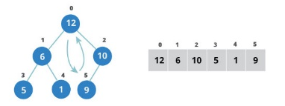


Slide 6



Slide 14
Heapsort
14
Min heap
Build a binary minHeap of N elements
O(N) time
Then perform N findMin and deleteMin operations
log(N) time per deleteMin
Total complexity O(N log N)
It requires an extra array to store the results
Max heap
Storing deleted elements at the end avoid the need for an extra element
Notes:
14

Slide 15
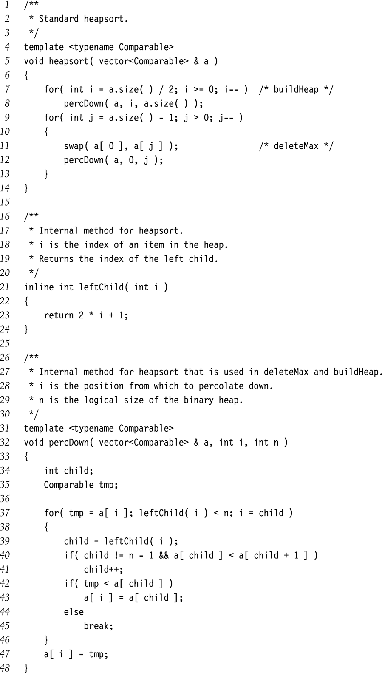
Heapsort Implementation
15
Notes:
15

Slide 16
Heapsort Code
public static <T extends Comparable<T>>
void sort (T[] a) {
buildHp(a);
shrinkHp(a);
}
private static ... void buildHp (T[] a) {
for (int n = 2; n <= a.length; n++) {
int chld = n-1; // add item and reheap
int prnt = (chld-1) / 2;
while (prnt >= 0 &&
a[prnt].compareTo(a[chld])<0) {
swap(a, prnt, chld);
chld = prnt; prnt = (chld-1)/2
} } }

Slide 17
Heapsort Code (2)
private static ... void shrinkHp (T[] a) {
int n = a.length;
for (int n = a.length-1; n > 0; --n) {
swap(a, 0, n); // max -> next posn
int prnt = 0;
while (true) {
int lc = 2 * prnt + 1;
if (lc >= n) break;
int rc = lc + 1;
int maxc = lc;
if (rc < n &&
a[lc].compareTo(a[rc]) < 0)
maxc = rc;
....

Slide 18
Heapsort Code (3)
if (a[prnt].compareTo(a[maxc])<0) {
swap(a, prnt, maxc);
prnt = maxc;
} else {
break;
}
}
}
}
private static ... void swap
(T[] a, int i, int j) {
T tmp = a[i]; a[i] = a[j]; a[j] = tmp;
}

Slide 19
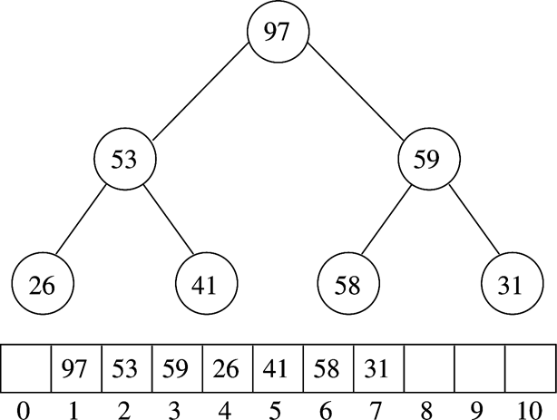
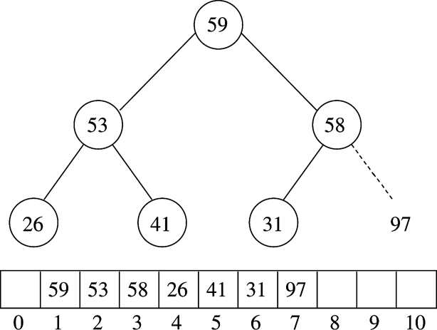
Example (MaxHeap)
After BuildHeap
After first deleteMax
19
Notes:
19

Slide 20
Lower Bound on ‘Simple’ Sorting
Simple sorting
Performing only adjacent exchanges
Such as bubble sort and insertion sort
Inversions
an ordered pair (i, j) such that i<j but a[i] > a[j]
34,8,64,51,32,21
(34,8), (34,32), (34,21), (64,51) …
Once an array has no inversions it is sorted
So sorting bounds depend on ‘average’ number of inversions performed

Slide 21
Theorem 1
Average number of inversions in an array of N distinct elements is N(N-1)/4
For any list L, consider reverse list L_{r}
L: 34, 8, 64, 51, 32, 21
Lr: 21, 32, 51, 64, 8, 34
All possible number of pairs is in L and Lr
= N(N-1)/2
Average number of inversion in L = N(N-1)/4

Slide 22
Theorem 2
Any algorithm that sorts by exchanging adjacent elements requires Ω(n²) average time
Average number of inversions = Ω(n²)
Number of swaps required = Ω(n²)

Slide 23
Bound for Comparison Based Sorting
O( n logn )
Optimal bound for comparison-based sorting algorithms
Achieved by Quick Sort, Merge Sort, and Heap Sort

Slide 24
Heapsort Analysis
Insertion cost is log i for heap of size i
Total insertion cost = log(n)+log(n-1)+...+log(1)
This is O(n log n)
Removal cost is also log i for heap of size i
Total removal cost = O(n log n)
Total cost is O(n log n)

Slide 25
Testing Sortiing Algorithms
Need to use a variety of test cases
Small and large arrays
Arrays in random order
Arrays that are already sorted (and reverse order)
Arrays with duplicate values
Compare performance on each type of array

Slide 26
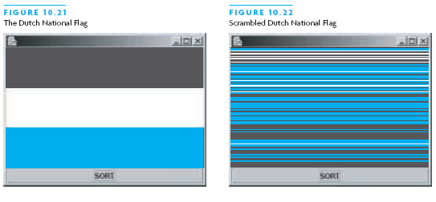
The Dutch National Flag Problem
Variety of partitioning algorithms have been published
One that partitions an array into three segments was introduced by Edsger W. Dijkstra
Problem: partition a disordered three-color flag into three contiguous segments
Segments represent < = > the pivot value

Slide 27
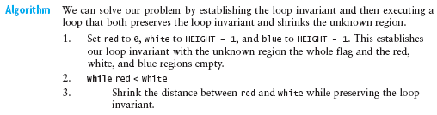
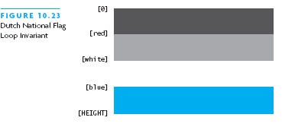
The Dutch National Flag Problem

