Slide 1

Navier-Stokes
example in libCEED
Leila Ghaffari
Dec. 15, 2019

Slide 2
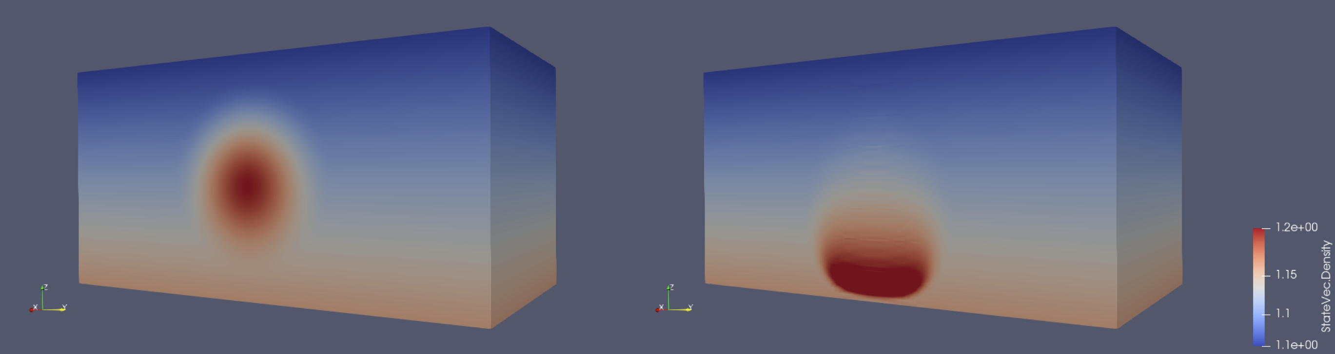

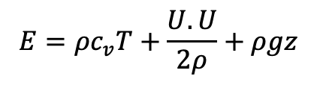
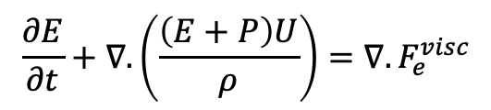

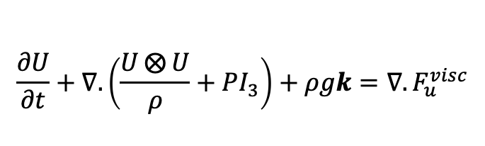
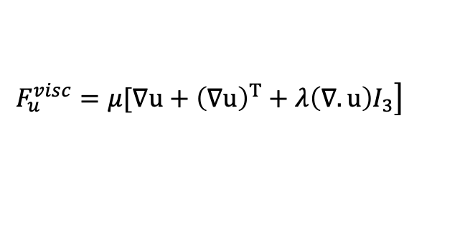
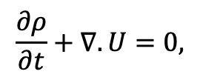
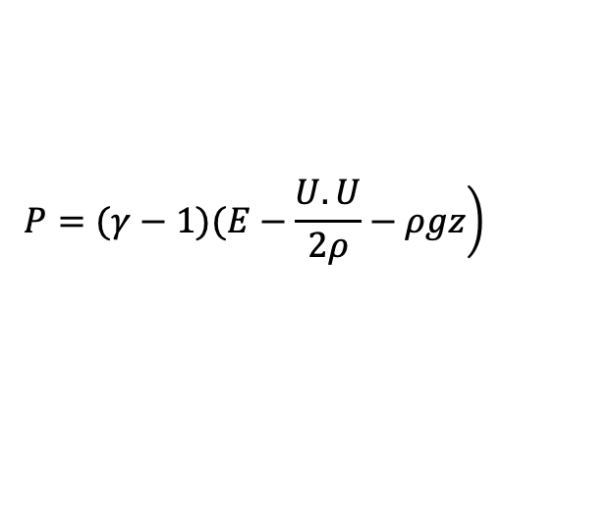
Navier-Stokes equations
$${q=\left(ρ, U^{T}, E\right)}^{𝕋}$$
Strong Form
$$E=ρc_{v}T+\frac{U.U}{2ρ}+ρgz$$
$$\left.P=(γ−1)(E−\frac{U.U}{2ρ}−ρgz\right)$$
$$\frac{∂ρ}{∂t}+∇.U=0,$$
$$\frac{∂U}{∂t}+∇.\left(\frac{U⨂{U}}{ρ}+PΙ_{3}\right)+ρgk=∇.F_{u}^{visc}$$
$$\left.F_{u}^{visc}=μ[∇u+{\left(∇u\right)}^{T}+λ\left(∇.u\right)Ι_{3}\right]$$
$$F_{e}^{visc}=u.F_{u}^{visc}+K∇T$$
$$\frac{∂E}{∂t}+∇.\left(\frac{\left(E+P\right)U}{ρ}\right)=∇.F_{e}^{visc}$$

Slide 3
FEM & stabilization
+
SU
Weight Convective Flux
IBP
+
Strong
Form
Weak
Form
+
SUPG
Weight Strong Form

Slide 4

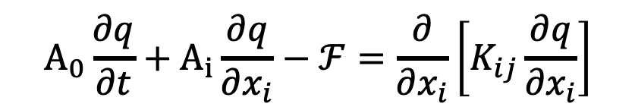
Navier-Stokes Equations
With Primitive Variables
And
Implicit Scheme
$$A_{0}\frac{∂q}{∂t}+A_{i}\frac{∂q}{∂x_{i}}−ℱ=\frac{∂}{∂x_{i}}\left[K_{ij}\frac{∂q}{∂x_{i}}\right]$$
$${q=\left(P, u^{T}, T\right)}^{𝕋}$$

Slide 5
Thank You!

