Slide 1
2330760,23年Z题
Evaluation model of the impact of hosting the Olympic Games
Distinguishability
Economy
AHP-CRITIC
K-means
Society
Combined
Weights
Environment
Elbow
Law
Politics
3 types of areas
OFI
Radar map
Generalizability
Strategies
Timeline for the next 50 years
Sore analysis of the strategies
Strategy 1 :
Selecting permanent venues for highly environmentally demanding competitions
Strategy 2 :
Decentralization of the host region
Strategy 3 :
One permanent location for the Summer and one for the Winter Olympic
Strategy 4 :
Holding four small-scale Olympics
Gray Prediction Model
Strategy 1:Social,OFI
Strategy 2:All
Strategy 3:Economy,
Environment, OFI
Strategy 4:Society, Politics

Slide 2
23年C题，2300348
GPU Prediction Model
Relationship of Word Attributes and Scores from Percentage
Interesting Features of Data
input
Regression Analysis
Box Plot Analysis
Not linearly related
Hard Mode Pecentage
Word Attributes
Word Frequency
Letter Frequency
Repetition of Letter
Part of Speech
rep
pos
No obvious diff
Reset
gate
GPU model
Update gate
The most “hellsh” level:PAPER
Hard to guess
Regression analysis
Box length difference
Number difference of outlines
Median difference
√
√
√
×
similar
output
GPU
Pridiction
Model
Difficulty Pate Classification Model by K-Means++
input
Difficulty Rate
Grid Search
Best gparams
March 1,2023
5
prediction
4
EERIE
predicion
3
2
EERIE
1
Random Forest
Output
K-Means++
Clustering Analysis
Difficulty
classification
March 1,2023

Slide 3
Task 1
Task 2
Application in a protected land location
Superior
Indicators
Identification
of Indicatores
Multilayer factor metric of light pollution risk level
23年E，2314354
Society
EWM
Application in a rural community
K-Means
Ecology
Application in a urban community
Traffic
Application in a suburban dommunity
Energy
Task 3
Task 4
Average situations in four locations
Impacts level prediction
Three strategies
Effect
analysis
Energy
strayegy
A suburban Community
Urban planning strategy
A urban Community
Ideal visions in four location

Slide 4
23,F
2311258
SustainaDility
TASK 1
Carbon dioxide emmissions
TASK 4
Policy
Industrial structure
GGDP
Consumption of natural resource
Australia
Waste treatment
TASK 5
Waste utilization cost
Report
TASK 2
TASK 3
Air temperature
Time
Space
Environmental pollution degree
Trend prediction
Strengths and weaknesses
Game thory
Climate
The stability of ecosystems
Climate mitigation

Slide 5
22D,2208928.
Step1:Assessment
Step2:Optimiza
(DAS Maturity Assessment Model)
(VOM Model)
IR,WE,WQ
People
x:The Performance of People
FESM
SA,CA,Rob,DPC
Tech
y:The Performance of Tech
Level of Maturity
EWM-AHP
z:The Performance of Process
MC,DS,DQ,DPE,DACSR
Process
z
Step5:One-page Letter
Step4:Model Extension
Step3:Protocols
y
Assessment model instruction
Scale-Demand Method
Text Insteuctions of model using
x
A Letter to Post Users
Instilling confidence
Analyze Different Scales
Analyze Different Industries
Visualization by Flowcharts
Optimizing Proposal

Slide 6
Grey Correlation
Analysis
Indicator selection
Given
Data
TASK 1 Network analysis
TASK 2 Determine performance cooperation indicators
TASK 3 Team formation & Training methods
Target
and
Action
Pass quality network
Indicators determine
Formation utilization
Look for effective formations
Dyadic Configurations
Huskie team
Quantification of performance indicators
Five success measures
Triadic Configurations
Team formation
Topsis
AHP
TASK 4 Indicators of a good social team
Time and Space
Three dimensional dynamic model of team cooperation
Obtained indicators
Additional indicators
fullevents.csv

Slide 7
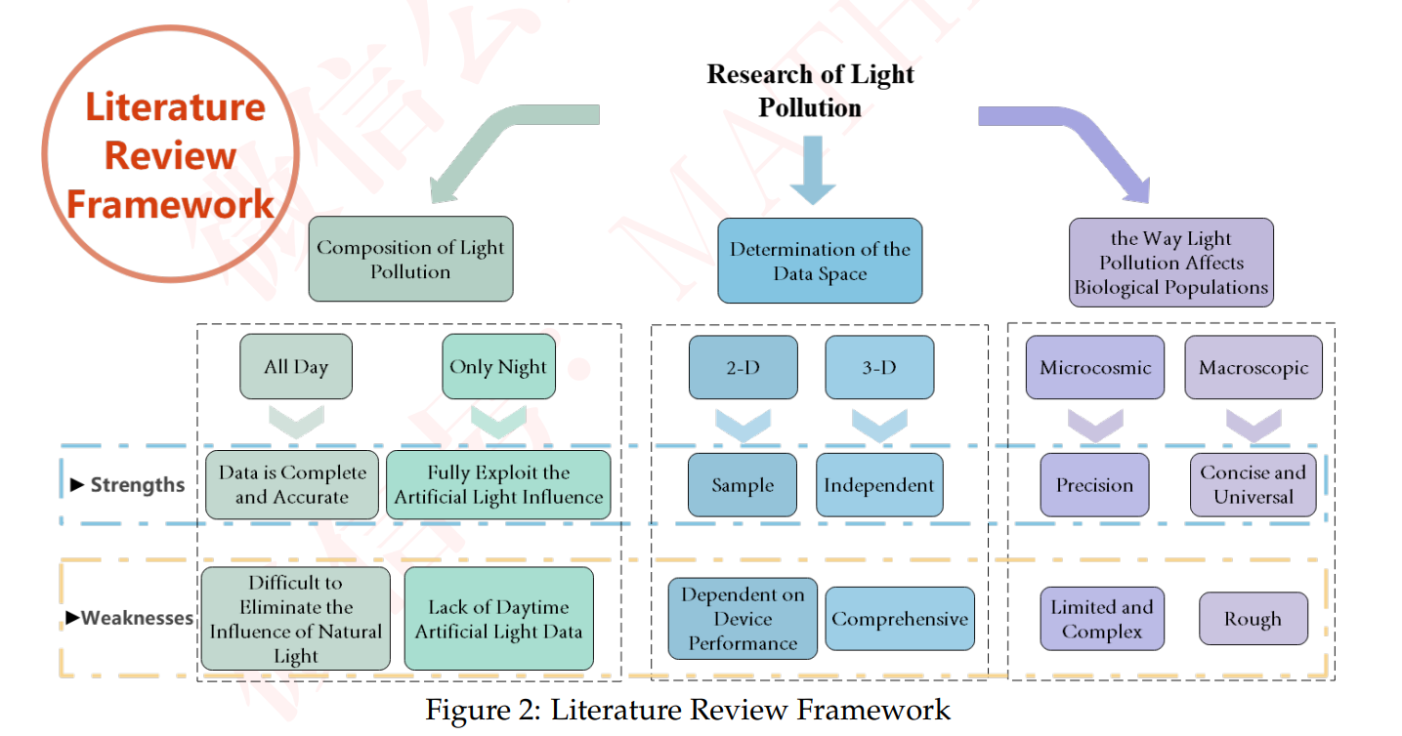
Research of Light
Pollution
Literature
Review
Framework
Composition of Light Pollution
Determination of the Data Space
The Way Light Pollution Affects Biological Populations
All Day
Only Night
2-D
3-D
Microcosmic
Macroscopic
Strengths
Data is Complete and Accurate
Fully Exploit the Artificial Light Influence
Sample
Independent
Precision
Concise and Universal
Difficult to
Eliminate the Influence of Natural Light
Lack of Daytime Artificial Light Data
Dependent on Device Performance
Weaknesses
Comprehensive
Limited and Complex
Rough

Slide 8
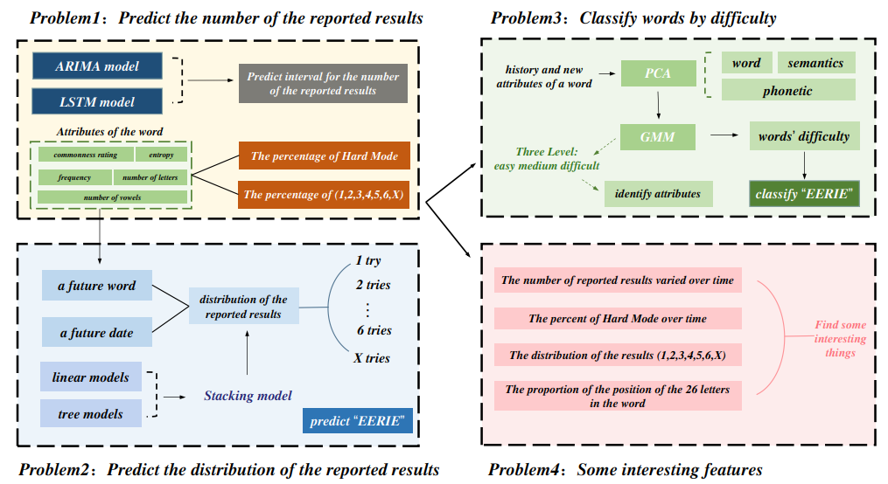
Problem1:Predict the number of the reported results
Problem3:Classify words by difficulty
ARIMA model
History and new
attributes of a word
PCA
word
semantics
Predict interval for the number of the reported results
LSTM model
phonetic
Attributes of the word
GMM
Words’ difficulty
commonness rating
entropy
The precentage of Hard Mode
Three Level:
Easy medium difficult
frequency
number of letters
Identify attributes
Classify “EERIE”
number of vowels
The percentage of (1,2,3,4,5,6,X)
1 try
A future word
2 tries
The number of reported results varied over time
Distribution of the reported results
…
The percent of Hard Mode over time
Find some
interesting
things
A future date
6 tries
X tries
The distribution of the results(1,2,3,4,5,6,X)
Linear models
Stacking model
The proportion of the position of the 26 letters in the word
Tree models
Predict “EERIE”
Problem2:Predict the distribution of the reported results
Problem4:Some interesting features

Slide 9
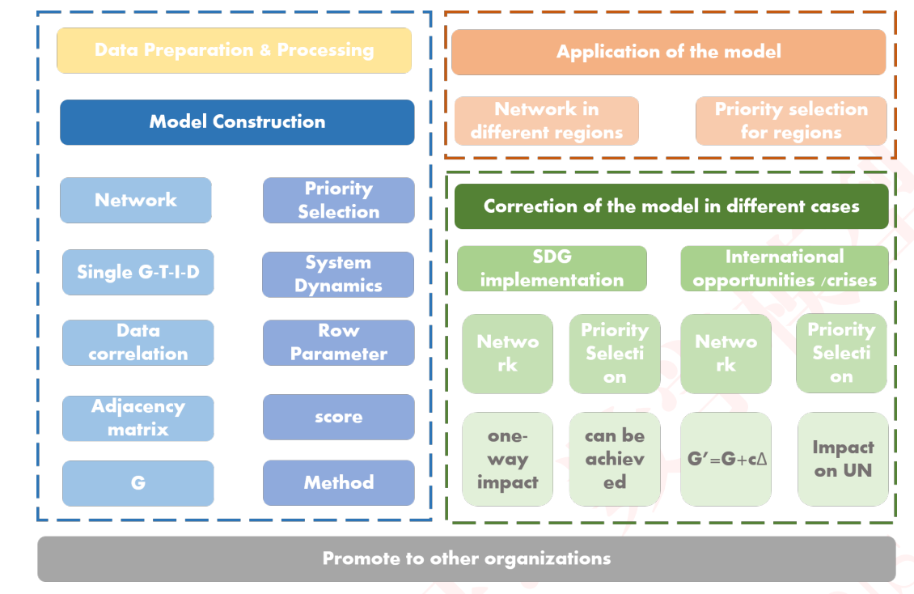
Data Preparation & Processing
Application of the model
Model Constructing
Network in
Different regions
Priority election
For regions
Network
Priority
Selection
Correction of the model in different cases
Single G-T-I-D
System
Dynamics
SDG
implementation
International
Opportunities/crises
Data
correlation
Row
Parameter
Network
Priority
Selection
Network
Priority
Selection
Adjacency
matrix
score
One-way
impact
Can be achieved
G’=G+c▲
Impact
On UN
G
Method
Promote to other organizations

Slide 10
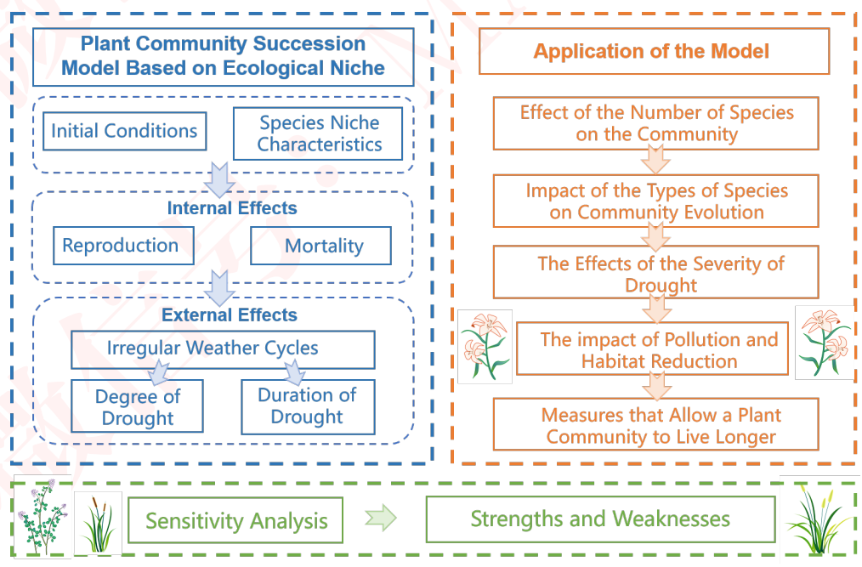
Plant Community Succession
Model Based on Ecological Niche
Application of the Model
2
Effect of the Number of Species
on the Community
Initial Conditions
Species Niche
Characteristics
Impact of the Types of Species
on Community Evolution
2
Internal Effects
Reproduction
Mortality
The Effects of the Severity of
Drought
2
External Effects
Irregular Weather Cycles
The impact of Pollution and
Habitat Reduction
Degree of Drought
Duration of
Drought
Measures that Allow a Plant Community to Live Longer
Sensitivity Analysis
Strengths and Weaknesses

