Slide 1
Part I (Section 3&4): Data Processing and Construct Graph
Part II (Section 5): KEGSDG Model
Part III (Section 6): VKEGSDG Model
Data cleaning
Quantify push
Quantify external change
Analyze the meaning of growth rate of indicator values
Transfer growth rate of SDG into SDG Score
Quantify push
KNN predict SDG Score
Transfer growth rate of SDG into SDG Score
Annual growth rate of indicators for countries
PCA weighting to quantify the target
Calculate eigenvector centrality for each SDG
Predict SDG Score next year
KNN predict SDG Score
Calculate eigenvector centrality for each SDG
Predict SDG Score next year
Annual growth rate of indicators for world
Obtain inter-target correlation
Part IV : Result Analysis
Model effectiveness analysis
Model advantage and disadvantage
Sensitivity analysis
Notes:
模型总流程图模板

Slide 2
Part I (Section 3&4): Data Processing and Construct Graph
Part II (Section 5): KEGSDG Model
Part III (Section 6): VKEGSDG Model
Data cleaning
Quantify push
Quantify external change
Analyze the meaning of growth rate of indicator values
Transfer growth rate of SDG into SDG Score
Quantify push
KNN predict SDG Score
Transfer growth rate of SDG into SDG Score
Annual growth rate of indicators for countries
PCA weighting to quantify the target
Calculate eigenvector centrality for each SDG
Predict SDG Score next year
KNN predict SDG Score
Calculate eigenvector centrality for each SDG
Predict SDG Score next year
Annual growth rate of indicators for world
Obtain inter-target correlation
Part IV : Result Analysis
Model effectiveness analysis
Model advantage and disadvantage
Sensitivity analysis
Notes:
模型总流程图模板

Slide 3

DATA PREPROCESSING
Data Substitution
Period Confirmation
Missing Values
Replace [Y, N] with [1, 0]
Regard 3 months as a period
Delete rows with missing values
INDICATORS CALCULATION
Market Share
Consumer Feedback
Repurchase Rate
$$N_{r}^{3}=$$
$$N_{r}^{3}=$$
$$N_{r}^{3}=$$
MODEL SETUP
XXX Model
Notes:
模型流程

Slide 4
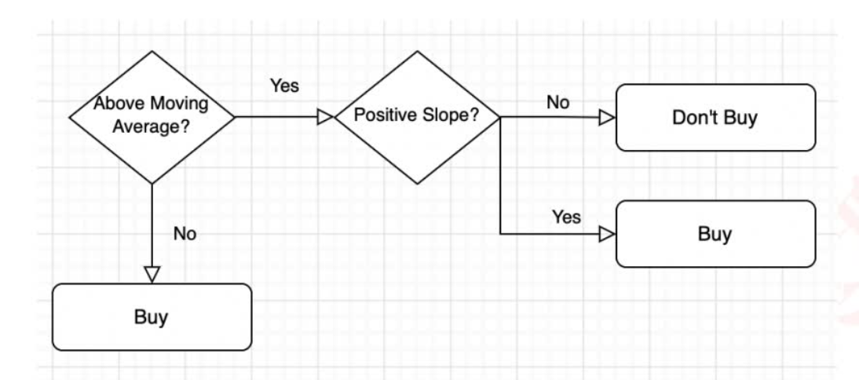
Notes:
模型流程

Slide 5
Start
Action
Judgement true?
NO
YES
Action
End
Notes:
模型流程

Slide 6
Starting line
Ending line
HEIGHT
START
electrode
END
electrode
WIDTH
Notes:
模型流程

Slide 7


WIN_A
$$p_{0}$$
$$p_{0}$$
$$p_{0}$$
$$p_{0}$$
(40:0)
$$q_{0}$$
$$p_{0}$$
$$p_{0}$$
(30:0)
$$q_{0}$$
$$p_{0}$$
(40:15)
$$q_{0}$$
$$p_{0}$$
(15:0)
$$q_{0}$$
$$p_{0}$$
(30:15)
$$q_{0}$$
AD_A
$$q_{0}$$
(0:0)
$$q_{0}$$
$$p_{0}$$
(15:15)
$$q_{0}$$
$$p_{0}$$
Deuce
(0:15)
$$q_{0}$$
(15:30)
$$q_{0}$$
$$p_{0}$$
AD_B
$$p_{0}$$
$$p_{0}$$
(0:30)
$$q_{0}$$
$$p_{0}$$
(15:40)
$$q_{0}$$
$$q_{0}$$
(0:40)
$$q_{0}$$
$$q_{0}$$
WIN_B
Notes:
模型流程

Slide 8
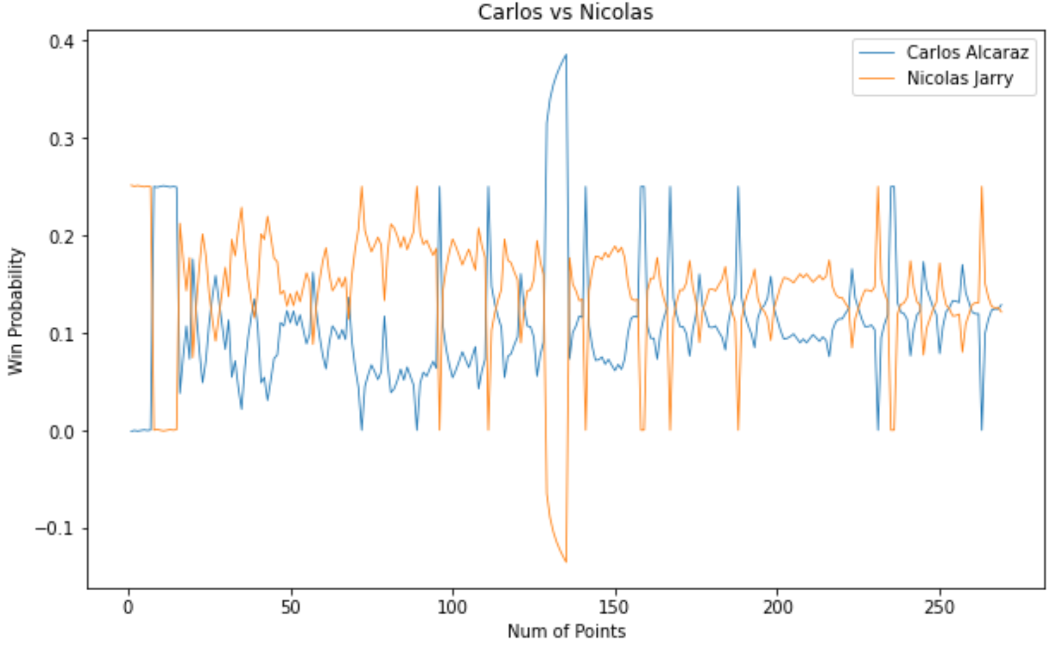
Notes:
模型流程

Slide 9
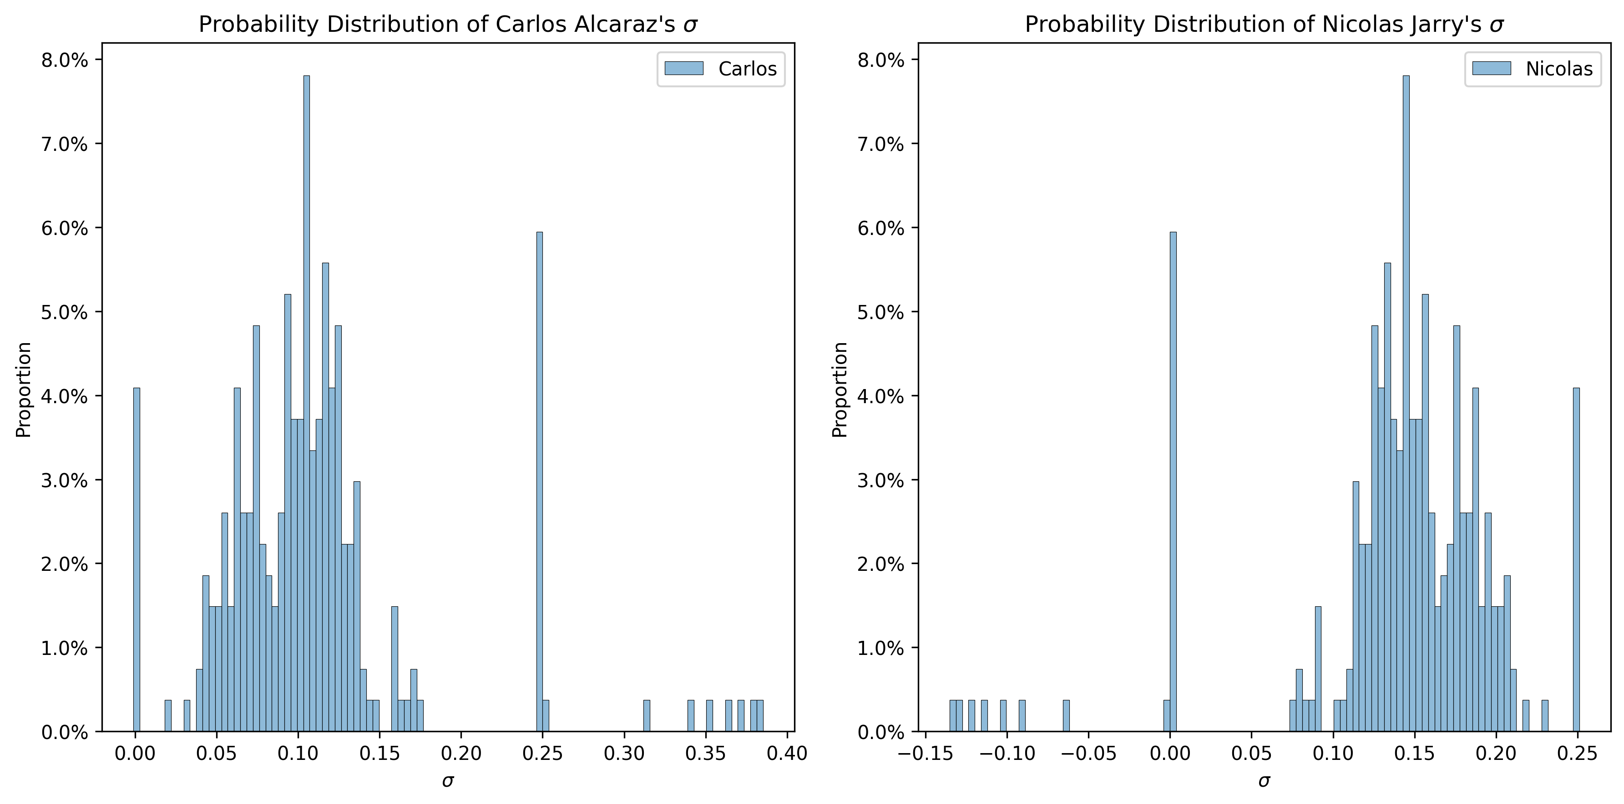
Notes:
模型流程

Slide 10
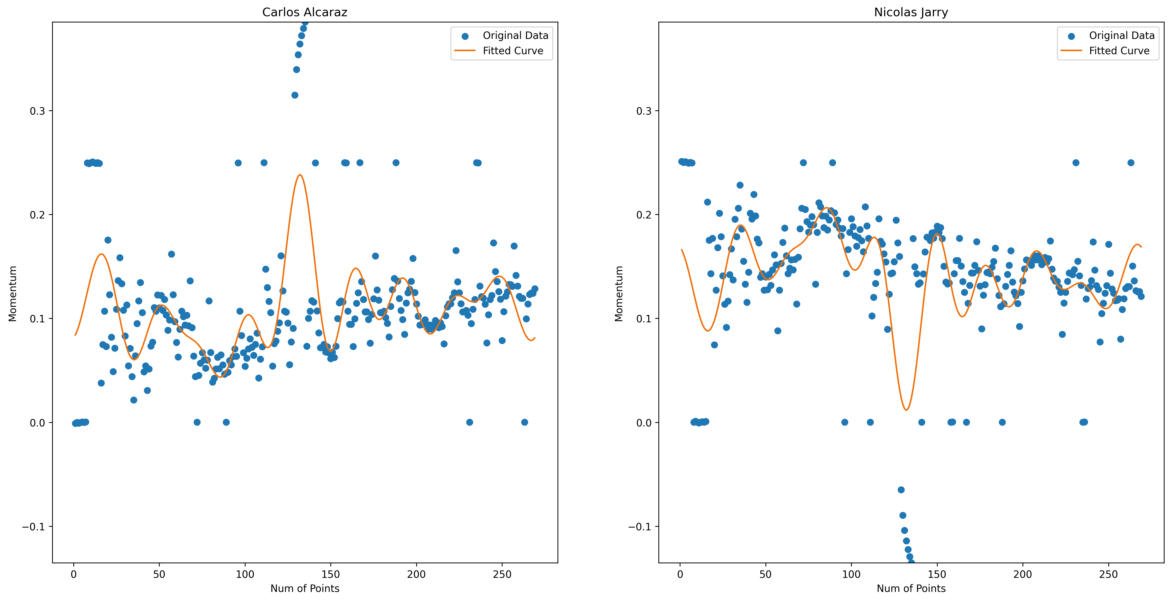
Notes:
模型流程

Slide 11
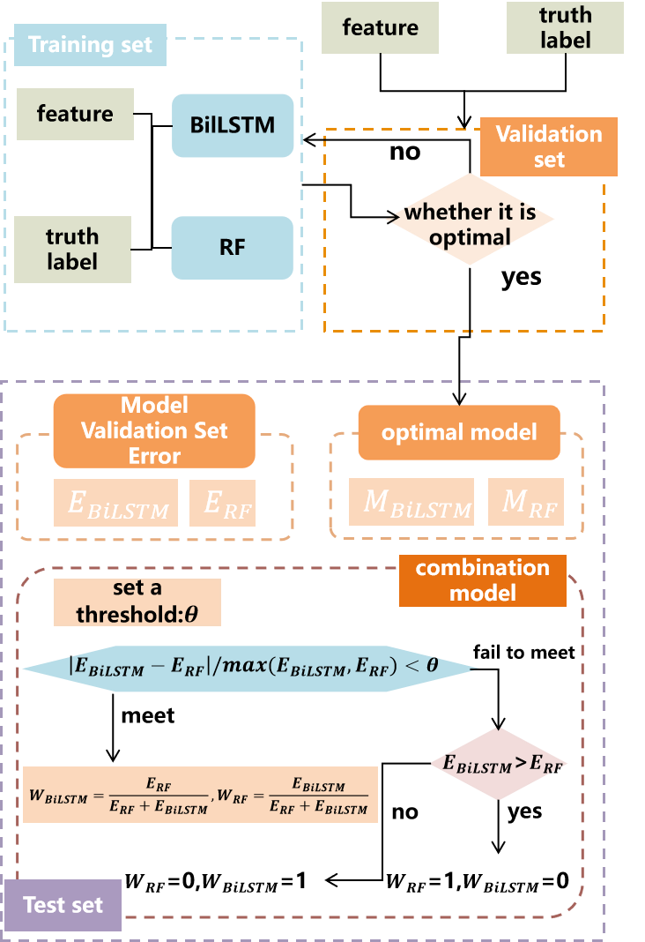









feature
truth label
Training set
feature
BilLSTM
no
Validation set
whether it is optimal
truth label
RF
yes
Model Validation Set Error
optimal model
$$E_{BiLSTM}$$
$$E_{RF}$$
$$M_{BiLSTM}$$
$$M_{RF}$$
combination model
set a threshold:$θ$
$$\left|E_{BiLSTM}−E_{RF}\right|/max(E_{BiLSTM},E_{RF})<θ$$
fail to meet
meet
$E_{BiLSTM}$>$E_{RF}$
$$W_{BiLSTM}=\frac{E_{RF}}{E_{RF}+E_{BiLSTM}},W_{RF}=\frac{E_{BiLSTM}}{E_{RF}+E_{BiLSTM}}$$
no
yes
Test set
$W_{RF}$=0,$W_{BiLSTM}$=1
$W_{RF}$=1,$W_{BiLSTM}$=0
Notes:
分模型流程图-reference素材

Slide 12

特征
真实标签
训练集
特征
BilLSTM
no
验证集
真实标签
RF
是否最优
yes
模型验证集误差
最优模型
$$E_{BiLSTM}$$
$$E_{RF}$$
$$M_{BiLSTM}$$
$$M_{RF}$$
集成组合模型
设置阈值:$θ$
$$\left|E_{BiLSTM}−E_{RF}\right|/max(E_{BiLSTM},E_{RF})<θ$$
不满足
满足
$E_{BiLSTM}$>$E_{RF}$
$$W_{BiLSTM}=\frac{E_{RF}}{E_{RF}+E_{BiLSTM}},W_{RF}=\frac{E_{BiLSTM}}{E_{RF}+E_{BiLSTM}}$$
no
yes
测试集
$W_{RF}$=0,$W_{BiLSTM}$=1
$W_{RF}$=1,$W_{BiLSTM}$=0
Notes:
分模型流程图-reference素材

Slide 13

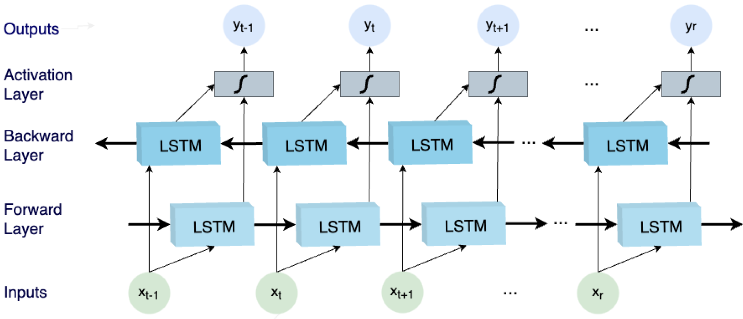
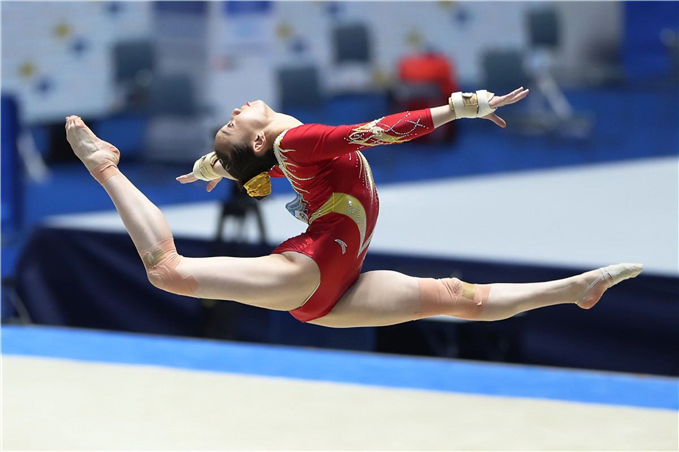
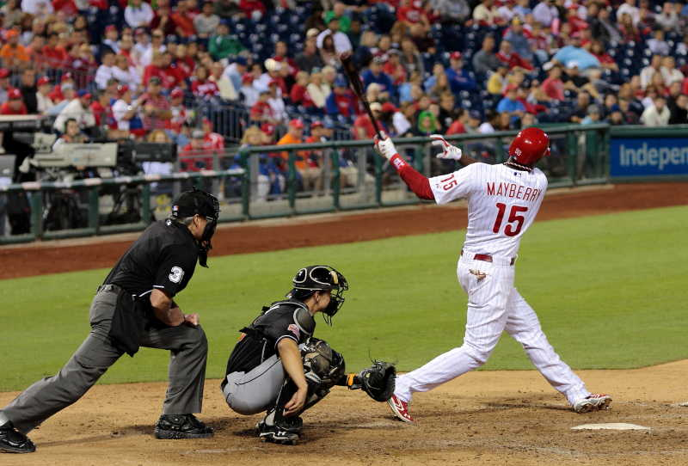
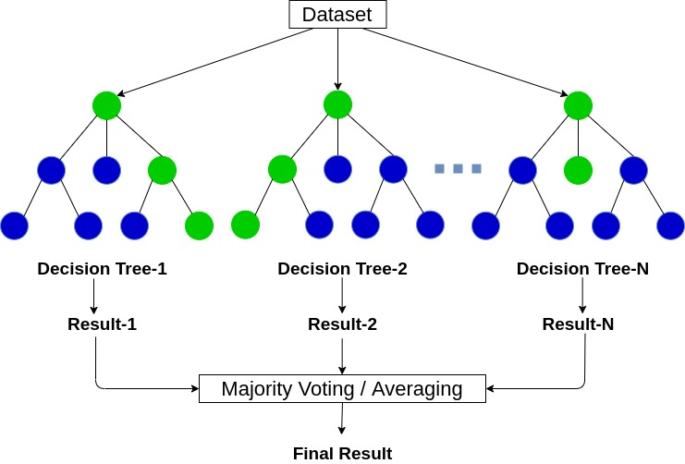

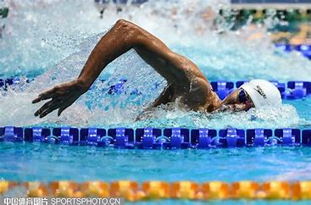

dependent variable
BiLSTM
Predict
$$W_{BiLSTM}$$
tournament
features
value
output
Hyperparameter algorithm tuning
dataset splitting
RF
value
$$W_{RF}$$
Predict
Notes:
分模型流程图-reference素材

Slide 14
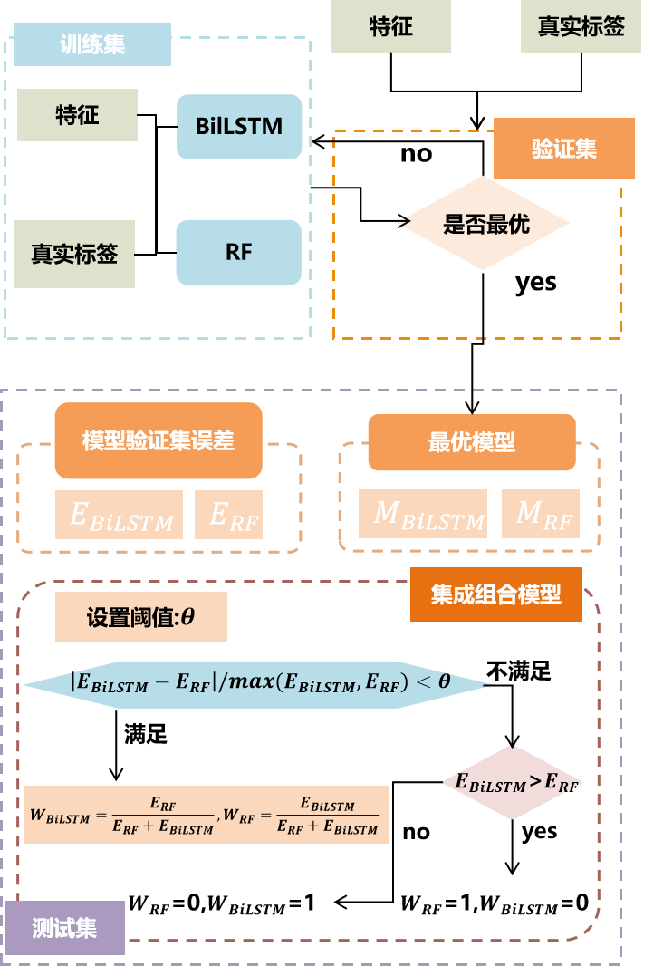



目标变量：消费频率
优化BiLSTM
预测值
○经常购买（每周≥1次）
○偶尔购买（每月1-3次）
○很少购买（每月≤1次）
$$W_{BiLSTM}$$
特征工程
正式量表题的36个特征
组合加权
输出
贝叶斯优化算法：超参数算法调优
数据集划分-10折交叉验证
RF随机森林
组合加权
$$W_{RF}$$
预测值
Notes:
分模型流程图-reference素材

Slide 15







Obtain Pre-match Win Prediction
$$Calculate K_{i}$$
$$Calculate E_{i}(t)$$
$$Calculate P_{ij}(t)$$
$$K_{i}=\frac{250}{{\left(m_{i}\left(t\right)+5\right)}^{0.4}}$$
$$E_{i}\left(t+1\right)=E_{i}\left(t\right)+K_{i}×(P_{ij}\left(t\right)−W_{i}(t))$$
$$P_{ij}\left(t\right)={\left(1+{10}^{\frac{E_{j}\left(t\right)−E_{i}\left(t\right)}{400}}\right)}^{−1}$$
Probability of Winning the First Point
$$Assumption$$
$$Calculate p_{GX}, q_{GX}$$
$$Calculate p_{SA}(6,k)$$
$$Calculate P_{ij}$$
$$Calculate p_{0}$$
$$P_{ij}=\sum_{k=0}^{5}{p_{SA}(6,k)}$$
The inverse solution
yields $p_{0}$.
$$f_{0}\left(p_{0},q_{0}\right)=P_{ij}$$
$$p_{GX}=f\left(p_{0}\right), q_{GX}=1−p_{GX}$$
$$p_{SA}\left(6,k\right)=g(p_{GX},q_{GX})$$
Real-Time Win Probability
$$Calculate λ_{i}$$
$$Optimize n$$
$$Calculate η(S_{m})$$
$$Calculate \hat{p_{s}}(S_{m})$$
$$Calculate P^{A}(t)$$
$$λ_{i}=\frac{i}{\sum_{i=1}^{m}{i}}$$
$$Loss\left(n\right)=G(m, λ_{i},y_{i},p_{0},\overline{p_{s}}\left(S_{i}\right))$$
$$η\left(S_{m}\right)=\frac{α}{α+n}$$
$$\hat{p_{s}}\left(S_{m}\right)=η\left(S_{m}\right)×p_{0}$$
$$+\left(1−η\left(S_{m}\right)\right)×\overline{p_{s}}(S_{m})$$
$$P^{A}\left(t\right)=p_{s}^{A} or p_{r}^{A}$$
Quantification of Momentum
$$Calculate λ_{i}$$
$$Optimize n$$
$$Calculate η(S_{m})$$
$$Calculate \hat{p_{s}}(S_{m})$$
$$Calculate P^{A}(t)$$
$$λ_{i}=\frac{i}{\sum_{i=1}^{m}{i}}$$
$$Loss\left(n\right)=G(m, λ_{i},y_{i},p_{0},\overline{p_{s}}\left(S_{i}\right))$$
$$η\left(S_{m}\right)=\frac{α}{α+n}$$
$$\hat{p_{s}}\left(S_{m}\right)=η\left(S_{m}\right)×p_{0}$$
$$+\left(1−η\left(S_{m}\right)\right)×\overline{p_{s}}(S_{m})$$
$$P^{A}\left(t\right)=p_{s}^{A} or p_{r}^{A}$$
Notes:
分模型流程图-真

Slide 16

Obtain Pre-match Win Prediction
$$Calculate K_{i}$$
$$Calculate E_{i}(t)$$
$$Calculate P_{ij}(t)$$
$$K_{i}=\frac{250}{{\left(m_{i}\left(t\right)+5\right)}^{0.4}}$$
$$E_{i}\left(t+1\right)=E_{i}\left(t\right)+K_{i}×(P_{ij}\left(t\right)−W_{i}(t))$$
$$P_{ij}\left(t\right)={\left(1+{10}^{\frac{E_{j}\left(t\right)−E_{i}\left(t\right)}{400}}\right)}^{−1}$$
Probability of Winning the First Point
$$Assumption$$
$$Calculate p_{GX}, q_{GX}$$
$$Calculate p_{SA}(6,k)$$
$$Calculate P_{ij}$$
$$Calculate p_{0}$$
$$P_{ij}=\sum_{k=0}^{5}{p_{SA}(6,k)}$$
The inverse solution
yields $p_{0}$.
$$f_{0}\left(p_{0},q_{0}\right)=P_{ij}$$
$$p_{GX}=f\left(p_{0}\right), q_{GX}=1−p_{GX}$$
$$p_{SA}\left(6,k\right)=g(p_{GX},q_{GX})$$
Real-Time Win Probability
$$Calculate λ_{i}$$
$$Optimize n$$
$$Calculate η(S_{m})$$
$$Calculate \hat{p_{s}}(S_{m})$$
$$Calculate P^{A}(t)$$
$$λ_{i}=\frac{i}{\sum_{i=1}^{m}{i}}$$
$$Loss\left(n\right)=G(m, λ_{i},y_{i},p_{0},\overline{p_{s}}\left(S_{i}\right))$$
$$η\left(S_{m}\right)=\frac{α}{α+n}$$
$$\hat{p_{s}}\left(S_{m}\right)=η\left(S_{m}\right)×p_{0}$$
$$+\left(1−η\left(S_{m}\right)\right)×\overline{p_{s}}(S_{m})$$
$$P^{A}\left(t\right)=p_{s}^{A} or p_{r}^{A}$$
Quantification of Momentum (MMT)
$${MMT}^{A}\left(t\right)=\left\{ \begin{aligned}{ P}^{A}\left(t\right)−p_{0}^{A}, if A is server \\ P^{A}\left(t\right)−p_{0}^{A}+ε, if A is receiver\end{aligned}\right.$$
Notes:
分模型流程图-真

Slide 17
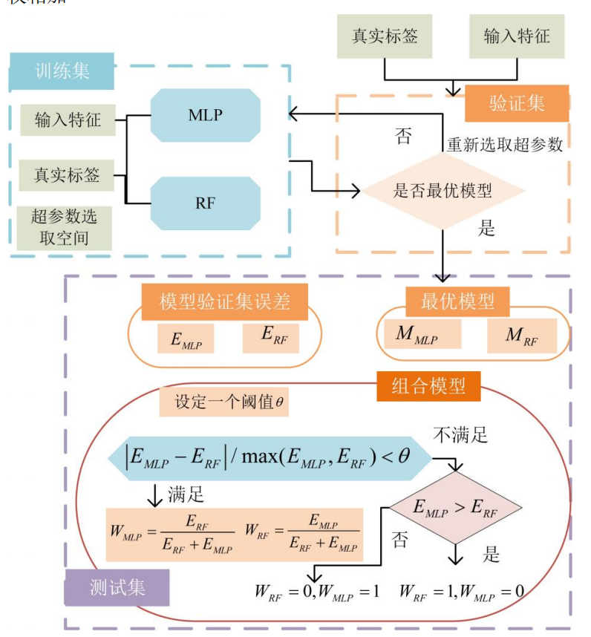
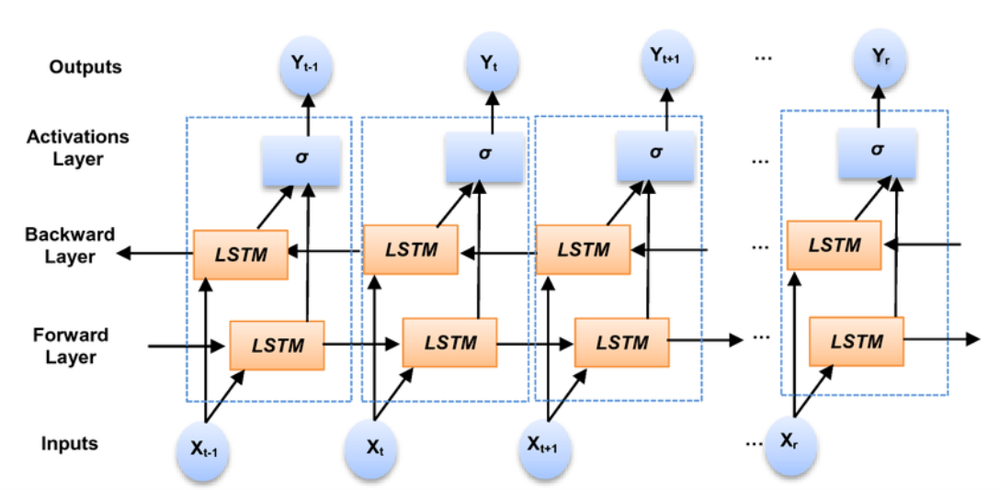
Part I
: 超参数算法调参
BiLSTM
数据集划分8
：1
：1
RF
Notes:
分模型流程图-reference素材

Slide 18

DATA PREPROCESSING
Missing Values: Step 1
Missing Values: Step 1
Missing Values: Step 2
Missing Values: Step 2
NA = ‘F’ in column AR, AS, AT
if AB || AC = 1
NA = ‘UN’ in column AR, AS, AT
if U || V || W || X = 1
Delete the two matches where speed_mph is totally abscent
NA = avg(speed) in column AQ
If U || V || W || X || AB || AC || AD || AE = 1
Missing Values: Step 1
INDICATORS CALCULATION
Market Share
Consumer Feedback
Repurchase Rate
$$N_{r}^{3}=$$
$$N_{r}^{3}=$$
$$N_{r}^{3}=$$
MODEL SETUP
Factor Analysis Model
Notes:
模型流程

Slide 19
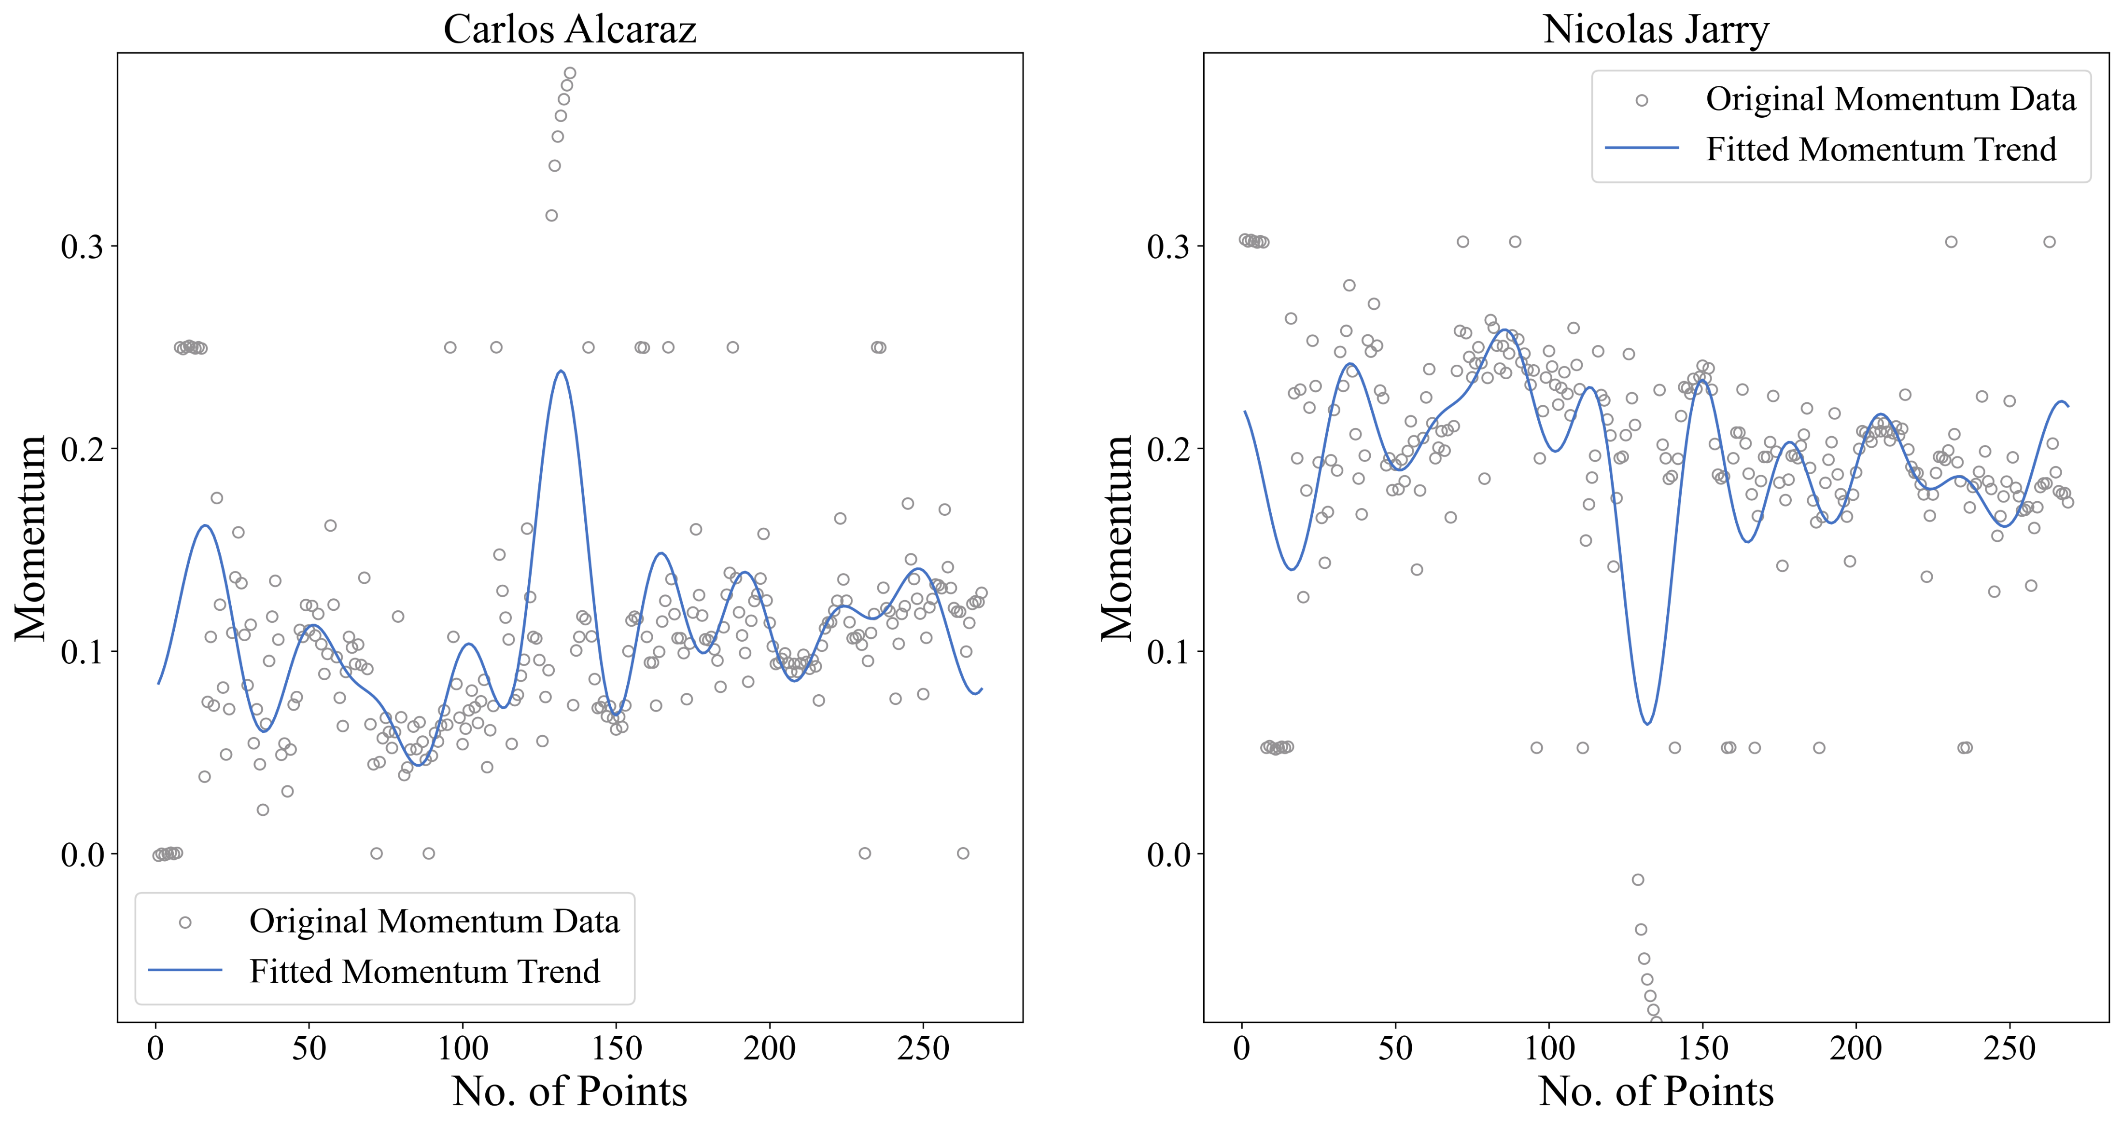
Real-Time Momentum Trend Value (MMTTV)
Real-Time Momentum Trend Value (MMTTV)
Notes:
模型流程

Slide 20
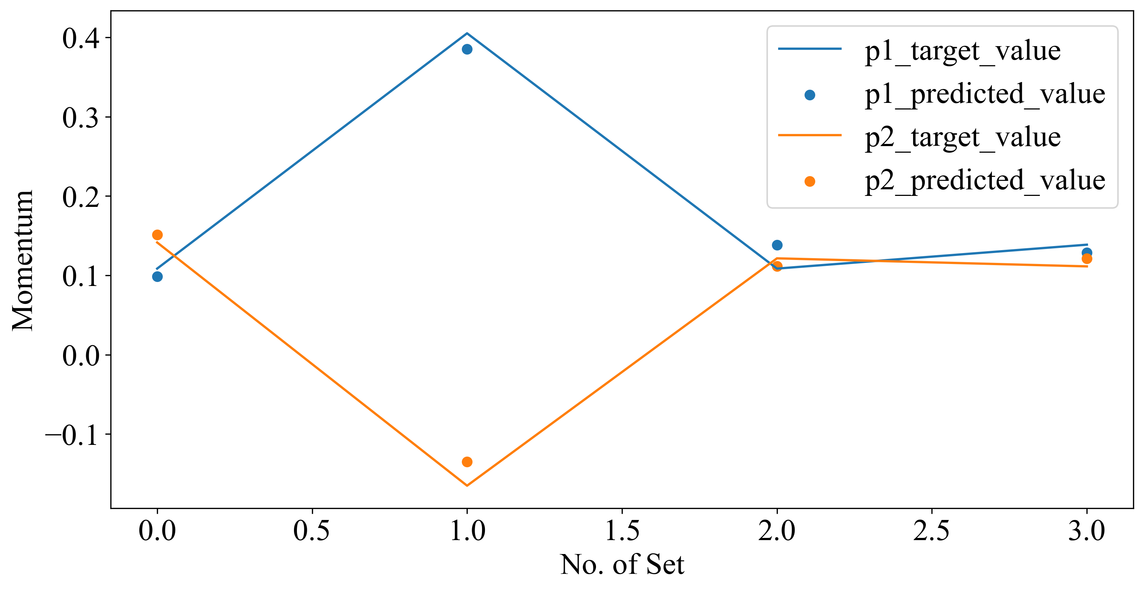
Real-Time Momentum Trend Value (MMTTV)
Notes:
模型流程

Slide 21
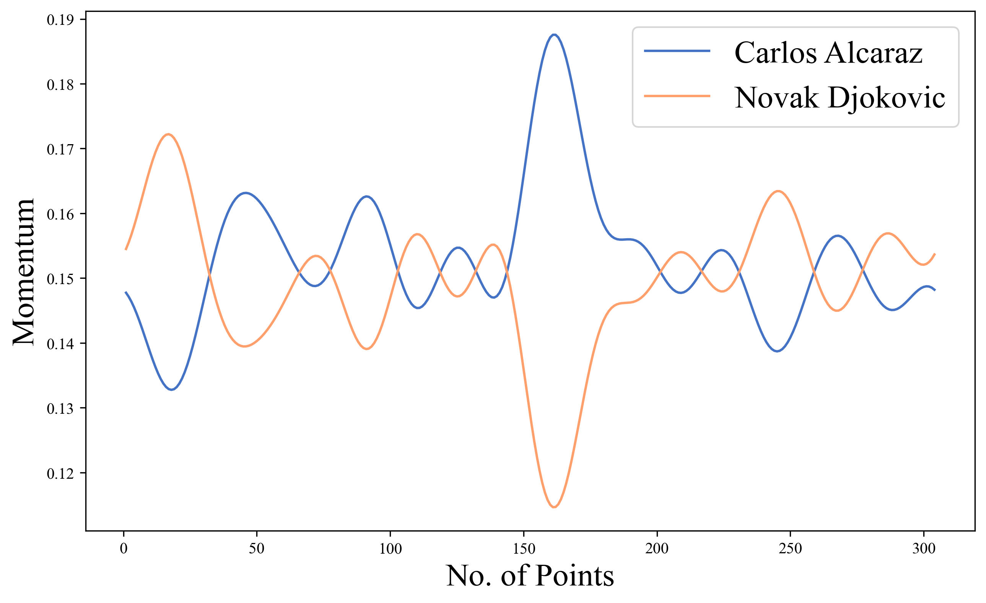
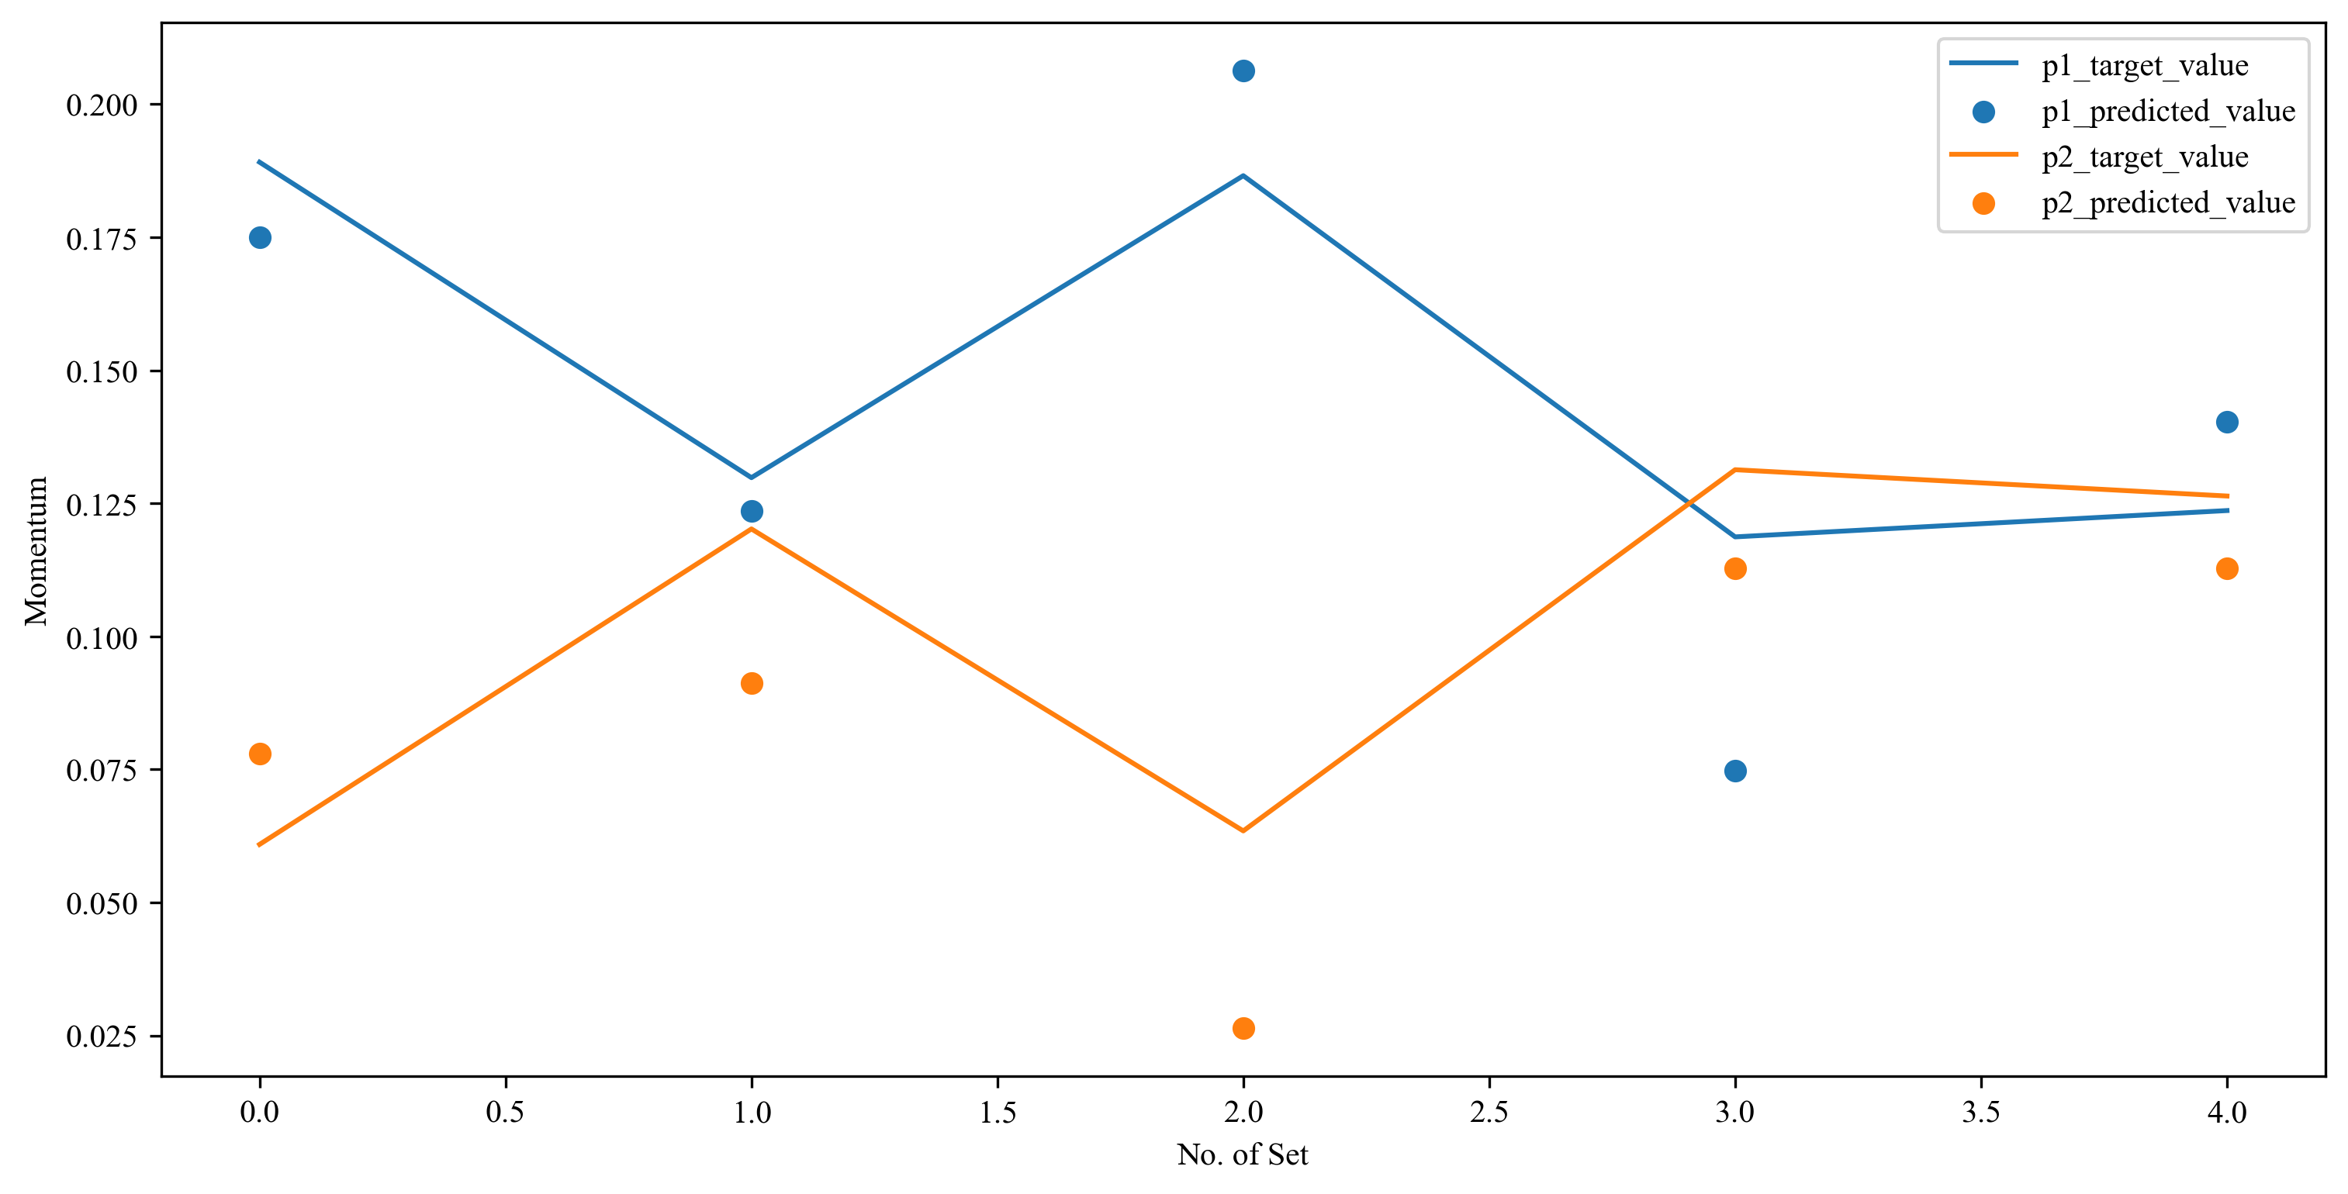
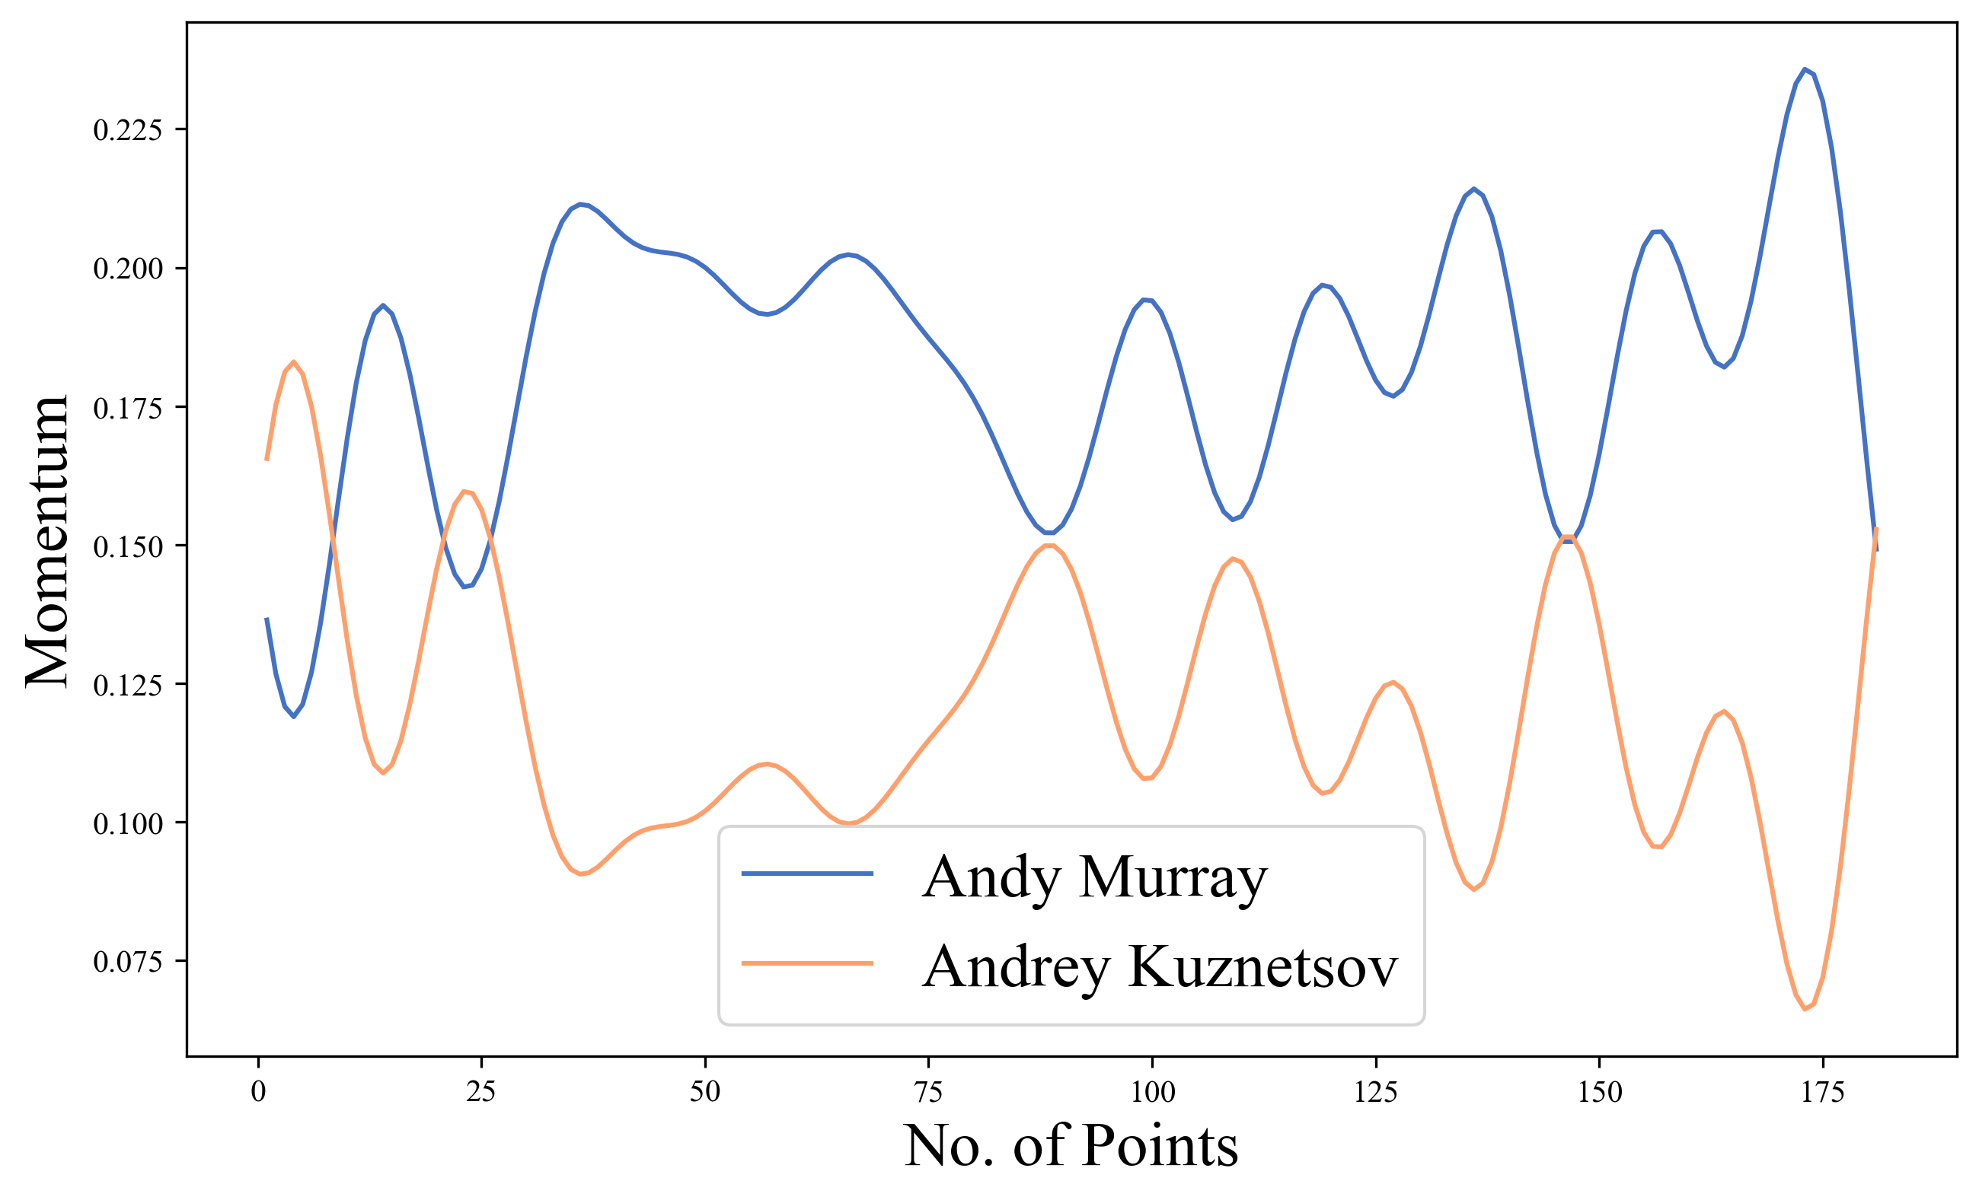
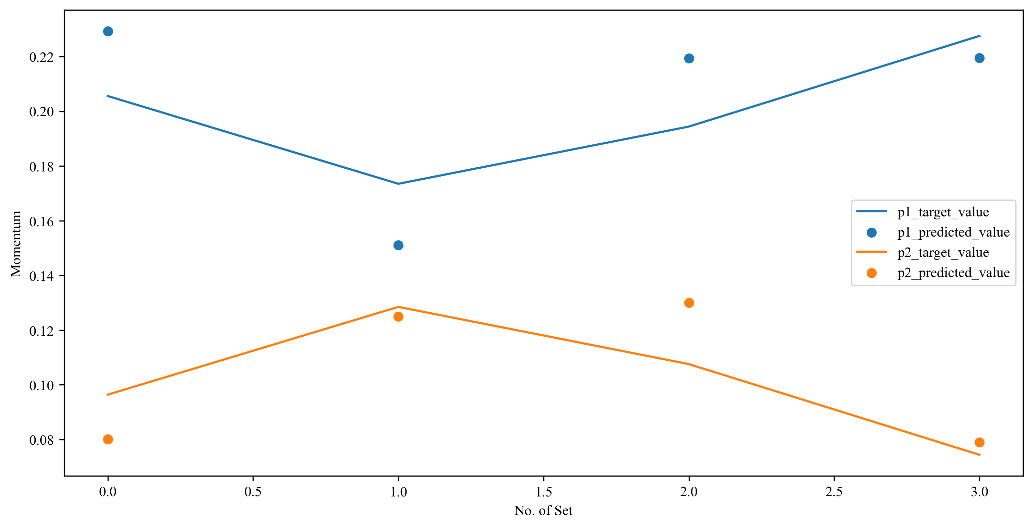
MMTTV
MMTTV
No. of Set
MMTTV
MMTTV
No. of Set
Notes:
模型流程

Slide 22


Slide 23
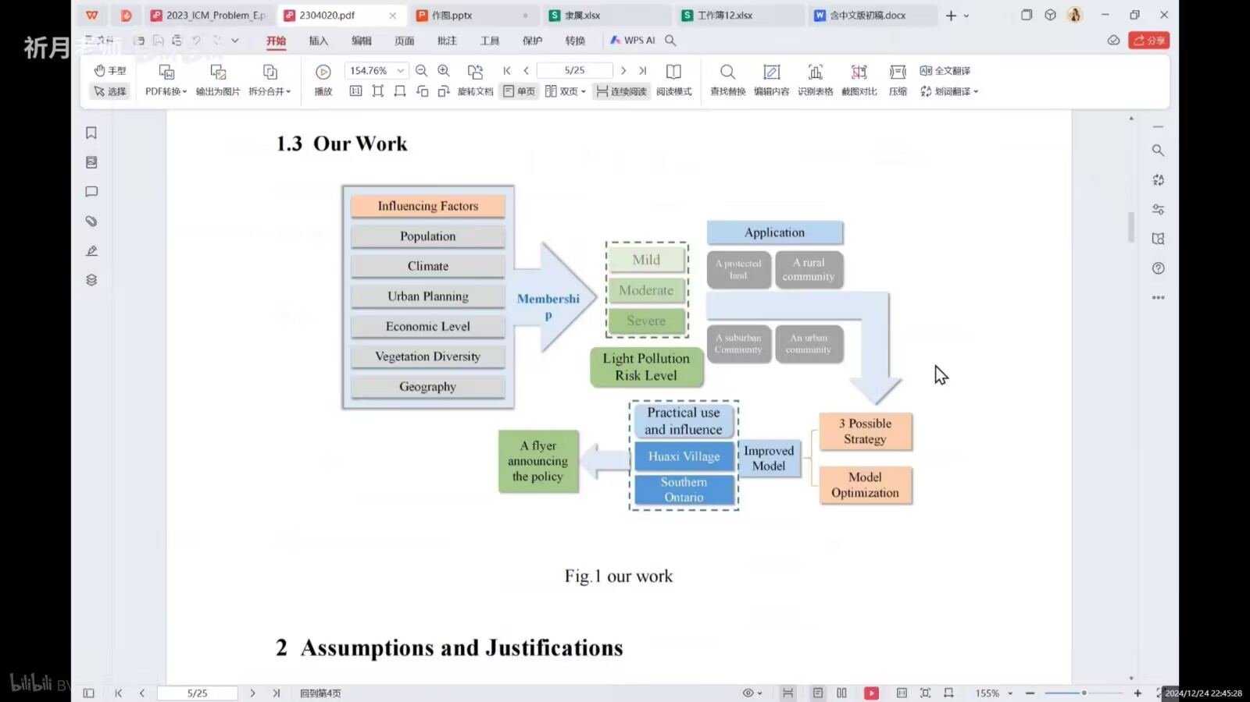

Slide 24


