Slide 1
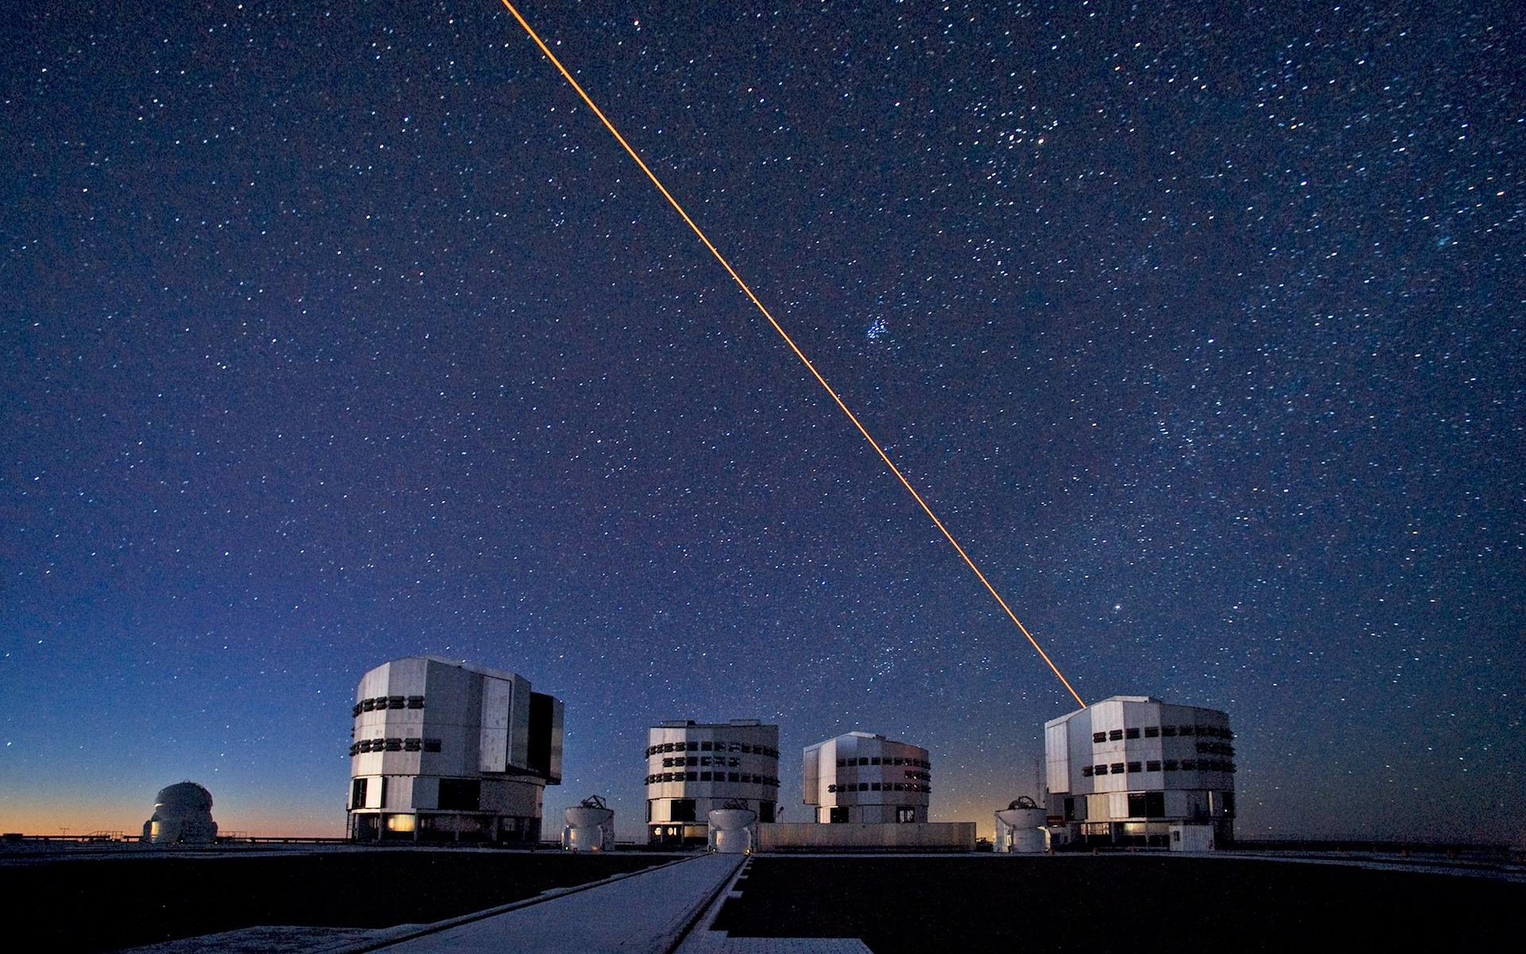




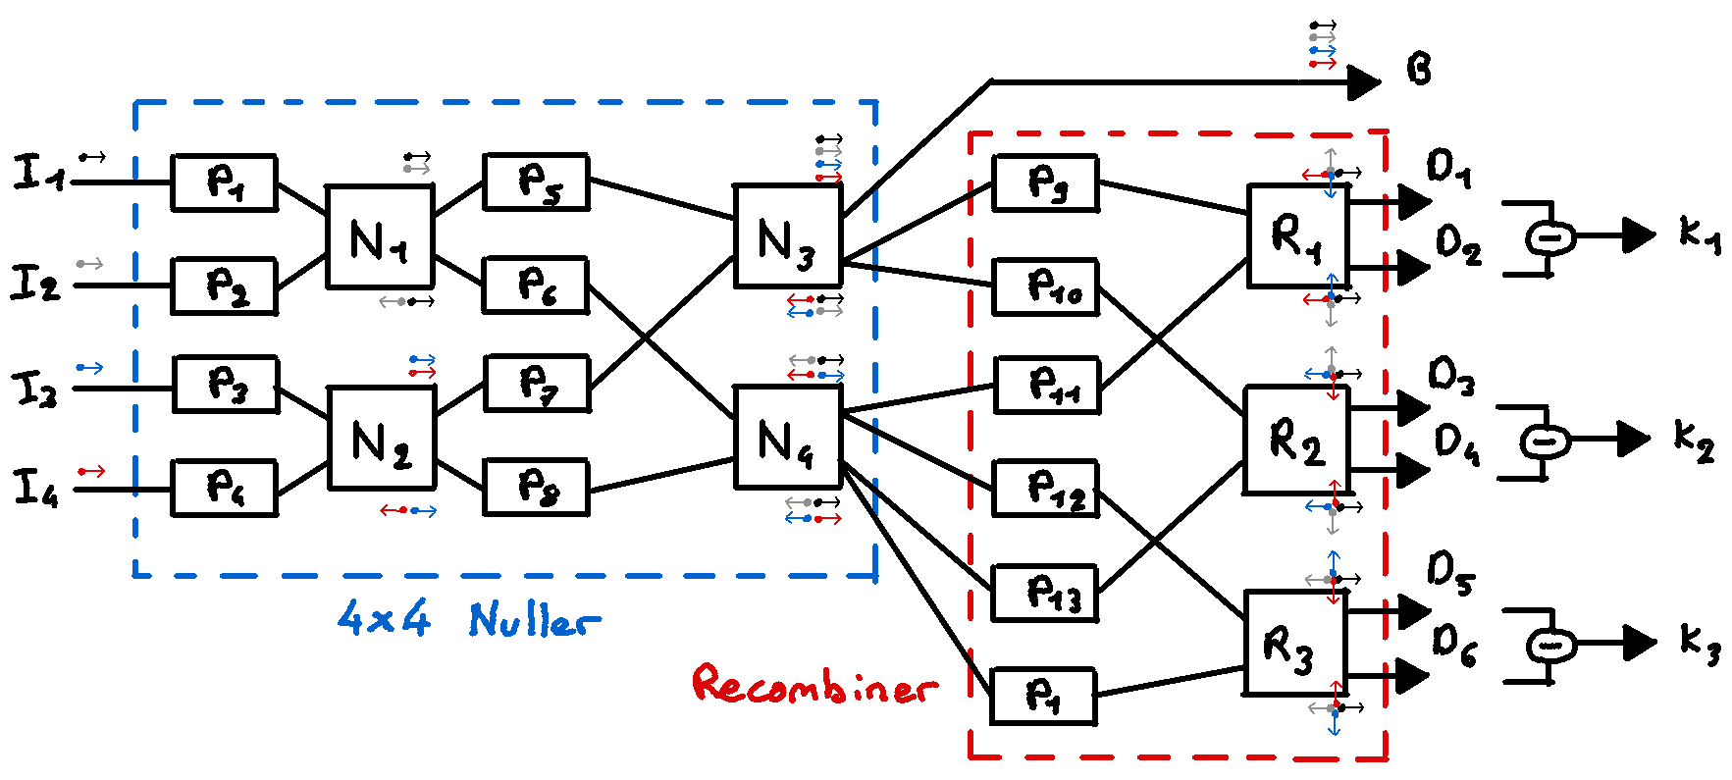
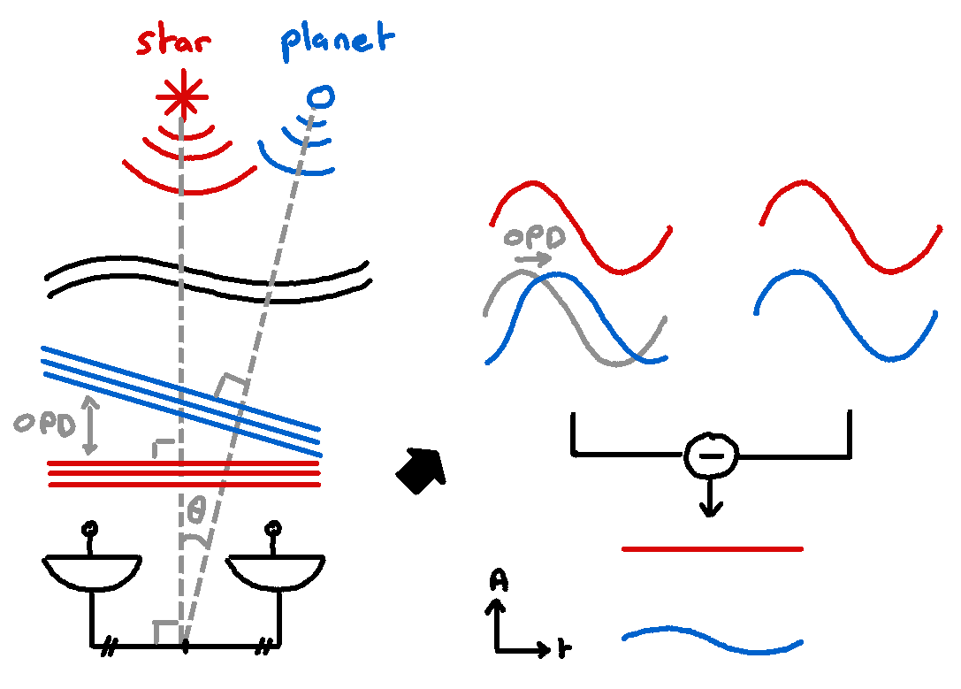
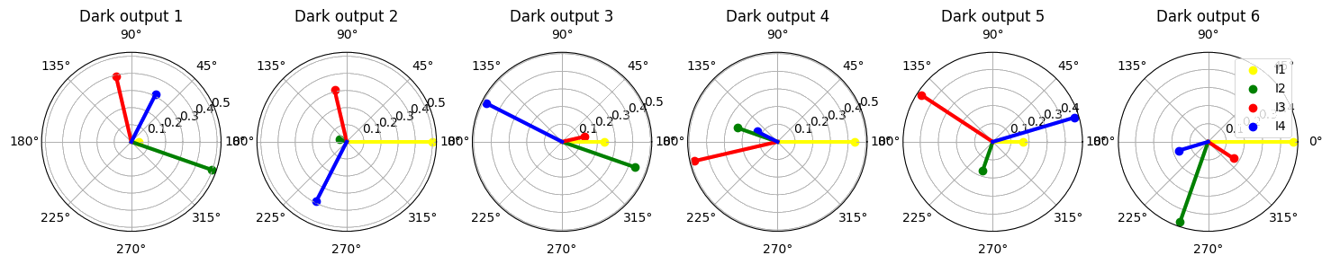
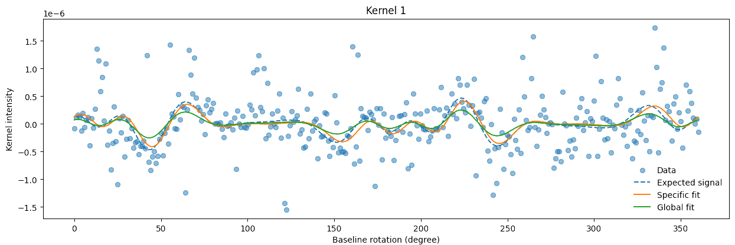
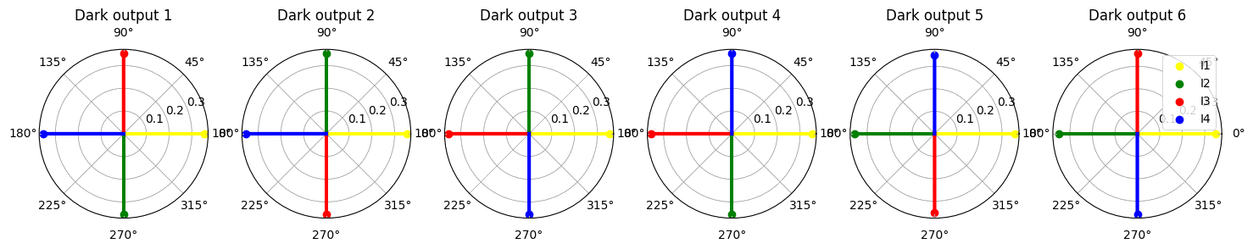
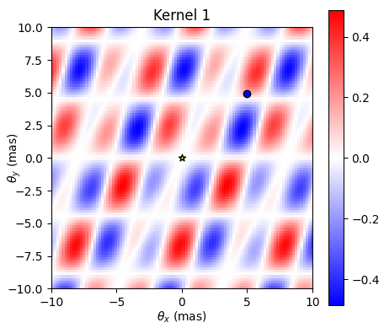
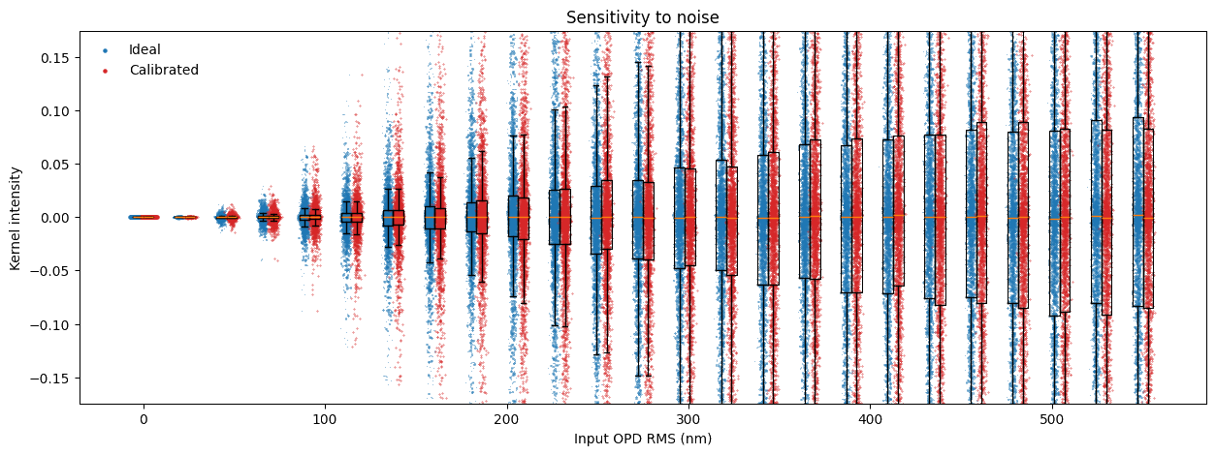
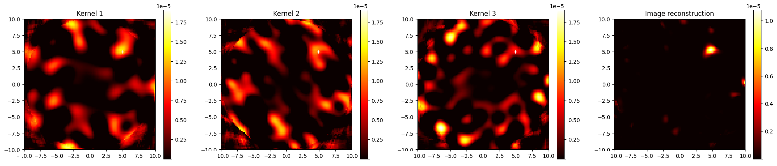
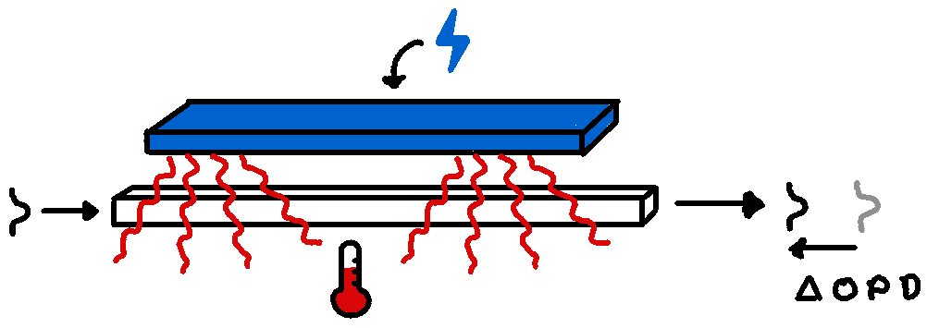
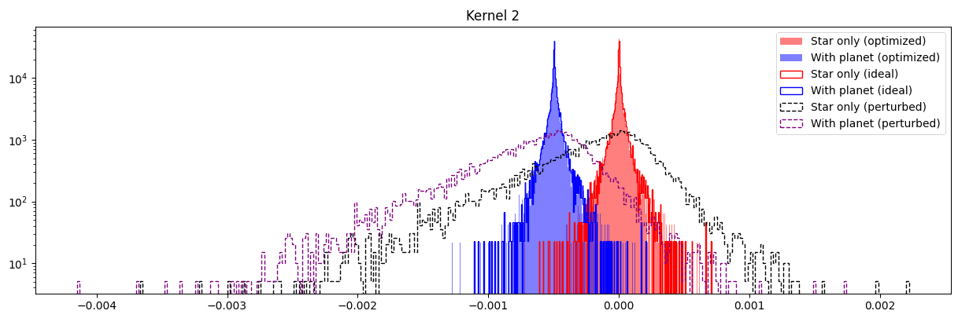
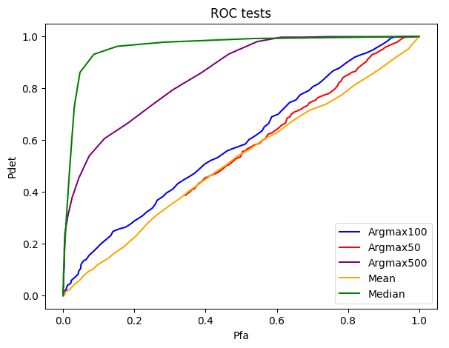
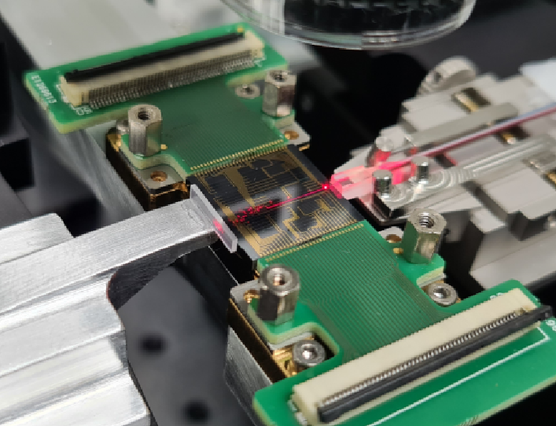

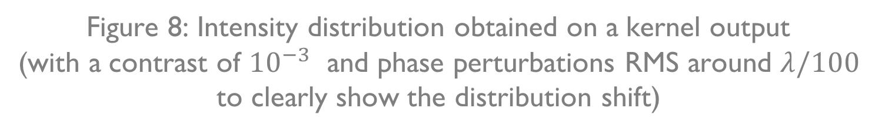
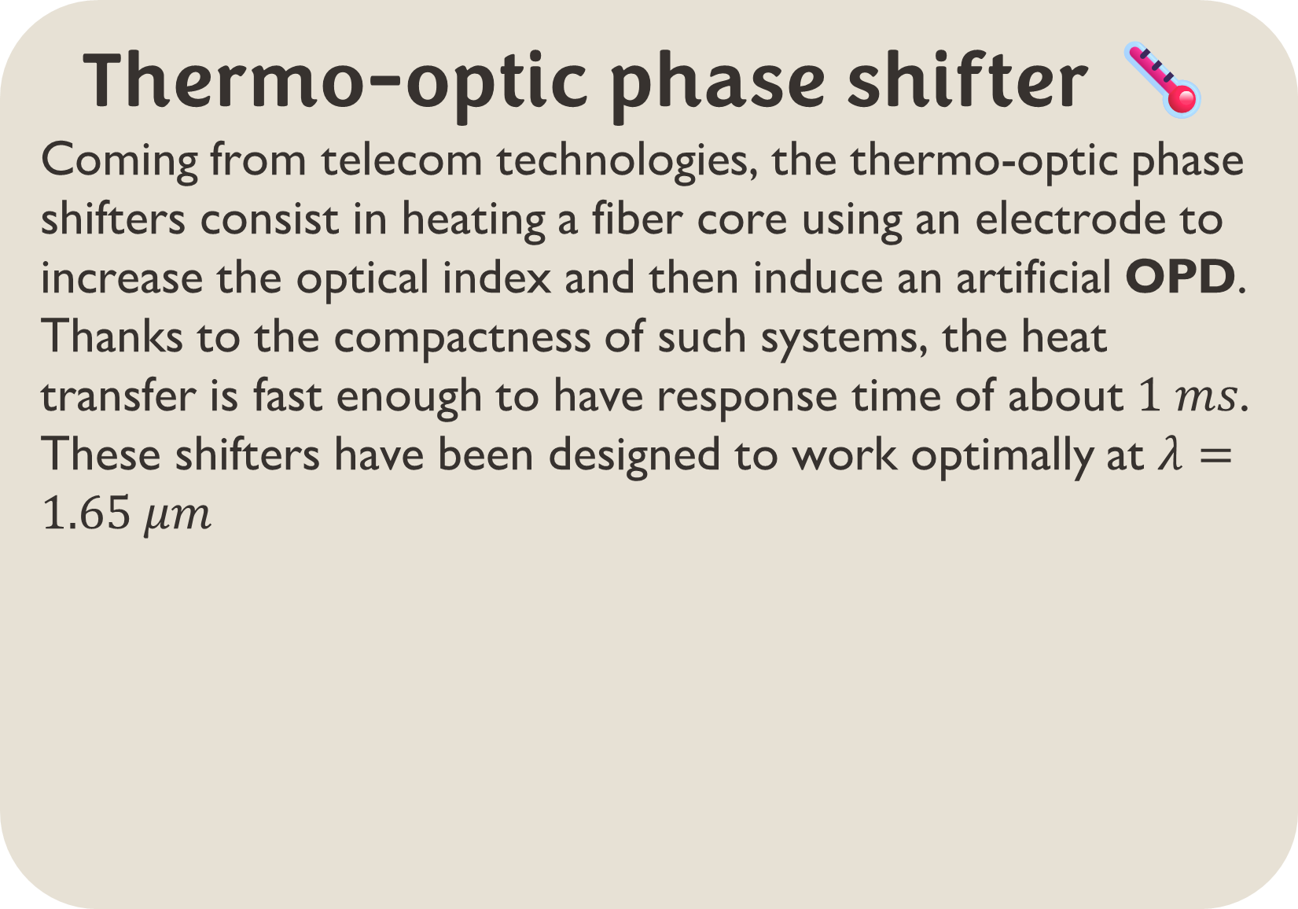
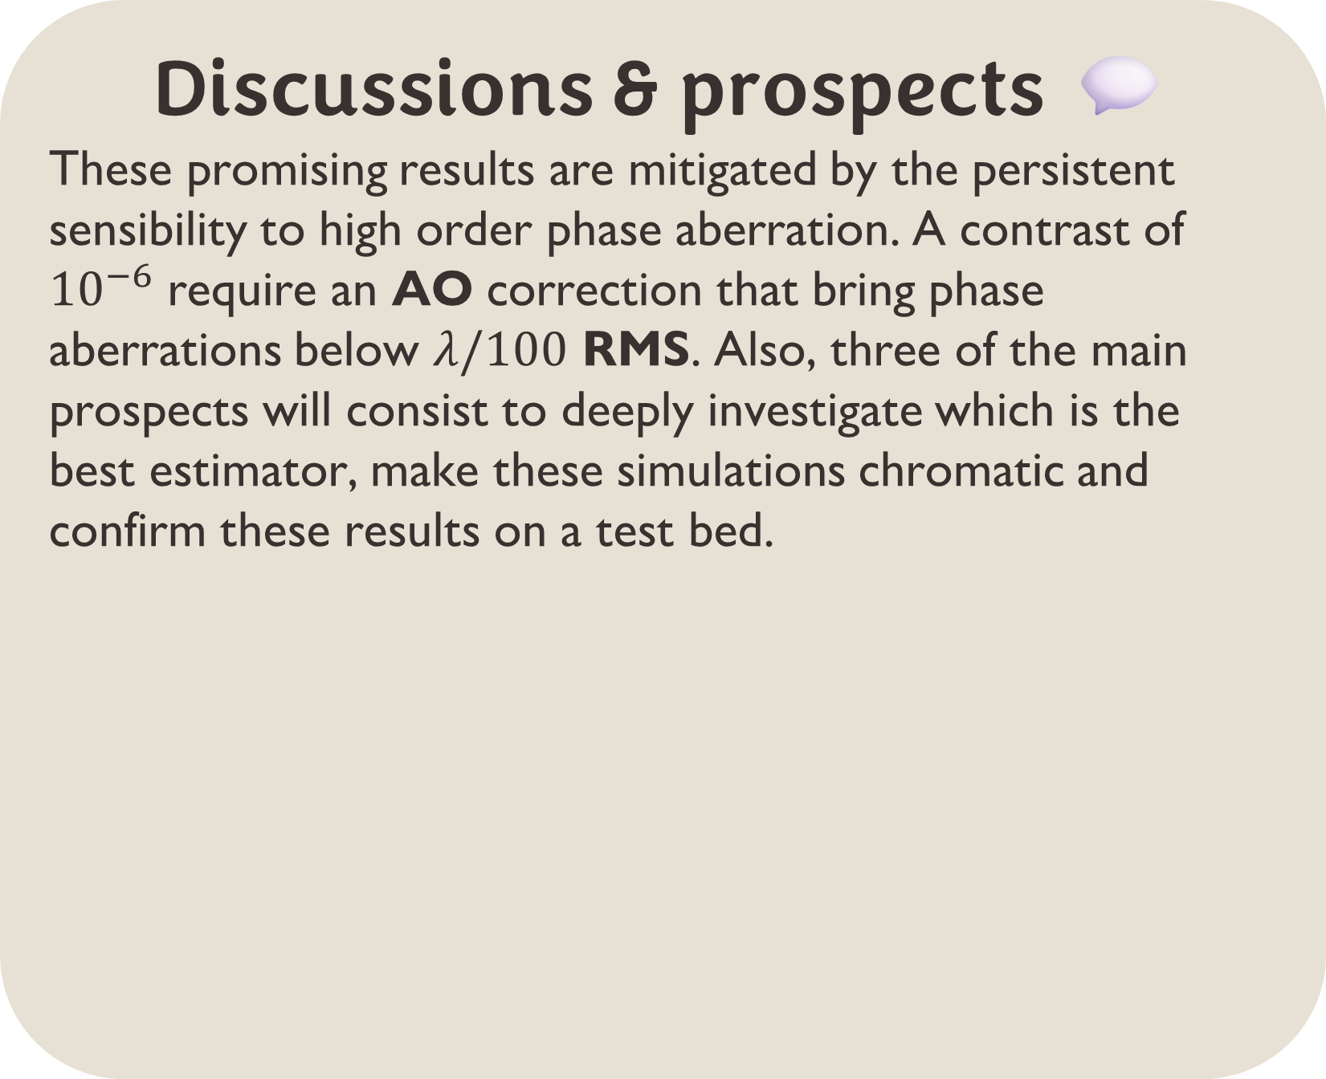
DIRECT DETECTION OF EXOPLANETS USING TUNABLE KERNEL-NULLING Vincent Foriel^{1,*}, Frantz Martinache¹, David Mary¹ ¹ Université Côte d'Azur, Observatoire de la Côte d'Azur, CNRS, Laboratoire Lagrange, France * vincent.foriel@oca.eu
In a nutshell 🥜
This poster present a thesis that aim to enhance nulling interferometry for exoplanet detection using a four-telescope architecture named Kernel-Nuller. By integrating 14 active phase shifters, we aim to mitigate phase aberrations caused by manufacturing defects. A first objective is to develop a technique that allow to find the good shifts to inject to optimize the component performances. A second step consists in analyzing intensity distributions produced and applying statistical tests and machine learning to extract valuable information. This poster present the preliminary results.
Nulling interferometry 〰️ On the VLTI
This technique consist in taking advantage of the angular separation and the coherence properties of the light to destroy the star light without destroying the one coming from the planet. Our approach
enhance this principle by
introducing « Kernels »
which combine the light
from 3 telescopes ^{[1]} or
more to be less sensitive to
low order phase aberrations
and asymmetries ^{[2]} the output to better constrain the planet position.
Calibration algorithm 🗜️
To find the best phase shifts to introduce, I proposed an algorithm inspired from dichotomy and gradient descent that accepts or rejects steps in the parameter space according to the bright $M_{1}$ and dark asymmetry $M_{2}$ metrics. $B$ and $D$ are respectively the bright and darks output intensities (Fig. 1).
$$M_{1}=B$$
$$M_{2}=\left|D_{1}−D_{2}\right|+\left|D_{3}−D_{4}\right|+\left|D_{5}−D_{6}\right|$$
Figure 1: Scheme of our Kernel-Nulling architecture
Parallactic diversity 🔄️
Taking advantage of the earth rotation, the kernel distribution will shift according to a known modulation. For each kernel output, one fit this modulation to the data points, giving the position and contrast of the potential object. By averaging all these parameter and computing a global fit, we can then see if this last one is well correlated to each kernel modulation.
Figure 2: Concept of nulling. The signals are placed in phase opposition to destroy the on-axis source and let pass the light from nearby objects
Figure 3: Transmission map of one of the Kernels obtained using the 4 telescopes of the VLTI. The transmission zones and blind bands are directly derived from the telescopes position. By rotating the baseline, we can get a modulated signal from which we can precisely constrain the planet position. (cf. “Parallactic diversity” block)
Figure 6: phase and amplitude of the 4 input signals on the 6 dark outputs before (top) and after (bottom) the calibration process
Figure 9: Kernel modulation & fitting
On-sky contribution 🌌
By weighting the kernel transmission map by the output intensity and integrating it over the parallactic angle, we can dress a map of the source of input light. By cumulating the 3 maps, one can constrain precisely which part of the sky contributed the most to the data we have. Thus, this process reveal the approximative object location, spreaded by the input phase aberrations.
Distribution analysis 📊
In presence of unavoidable input phase aberrations, the system is not able to perfectly cancel the star light. By performing many observations, we obtain some intensity distribution intensity at the kernels output.
The presence of an exoplanet in the field of view result in a shift of the distribution. The brighter the planet, the more pronounced the shift will be. When one increase the contrast, both distributions quickly become hard to distinguish. One then study different statistical (Fig. 11) tests to determine the one offering the best detection reliability.
Thermo-optic phase shifter 🌡️
Coming from telecom technologies, the thermo-optic phase shifters consist in heating a fiber core using an electrode to increase the optical index and then induce an artificial OPD. Thanks to the compactness of such systems, the heat transfer is fast enough to have response time of about $1 ms$. These shifters have been designed to work optimally at $λ=1.65 μm$
Figure 10: Repartition of on-sky contributions and cumulation of these maps to reveal the object location.
Figure 7: Evolution of kernel distribution spread according to the input phase aberrations.
Discussions & prospects 💬
These promising results are mitigated by the persistent sensibility to high order phase aberration. A contrast of ${10}^{−6}$ require an AO correction that bring phase aberrations below $λ/100$ RMS. Also, three of the main prospects will consist to deeply investigate which is the best estimator, make these simulations chromatic and confirm these results on a test bed.
Figure 4: Scheme of thermo-optic phase shifter
Active optical components 💡
The idea of our architecture is to combine the nulling interferometry with the phase shifter technologies to make an active optical component that can be calibrated to compensate the phase aberration induced by the manufacturing defects.
Figure 11: ROC test to compare the detection performance of different estimators according to the probability of false alarm.
Figure 5: Picture of the waffle that contain several prototype architectures of Kernel-Nuller. The overall component size is comparable to a 1 cent coin.
Figure 8: Intensity distribution obtained on a kernel output
(with a contrast of ${10}^{−3}$ and phase perturbations RMS around $λ/100$ to clearly show the distribution shift)
References 📜
Cvetojevic, N. et al. “3-beam self-calibrated Kernel nulling photonic interferometer” (2022). Preprint at http://arxiv.org/abs/2206.04977.
Martinache, Frantz, et Michael J. Ireland. ”Kernel-Nulling for a Robust Direct Interferometric Detection of Extrasolar Planets”. Astronomy & Astrophysics 619 (2018): A87. https://doi.org/10.1051/0004-6361/201832847.
Acknowledgment 🤝
Thanks to Romain Laugier for his many wise advices, to Nick Cvetojevic for his help to introduce me to the subject and Margaux Abello for the help on the presentations. This thesis is made possible by the PHOTONICS project of the PEPR ORIGINS and Thales Alenia Space
Glossary 📖
AO: Adaptative Optics
OPD: Optical Path Difference
RMS: Root Mean Square ROC: Receiver operating characteristic
VLTI: Very Large Telescope Interferometer

