Slide 1
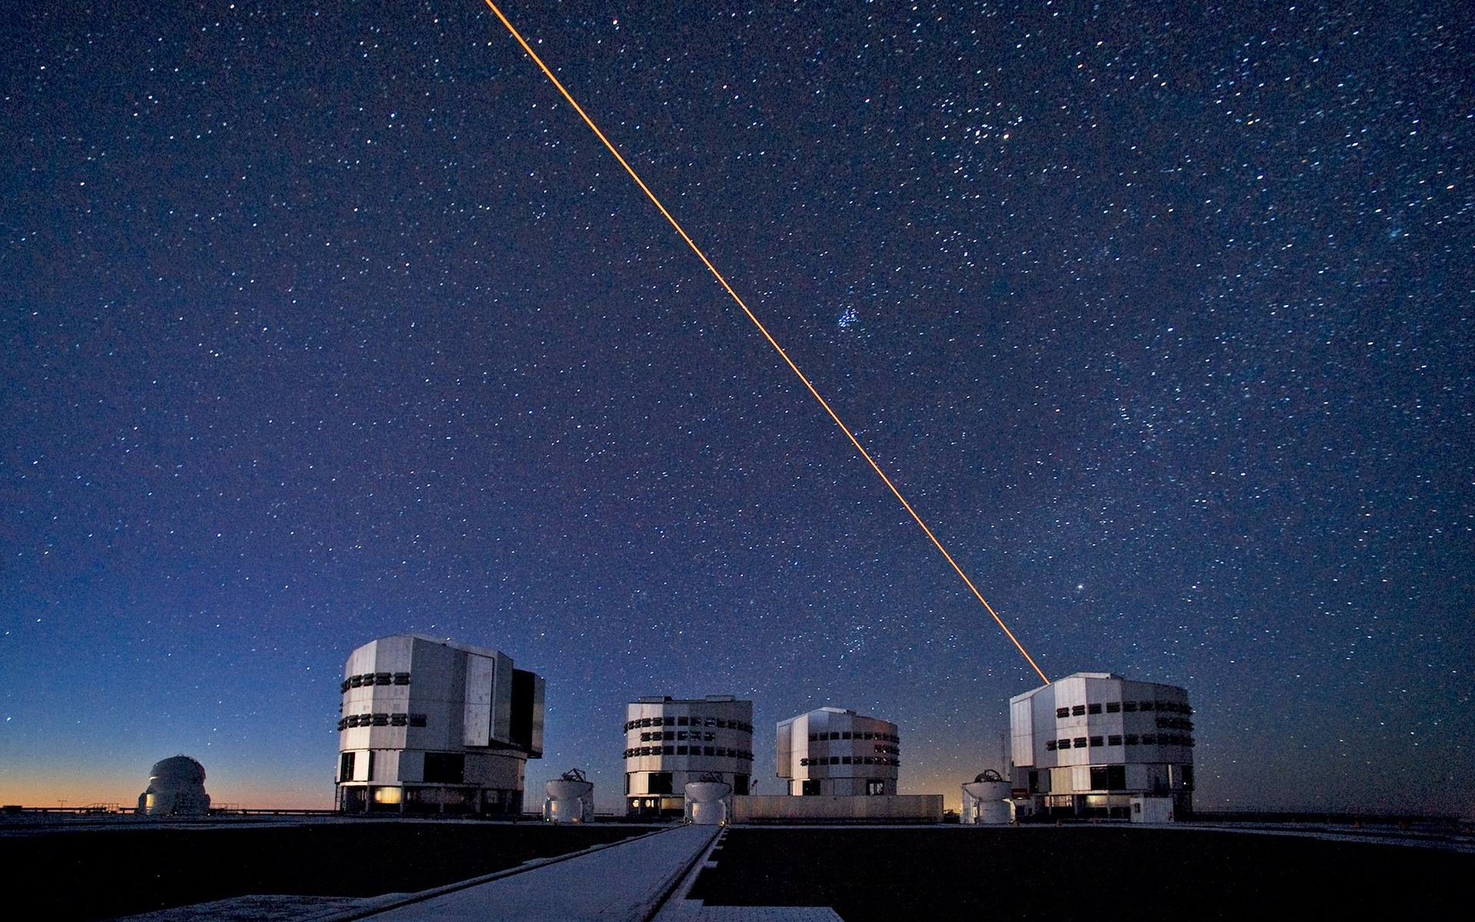




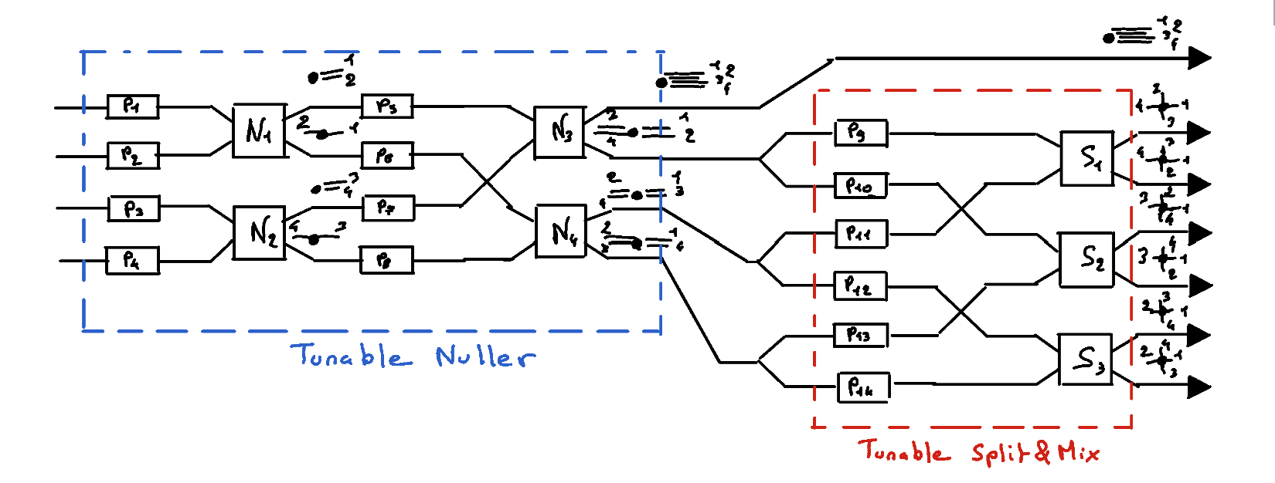
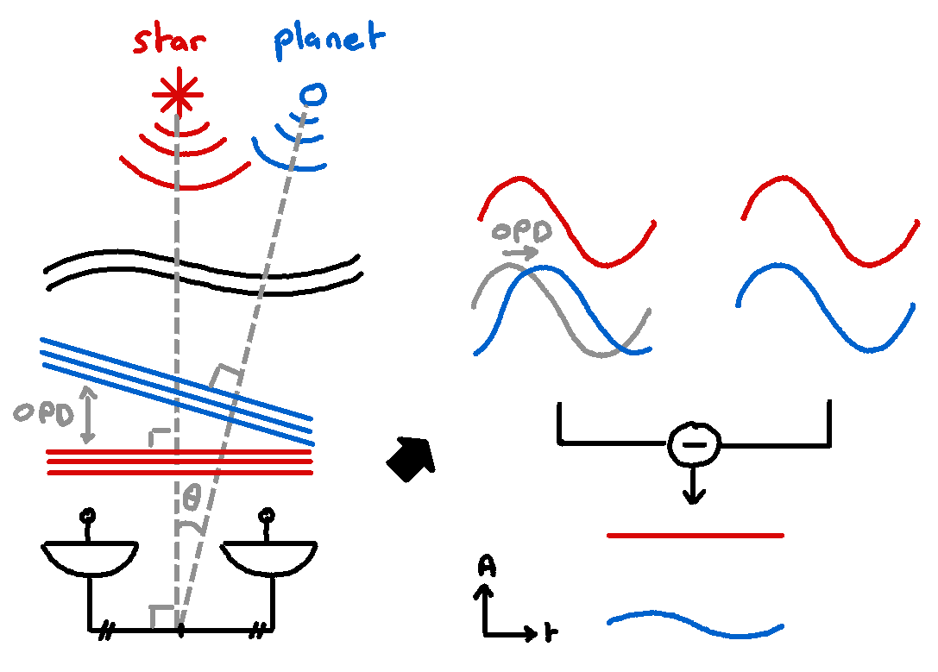
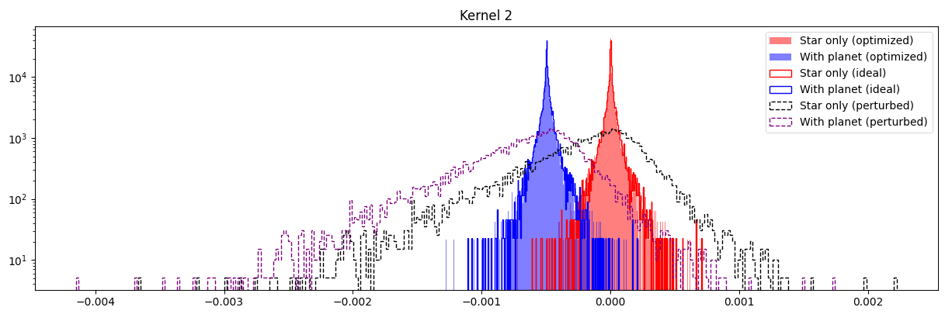
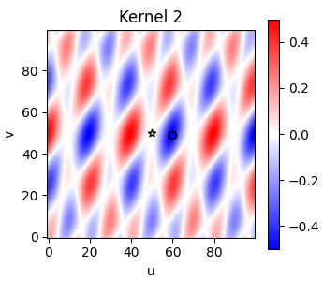
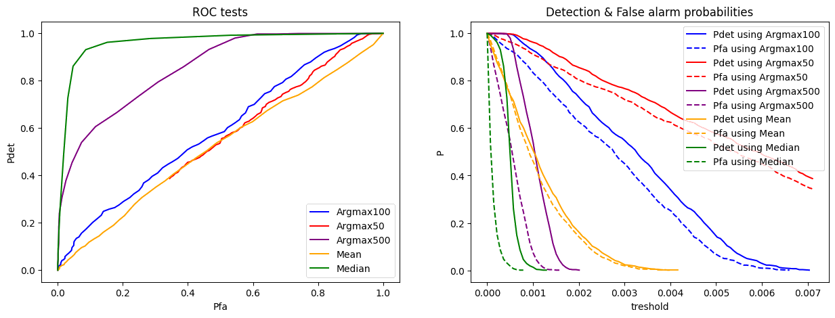
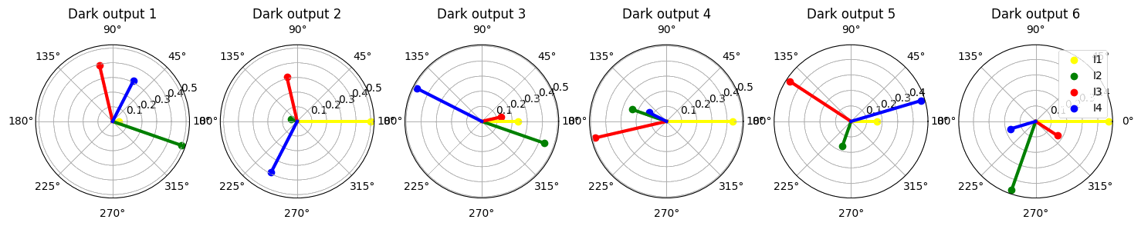
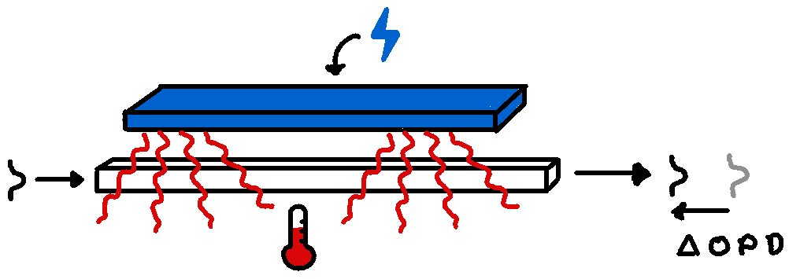
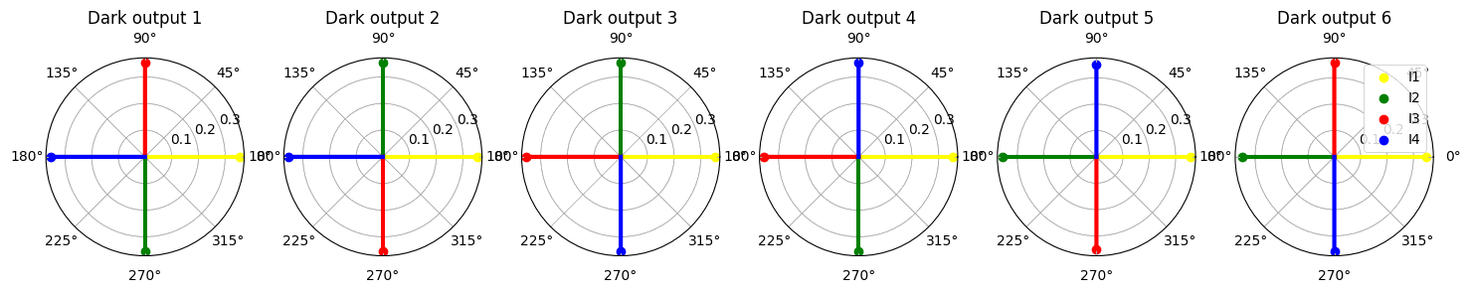
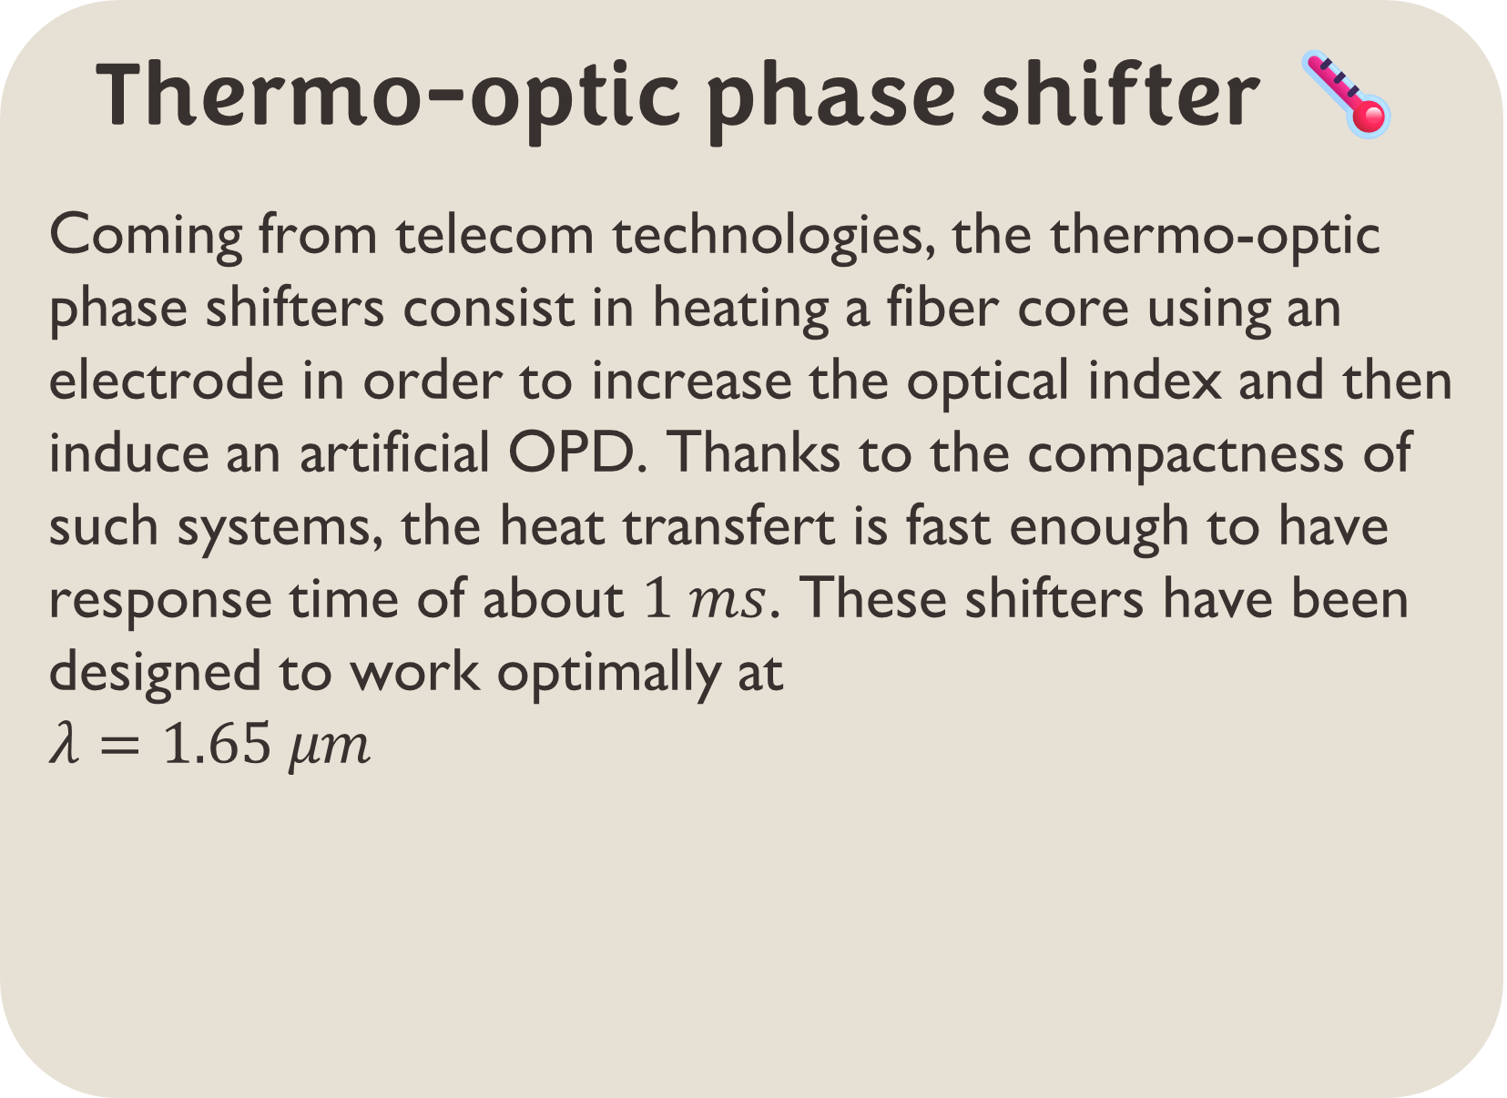
DIRECT DETECTION OF EXOPLANETS USING TUNABLE KERNEL-NULLING Vincent Foriel^{1,*}, Frantz Martinache¹, David Mary¹ ¹ Université Côte d'Azur, Observatoire de la Côte d'Azur, CNRS, Laboratoire Lagrange, France * vincent.foriel@gmail.com
In a nutshell 🥜
This thesis aim to enhance nulling interferometry for exoplanet detection using a four-telescope architecture named Kernel-Nuller. By integrating 14 active phase shifters, we aim to mitigate phase aberrations caused by manufacturing defects. An algorithm is developed to optimize device performance, validated through simulations and lab experiments. A second phase consist in analyzing intensity distributions produced by Kernel-Nuller and applying statistical tests and machine learning to extract science information. This poster present the preliminary results.
Figure 1: Scheme of our Kernel-Nulling architecture
Nulling interferometry 〰️ On the VLTI
This technique consist in taking advantage of the angular separation and the coherence properties of the light to destroy the star light and combine the planet light in the same process.
Our approach enhance this principle by introducing « Kernels » which combine the light from 3 telescopes or more in order to be less sensitive to low order phase aberations and asymetrize the output to better constrain the planet position.
Active optical components 💡
The idea of our architecture is to combine the nulling interferometry with the phase shifter technologies to make an active optical component that can be calibrated to compensate the phase aberration induced by the manufacturing defects.
Statistical analysis 📊
Kernel outputs
Distributions
Estimation of the true value
Calibration algorithme 🗜️
Method
Metrics
Convergence speed
Limitations
Figure 2: Concept of nulling interferometry
Figure 3: Transmission map of one of the Kernels obtained using the 4 telescopes of the VLTI. The transmission zones and blind bands are directly derived from the UT position. By rotating the baseline, we can get a modulated signal from which we can precisely constrain the planet position.
Thermo-optic phase shifter 🌡️
Coming from telecom technologies, the thermo-optic phase shifters consist in heating a fiber core using an electrode in order to increase the optical index and then induce an artificial OPD. Thanks to the compactness of such systems, the heat transfert is fast enough to have response time of about $1 ms$. These shifters have been designed to work optimally at $$λ=1.65 μm$$
Discussions & prospects 💬
Angular diversity
Test in lab
Usage of physics based MMI models
Implementation on the VLTI
Figure 3: Scheme of thermo-optic phase shifter
References 📜
Blablabla
Acknowledgment 🤝
Blablabla
Financement projet PHOTONICS

