Slide 1




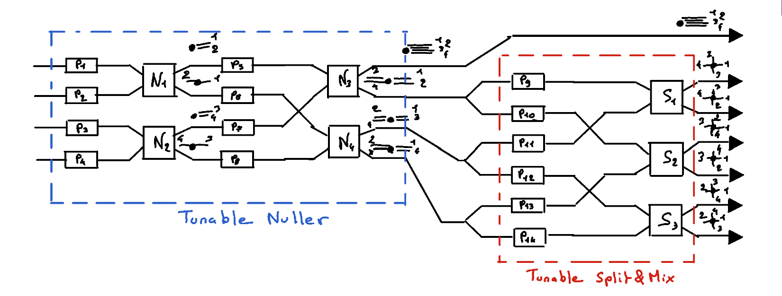
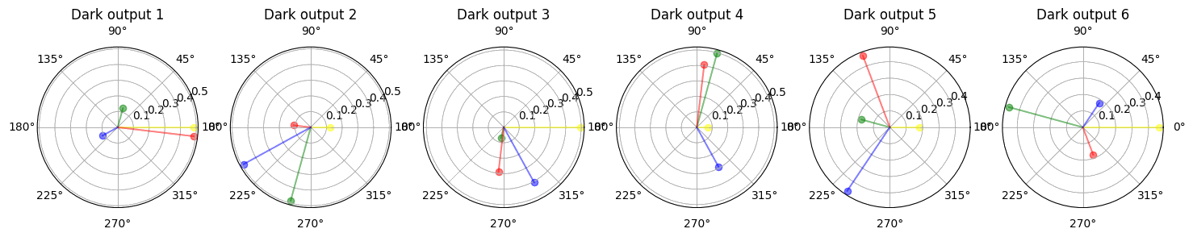
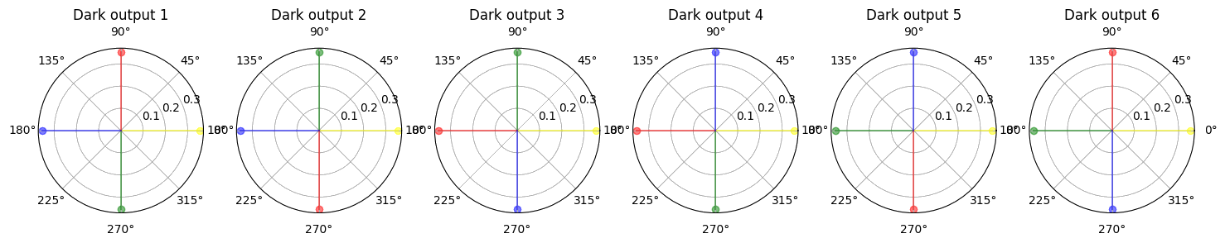
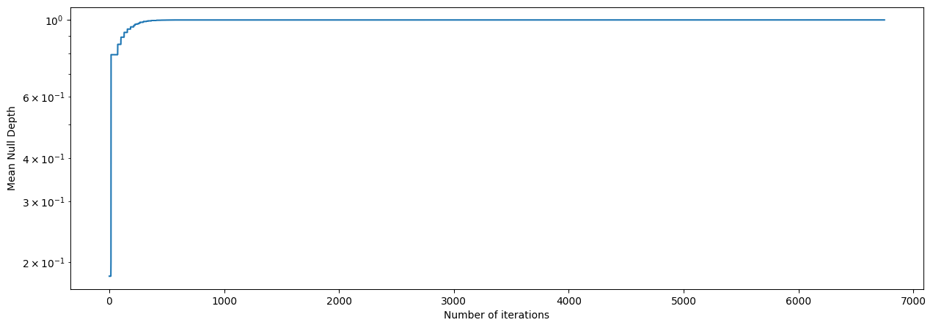
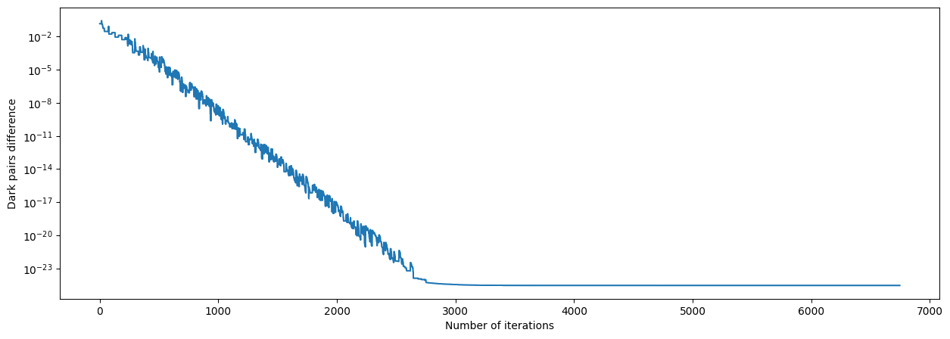
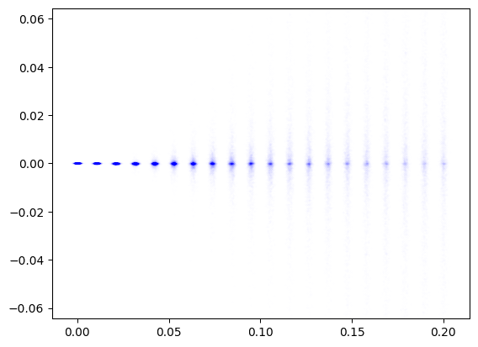
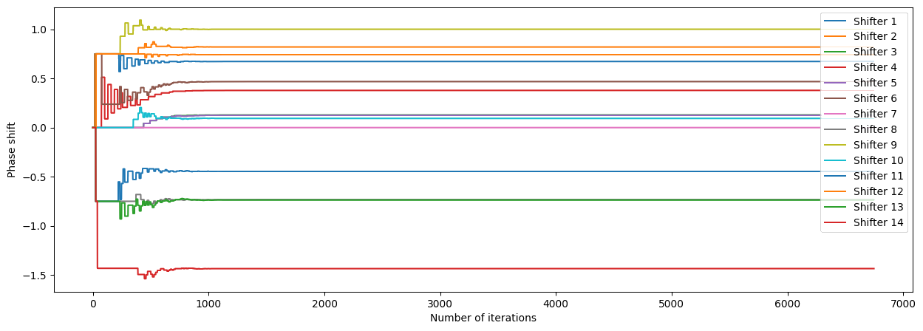
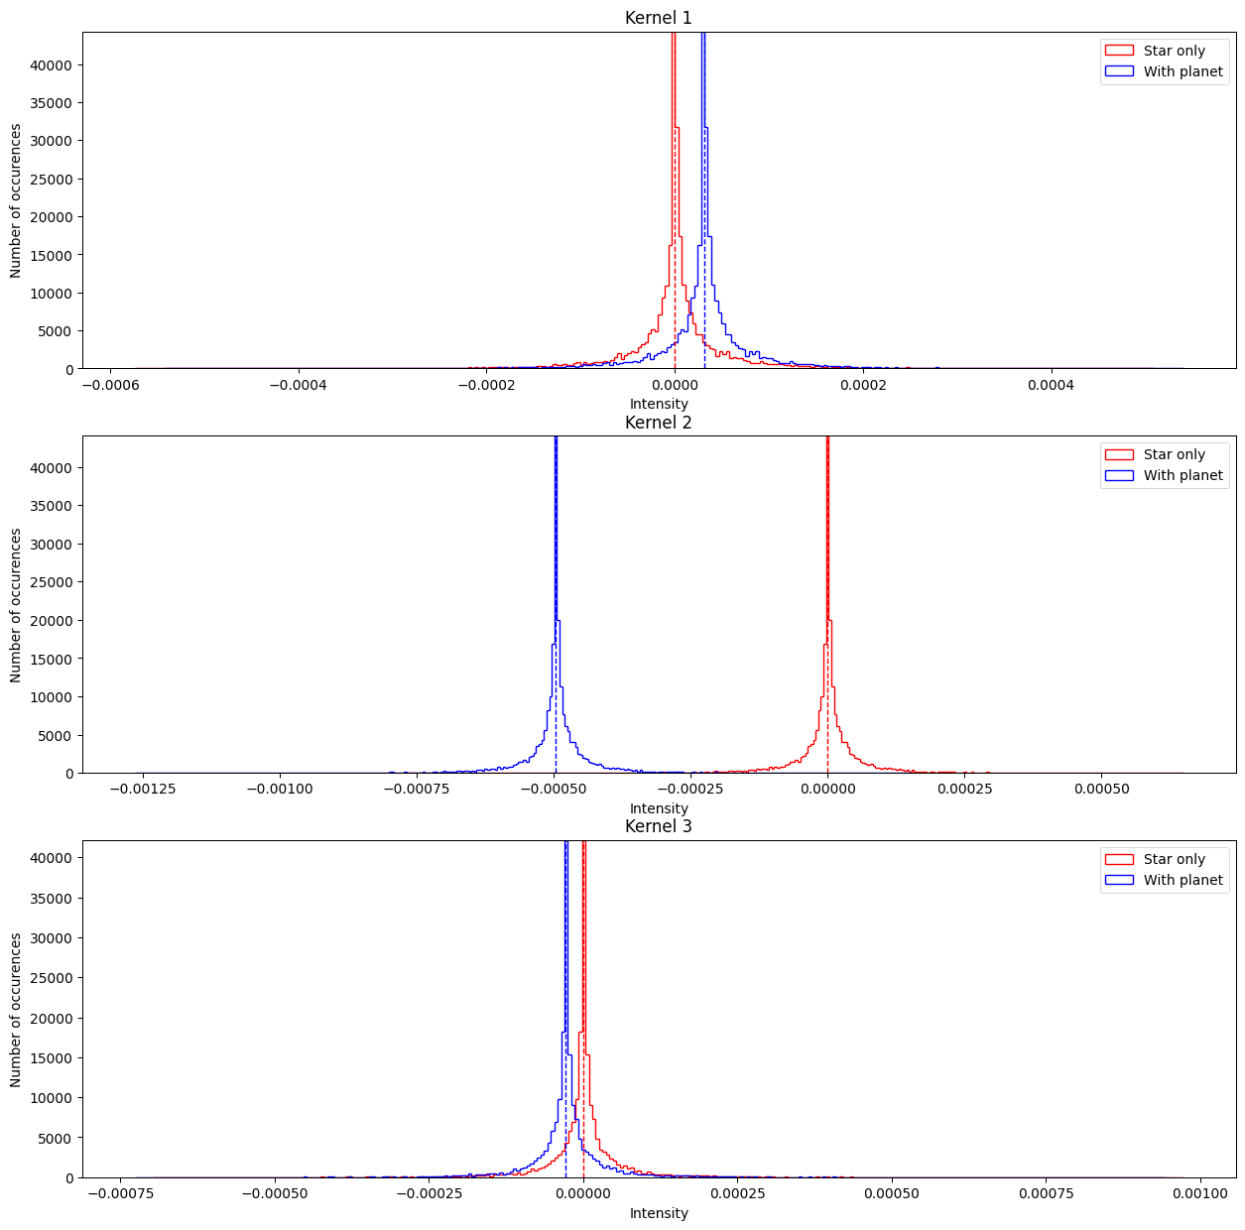
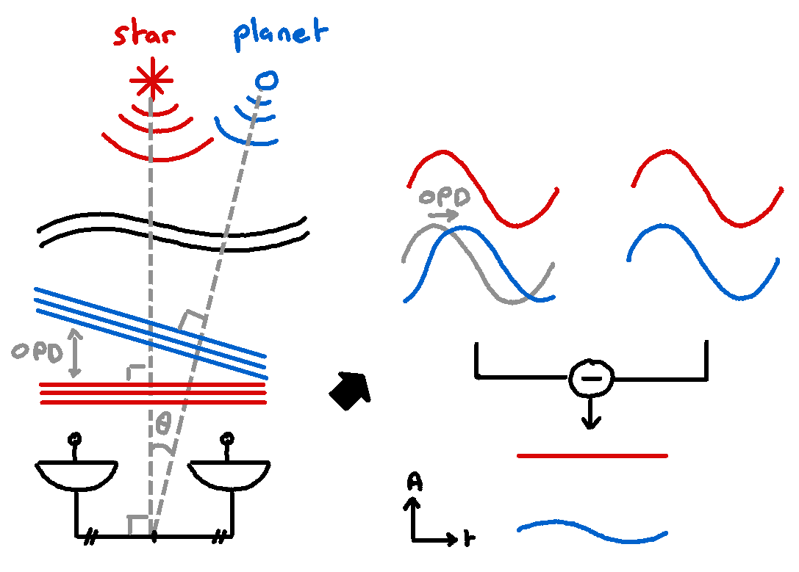
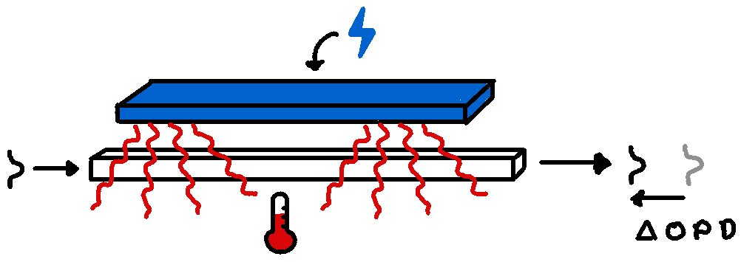
DIRECT DETECTION OF EXOPLANETS USING TUNABLE KERNEL-NULLING Vincent Foriel ^{1,*}, Frantz Martinache ¹, David Mary ¹ ¹ Université Côte d'Azur, Observatoire de la Côte d'Azur, CNRS, Laboratoire Lagrange, France * vincent.foriel@gmail.com
Abstract 🔎
This thesis proposes an innovative approach, tunable Kernel-Nulling, for high-contrast imaging of exoplanets. Using integrated optics technology with electronically controlled phase shifters, the method asymmetrically modifies the nuller's response, allowing the discrimination of astrophysical signals from diffraction-induced speckles. The device's performance optimization involves machine learning techniques, initially in a controlled setting and later in realistic observing conditions. This approach promises to significantly enhance interferometric high-contrast imaging, providing a powerful solution for achieving deep and robust observations.
Results 📊
Blablabla
Figure 2: Scheme of our Kernel-Nulling architecture
Methodology 🪛
Blablabla
Introduction 👋
Blablabla
Discussions 💬
Blablabla
Figure 1: Concept of nulling interferometry
Figure 3: Scheme of thermo-optic phase shifter
References 📜
Blablabla
Acknowledgment 🤝
Blablabla

