Slide 1




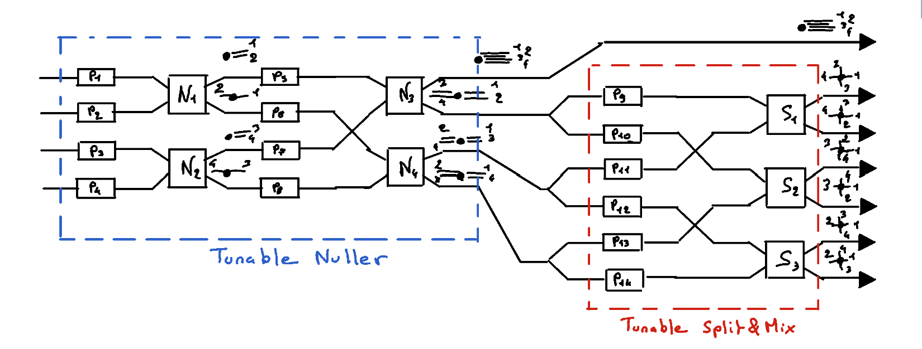
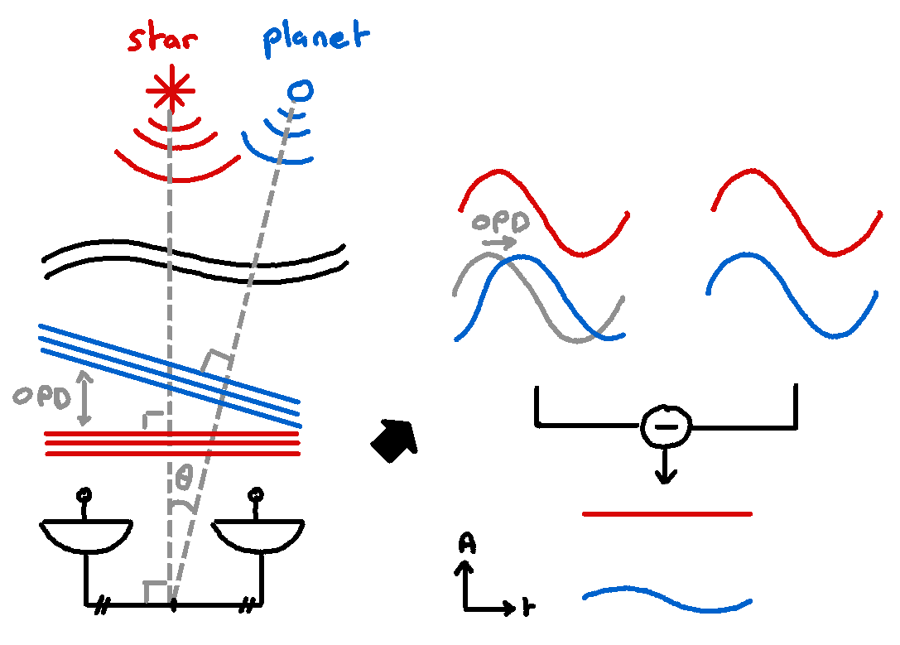
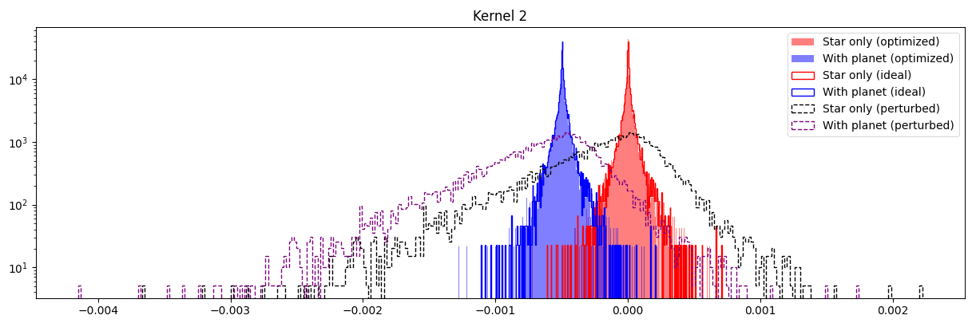
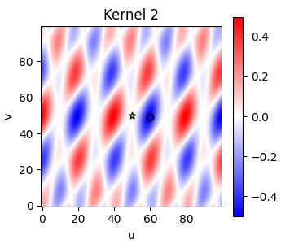
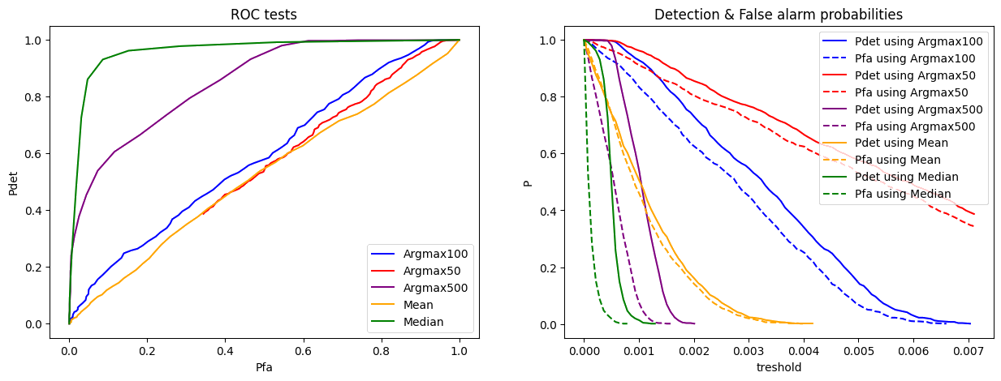
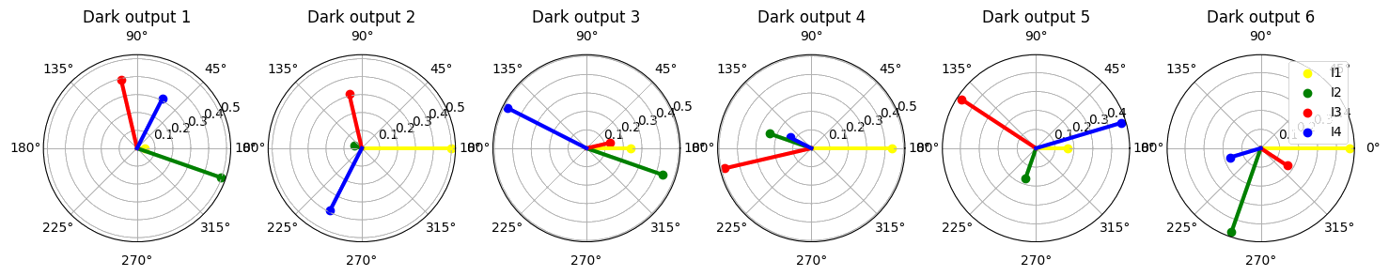
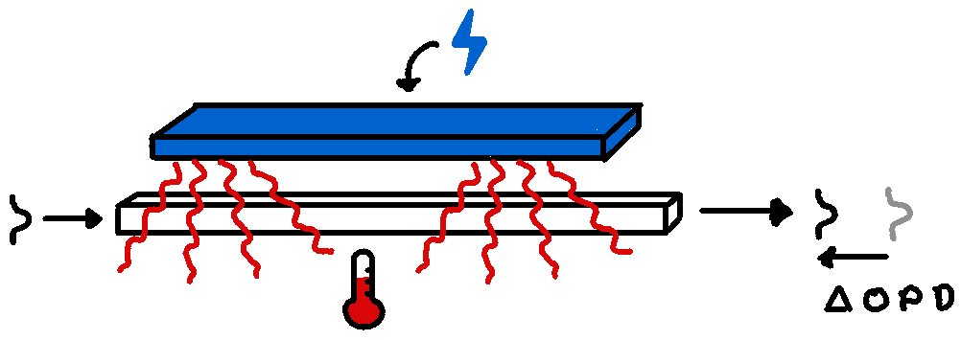
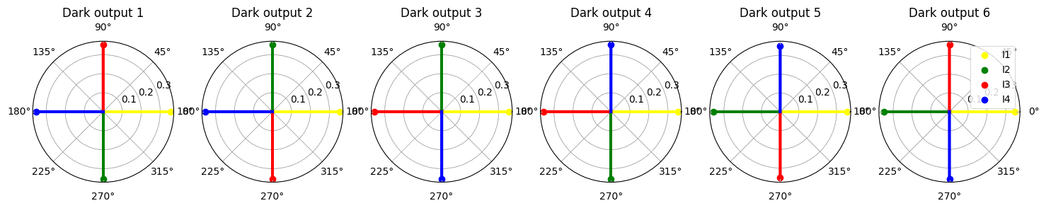

DIRECT DETECTION OF EXOPLANETS USING TUNABLE KERNEL-NULLING Vincent Foriel^{1,*}, Frantz Martinache¹, David Mary¹ ¹ Université Côte d'Azur, Observatoire de la Côte d'Azur, CNRS, Laboratoire Lagrange, France * vincent.foriel@gmail.com
In a nutshell 🥜
This thesis aim to enhance nulling interferometry for exoplanet detection using a four-telescope architecture named Kernel-Nuller. By integrating 14 active phase shifters, it aims to mitigate phase aberrations caused by manufacturing defects. An algorithm is developed to optimize device performance, validated through simulations and lab experiments. A second phase consist in analyzing intensity distributions produced by Kernel-Nuller and applying statistical tests and machine learning to extract science information. This poster present the preliminary results.
Figure 1: Scheme of our Kernel-Nulling architecture
Nulling interferometry 〰️ On the VLTI
Blablabla
Active optical components
Blablabla
Statistical analysis 📊
Kernel outputs
Distributions
Estimation of the true value
Figure 2: Concept of nulling interferometry
Calibration algorithme 🗜️
Method
Metrics
Convergence speed
Limitations
Thermo-optic phase shifter 🌡️
- Wavelenght : $1.65μm$
- Response time: $<1 ms$
Discussions & prospects 💬
Angular diversity
Test in lab
Usage of physics based MMI models
Implementation on the VLTI
Figure 3: Scheme of thermo-optic phase shifter
References 📜
Blablabla
Acknowledgment 🤝
Blablabla
Financement projet PHOTONICS

