Slide 1
Battle of Healthcare System between The U.S and Canada
Michael Tang

Slide 2
Background Information
Canada and the U.S uses two different healthcare systems
Canada: Single-payer
The U.S: Multi-payer
Canada seems to be doing more for less on its healthcare
Canada: 10.4% of its GDP
The U.S: 16%

Slide 3
Motivation – Who is the audience
In this project, two studies were done for two separate groups of audiences
For the U.S politicians:
What is the pros and cons of the Canadian healthcare system
For someone who wants to have a career in medicine and run his/her clinic in Toronto
What type of healthcare facility is ideal in each Toronto ward

Slide 4
Data Sources:
Using Toronto and Boston to represent Canada and the U.S respectively
Data needed:
Geological information (Latitude & Longitude, Area)
Demographics information (Number of households & Median household income)
24 Toronto wards:
Demographics and area data (Downloaded in .excel format)
Latitude and longitude (Downloaded in .csv format)
256 Boston neighborhoods:
Demographics data (Downloaded in .excel format)
Area data (Downloaded in .json format)
Latitude and longitude (Downloaded in .csv format)

Slide 5
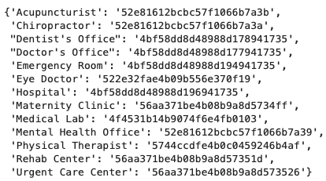
Foursquare API
Use Foursquare search venue endpoint
Use radius of each ward (assuming a circular shape) to define a search boundary
Use category ID to narrow down returned venues

Slide 6
How to Evaluate a Healthcare system
Healthcare Accessibility in each city
Wait time for each type of healthcare facility
Number of households / Number of each healthcare facility type
Area of a city / Number of each healthcare facility type
Affordability
Average healthcare cost per household / Number of households
The longer the wait time & the lower the affordability, the more a healthcare system needs to improve

Slide 7
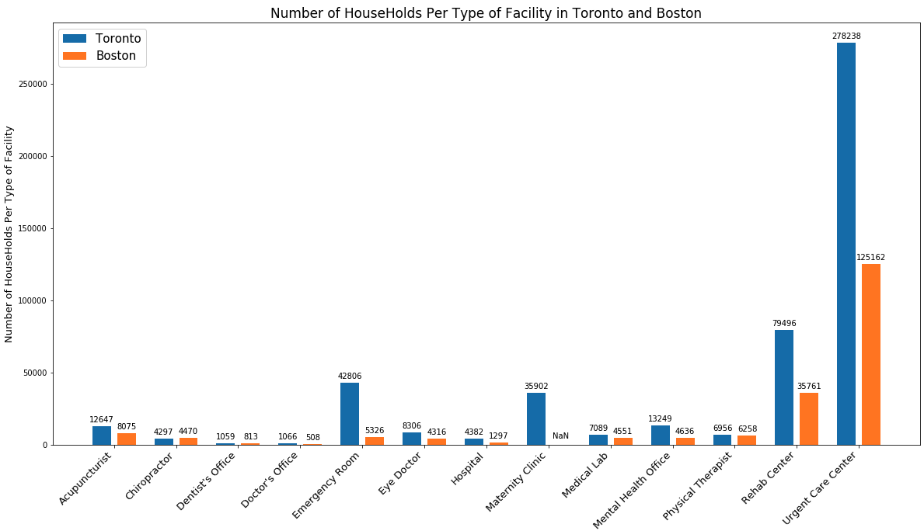
Comparison - Findings 1
Healthcare facilities in Boston are less crowded
Shorter wait time
more satisfied patients

Slide 8
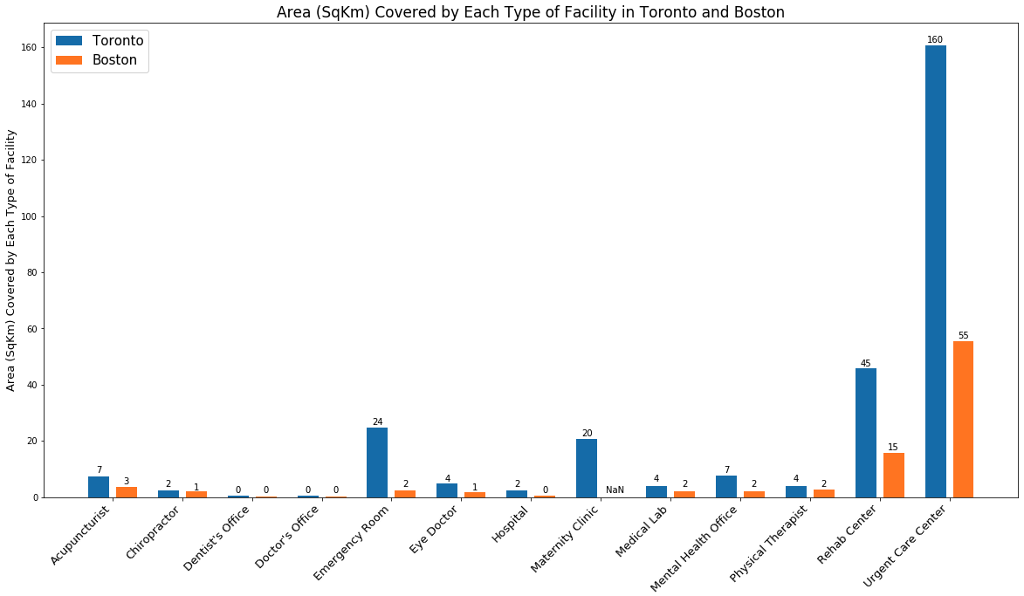
Comparison - Findings 2
More healthcare facilities per land area in Boston
Shorter wait time
more satisfied patients

Slide 9
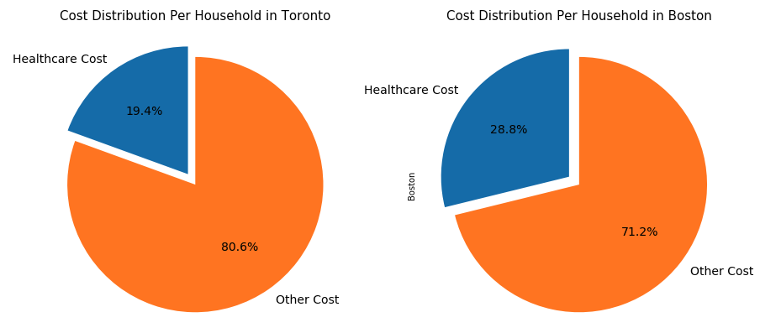
Comparison - Finding 3
Lower healthcare cost in Canada
More affordable
More patient taking the treatments

Slide 10
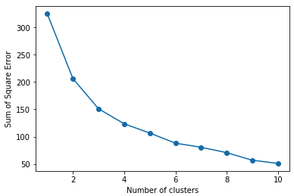
Clustering – Findings 1
SSE vs. Number of clusters are used to determine the k value
No sharp change is observed
6 is used (relatively sharper change)

Slide 11
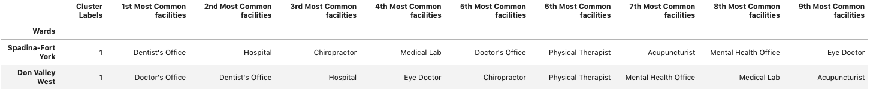
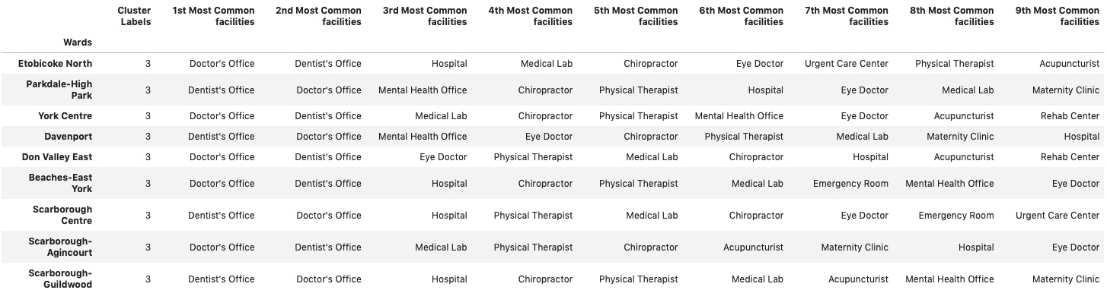
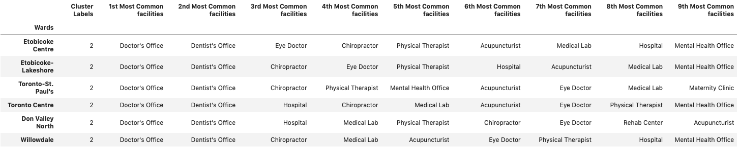
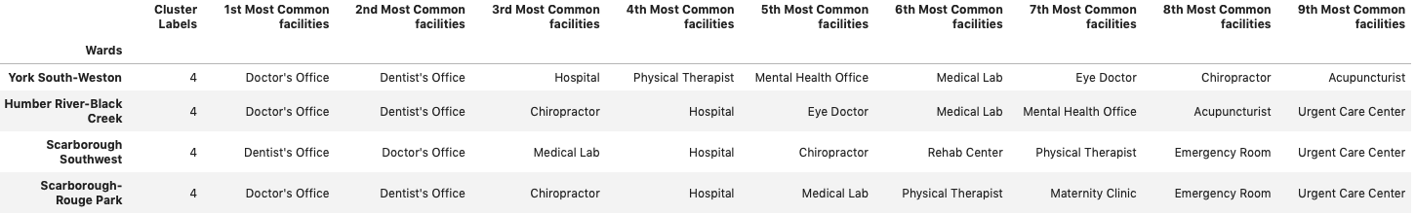
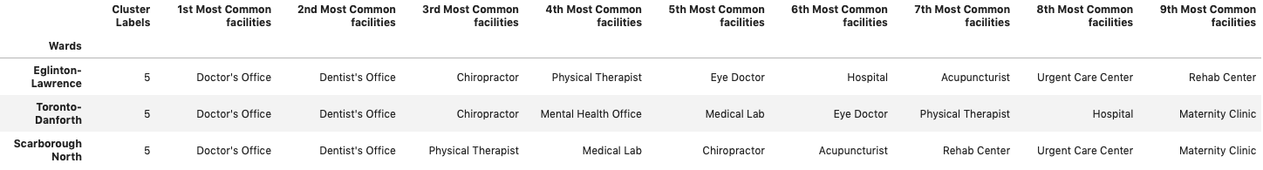
Clustering – Findings 2

Slide 12
What Should You Open?
Cluster 1 | 1st | Medical Lab
 | 2nd | Physical therapist
 | 3rd | Chiropractor
Cluster 2 | 1st | Physical therapist
 | 2nd | Medical Lab, Doctor’s office, Eye doctor, Chiropractor
Cluster 3 | 1st | Physical therapist
 | 2nd | Acupuncturist
 | 3rd | Chiropractor
Cluster 4 | 1st | Chiropractor
 | 2nd | Physical therapist
 | 3rd | Medical lab
Cluster 5 | 1st | Medical lab
 | 2nd | Physical therapist
 | 3rd | Eye doctor, Rehab center, Mental health office, chiropractor
Cluster 6 | 1st | Eye doctor
 | 2nd | Physical therapist, Mental health office, Medical lab, Chiropractor, Acupuncturist

Slide 13
Conclusion
Toronto and Boston each has its pros and cons:
Toronto: more affordable
Boston: shorter wait time
Further study needs to include other factors (e.g. treatment efficacy, readmission rate)
Distribution of healthcare facilities are not the best features to cluster Toronto wards
Further study needs to include other factors (e.g. age and income distribution)

Slide 14
Thank You!

