Slide 1
Die Zeit in der Astronometria
UTC, TT, TBC

Slide 2
final implementation idea: starting point
GUI / CLI: Input Data – Time from To, Observation Point, etc.
User Domain UTC
Time domain
unclear
External
Data Sources:
BS-Catalog
VSOP data
Tycho
…
Data Layer (Parser)
Parser, Catalog, Orbital
elements, VSOP Loader, …
Astro Domain
Ephemerides Layer
VSOP, Aberration, Nutaiton, Precession,
Light-Runtime
TT, TDB
Core Layer
Planets, Moon, Stars, Sun, Comets,
„Sky Objects“
Report Layer
Simulation Layer
Projection Layer
UTC
GUI: Output Data – Maps, Trajectories, …
UTC

Slide 3
final implementation:
GUI / CLI: Input Data – Time from To, Observation Point, etc.
User Domain UTC
Time domain
unclear
External
Data Sources:
BS-Catalog
VSOP data
Tycho
…
Data Layer (Parser)
UTC Instant
Astro Domain
Ephemerides Layer
UTCToTT
Converter
TT, TDB
Core Layer
TTInstant
Report Layer
Simulation Layer
Projection Layer
UTC
GUI: Output Data – Maps, Trajectories, …
UTC

Slide 4
Use Case: GUI says „Simulate Positions in January and create a report“
Astro Domain TT
(AstroSim.Time.Astro)
Determine 1.1. UTC
Determine 31.1. UTC
User Domain UTC
(AstroSim.Time.User)
Create 1.1. TT
Create 31.1. TT
1.1. UTC
To TT
31.1. UTC
to TT
1.1. TT
31.1. TT
Simulation (1.1. TT - 31.1. TT):
List<TTInstant time, Position pos)
1.1. TTInstant Pos@ TTInstant
2.1. TTInstant Pos@ TTInstant
…
31.1. TTInstant Pos@ TTInstant
Simuliere jetzt
(1.1. TT bis 31.1. TT)
Result: List<TTInstant time, Position pos)
1.1. TTInstant Pos@TTInstant
2.1. TTInstant Pos@TTInstant
…
31.1. TTInstant Pos@TTInstant
1.1. TT
To UTC
31.1. TT
to UTC
Create for these TTs their UTCs again:
1.1. TTInstant Pos@TTInstant 2.1. TTInstant Pos@TTInstant …
31.1. TTInstant Pos@TTInstant
Converter Domain UTC/TT
(AstroTim.Time.
Conversion)
Final Report: List<UTCInstant time, Position pos)
1.1. UTCInstant Pos@UTCInstant
2.1. UTCInstant Pos@UTCInstant
…
31.1. UTCInstant Pos@UTCInstant

Slide 5
Zeit bei Test Cases
Use Case: GUI says „Simulate Positions in January and create a report“
Astro Domain TT
(AstroSim.Time.Astro)
User Domain UTC
(AstroSim.Time.User)
Converter Domain UTC/TT
(AstroTim.Time.
Conversion)

Slide 6
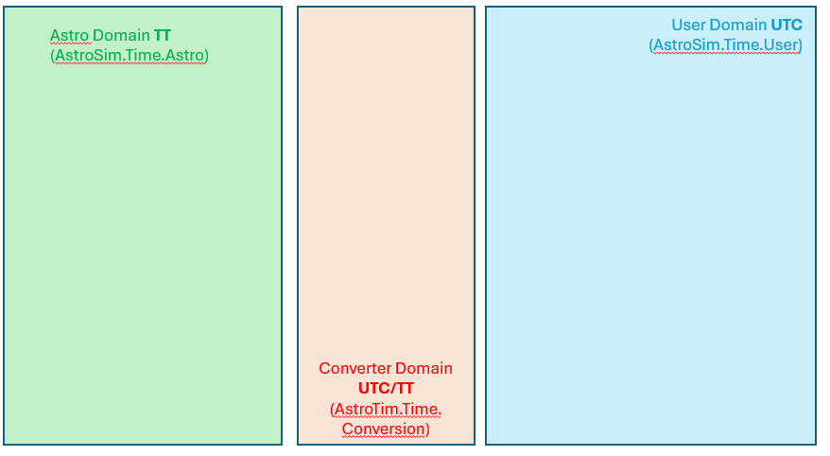
Verweis: AstroSim.Ephemeris.Test nach AstroTime.Time.Conversion
Astronometria
Astro Domain TT
(AstroSim. EphemerisTest)
Header
StateVector
{
JD (UTC!)
{x, y, z, vx, vy, vz}
}
json
JD (UTC!)
UTC
To TT
json
json
JD (TT!)
Header
StateVector
{
JD (UTC!)
{x, y, z, vx, vy, vz}
}
JD (TT!)
VSOP with TT
x_VSOP,
y_VSOP,
z_VSOP
Converter Domain UTC/TT
(AstroTim.Time.
Conversion)
EphemerisRegression
Assert
x, x_VSOP
y, y_VSOP
z, z_VSOP
JD Mesh
Horizons
Exporter

Slide 7
Backup

Slide 8
GUI / CLI: Input Data – Time from To, Observation Point, etc.
User Domain UTC
Time domain
unclear
External
Data Sources:
BS-Catalog
VSOP data
Tycho
…
Data Layer (Parser)
Parser, Catalog, Orbital
elements, VSOP Loader, …
Astro Domain
Ephemerides Layer
VSOP, Aberration, Nutaiton, Precession,
Light-Runtime
Initial implementation idea: starting point
TT, TDB
Core Layer
Planets, Moon, Stars, Sun, Comets,
„Sky Objects“
Report Layer
Simulation Layer
Projection Layer
UTC
GUI: Output Data – Maps, Trajectories, …
UTC

Slide 9
GUI / CLI: Input Data
User Domain UTC
Time domain
unclear
Class UserTime
{
private double UTC;
private double time shift;
private double DaylightSavings;
JD_UTC_to_GregorianDate
}
External
Data Sources:
BS-Catalog
VSOP data
Tycho
…
Data Layer (Parser)
Astro Domain
Class iAstroTimeInterface
{
Get_UTC(TT)
Get_TT(UTC)
}
Class AstroTime
{
private double TT;
private double TDB;
private double Delta T;
}
Initial implementation idea
UTC
GUI: Output Data – Maps, Trajectories, …
UTC

Slide 10
GUI / CLI: Input Data – Time from To, Observation Point, etc.
User Domain UTC
Time domain
unclear
Class UserTime
{
private double UTC;
private double time shift;
private double DaylightSavings;
JD_UTC_to_GregorianDate
}
External
Data Sources:
BS-Catalog
VSOP data
Tycho
…
Data Layer (Parser)
Astro Domain
Class iAstroTimeInterface
{
Get_TT(UTC)
}
Class iUserTimeInterface
{
Get_JD_UTC(JD_ TT)
}
Class AstroTime
{
private double TT;
private double TDB;
private double Delta T;
CalcDeltaT(UTC)
}
Ephemerides Layer
Initial implementation idea
Core Layer
Report Layer
Simulation Layer
Projection Layer
UTC
GUI: Output Data – Maps, Trajectories, …
UTC

