Slide 1
TX
TY
TZ
PHYS. MEASUREMENT DIMENISION
EPHEM-TYPE = { VECTORS}
INSTRUMENT DIMENSION
DERIVED MEASUREMENT DIMENISION
EPHEM-TYPE = { OBSERVER}
DERIVED MEASUREMENT DIMENISION
EPHEM-TYPE = { OBSERVER} + QUANTITIES
FREEZE
2026-05-17
VSOP
(X, Y, Z)_{HE}
FRAME
HE2GE
VECTOR_CORR=NONE
500@399
EPHEM-TYPE=OBSERVER
EPOCH= NOW
REF_SYSTEM=ICRF
TimeScale only for SimModel
not for MeasurementDef.
VECTOR_CORR=NONE
500@10
EPHEM-TYPE=VECTORS
(X, Y, Z)_{GE}
VECTOR_CORR=NONE
500@399
EPHEM-TYPE=VECTORS
GE2GA
GA+Prec
GA+Prec+Nut
GA+Prec+Nut+Obl
15
L0
Geometry
TIME-SCALE
TIME-SCALE
(RA, DEC)_{GA}
VECTORS
VECTORS
VECTOR_CORR=NONE
EPHEM-TYPE=OBSERVER
REF_System=ICRF
REF_PLANE=FRAME
QUANTITIES=1
TIME-SCALE
Topo Projection
OBSERVER+
1
2
3
VECTOR_CORR=NONE
EPHEM-TYPE=OBSERVER
REF_System=ICRF
REF_PLANE=FRAME
QUANTITIES=AZ;ALT
Topo Projection
VECTOR_CORR=NONE
CENTER=coord@399
SITE_COORD=‚lon, lat, elevation‘
COORD_TYPE=GEODETIC
EPHEM-TYPE=OBSERVER
EPOCH= NOW
REF_SYSTEM=ICRF
1b
2b
3b
(X, Y, Z)_{HE}
(X, Y, Z)_{GE}
OBSERVER
4
16
CORRECTION DIMENTION
VECTOR_CORR DIMENISION
VECTOR_CORR = { NONE, LT, LT+S}
LEVEL DIMENSION
Spherical(RA, DEC)_{GA}
(AZ, ALT)_{TP}
L1
Physics
5
5b
6
6b
7
7b
8
L2
Physics
Aberration
9
9b
10
10b
11
11b
12
Not Horizons; Later: Relativity, Parallax, Refraction
Legend:
Grün: Correction Dimension
Blue: Frame Dimension
Rot: physical Horizons Measurement Points
Gelb: derived Horizons Measurement Points
Lila: UI Outputs
Boxes are Astronometria
Algo parts
VECTOR_CORR=LT+S
CENTER=coord@399
SITE_COORD=‚lon, lat, elevation‘
COORD_TYPE=GEODETIC
EPHEM-TYPE=OBSERVER
QUANTITIES=AZ; ALT
EPOCH= NOW
REF_SYSTEM=ICRF
VECTOR_CORR=LT+S
500@399
EPHEM-TYPE=OBSERVER
EPOCH= NOW
REF_SYSTEM=ICRF
13
14
Numbers are any kind of
Horizons Measurement Points
Apparent Position (RA,DEC)
Apparent Position (AZ, ALT)

Slide 2
TX
TY
TZ
PHYS. MEASUREMENT DIMENISION
EPHEM-TYPE = { VECTORS}
INSTRUMENT DIMENSION
DERIVED MEASUREMENT DIMENISION
EPHEM-TYPE = { OBSERVER}
DERIVED MEASUREMENT DIMENISION
EPHEM-TYPE = { OBSERVER} + QUANTITIES
FREEZE
2026-03-27
VSOP
(X, Y, Z)_{HE}
FRAME
HE2GE
VECTOR_CORR=NONE
500@399
EPHEM-TYPE=OBSERVER
EPOCH= NOW
REF_SYSTEM=ICRF
(X, Y, Z)_{GE}
VECTOR_CORR=NONE
500@10
EPHEM-TYPE=VECTORS
VECTOR_CORR=NONE
500@399
EPHEM-TYPE=VECTORS
GE2GA
GA+Prec
GA+Prec+Nut
GA+Prec+Nut+Obl
15
L0
Geometry
VECTORS
(RA, DEC)_{GA}
VECTORS
VECTOR_CORR=NONE
EPHEM-TYPE=OBSERVER
REF_System=ICRF
REF_PLANE=FRAME
QUANTITIES=1
Topo Projection
1
2
VECTOR_CORR=NONE
EPHEM-TYPE=OBSERVER
REF_System=ICRF
REF_PLANE=FRAME
QUANTITIES=AZ;ALT
Topo Projection
VECTOR_CORR=NONE
CENTER=coord@399
SITE_COORD=‚lon, lat, elevation‘
COORD_TYPE=GEODETIC
EPHEM-TYPE=OBSERVER
EPOCH= NOW
REF_SYSTEM=ICRF
3
OBSERVER+
(X, Y, Z)_{HE}
(X, Y, Z)_{GE}
OBSERVER
4
16
CORRECTION DIMENTION
VECTOR_CORR DIMENISION
VECTOR_CORR = { NONE, LT, LT+S}
LEVEL DIMENSION
Spherical(RA, DEC)_{GA}
(AZ, ALT)_{TP}
L1
Physics
LightTime
5
6
7
8
L2
Physics
Aberration
9
10
11
12
Not Horizons; Later: Relativity, Parallax, Refraction
Legend:
Grün: Correction Dimension
Blue: Frame Dimension
Rot: physical Horizons Measurement Points
Gelb: derived Horizons Measurement Points
Lila: UI Outputs
Boxes are Astronometria
Algo parts
VECTOR_CORR=LT+S
CENTER=coord@399
SITE_COORD=‚lon, lat, elevation‘
COORD_TYPE=GEODETIC
EPHEM-TYPE=OBSERVER
QUANTITIES=AZ; ALT
EPOCH= NOW
REF_SYSTEM=ICRF
VECTOR_CORR=LT+S
500@399
EPHEM-TYPE=OBSERVER
EPOCH= NOW
REF_SYSTEM=ICRF
13
14
Numbers are any kind of
Horizons Measurement Points
Apparent Position (RA,DEC)
Apparent Position (AZ, ALT)

Slide 3
Backup / Herleitung

Slide 4
TX
TY
TZ
PHYS. MEASUREMENT DIMENISION
EPHEM-TYPE = { VECTORS}
INSTRUMENT DIMENSION
DERIVED MEASUREMENT DIMENISION
EPHEM-TYPE = { OBSERVER}
DERIVED MEASUREMENT DIMENISION
EPHEM-TYPE = { OBSERVER} + QUANTITIES
VERWORFEN!
2026-05-17
VSOP
(X, Y, Z)_{HE}
FRAME
HE2GE
VECTOR_CORR=NONE
500@399
EPHEM-TYPE=OBSERVER
EPOCH= NOW
REF_SYSTEM=ICRF
(X, Y, Z)_{GE}
VECTOR_CORR=NONE
500@10
EPHEM-TYPE=VECTORS
VECTOR_CORR=NONE
500@399
EPHEM-TYPE=VECTORS
GE2GA
GA+Prec
GA+Prec+Nut
GA+Prec+Nut+Obl
15
L0
Geometry
VECTORS
(RA, DEC)_{GA}
VECTORS
VECTOR_CORR=NONE
EPHEM-TYPE=OBSERVER
REF_System=ICRF
REF_PLANE=FRAME
QUANTITIES=1
Topo Projection
1
2
3
VECTOR_CORR=NONE
EPHEM-TYPE=OBSERVER
REF_System=ICRF
REF_PLANE=FRAME
QUANTITIES=AZ;ALT
Topo Projection
VECTOR_CORR=NONE
CENTER=coord@399
SITE_COORD=‚lon, lat, elevation‘
COORD_TYPE=GEODETIC
EPHEM-TYPE=OBSERVER
EPOCH= NOW
REF_SYSTEM=ICRF
1b
2b
OBSERVER+
(X, Y, Z)_{HE}
(X, Y, Z)_{GE}
OBSERVER
3b
4
16
CORRECTION DIMENTION
VECTOR_CORR DIMENISION
VECTOR_CORR = { NONE, LT, LT+S}
LEVEL DIMENSION
Spherical(RA, DEC)_{GA}
(AZ, ALT)_{TP}
L1
Physics
LightTime
5
5b
6
6b
7
8
L2
Physics
7b
Aberration
9
9b
10
11
10b
12
11b
Glaubst Du nicht, dass es komplett confusing wird, wenn L0 in TT gerechnet wird, die Ergebnisse für L1 verwendet werden, dann dort in TDB gewechselt wird und der L1 StateVector dann teilweise auf TT Historie *und* aktueller TDB Transformation basiert? Ich glaube eher, dieser Schritt wäre unphysikalisch.
Not Horizons; Later: Relativity, Parallax, Refraction
Legend:
Grün: Correction Dimension
Blue: Frame Dimension
Rot: physical Horizons Measurement Points
Gelb: derived Horizons Measurement Points
Lila: UI Outputs
Boxes are Astronometria
Algo parts
VECTOR_CORR=LT+S
CENTER=coord@399
SITE_COORD=‚lon, lat, elevation‘
COORD_TYPE=GEODETIC
EPHEM-TYPE=OBSERVER
QUANTITIES=AZ; ALT
EPOCH= NOW
REF_SYSTEM=ICRF
VECTOR_CORR=LT+S
500@399
EPHEM-TYPE=OBSERVER
EPOCH= NOW
REF_SYSTEM=ICRF
13
14
Numbers are any kind of
Horizons Measurement Points
Apparent Position (RA,DEC)
Apparent Position (AZ, ALT)

Slide 5
TX
TY
TZ
EPHEM-TYPE DIMENISION
EPHEM-TYPE = { VECTORS, RADEC, ALTAZ }
INSTRUMENT DIMENSION
VECTOR_CORR=NONE
500@10
EPHEM-TYPE=VECTORS
Helioecliptical
Heliocentric
L0: (X,Y,Z)_{HE,L0}
1
VSOP
2
VECTOR_CORR=NONE
500@399
EPHEM-TYPE=VECTORS
Geoecliptical
Geocentric
L0: (X,Y,Z)_{GE,L0}
(X, Y, Z)_{HE}
HE2GE
3
VECTOR_CORR=NONE
EPHEM-TYPE=RADEC
Geoequatorial
Geocentric
L0: (RA,DEC)_{GA,L0}
(X, Y, Z)_{GE}
VECTORS
GE2GA
VECTOR_CORR=NONE
EPHEM-TYPE=ALTAZ
Horizontal
Topocentric
L0: (AZ,ALT)_{TP,L0}
(RA, DEC)_{GA}
4
L0
1
VECTORS
GA2TP
2
RADEC
Helioecliptical
Heliocentric
L1: (X,Y,Z)_{HE,L1}
3
5
VECTOR_CORR=LT
500@10
EPHEM-TYPE=VECTORS
(X, Y, Z)_{HE}
(X, Y, Z)_{GE}
(RA, DEC)_{GA}
(AZ, ALT)_{TP}
ALTAZ
4
L1
LightTime
6
VECTOR_CORR=LT
500@399
EPHEM-TYPE=VECTORS
Geoecliptical
Geocentric
L1: (X,Y,Z)_{GE,L1}
VECTOR_CORR DIMENISION
VECTOR_CORR = { NONE, LT, LT+S}
LEVEL DIMENSION
5
6
7
8
VECTOR_CORR=LT
EPHEM-TYPE=RADEC
Geoequatorial
Geocentric
L1: (RA,DEC)_{GA,L1}
7
L2
Aberration
11
8
VECTOR_CORR=LT
EPHEM-TYPE=ALTAZ
Horizontal
Topocentric
L1: (AZ,ALT)_{TP,L1}
9
10
12
L3
Relativistic (not covered by Horizons)
9
VECTOR_CORR=LT+S
500@10
EPHEM-TYPE=VECTORS
Helioecliptical
Heliocentric
L2: (X,Y,Z)_{HE,L2}
L4
Parallax (not covered by Horizons)
10
VECTOR_CORR=LT+S
500@399
EPHEM-TYPE=VECTORS
Geoecliptical
Geocentric
L2: (X,Y,Z)_{GE,L2}
11
VECTOR_CORR=LT+S
EPHEM-TYPE=RADEC
Geoequatorial
Geocentric
L2: (RA,DEC)_{GA,L2}
L5
Refraction (not covered by Horizons)
12
VECTOR_CORR=LT+S
EPHEM-TYPE=ALTAZ
Horizontal
Topocentric
L2: (AZ,ALT)_{TP,L2}

Slide 6
TX
TY
TZ
EPHEM-TYPE DIMENISION
EPHEM-TYPE = { VECTORS, RADEC, ALTAZ }
INSTRUMENT DIMENSION
VSOP
VECTOR_CORR=NONE
500@399
EPHEM-TYPE=OBSERVER
EPOCH= NOW
REF_SYSTEM=ICRF
(X, Y, Z)_{HE}
HE2GE
VECTOR_CORR=NONE
EPHEM-TYPE=OBSERVER
FRAME DIM=ICRF
VECTOR_CORR=NONE
EPHEM-TYPE=OBSERVER
FRAME DIM=MeanOfFDate
(X, Y, Z)_{GE}
EPOCH
VECTOR_CORR=NONE
500@10
EPHEM-TYPE=VECTORS
15
VECTOR_CORR=NONE
EPHEM-TYPE=OBSERVER
FRAME DIM=TueOfFDate
VECTORS
VECTOR_CORR=NONE
500@399
EPHEM-TYPE=VECTORS
GE2GA
GA+Prec
GA+Prec+Nut
GA+Prec+Nut+Obl
(RA, DEC)_{GA}
VECTOR_CORR=NONE
LOCATION???@399
EPHEM-TYPE=OBSERVER
EPOCH= NOW
REF_SYSTEM=ICRF
L0
1
VECTORS
VECTOR_CORR=NONE
EPHEM-TYPE=OBSERVER
GA2TP
2
OBSERVER
VECTOR_CORR=NONE
EPHEM-TYPE=OBSERVER
QUANTITIES=AZ;ALT
GA2TP
3
OBSERVER
(X, Y, Z)_{HE}
(X, Y, Z)_{GE}
(RA, DEC)_{GA}
(AZ, ALT)_{TP}
4
16
VECTOR_CORR DIMENISION
VECTOR_CORR = { NONE, LT, LT+S}
LEVEL DIMENSION
VECTOR_CORR=NONE
EPHEM-TYPE=OBSERVER
FRAME DIM=Topocentric
L1
LightTime
5
6
7
8
L2
Aberration
9
10
11
12
Apparent
Position
(RA,DEC)
Apparent
Position
(AZ, ALT)
Grün: Correction Dimension
Blue: Frame Dimension
Rot: Horizons Messpunkte
13
14
VECTOR_CORR=LT+S
500@399
EPHEM-TYPE=OBSERVER
EPOCH= NOW
REF_SYSTEM=ICRF
VECTOR_CORR=LT+S
LOCATION@399
EPHEM-TYPE=OBSERVER
QUANTITIES=AZ; ALT
EPOCH= NOW
REF_SYSTEM=ICRF

Slide 7
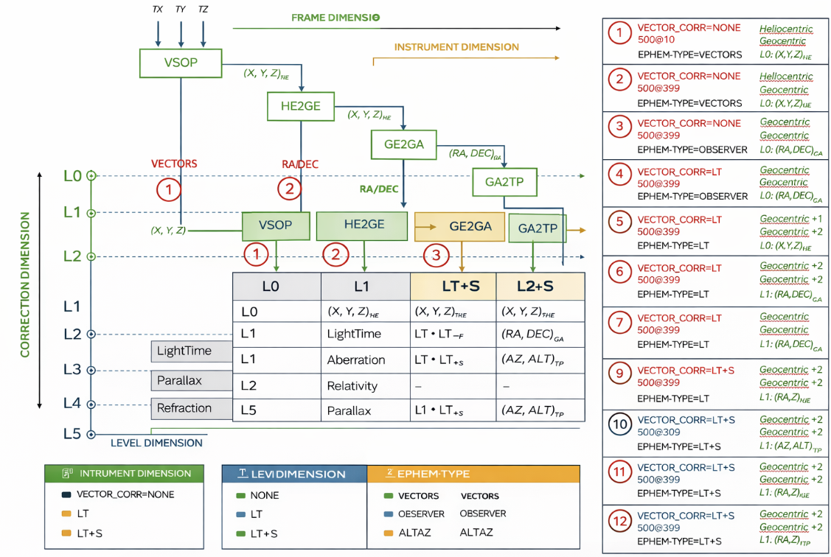

Slide 8
