Slide 1
Benchmark for Text to Scientific Graph Generation
June 13th , 2024

Slide 2
Content
Taxonomy
Dataset/benchmark Process
Insights from Initial GPT4 Test
Following Steps
Contributions and Research Directions
Difficulties

Slide 3
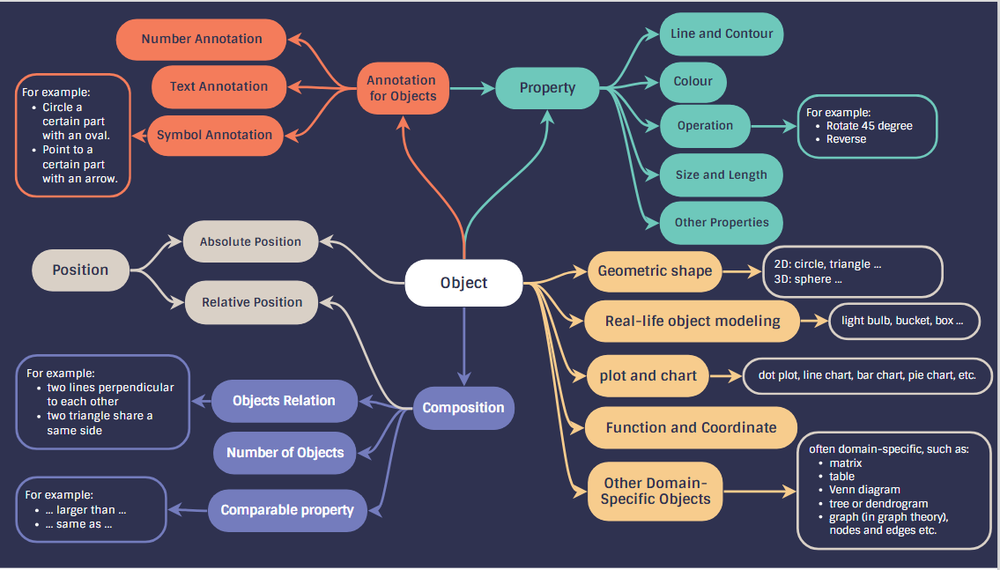
Taxonomy of Scientific Graph

Slide 4
Dataset Preparation and Process
Caption and Tikz Creation (mainly geographic objects)
Create captions/texts —-> add TikZ graphs using the Tool: Detikzify.
Ensure coverage of objects that frequently appear in Datikz and can be drawn from Detikzify.
Include all predefined properties in taxonomy.
Create examples covering diverse compositions of geographical objects.

Slide 5
Dataset Preparation and Process
2. Caption and TikZ Modifications of samples from Datikz
Captions:
Provide clear and specific guidance for deriving scientific graphs.
Convert abstract descriptions into more actionable steps.
TikZ Codes:
Remove context-dependent information in graphs.
Eliminate unnecessary details that are not intended to test the performance of the LLM.
Prepare three reference TikZ graphs by altering color, size, position, TikZ libraries, and adding text annotations, while ensuring all three references meet the requirements specified in the captions.

Slide 6
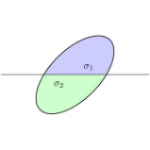
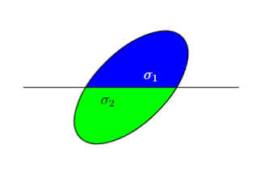
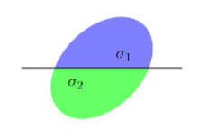
Examples
Original Caption: Diagram for Lemma pasting-lemma-ac.
Modified Caption: An ellipse rotated 45 degrees counterclockwise. A horizontal line passes through it and divides the ellipse into two parts of equal area. The upper part is blue and marked as sigma 1, and the lower part is green and marked as sigma 2.
Three reference

Slide 7
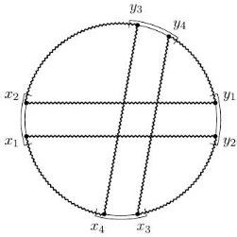
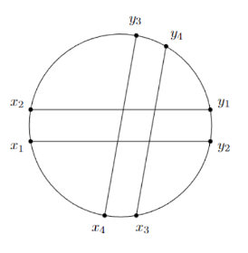
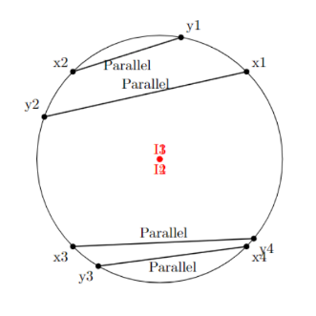
Examples
Modified Caption: There are four sets of points on the boundary of the circle, (x1, x2), (x3, x4), (y1, y2) and (y3, y4), where the line segment x4-y3 is parallel to x3-y4, and the line segment x1-y2 is parallel to x2-y1. These four line segments have four intersection points.
Original Graph
Modified Graph
GPT4 Graph

Slide 8
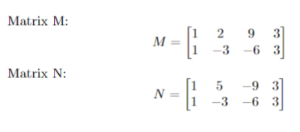
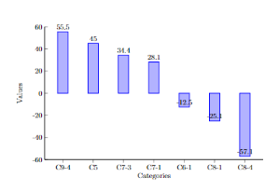
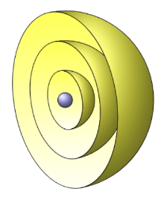

Initial GPT4 Tests
Spatial Reasoning: concept of spatial reasoning is not evident, heavily rely on the TikZ grammar/library.
\{bmatrix} \{pgfplot}
← Two Successful examples:
designed/covered by tikz libraries.
reference GPT 4
← Failed examples:
When some spatial reasoning/planning is required but there is not a library available.

Slide 9
GPT4 Problems
Position Computation: position computation failure, exceed the canvas boundaries; annotations can overlap, etc
Caption Sequencing: Fail long captions when additional requirements are specified later on.
Data Input: Inability to handle large sets of x/y values as input within caption.
Library Missing: frequently missed \usetikzlibrary{calc}
Color Settings: add color in a wrong way because of certain caption requirement e.g. a light blue color. wrong way [color=light blue], correct way [color = blue!20]

Slide 10

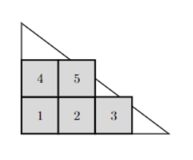
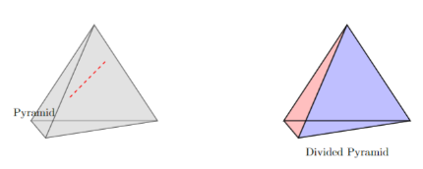

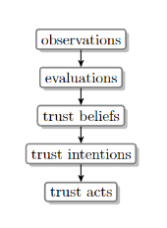
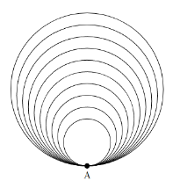
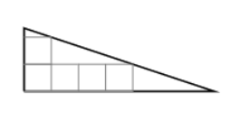
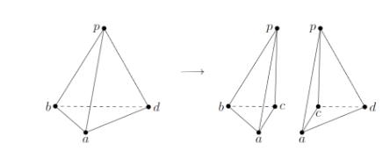
GPT failed Examples
GPT4 Generated Graphs
Reference Graphs

Slide 11
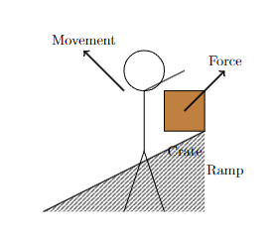
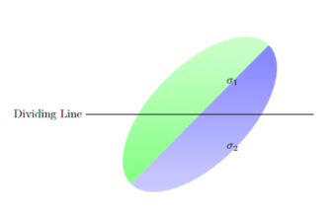
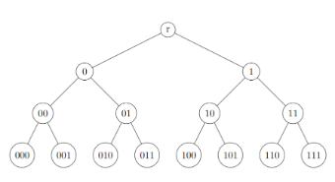

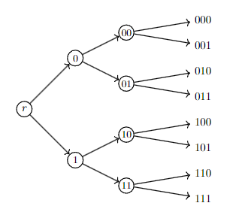
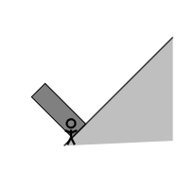
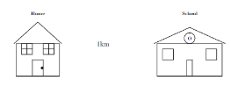
GPT failed Examples
GPT4 generated Graphs
Reference Graphs

Slide 12
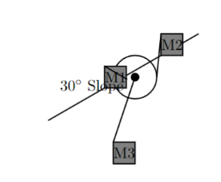
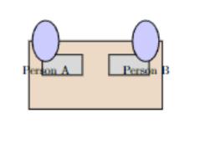


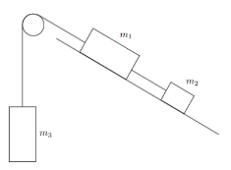
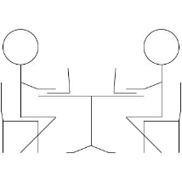

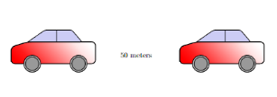
GPT failed Examples
GPT4 generated Graphs
Reference Graphs

Slide 13
Following Steps
Complete the benchmark.
Re-compile previous tikz codes and generate high quality, equal-size scientific graphs.
Run Automatikz 13b models, also test the outputs from other large language models.
Automatic evaluation vs. human evaluation, compare correlation.
Systematically analyze llm’s reasoning ability in generating scientific graphs

Slide 14
Contributions of the Study
Taxonomy of scientific graphs
Provide a scientific graph benchmark with high quality.
Test current automatic evaluation metrics in evaluating graphs with scientific purpose, by comparing with human evaluation.
Question the spatial reasoning ability of LLMs: spatial reasoning or tikz code conversion ability.
Hypothesis : the longer tikz code required, the worse LLMs’ performance can be.

Slide 15
Difficulties
Complete the benchmark.
Current Progress: tikz codes for 40 captions (~ 40 x 3 tikz references) [spent 1 week]
Additional 1-2 months required for 300~500 captions in total.
Difficulty of real-life modeling examples and hard cases without tikz code ready.
Run automatikz model 13b [YiPeng’s part] memory problem
To be decide: Annotation and Evaluation Guidelines for human evaluation:
object / property / annotation correctness
visibility of each parts
composition (number of objects, relation of objects)
overall complexity degree of caption requirement
(Potential if we include) automatic evaluation of tikz codes: reference tikz code has redundant, repetitive parts among three references (though images are perfect, the tikz codes are not perfect as references).

