Slide 1
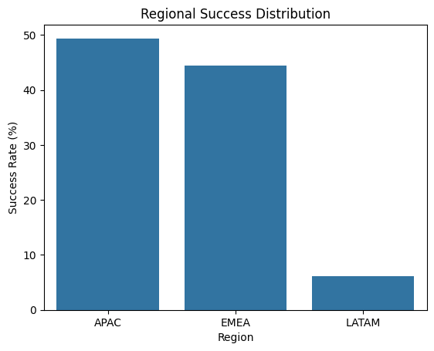
Analysis of winning test designs
Comparing the success rates of advertising campaigns across different regions: APAC, EMEA and LATAM
The Regional Success Distribution indicates that APAC has a higher success rate followed by EMEA.
However, LATAM seems to have a significantly low success rate compared to the other two regions.
Indicates new product has a higher success rate in APAC but is struggling in LATAM

Slide 2
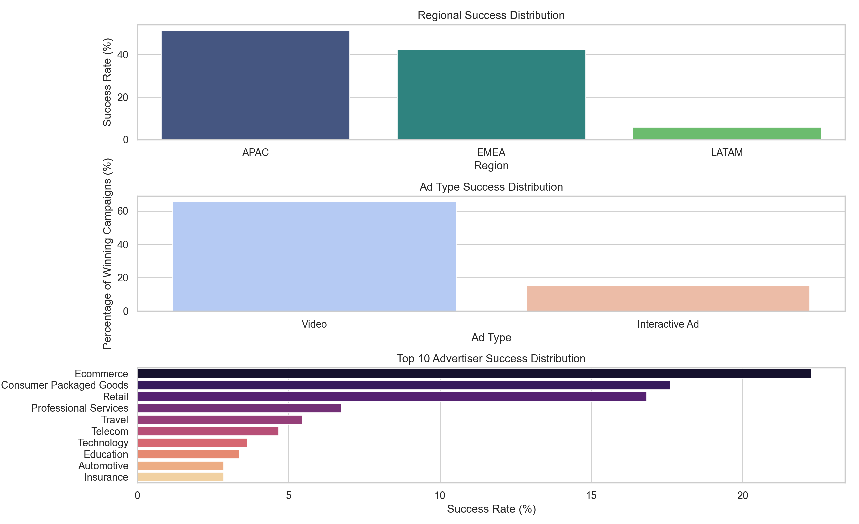
Ad Type Success
Video ads appear to be more prominent and a more successful campaign with 70.5%
However, interactive ads contributed less with roughly 16%
Suggesting it has some advantage but not as strong as a video format
Advertiser Vertical Success
Leading vertical includes Ecommerce, Consumer Packaged Goods and Retail.
Indicates strong performance in sectors focused on direct consumer engagement

Slide 3
Overall Summary:
Successful outcomes across studies were mainly influenced by video ad formats, particularly in APAC and EMEA regions
More noticeably it was more frequent in Ecommerce, Consumer Packaged Goods and Retails
This suggests, to increase brand awareness and overall sales it may be strongest for advertisers in consumer-oriented sectors with visual ad engagement for the global sportswear brand

