Slide 1
DarahlLand
Daniel Jaššo
Rafail Giannelakis
Humberto Garcia Galvan

Slide 2
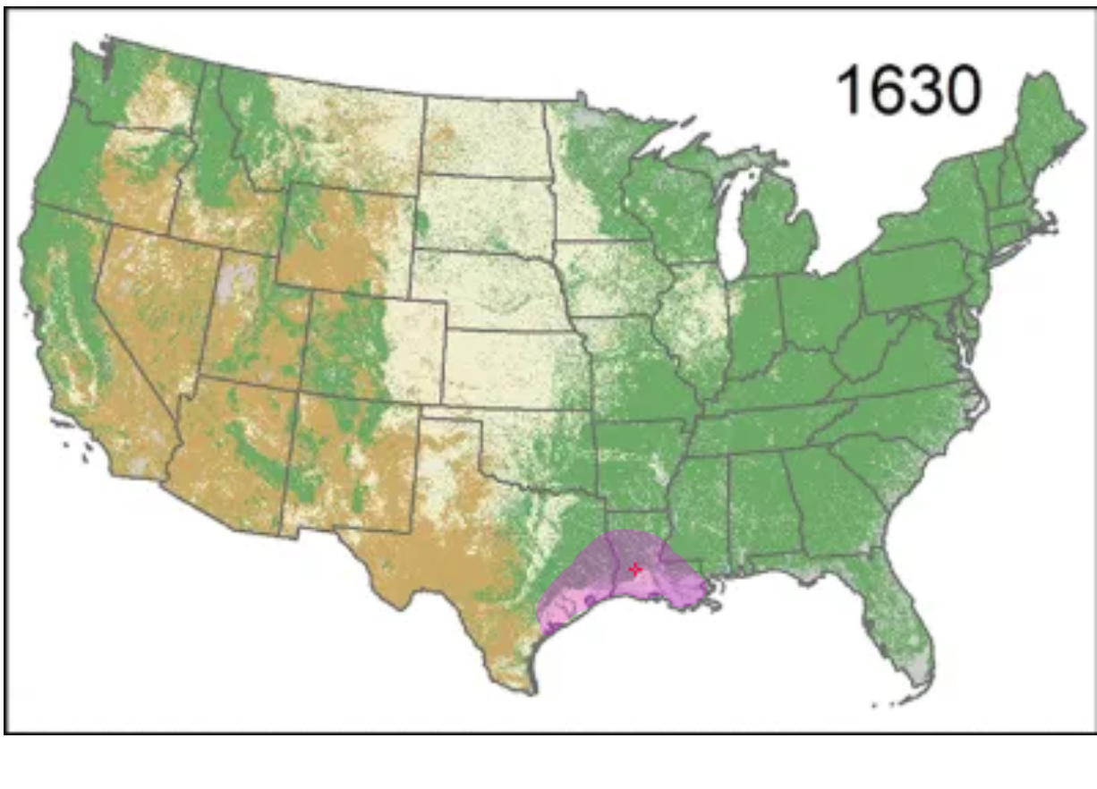
Location
Modern day Alexandria, LA
Red River passing through

Slide 3
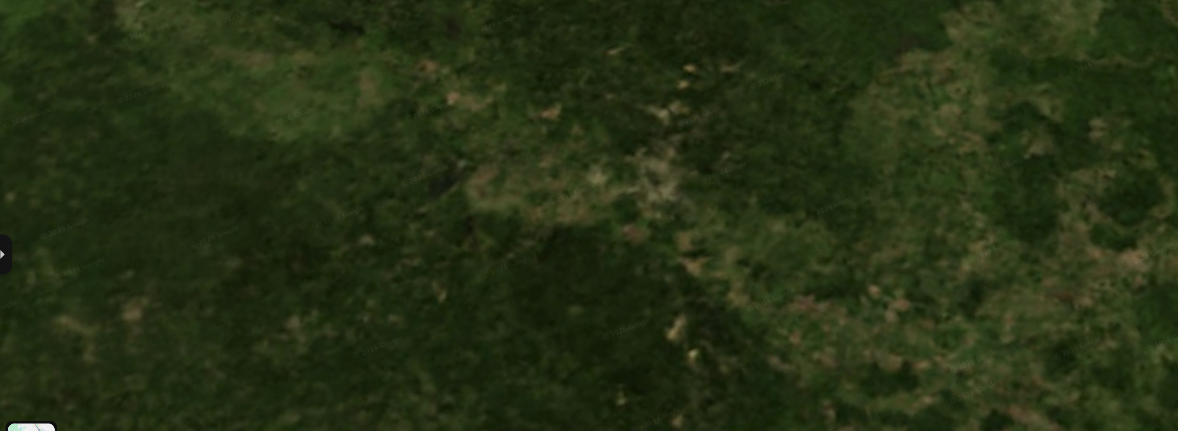
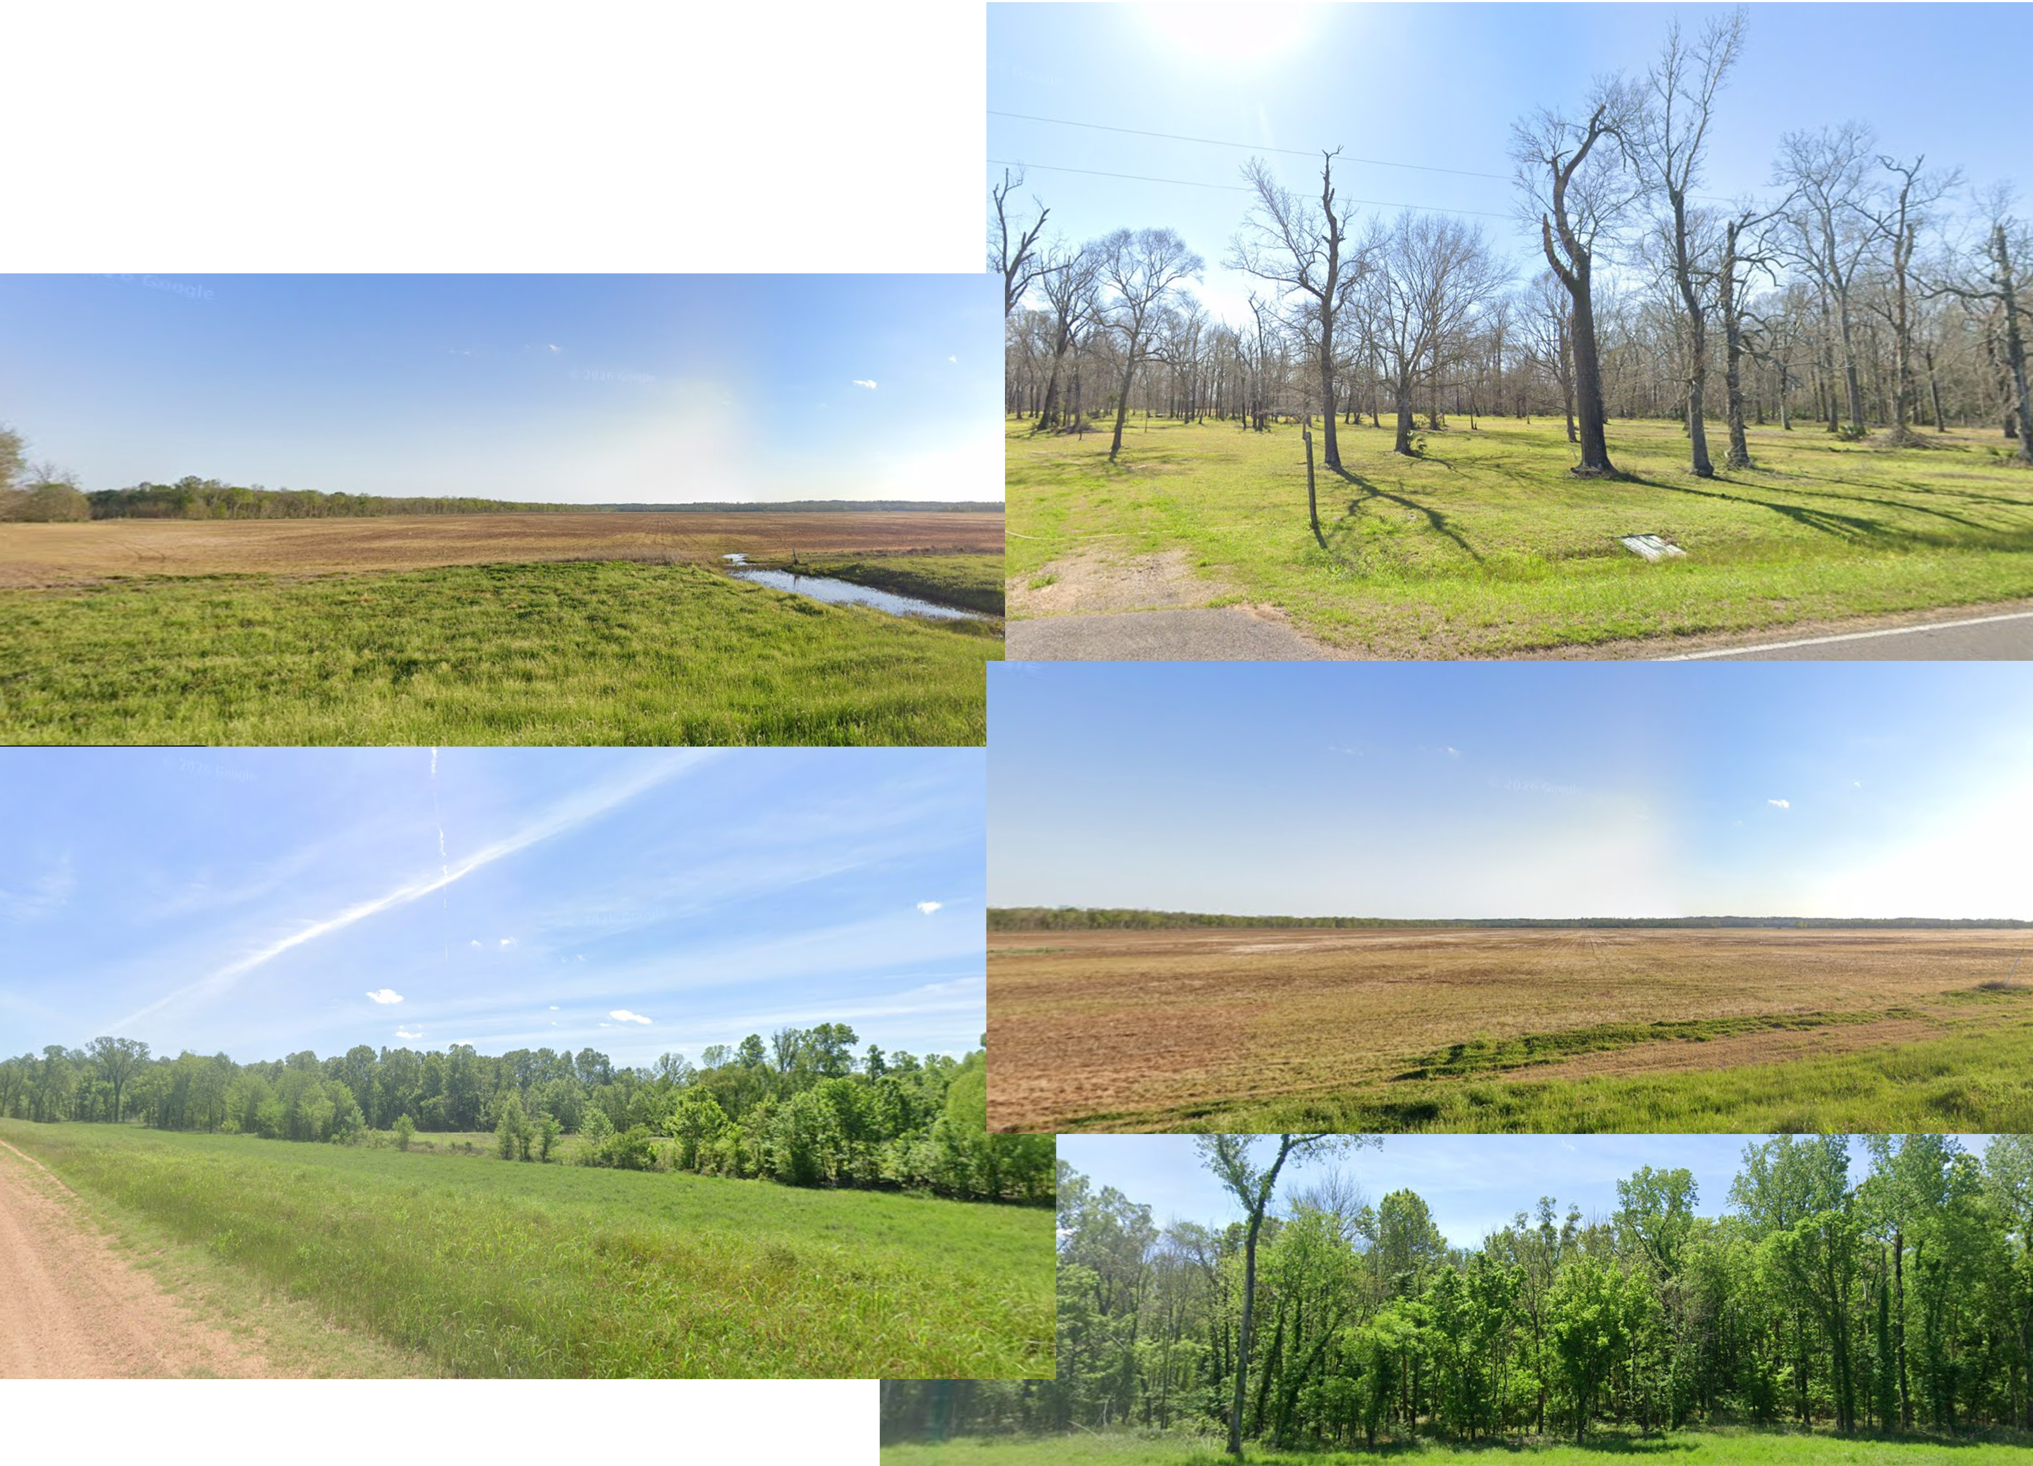
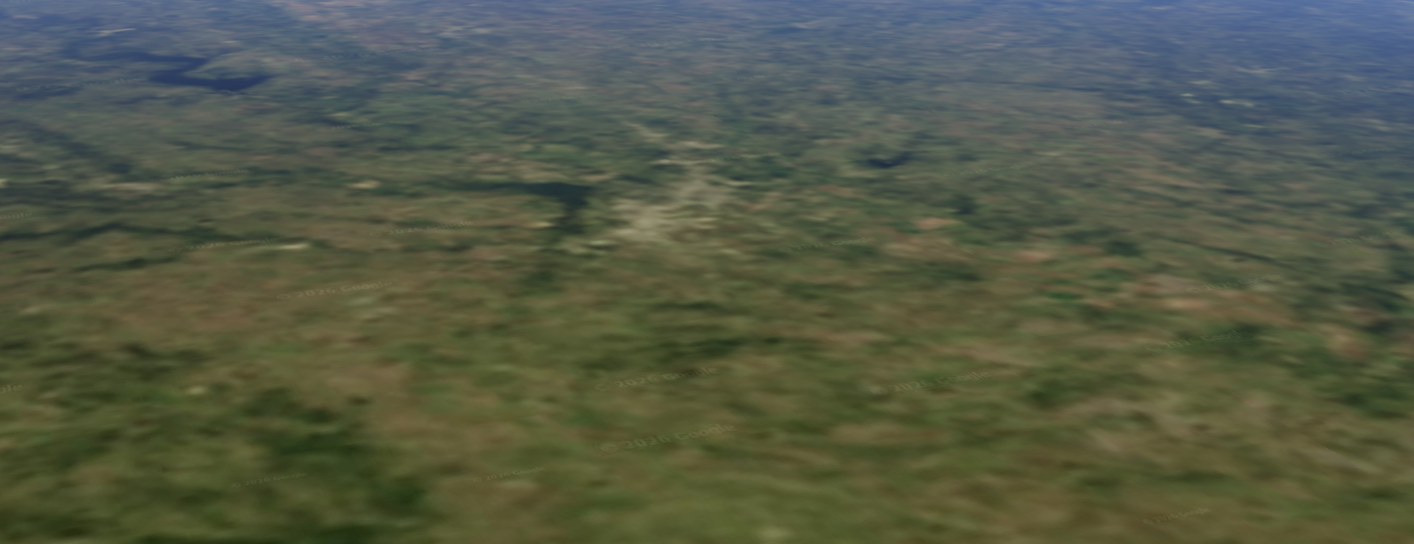
New Huntington
Water
Temperature
Farmland

Slide 4
Territory
Plains
Rivers
Ideal for farming
Notes:
Plains
Rivers => Red River, Sabine River
Surounded by Gulf of Mexico
Major water bodies => lake Pontchartrain
Highest point => Driskill mountain

Slide 5
Weather

Slide 6
Spring
Sunny
Sometimes rainfalls
Day time: 70°F – 80°F
Night time: 50°F – 60°F

Slide 7
Summer
Sunny
Possibility of hurricanes
Day time: 90°F – 95°F
Night time: 90°F – 95°F

Slide 8
Autumn
Sunny
Rainy
Slowly decreasing from 75°F
Notes:
Sunny rainy 50/50
Temps slowly decreasing towards winter from 75 degrees

Slide 9
Winter
Rainy
Heavy rains
Day time: 60°F
Night time: 40°F

Slide 10
Tribes

Slide 11
Caddo people
Northwestern
Farming, pottery, trade, political systems
Permanent villages
Corn, beans, squash
Hunting, fishing
Notes:
Live in northwestern Luisiana
Are very known for farming, pottery, trade political systems and ceremonial systems
They have permanent villages
They grow corn, beans, squash
They are known for hunting, fishing
Also they have extensive trade with Europe primarily French

Slide 12
Natchez
Mississippi river
Permanent settlements
Complex social hierarchy
Trade & diplomacy with Europeans

Slide 13
Chitimacha
Southern
Regional trade
Notes:
Live in southern luisiana
Are very important for regional trade.

Slide 14
Bayagoula
Lower Mississippi river
Southeastern
Notes:
Southeastern part of Luisiana

Slide 15
Taensa
Lower Mississippi river
Northeastern
Notes:
Northeastern part of Luisiana

Slide 16
Avoyel
Central Louisiana
Agriculture, hunting, fishing
Regional trade

Slide 17
Who are we looking for?
Farmers
Sawyers
Blacksmiths
Carpenters
Millwrights

Slide 18
Major natural resources
Rich soil
Pine
Animal fur

Slide 19
Native animals
Deer
Black bears
Wild turkeys
Fish
Alligators

Slide 20
Native plants
Oak, pine
Corn
Squash

Slide 21
Initial settlers
150
80

Slide 22
How to make profit?
Trading with tribes
Export raw materials
Selling wood
Selling tabacco

Slide 23
How are we attracting new settlers
Land for working
Possible to vote
Religious freedom
They will receive tools
Notes:
Also we should say that we are not allowing slavery so it will attract new settlers who can be black.

Slide 24
Laws
Notes:
Also we should say that we are not allowing slavery so it will attract new settlers who can be black.

Slide 25
1. Land and Resource Protection Law which ensures that there are designated areas for cutting timber and for farmland. In addition, forests and waterways will need to be protected and negotiations must be made with the Native Americans so that there are agreements in place.
2. Food and Community Survival Law which ensures that each farmer contributes to the community food resources for times when food is limited.
3.

Slide 26
Thank you for your attention
If you have any questions we would gladly answer them

