Slide 1
Overview
The Solution is a set of RESTful APIs designed to manage digital assets, briefings, and content distribution metadata.
Aimed to streamline the management and distribution of multimedia assets for various channels and platforms.
Objective: scalable, maintainable, secure architecture, easy integration with other services.

Slide 2
Structure
Model: structure of asset data, reflects the database schema
Data: Entity Framework Core (EF Core) context, for managing the interaction between the application and the database
Validator: checks the integrity and correctness of the objects before they are persisted to the database.
Repository: Encapsulates data access logic: CRUD operations, logging.
Services: an intermediary between the repository and the API controller.
Security: authentication with JWT
API controller: exposes endpoints for asset management.
Program: configuration, initialize services, register dependencies

Slide 3
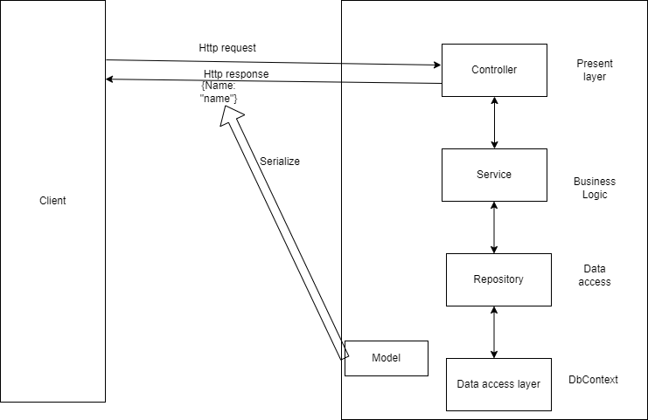
Application architecture

Slide 4
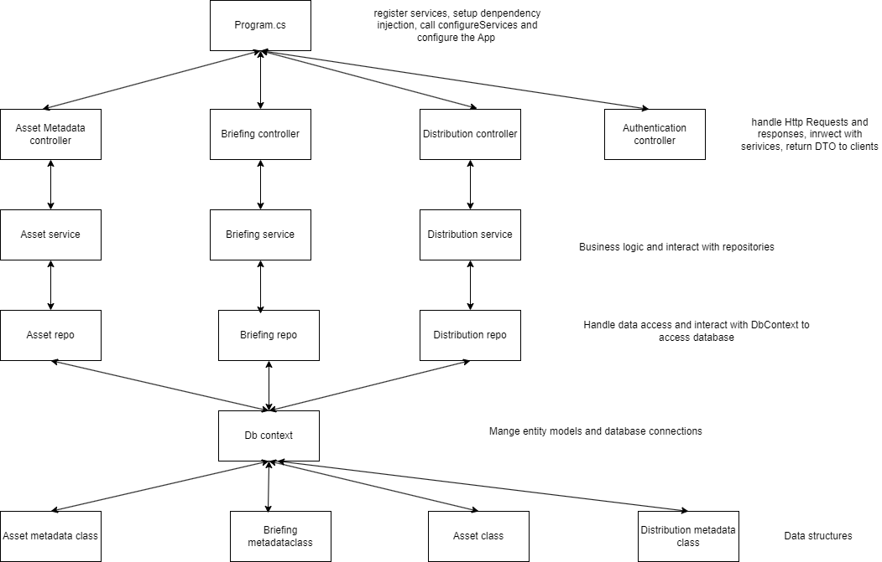
Application architecture

Slide 5
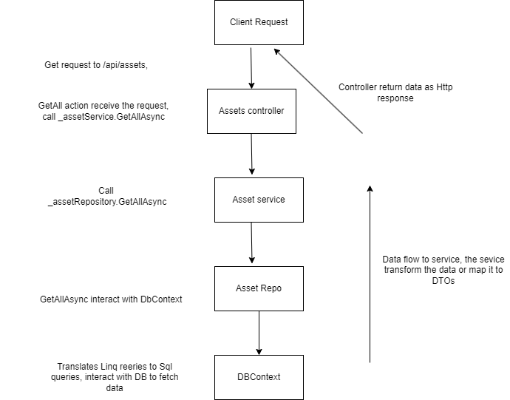
Example: Get all assets metadata

Slide 6
Design principle
Rest API design
Separation of Concerns: controller, services, Repotories, Data, Models
Dependency injection
Validation
Sensitive data is not exposed via APIs.
Exception handling, logging

Slide 7
Target: Use REST APIs for communication between microservices
APIs for Authentication: auth user and issue jwt token
APIs for AssetMetadata
APIs for BriefingMetadata
APIs for ContentDistributionMetadata

Slide 8
Auth API
Authentication for JWT token
Role based access control

Slide 9
Asset Management API
Get all, Get by ID
Post
Put
Delete

Slide 10
Asset Metadata Endpoint
GET /api/assets
GET /api/assets/{id}
POST /api/assets
PUT /api/assets/{id}
DELETE /api/assets/{id}

Slide 11
Briefing Endpoint
GET /api/briefings
GET /api/briefings/{id}
POST /api/briefings
PUT /api/briefings/{id}
DELETE /api/briefings/{id}

Slide 12
Content Distribution Endpoint
GET /api/contentdistributions
GET /api/contentdistributions/{id}
POST /api/contentdistributions
PUT /api/contentdistributions/{id}
DELETE /api/contentdistributions/{id}

Slide 13
Technology
Backend: ASP.NET core webAPI
Database: In momory database, EF
Authentication: JWT
Test: Nunit, Moq, FluentValidation
Tool: VS, Postman

Slide 14
Test
Nunit and moq
Controllers, services, validators, repostories
All scenario

Slide 15
Chanllenges and Solutions
InvalidOperation Exception due to unregistered services
Azure Sql firewall, local Sql database with containerition
System.text.json json exception due to cyclic references, Solution: AddJsonOptions(x =>x.JsonSerializerOptions.ReferenceHandler = ReferenceHandler.Preserve); or data annotation with Json ignore

Slide 16
Furture improvement
Event driver architecture: a message broker for asynchronous communication, decouple services.
On demand and scheduled request data from APIS and publish message
Deployment with auto-scale (Kubernetes or docker swarm)
Retry strategy: for disconnections, timeout and unavailable services
Using persistent database and containerization database
Caching (memory cache and redis)
Health monitoring and alerts
Use Swagger/OpenAPI for documentation

Slide 17
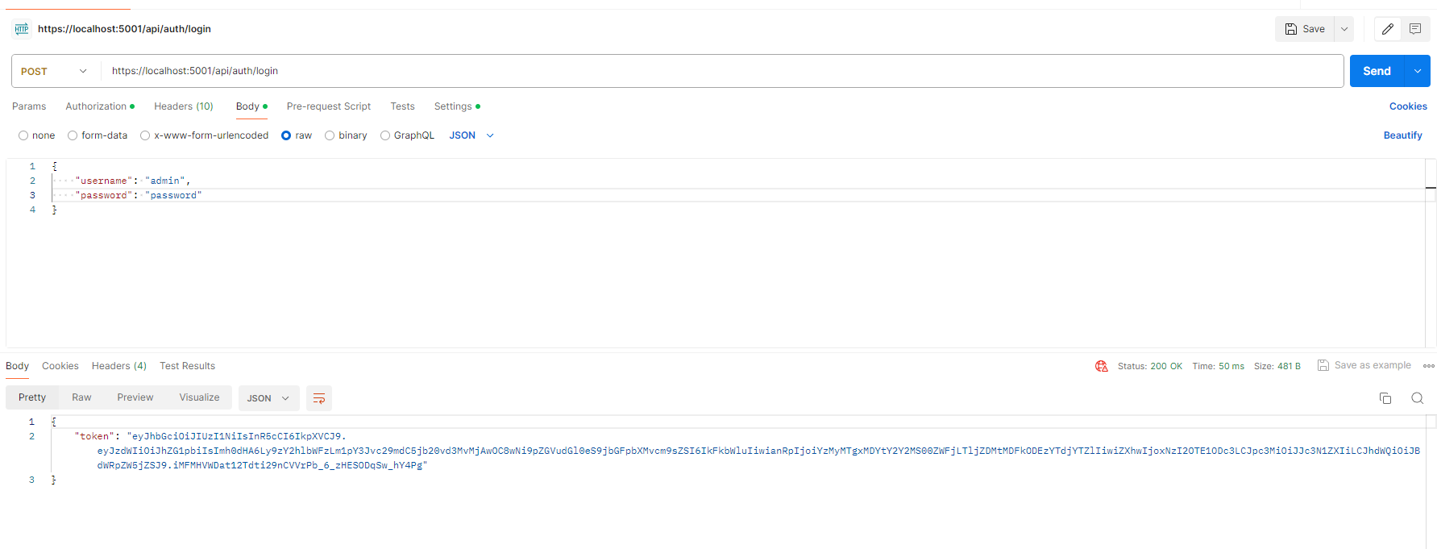
Login to get jwt token

Slide 18
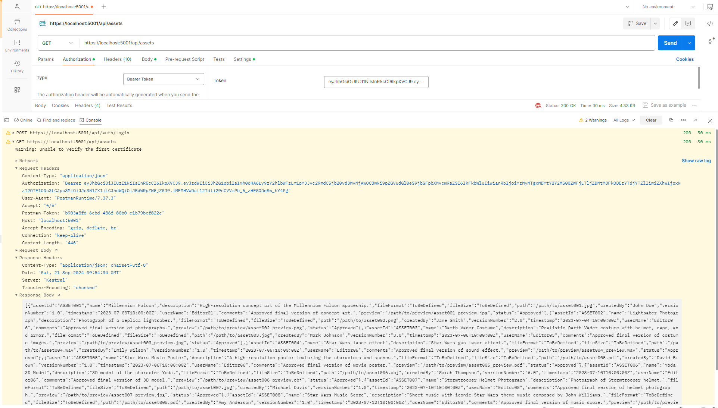
Get all assets medata

Slide 19
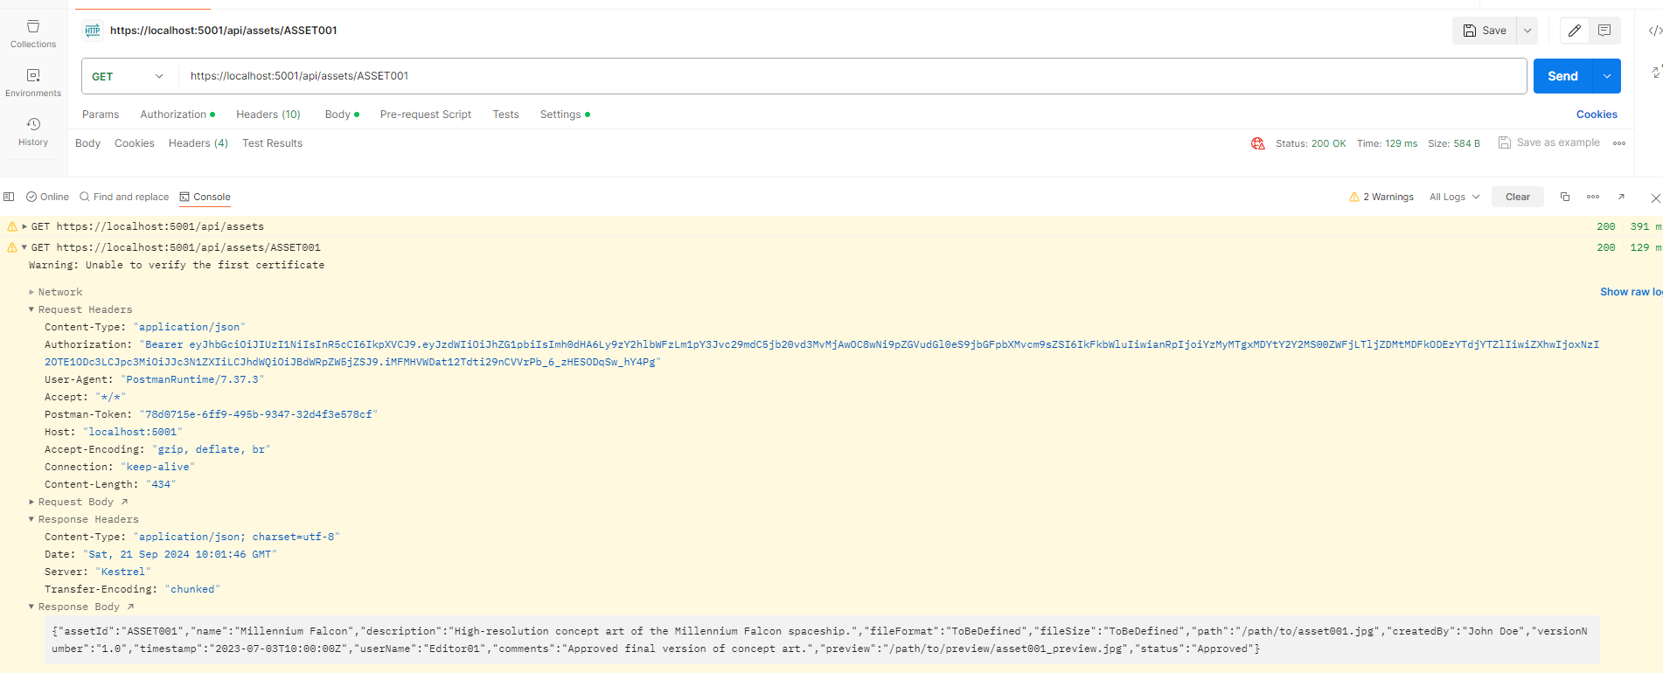
Get by AssetId

Slide 20
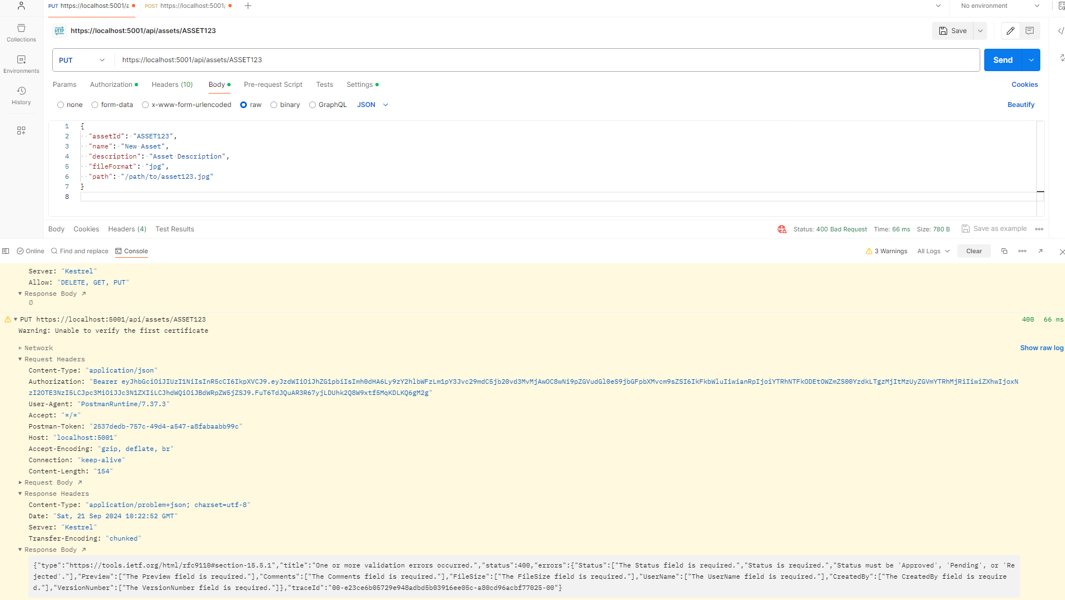
Update by AssetId: failure due to input validation

Slide 21
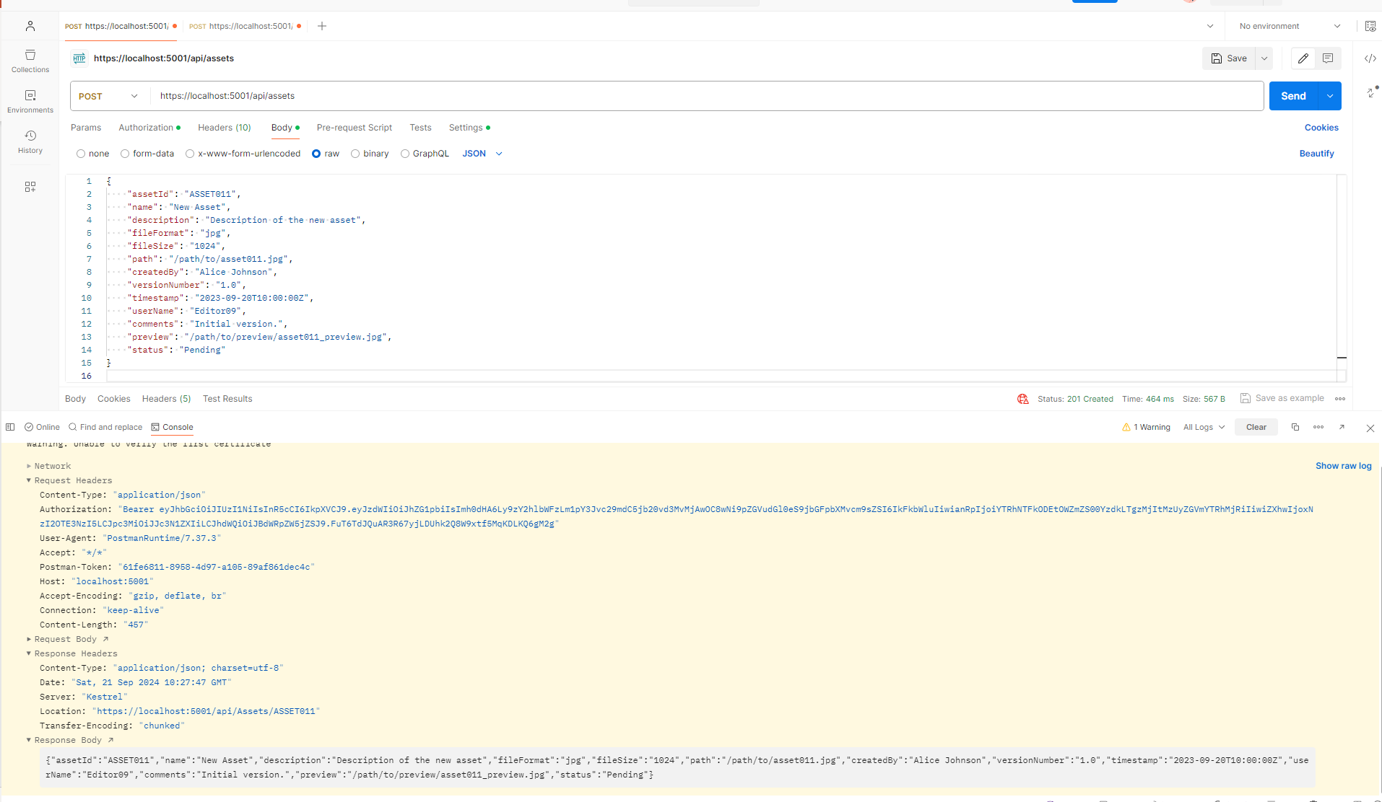
Add metadata

Slide 22
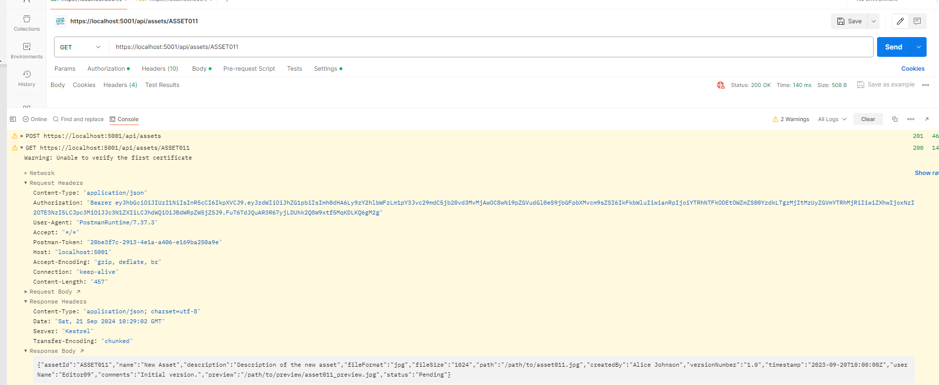
Get newly added by AssetId

Slide 23
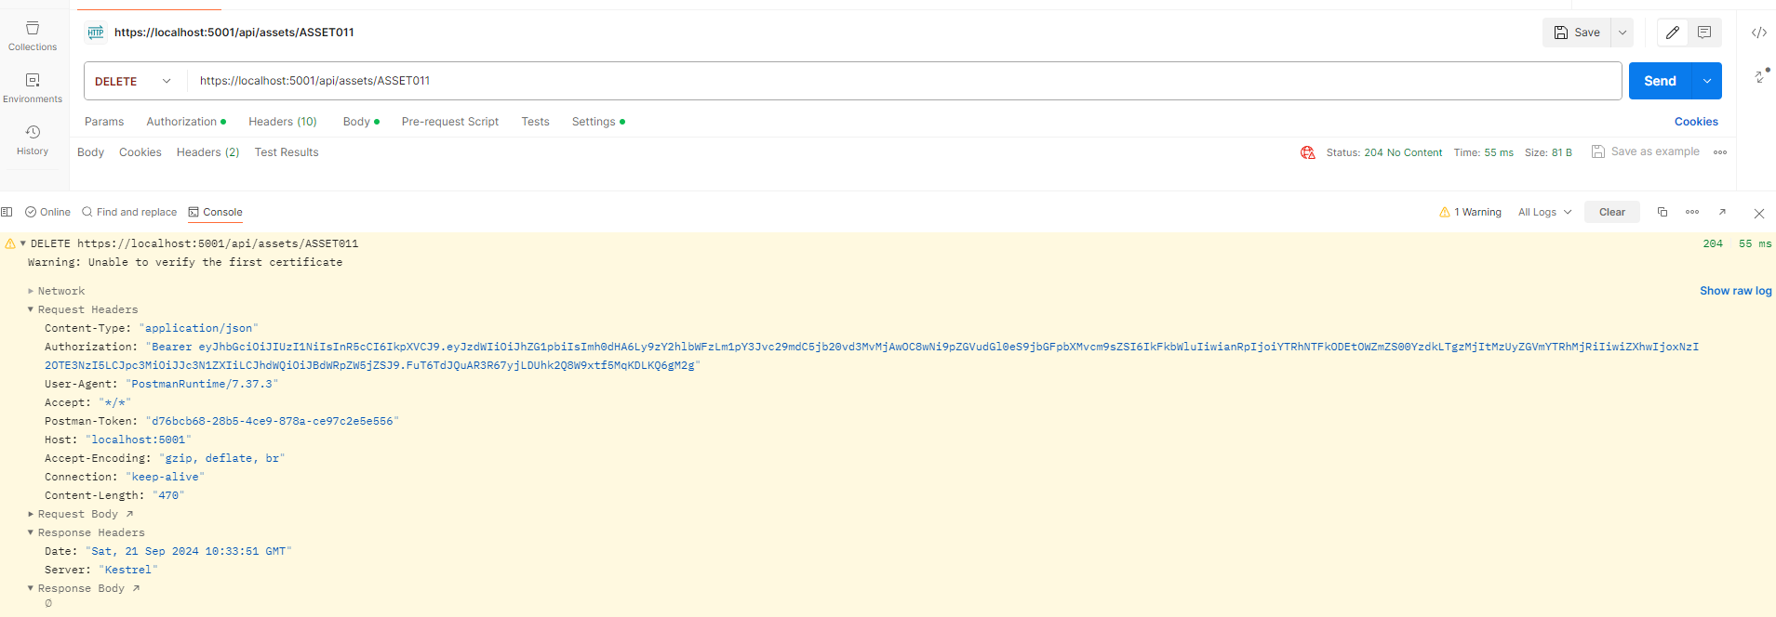
Delete by AssetId

Slide 24
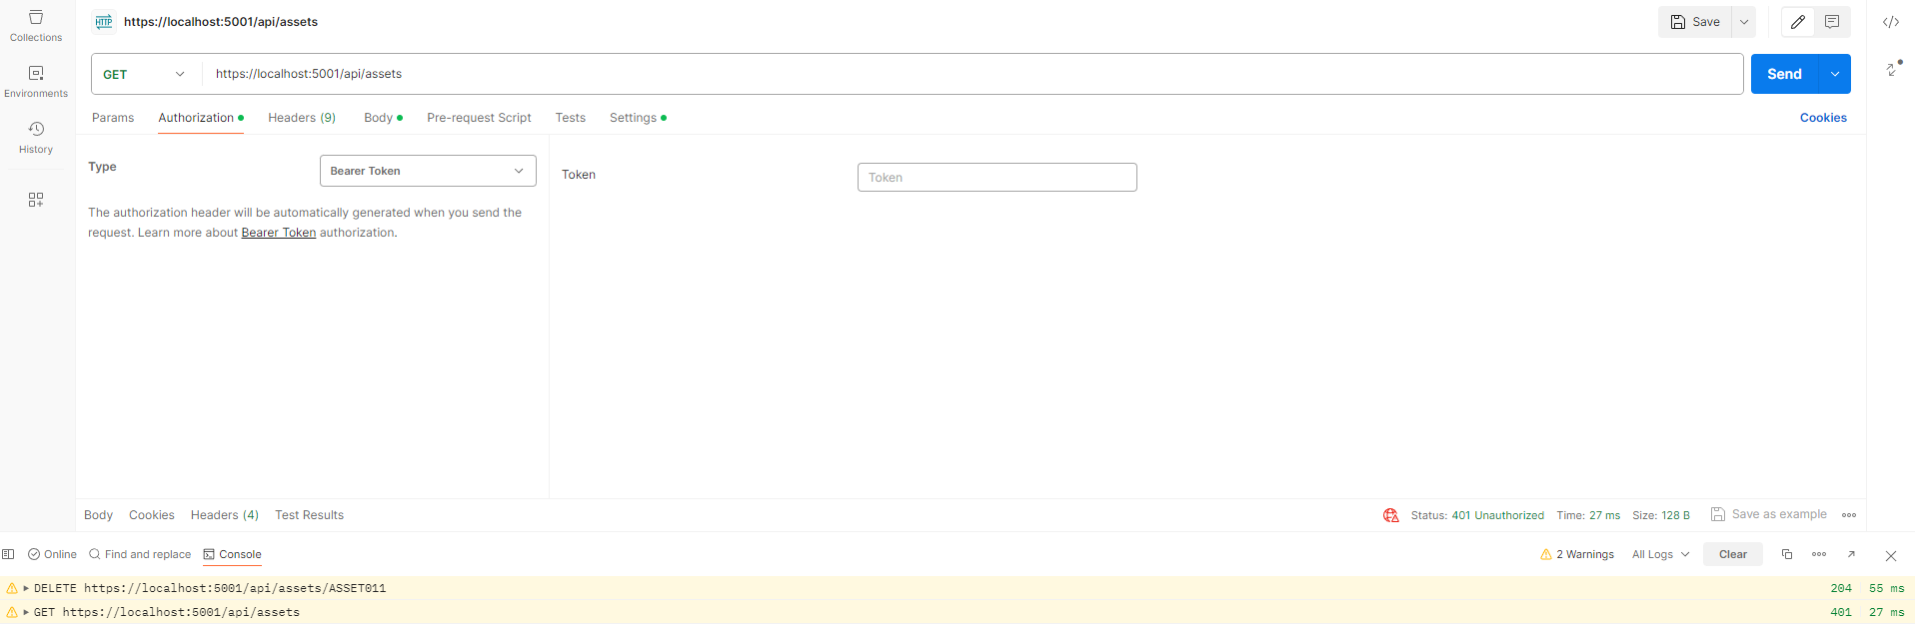
Request without token

Slide 25
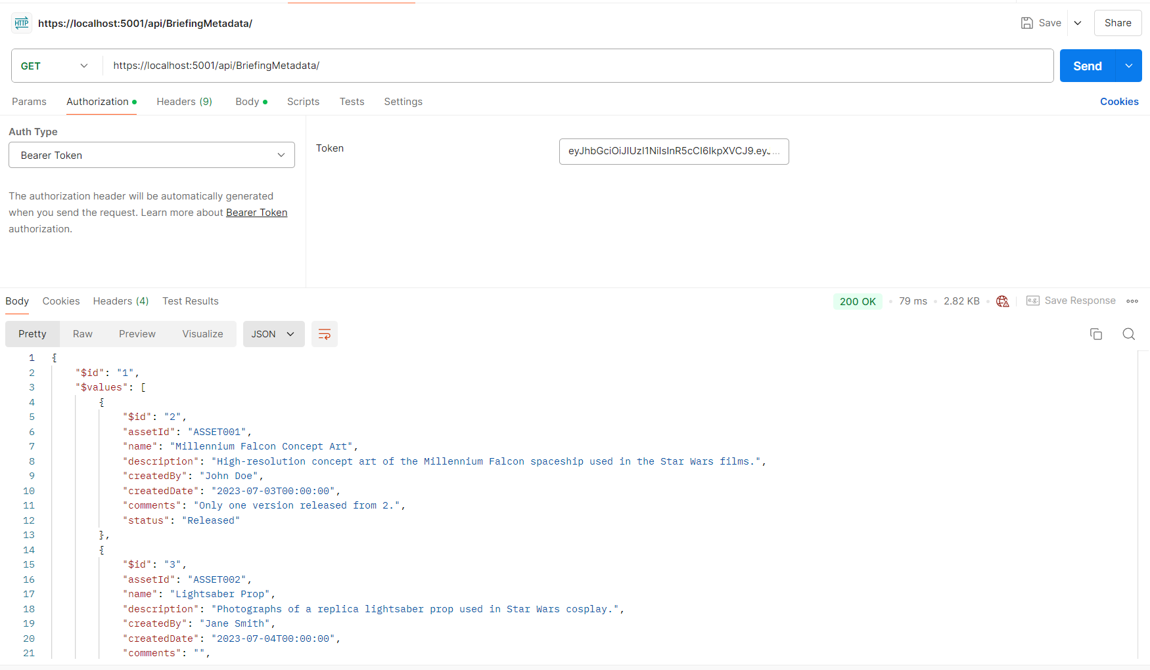
Get all briefing metadata

Slide 26
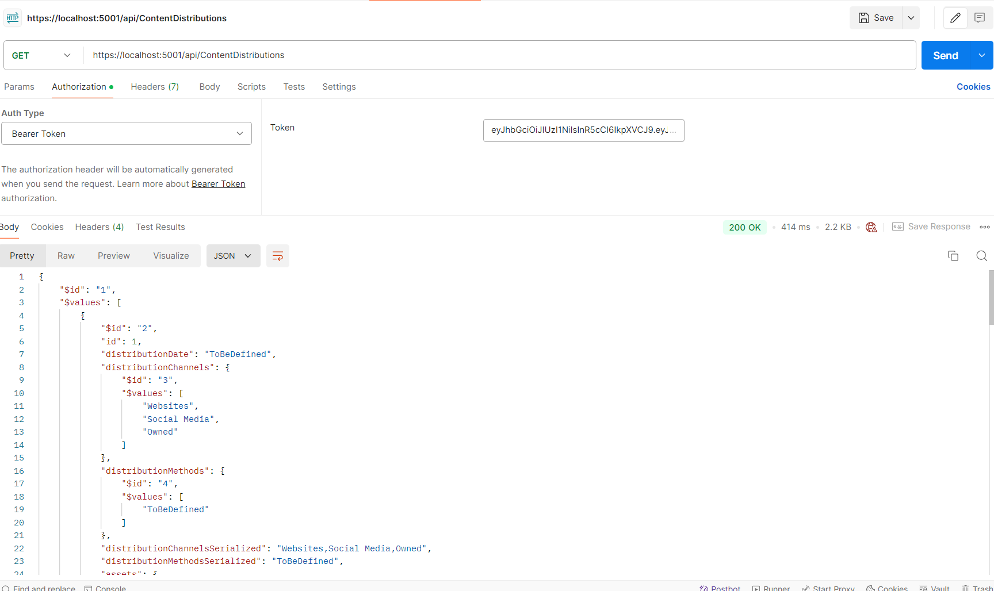
Get all distribution metadata

