Slide 1
Agenda
Overivew
Structure and Architecure
Components of APIs
API Example
Test APIs

Slide 2
Overview
The Solution is a set of RESTful APIs designed to manage digital assets, briefings, and content distribution metadata.
Aimed to streamline the management and distribution of multimedia assets for various channels and platforms.
Objective: scalable, maintainable, secure architecture, easy integration with other services.

Slide 3
Structure
Model: structure of asset data, reflects the database schema
Data: Entity Framework Core (EF Core) context, for managing the interaction between the application and the database
Validator: checks the integrity and correctness of the objects before they are persisted to the database.
Repository: Encapsulates data access logic: CRUD operations, logging.
Services: an intermediary between the repository and the API controller.
Security: authentication with JWT
API controller: exposes endpoints for asset management.
Program: configuration, initialize services, register dependencies

Slide 4
Design principle
Rest API design
Separation of Concerns: controller, service, Repository, Data, Model
Dependency injection
Validation
Sensitive data is not exposed via APIs.
Exception handling, logging

Slide 5
Target: Use REST APIs for communication between microservices
APIs for Authentication: auth user and issue jwt token
APIs for AssetMetadata
APIs for BriefingMetadata
APIs for ContentDistributionMetadata

Slide 6
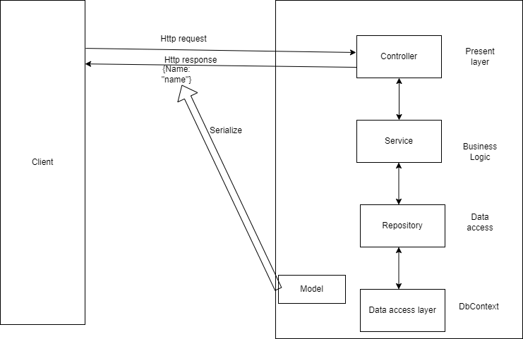
Application architecture

Slide 7
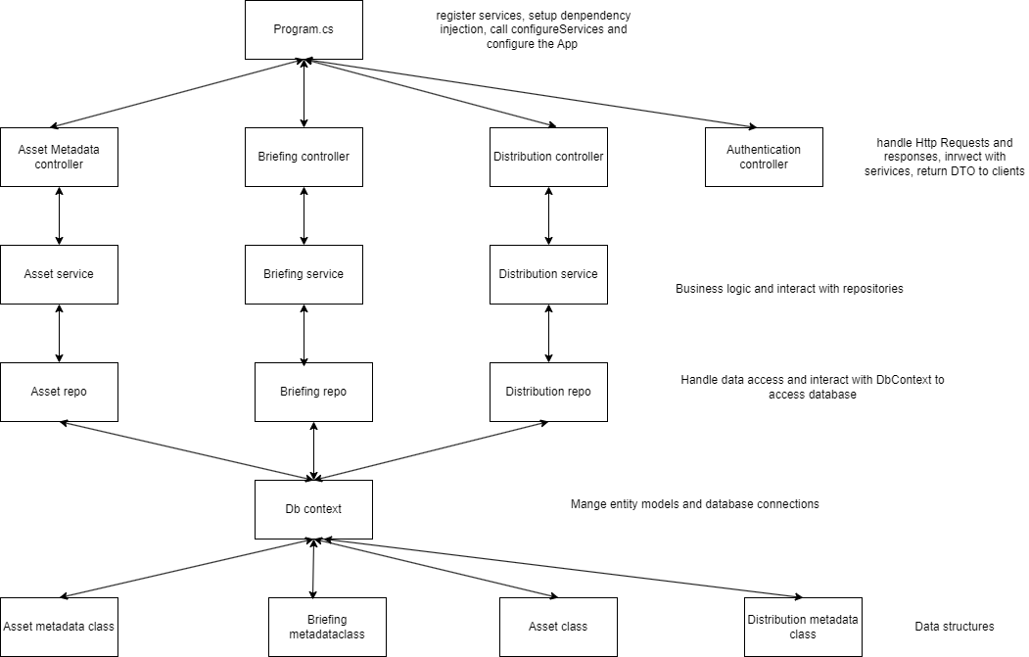
Components

Slide 8
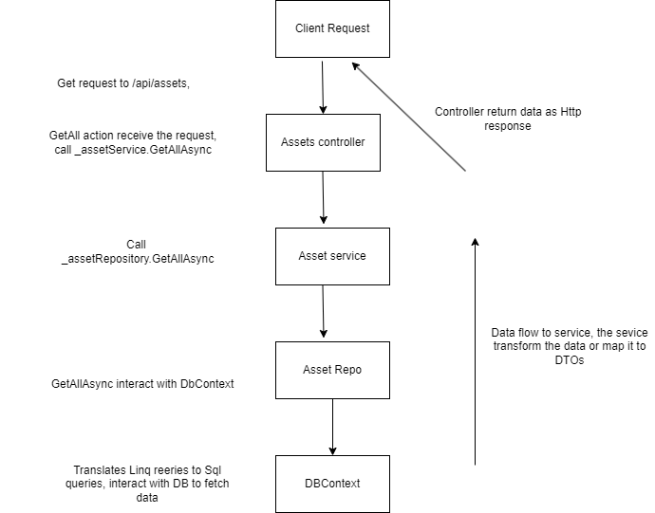
Example: Get all assets metadata

Slide 9
Technology
Backend: ASP.NET core webAPI
Database: In momory database, EF
Authentication: JWT
Test: Nunit, Moq, FluentValidation
Tool: VS, Postman

Slide 10
Auth API
Authentication for JWT token
Role based access control

Slide 11
Asset Management API
Get all, Get by ID
Post
Put
Delete

Slide 12
Asset Metadata Endpoint
GET /api/assets
GET /api/assets/{id}
POST /api/assets
PUT /api/assets/{id}
DELETE /api/assets/{id}

Slide 13
Briefing Endpoint
GET /api/briefings
GET /api/briefings/{id}
POST /api/briefings
PUT /api/briefings/{id}
DELETE /api/briefings/{id}

Slide 14
Content Distribution Endpoint
GET /api/contentdistributions
GET /api/contentdistributions/{id}
POST /api/contentdistributions
PUT /api/contentdistributions/{id}
DELETE /api/contentdistributions/{id}

Slide 15
Test
Nunit and moq
Controllers, services, validators, repostories
All scenario

Slide 16
Chanllenges and Solutions
InvalidOperation Exception due to unregistered services
Azure Sql firewall, local Sql database with containerization
Data validation error in data bing and validation
System.text.json json exception due to cyclic references, Solution: AddJsonOptions(x =>x.JsonSerializerOptions.ReferenceHandler = ReferenceHandler.Preserve); or data annotation with Json ignore

Slide 17
Furture improvement
Event driver architecture: a message broker for asynchronous communication, decouple services.
On demand and scheduled request data from APIS and publish message
Deployment with auto-scale (Kubernetes or docker swarm)
Retry strategy: for disconnections, timeout and unavailable services
Using persistent database and containerization database
Caching (memory cache and redis)
Health monitoring and alerts
Use Swagger/OpenAPI for documentation

Slide 18
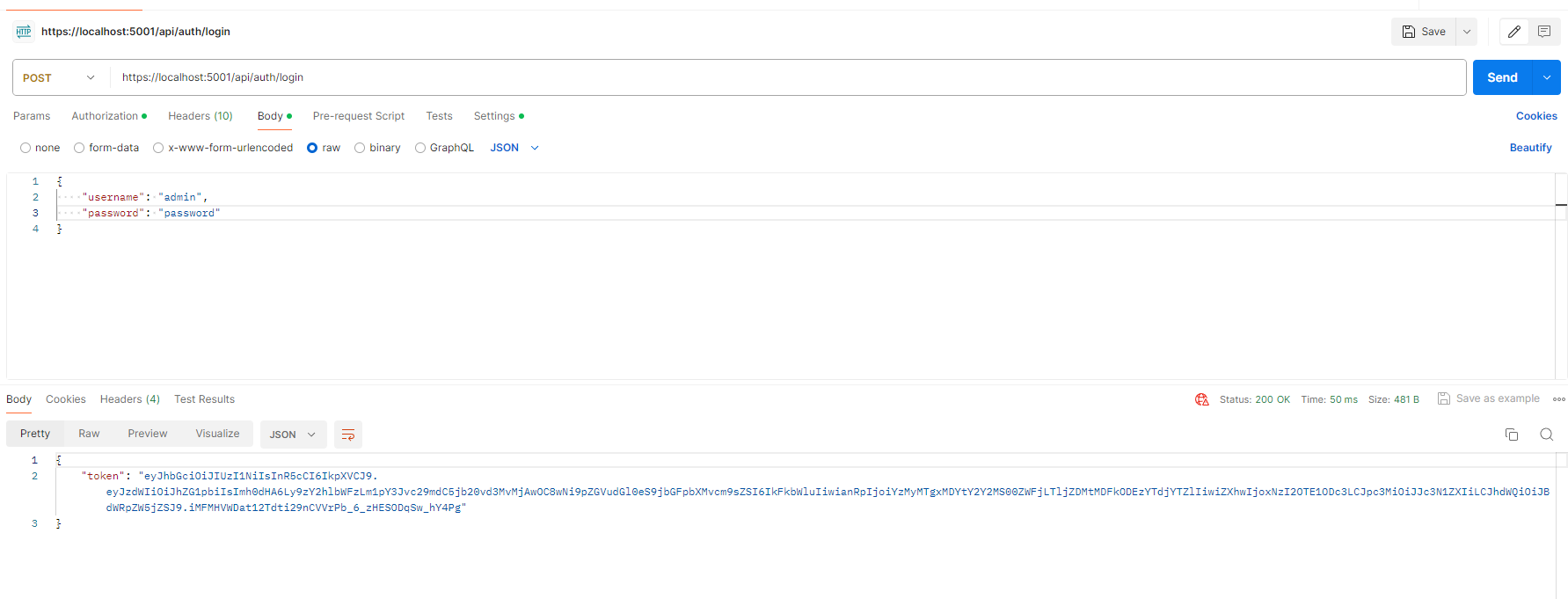
Login to get jwt token

Slide 19
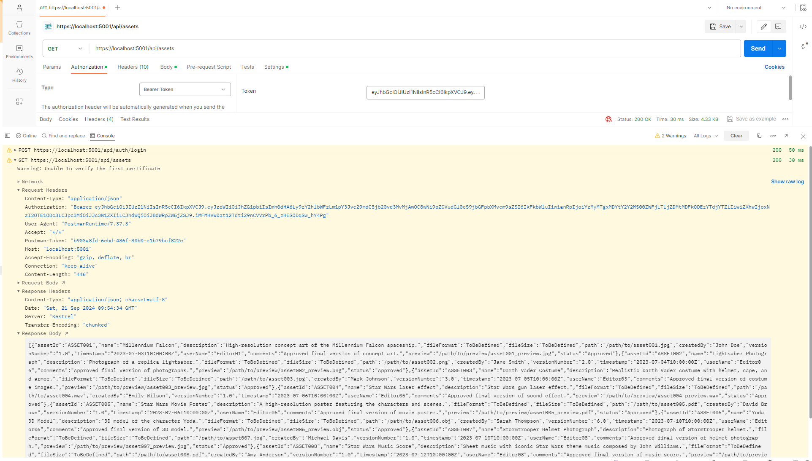
Get all assets medata

Slide 20
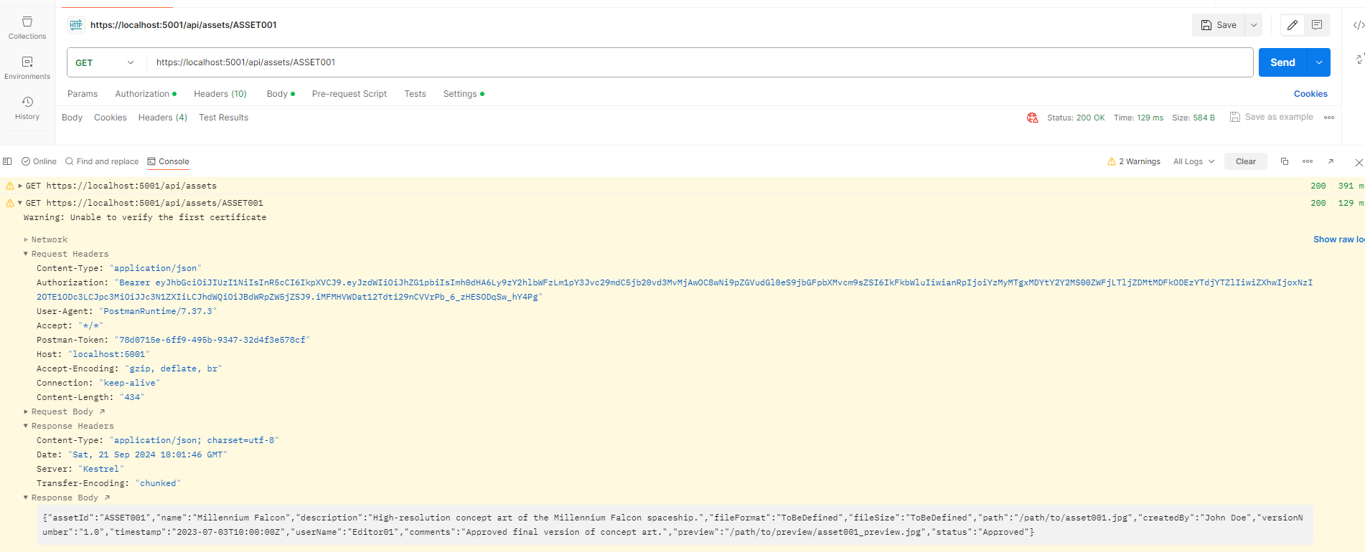
Get by AssetId

Slide 21
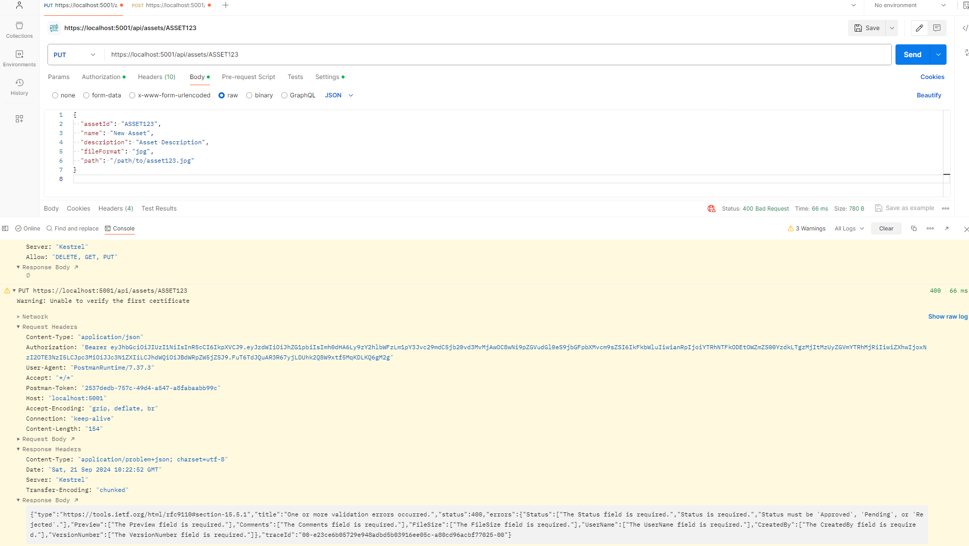
Update by AssetId: failure due to input validation

Slide 22
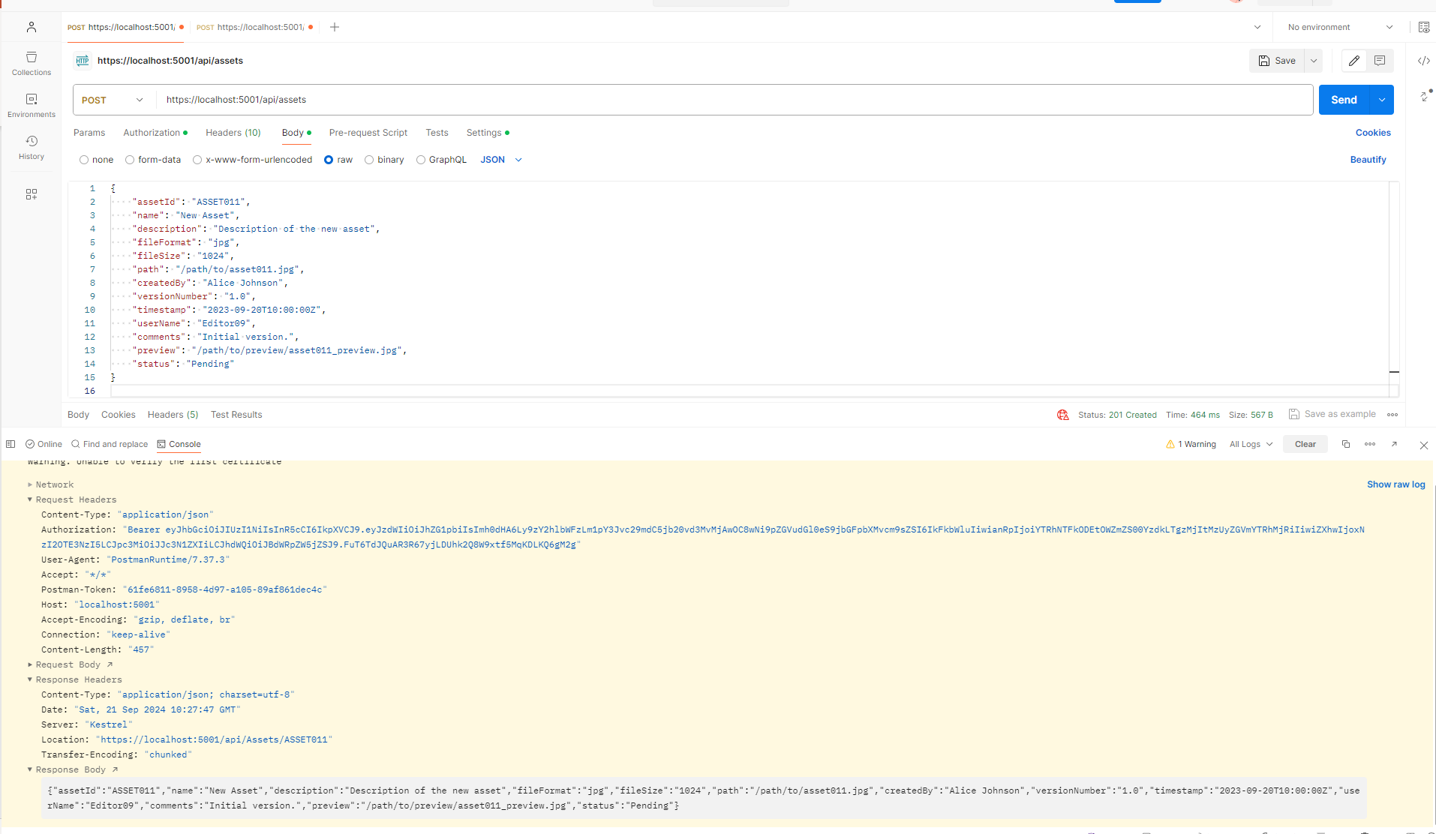
Add metadata

Slide 23
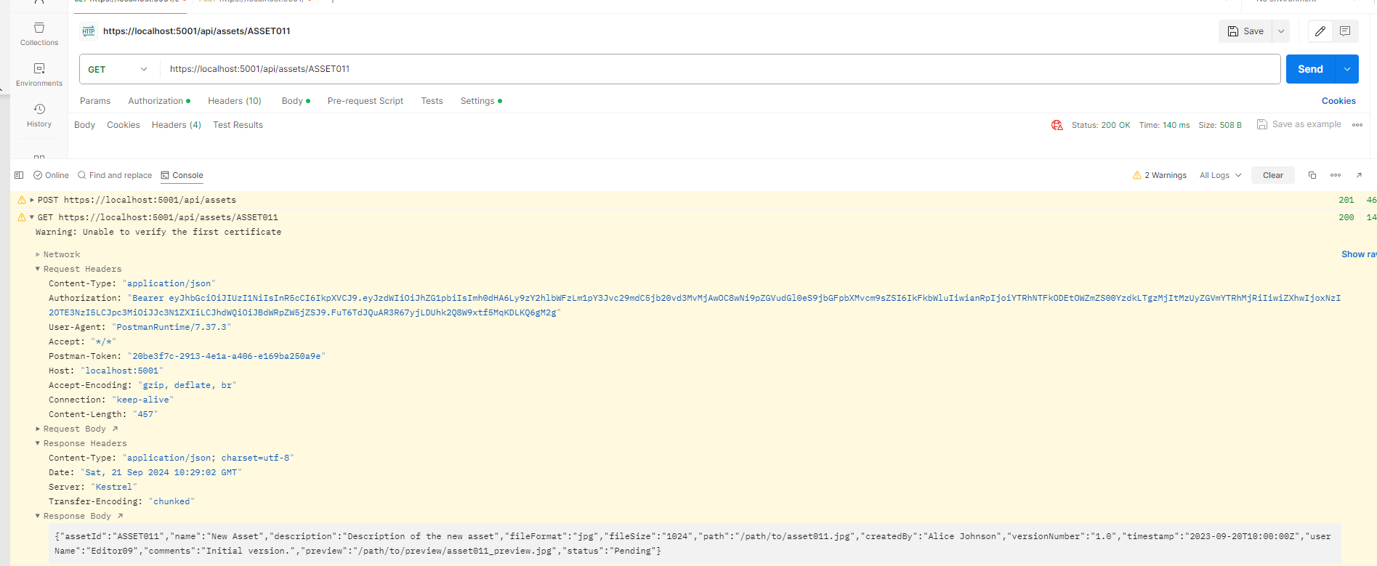
Get newly added by AssetId

Slide 24
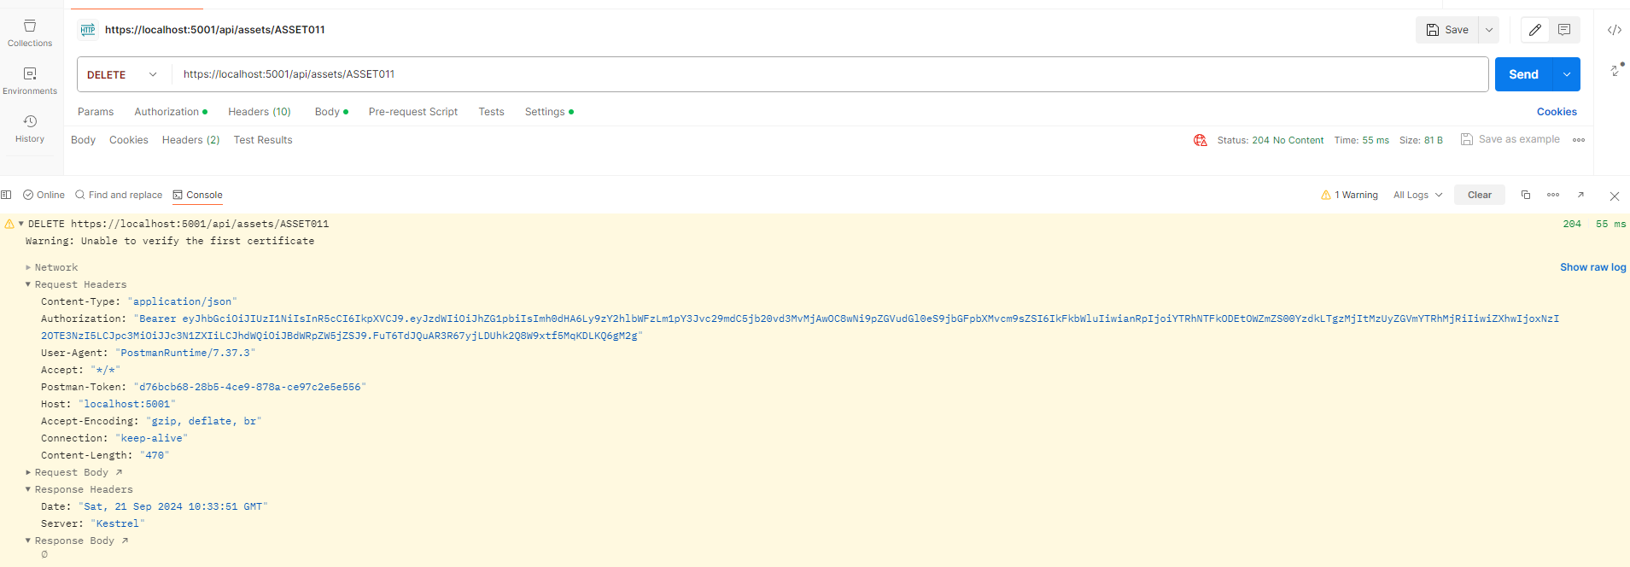
Delete by AssetId

Slide 25
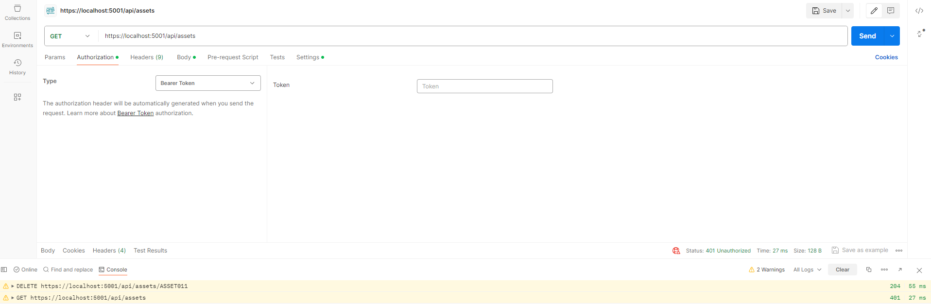
Request without token

Slide 26
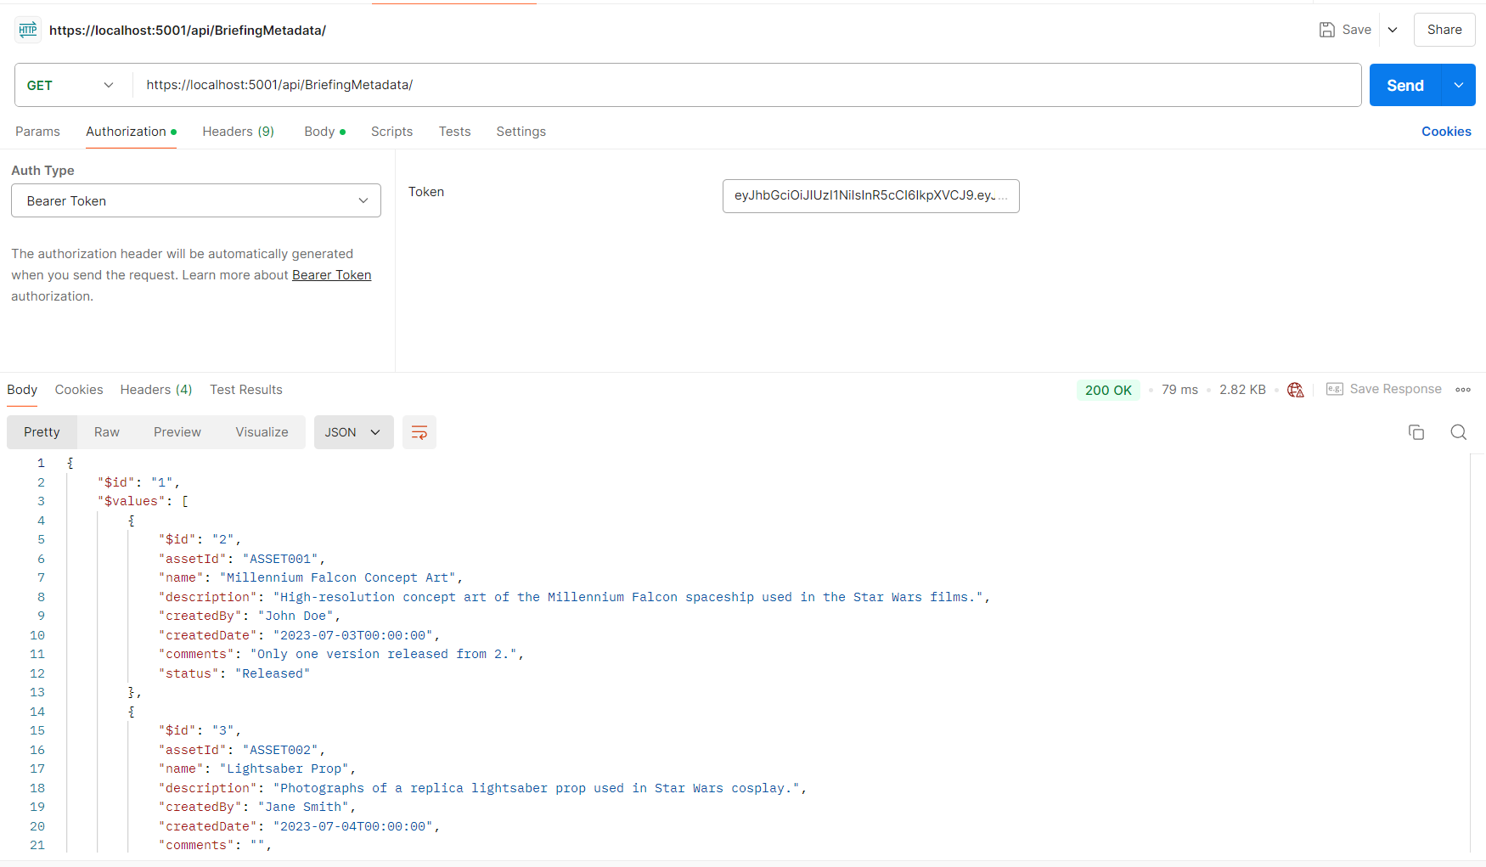
Get all briefing metadata

Slide 27
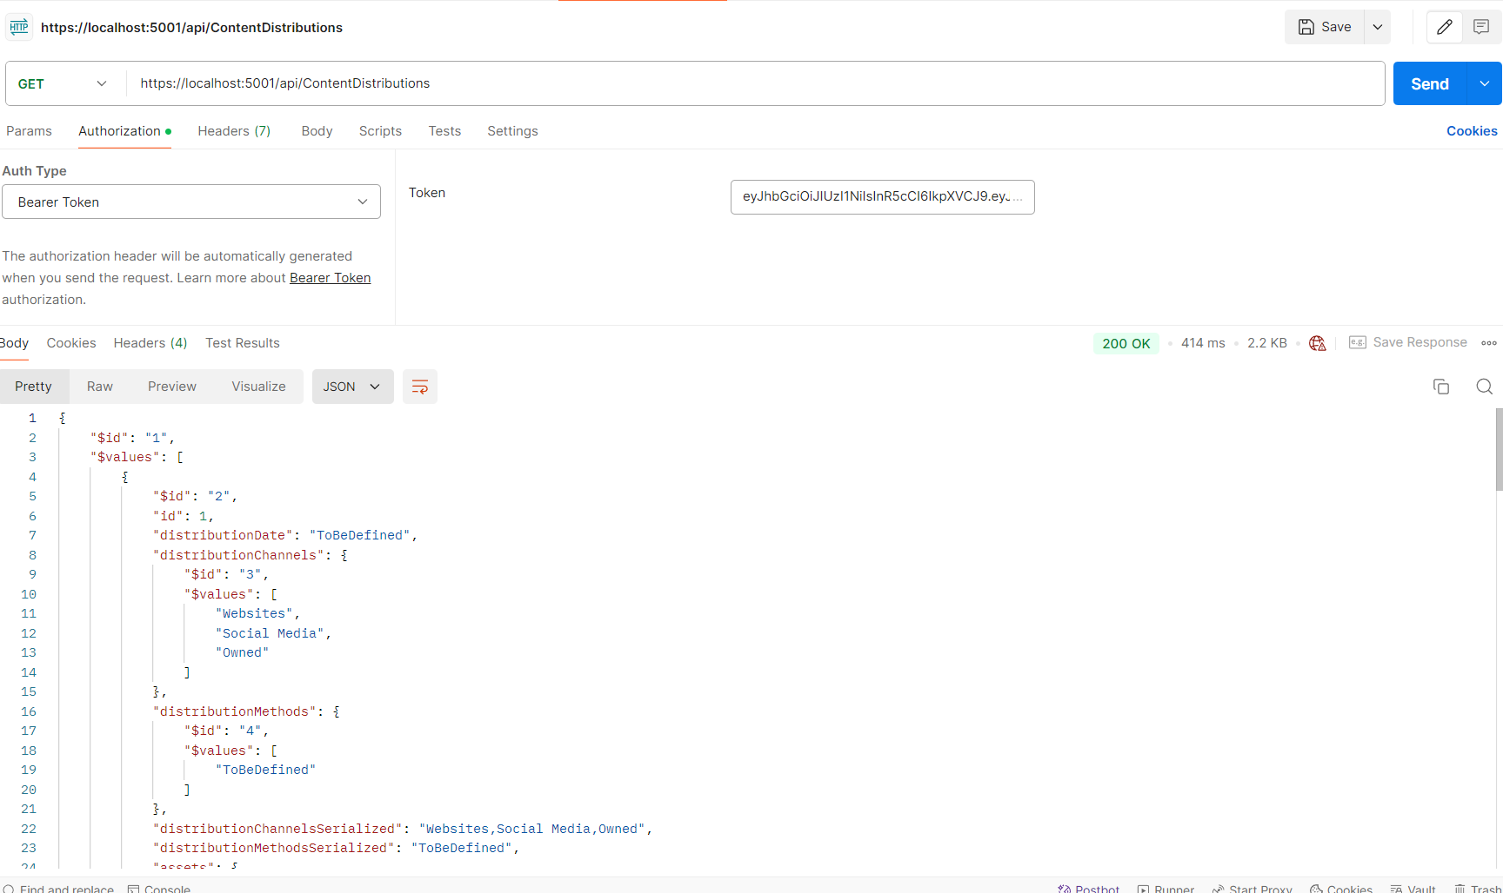
Get all distribution metadata

