Slide 2
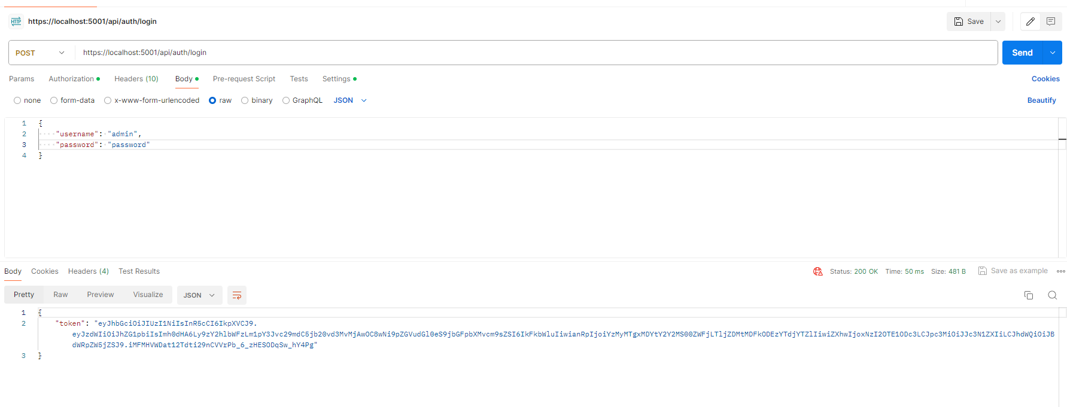
Login to get jwt token

Slide 3
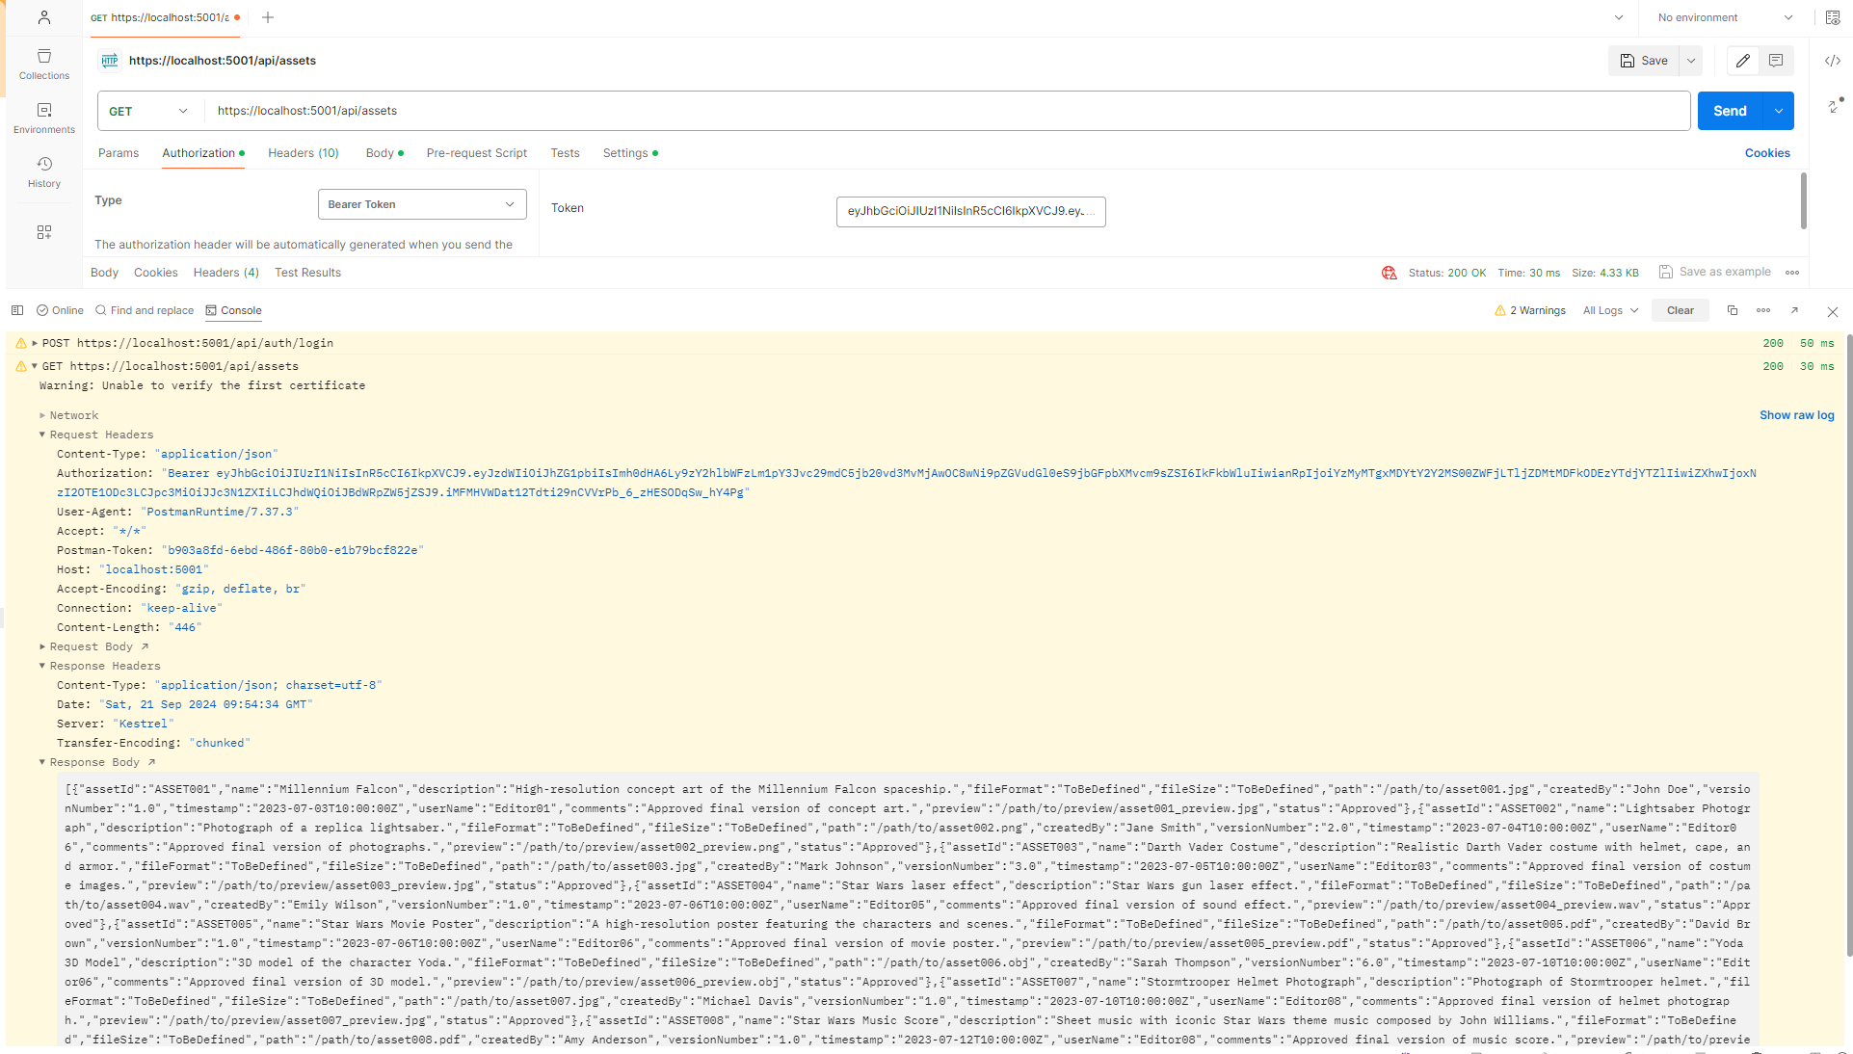
Get all assets medata

Slide 4
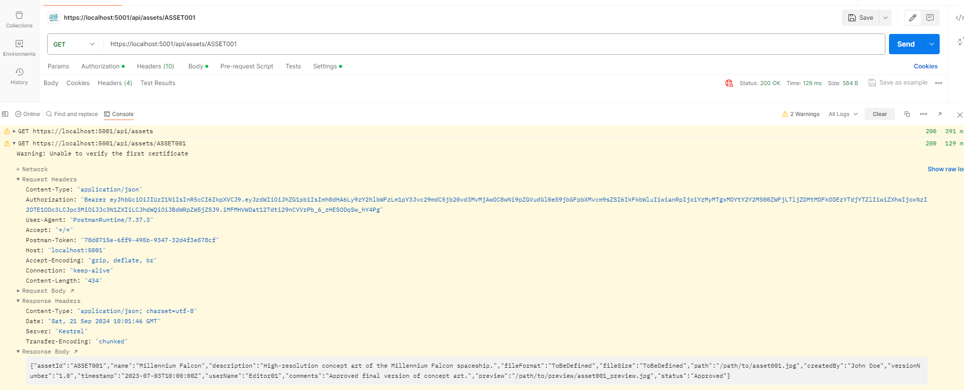
Get by AssetId

Slide 5
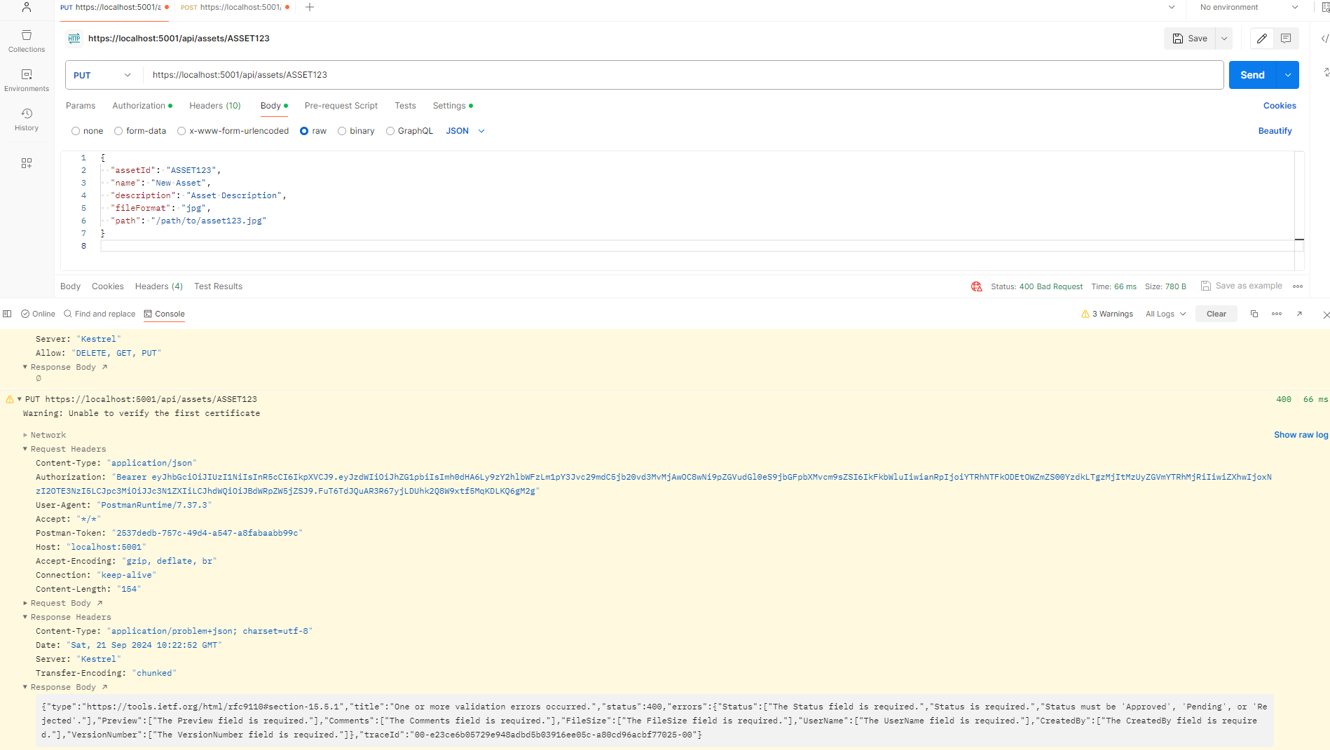
Update by AssetId: failure due to input validation

