Slide 1
Structure
Model: structure of asset data, reflects the database schema
Data: Entity Framework Core (EF Core) context, for managing the interaction between the application and the database
Validator: checks the integrity and correctness of the objects before they are persisted to the database.
Repository: Encapsulates data access logic: CRUD operations, logging.
Services: an intermediary between the repository and the API controller.
Security: authentication with jwt
API controller: exposes endpoints for asset management.
Program: configuration, initialize services, dependencies

Slide 2
Target: Use REST APIs for communication between microservices
APIs for AssetMetadata
APIs for BriefingMetadata
APIs for ContentDistributionMetadata
APIs for Authentication: get jwt token

Slide 3
Furture improvement
Event driver architecture: a message broker for asynchronous communication, decouple services.
On demand and scheduled request data from APIS and publish message
Deployment with auto-scale (Kubernetes or docker swarm)
Retry strategy: for disconnections, timeout and unavailable services
Using persistent database and containerization database
Caching (memory cache and reids)
Health monitoring and alerts

Slide 4
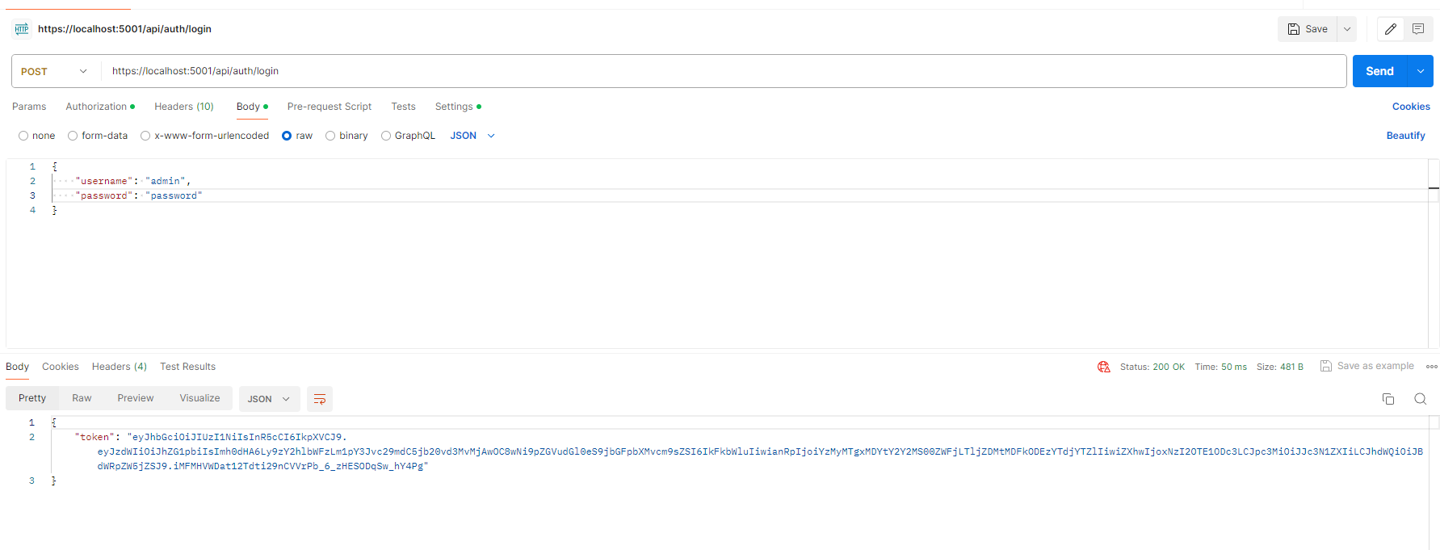
Login to get jwt token

Slide 5
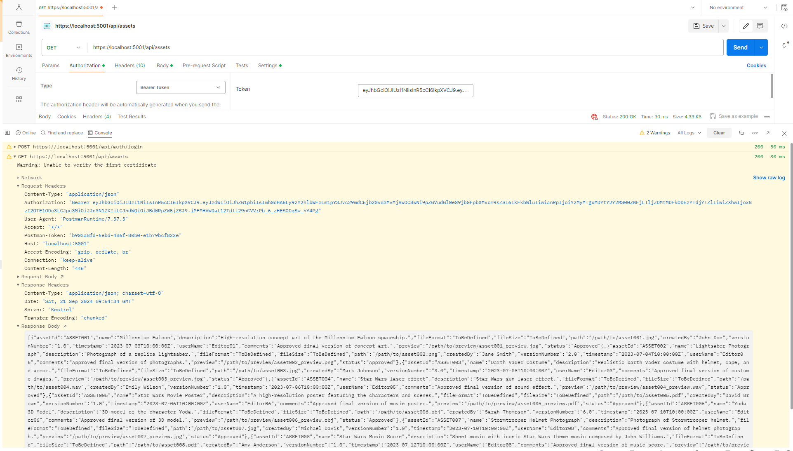
Get all assets medata

Slide 6
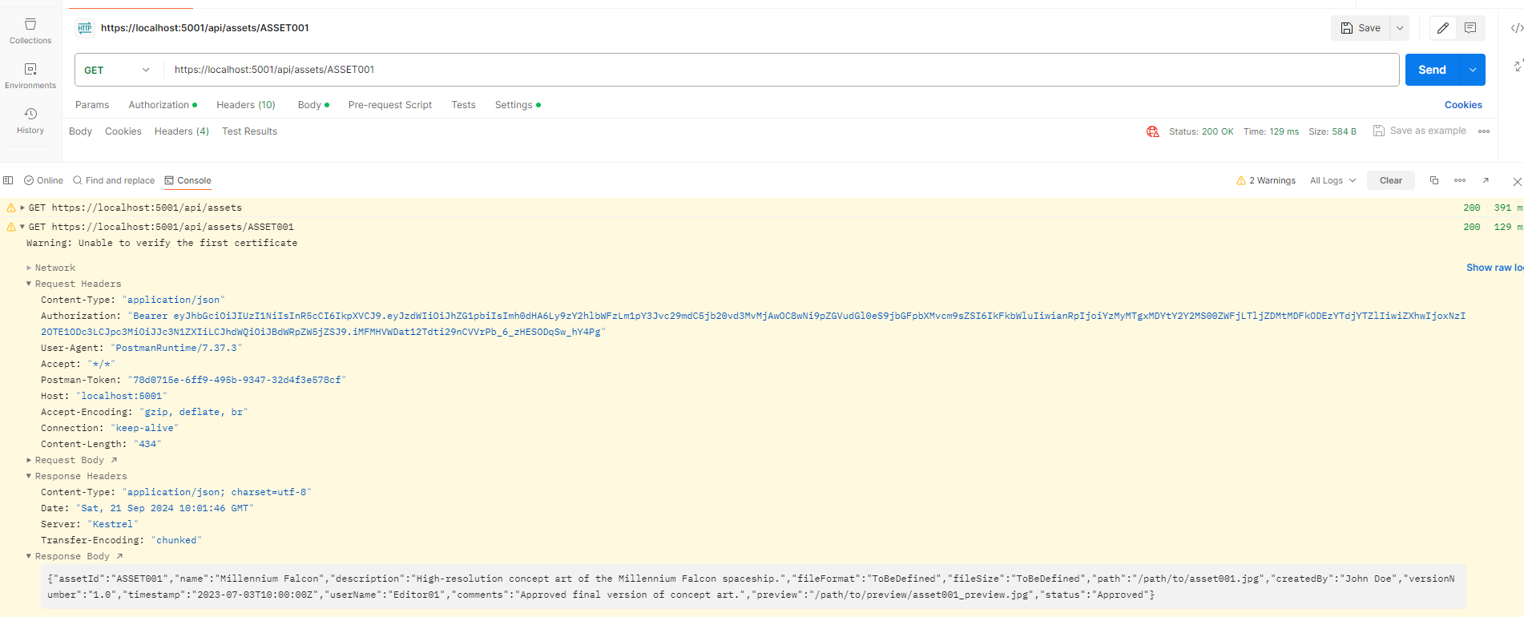
Get by AssetId

Slide 7
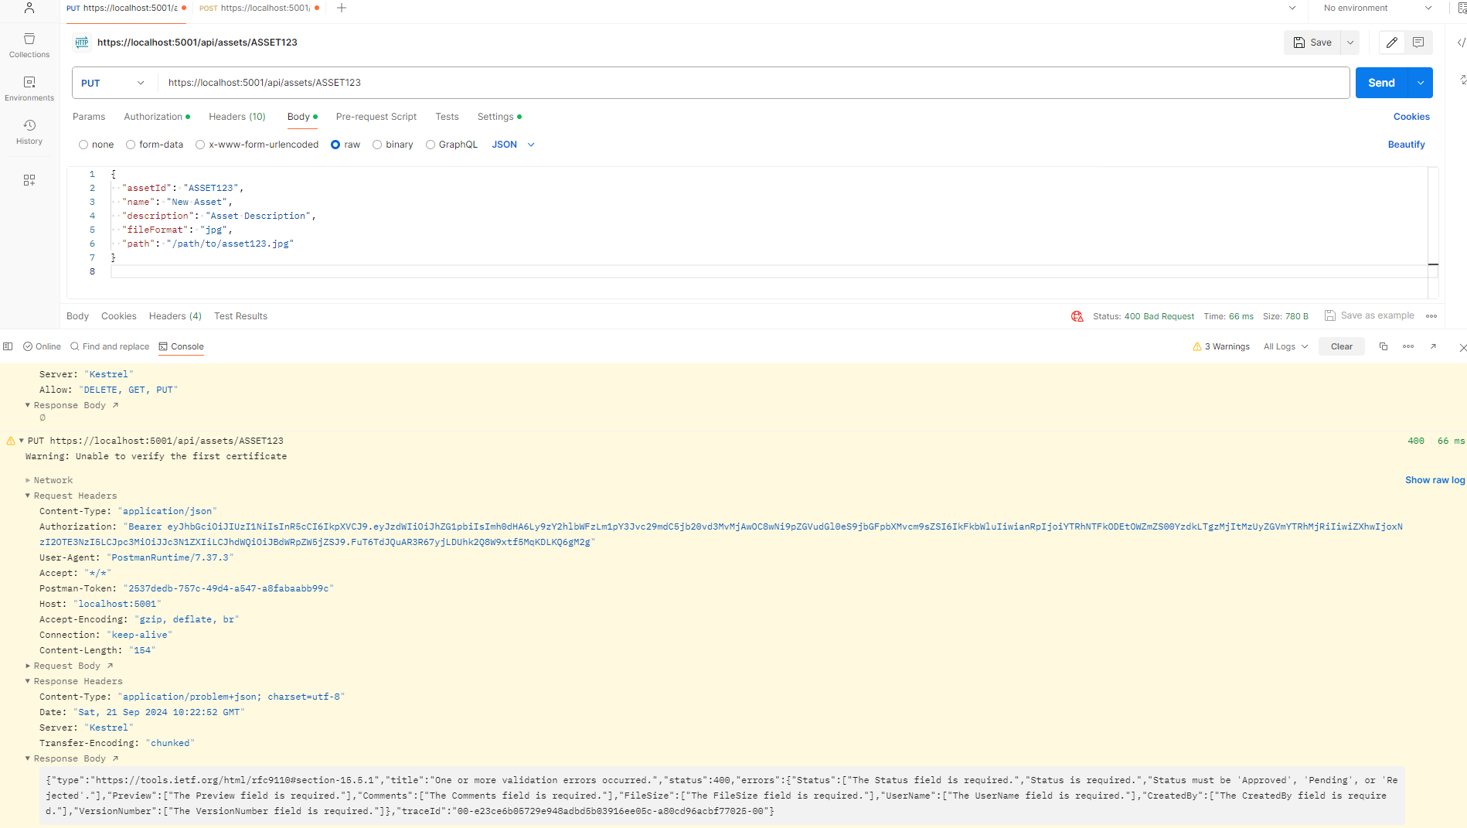
Update by AssetId: failure due to input validation

Slide 8
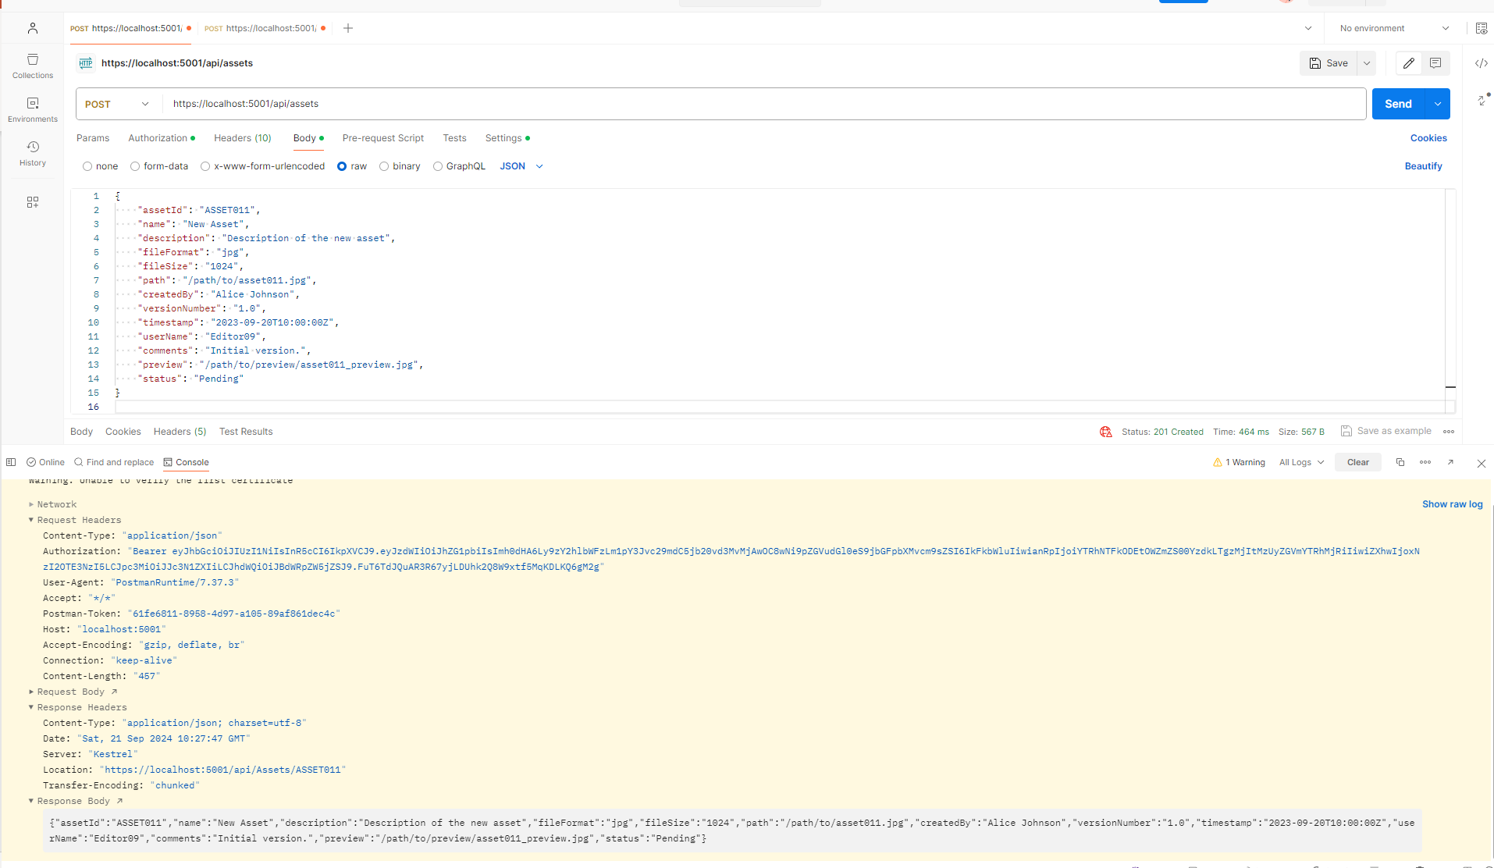
Add metadata

Slide 9
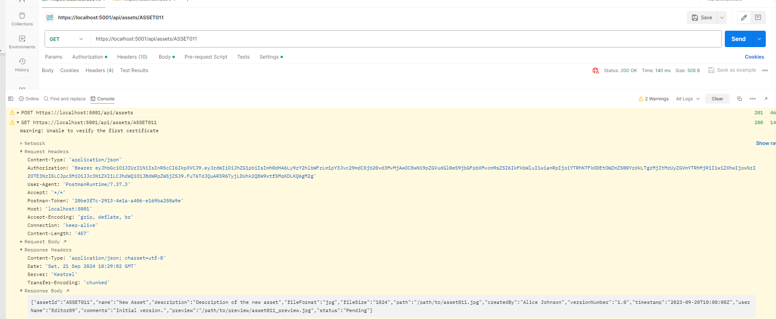
Get newly added by AssetId

Slide 10
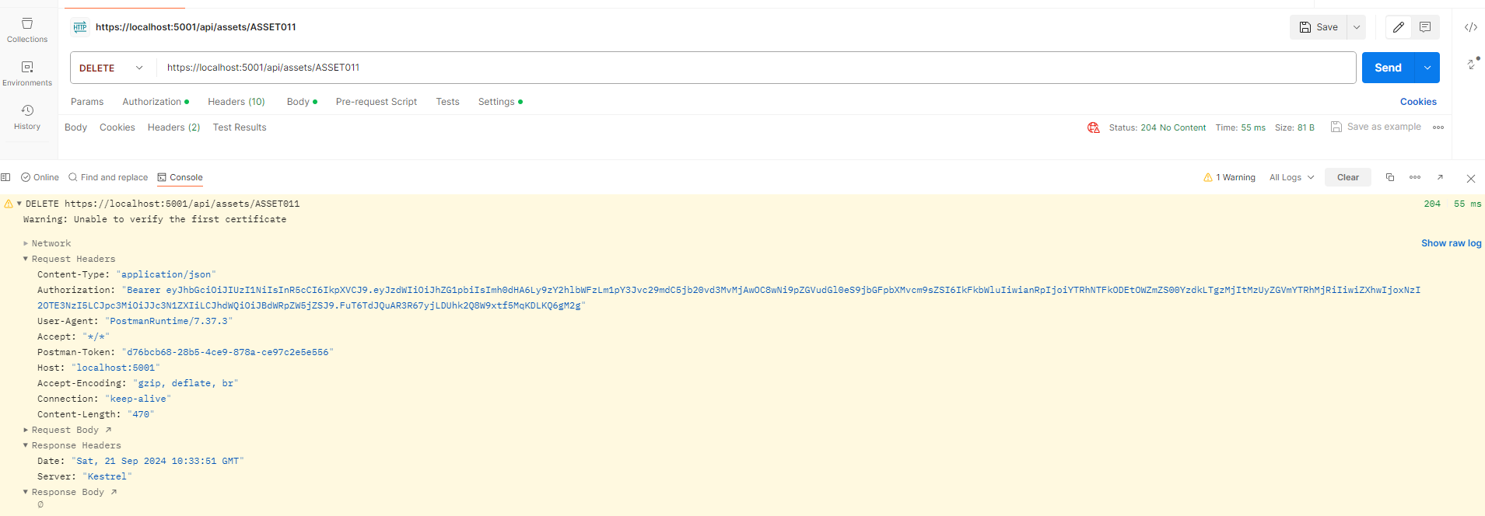
Delete by AssetId

Slide 11
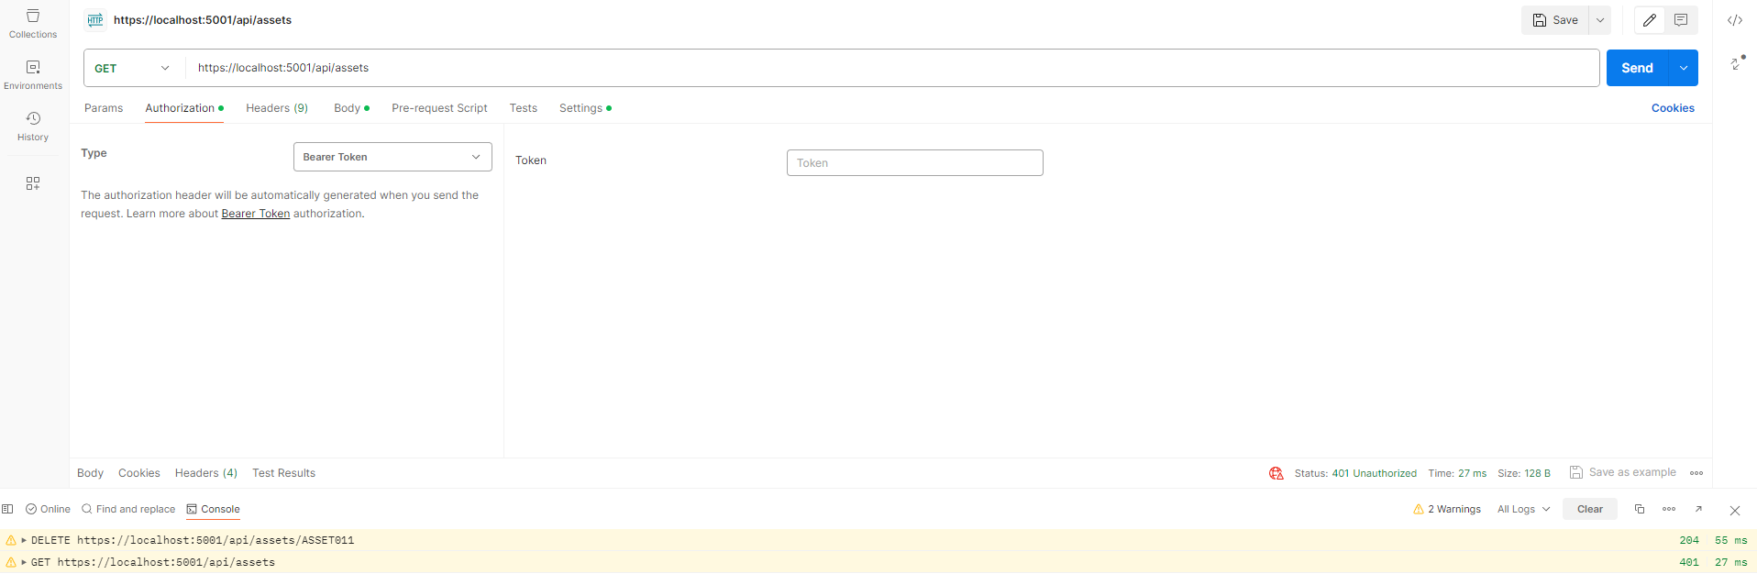
Request without token

Slide 12
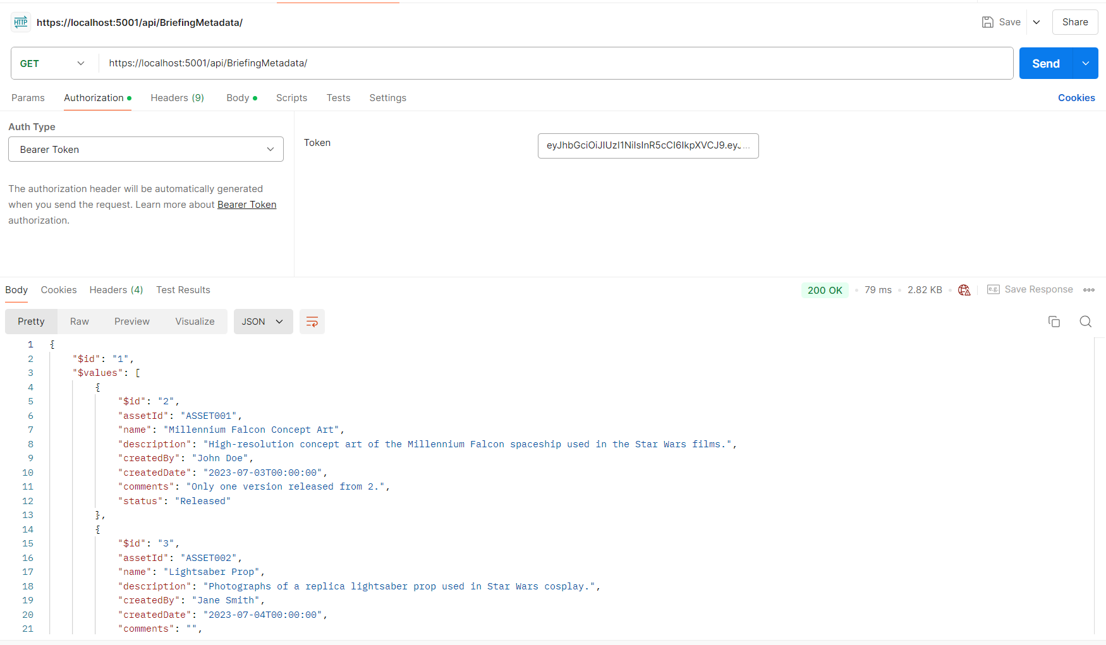
Get all briefing metadata

Slide 13
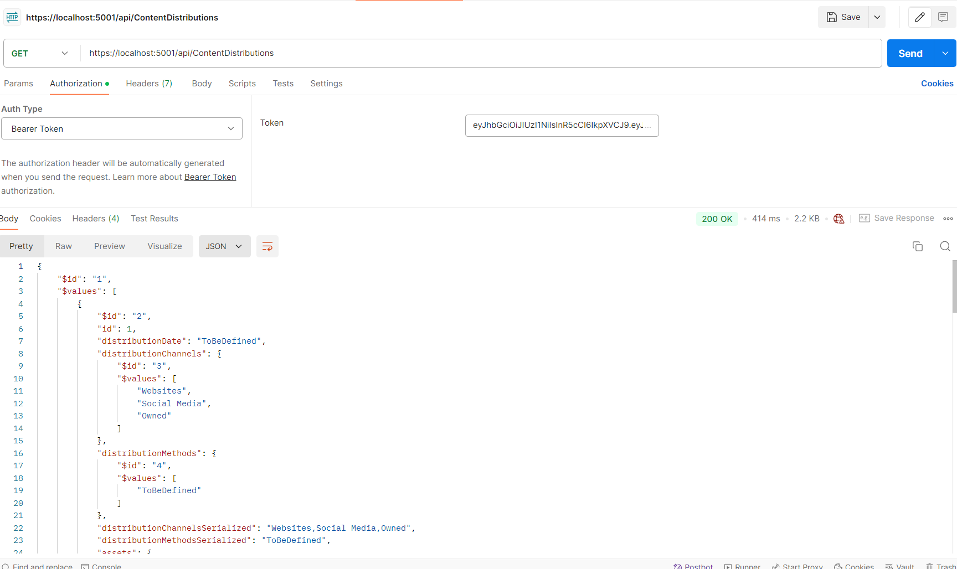
Get all distribution metadata

