Slide 1



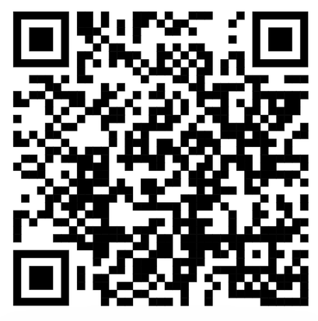
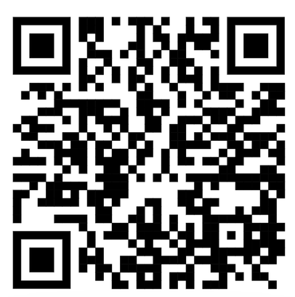
19TH ISC THEME
In-Space Servicing, Assembly and Manufacturing
EARLY BIRD PROMO: $99 PER TEAM (EXCLUDE GST)
Register Now
More Info

Slide 2



Precise Positioning for Public Good
More Info

Slide 3
Satellite Building Project

Slide 4
Industry Engagement Sessions
To better prepare you for a career in the space industry, Space Faculty will arrange engagement sessions with industry experts for workshop participants
Interact and learn from the experts
Understand more about the space industry
Look out for your emails!

Slide 5
Satellite Building Project
Mission: In-Orbit sensing for in-space situation awareness (SSA)
Platform: 3U CubeSat
Schedule:
Date | Event
Aug 2026 to Jul 2027 | Design and development of CubeSat, including various technical review meetings
Aug 2027 | Shipping of CubeSat for integration with deployer
Oct 2027 to Nov 2027 | Launch and Early Orbit Phase (LEOP)
Nov 2027 to May 2028 | Operation Phase

Slide 6
Methods to Join the Project
Methods | Duration / Time Commitment | Involvement
One year Internship* | One year / full-time | Follow through entire duration of satellite development
Internship* | One semester or trimester or holiday period / full-time | Involvement to be determined by Space Faculty
Final year / Capstone Project | One year / part-time | Follow through entire duration of satellite development. Scope determined with university
Project Module | One semester or trimester / part-time | Defined sub-system / module project with university
Self-interest | Part-time | Depends
* Internships will be very limited

Slide 7
Satellite Building Project
After selection, participants will be grouped into teams to work on a sub-system or module
For those who can commit for at least one year, they might be chosen as system engineers or project manager
Contribute towards the satellite design, development, integration, testing and operation
Attend technical review meetings
Do more, learn more!

Slide 8
Satellite Building Project
If you are interested, write an email to us:
Address: nelson.tan@spacefaculty.asia
Subject: “Application for Satellite Building Project”
Treat it like a job application and send us your resume!
What are your skills or strengths?
What would you like to work on? How do you think that you can contribute to the project team?
How are you intending to join the project? How much time can you commit to the project (for the different phases)?
Do so before 3rd July!

Slide 9
Satellite Building Workshop
Q&A

Slide 10
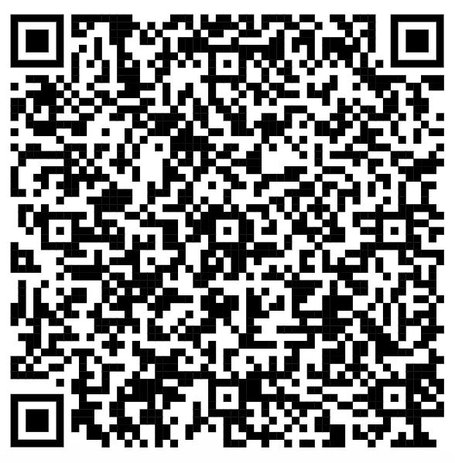
Post-Workshop Survey

