Slide 1


Slide 2
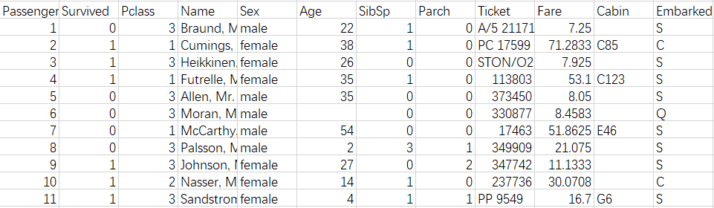
Given a list of Titanic passengers w/ personal info, WHAT we can do …
Survival Prediction!

Slide 3

Data Preparation
Data Cleaning

Slide 4
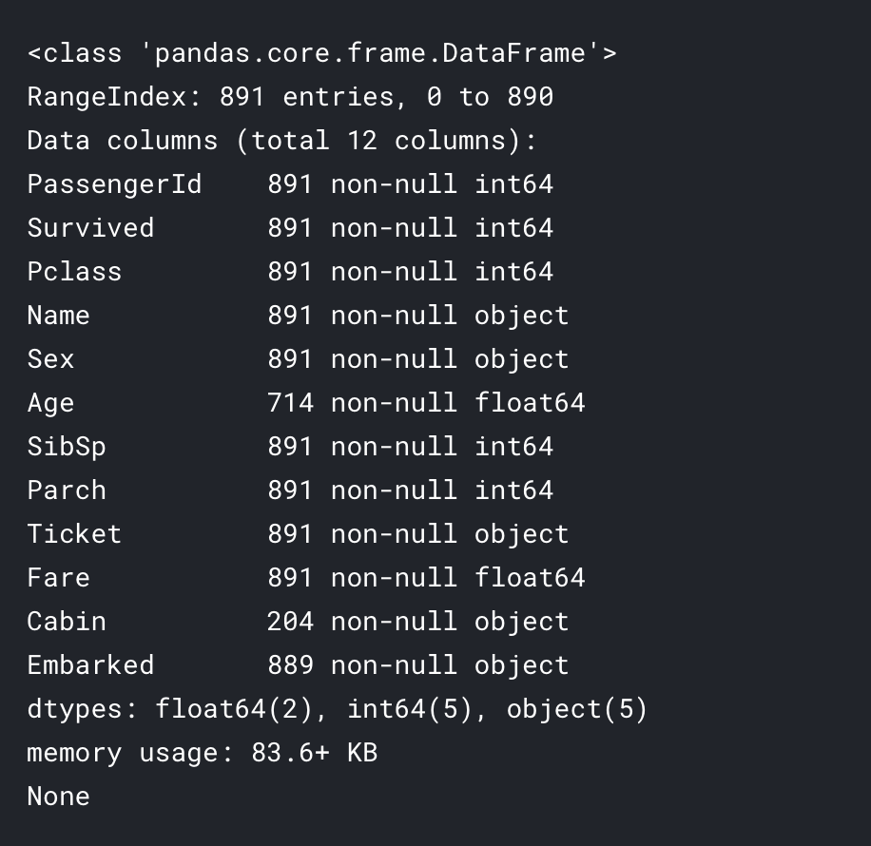
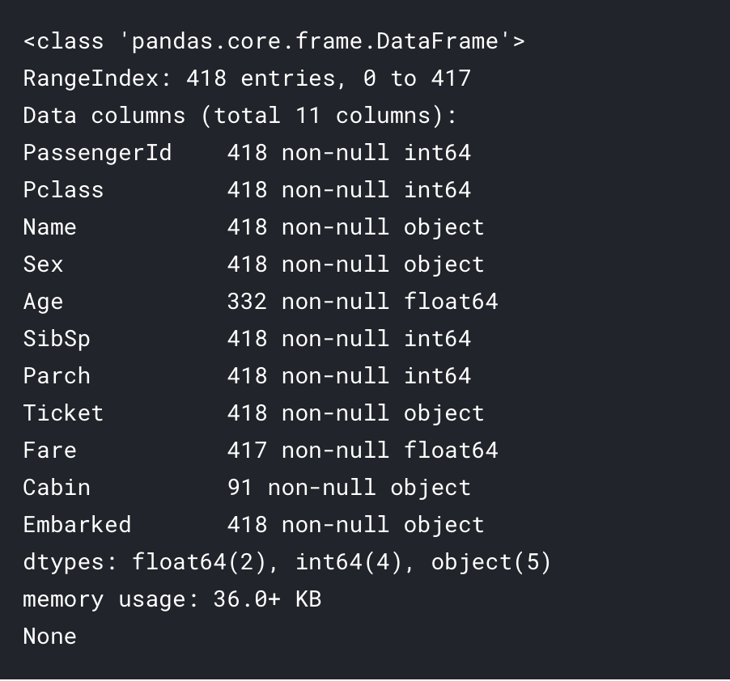
Data Cleaning
Fill in the missing values

Slide 5
Feature Engineering
Create New Features
Features Selection

Slide 6
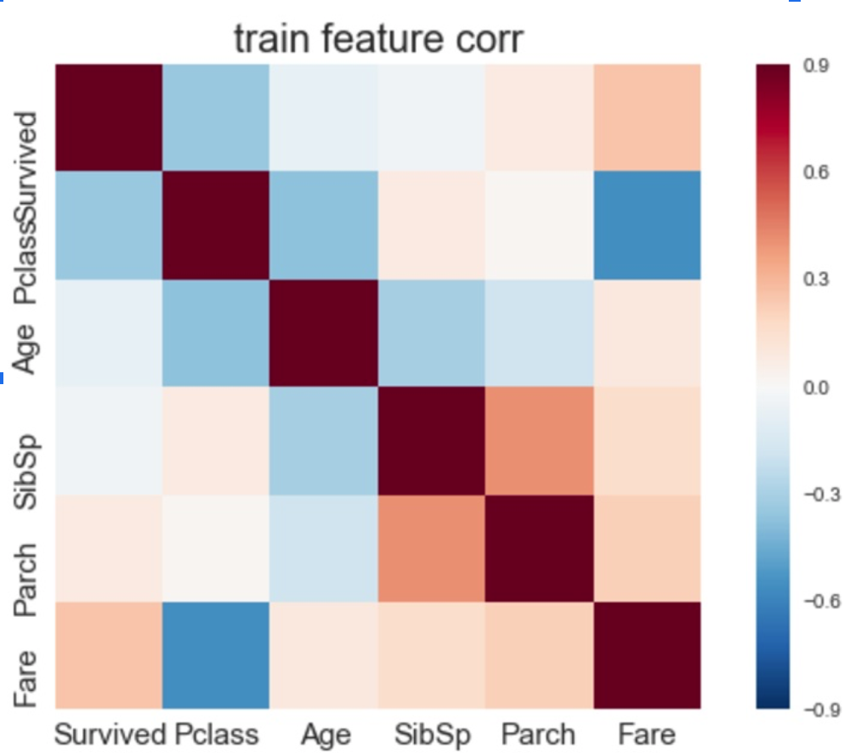
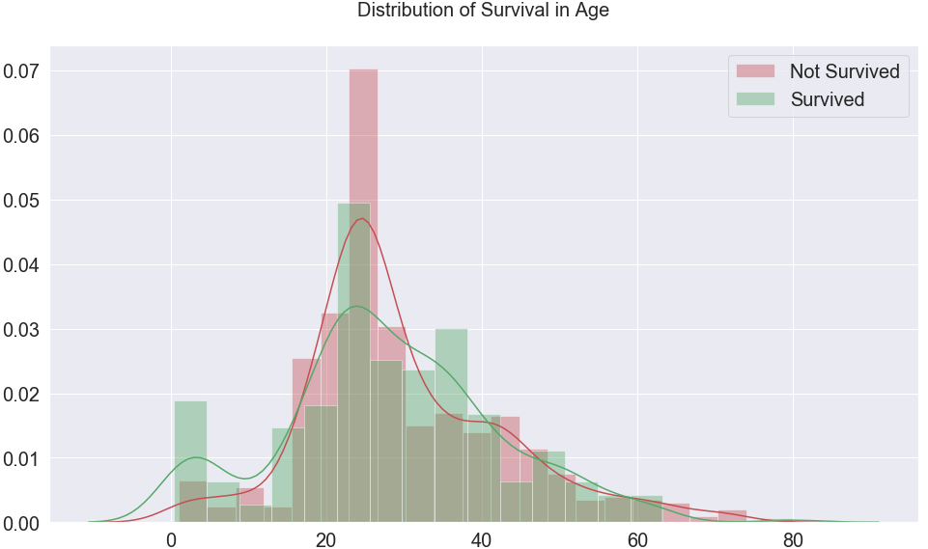
Feature Engineering
Original Feature:
Name/Title -->
Mme, Jonkheer, Capt, Lady, The countess, Colonel, Major, Rev, Dona, Don, Mlle, ...
SibSp, Parch -->
# of siblings/spouses
# of parents/children
Age -->
...
New Feature:
Title (common)
Mr, Mrs, Miss, ...
FamilySize = SibSp+Parch+1
1, 2, 3, ...
AgeBin
[0,12), [12,24), …
...
Fig.1 Distribution of survival in age

Slide 7
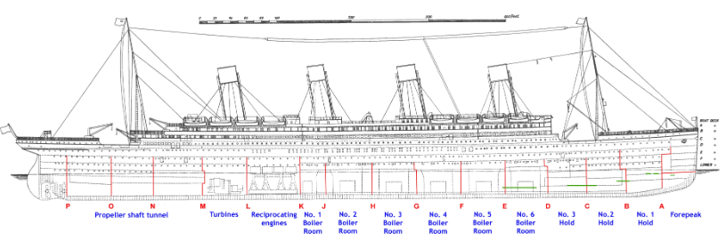
Feature Engineering
Tickets: determines where the passenger’s cabin is
--> High survival tickets and Low survival tickets
Embarked: shows where the passenger boards
--> Embarked_S, Embarked_Q, Embarked_C
Fig.2 Cabins

Slide 8
Feature Engineering
Fig.3 Sinking Simulation

Slide 9
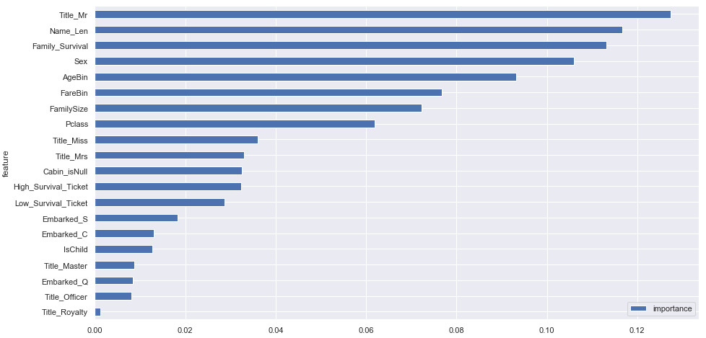
Feature Selection
Top 8
Fig.4 Feature Importance with RandomForestClassifier

Slide 10

Model Training
Hyperparameter
Cross Validation
Ensemble Learning

Slide 11
Hyperparameter
Classifiers
LogisticRegression, SVC, KNeighborsClassifier, DecisionTreeClassifier,
RandomForestClassifier, GradientBoostingClassifier, XGBClassifier
GridSearchCV (Automatically Optimize Hyperparameters)
RF = RandomForestClassifier(n_estimators=410,max_depth=6, min_samples_split=4,min_samples_leaf=1,max_features=4,oob_score=True,random_state=10)
param_test1 = {'n_estimators':range(50,500,20)}
gsearch1 = GridSearchCV(estimator = RandomForestClassifier(min_samples_split=100, min_samples_leaf=20, max_depth=8, max_features='sqrt', random_state=10), param_grid = param_test1, scoring='roc_auc',cv=5)
gsearch1.fit(X_all.values,Y_all.values)
print(gsearch1.grid_scores_)
print("For RF, the best n is", gsearch1.best_params_, "score is", gsearch1.best_score_)
# result: 'n_estimators': n=410

Slide 12
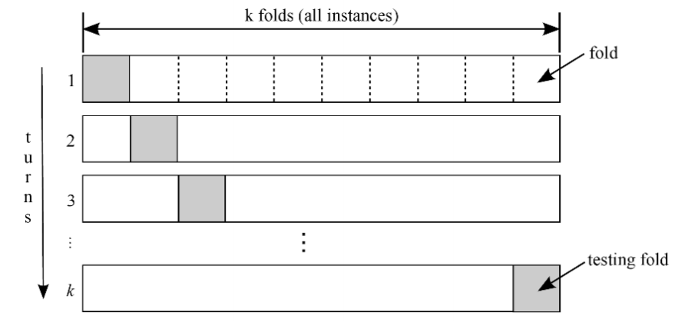
Cross Validation
What is Cross Validation?
A method to evaluate the performance of any machine learning
-> Train_Test_Split approach
-> K-Folds Cross Validation:
Partition training data into K equally
sized subsamples. For each fold, use the other K1 subsamples as training data with the last subsample as validation.
Fig.5 K-folds validation process

Slide 13
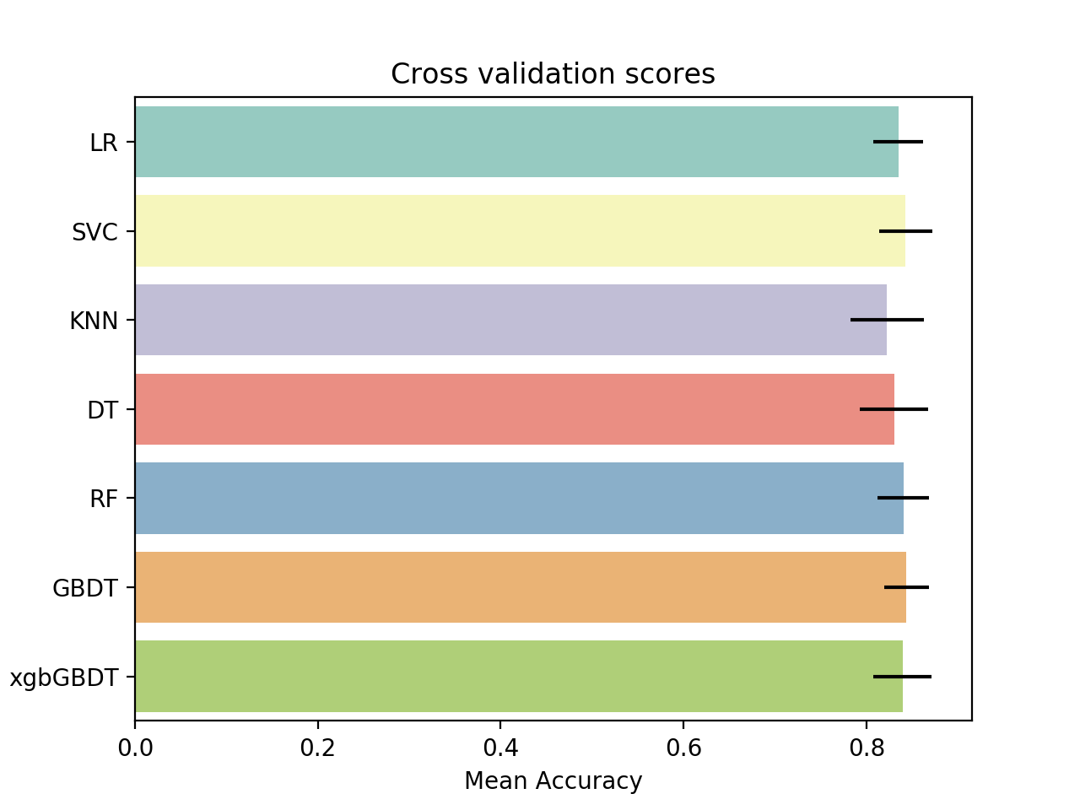
Cross Validation
0.835064124389967
0.8427925320621948
0.8228175008512087
0.8305705935762114
0.8405949948927477
0.8440035183293612
0.8394963681761434
Ensemble model — 0.8462007717625696
Fig.6 Cross validation scores

Slide 14
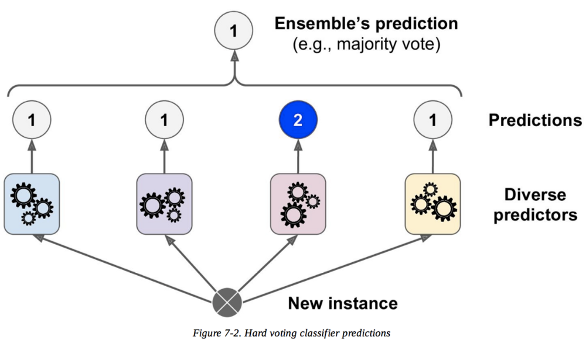
Ensemble Learning
What is ensemble learning?
Ensemble learning is a machine learning paradigm where multiple learners are trained to solve the same problem. In contrast to ordinary machine learning approaches which try to learn one hypothesis from training data, ensemble methods try to construct a set of hypotheses and combine them to use.
Fig.7 Ensemble Learning

Slide 15
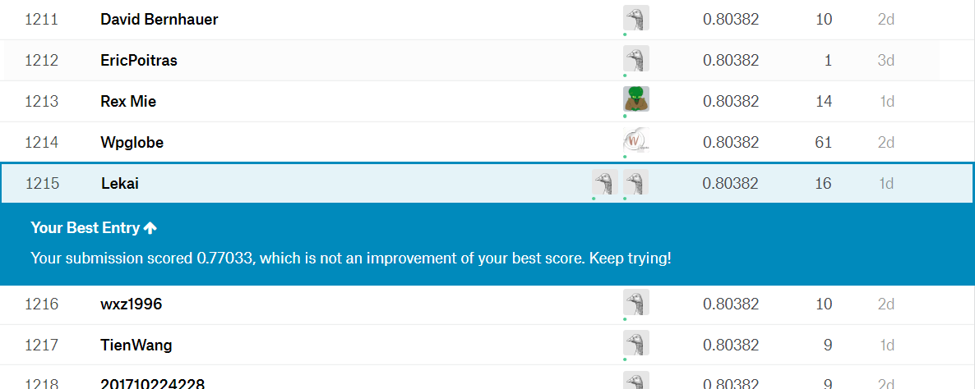
Final Submission

