Slide 1
Acoustic Source Localization
on a Wireless Sensor Node
Leke, University of Virginia
Summer 2026

Slide 2
The goal
• A small node that hears a sound and reports the direction it came from
• Several nodes cross their bearings to locate a source
• This summer: ONE node, microphone to bearing in degrees

Slide 3
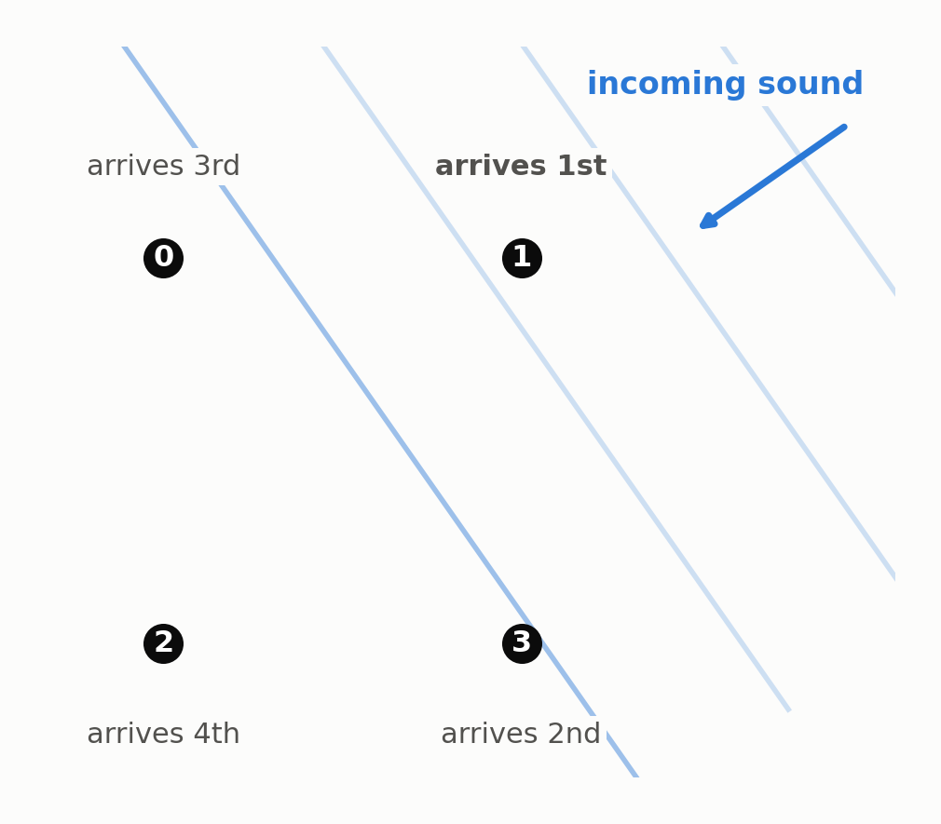
How direction comes out of timing
Direction shows up as the ORDER and SPACING of arrivals
• Sound reaches the four mics at slightly different times
• Those differences depend on direction
• At 16 kHz one sample is 2.1 cm of travel
• So delays need sub-sample accuracy
• GCC-PHAT plus peak interpolation gets it
1 sample at 16 kHz = 62.5 us = 2.1 cm of travel, so delays must be measured to a fraction of a sample.
Notes:
=

Slide 4
System overview
• Four PDM MEMS mics, 16 kHz per channel
• STM32L552 at 96 MHz: DFSDM decimation, DMA into RAM
• Clap trigger, one second stored
• Bearing computed on the board with CMSIS-DSP
• Raw audio also dumped over serial

Slide 5
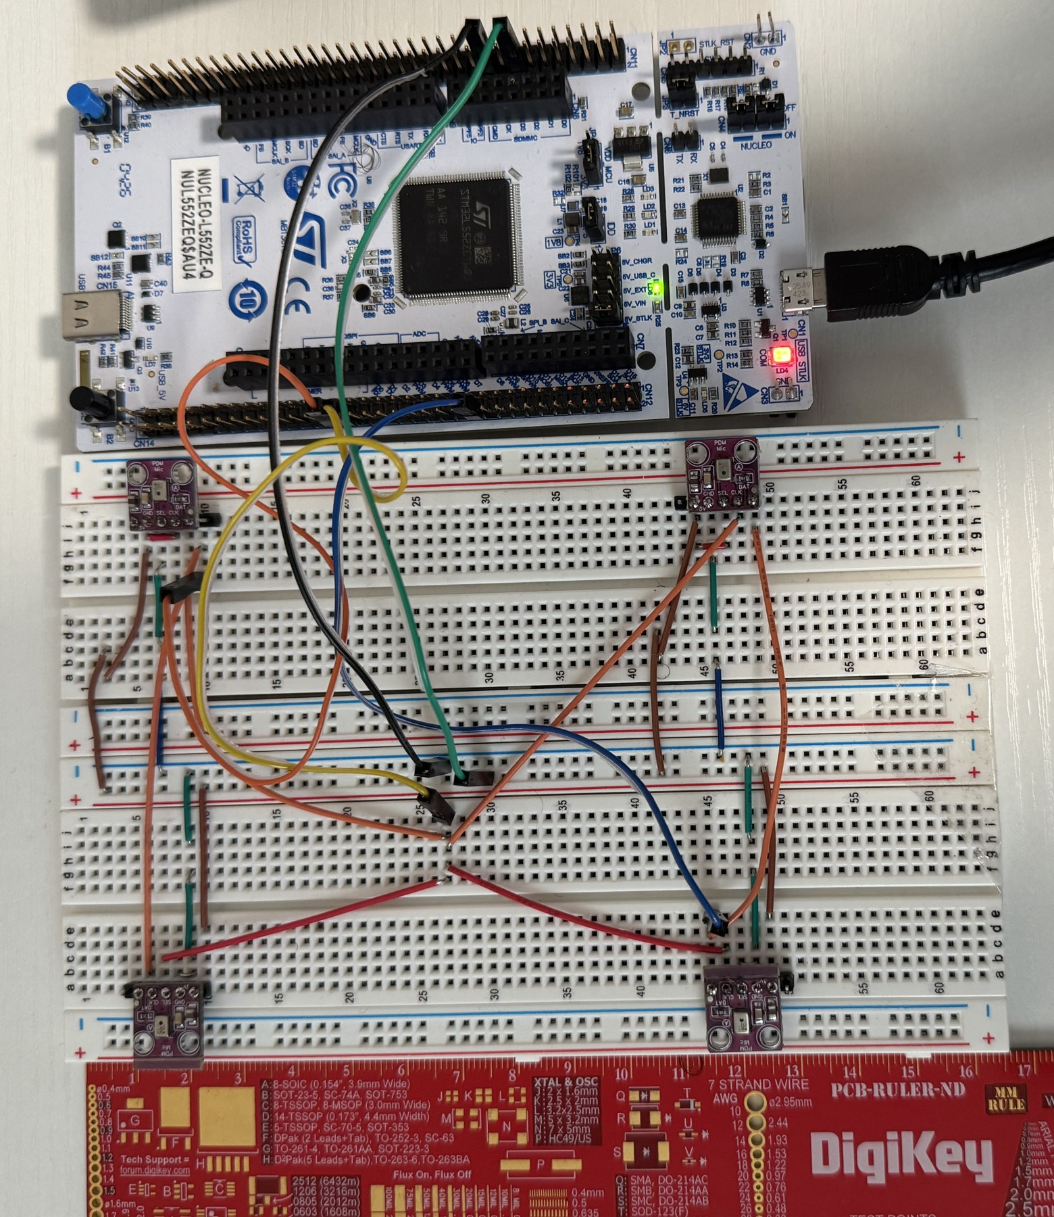
The hardware
The array as built, on the bench
• NUCLEO-L552ZE-Q, four MP34DT01-M PDM mics
• Two full-size breadboards glued together, one mic per corner
• One clock net fans out to all four mics
• Two mics share each data line, using SEL to pick opposite clock edges
• The red ruler at the bottom is the instrument the array was measured with
Four PDM mics at the corners of a 9.25 by 9.9 cm rectangle. The red PCB ruler gives the scale.

Slide 6
Four microphones on two data pins
• The chip has four DFSDM channels, not eight
• Each mic's SEL pin picks the rising or the falling clock edge
• Two mics with opposite SEL share one wire without colliding
• Mics 0 and 1 on PE7, mics 2 and 3 on PB1, one clock net to all four

Slide 7
The problem that had to be solved first
• The four digital filters must start on the same clock edge
• If they do not, every channel carries an unknown offset
• An unknown offset is indistinguishable from real acoustic delay
• Fix: synchronized start, followers armed first, trigger filter last

Slide 8
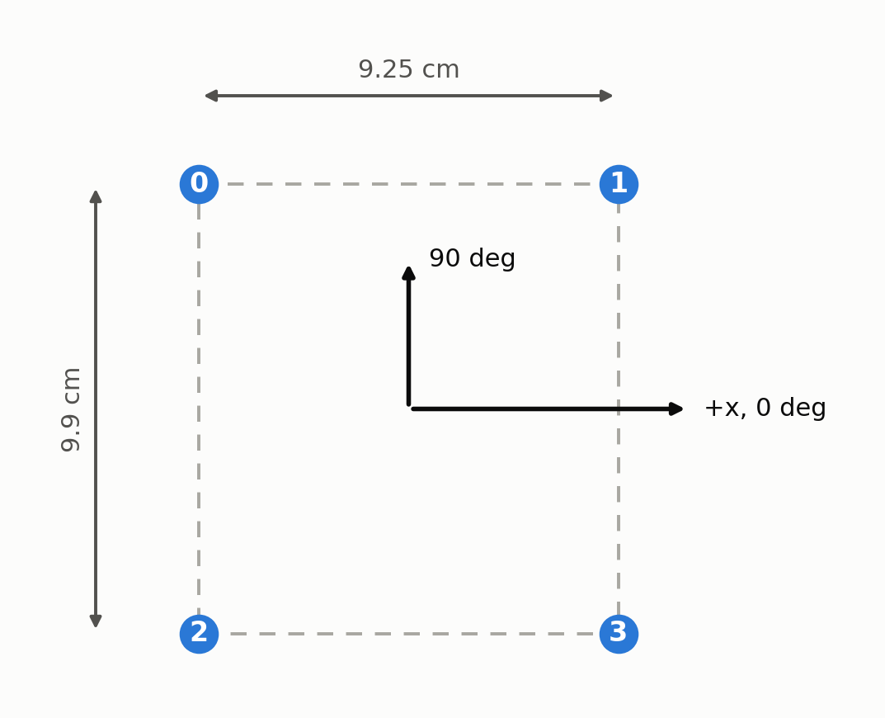
Array geometry, and why it is not hardcoded
Built array, measured port to port with a ruler
• Built array 9.25 x 9.9 cm, measured port to port with a ruler
• Condition number 1.07, so no blind directions
• Trying another layout is a one line change
Aperture 13.5 cm (6.32 samples). Condition number 1.07, so no blind directions.

Slide 9
Python Simulations
Layout | Aperture | Condition number | Mean | p90 | Worst
9.25 x 9.9 cm (BUILT) | 13.5 cm | 1.07 | 1.04 deg | 2.14 deg | 2.25 deg
9.25 x 12 cm | 15.2 cm | 1.30 | 0.70 deg | 2.02 deg | 2.14 deg
9.25 x 16 cm | 18.5 cm | 1.73 | 0.52 deg | 1.19 deg | 1.57 deg
10 cm square (sim reference) | 14.1 cm | 1.00 | 1.11 deg | 2.33 deg | 2.42 deg
2.8 x 10 cm (one breadboard) | 10.4 cm | 3.57 | 1.87 deg | 7.80 deg | 8.52 deg
2.5 cm square | 3.5 cm | 1.00 | 6.30 deg | 8.59 deg | 9.57 deg
Simulation only: 36 angles x 3 trials, 2 m source, 20 dB SNR. No reverberation, and the estimator is handed the exact geometry, so this RANKS layouts rather than predicts real accuracy.
Notes:
\

Slide 10
How correctness was established
• Build ONE trusted reference, check everything against it
• 1. Verify in simulation, where truth is known
• 2. Prove channel sync separately from geometry
• 3. Share code between the test and the reference so they cannot drift
• 4. Compare the embedded port to the reference on identical samples
Simulation: delay bias under 0.001 samples, angle error under 0.1 deg, about 0.4 deg at 0 dB SNR

Slide 11
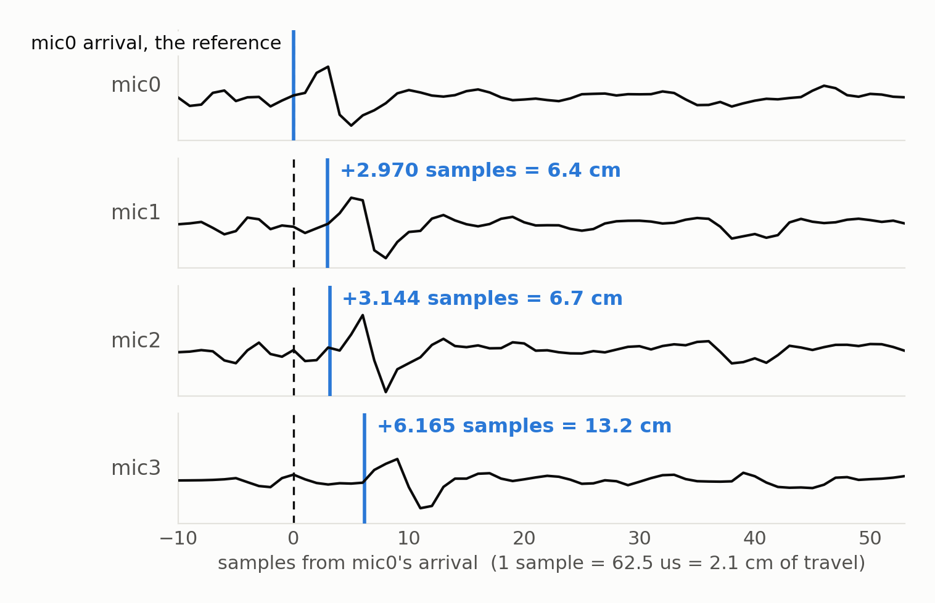
One clap, as the array actually heard it
One real clap, arriving at the four mics in turn
• Real capture, not a simulation
• The same waveform, four times, shifted
• Delays here are 2.970, 3.144 and 6.165 samples
• That is 6.4, 6.7 and 13.2 cm of extra path
• The whole bearing comes out of numbers this small
2026-07-29-sweep angle135 trial3, a clap from a true 135 deg. Dashed line is mic0's arrival, carried down the stack so the shift is measured against something fixed. Delays are the GCC-PHAT values, not eyeballed from the traces.

Slide 12
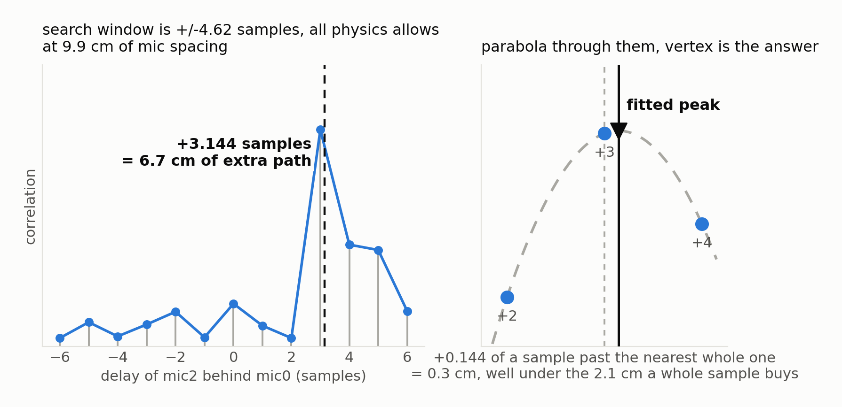
What GCC-PHAT does with it
GCC-PHAT on that same clap, one mic pair
Whole samples are all the correlation has. The parabola through the peak and its two neighbours puts the answer between them.
Same clap, mics 0 and 2. The search is restricted to the delays the 9.9 cm spacing physically permits, which throws away most of the places a wrong answer could hide.

Slide 13
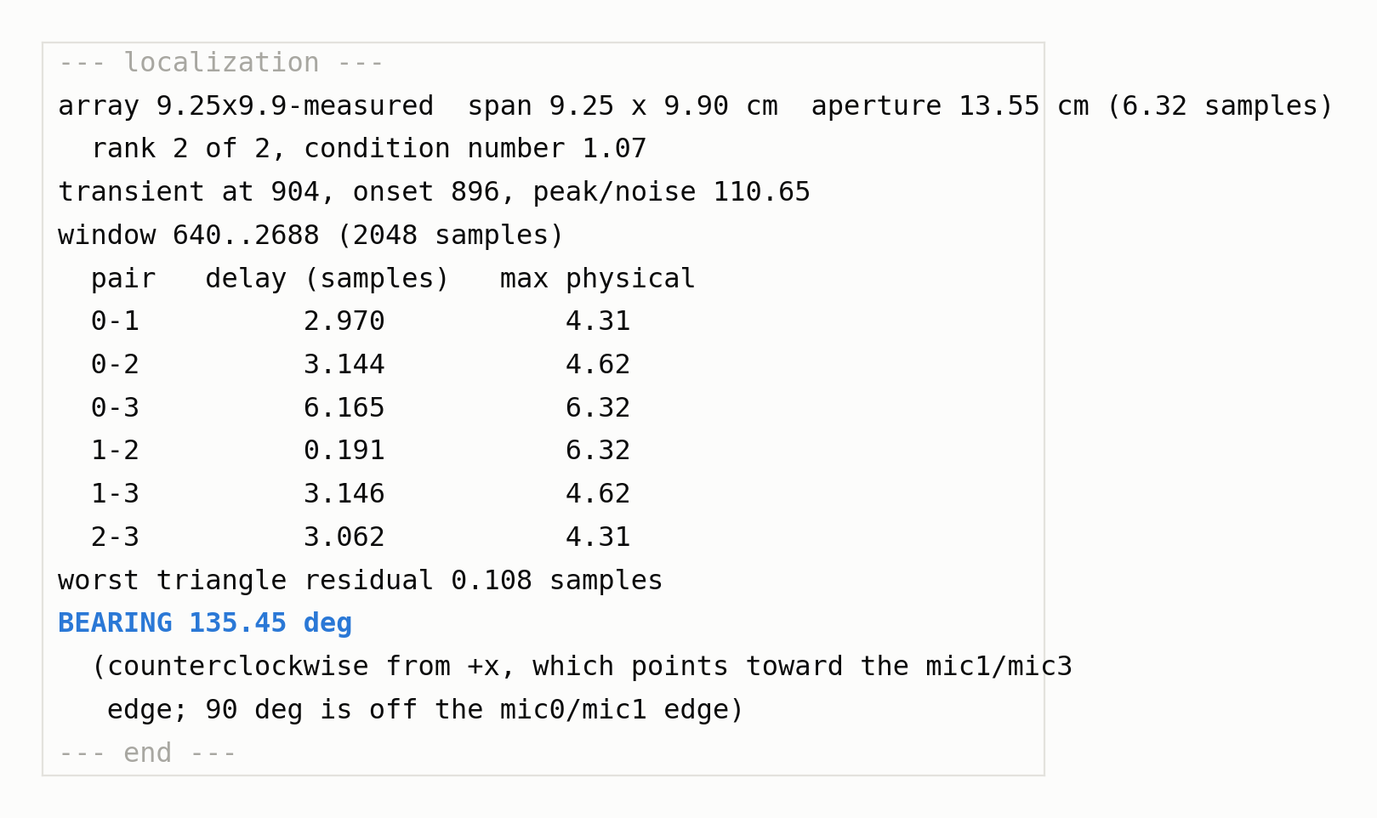
what the board printed for that same clap
What the board itself printed for that clap
• The board computed this itself, with CMSIS-DSP
• The PC only received the text
• Saved next to the samples that produced it. Which is what makes the acceptance test possible
• All 44 captures: delays agree to 0.000 samples, bearings to 0.004 deg
Saved verbatim beside the samples that produced it. The board computed this on its own with CMSIS-DSP; the PC only received the text.

Slide 14
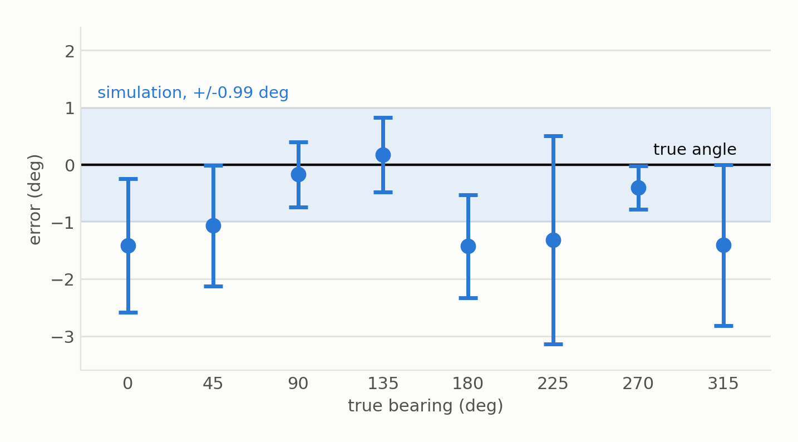
Results
1.11 degrees mean error across eight angles
39 claps, source 1.1 m out, 2.1 m of wall clearance. Worst single clap 4.04 deg. Bars are the trial-to-trial spread at each angle.
Simulation on the same geometry, with no reverberation and exact geometry handed to it, gives 0.99 deg. The real array is at the simulation's own accuracy floor.

Slide 15
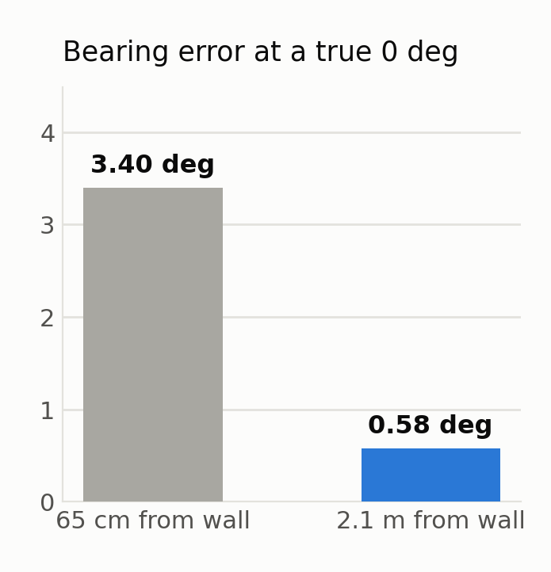
What dominated the error
Same code, same array, same room. Only the wall moved.
At 65 cm the wall reflection arrived inside the analysis window and corrupted one specific mic pair. Moving to 2.1 m fixed it with no code change at all.

Slide 16
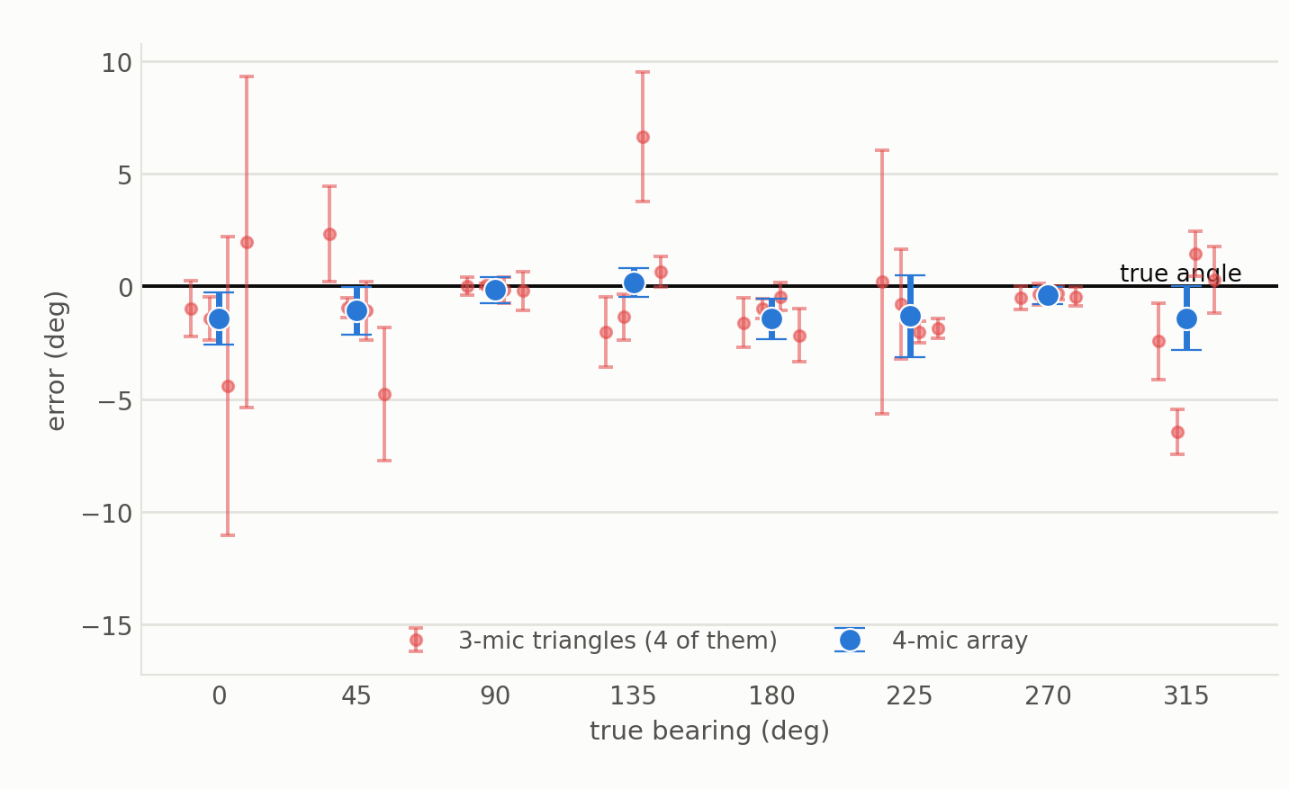
Does the fourth microphone earn its place?
Would three mics have done? Scored on the same 39 claps
Left: every 3-mic triangle against the 4-mic array, angle by angle. Right: what each triangle costs, paired clap by clap.
4 mics 1.11 deg, best 3-mic triangle 1.76 with a worst single clap of 7.70

Slide 17
A self-check
• Delay is antisymmetric: A to B, plus B to C, must equal A to C
• It does not, when a reflection has corrupted a pair
• Worst violation across all four triangles flags a bad capture
• Residual tracked the error: 0.119, 0.347, 0.499 samples
against errors of 0.6, 2.1 and 6.4 degrees
• The firmware flagged both bad captures on its own

Slide 18
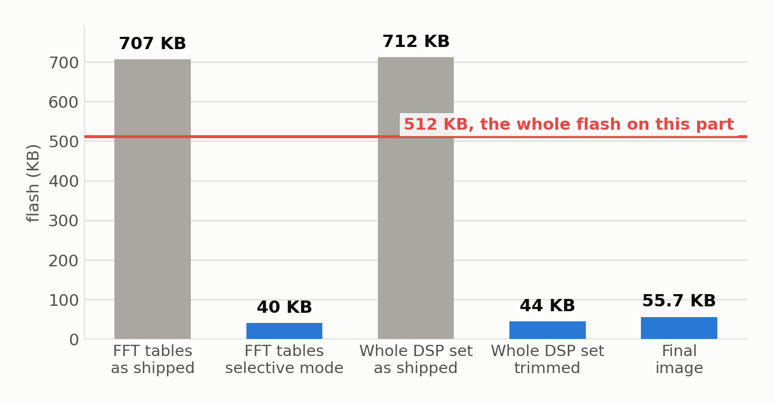
Putting it on the microcontroller
The FFT tables alone did not fit in flash
Selective table mode names only the three tables a 4096 point real FFT needs. Final image 55.7 KB (-02), with 48 KB of FFT buffers in a separate RAM section that costs no flash.
Notes:
Good slide for showing that embedded work is largely about budgets.
CMSIS-DSP was vendored in by hand rather than added through the config tool, because the only available pack carrying it also switches on a USB device stack, a USB core and an AI application, all competing for the RAM the capture buffers need.
Then the size problem: compiled whole, the tables file is 707 KB, larger than the entire 512 KB flash. It holds twiddle and bit-reversal tables for every FFT length and data type, and the generic initializer references all of them, so the linker cannot drop any. Naming only the three tables actually needed took it to 40 KB.
Timing estimate is about 10 ms of FFT work per 32 ms frame at 96 MHz, so roughly 3x headroom.

Slide 19
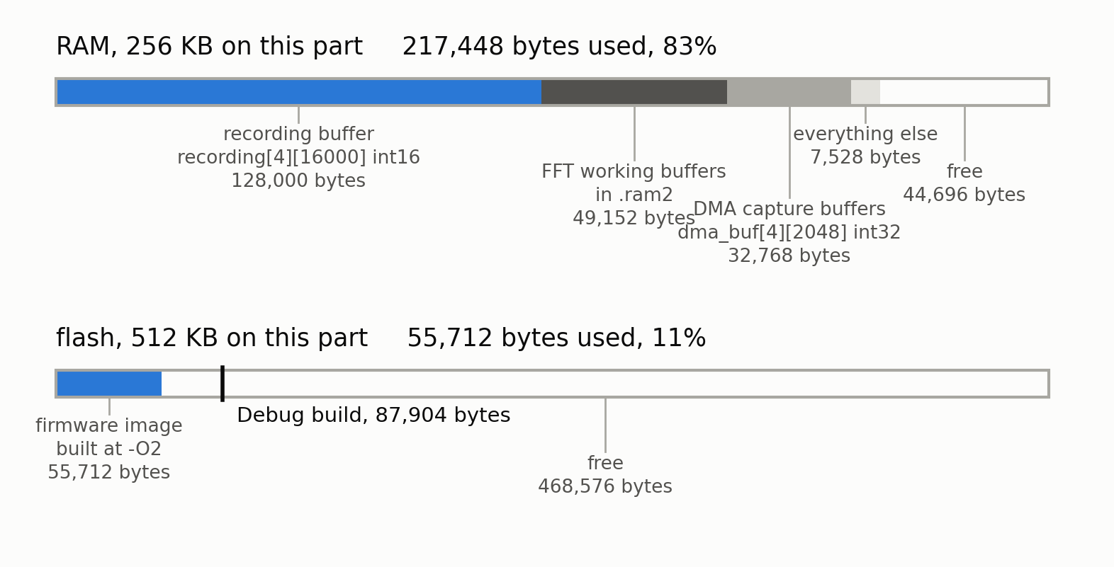
The budget that left
Where the 512 KB of flash and 256 KB of RAM went
Bytes as the toolchain reports them. The two capture buffers alone are 96% of .bss.
RECORD_SECS is 1 because of this figure, not by preference.

Slide 20
Where the 398 ms actually goes
Stage | Cycles | Time | Share
find_clap | 8,677,046 | 90.4 ms | 22%
GCC-PHAT, all six pairs | 29,526,954 | 307.6 ms | 77%
Fit and triangle residual | 2,312 | 0.024 ms | 0%
Total | 38,206,623 | 398.0 ms | 100%

Slide 21
What is not done
• Accuracy is bounded not by the array
the angles come from hand-placed floor marks
• One room, one sitting, one distance
nothing tests whether 1.11 deg survives a different environment
• Nothing is wireless, and there is one node
multi-node needs inter-node time sync, a hard problem itself
• Claps only, one second at a time
no continuous operation, no speech, no battery
• Elevation is unreachable with a planar array
a source above the plane cannot be told from its mirror below

Slide 22
Backup
for questions

Slide 23
Backup: why GCC-PHAT and not plain cross correlation
• Plain cross correlation is dominated by whatever frequencies are loudest
• A clap is broadband but very uneven, and a room colours it further
• PHAT divides out the magnitude and keeps only phase
• That gives a sharp correlation peak instead of a broad one
• Peak is then interpolated for sub-sample resolution
Cost: PHAT is noisier at low SNR, since it trusts quiet frequencies as much as loud ones

Slide 24
Backup: the signal chain
• PDM mic at 2.4 MHz, one bit per clock
• DFSDM sinc3 filter, oversampling ratio 150, gives 16 kHz
• Each 32-bit filter result is shifted right by 8 to make int16 PCM
• DMA in circular ping-pong halves, so capture never stops to copy
• All four channels drained as ONE aligned frame

Slide 25
Backup: why the array is planar
• Four mics in a plane give BEARING only, not elevation
• A source above the plane is indistinguishable from its mirror below
• Elevation would need a non-planar layout, for example a tetrahedron
• For a node on a ceiling or a wall, bearing in the plane may be enough

