Slide 1



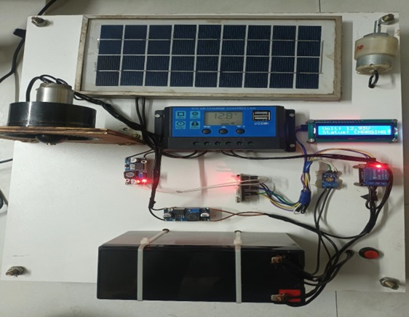
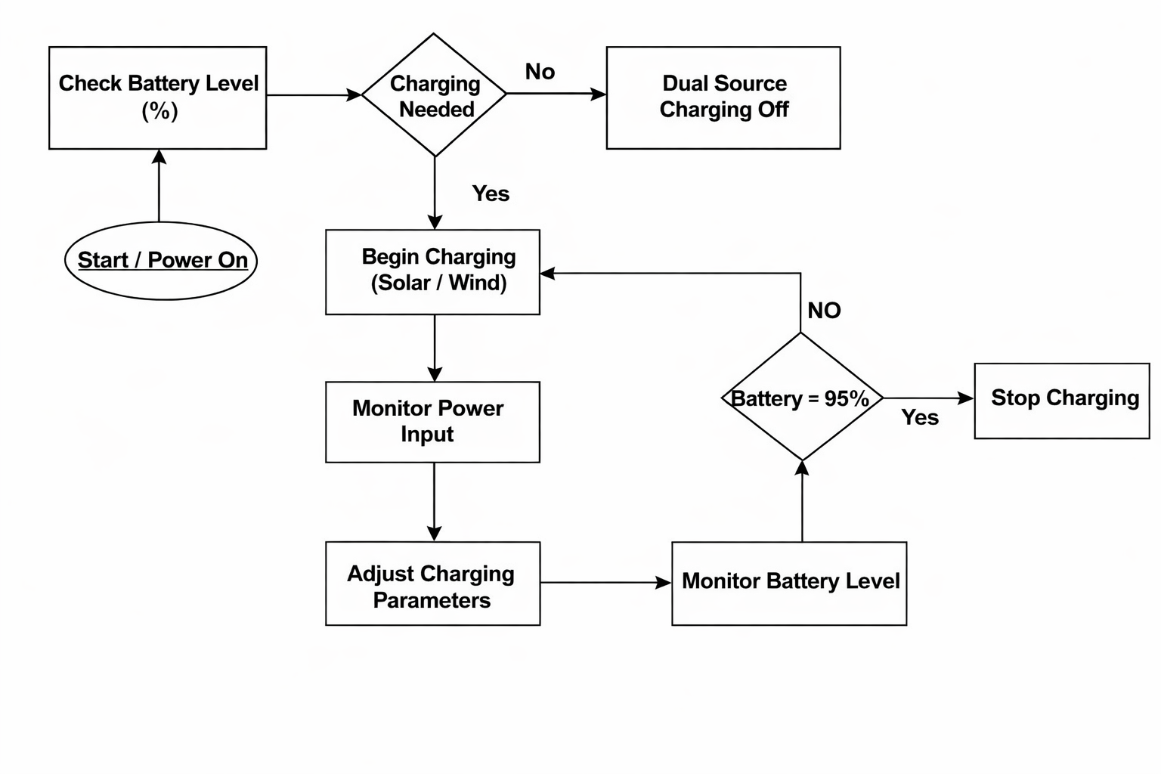
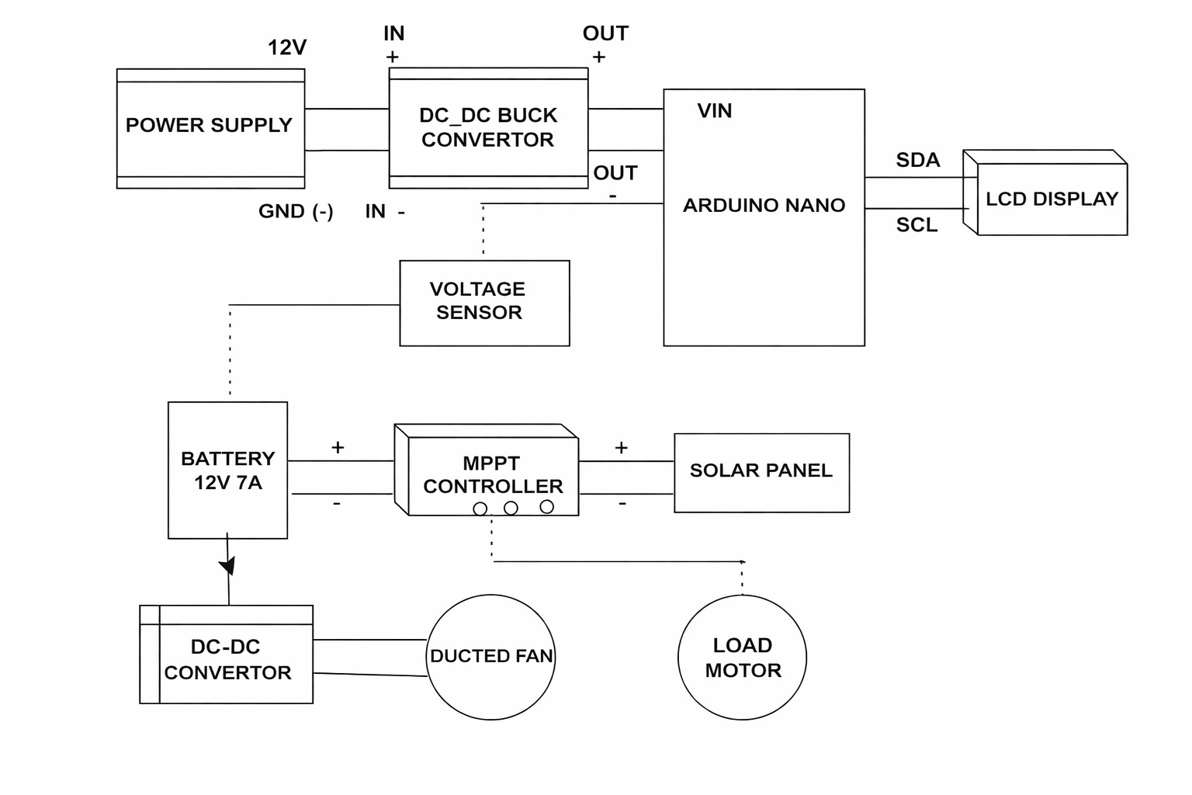
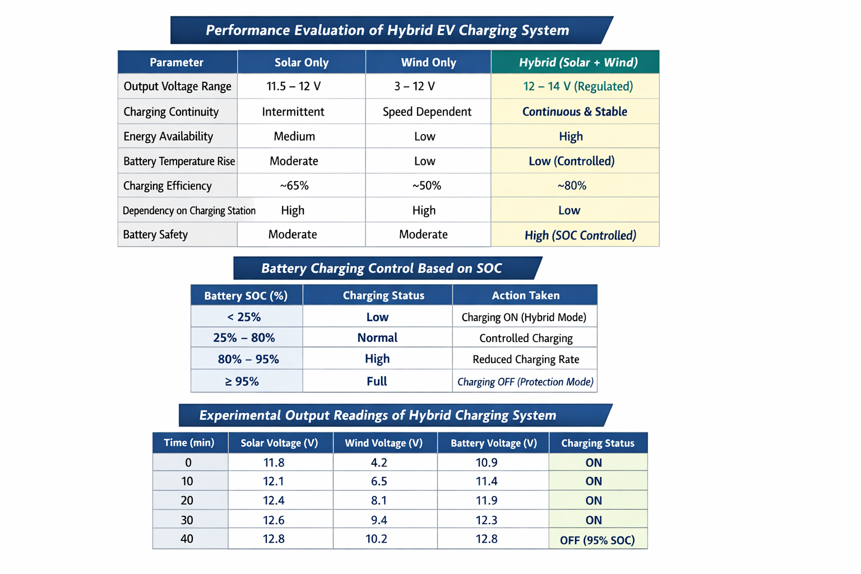
Hybrid Photovoltaic and Ducted Energy Integration for Dynamic EV Charging
Department of Artificial Intelligence and Data Science
School of Computing
10214AD701-MAJOR PROJECT 1
WINTER SEMESTER
ABSTRACT
INTRODUCTION
RESULTS
STANDARDS AND POLICIES
Electric vehicles (EV’s) are encountering situations where they lack to get a sufficient charging infrastructure, Where there is a long time to charge, and their batteries got worn out. This article suggests a hybrid renewable energy powered automatic charging system consisting of solar photovoltaic panels and ducted wind energy generation for electric vehicles.
The system allows charging on the-go by using solar energy and wind energy generated from the airflow around the vehicle. A smart micro-controller unit that controls the energy, monitors the battery voltage for charging safety, it has a normally closed contact which is operated automatically by the switch, is the control unit.
The hybrid system, as verified through real-world performance evaluations on charging continuity, battery voltage regulation, and temperature stability, lowers the dependence on fixed charging stations while ensuring battery safety.
The assessment result which is ,indicate the regulated DC output and improved charging continuity through dual-source operation, thereby reducing dependence on fixed charging infrastructure.
Key Terms : Renewable Assistance, Embedded Safety, Hybrid Charging, Power Conditioning, Self-Sustained Charging.
In an effort to reduce air pollution and cut down on the use of non-renewable fuels, electric cars (EVs) are gaining popularity day by day. However, there are some practical issues for car users to which electric vehicles are not environmentally friendly. Inadequate charging infrastructure is another problem, and also the long charge-up time. In a similar way, these obstacles can make long road trips less comfortable and may also discourage people from using EVs for short errands around town. A charging system dependent on renewable energy is a more efficient and environmentally friendly way.
We present a Combined Hybrid solar wind charging system for the mobile vehicle to absorb both sun and wind power while moving. The solar cells absorb power from the sun and the ducted fan produce energy upon motion through the air. The energy is stored in the vehicle’s battery and controlled by a microcontroller system that tracks temperature and charging status. The result is fewer charging station stops, longer battery life, and cleaner, more environmentally friendly transportation
While numerous studies have investigated electric vehicle (EV) charging using solar energy, wind energy, wireless charging, and automation, a majority of the present systems still rely on fixed charging stations. In general, solar-based charging is effective only when the vehicle is stationary , whereas standalone wind-based systems are inherently unstable due to fluctuations in wind speed and weather conditions . Furthermore, only a limited number of studies have focused on automatic on-the-go charging using a hybrid renewable energy source integrated with real-time battery safety monitoring.
The performance evaluation shows that the proposed hybrid charging system can effectively support EV battery charging using both solar and ducted wind energy. The solar panel provides a regulated 12 V DC output with energy between 15–60 W under suitable conditions, while the ducted wind turbine generates a variable DC output of 3–12 V depending on vehicle speed. The hybrid operation improves charging continuity and stability compared to single-source charging. The control system maintains safe battery voltage levels and supports continuous charging under changing conditions. These results confirm that the hybrid renewable charging system reduces dependence on fixed charging stations and improves overall charging reliability.
C++: It is a powerful, high-performance programming language that is widely used in system development, embedded applications, real-time processing, and simulation-based projects. It supports object-oriented programming, memory management, and low-level hardware interaction, which makes it suitable for building efficient algorithms and control systems. C++ can also be integrated with Machine Learning libraries and hardware-level applications where speed and optimization are critical.
Arduino Nano: It is a compact microcontroller board based on the ATmega328P that is widely used in embedded systems, automation, and IoT-based applications. It is commonly employed for sensor interfacing, motor control, power management, and real-time monitoring in engineering projects. Arduino Nano can be programmed using the Arduino IDE and easily integrated with components such as voltage sensors, temperature sensors, relays, LCD displays, and power converters, making it suitable for implementing intelligent control systems.
PROTOTYPE
FLOW CHART
ARCHITECTURE
CONCLUSIONS
This project presents a hybrid renewable energy-based automatic charging system for electric vehicles. The charging system utilizes solar photovoltaic energy and ducted wind energy as the primary source to allow for recharging while on the move. Results from an experimental evaluation of performance show that the proposed hybrid charging system is capable if maintaining battery voltage and continuous charging even with fluctuating operational conditions, which helps to reduce the degradation of batteries and increase the reliability of the overall hybrid charging system Therefore, the hybrid charging system offers a clean, practical and sustainable method of charging electric vehicles and is well suited to support eco-friendly transportation in both urban and rural environments.
METHODOLOGY
The proposed system uses a hybrid photovoltaic and ducted wind energy (HPDE) approach to charge electric vehicles while they are in motion. Solar panels mounted on the vehicle convert sunlight into electrical energy, while a ducted wind turbine generates power from airflow during vehicle movement. The outputs from both sources are processed through rectifier and voltage regulation circuits to obtain a suitable DC voltage level. These two renewable sources are then combined to provide continuous energy supply for battery charging.
A Dynamic Energy Management System (DEMS) controlled by an Arduino Nano monitors battery voltage and temperature in real time. When the battery state of charge drops below 25%, charging is automatically started to avoid deep discharge. When the battery reaches 95% state of charge, charging is stopped to prevent overcharging and thermal stress. The system also selects between solar and wind energy based on availability, ensuring stable charging under different driving and weather conditions. Battery voltage and charging status are displayed on an LCD for user monitoring, ensuring safe and reliable operation.
TEAM MEMBER DETAILS
<VTU22973/K.SESHATHRI>
<VTU21508/K.LEKHA>
<VTU21450/B.JAYANTHA SRI>
<73056 51408>
<98403 38329>
<90258 16927>
<vtu22973@veltech.edu.in>
<vtu21508@veltech.edu.in>
<vtu21450@veltech.edu.in>
Hybrid EV Charging System Analysis
SUPERVISOR
Dr. M. SAM NAVIN, B.Tech., M.Tech.,Phd., ASSISTANT PROFESSOR
+91 7639077696
samnavinm@veltech.edu.in

