Slide 1

SRINIVAS UNIVERSITY INSTITUTE OF ENGINEERING AND TECHNOLOGY
MUKKA MANGALURU- 574146
Department of Computer Science and Engineering
Major Project Final Phase Presentation
on “HealthSense: Proximity Based Alert System with Predictive AI”
Team Members:
Lekhan M 1SU20CS029
Lekhana Samudra 1SU20CS030
Mohammad Azmal 1SU20CS034
Mohammad Ali 1SU20CS038
Under The Guidance of,
Name : Prof Swarna H R
Designation: Assistant Professor

Slide 2
I N D E X
Abstract
Project Overview
Objectives
Existing Model
Literature Survey
Resources Required
Methodology
System Architecture
System Design
Flowchart
Device Working
Development Process
Implementation
Expected Outcomes
Conclusion
References

Slide 3
ABSTRACT
Our initiative utilizes IoT to remotely monitor surroundings, health, and proximity to a specific location. In case of issues like distance or health issues, our system sends discreet alerts, especially during emergencies. Information is securely stored in a database, analyzed by advanced programs to predict future scenarios. We aim to create an adaptable, user-friendly, affordable, and energy-efficient device to cater to diverse needs.

Slide 4
PROJECT OVERVIEW
HealthSense is a handheld device that can function as a smart band to acquire the data we need. Based on that, we can provide assistance to the patients and take necessary measures regarding their situation. From the alert system, we receive an alert when the patient is moved from the radius.
Patient Safety Matters: In healthcare, keeping patients safe is the most important thing. So, we need better ways to watch over them.
Who We're Helping: We're creating a special device for kids, seniors, and people with disabilities who need someone to keep an eye on them.

Slide 5
Real-time Alerts: Our device is like a guardian angel. It tells us right away if someone goes too far from where they should be or if they start feeling unwell
What We Want: We want to make sure that when someone needs help, we're there on time. Our goal is to make patient care better and keep people healthy.

Slide 6
OBJECTIVES
Hospital Application:
Enhance Hospital Security: Make hospitals safer by preventing patients from disappearing while getting treatment.
Improve Patient Care: Ensure that patients who are mentally unstable always have someone looking out for them.
Prevent Baby Kidnappings: Stop bad things from happening by keeping an eye on newborn babies.
Timely Check-ups: Make sure patients get the check-ups they need, even when there aren't enough staff.

Slide 7
EXISTING MODEL
The Philips Efficia CMS200 Central Monitoring System is a sophisticated healthcare solution designed for monitoring multiple patients simultaneously within hospital facilities. With a price tag of $20,022 or ₹1,50,000.00, this centralized monitoring system delivers comprehensive data, enabling healthcare professionals to closely observe and manage the health parameters of patients. While it comes at a significant cost, its advanced capabilities make it a crucial tool in hospital settings where real-time monitoring of patients is essential.
The Motorola Baby Monitor VM36XL is a more budget-friendly option at ₹18,000.00, specifically designed for home use to monitor infants. Tailored for parents, this baby monitoring system offers a more limited set of features compared to healthcare-centric solutions. With a focus on simplicity and ease of use, the VM36XL provides peace of mind to parents by allowing them to keep a close eye on their babies within the comfort of their homes.

Slide 8
LITERATURE REVIEW SUMMARY
Khan, M.A., Ud Din, I., Kim, B.S., & Almogren, A. (2023) - "Visualization of Remote Patient Monitoring System Based on Internet of Medical Things" in Sustainability: This study focuses on the visualization of a remote patient monitoring system based on the Internet of Medical Things (IoMT). It likely discusses how IoT technology is used in healthcare to monitor patients remotely.
Hassani, S., & Dackermann, U. (2023) - "Systematic Review of Advanced Sensor Technologies for Non-Destructive Testing and Structural Health Monitoring" in Sensors: This systematic review is likely related to advanced sensor technologies used in non-destructive testing and structural health monitoring. It may provide an overview of cutting-edge sensor technologies in these fields.
Richa, Anwesha Das, Ajeet Kumar Kushwaha, Mini Sreejeth (2021) - "An IoT based Health Monitoring System using Arduino Uno" in the International Journal of Engineering Research & Technology (IJERT): This source discusses an IoT-based health monitoring system using Arduino Uno. It likely details the implementation of an IoT system for health monitoring and may describe the hardware and software used.

Slide 9
Mohit Yadav, Aditya Vardhan, Amarjeet Singh Chauhan, Dr. Sanjay Saini (2022) - "IOT BASED HEALTH MONITORING SYSTEM" in the International Journal of Creative Research Thoughts (IJCRT): This source is also related to an IoT-based health monitoring system. It may provide insights into the IoT technologies and methodologies used for health monitoring.
Ritish Khangar, Lokesh Yelne, Nikhil Mahure, Hanuman Jambulkar, Shailesh Sakhare (2022) - "IOT Based Health Monitoring System for Covid Patients Monitoring" in the International Journal of Scientific Research in Science and Technology (IJSRST): This source likely discusses an IoT-based health monitoring system specifically designed for monitoring COVID-19 patients. It may address the unique requirements and challenges posed by the pandemic.
Abdulmalek, S., Nasir, A., Jabbar, A., Almuhaya, W., Bairagi, A.K., Khan, M.A.M., & Kee, S.H. (2022) - "IoT-Based Healthcare Monitoring System towards Improving Quality Of Life: A Review" in Healthcare: This source is a review that focuses on IoT-based healthcare monitoring systems with the goal of improving the quality of life. It may provide an overview of the state of the art in IoT applications in healthcare.
Anirudh, P., Kumar, G.A.E.S., Vidyadhar, R.P., Pranav, G., & Aumar, B.A. (2023) - "Automatic Patient Monitoring and Alerting System based on IoT" in the 2023 8th International Conference on Communication and Electronics Systems (ICCES): This source appears to discuss an automatic patient monitoring and alerting system based on IoT. It may detail a specific system and its capabilities in patient monitoring and alerting.

Slide 10
LITERATURE SURVEY
PAPER TITLE AND AUTHORS | USES TECHNOLOGY | HIGHLIGHTS | LIMITATIONS
Khan et al., 2023 ("Visualization of Remote Patient Monitoring System Based on Internet of Medical Things") | - IoT - Internet of Medical Things (IoMT) - Remote Patient Monitoring | - Visualizes the use of IoT in remote patient monitoring. - Discusses IoMT applications in healthcare. | - The paper primarily focuses on visualization and lacks in-depth technical implementation details.
Hassani & Dackermann, 2023 ("Systematic Review of Advanced Sensor Technologies for Non-Destructive Testing and Structural Health Monitoring") | - Advanced Sensor Technologies - Non-Destructive Testing - Structural Health Monitoring | - Provides a systematic review of advanced sensor technologies. - Relevant for structural health monitoring. | - The paper may not directly relate to patient health monitoring and IoT.
Richa et al., 2021 ("An IoT-based Health Monitoring System using Arduino Uno") | - IoT - Arduino Uno | - Presents an IoT-based health monitoring system. - Utilizes Arduino Uno for implementation. | - Lacks information on scalability and real-world implementation. - Limited details on predictive AI.
Mohit Yadav et al., 2022 ("IoT-Based Health Monitoring System") | - IoT - Health Monitoring | - Provides insights into an IoT-based health monitoring system. | - The paper is relatively short on details and technical specifications.
Ritish Khangar et al., 2022 ("IoT-Based Health Monitoring System for Covid Patients Monitoring") | - IoT - Health Monitoring - Specific focus on Covid patients | - Focuses on health monitoring for Covid patients. | - Limited discussion on applicability to broader health monitoring scenarios.
Anirudh et al., 2023 ("Automatic Patient Monitoring and Alerting System based on IoT") | - IoT - Patient Monitoring | - Discusses an automatic patient monitoring and alerting system. | - The paper might lack a comprehensive analysis of the predictive AI component.

Slide 11
RESOURCES REQUIRED
Hardware
ESP32 microcontrollers SpO2 and heart rate sensors Accelerometer module Temperature and humidity sensors Bluetooth modules Power supply components PCs, iOS, or Android devices for monitoring
Software
Python programming language ESP32 development environment Firebase for data storage Database management software Integrated development environment (IDE) for coding

Slide 12
METHODOLOGY
1. Hardware Components:
- ESP32: Utilized as a Wi-Fi module.
- DHT11: Functions as a temperature and humidity sensor.
- MAX30102: Used for SpO2 (blood oxygen saturation) monitoring.
- ADXL345: An accelerometer for motion sensing.
2. Backend Database:
- Firebase: Real-time database that allows you to store and sync data in real-time across all connected devices. It eliminates the need for manual data syncing and ensures that all updates are automatically reflected in real-time.

Slide 13
3. Software Development:
- Android Studio : The development environment for creating the Android application.
4. Development Tool:
- Arduino IDE 1.8.15: Used for programming and uploading code to the microcontrollers.

Slide 14
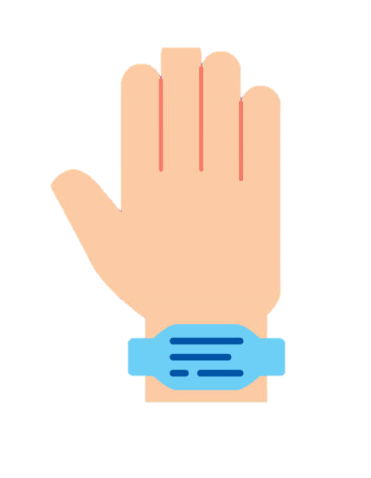
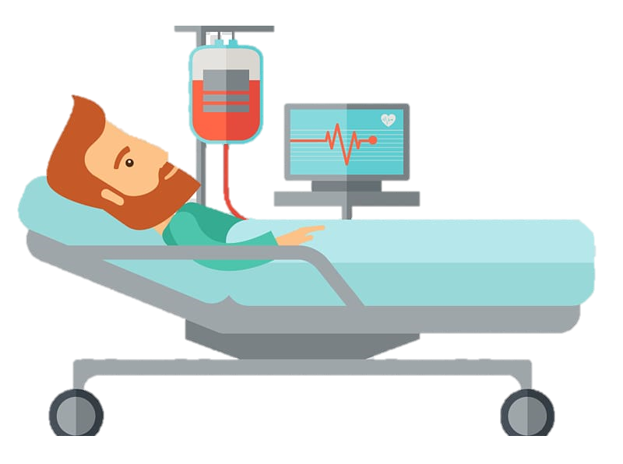

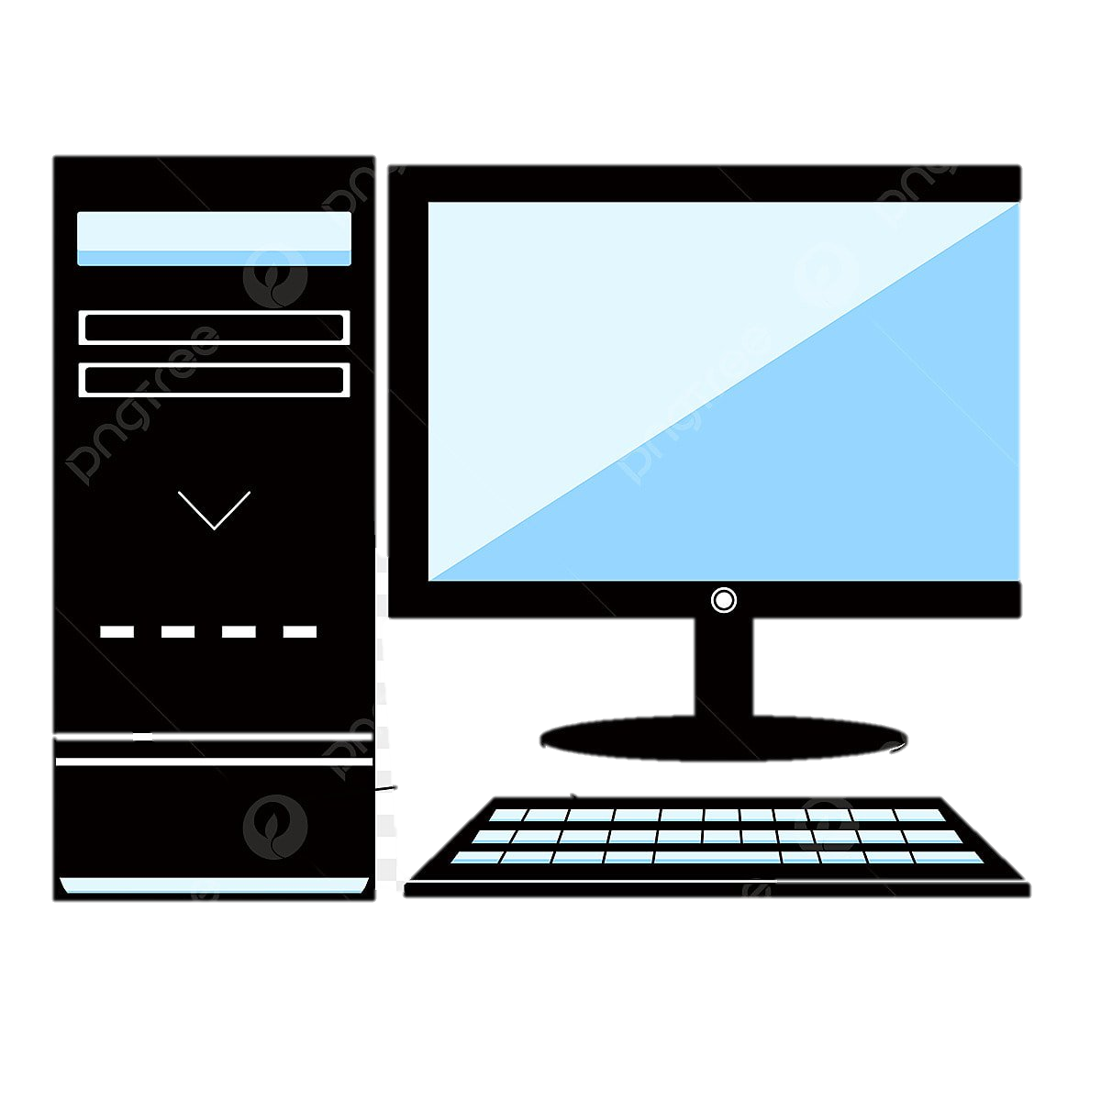
DEVICE WORKING
Device with Patient
Device Placed by Supervisor
Wireless Communication Technologies
Data Stored
Data Transfer
Data Transfer
Monitoring Device

Slide 15
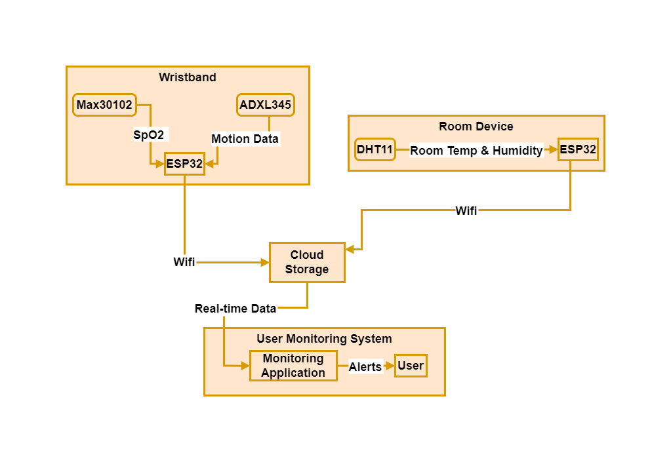
SYSTEM ARCHITECTURE

Slide 16
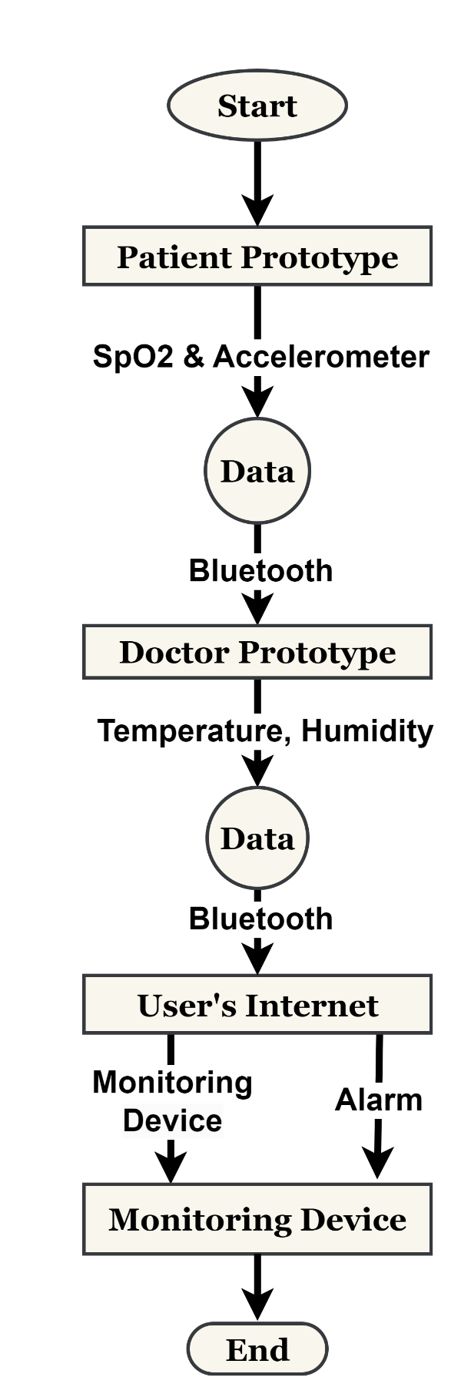
FLOWCHART

Slide 17
DEVELOPMENT PROCESS
A) MONITORS :
• Sp02
• Body Temperature
• Room Temperature
• Room Humidity
• Motion
B) ALERTS :When Person under surveillance
• Moves above the set distance.
• Sp02 /Body Temperature is undesirable.
• Room Temperature /Room Humidity is undesirable.
• Motion ( For necessary Observations).
C) COLLECTS :Data for Observation and Analysis

Slide 18
WORKING
STEP 1:Supervisor sets the Parameters and Distance for the person under observation.
STEP 2:Pairs the Bluetooth in module B.
STEP 3:Ties the Module A to Patient's hand.
STEP 4:Module B is kept within the range.
STEP 5:Monitoring Starts.
ALERT CASES
CASE 1: Moves above the set distance .
CASE 2: Sp02 /Body Temperature is undesirable.
CASE 3: Room Temperature 'Room Humidity is undesirable.
CASE 4: Motion ( For necessary Observations).

Slide 19
IMPLEMENTATION
The HealthSense project combines hardware and software components to enable comprehensive health monitoring and management. Sense Band, a wearable wristband, integrates sensors such as ESP32 for Bluetooth connectivity, MAX30102 for SpO2 monitoring, and ADXL345 for motion detection. This device continuously collects vital health data, including blood oxygen levels, and activity levels. Sense Hud, acting as a stable monitoring unit, houses an ESP32 and a DHT11 sensor for room temperature and humidity monitoring, providing environmental context to the patient's health data.

Slide 20
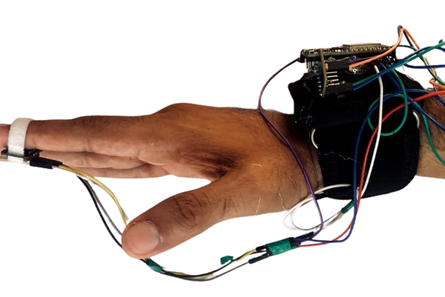
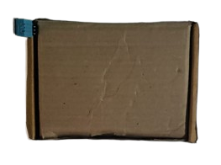
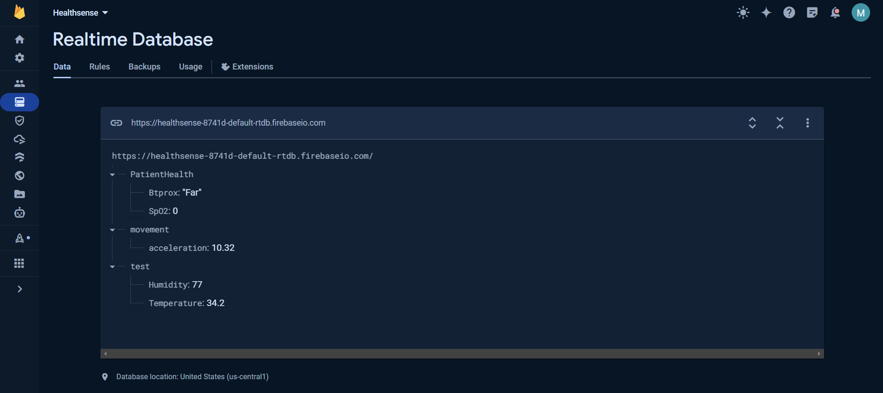
SENSE WRIST BAND
SENSE HUB
(ROOM DEVICE)
FIREBASE
REAL-TIME DATABASE

Slide 21
The data collected by Sense Band and Sense Hud are transmitted via Bluetooth to a central monitoring system, which is connected to Firebase for data storage and analysis. Firebase's cloud platform enables real-time data processing. Additionally, the system incorporates AI algorithms to analyze the data and provide personalized health insights and alerts based on predefined thresholds or patterns.
The user interface of the monitoring system allows healthcare professionals or caregivers to view detailed patient profiles, monitor vital signs in real time, track trends over time, and receive timely alerts for any abnormalities or critical events. This comprehensive approach to health monitoring and AI-driven analysis empowers proactive healthcare management, early intervention, and improved patient outcomes.

Slide 22
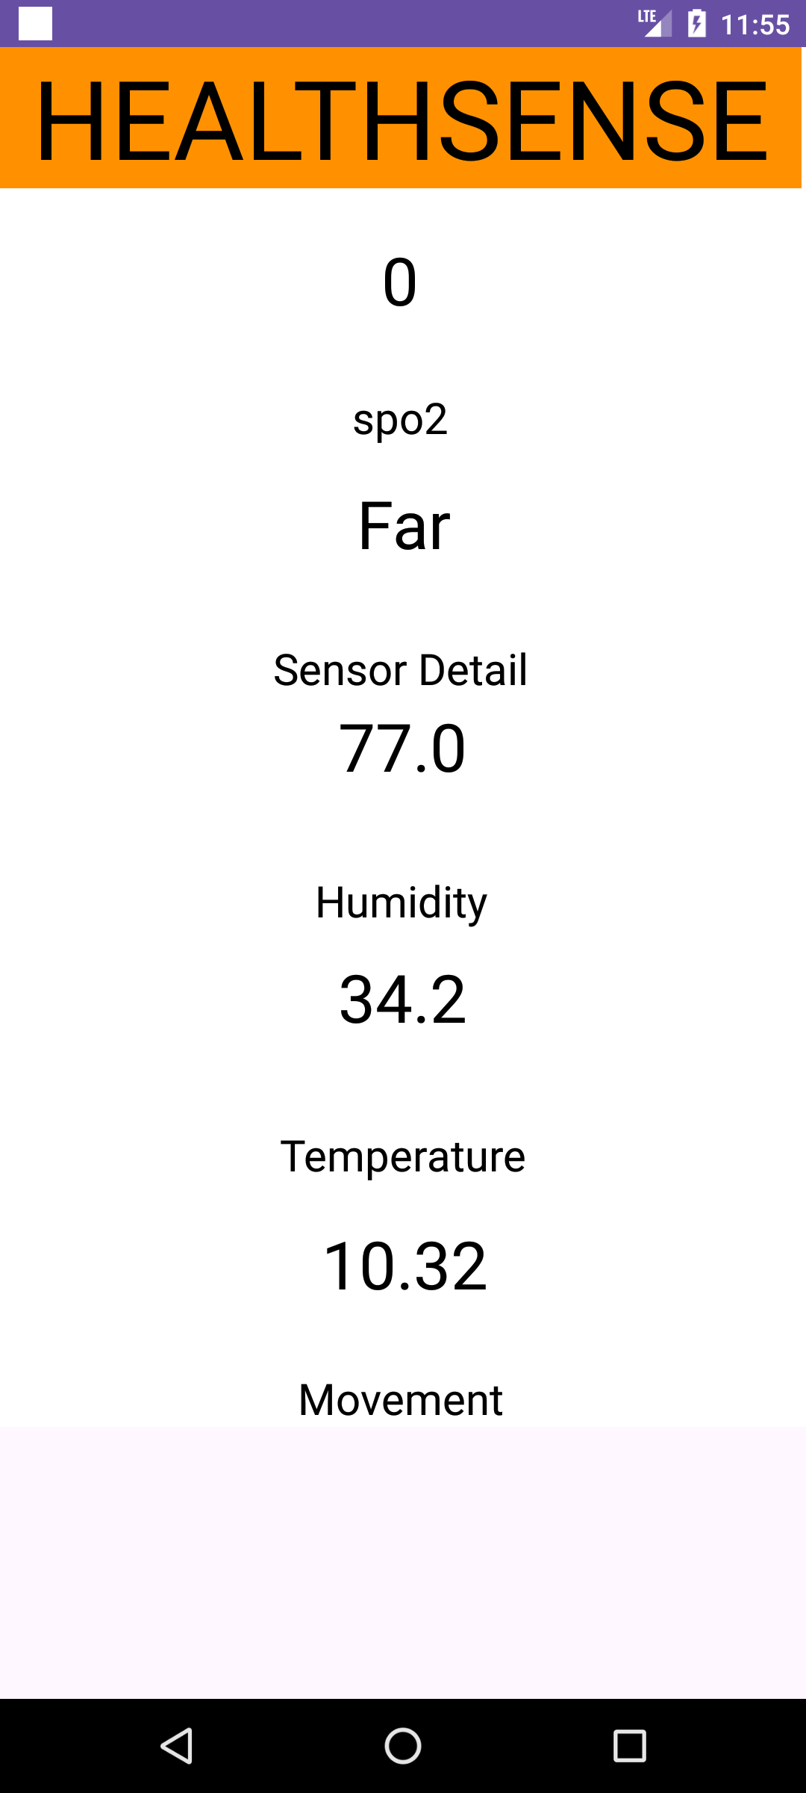
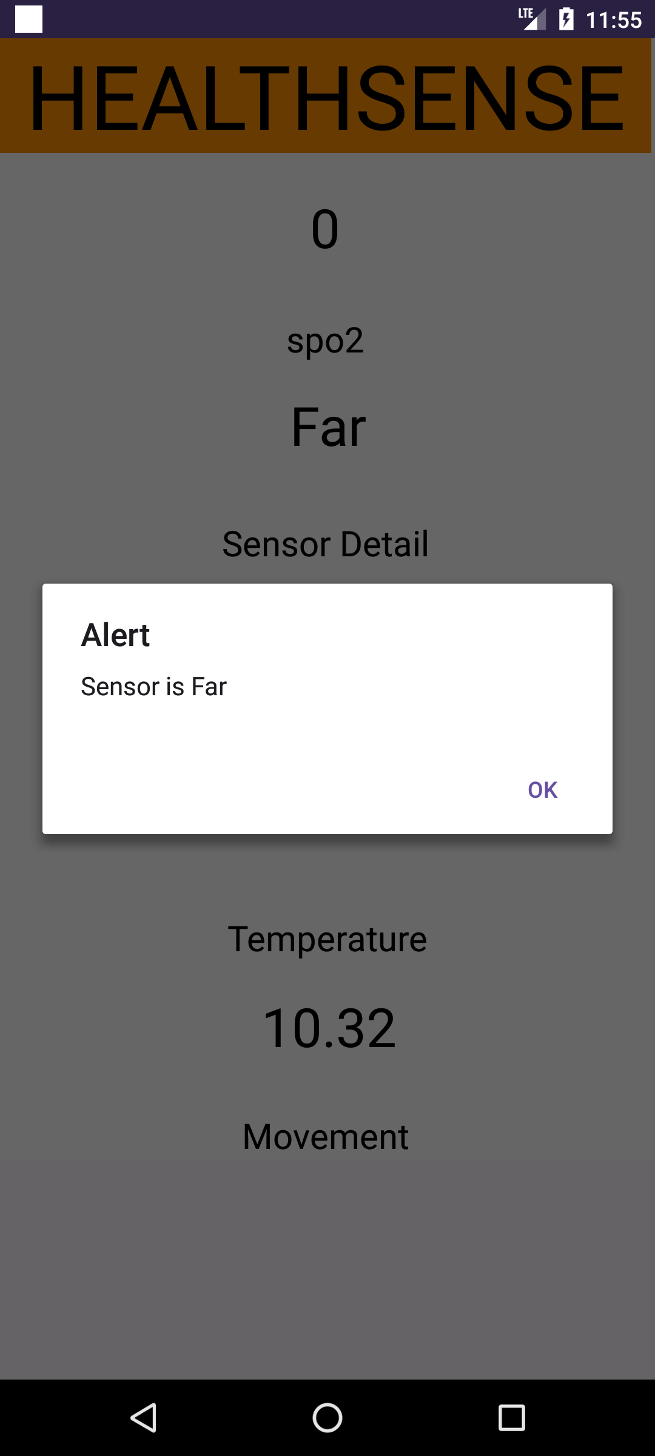
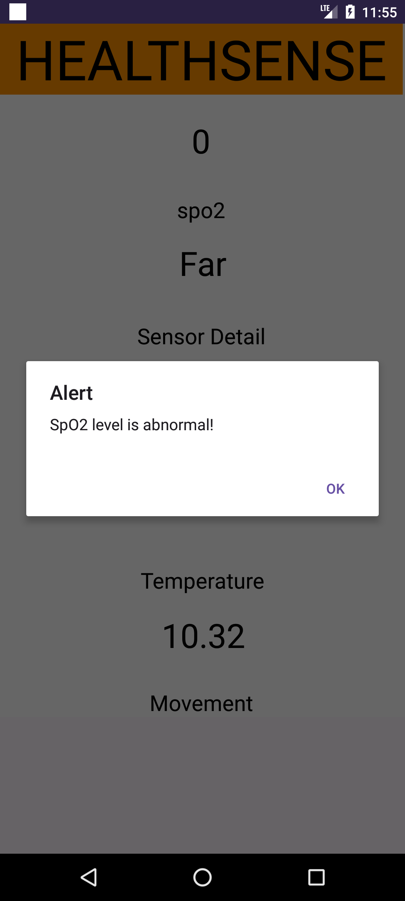
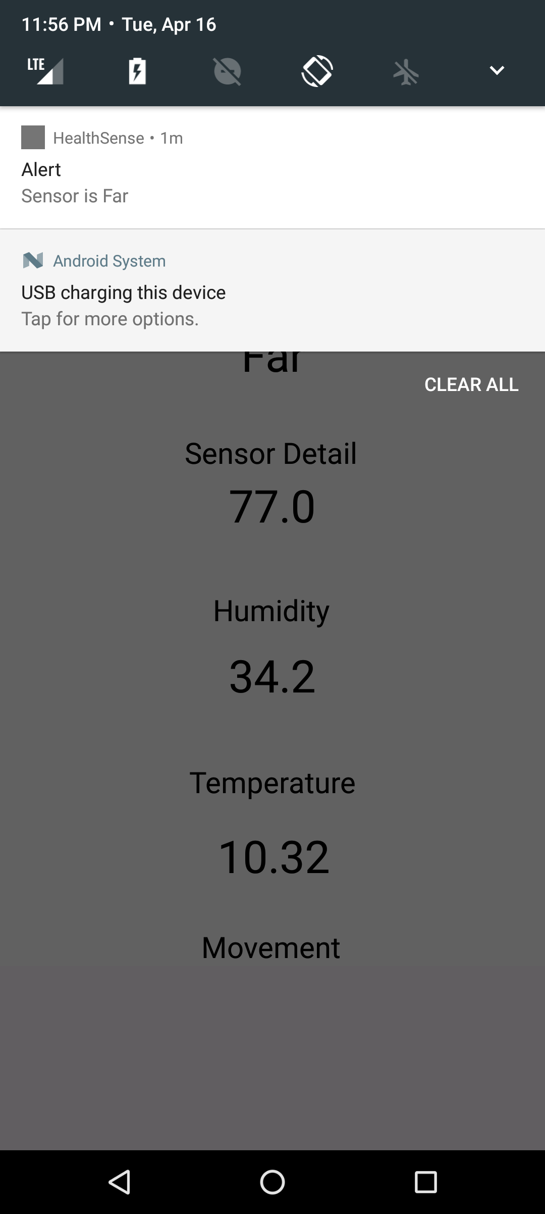
RESULTS
HEALTHSENSE CARETAKER APP

Slide 23
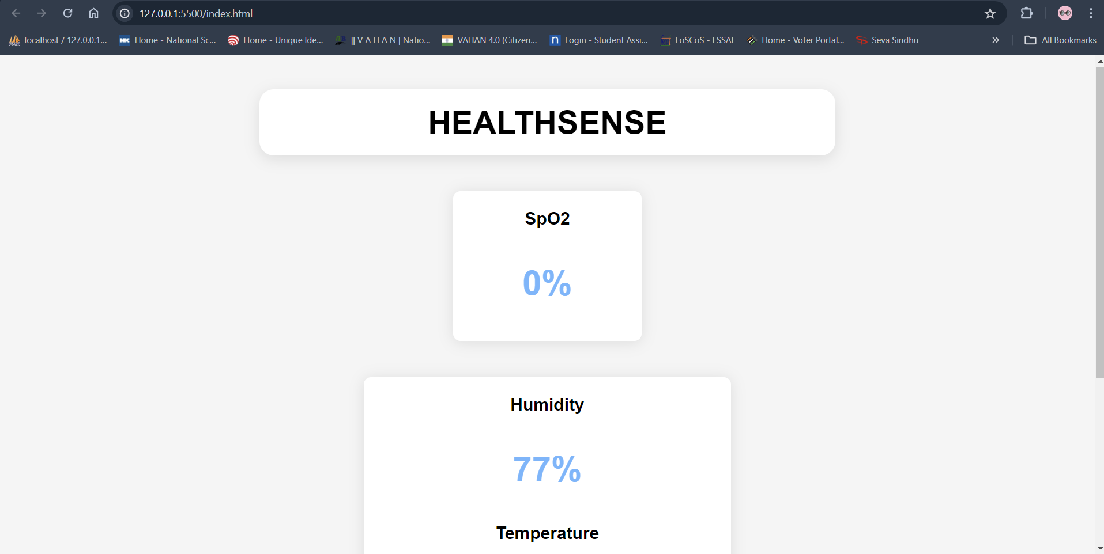
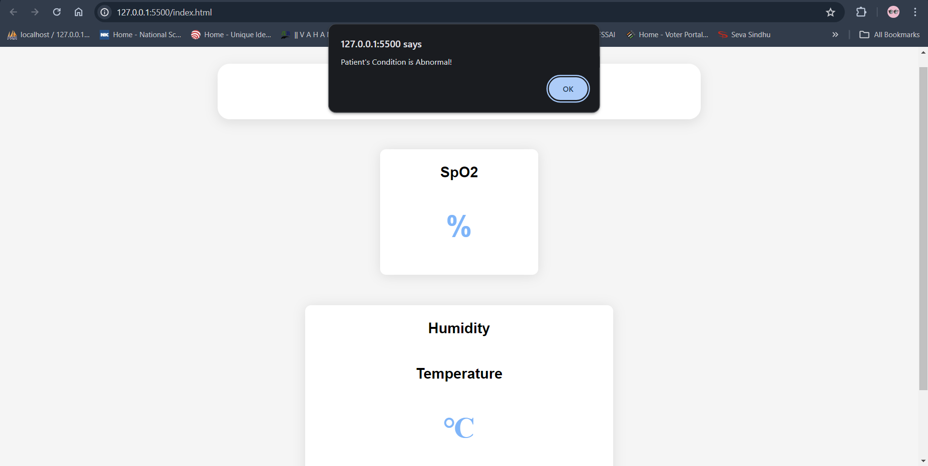
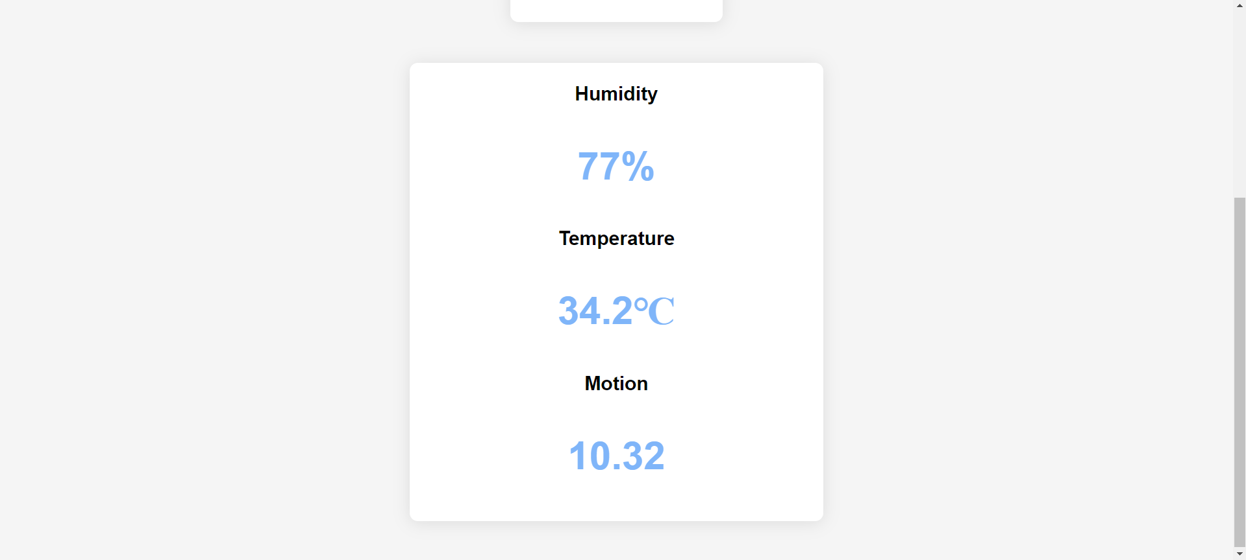
DOCTOR MONITORING SYSTEM

Slide 24
REFERENCES
Khan, M.A., Ud Din, I., Kim, B.S., & Almogren, A. (2023). "Visualization of Remote Patient Monitoring System Based on Internet of Medical Things." Sustainability, 15(10), 8120. DOI.
Hassani, S., & Dackermann, U. (2023). "Systematic Review of Advanced Sensor Technologies for Non-Destructive Testing and Structural Health Monitoring." Sensors, 23(4), 2204. DOI.
Richa , Anwesha Das , Ajeet Kumar Kushwaha , Mini Sreejeth, 2021, An IoT based Health Monitoring System using Arduino Uno, INTERNATIONAL JOURNAL OF ENGINEERING RESEARCH & TECHNOLOGY (IJERT) Volume 10, Issue 03 (March 2021),
Mohit Yadav,Aditya Vardhan,Amarjeet Singh Chauhan,Dr. Sanjay Saini, "IOT BASED HEALTH MONITORING SYSTEM", International Journal of Creative Research Thoughts (IJCRT), ISSN:2320-2882, Volume.10, Issue 1, pp.c708-c715, January 2022, Available at :http://www.ijcrt.org/papers/IJCRT2201306.pdf
Ritish Khangar, Lokesh Yelne, Nikhil Mahure,Hanuman Jambulkar, Shailesh Sakhare, "IOT BasedHealth Monitoring System for Covid PatientsMonitoring", International Journal of ScientificResearch in Science and Technology (IJSRST), OnlineISSN : 2395-602X, Print ISSN : 2395-6011, Volume 9Issue 3, pp. 296-299, May-June 2022. Available at doi :https://doi.org/10.32628/IJSRST229340Journal URL : https://ijsrst.com/IJSRST229340
Abdulmalek, S., Nasir, A., Jabbar, A., Almuhaya, W., Bairagi, A.K., Khan, M.A.M., & Kee, S.H. (2022). "IoT-Based Healthcare Monitoring System towards Improving Quality Of Life: A Review." Healthcare, 10. DOI.
Anirudh, P., Kumar, G.A.E.S., Vidyadhar, R.P., Pranav, G., & Aumar, B.A. (2023). "Automatic Patient Monitoring and Alerting System based on IoT." 2023 8th International Conference on Communication and Electronics Systems (ICCES). DOI.

Slide 25
CONCLUSION
In conclusion, HealthSense revolutionizes healthcare monitoring by integrating IoT and ML for real-time and predictive insights. Its adaptability across settings and focus on inclusivity promise enhanced care, accessibility, and prompt intervention. Our agile approach ensures flexibility, collaboration, and responsiveness. Together, we aim to create a brighter, safer future in healthcare.

Slide 26
THANK YOU

