Slide 1

OPERATING SYSTEM
ASSIGNMENT-1
Q-5 GROUP NO.-15
MITTA LEKHANA REDDY(IIT2019204)
SANSKAR PATRO(IIT2019205)
DHANUSH VASA(IIT2019208)
GITIKA YADAV(IIT2019219)
KODI PRAVALLIKA(IIT2019234)

Slide 2
Contents
Code
Flow Chart
Code Explanation
Example 1
Example 2
Example 3
Slide 3
Slide 4 - 6
Slide 7 - 20
Slide 21 - 24
Slide 25 - 28
Slide 29 - 30

Slide 3
Code
echo input origin directory path (1)
read FROM_DIR
if [ -z “$FROM_DIR” ];
then
echo please input origin directory
exit
fi
echo input destination directory path
read TO_DIR
if [ -z “$TO_DIR” ];
then
echo please input destination directory
exit
fi
echo input starting string (2)
read START_STR
find $FROM_DIR/ -name $START_STR\* -exec cp -i -v -t $TO_DIR/ {} +
echo -n number of files copied is: 0
find $FROM_DIR/ -name $START_STR\* | wc -l
cd $TO_DIR
Pwd

Slide 4
Flow Chart

Slide 5
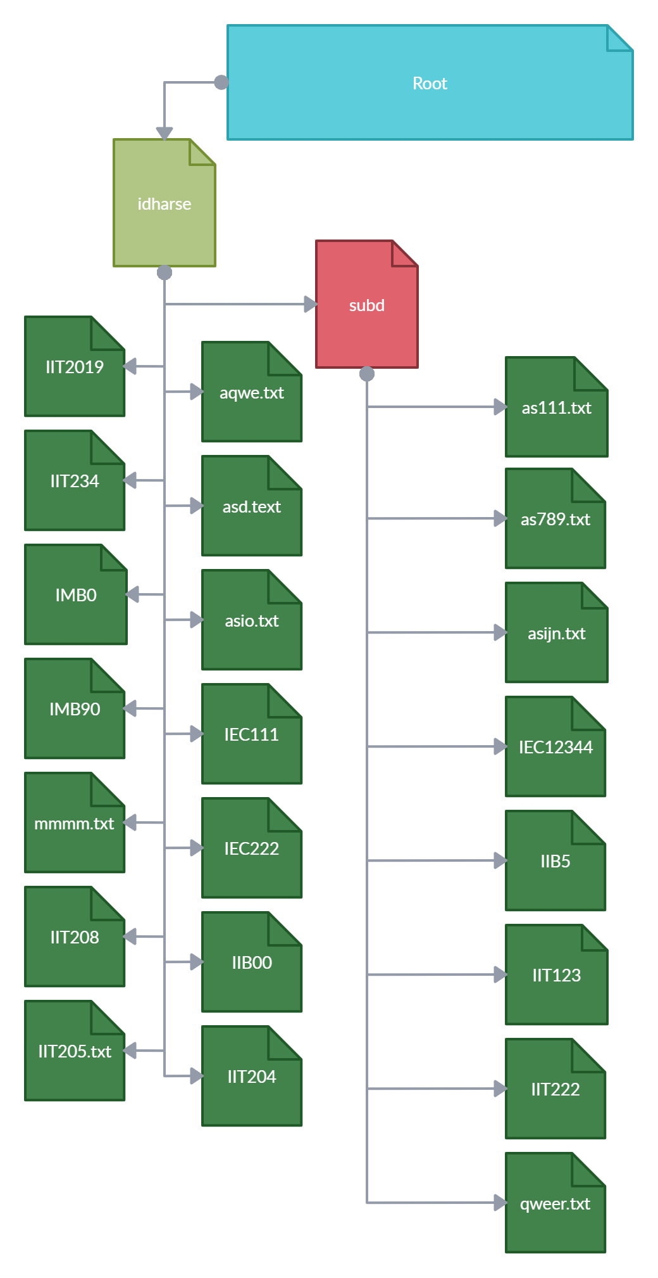
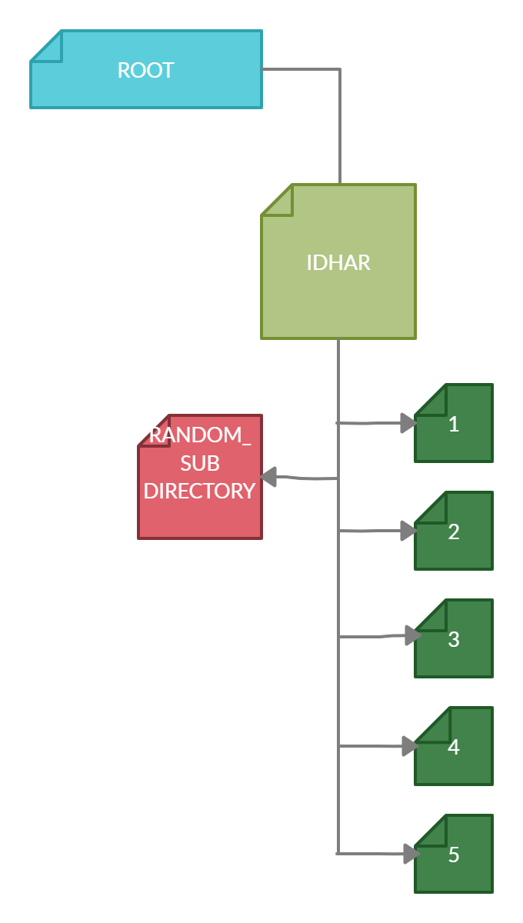
Initial state of the Source Directory and Destination Directory
Source Tree
Destination Tree

Slide 6
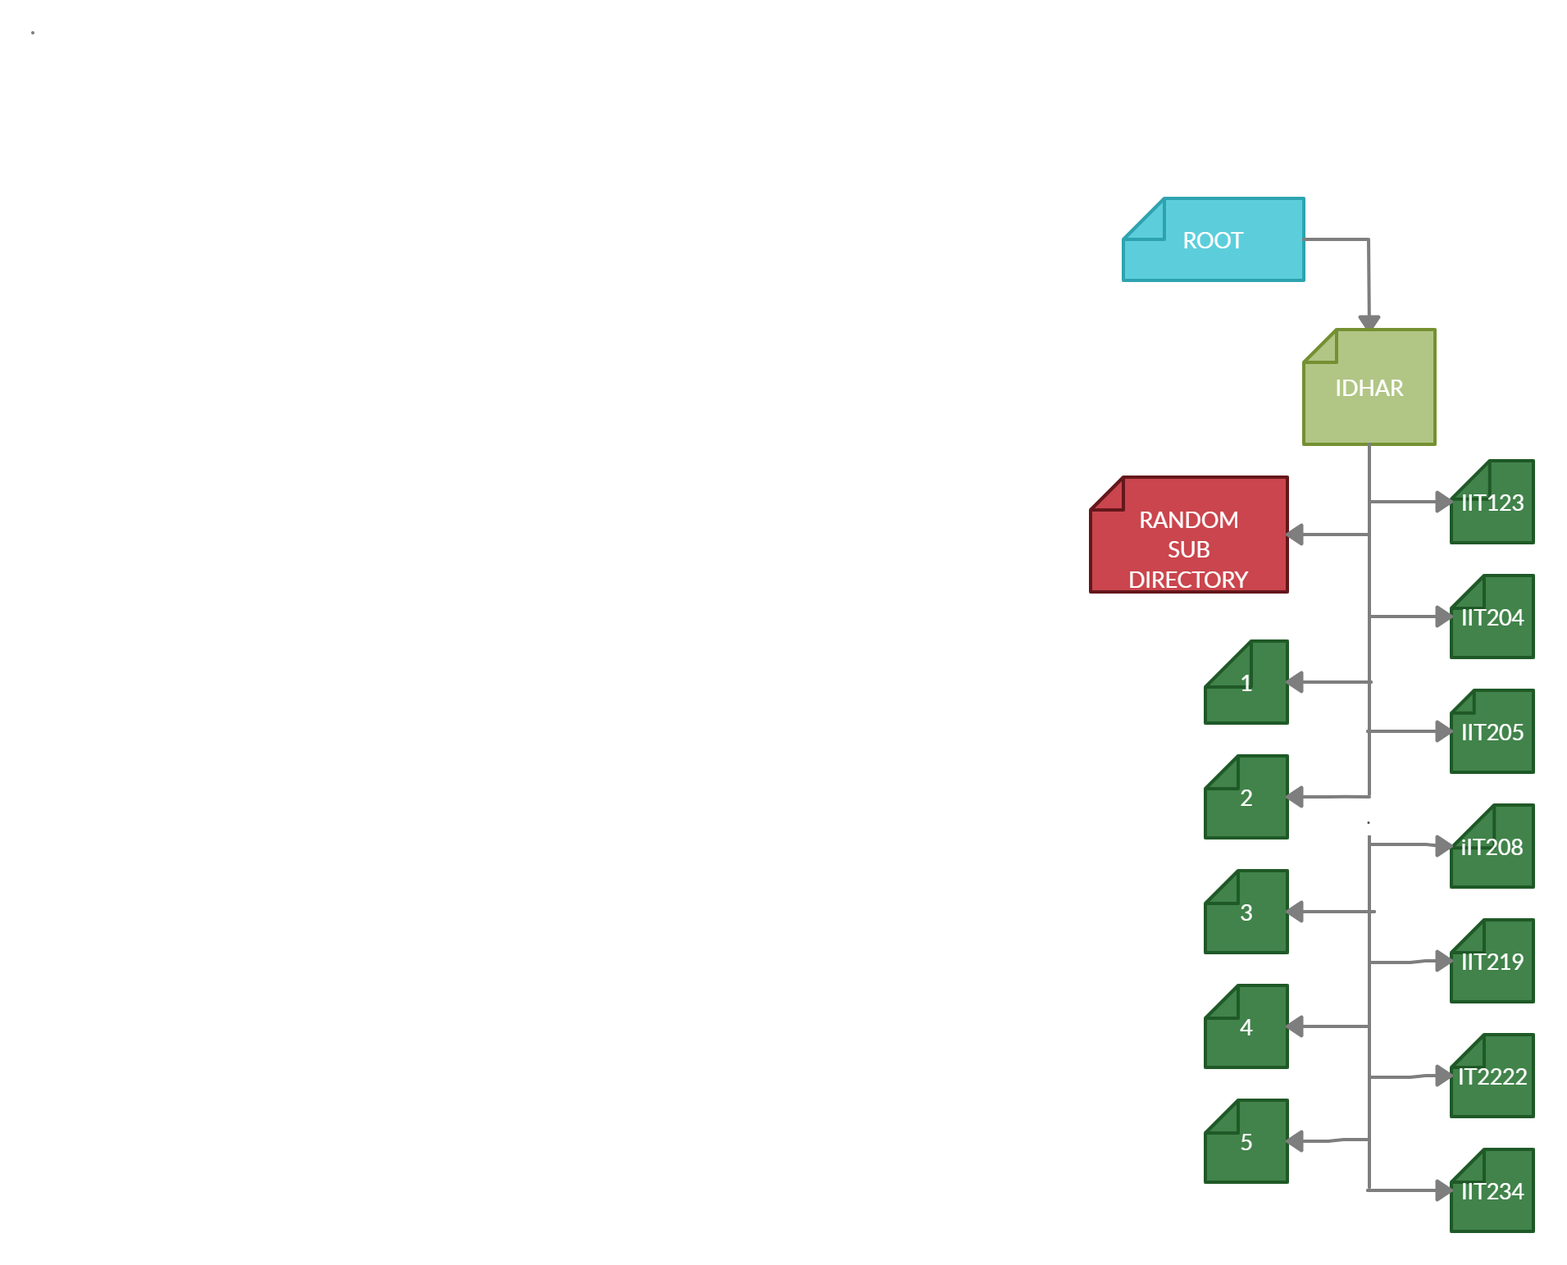
Source Tree
Destination Tree
Final state of the Source Directory and Destination Directory
find $FROM_DIR/ -name $START_STR\* -exec cp -i -v -t $TO_DIR/ {} +
Here, ‘find’ command recursively finds all files whose names start with the input string and then executes the ‘cp’ command to copy those files to the destination directory

Slide 7
Code
Explanation

Slide 8
echo and read command
-echo command is a built-in command which is used to display strings that are passed as arguments.
SYNTAX: echo [option] [string]
-read command is also a built-in command, which asks the user for an input and stores it in a variable.
SYNTAX: read variable_name
Here, it asks for the input and stores the input into variable_name.

Slide 9
Using echo and read commands
-Now, as we got to know about echo and read commands, let us use them to take input of source directory pathname/dirname and destination directory pathname/dirname.
Code:
echo input origin directory path
read FROM_DIR
Here, it prints the given argument of echo and then reads the input (source file path) and stores in FROM_DIR
echo input destination directory path
read TO_DIR
Here, it prints the argument in echo and then reads the input and stores in TO_DIR.

Slide 10
Using echo and read commands
Code:
echo input starting string
read START_STR
Here, it prints the given argument of echo and then reads the string (files that start with the given string) and stores in START_STR
echo -n number of files copied is: 0
Here,it prints the given statement of echo

Slide 11
What if the user inputs a string with length zero…
We use operator -z ,which returns true if the given string operand size is zero, else returns false.
SYNTAX: [ -z $Variable ]
Explanation: Here, after the reading the input, we store it in the Variable. Now, by using -z operator, we check whether length of the Variable is zero or not. If it is zero this command returns true, else it returns false.

Slide 12
The if...else...fi Statement
The if...else...fi statement is the fundamental control statement that allows Shell to execute statements in a controlled way and make the right choice.
SYNTAX:
if [ expression ]
then
Statement(s) to be executed if expression is true
else
Statement(s) to be executed if expression is false
fi

Slide 13
Using if loop with -z
Code:
if [ -z “$FROM_DIR” ];
then
echo please input origin directory
exit
fi
Explanation: If there is no input(input with length 0) given for the origin directory path which is stored in the variable FROM_DIR (represented as $FROM_DIR), then it displays “please input origin directory” and exits the shell. If the input length is more than zero, then it skips this control statement (because it returns false).

Slide 14
Using if loop with -z
Code:
if [ -z “$TO_DIR” ];
then
echo please input destination directory
exit
fi
Explanation:if there is no input(input length zero) given to the destination directory path that has to be stored in the variable TO_DIR(represented as $TO_DIR), then it displays “please input destination directory” and exits the shell. If the input length is more than zero, then it skips this control statement (because it returns false).

Slide 15
Other commands used in the code
find:The find command in UNIX is a command line utility for walking a file hierarchy. It can be used to find files and directories and perform subsequent operations on them. It supports searching by file, folder, name, creation date, modification date, owner and permissions
syntax:$
find [where to start searching from] [expression determines what to find] [-options] [what to find]
Options for find command:
-name: searches for the files that are specified by [WHAT TO FIND]
-exec: other UNIX commands can be executed on files or folders found.

Slide 16
Copy command (cp)
cp:
cp stands for copy. This command is used to copy files or group of files or directory. It creates an exact image of a file on a disk with different file name. cp command require at least two filenames in its arguments
Syntax:
cp [OPTION] Source Destination
cp [OPTION] Source Directory
cp [OPTION] Source-1 Source-2 Source-3 Source-n Directory

Slide 17
Options for cp command:
-i, --interactive prompt before overwrite
-t, --target-directory copy all SOURCE arguments into DIRECTORY
-v, --verbose explain what is being done
wc: displays the number of lines, words, and bytes contained in each input file
SYNTAX:
wc [OPTION]... [FILE]...

Slide 18
Options for wc command:
-l: With this option wc command displays two-columnar output, 1st column shows number of lines present in a file and 2nd itself represent the file name
cd:
Current directory: It is used to change current working directory.
Syntax: $ cd [directory]
pwd: It prints the path of the working directory, starting from the root.
Syntax: pwd

Slide 19
find $FROM_DIR/ -name $START_STR\* -exec cp -i -v -t $TO_DIR/ {} +
The find command searches for the files whose name starts with the string $START_STR from the origin directory and executes the copy command with the options -i, -v and -t on the appropriate files.
-i: If there is a file with the same name in the destination directory, it asks the user
to rewrite or skip the file.
-v: Explains what is being done while copying files.
-t: Does not copy target directory respectively, to the destination directory.

Slide 20
find $FROM_DIR/ -name $START_STR\* | wc -l
-The find command searches for the file name starting with $START_STR and executes the command wc which gives the count of files that start with the string $START_STR.
-Now, at last we go to the destination directory and print its path using cd and pwd command.
cd $TO_DIR
pwd

Slide 21
Example 1 :
Copying files starting with “IIT”

Slide 22
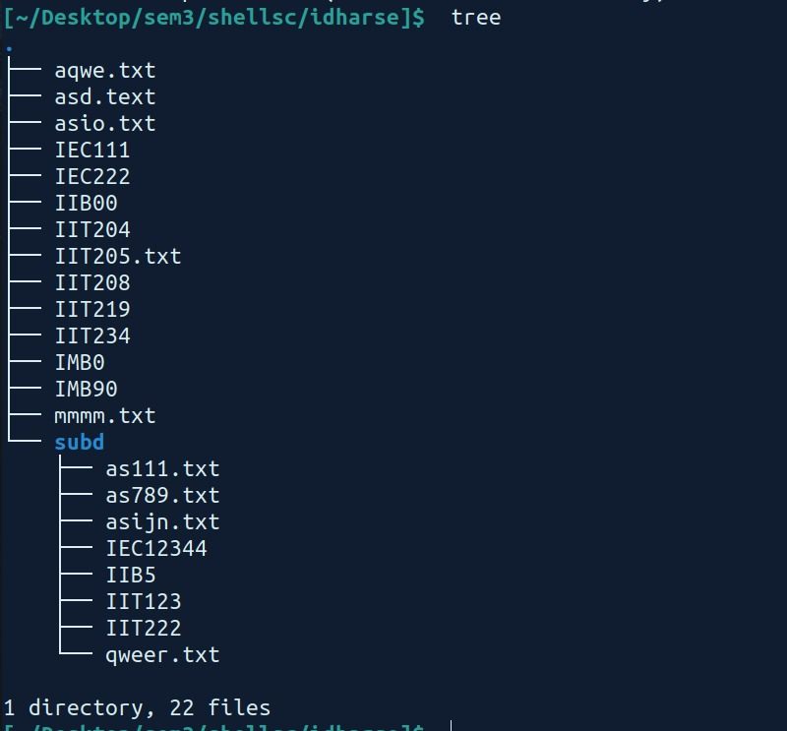
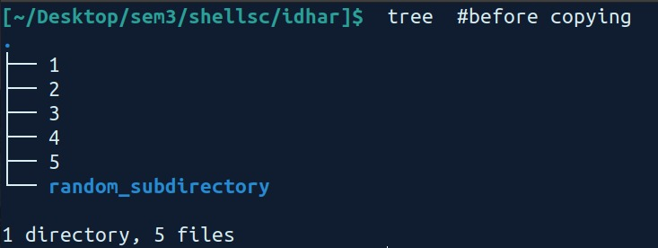
Example 1 - Initial state of Directories
Source Directory
Destination Directory - Before copying

Slide 23
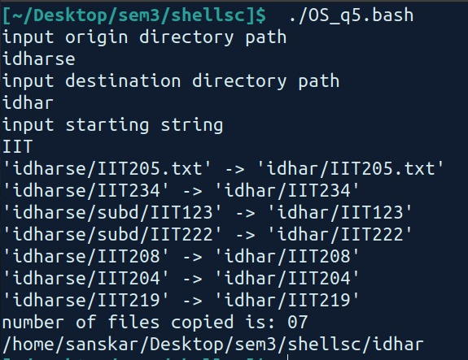
Example1:Execution of script for files starting with “IIT”

Slide 24
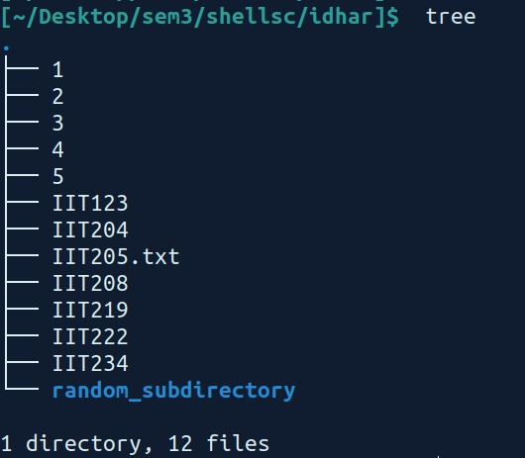
Example 1 - Final state of Directories
Source Directory
Destination Directory - After copying

Slide 25
Example 2:
Copying files starting with “IIB”

Slide 26
Example 2 - Initial state of Directories
Source Directory
Destination Directory - Before copying

Slide 27
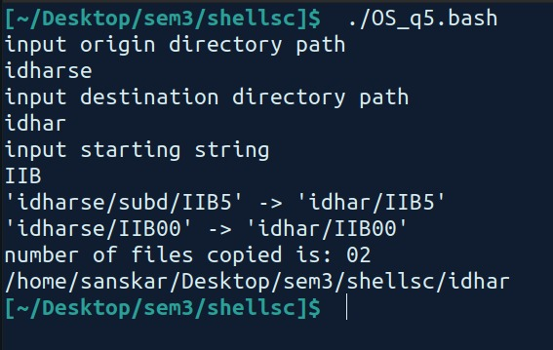
Example 2 - Execution of script for files starting with “IIB”

Slide 28
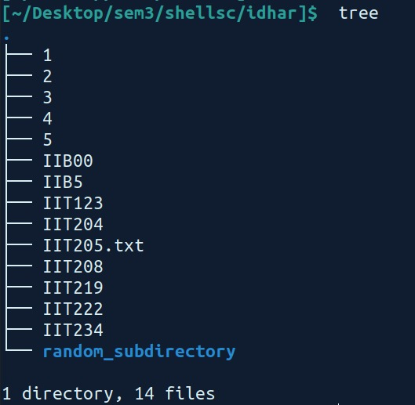
Example 2 - Final state of Directories
Source Directory
Destination Directory - Before copying

Slide 29
Example 3 -
Giving empty input

Slide 30
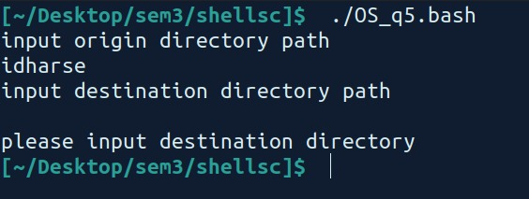
Example 3 - Giving empty input

