Slide 1
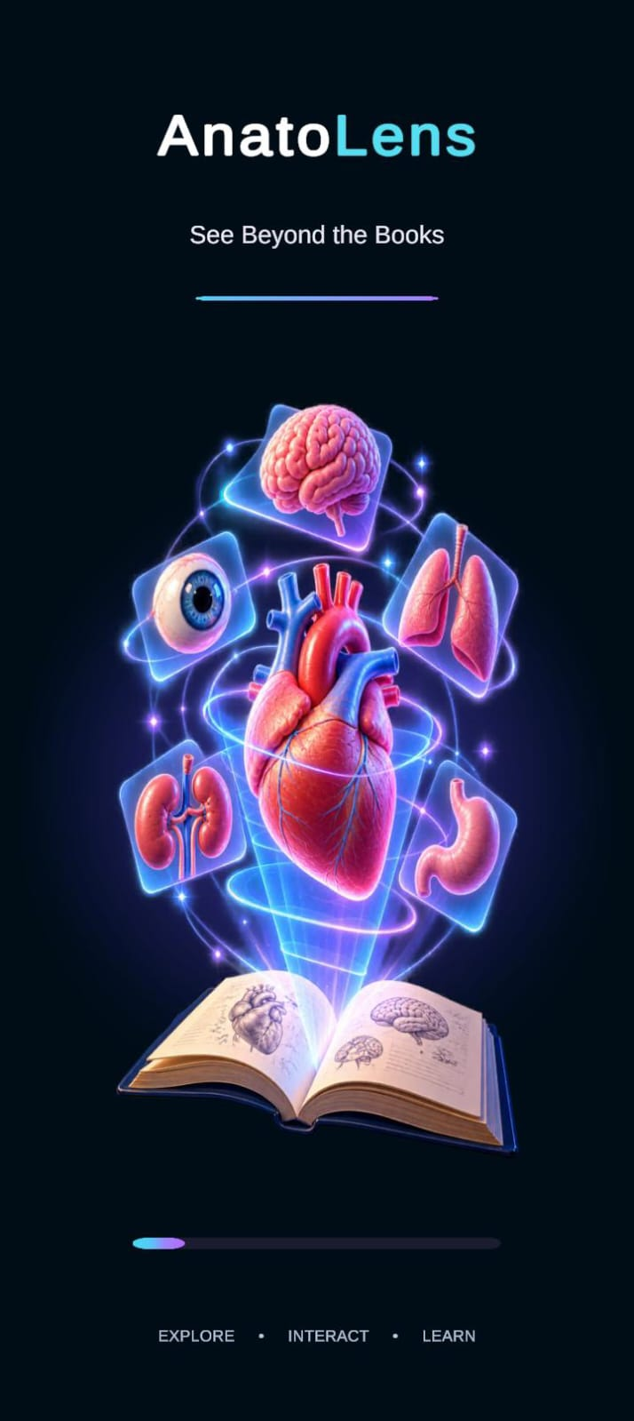
EDUCATIONAL TECHNOLOGY / AUGMENTED REALITY
ANATO
LENS
Interactive 3D Anatomy Learning
Through Augmented Reality
A Unity-based Android learning experience using registered image targets and interactive anatomical models.
Presented by [Team members]
[Department] • [College]
Project guide: [Guide name]
See Beyond the Books
Notes:
Speaker notes
Introduce AnatoLens as a student-built mobile AR anatomy viewer. The project pairs a printed or displayed registered reference image with a corresponding 3D model, then provides touch interaction and learning UI. The cover image is the supplied AnatoLens splash artwork, not a claim about a live app screen. Fill the bracketed team, department, college, and guide details before presenting.
Transition
First, a quick view of what the application does.
Suggested speaking time
35 seconds

Slide 2
ANATOLENS PROJECT SHOWCASE
A scan turns a reference into an interactive anatomy view
AnatoLens is a mobile learning prototype built in Unity for exploring selected anatomy models through image-target AR.
01
02
03
04
Learners scan one of the targets configured in the project, then rotate, zoom, reset, or fix the matched model in view. Contextual labels and organ explanations support exploration.
REGISTERED IMAGE
AR TRACKING
MODEL DISPLAY
LEARN & EXPLORE
Reference target
AR Foundation / ARCore
Mapped prefab
Touch + learning UI
Who it serves
Learning approach
Current boundary
Students and educators exploring anatomy concepts.
Spatial, visual exploration with a mobile camera.
Only targets configured in the reference library are tracked.
ANATOLENS • SEE BEYOND THE BOOKS
02
Notes:
Speaker notes
Give the audience the 30-second explanation. The app does not analyze arbitrary camera images. The marker set is preconfigured in the Unity reference image library and each supported marker maps to a prefab. The central value is being able to inspect a 3D object in a camera view, with direct controls.
Transition
The project is motivated by a visualization challenge in anatomy learning.
Suggested speaking time
40 seconds

Slide 3
ANATOLENS PROJECT SHOWCASE
The learning challenge: anatomy is spatial, while many study views are flat
Static diagrams are valuable references, but a single view can make depth, orientation, and spatial relationships harder to explore.
TRADITIONAL RESOURCE
LEARNING CHALLENGE
OPPORTUNITY
Fixed viewpoint
Spatial complexity
Need to revisit
A printed diagram presents one selected perspective.
Structures overlap and occupy depth, especially in organs and systems.
Students benefit from tools that let them inspect and revisit structures.
AnatoLens adds an interactive 3D view alongside existing learning resources.
ANATOLENS • SEE BEYOND THE BOOKS
03
Notes:
Speaker notes
Frame this respectfully: textbooks and diagrams remain important, and the application supplements them. The design opportunity is to make a structure manipulable so that a learner can change viewpoint and scale. Avoid claiming measured learning gains; the project has no user-study results in the repository.
Transition
That opportunity led to a small set of concrete development objectives.
Suggested speaking time
35 seconds

Slide 4
ANATOLENS PROJECT SHOWCASE
From a student idea to a buildable set of objectives
Motivation
01
Build an Android AR experience in Unity
Explore how mobile AR, 3D assets, and educational UI can make anatomy more engaging and spatial.
02
Map registered image targets to 3D prefabs
03
Support rotation, zoom, reset, and fixed viewing
04
Add selected labels and organ-specific explanations
PROJECT PRINCIPLE
A focused prototype with an explicit target-to-model workflow.
Explore AI chat and voice as optional assisted learning
05
ANATOLENS • SEE BEYOND THE BOOKS
04
Notes:
Speaker notes
Describe these as project objectives reflected in the implementation, not as evidence of educational outcomes. The AI/chat and voice objective is conditional: the Unity integration exists, but the service calls depend on valid credentials and network access and have not been verified during this repository review.
Transition
Here is the user journey the team implemented.
Suggested speaking time
35 seconds

Slide 5
ANATOLENS PROJECT SHOWCASE
The user journey: scan, inspect, and learn
1
2
3
4
5
6
Launch
Scan
Detect
Display
Explore
Learn
Welcome and instructions
Open AR scanner
Recognize registered target
Spawn mapped model
Rotate / zoom / reset / fix
Labels and explanation
AR tracking is gated behind the onboarding flow until the user starts scanning.
ANATOLENS • SEE BEYOND THE BOOKS
05
Notes:
Speaker notes
Walk from launch through learning. The onboarding controller creates its interface at runtime and keeps AR tracking disabled until Start Scanning. Then a reference target triggers the matching model. The learner can manipulate the model and open the learning interface. Chat and voice are optional and require external service setup.
Transition
The next diagram shows the software components that support that flow.
Suggested speaking time
40 seconds

Slide 6
ANATOLENS PROJECT SHOWCASE
System architecture: a local Unity app with image-target mapping
ANDROID DEVICE
UNITY APP
AR FOUNDATION + ARCORE
REFERENCE LIBRARY
TRACKED IMAGE SPAWNER
Camera • touch • microphone
Scene • onboarding • menu / UI
Tracked image manager
11 named image targets
Exact image-name mapping
Learning UI
Model controls
Prefab mapping
Hotspots • explanations • chat / voice
Rotate • pinch zoom • reset • fix/unlock
Image name → matching organ prefab
External service path: OpenAI Chat Completions (chat) and Whisper transcription (voice) — requires valid configuration and connectivity.
ANATOLENS • SEE BEYOND THE BOOKS
06
Notes:
Speaker notes
The active build scene is SampleScene. Its ARTrackedImageManager uses MyImages.asset and TrackedImageSpawner maps configured image names to prefabs. Touch controls and UI are in the Unity client. The project makes direct client-side OpenAI requests for chat/explanations and Whisper transcription. This is not a backend architecture; no server-side proxy was found. Do not expose API credentials in the presentation.
Transition
The stack is intentionally centered on Unity and AR Foundation.
Suggested speaking time
45 seconds

Slide 7
ANATOLENS PROJECT SHOWCASE
Technology stack verified in project configuration
UNITY
C#
AR FOUNDATION
ARCORE
2022.3.62f3
Scene, prefabs, Android app
Unity scripts
Tracking, interactions, UI logic
5.2.2
Cross-platform AR tracking API
5.2.2
Google AR runtime for Android
UNITY UI + TMP
GLTFAST
ANDROID
AI SERVICE
Scene UI / runtime UI
Controls, labels, chat, explanations
6.14.1 embedded
Imports GLB anatomy assets
Configured target
Mobile deployment target
OpenAI endpoints configured in code; active credentials and live calls not verified.
ANATOLENS • SEE BEYOND THE BOOKS
07
Notes:
Speaker notes
Versions are read from the project handoff/package manifest, not inferred from current product versions. The project embeds glTFast locally and includes a targeted Android GLES3 shader correction. ARCore is the Android runtime. AI endpoints appear in source, but the API key state is not suitable for a successful live request and no request was made during inspection.
Transition
The project has been developed as an iterative integration pipeline.
Suggested speaking time
40 seconds

Slide 8
ANATOLENS PROJECT SHOWCASE
Development process: integrate one layer at a time
01
Scope
02
Prepare
03
Configure
Organ targets + learner flow
Models, textures, reference images
Unity scene + AR library
04
Implement
05
Integrate
06
Verify
Spawner, controls, educational UI
Prefabs, mappings, Android build setup
Unity import + on-device scan checks
This is a project workflow summary; no formal Scrum/Agile cadence is claimed.
ANATOLENS • SEE BEYOND THE BOOKS
08
Notes:
Speaker notes
Describe the development stages without assigning a formal methodology that is not documented. The handoff notes explain model ingestion, marker registration, exact prefab mapping, and a recommendation to build on an ARCore Android device. The current project includes an embedded glTFast package fix, which illustrates integration work.
Transition
Next, let’s look at the most important AR behavior: how markers select models.
Suggested speaking time
35 seconds

Slide 9
ANATOLENS PROJECT SHOWCASE
Image tracking is predefined and deterministic
01
02
03
04
TARGET IMAGE
TRACKING EVENT
EXACT LOOKUP
PREFAB INSTANCE
Name stored in MyImages.asset
AR Foundation reports tracked image
Spawner matches imageName
Matching organ appears at target
What it does
What it does not do
Recognizes only reference images registered in the library.
No arbitrary-image anatomy classification or automatic image-to-3D generation.
One active build scene: Assets/Scenes/SampleScene.unity
ANATOLENS • SEE BEYOND THE BOOKS
09
Notes:
Speaker notes
A key technical distinction: ARCore image tracking is used for targets already in the reference image library. The spawner looks up a case-sensitive image name and uses an explicit prefab mapping. The app does not infer that a new arbitrary image contains a kidney or brain and does not generate a model from a picture.
Transition
The current model catalog covers 11 registered targets.
Suggested speaking time
40 seconds

Slide 10
ANATOLENS PROJECT SHOWCASE
Model catalog: 11 registered targets in the active scene
Heart
FBX
Screenshot provided
Brain
GLB
Mapping verified
Eye
GLB
Screenshot provided
Lung
FBX
Mapping verified
Kidney
FBX
Screenshot provided
Neuron
GLB
Mapping verified
Female reproductive
GLB
Labels screenshot
Digestive system
Stomach GLB
Asset scope: stomach
Plant cell
GLB
Mapping verified
Nephron
GLB
Mapping verified
Animal cell
GLB
Mapping verified
Prefab + target mappings are present in the active-scene configuration; broad device validation is not documented.
ANATOLENS • SEE BEYOND THE BOOKS
10
Notes:
Speaker notes
The list comes from the current library and the active SampleScene mappings, as documented and inspected. “Mapping verified” means project setup evidence, not a successful physical scan on each device. The digestive prefab is based on a stomach asset; don’t describe it as a complete digestive tract. Screenshots attached by the team show heart, eye, kidney, and female reproductive content.
Transition
Each spawned model shares a small set of direct manipulation controls.
Suggested speaking time
45 seconds

Slide 11
ANATOLENS PROJECT SHOWCASE
Model controls keep exploration direct
ROTATE
ZOOM
One-finger drag
TouchRotate
Two-finger pinch
PinchZoom
RESET
FIX / UNLOCK
Restore authored start pose
ResetHeart class; historical name
Detach from tracked image; reattach on unlock
TrackedImageSpawner + ScreenLockFollower
Zoom limits are controller-scale multipliers; the current documented range is 0.5×–2.0×.
ANATOLENS • SEE BEYOND THE BOOKS
11
Notes:
Speaker notes
The code contains one-finger drag rotation, two-finger pinch zoom, reset to the controller’s starting rotation and scale, and fix/unlock placement. Fixing detaches the visible model from the tracked image and follows the camera; unlocking reparents it to the image. These are code-verified features. The submitted images show AR output and controls, but this review did not run Unity on a phone.
Transition
Some models also expose numbered anatomy hotspots.
Suggested speaking time
40 seconds

Slide 12
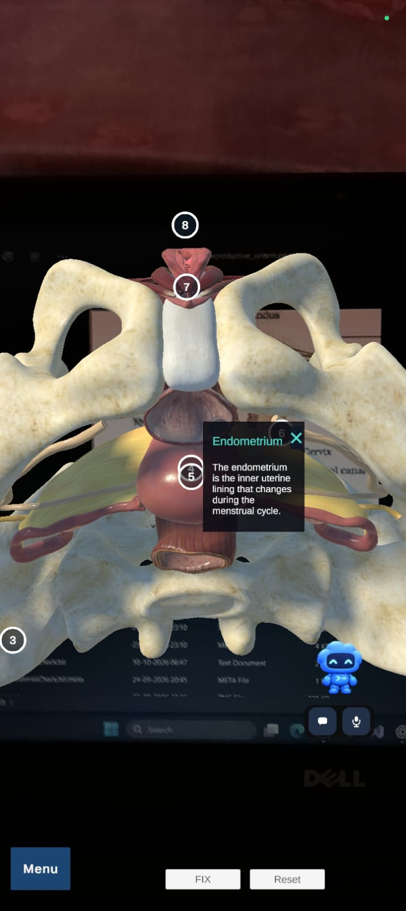
ANATOLENS PROJECT SHOWCASE
Numbered labels are available on selected models
Label support in code
Heart
Heart structures from configured hotspot data
Brain
Seven regions: lobes, cerebellum, brainstem, cerebrum
Neuron
Hotspot data and a focused dendrite view
Female reproductive system
Hotspots with descriptions
Other catalog models do not currently have equivalent hotspots documented.
ANATOLENS • SEE BEYOND THE BOOKS
12
Notes:
Speaker notes
The screenshot is a real user-provided capture of the female reproductive model with numbered pins and a selected Endometrium card. The source hotspot data also supports heart, brain, and neuron. Do not generalize label coverage to all 11 models. Brain anchors and exact on-surface placement still need visual review, according to the handoff.
Transition
The explanation feature is a separate, locally authored learning panel.
Suggested speaking time
45 seconds

Slide 13
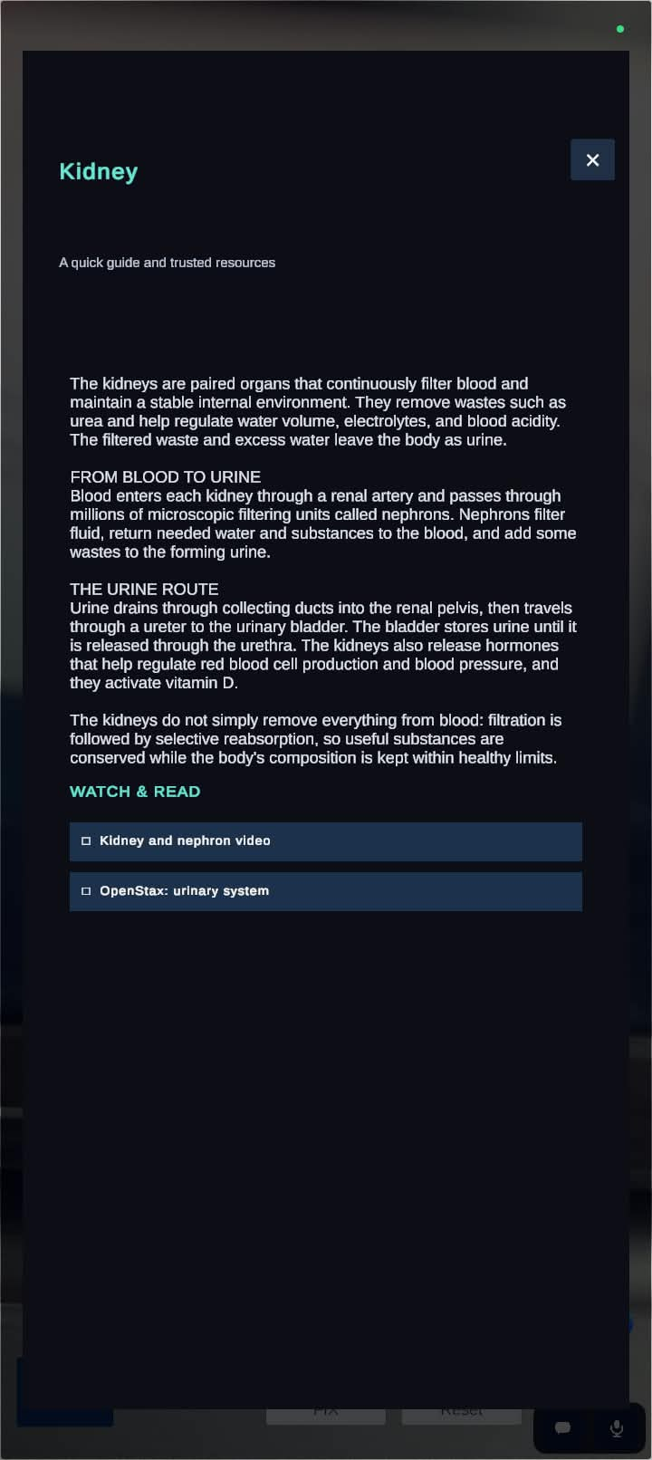
ANATOLENS PROJECT SHOWCASE
Organ explanations are local content with learning links
The explanation controller selects organ-specific content and learning resources.
Concise organ overview plus structured sections
Scrollable content panel with “Watch & Read” resources
Model context comes from the active prefab’s organ identity
This panel is local static content; it does not need an AI response
EXAMPLE CAPTURE: KIDNEY
ANATOLENS • SEE BEYOND THE BOOKS
13
Notes:
Speaker notes
The screenshot shows the Kidney explanation with several paragraphs and two resource links. The current ExplanationPanelController has organ-specific entries for the model catalog. It is a locally authored panel, distinct from the AI chatbot. A model can have explanatory content even when it does not have tappable anatomical pins.
Transition
The optional chat and voice features use external AI services.
Suggested speaking time
40 seconds

Slide 14
ANATOLENS PROJECT SHOWCASE
AI chat and voice are integrated, but service-dependent
VOICE
TRANSCRIBE
CHAT
ANSWER
Android microphone
Whisper API
Chat UI + organ context
Chat Completions API
Implemented path
Needs configuration
Verification status
Chat uses current-organ context; voice transcription feeds chat.
Valid service credentials, internet, and Android microphone permission.
Live service success was not tested; no credentials are included here.
Security note: client-embedded API keys are exposed in project/build files; use a server-side proxy before public distribution.
ANATOLENS • SEE BEYOND THE BOOKS
14
Notes:
Speaker notes
The chat client calls OpenAI Chat Completions using the active organ as context. Voice records on Android, requests Whisper transcription, then sends the resulting text into chat. Both integrations are visible in source. The handoff notes state that current configured key values do not match the expected format, which means a working live request cannot be assumed. Do not show or copy the key values. A client APK cannot securely hide a secret; a backend proxy is future security work.
Transition
The user-facing experience starts with a short onboarding flow.
Suggested speaking time
45 seconds

Slide 15
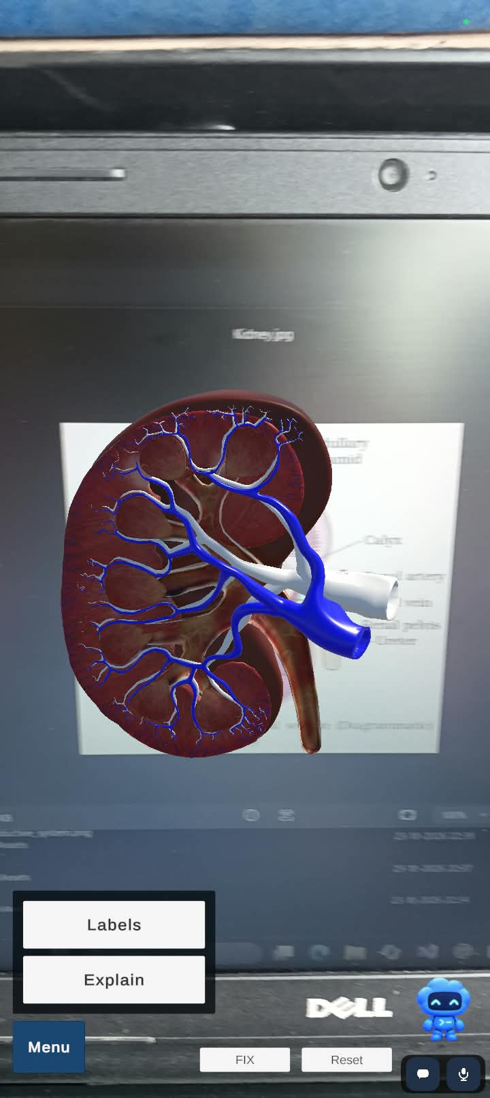
ANATOLENS PROJECT SHOWCASE
Onboarding and AR interface guide the learner
SUPPLIED ONBOARDING ART
APP CAPTURE • KIDNEY + MENU
APP CAPTURE • EXPLANATION
ANATOLENS • SEE BEYOND THE BOOKS
15
Notes:
Speaker notes
The splash visual is supplied onboarding artwork. The other images are user-provided app captures that show a kidney model with labels/explain menu and the explanation panel. The onboarding itself is generated at runtime by WelcomeScreenController; the screenshot of the splash artwork should not be presented as a capture of every onboarding step.
Transition
This sequence provides a clear live-demo path.
Suggested speaking time
35 seconds

Slide 16
ANATOLENS PROJECT SHOWCASE
Suggested live demo: follow the model from target to learning
01
Show the registered target
Use the corresponding reference card.
02
Scan in the active app
Wait for tracking and the mapped prefab.
03
Explore the model
Rotate, pinch zoom, reset, then fix/unlock.
04
Open learning UI
Show labels where supported; open Explain.
05
Discuss optional AI
Only demo chat/voice if valid setup is available.
Keep the printed image at its configured size; device-based AR behavior can differ from Editor previews.
ANATOLENS • SEE BEYOND THE BOOKS
16
Notes:
Speaker notes
This is a suggested demonstration sequence based on implemented controls. Use an Android ARCore device and a matching target. If a feature has not been rehearsed on the presentation device, state that it is a project implementation and move on rather than presenting an unverified result. Chat/voice should be omitted from the live demo unless the service setup is working safely.
Transition
Behind that experience are a few reusable Unity components.
Suggested speaking time
40 seconds

Slide 17
ANATOLENS PROJECT SHOWCASE
Implementation highlights: reusable scene components
ACTIVE SCENE
REFERENCE SET
MODEL MAP
SampleScene.unity
MyImages.asset
TrackedImageSpawner
AR session, tracked image manager, spawner, UI
11 named targets and physical-size metadata
Exact imageName → prefab entries
PREFABS
CONTROLS
LEARNING
One prefab per anatomy target
TouchRotate / PinchZoom / reset bridge
AnatomyHotspotOverlay / ExplanationPanelController
Model + interaction and identity components
Shared interaction behavior
Contextual labels and content
Package note: glTFast 6.14.1 is embedded locally with a project-specific Android GLES3 shader include correction.
ANATOLENS • SEE BEYOND THE BOOKS
17
Notes:
Speaker notes
This is the implemented project structure rather than a generic Unity diagram. SampleScene is the sole enabled build scene. MyImages.asset holds the targets. TrackedImageSpawner uses exact name mappings. Prefabs encapsulate model setup. Interaction scripts are shared. The project also embeds glTFast locally because of a shader issue and targeted correction described in the handoff.
Transition
We’ll separate evidence-backed implementation from what still needs testing.
Suggested speaking time
40 seconds

Slide 18
ANATOLENS PROJECT SHOWCASE
Verification status: code evidence is not the same as device testing
Feature
Repository evidence
Status for presentation
Reference target mappings
11 configured targets; explicit active-scene mappings
Implemented; device coverage not recorded
Rotate / zoom / reset / fix
Interaction scripts and prefab references present
Implemented in code; physical-device test not recorded
Heart / Eye / Kidney output
User-provided application captures
Observed in supplied captures; not independently rerun
Labels / explanation
Hotspot and content controllers; screenshots supplied
Partial by model; not all models have labels
Chat / voice
API clients + microphone/transcription code
Configuration-dependent; live request unverified
Performance / learning outcomes
No benchmark or user-study data found
Not measured; no quantitative claims
No accuracy %, FPS, latency, user counts, or educational improvement figures are claimed.
ANATOLENS • SEE BEYOND THE BOOKS
18
Notes:
Speaker notes
This slide is deliberately conservative. The project files establish code/configuration. User-supplied captures establish that selected views were observed at some point, but this review did not rerun the app. There is no recorded benchmark, numerical image-tracking accuracy, FPS measurement, user study, or learning gain. Call external API behavior unverified until a real request is tested with safe configuration.
Transition
The captures show what the current project has looked like in use.
Suggested speaking time
45 seconds

Slide 19
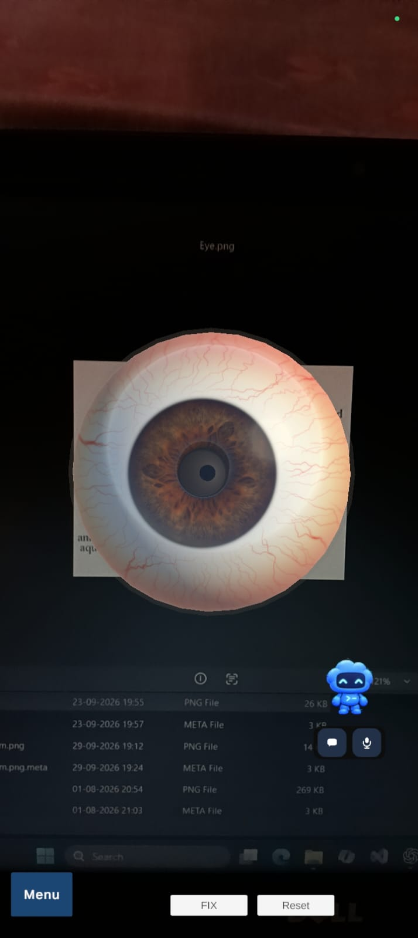
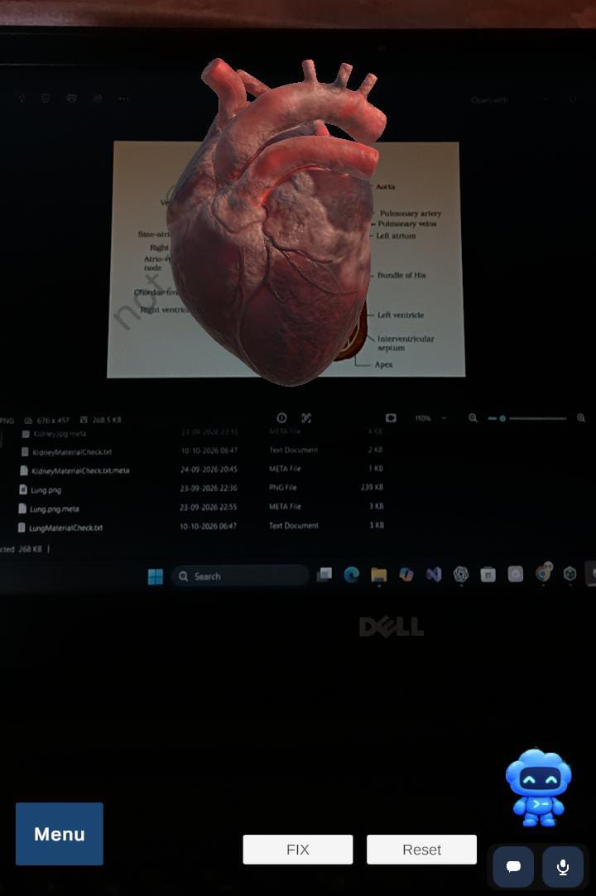
ANATOLENS PROJECT SHOWCASE
Actual application output: selected anatomy views
HEART
EYE
KIDNEY + MENU
FEMALE REPRODUCTIVE + LABEL
ANATOLENS • SEE BEYOND THE BOOKS
19
Notes:
Speaker notes
These are the four real images provided for the presentation, each showing an AnatoLens model view photographed from a display. They are not newly generated. The photos include surroundings from the capture, so explain that they document model output rather than polished in-app screenshots. They show a heart, eye, kidney with menu, and female reproductive model with labels.
Transition
The project includes a few integration challenges worth mentioning.
Suggested speaking time
40 seconds

Slide 20
ANATOLENS PROJECT SHOWCASE
Engineering challenges recorded in the project
Model scale & pose
Imported anatomy assets need per-prefab scale/orientation tuning.
Use prefab transforms and on-device review.
Tracking setup
Each marker needs a stable library entry and matching prefab map.
Use explicit names and mappings in the active scene.
GLB Android rendering
A glTFast shader include caused an Android GLES3 build issue.
Embed package and correct targeted conditional; build confirmation still pending.
Model visibility & labels
Surface pin positions and visibility vary by mesh and view.
Anchor helpers exist; visual placement review remains necessary.
Outcome claims are limited to what is documented in the repository handoff.
ANATOLENS • SEE BEYOND THE BOOKS
20
Notes:
Speaker notes
Challenges are taken from project documentation: asset scaling and pose, explicit reference mappings, Android GLB shader compatibility, and accurate hotspot placement. The shader correction is present in the package, but the project handoff explicitly says a post-correction Android build still needs confirmation. Do not overstate it as fully resolved in a tested build.
Transition
Here are the current limits and sensible next steps.
Suggested speaking time
40 seconds

Slide 21
ANATOLENS PROJECT SHOWCASE
Current boundaries define the next development steps
CURRENT LIMITS
FUTURE SCOPE
• Predefined image targets only
• Label coverage varies by model
• Physical-device checks remain incomplete
• AI features require active configuration
• Digestive prefab currently uses a stomach model
• No performance or learning-outcome measurements
• Validate every target/model on Android
• Expand labels and verify anchor placement
• Add quizzes and progress tracking
• Improve asset optimization and accessibility
• Move AI credentials behind a secure service
• Evaluate learning experience with students
Future items are proposals, not current application features.
ANATOLENS • SEE BEYOND THE BOOKS
21
Notes:
Speaker notes
Separate actual limitations from potential future work. The app is tied to a predefined image set. Labels are selective. Device testing and service integration need validation. Security should be addressed before public release because client-side API keys are extractable. Structured educational evaluation is needed before making learning-effectiveness claims.
Transition
To close, summarize what AnatoLens demonstrates today.
Suggested speaking time
45 seconds

Slide 22
ANATOLENS
AR
A mobile AR prototype for exploring registered anatomy models.
See Beyond the Books.
THANK YOU
Questions?
Team • Department • College — complete these details before presenting
Notes:
Speaker notes
Conclude with what is actually in the project: a Unity Android AR prototype with a predefined reference-image library, mapped 3D model prefabs, touch controls, selected labels and educational explanations, and optional API-dependent chat/voice. Invite questions. Add team and institution details to the cover before presenting.
Transition
Open the project for questions or a live demonstration.
Suggested speaking time
25 seconds

