Slide 1


Comprehensive Report on Nursing Homes
Subtitle: BANA 620 Data Mining Project
Date: 5/8/2024
Presented by: LEKHANA CHANDRA PALAMURI
SRI SAI MANOGNA GOLLAPALLE
NAMRATHA ETI

Slide 2
Abstract
Analyzed healthcare facility data over multiple years to evaluate financial performance.
Significant variability in gross revenue, net income, and patient revenue across different types of facilities and regions.
Focus on improving operational efficiency in facilities with lower revenues and higher costs.
Compiled data from multiple healthcare facilities to assess trends in total income, operating expenses, and net income.
Provide actionable insights for enhancing financial stability and operational effectiveness in healthcare facilities.

Slide 3

Introduction
The U.S. healthcare sector operates in a complex financial setting with different funding sources, regulatory challenges, and high costs. Financial stability is crucial for healthcare administrators to ensure quality care, address staff needs, and invest in necessary technology. This report analyzes the financial performance of over 106,000 health institutions from 2015 to 2021. It focuses on understanding the financial differences between rural and urban health facilities. The goal is to uncover factors that affect the financial health of these institutions and offer insights to help policymakers and strategists make informed decisions. This analysis is critical due to ongoing healthcare reforms and financial uncertainties brought by events like the COVID-19 pandemic.

Slide 4
Project Objectives
- To conduct a detailed analysis of financial trends affecting healthcare facilities across various regions.
- To highlight the financial discrepancies between rural and urban healthcare settings.
- To offer actionable insights and recommendations that can enhance financial strategies and operational efficiencies in healthcare facilities.

Slide 5
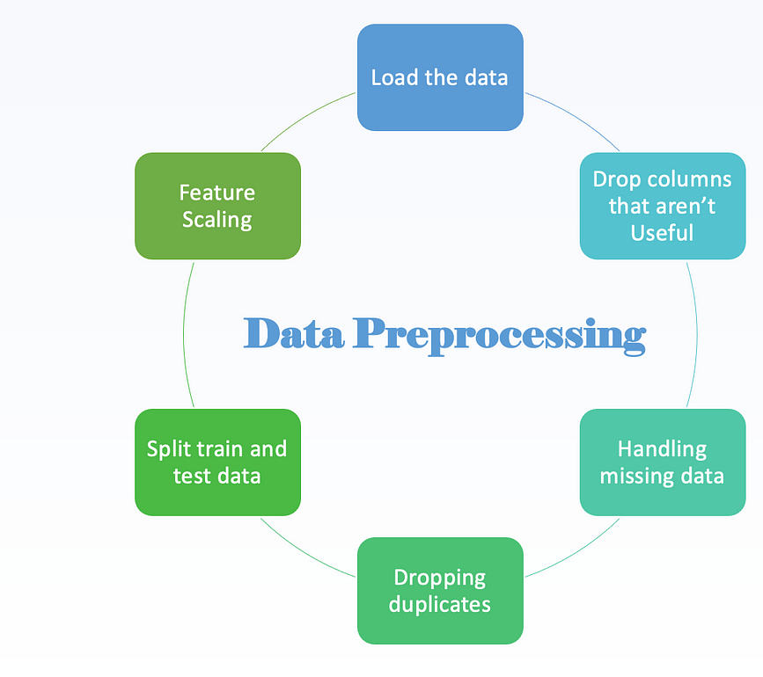
Methodology

Slide 6
Preprocessing Steps
Datasets: Using the panda module, the study simple merging cost report datasets from several years into a single data frame with a new column called "Year".
Managing Missing Values: Any columns with more than 50% missing values will be deleted from analysis, as will the occurrence in which those values are absent.
Duplicate Columns: After the dataset was cleaned, any two columns containing the Identical information was found and eliminated.

Slide 7
Analysis and Findings
The analysis of the healthcare facility data focused on several key areas, including financial performance, operational metrics, and regional differences. The use of statistical and machine learning techniques provided insights that are essential for strategic planning and operational improvements.
Revenue and Expense Analysis
Significant differences in gross revenue and net income across regions and facility types.
Fluctuations in net income highlight the need for robust financial management.
Operational Efficiency
Larger facilities have stabilized revenues but also higher expenses.
Operational efficiency directly correlates with profitability; more efficient facilities are more profitable.

Slide 8
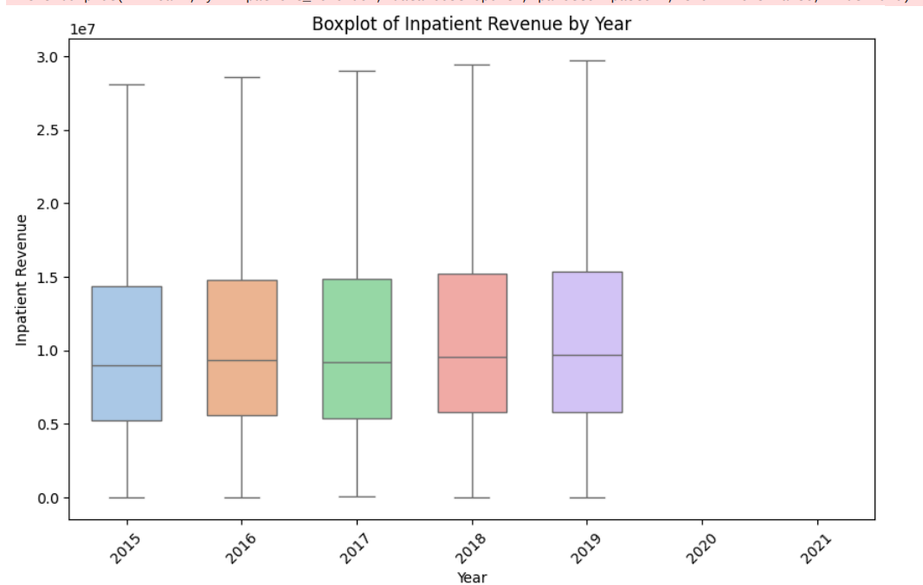
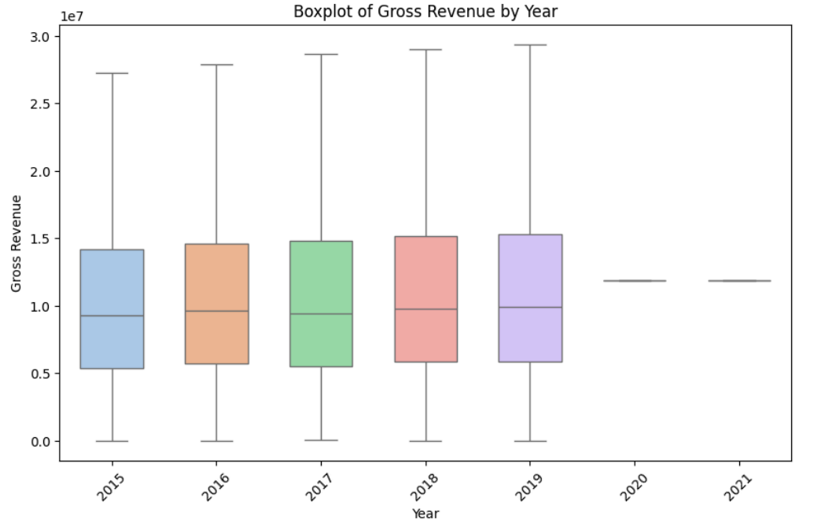
plot shows the distribution and variation of gross revenue across different years, helping to identify trends or significant changes in revenue generation.
graph illustrates the fluctuations in inpatient revenue over the years, which can be crucial for analyzing operational effectiveness.

Slide 9
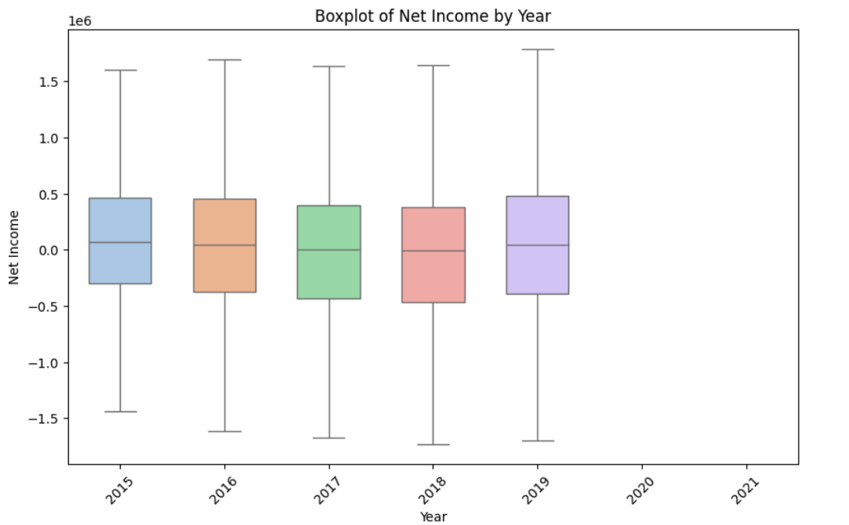
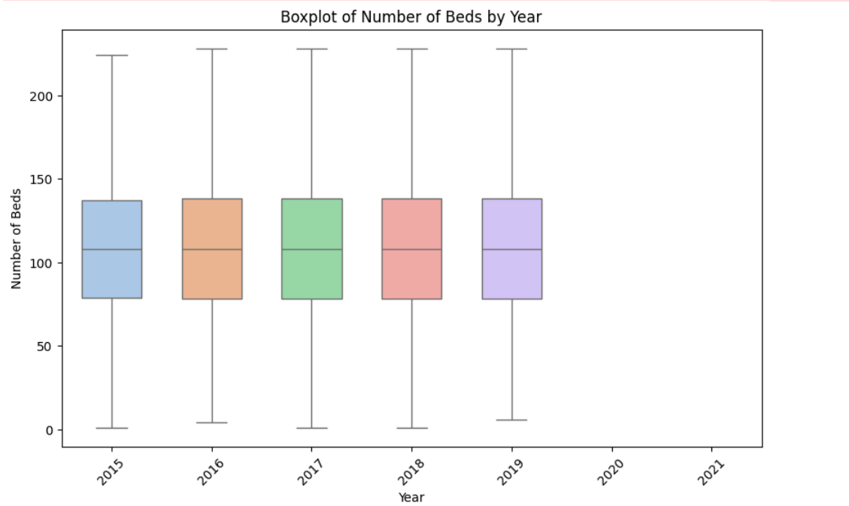
the net income plot highlights the financial health of facilities year-over-year, pointing out years with unusual profits or losses.
this visual depicts the changes in the number of beds available, indicating capacity expansions or reductions over time.

Slide 10
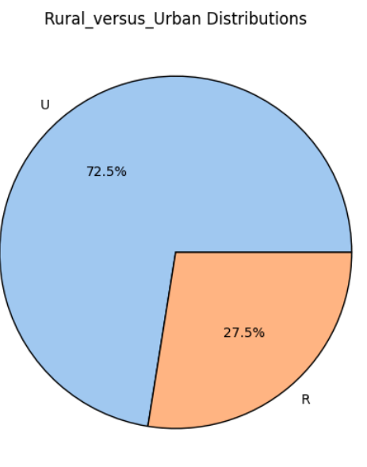
Urban Facilities (U): Represented in blue, making up 72.5% of the total. This shows that the majority of the healthcare facilities in the dataset are located in urban areas. Rural Facilities (R): Shown in orange, comprising 27.5% of the total. This indicates a smaller proportion of facilities are located in rural areas.

Slide 11
Decision Tree and Random Forest Models: Used to predict financial outcomes based on operational metrics, with a predictive accuracy of around 68.23% for decision trees and 74.93% for random forests.
Logistic Regression: Utilized to understand the influence of various features on the likelihood of a facility being profitable, achieving an accuracy of 72.55%.

Slide 12
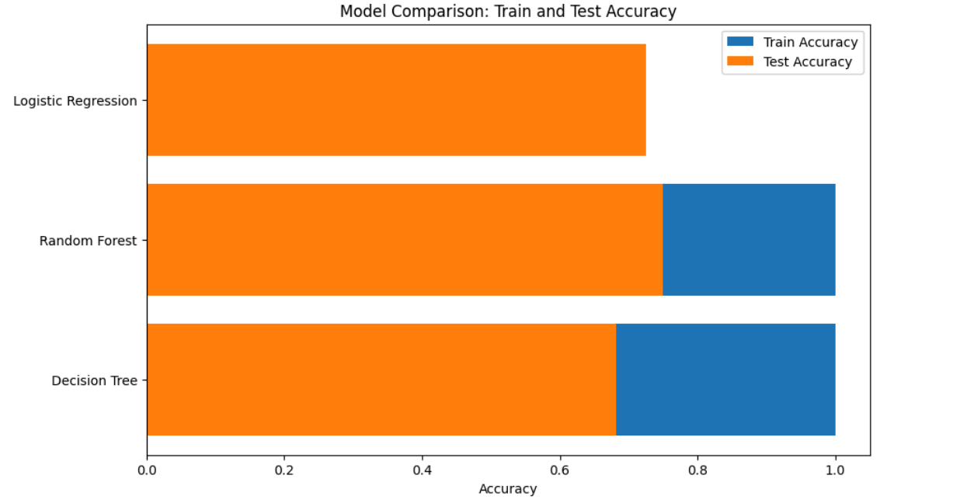

Slide 13
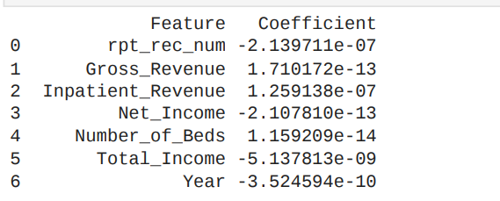

Slide 14
Logistic Regression Model: 72.55% ROC AUC: : 0.5163909694260952 confusion matrix : ([241, 3789] [293, 10551]) Decision Tree Model: 68.23% ROC AUC: 0.6066154523478924 confusion matrix : ([1778 2252] [2472 8372]) Random Forest Model: 74.93% ROC AUC: 0.755302402764951 confusion matrix : ([1485 2545] [1183 9661])

Slide 15


Discussion
The limitations of the analysis: Data limitations and methodological weaknesses could have influenced the scope of the findings. This kind of limitation should, therefore, be recognized. This, in relation to decision-making effects and a way to ensure transparency while reporting, can be achieved.
Considerations for Future research: It should be taken into account that future researches could improve the methodology and that new variables can be sought in order to add greater richness in the analysis. Consider, too, long-term trends, bearing in mind that the market evolves incessantly.

Slide 16
Recommendation
Staffing and Bed Utilization
Minimize the operational cost
Enhance billing processes
Diversify Service Lines
Quality Improvement Initiative Initiatives

Slide 17


Conclusion
The report identifies key areas for improvement in healthcare institutions based on metrics like gross revenue, total net income and inpatient revnue.
Recommendations include deploying advanced billing systems, implementing cost control strategies, and investing in technology to enhance operational efficiency and financial stability.
Emphasizing the value of data-driven strategies, the report underscores actionable and sustainable approaches for transformation in healthcare operations.

Slide 18


Thank you

