Slide 1
Predicting Mortality in Sepsis-Associated Acute Respiratory Distress Syndrome (ARDS)
Rithvik V.Sourab
Lekhana Chandra Palamuri
Wenjia Duan

Slide 2
Introduction
ARDS is a critical illness associated with sepsis, and its early prediction is crucial for improving clinical outcomes. Despite advancements in medical care, ARDS-related mortality remains high(30%-50%), requiring the development of robust prediction models for better resource allocation and clinical decision-making.
This research aims to build and validate a machine learning model to predict mortality in patients with Sepsis-Associated ARDS, leveraging the MIMIC-III database.

Slide 3
Data collection
Patients: get demographic information
Admissions: Extract admission details such as admission time, admission type
Icustays: filter icustay<=48
diagnoses_icd /d_icd_diagnoses: find patients diagnosed with ARDS
Chartevents/d_items: Extract clinical data and other bedside monitoring information.
Labevents/d_labitems: Obtain laboratory test results
Used HADM_ID join all table together

Slide 4
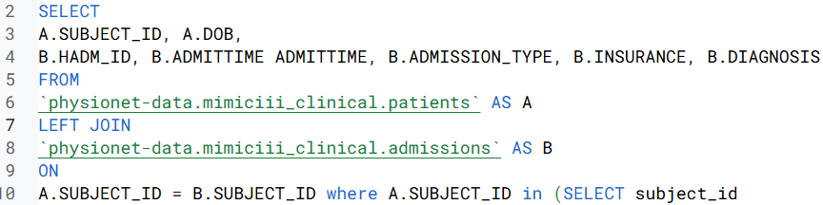
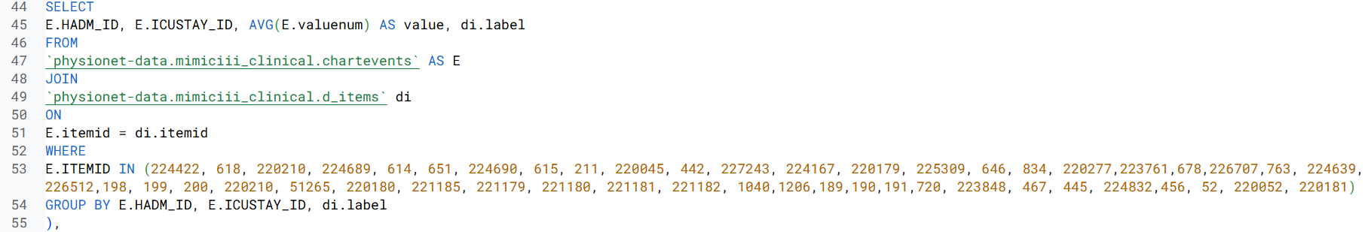
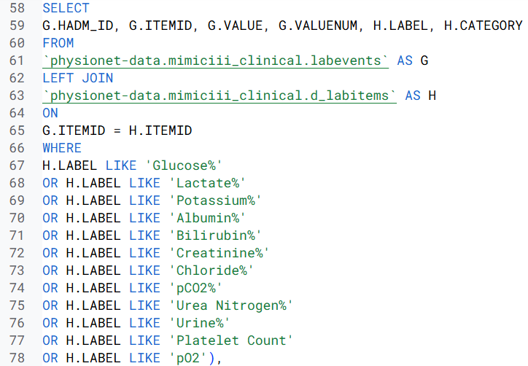
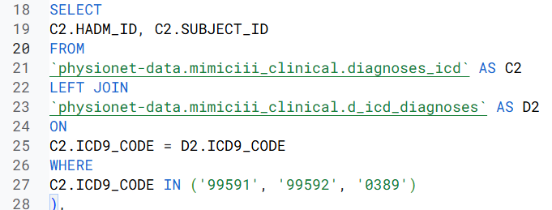
SQL Code breakdown:
Step 1,2:
Step 5:
Step 3:
Step 6:
Step 4:

Slide 5
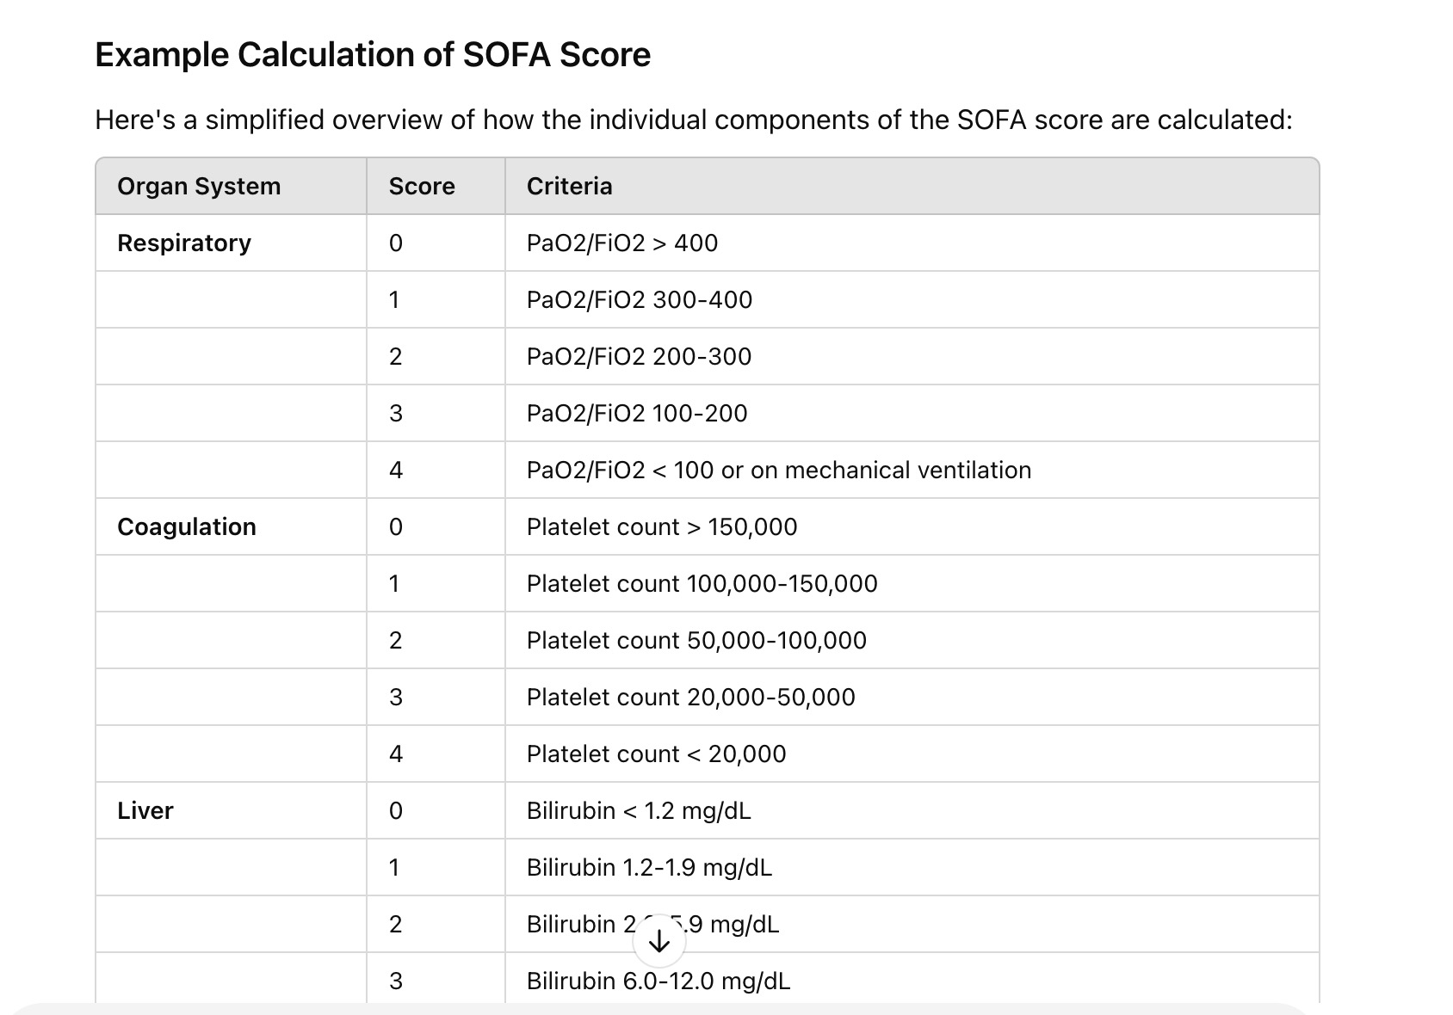
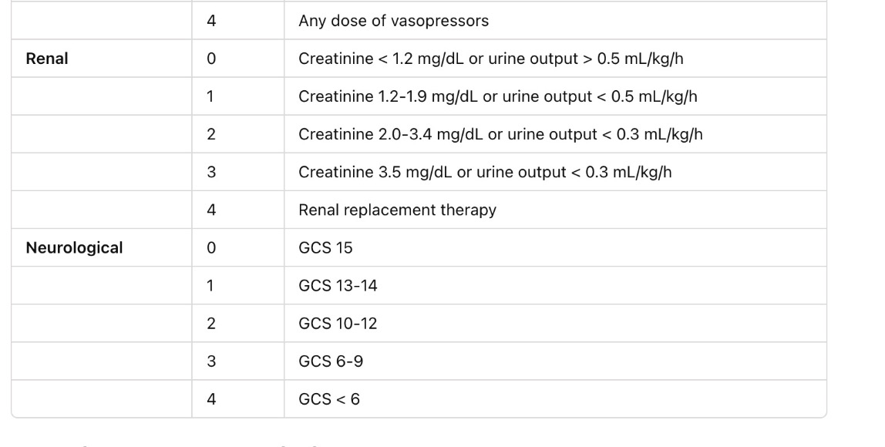
Calculating SOFA Score: Convert long-format to wide-format calculate clinical index depend on exist data
Data Extraction -

Slide 6
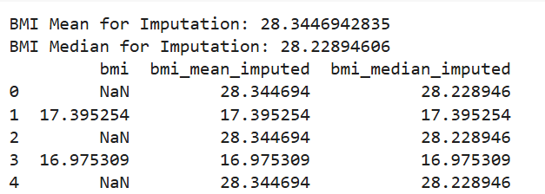


Data cleaning
Filling the missing values:
BMI mean and median imputation
within range (27-30) replaced with NaN Values.
Removed missing values from pt and ptt
average.
Removed rows where age is >=300
convert any categorical outcomes appropriately
After Data Cleaning -

Slide 7
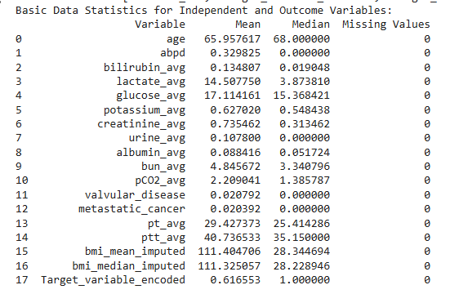
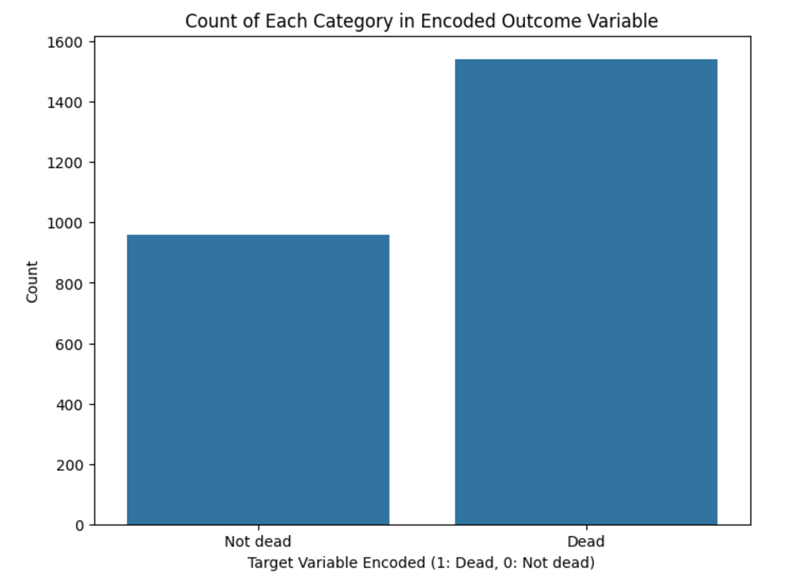

Outcome Variable Statistics
Calculated target variable using EXPIRE_FLAG, Whether a patient died during their hospital stay(1-Dead, 0-Not dead)
Data Statistics: Mean, Median, Missing Value count for independent and dependent variables.

Slide 8
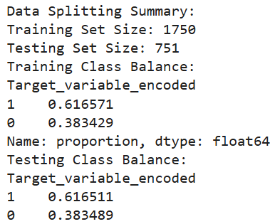
Data Splitting & Model Development
Trained seven machine learning models:
Logistic Regression, Random Forest, Naive Bayes, K-Nearest Neighbor (KNN), Support Vector Machine (SVM), Decision Tree, and XG Boost.
Randomly split data into training (70%) and
testing (30%) cohorts. Ensured balanced
data distribution between training
and test sets.

Slide 9
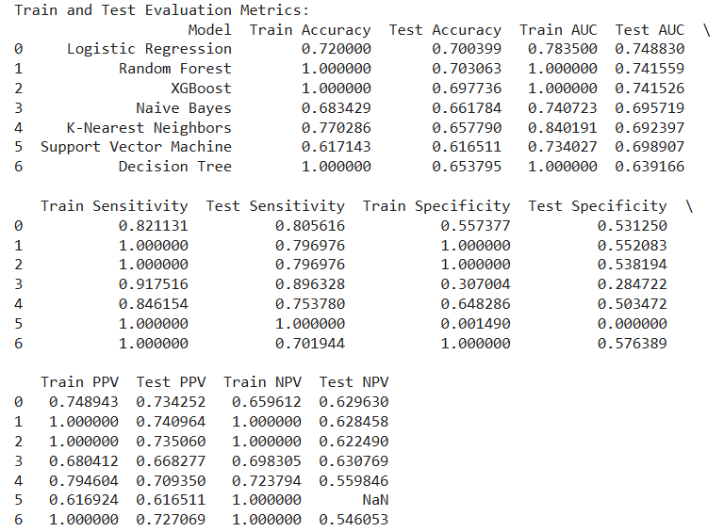
Model Evaluation
Performance metrics included AUC (Area Under the Curve), accuracy, sensitivity, specificity, positive predictive value (PPV), and negative predictive value (NPV).

Slide 10
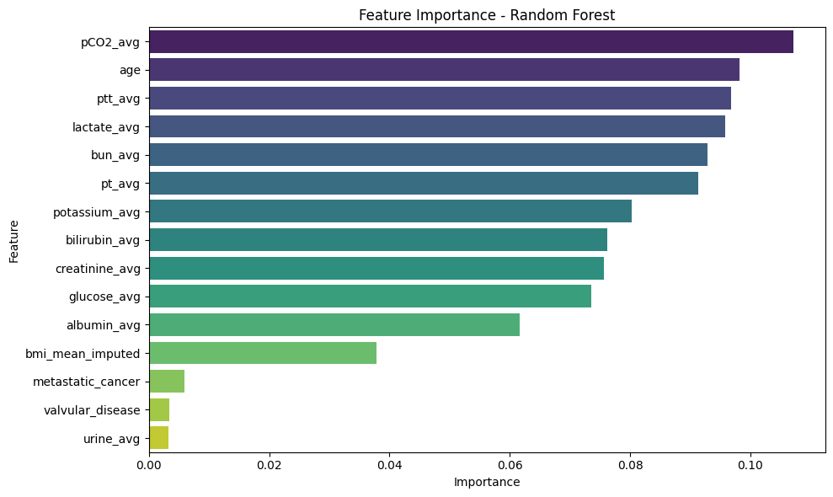
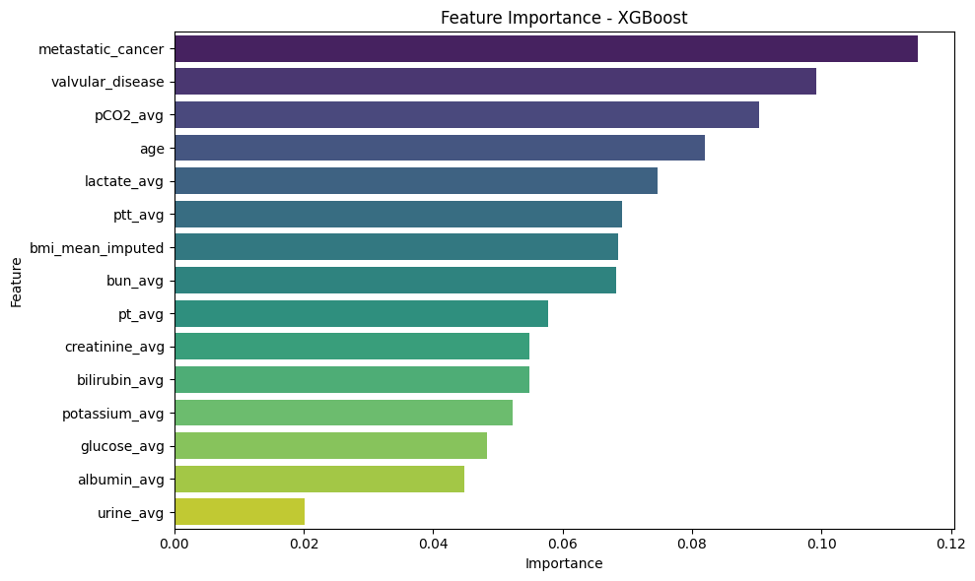
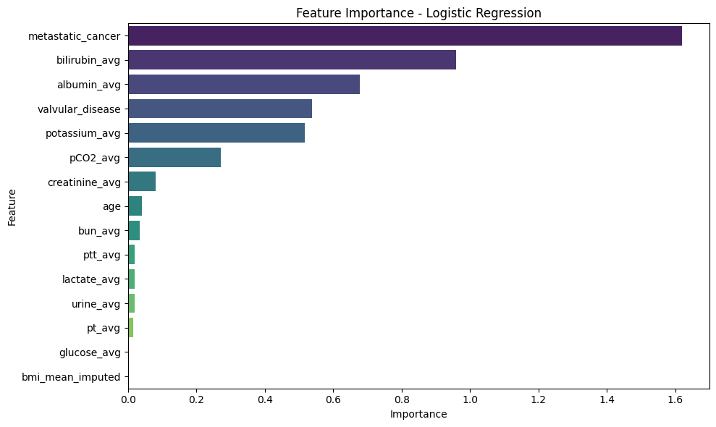
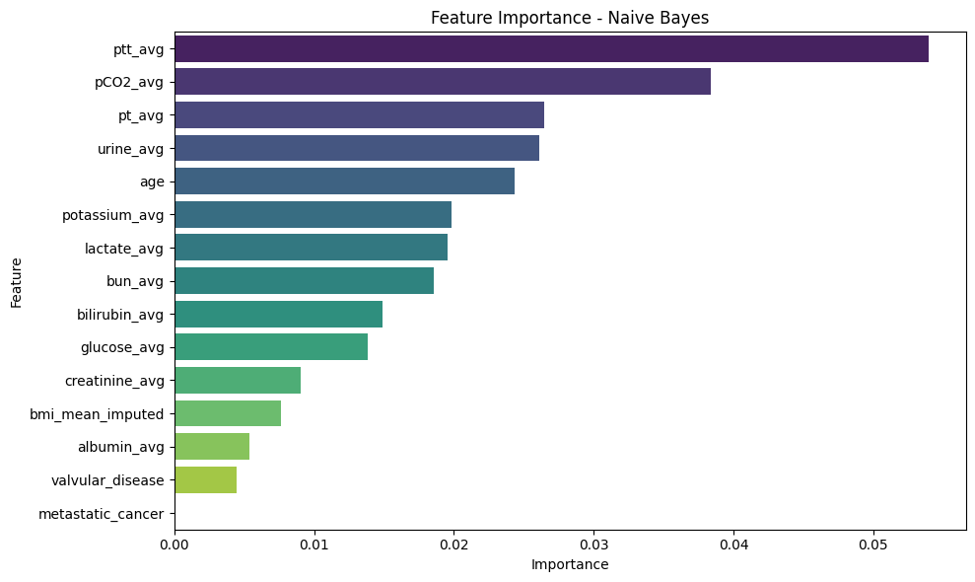
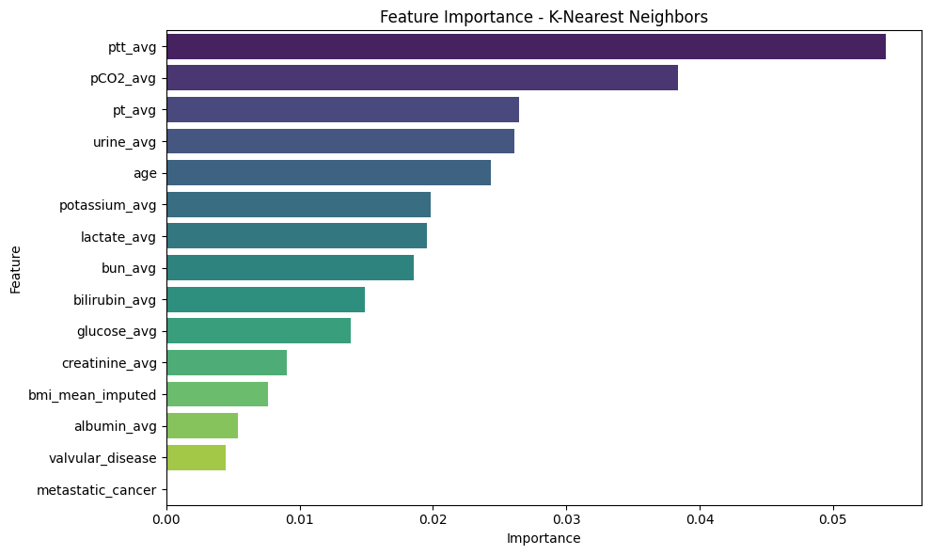
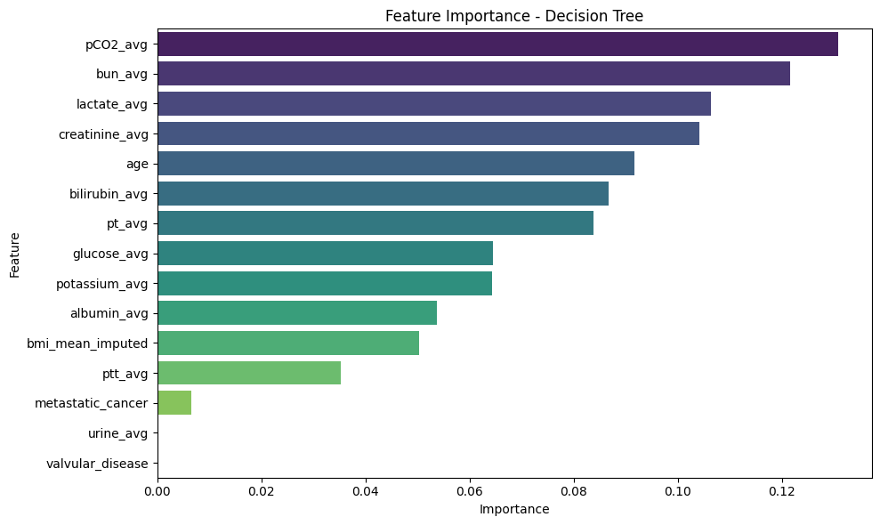
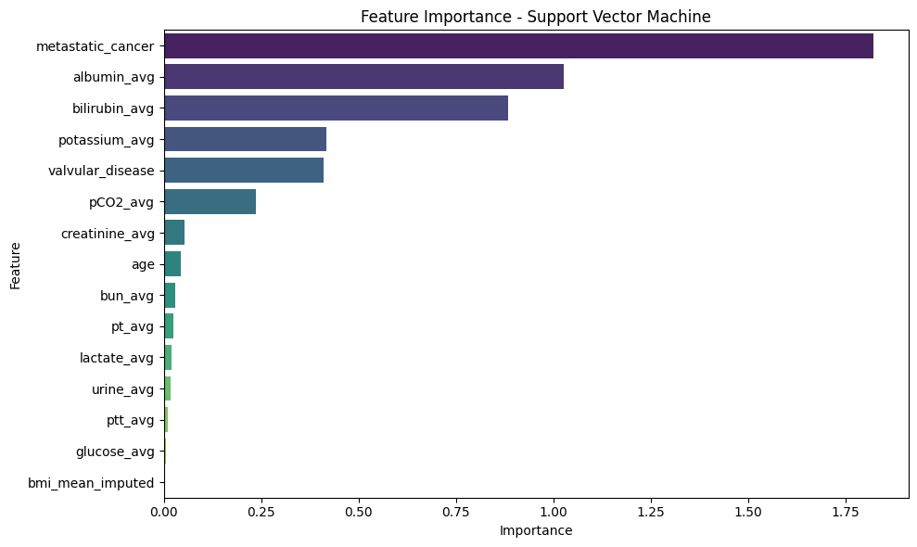
Feature Importance:
Random Forest XG Boost logistic Regression
Navies Bayes K-nearest neighbors Decision Tree
Support vector Machine

Slide 11
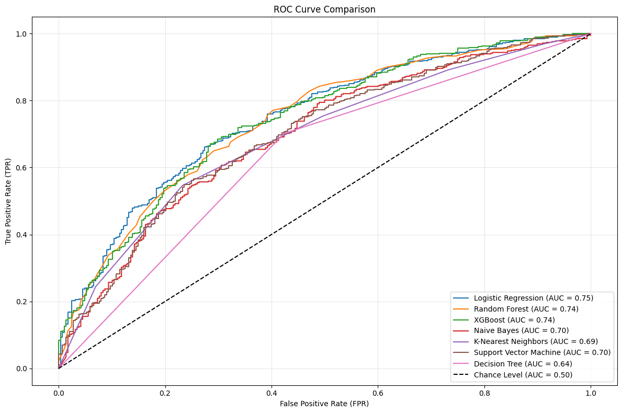
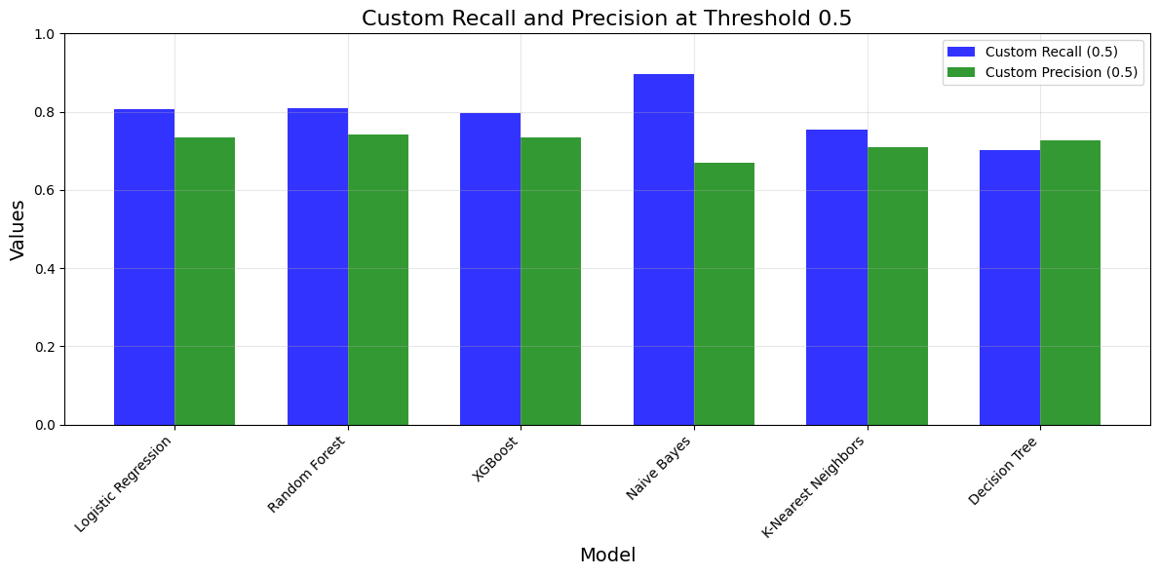
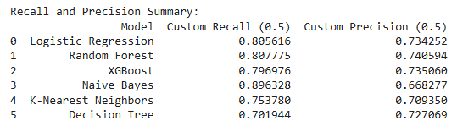
Model Validation:
Logistic regression have highest AUC Naïve Bayes have highest Recall Rate

Slide 12
Conclusion:
Logistic Regression demonstrated the highest AUC (overall performance).
Naive Bayes achieved the highest Recall (Sensitivity) rate.
Clinical Importance:
- In ARDS, Recall (Sensitivity) is prioritized to ensure all potential cases are identified.
Missing a case (false negative) can delay life-saving interventions, posing severe risks to patients.
Naive Bayes, is highly effective in maximizing Recall, making it a preferred choice in critical clinical settings.

