Slide 1
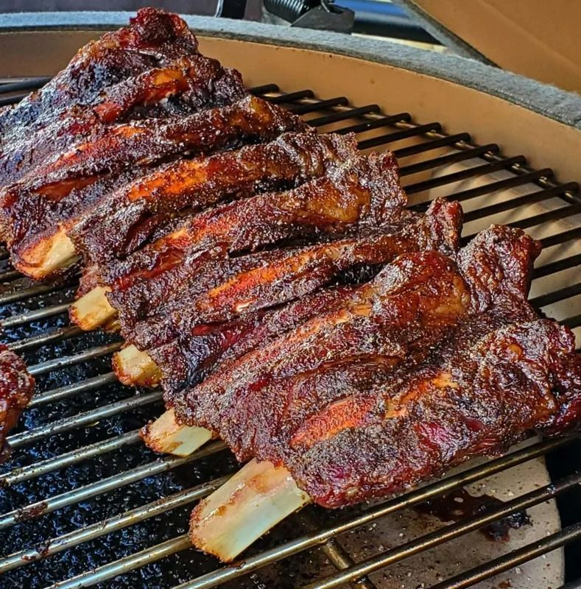
PHASE 3 · PROTOTYPE DEVELOPMENT, INTEGRATION AND EVALUATION
Nama Nameng
A mobile and web-based ordering, payment and queue management system
Group 4 — Digital Vanguard | ITC327W · Diploma in Information Technology
External stakeholder: Nama Nameng (Chisa Nyama) — Owner: Doja
Notes:
Whole group stands. Neo opens (about 1 minute): this is the Phase 3 presentation. In Phase 2 we designed the system; in Phase 3 we built it. Each of us presents the part we own. Total time about 35 minutes including demos and questions.

Slide 2
Six portfolios, six presenters
TODAY’S PRESENTATION
1
2
3
Neo Lekhelebana
Hlayiseka Matsimbi
Tshepang Morake
Supabase backend and security
ASP.NET customer web
ASP.NET staff and manager portal
4
5
6
Charmaine Mogotsi
Lesedi Ramolahloane
Portia Nkotseng Sefatsa
Flutter customer app and GitHub
Flutter staff and manager app
Testing and stakeholder evaluation
Notes:
Neo, 1 minute. Each slot is about 5 minutes including a live demo. The order follows the data: backend first, then the two web areas, then the two phone dashboards, then testing and the stakeholder. Everyone must be able to explain every file they pushed to GitHub.

Slide 3
We went from designs to a working system
WHERE WE ARE
6
2
2
database tables
server functions that place orders and change status
apps: Flutter and ASP.NET
4
~3,100
~900
dashboards: customer and staff, on each app
lines of Dart in the Flutter app
lines of ASP.NET controller code
Notes:
Neo. The numbers are from the code we are about to push. Be clear that all of it is built but testing is the next step: slide 14 shows the plan. Four dashboards sit on two apps and one shared Supabase project.

Slide 4
One Supabase project serves both apps
PRESENTED BY NEO LEKHELEBANA
Guest
Flutter app
Supabase (PostgreSQL)
RLS applies
Customer + Staff/Manager
Supabase client · Realtime
Auth
email, anonymous guests
Customer
Row-level security
role rules on all 6 tables
Staff / Manager
ASP.NET web
Functions
place_order · set_order_status
Customer site + Staff portal
EF Core · 4–5 s refresh
Realtime
publication on orders
Direct Postgres + Auth
Menu pictures are bundled in each app; Supabase Storage is not used yet.
Notes:
Neo. Walk left to right. Flutter talks to Supabase through the Supabase client, so row-level security applies to every request. The ASP.NET web app connects to Postgres directly and uses Supabase Auth over HTTPS, so for the web app the role checks live in the controllers. That is change CL-05 and it is why test TC-09 exists. Live updates: Flutter uses Realtime with a 5 second timer as a fallback; the web polls every 4 to 5 seconds.

Slide 5
What changed between design and build
PRESENTED BY NEO LEKHELEBANA
Area | Designed in Phase 2 | Built in Phase 3
Web data access | Supabase API under RLS | Direct Postgres (EF Core); role checks in controllers
Live updates | Realtime on both apps | Flutter: Realtime + 5 s timer. Web: polling every 4–5 s
Roles | Roles table with permission flags | One role column: Customer, Staff, Manager
Order status | Received, Preparing, Ready, Collected | Adds Cancelled; order numbers NN-1001 upward
Menu pictures | Supabase Storage | Bundled inside each app
Extras | — | Forgot password (Flutter), shift timer, kitchen queue, Order again
Notes:
Neo. Honest slide: the build differs from the Phase 2 documents in these ways and each one is logged as a change (CL-05 to CL-13) in the SRS. Do not skip the first row: the web app bypasses row-level security, which is why we test every staff route with a customer account. Ask Doja about the new staff features at the evaluation.

Slide 6
Who can do what is decided in the database
PRESENTED BY NEO LEKHELEBANA
Role | Read menu | Place order | See orders | Change status | Edit menu
Guest | Yes | Yes | Own only | No | No
Customer | Yes | Yes | Own only | No | No
Staff | Yes | — | All | Yes | No
Manager | Yes | — | All | Yes | Yes
Prices are worked out on the server
New accounts are always Customer
place_order recalculates every total, so the app cannot forge one.
The role is never read from user data. Staff are promoted by a script.
Notes:
Neo. Prices and totals are calculated inside place_order, so a modified app cannot send its own price. The role is always Customer when an account is created; staff are promoted by a script. Demo: show a customer account failing to read another customer’s order (test TC-08).

Slide 7
A password in a settings file: fix before any push
PRESENTED BY NEO LEKHELEBANA
1
2
3
4
Reset the database password in Supabase
Remove it from appsettings.json
Load it from User Secrets instead
Check Git history; search the repo (TC-15)
Safe to publish: the project URL and the anon key (protected by row-level security).
Never published: the database password and the service_role key.
Notes:
Neo. On 22 October we found the Supabase database password in plain text in the ASP.NET appsettings.json, which .gitignore did not exclude. Say what you did, not the password. Steps: reset the password first because the old one was in shared files; remove it from the file; load from User Secrets; check Git history; finally test TC-15 searches the repository for secrets. Update this slide with the real outcome before presenting.

Slide 8

Customers can order on the web, no install
PRESENTED BY HLAYISEKA MATSIMBI
Home
Menu
Cart
Checkout
Order received
Track
Guests order with just a name and an optional note; registered customers also get a profile, history and Order again
Sign-in and registration use Supabase Auth, so the same account works on the phone
Order tracking refreshes every 5 seconds
Open decision: Forgot password exists in Flutter but not on the web yet
Notes:
Hlayiseka. Demo on the website: open the home page, browse and search the menu, add to cart, check out as a guest with a name, see Order received, then watch the status change when staff update it (the page refreshes every 5 seconds). Then log in as a registered customer and show history and Order again. Mention the Forgot password decision (CL-09): the Flutter app has it, the web code we have does not.

Slide 9
Staff run the queue; managers run menu and sales
PRESENTED BY TSHEPANG MORAKE
Staff
Manager adds
Home with live alerts, shift timer and today’s numbers
Incoming orders: start or cancel
Order details
Kitchen queue: Ready, Collected
Take a break pauses order actions; End shift signs out
Menu management: add, edit, sold out, remove, add categories
Sales overview: orders and value today, totals, average order, cancelled, top items
Top sellers on the home page
ERD to be redrawn to match the real schema
Notes:
Tshepang. Demo: log in on the Staff tab, show the incoming board, start an order, then the kitchen queue to mark it Ready and Collected. Then log in as manager: edit a menu item, mark one sold out, open the Sales overview. Finish with the ERD slide point: the real schema has a role column instead of the roles table and a Cancelled status, so we are redrawing the ERD.

Slide 10

The same ordering flow, built for the phone
PRESENTED BY CHARMAINE MOGOTSI
Welcome
Home
Menu
Cart
Checkout
Track
Guest checkout through anonymous sign-in; registered customers keep history
Live status through Supabase Realtime, with a 5 second timer as a fallback
Forgot password with a 6-digit code sent by email
Order again adds only items that are still available
Only the public anon key is inside the app
Notes:
Charmaine. Demo on a phone or emulator: Explore Menu as a guest, add items, checkout, Track Order, then show the order on the web staff board within about 5 seconds. Show Register and Forgot password (6-digit emailed code). Point out that the app uses the public anon key only.

Slide 11
GitHub: every member, every portfolio, reviewed
PRESENTED BY CHARMAINE MOGOTSI
/flutter-app
/aspnet-web
/supabase
/docs
/design /security
/testing /stakeholder
/project-management
Own branch per portfolio, for example feature/flutter-customer
At least 4 commits on at least 2 different days
Pull request into main, approved by another member
No passwords or service_role key in any file
Release tag v1.0-prototype on 30 October
Notes:
Charmaine. The Phase 2 contributors page showed 14 commits from one member and 1 to 4 from the others. For Phase 3 each member works on their own branch with at least 4 commits on at least 2 days, and a pull request that another member reviews. Show the final folder layout and the release tag v1.0-prototype. Update the layout once the restructure is done.

Slide 12
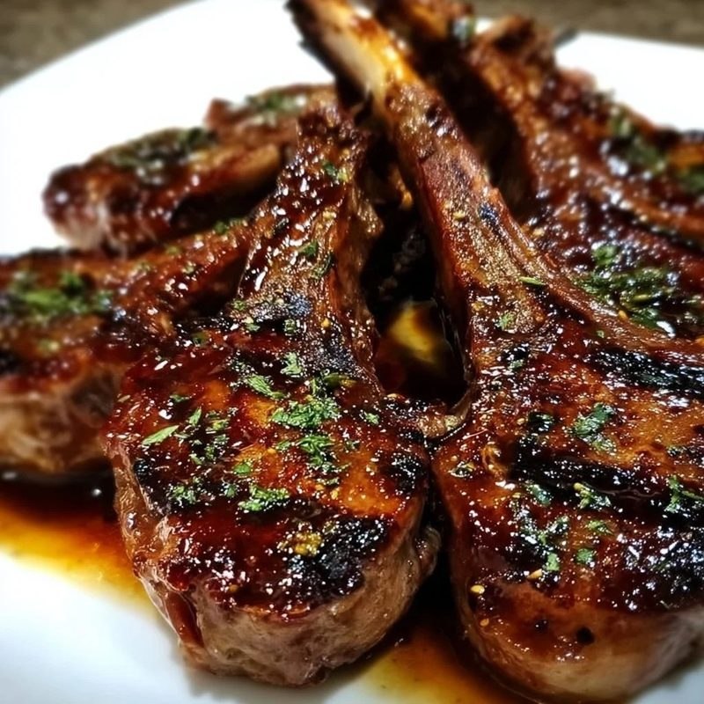
Staff and managers work from a phone or tablet
PRESENTED BY LESEDI RAMOLAHLOANE
Home
Incoming
Order detail
Kitchen
Menu
Profile
One app, two dashboards: staff accounts open the staff side
Status buttons call set_order_status, which only staff can use
Managers edit the menu, add categories and mark items sold out; row-level security blocks everyone else
Shift timer and Take a break pause order actions on this device
Seven unit tests cover totals, status values, parsing and Order again
Notes:
Lesedi. Demo: log in on the Staff tab, show Incoming orders and start one, then the Kitchen queue. Then the manager login: add a menu item and mark one sold out. Mention the shift timer and Take a break. Tie back to the use case diagram: Manager inherits every Staff use case.

Slide 13
Every requirement maps to code on both apps
PRESENTED BY LESEDI RAMOLAHLOANE
Requirement | Flutter | ASP.NET | Supabase
FR-03 Cart and order | checkout.dart | ShopController | place_order
FR-04 Order status | Track Order screen | Shop Track page | Realtime on orders
FR-06 Manage menu | staff.dart (manager) | ManagerController | items_write policy
FR-08 Update status | staff.dart | StaffController | set_order_status
FR-11 Sales overview | Manager home | ManagerController Sales | —
FR-12 Sync | Realtime + 5 s timer | 4–5 s polling | Shared schema
Status for all rows: built, test pending.
Notes:
Lesedi. This is the traceability matrix: the full version for FR-01 to FR-12 is in SRS Section 31 and docs/design/traceability-matrix.md. Pick two rows and trace them from use case to screen to code. All statuses mean built, test pending, until Portia reports.

Slide 14
Testing: 15 cases, run by someone who did not build it
PRESENTED BY PORTIA NKOTSENG SEFATSA
Test | What it proves | Tester | Result
TC-05 | Order placed in Flutter appears on the web board in about 5 seconds | Portia | Add after run
TC-06 | Status change on the web shows in Flutter in about 5 seconds | Portia | Add after run
TC-08 | Customer A cannot read customer B’s orders | Neo | Add after run
TC-09 | A customer account is refused on every staff route | Hlayiseka | Add after run
TC-04 | A tampered price or quantity is rejected or recalculated | Neo | Add after run
TC-14 | The Flutter app runs on a real Android phone | Portia | Add after run
TC-15 | No password or service_role key anywhere in the repository | Portia | Add after run
Notes:
Portia. Add the real result to each row before presenting: Pass, Fail with the problem log number, or Not run. The first two rows decide whether risk R-03 (real-time integration) can be closed. Show a screen recording of TC-05. Do not show a result that was not actually run.

Slide 15
Doja’s evaluation and the risks still open
PRESENTED BY PORTIA NKOTSENG SEFATSA
Evaluation with Doja
Show: order on the phone, board on the web, status back on the phone
Confirm: staff shift timer and kitchen queue are wanted
Confirm: wording says Order received, not payment
Record: his feedback and any changes he asks for
Planned for 28–29 October, if he is available
Notes:
Portia. Left: what we will show Doja and the decisions we need from him; add his actual feedback after the session. Right: the proposed risk scores (likelihood times impact, 1 to 5 each). R-08 is high because of the credential finding and drops once the password is reset and TC-15 passes. R-07 stays high: eight days left. Also tell the panel we will reconcile Section 25 of the SRS with the tracker on whether Doja asked for wording changes on 20 September.

Slide 16
Eight days to the final release
NEXT STEPS
Thu 22
Fri 23 – Sun 25
Mon 26
Tue 27 – Wed 28
Thu 29
Fri 30
Reset password, clean settings, branches created
Portfolios pushed, pull requests opened
Reviews and merges, credential check
Tests run, bugs fixed, Sprint 2 closes
Doja evaluation, full rehearsal
Release tag, final SRS and tracker, presentation
The credential fix comes first: nobody can push safely until it is done.
Notes:
Neo or whole group, 2 minutes. Walk the timeline. The blocking item is the credential fix because nobody can push safely until it is done. Dates are proposed in SRS Section 37 and depend on Doja’s availability.

Slide 17
Thank you
Nama Nameng — Group 4: Digital Vanguard
github.com/Lekhelebana/WIL-Project
Questions?
Notes:
Whole group. Take questions; each member answers about their own portfolio.

