Slide 1
S6 MCA
PROJECT
PRESENTATION

Slide 2
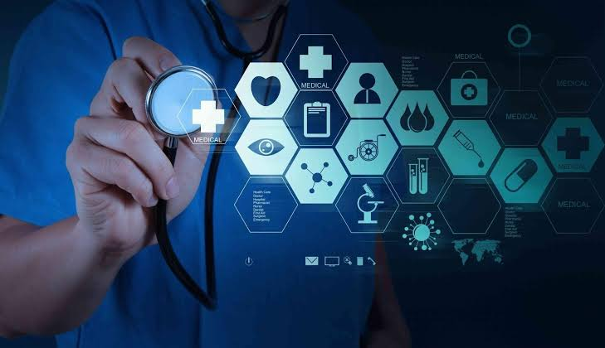
A SECURE IoT BASED MODERN HEALTHCARE SYSTEM USING BODY SENSOR NETWORK
Internal Guide:Prof. Anjana J
Submitted By
Lekshmi S R
LLMC17MCA020
S6 MCA,LMST

Slide 3
A SECURE IOT BASED MODERN HEALTHCARE SYSTEM USING BODY SENSOR NETWORK
Internal Guide:Prof. Anjana J
Submitted By
Lekshmi S R
LLMC17MCA020
S6 MCA,LMCST

Slide 4
AGENDA/TOPICS
Introduction
Existing System and drawbacks
Proposed System and advantages
Block Diagram
Hardware Requirements
Software Requirements
UML Diagram
Program Design
IoT Healthcare system Architecture
IoT Healthcare Applications
Conclusion
Future Enhancement

Slide 5
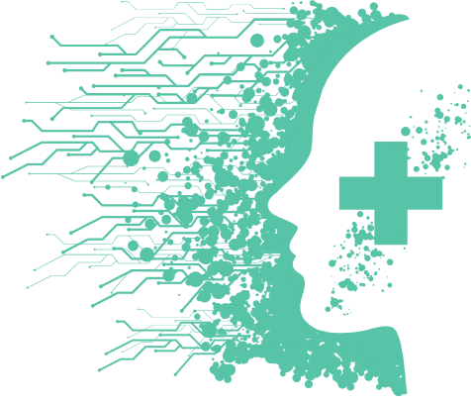
INTRODUCTION
In the present-day scenario, we find a large number of elderly people staying alone in flats or at isolated places.
Recent research indicates that about 80% of aged people above the age of 65 are suffering from at least one chronic life style disease.
IOT based modern healthcare is intended to meet the urgent medical needs of patients particularly isolated senior citizens.
IOT enables to extend the concept to internet and make it more feasible by providing seamless interactions with different types of devices.
The proposed modern IOT based BSN care envisages provision of affordable and timely healthcare at their door step and thus improving the quality of life.

Slide 6
OBJECTIVE & SCOPE
The information is passed to the cloud server of the medical team on real time. The medical team then take appropriate action to save the patient.
5
4
NODE MCU worn by patient consolidates the readings and pass it on to Blynk server an android application and then through mobile network.
3
Objective of the project is to make affordable, fully secure and timely healthcare to the elderly. The system make use of the body sensor networks which with the help of various body sensors measures the health parameters of the patient on Realtime.
2
This will help them abundantly in ageing gracefully with all possible and timely healthcare which is affordable and fully secured. When fully implemented IOT based BSN-CARE will revolutionize the healthcare all over the world
1
IOT based modern healthcare system is primarily intended to take care of the health aspects of older people staying alone. The system is envisages to real time monitoring of the health parameters of dependent patients and provide timely and quality healthcare to them.

Slide 7
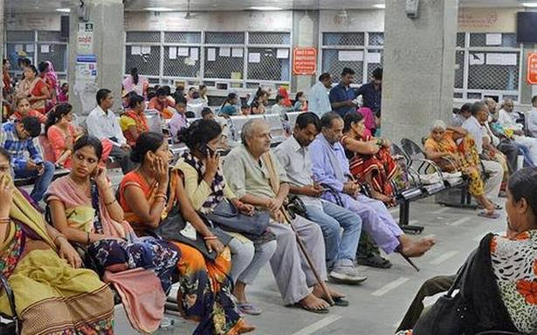
EXISTING SYSTEM
At present a patient has to travel to the nearest hospital for treatment. To see a doctor, he has to wait there for his turn. Doctor on examination of basic medical parameters prescribe medicines or ask for further investigation at the lab.
After that patient if required will be admitted for in patient treatment or will be disposed off as an out patient with necessary medicines. This process is time and effort consuming and is expensive. Moreover, in case of a medical emergency it will take time to reach a doctor/hospital.
In many such emergencies a patient by the time he reaches the hospital is dead. There are many such case of “brought dead” in our present scenario.
Modern healthcare system with the advent of IOT is able to provide BSN CARE and thus saving many lives. It is a boon to old people staying alone and at isolated places.

Slide 8
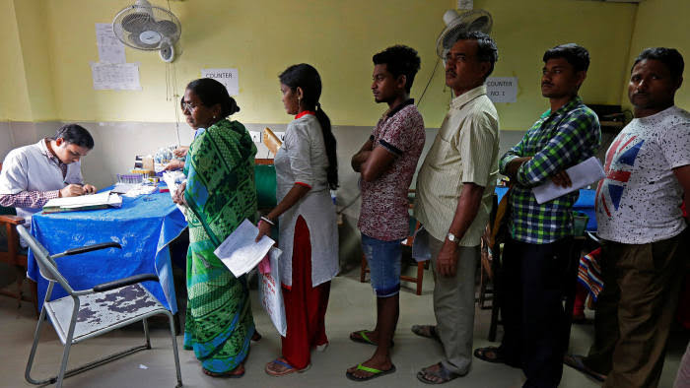
DRAWBACKS OF EXISTING SYSTEM
Existing System is inefficient.
It is very tedious and time consuming.
Lack of safe and security.
Complexity.
More human efforts.
Implementation Issues.
High Expenses.

Slide 9
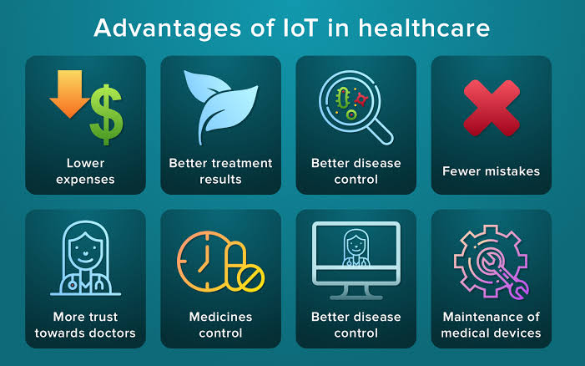
ADVANTAGES OF IoT HEALTHCARE

Slide 10
HARDWARE REQUIREMENTS
NODE MCU ESP8266 1.0 Wi-Fi Module
DHT11 Temperature sensor
Heart beat pulse sensor Amped

Slide 11
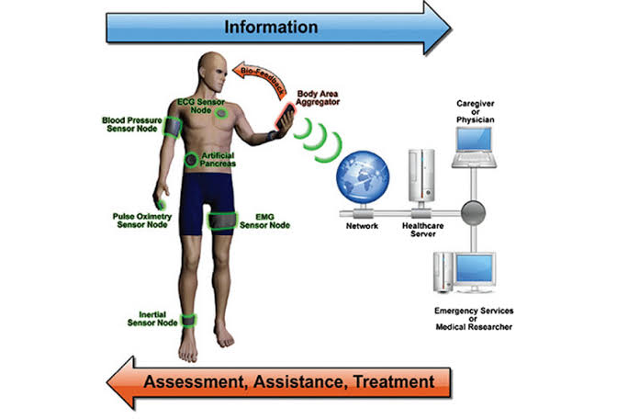
SCREENSHOT
DESCRIPTION
In this diagram a patient wearing various body sensors as desired is seen with a mobile in his hand. Wrist band on his hand consolidates the sensor output and feed to the mobile network. It also gives bio feed back to the patient in case of up normal readings. Data of the patient through the mobile network reaches the designated health care server on real time. The health care server then feed the data to the concerned health care giver or physician who take appropriate action instantly. Health care server also feed the patient medical status to the emergency and to the friend/family of the patient. Assessment, assistance and treatment are thus done by the health care giver at the right time thus enabling the patient to get efficient and timely medical care at the place of residence.

Slide 12
BLOCK DIAGRAM
DESCRIPTION
Sensors output of the sensors worn by the patient namely Temperature sensor, Heart beat pulse sensor, oxygen level and pulse rate sensor are fed to the NODE MCU. These sensor data are uploaded to Thingspeak using NODE MCU. Blynk server then forward the coded data to Healthcare server. The data so received is analysed and interpreted by the healthcare server. Healthcare server then feed the data to the concerned care giver or physician. It also simultaneously feed the data to emergency services or medical researcher. Healthcare giver and emergency services take appropriate action to treat the patient and also information is passed on to family or friends. The whole action is taking place on real time and hence no valuable time is lost in providing necessary treatment to the patient

Slide 13
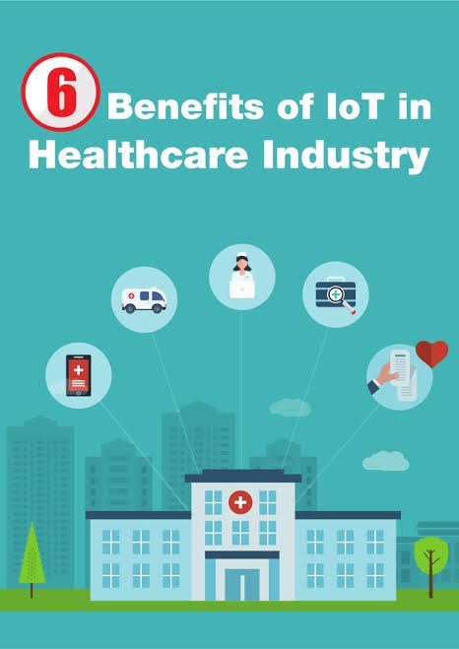
ADVANTAGES OF PROPOSED SYSTEM
The proposed IOT based BSN CARE health system is cost effective as its components are available at affordable prices.
The system is very efficient as the information on human health is obtained on real time at the health care provider.
A solar power system is provided for powering all the sensors.
An ESP8266 WIFI module is used for connecting to the internet
In this project, a system for 24*7 human health monitoring is designed and implemented.
The system can be implemented easily due to availability of wearable IOT devices and mobile network.
It is safe and secure as adequate security measures are incorporated.
It is easy to maintain, user friendly and light weight.
Analysis and prediction of chronic disorders in primary stage through the data mining techniques for better decision by doctors.
Future expansion is possible as advanced technologies can easily be added.

Slide 14
SOFTWARE REQUIREMENTS
Operating System : Windows 10
Front End : Arduino IDE
Server/Database :Blynk,Thingspeak

Slide 15
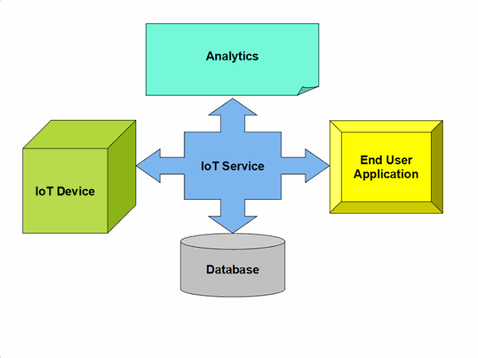
THINGSPEAK
Thingspeak is an IoT analytics platform service that allows you to aggregate, visualize and analyse live data streams in the cloud. Thingspeak provides instant visualizations of data posted by your devices to Thingspeak. With the ability to execute MATLAB code in Thingspeak you can perform online analysis and processing of the data as it comes in. Thingspeak is often used for prototyping and proof of concept IoT systems that require analytics.
Thingspeak key Features:
Easily configure devices to send data to Thingspeak using popular IoT protocols.
Visualize your sensor data in real-time.
Aggregate data on-demand from third-party sources.
Use the power of MATLAB to make sense of your IoT data.
Run your IoT analytics automatically based on schedules or events.
Prototype and build IoT systems without setting up servers or developing web software.
Automatically act on your data and communicate using third-party services like Twilio or Twitter.

Slide 16
BLYNK APPLICATION
Open Source Android App (Blynk)-: Blynk is an open source android app which is designed and developed in order to control the hardware via internet of things (IOT). This digitally displays sensor data, it can accumulate and visualize the data. Plus, it can also do other parameters such as:
Blynk App: This app gives us to create amazing interfaces for a project using multiple widgets which is an in-build app.
Blynk server: It acts as an interface between the smartphone and hardware which is responsible for the communication. We can also use blynk cloud or compile our private blynk server. It’s an open source that can control any number of devices plus can also be launched on Raspberry pi.
Blynk Libraries: For all the standard hardware platforms, supports communication with the sensor and the complete progression of incoming and outgoing instructions.

Slide 17
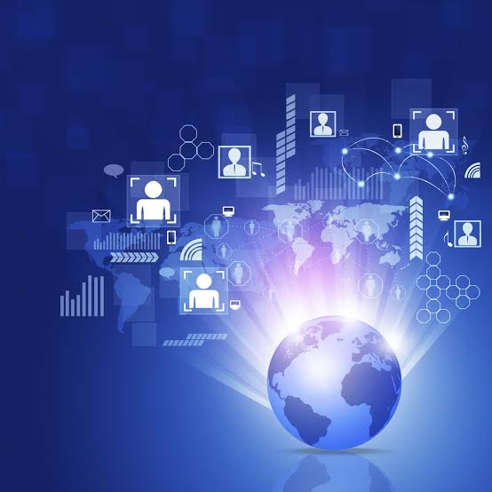
CONCLUSION
IOT based BSN-CARE healthcare system is undoubtedly going to revolutionize the existing conventional healthcare practices of the world.
Formation of long queues in hospitals and in front of renowned doctors for specialist consultation etc. will soon be a thing of the past.
Modern IOT based BSN healthcare system envisages provision of quality and timely healthcare at your door step based on data received on real time at the exclusive healthcare network.
More over global consultation of expert renowned specialist doctors will be just a click away when fully developed worldwide.

Slide 18
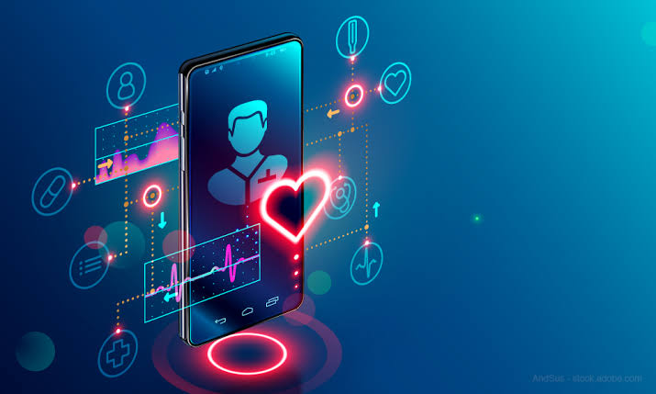
FUTURE ENHANCEMENT
The system can be enhanced to cover in remote villages where IOT can be gainfully utilised.
Body sensors in due course of time will be employing most modern technologies to minimise or make the radiations negligible.
Since internet and mobile network has conquered the whole world making the whole world a global village IOT based BSN healthcare can be extended to benefit the whole global population.
IOT based BSN healthcare will revolutise the field of medical care in due course of time benefitting the whole world.
Once fully developed and fully integrated consultation of an expert specialist anywhere in the world will be just a click away from you.

