Slide 1

Project 3
Fall 2016 – DATA 607 Oct. 23rd, 2016
“Which are the most
valued data skills?

Slide 2
Raphael Nash – Project Manager
Walt Wells – Word Counts, Data Mining
Liam Byrne – Indeed scraping
Ravi Kothari – Indeed scraping
Dmitriy Vecheruk – Word Counts, Word Cloud
Oluwakemi Omotunde – Domain SME
Todd Weigel – Stored Procedures
Ahmed Sajjad – Database Creation
Brandon O’Hara – Tableau Visualizations
Luisa Velasco – Quality Assurance and RMarkdown
Alexander Low – Quality Assurance and RMarkdown
Luis Calleja – Cluster Analysis
Jonathan Hernandez – Cluster Analysis
Leland Randles – Documentation and Presentation Moderator

Slide 3
Tools Used:
Slack – collaboration
GitHub – file repository, source code management (SCM)
R – web scraping, word counts, data mining, visualizations
R Markdown – code documentation, reproducibility
MySQL – data storage
Tableau – visualizations

Slide 4

What data we collected, where it can be found, and how we loaded it:
We collected text from San Francisco job postings on Indeed.com where the words “data science” were in the job title, company name, or were keywords (listed text and bulleted text only):
http://www.indeed.com/jobs?q=%22data+scientist%22&l=san+francisco
The results of the raw scrape can be found in our GitHub repository for the project: https://raw.githubusercontent.com/RaphaelNash/CUNY-DATA-607-2-Group-Project/master/ScrapeOutput/scrapeOutput.txt
This data was then cleaned and analyzed via two separate parsing tracks: a supervised track and an unsupervised track (see subsequent slides for details).

Slide 5
Code, Documentation, Results
Code:
Create RMySQL database and stored procedures for supervised analyses: https://github.com/RaphaelNash/CUNY-DATA-607-2-Group-Project/blob/master/completeDBScript_SuperVer.sql
Create RMySQL database and stored procedures for unsupervised analyses: https://github.com/RaphaelNash/CUNY-DATA-607-2-Group-Project/blob/master/completeDBScript_NonSuperVer.sql
Code creating R functions that call RMySQL stored procs which either get or insert data into the database: https://github.com/RaphaelNash/CUNY-DATA-607-2-Group-Project/blob/master/db_layer.r
Code that scrapes data from Indeed.com San Francisco data science job listings (listed text or bulleted text only): https://github.com/RaphaelNash/CUNY-DATA-607-2-Group-Project/blob/master/Project_3.R
Code which performs the supervised work count analyses: https://github.com/RaphaelNash/CUNY-DATA-607-2-Group-Project/blob/master/wordcountSuper.R
Code which performs the unsupervised word count analyses: https://github.com/RaphaelNash/CUNY-DATA-607-2-Group-Project/blob/master/wordcount.R
Code which performs the cluster analysis: https://github.com/RaphaelNash/CUNY-DATA-607-2-Group-Project/blob/master/cluster4upload.R

Slide 6
Code, Documentation, Results (continued)
Documentation:
Parsing Skills: Two Approaches:
Approach 1: “Supervised”
SME populates DB with a list of important skills.
Look through scrape data and count occurrences of those skills
Approach 2: “Unsupervised”
Use Natural Language Processing (NLP) to determine frequency of skills in listing
Create N-Gram phrases, count phrase frequency
Perform cluster analysis on counts to show relationships

Slide 7
Code, Documentation, Results (continued)
Making an
“N-Gram”
Documentation (continued):
Supervised vs. Unsupervised
Scrape
Clean and Prep
Divide Scrape into N-Gram Phrases
Pull Skills from DB
Count Frequency of N-Grams
Count Frequency of Skill Occurrences
Return top 1000 results
Cluster Analysis
"I went to a park"
N=2
"I went”
“went to”
“to a”
“a park”

Slide 8
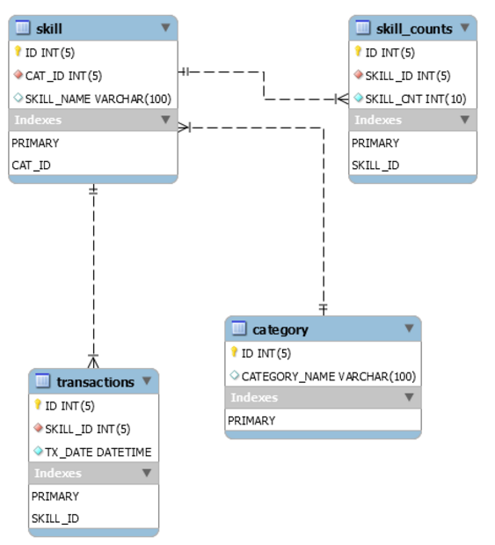
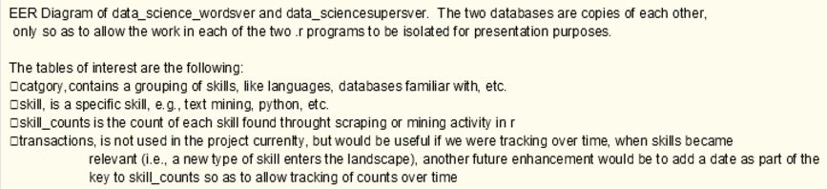
Code, Documentation, Results (continued)
Documentation (continued):
Database ERD:

Slide 9
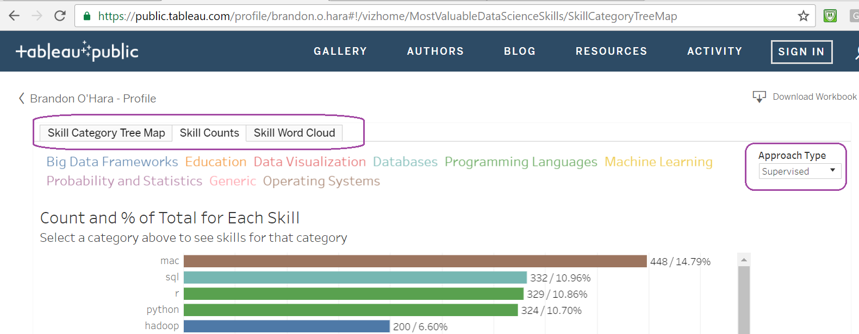
Code, Documentation, Results (continued)
Results:
Supervised
wordcountSuper.csv - https://raw.githubusercontent.com/RaphaelNash/CUNY-DATA-607-2-Group-Project/master/wordcountSuper.csv
Tableau Visualizations – https://public.tableau.com/profile/brandon.o.hara#!/vizhome/MostValuableDataScienceSkills/SkillCategoryTreeMap
(three tabs: Skill Category Tree Map, Skill Counts, and Skill Word Cloud)
(for Skill Counts and Skill Word Cloud, filter upper right Approach drop-down to “Supervised”)

Slide 10
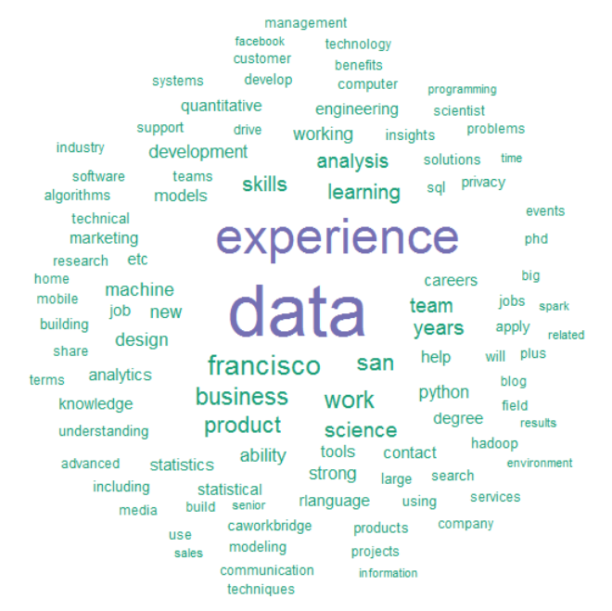
Code, Documentation, Results (continued)
Results (continued):
Unsupervised
Wordcounts.csv (https://raw.githubusercontent.com/RaphaelNash/CUNY-DATA-607-2-Group-Project/master/wordcount.csv)
Word Cloud in R:

Slide 11
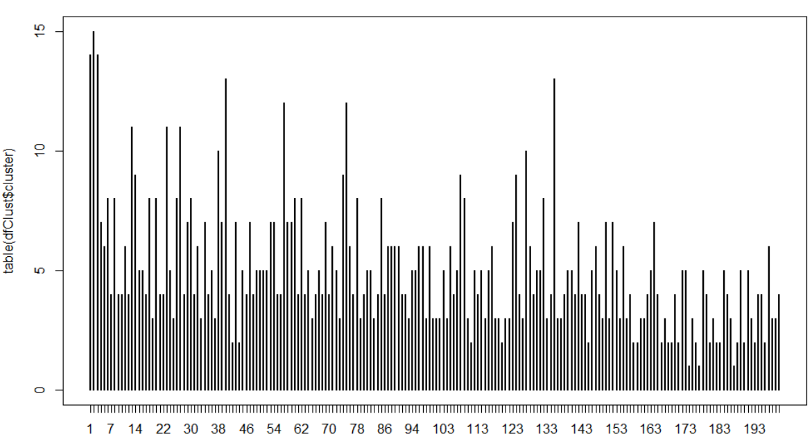
Code, Documentation, Results (continued)
Results (continued):
Unsupervised
Cluster Analysis – see Rpubs http://rpubs.com/stiltsie/220900
Terms which arguably should have been included in the supervised analysis based on the cluster analysis: "statistical analysis", "modeling", "zoomdata", and "optimization"

Slide 12
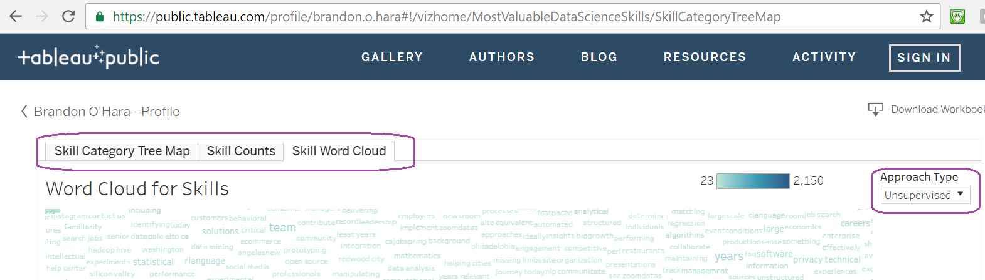
Code, Documentation, Results (continued)
Results (continued):
Unsupervised
Tableau Visualizations – https://public.tableau.com/profile/brandon.o.hara#!/vizhome/MostValuableDataScienceSkills/SkillCategoryTreeMap
(three tabs: Skill Category Tree Map, Skill Counts, and Skill Word Cloud)
(for Skill Counts and Skill Word Cloud, filter upper right Approach drop-down to “Unsupervised”)

Slide 13
Presenters:
Leland Randles – Moderator
Walt Wells – Word Count, Data Mining
Brandon O’Hara – Visualizations
Luis Calleja – Cluster Analysis

