Slide 1

CUNY HR Consultants

Slide 2

CUNY HR Consultants – We Identify Top Talent
Thanks, E-Corp, for retaining CUNY HR Consultants to assist you in building out your newly established Data Science Center of Excellence here in San Francisco.
We’re proud of our reputation as the top sourcing firm in the field of Data Science and we look forward to working with you.
To kick-off our engagement, today we will present the results of a study we recently completed to identify the most valued Data Science skills.

Slide 3
CUNY HR Consultants Team
Raphael Nash – Project Manager
Walt Wells –Data Mining and Natural Language Processing
Dmitriy Vecheruk – Data Mining and Natural Language Processing
Liam Byrne – Web Scraping
Ravi Kothari – Web Scraping
Todd Weigel – Data Architect
Ahmed Sajjad – Data Architect
Luisa Velasco – Quality Assurance
Alexander Low – Quality Assurance
Brandon O’Hara – Data Visualizations
Oluwakemi Omotunde – Domain Subject Matter Expert
Luis Calleja – Cluster Analysis
Jonathan Hernandez – Cluster Analysis
Leland Randles – Business Development

Slide 4
Our Approach
Identify Best Data Source
Extract Most Relevant Data
Perform Supervised and Unsupervised Text Mining
Perform Cluster Analysis

Slide 5
Text Mining: Two Approaches
Approach 1: “Supervised”
SME populates DB with a list of important skills.
Look through scrape data and count occurrences of those skills
Approach 2: “Unsupervised”
Use Natural Language Processing (NLP) to determine frequency of skills in listing
Create N-Gram phrases, count phrase frequency
Perform cluster analysis on counts to show relationships

Slide 6

Parsing Skills: Unsupervised v. Supervised
Scrape
Clean and Prep
Divide Scrape into N-Gram Phrases
Pull Skills from DB
Count Frequency of N-Grams
Count Frequency of Skill Occurences
Return top 1000 results
Cluster Analysis
Making an
“N-Gram”
Supervised
Unsupervised
"I went to a park"
N=2
"I went”
“went to”
“to a”
“a park”
Skills!

Slide 7
Results Brandon O’Hara - Tableau

Slide 8
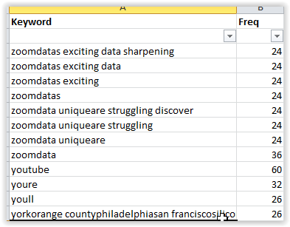
Applying Cluster Analysis to the Unsupervised Data
The scrape and subsequent text mining exercise yielded a vector of words and frequencies across all job postings
Which phrases are most similar to each other? Perhaps employers use different phrases around same skill.
Let’s learn from the data
Apply Jaro-Winkler Distance function

Slide 9
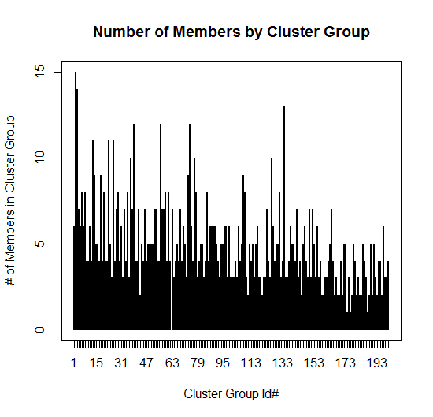
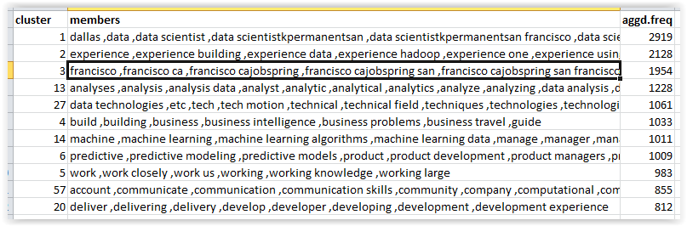
We Employ a Distance Algorithm to form groups of similar skill keywords
Visual Inspection

Slide 10
Improving Cluster Analysis
Increase number of groups
Run the analysis on stratified data (bi grams and tri grams in one analysis; tri grams and quad grams on another)
Different Algorithm, ex. Levenshtein, Optimal string Alignment, Full Damerau-Levenshtein distance

