Slide 1

CUNY – DATA 609 Final Project Bethany Poulin Leland Randles

Slide 2
Credit Card Processor – Maximize Revenue via Re-Pricing
We used deidentified data from an S&P 500 credit card processing company.
Based on this company’s rate and fee structure, along with the regulations and requirements applicable at a region, country, line of business and card brand (i.e., “VISA”, “MasterCard”, etc.) level, we optimized future revenue through a combination of rate and fee changes.
In addition to the above-mentioned controls (regulations and requirements), the repricing plan was constrained by churn thresholds
Using 2019 average monthly data to set strategy for 2020

Slide 3
Merchant Pricing Structure
Merchants pay for credit card processing through a combination of a per-transaction fee and/or a percentage fee based on the amount of the transaction.
For example, a merchant might be charged 1.95% on the amount of the transaction (referred to as the “volume”) and $0.15 per transaction.
Example – a $100.00 transaction:
(1.95% * 100) + (1 * 0.15) = $1.95 + $0.15 = $2.10
Therefore, in this case, $2.10 would go to the credit card processor, and $97.90 would go to the merchant.

Slide 4
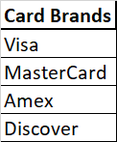
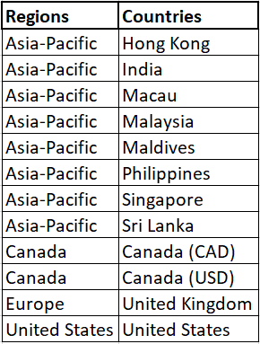
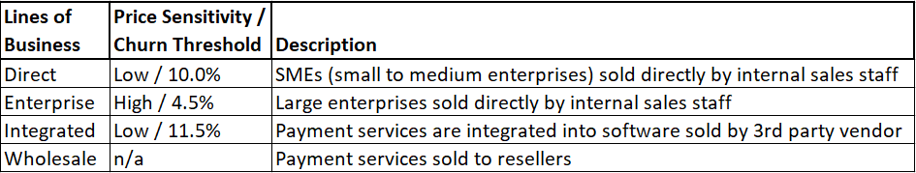
Company Overview
Dataset contains 638,074 rows of data for 277,498 merchants
Each Merchant / Card Brand has a distinct row
Each Merchant is tagged with a Region, Country and Line of Business
Constraints / Requirements exist at the Region, Country, Line of Business and Card Brand level
Propensity for churn based on Line of Business

Slide 5
Requirements
By Region
The max price increase by percentage for Canada is 10%
By Country
The max price increase by percentage for United Kingdom is 6%
The max price increase by percentage for India is 1% plus the inflation rate (2019 inflation rate was 4.54%, so 5.54%)
The max price increase by percentage for Malaysia is 20%
The max price increase by percentage for Singapore is 15%
Philippines - no price increases for competitive reasons
The max price increase by percentage for Sri Lanka is 1% plus the inflation rate (2019 inflation rate was 5.6%, so 6.6%)
By Card Brand
Cannot raise total percentage rate above 500 basis points for Amex
Only per-item rate increase are allowed for Discover (no limit)
Cannot raise the percentage rate a merchant is paying for MasterCard more than 100 basis points
Cannot raise the percentage rate a merchant is paying for Visa more than 100 basis points

Slide 6
Base Assumptions
Churn = New Business
Merchants/Card transaction count the same in 2020 as 2019
Merchant/Card average amount the same in 2020 as 2019

Slide 7
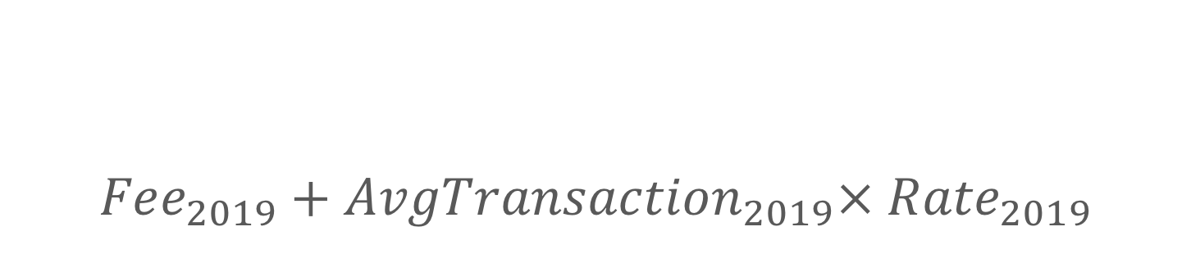
$${Fee}_{2019}+{AvgTransaction}_{2019}× {Rate}_{2019}$$
Objective Maximize:

Slide 8
Three Constraints
Rate
The actual percent of purchase charged to merchant
Minimum Rate
Maximum Rate
Fee
The fixed amount charged per transaction
Minimum Fee
Maximum Fee
Price
Total cost per average transaction (Rate x Amount + Fee)

Slide 9
Rate Constraints
Rate
Minimum Rate
Current Rate
Maximum Rate
If American Express
5% 500 basis points on purchase amount
Current rate if current rate is greater than 5%
Discover
Current Rate (not open to increase)
All Others
10% (company ceiling )

Slide 10
Fee Constraints
Fee
Minimum Fee
½ Current Fee (company limit)
Maximum Fee
2 times Current Fee (company limit)

Slide 11
Four Types of Price Constraint
Country/Region Price
Maximum increase to price by geographic regulations
Combined fee and rate*average transaction increase limit
Card Price
Maximum Price set by card providers
Amex None
Discover None
Visa 1% (100 basis points)
MasterCard 1% (100 basis points)
Line of Business Churn Risk
Maximum
Enterprise 4.5%
Integrated 11.5%
Direct 10%
Company Price
Maximum 18%

Slide 12
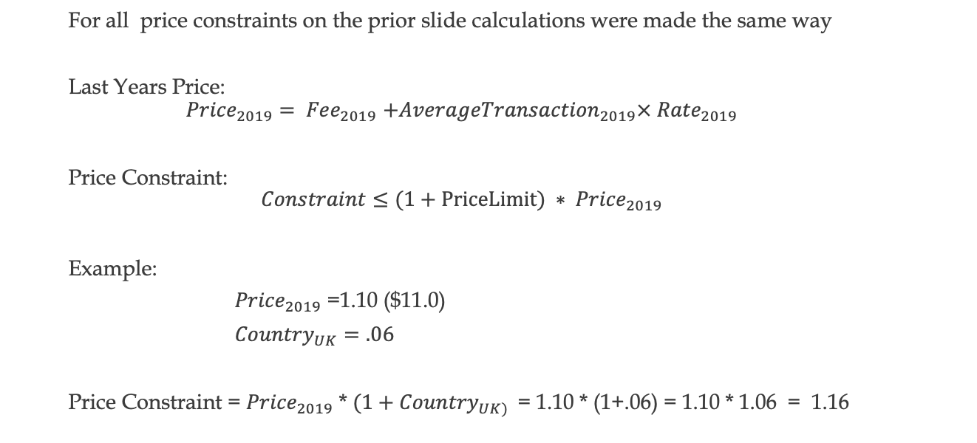
Price Constraints
For all price constraints on the prior slide calculations were made the same way
Last Years Price:
$${Price}_{2019}{= Fee}_{2019}+{AverageTransaction}_{2019}× {Rate}_{2019}$$
Price Constraint:
$$Constraint≤(1+PriceLimit) ∗ {Price}_{2019}$$
Example:
${Price}_{2019}$ =1.10 ($11.0)
${Country}_{UK}=.06$
Price Constraint = ${Price}_{2019}$ * ${(1+Country}_{UK) }$ = 1.10 * (1+.06) = 1.10 * 1.06 = 1.16

Slide 13
Example Price Constraint Selection
Because these constraints all have the same equation in the final linear model, only one is used, the lowest non-zero price
Sample Data
Country Price Constraint: .27797000
Card Constraint: Infinity (no cap)
Line of Business Churn Price: .27797000
Company; .29818600
From this, the minimum is chosen as it would be the constraint that dominated if all were included. This reduces the complexity of the code and the computational cost demonstrably!

Slide 14

Constraint Equations
Price Constraint Equation
$$Fee + {AvgTrans}_{2019}∗Rate ≤PriceConstraint$$
Rate Constraint Equations
$$0∗Fee +{AvgTrans}_{2019}∗Rate ≤MaxRateConstraint$$
$$0∗Fee +{AvgTrans}_{2019}∗Rate ≥MinRateConstraint$$
Rate Constraint Equations
$$Fee +0∗Rate ≤MaxFeeConstraint$$
$$Fee +0∗Rate ≥MinFeeConstraint$$

Slide 15
R Code For Each Observation
##Setting up linear model
obj = c(1, avgTransaction)
mat = matrix(c(1, avgTransaction, 1,0, 1,0,0,1,0,1),ncol =2, byrow=TRUE)
dir = c('<=', '>=', '<=', '>=', '<=')
rhs = c(min_max_price, min_fee, max_fee, min_rate, max_rate)
output =lp("max", obj, mat, dir, rhs)
new_fee = output$solution[1]
new_rate = output$solution[2]
new_transaction_price = new_fee + new_rate * avgTransaction
In a function which is applied to each observation in data frame, in this case 277,498 Linear Programs.

Slide 16
Results
Total Increase In Revenue : $ 1,359,632
Percent Increase in Revenue: 1.611406%
Lowest Increase Country-Line-Card Combination
Canada | Enterprise | Discover | $2,322.01 | $2,314.04 | 0.34474
United States | Integrated | Amex | $4,082,676.24 | $3,661,641.85 | 11.49851
Highest Increase Country-Line-Card Combination

