Slide 1
My Portfolio Website

Slide 2
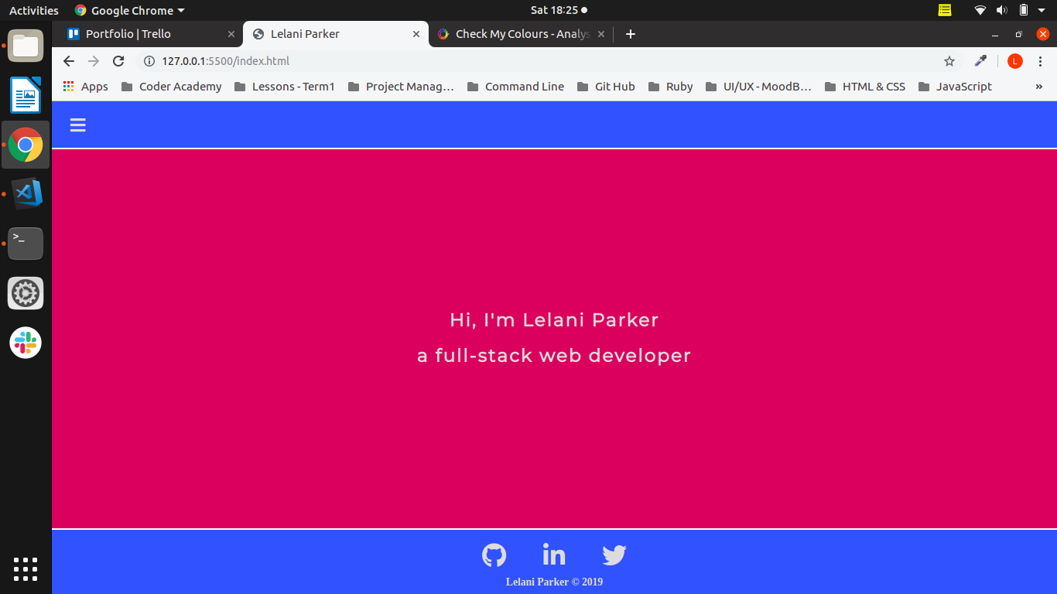
My Home Page

Slide 3
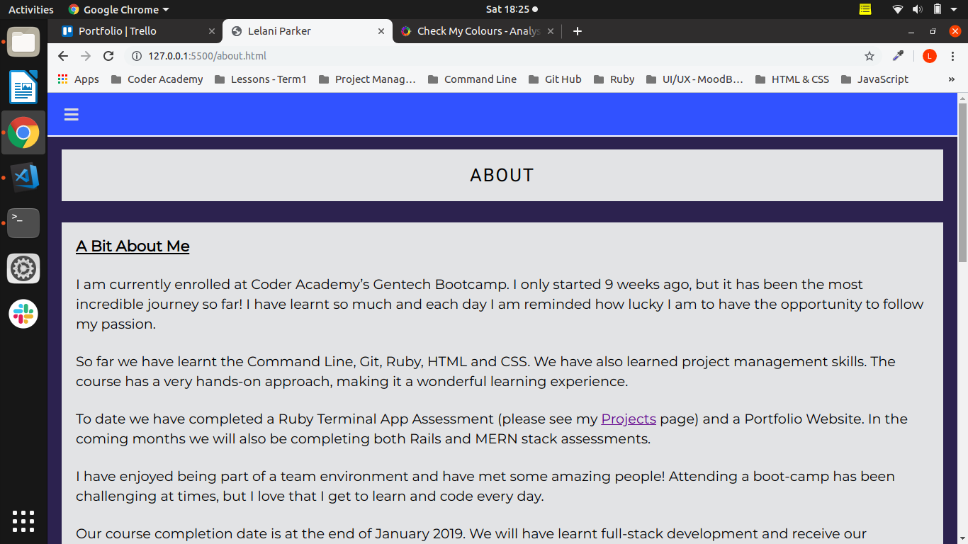
My About Page

Slide 4
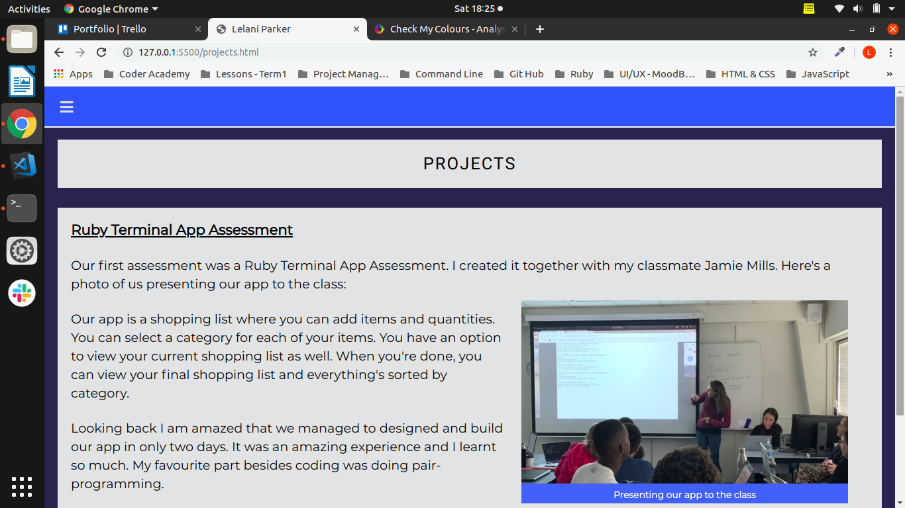
My Projects Page

Slide 5
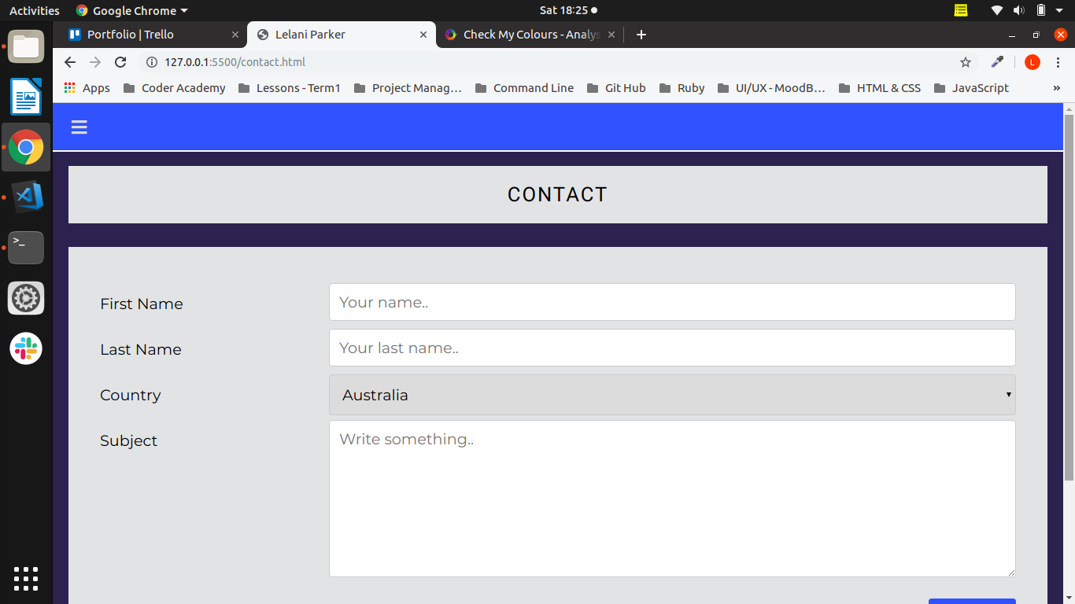
My Contact Page

Slide 6
Challenges
CSS
Redoing my lost work – always push your commits to the cloud!

Slide 7
Enjoyed
Project Management
Finally completing my site :)

Slide 8
Demo

