Slide 1



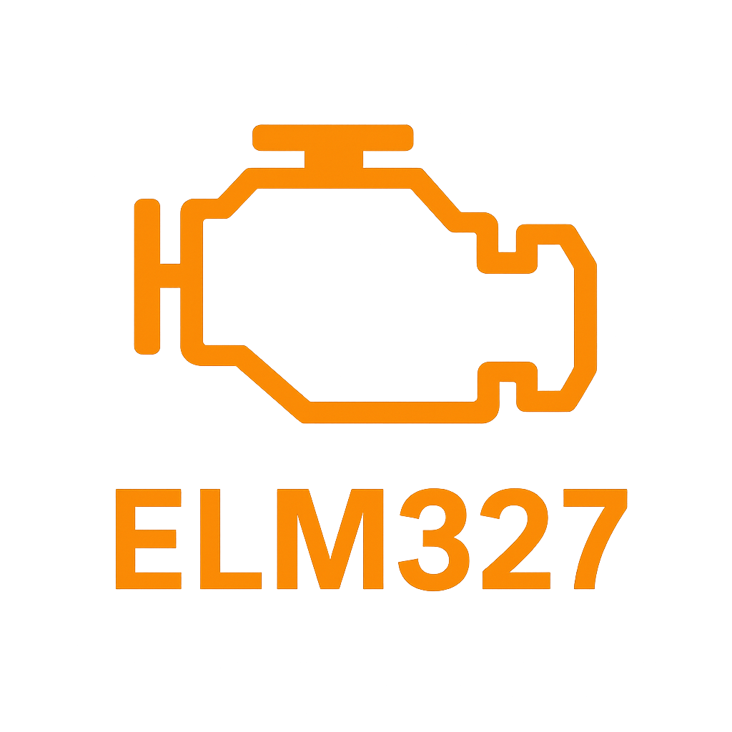




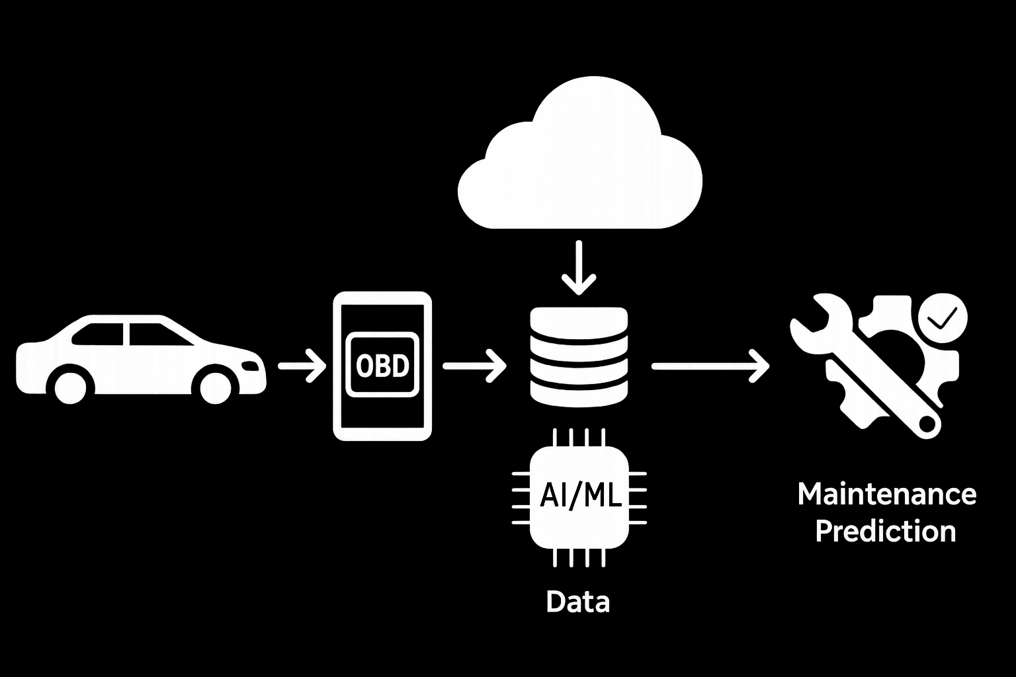


SkyLedge
Predictive Maintenance Modelling – Roadmap and Outcome
Unplanned vehicle breakdowns lead to expensive repairs, lost operational time, and disrupted delivery schedules.
Traditional maintenance methods rely on fixed intervals, which often miss early signs of wear, especially in fleet environments.
Without real-time visibility, both cost and safety risks increase — especially as vehicles age or are driven aggressively.
Approach
We collect real-time vehicle telemetry (RPM, temperature, throttle, etc.) using an OBD-II scanner connected to a Raspberry Pi.
Data is uploaded to a cloud backend (FastAPI + Docker) that automatically cleans, normalises, and engineers key features.
The cleaned data powers machine learning models that detect stress patterns, cluster driver behaviour, and estimate fault risk — all visible via a centralised dashboard.
Problem
🔴
🟡
🟢
⚠️
⚠️
Step 1 – Capture: Collect raw sensor logs through controlled driving sessions.
Step 2 – Clean: Automate cleaning, filtering, normalisation, export to drive.
Step 3 – Label: Apply hybrid driver behavior labelling (manual + clustering).
Step 4 – Predictors: ML model forecast stress/risk.
Step 5 – Deployment: Central pipeline backend and dashboard
Progress
Plans
Sprint 1 – Foundation & Research
Explored OBD-II datasets & literature on predictive maintenance
Designed system architecture & evaluated ML models (XGBoost, LSTM)
Prototyped cleaning and visualisation workflows using public data
Sprint 2 – Logging & Automation
Collected physical OBD-II data logs
Developed Python script for high- and low-frequency PID logging
Standardised cleaning pipeline with timestamp validation & feature engineering
Deployed cleaning automation FastAPI backend on Hugging Face Spaces with Google Drive syncing
Sprint 3 – Insights & Prototyping
Integrated web-based dashboard for live log status and admin control
Applied K-Means clustering for driving style detection and labelling
Labelled MaintenanceNeed using Isolation Forest (high-stress detection)
Trained & evaluated Random Forest/XGBoost with SHAP-based insights
Received SkyLedge feedback to refine focus on subsystem-level and time-series predictions
FIND MORE
Future Plans​
Expand Data Coverage
Continue capturing diverse driving conditions to improve model generalisation.
Maintenance Modelling
Redefine Maintenance. Predict targeted subsystems diagnostics. Implement LSTM time-series prediction.
Refine Driving Style Labelling
Strengthen hybrid labelling pipeline combining clustering and manual tags.
Upgrade Dashboard Features​
Add real-time alerts, session tagging, and driver-level insights.​
​
Security & Transparency​
Apply encryption, access control, and model explainability practices.​
​
Industry Collaboration​
Pilot the system with logistics or fleet partners to validate real-world value.​
​
Benchmark & Continuously​
Compare with industry tools, automate retraining, and apply user feedback loops.

