Slide 1
Medical Messenger - Revolutionizing Healthcare Communication
Project Background and Problem Statement
Problem Statement:
Market Need:
Traditional healthcare communication is fragmented and inefficient
Growing demand for telemedicine and digital health solutions
Patients struggle to find and connect with appropriate medical specialists
Need for specialized doctor discovery and subscription-based healthcare services
Lack of secure, direct communication channels between patients and doctors
Requirement for HIPAA-compliant, secure messaging platforms
Healthcare providers need better ways to manage patient relationships and consultations
Demand for streamlined patient-doctor communication workflows
Privacy and security concerns in medical communications
Target Users:
Patients seeking specialized medical care and direct communication with doctors
Medical professionals (doctors, specialists) wanting to expand their patient reach
Healthcare administrators needing audit trails and compliance monitoring

Slide 2






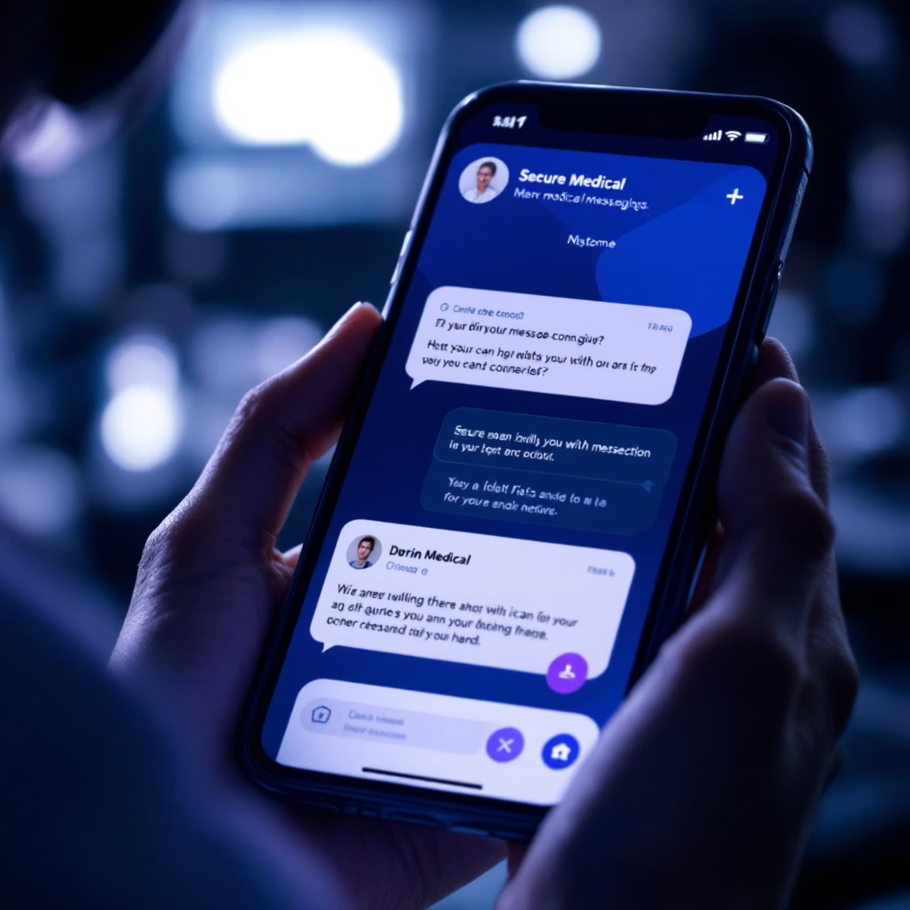
Comprehensive Medical Communication Platform - Complete Feature Set
Project Scope and Deliverables
Authentication System
Doctor Directory
Complete user registration, login, and role-based access control (Patient, Doctor, Admin)
Advanced search, filtering by specialty, location-based discovery, and detailed doctor profiles
Subscription Management
Real-time Chat
Patient-doctor subscription workflow with approval/denial system
Socket.IO powered messaging with delivery/read status and message persistence
Admin Audit System
Privacy & Security
Comprehensive audit logging with admin interface and data retention policies
GDPR-compliant data handling, consent management, and secure communication
Technical Deliverables:
Frontend: Next.js 14 with TypeScript, Tailwind CSS, shadcn/ui components
Backend: Fastify with TypeScript, MongoDB integration, RESTful APIs
Real-time Communication: Socket.IO for instant messaging
Database: MongoDB with optimized schemas and indexing
Infrastructure: Azure App Service with blue-green deployment
CI/CD Pipeline: Automated testing, deployment, and quality gates
Live Applications:
Frontend: https://medmsg-frontend.azurewebsites.net
Backend Blue: https://medmsg-blue.azurewebsites.net
Backend Green: https://medmsg-green.azurewebsites.net

Slide 3

Innovative Design Solutions for Healthcare Communication
Design Concepts and Problem Solutions
Privacy-First Approach
Scalable Architecture
All communications encrypted, GDPR-compliant data handling
Microservices-ready, cloud-native design
User-Centric Design
Security by Design
Intuitive interfaces for patients, doctors, and administrators
Role-based access control, audit trails, secure sessions
Patient Journey
Admin Journey
Key Design Solutions:
Registration to secure chat
System monitoring to user management
Doctor Discovery System
Advanced filtering by specialty, location, rating, and availability
Subscription-Based Model
Patients request access, doctors approve/deny with messaging
Real-time Communication
Instant messaging with delivery confirmation and read receipts
Audit Trail System
Complete logging of all user actions for compliance and security
Responsive Design
Doctor Journey
Mobile-first approach with accessibility features
Profile setup to patient communication

Slide 4
Enterprise-Grade Development Practices and Architecture
Design and Development Excellence
Code Quality Metrics:
Development Methodology:
87%+
100%
Agile Development: Iterative development with continuous integration
Test-Driven Development: Comprehensive unit, integration, and E2E testing
Test Coverage
Type Safety
Code Quality: ESLint, Prettier, TypeScript strict mode, pre-commit hooks
Across all modules
TypeScript Strict Mode
Documentation-Driven: Comprehensive documentation for all features and APIs
Architecture Excellence:
<200ms
Zero
Monorepo Structure: PNPM workspaces for efficient dependency management
Type Safety: Shared Zod schemas between frontend and backend
Performance
Code Quality
Database Design: MongoDB with optimized schemas, indexes, and relationships
Average response time
ESLint errors
API Design: RESTful APIs with comprehensive validation and error handling
Real-time Features: Socket.IO for instant messaging and notifications
Development Tools:
Frontend: Next.js 14, React, TypeScript, Tailwind CSS, shadcn/uiBackend: Fastify, MongoDB, Socket.IO, Pino loggingTesting: Vitest, React Testing Library, MongoDB Memory ServerQuality: ESLint, Prettier, Husky, CommitlintDeployment: Azure CLI, Bicep templates, GitHub Actions

Slide 5

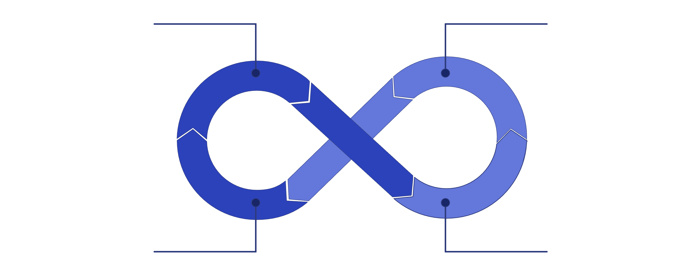


Enterprise-Grade CI/CD Pipeline and Deployment Excellence
Performance Metrics:
CI/CD Excellence and DevOps Practices
Build & Package
Run Tests
99.9%
Uptime
Deployment Automation:
One-Command Deployment: ./deploy.sh for complete deployment
Debug Tools: ./debug-deploy.sh for monitoring and troubleshooting
Health Validation: Automated post-deployment health checks
Rollback Capability: Instant reversion to previous stable version
<200ms
Response Time
Blue‑Green Deploy
Quality Gates
CI/CD Pipeline Excellence:
GitHub Actions: Automated build, test, and deployment workflows
Quality Gates: ESLint, Prettier, TypeScript, unit tests, integration tests
Pre-commit Hooks: Husky + lint-staged for code quality enforcement
5 min
Conventional Commits: Semantic versioning and automated changelogs
Branch Protection: Required reviews, status checks, and merge restrictions
Deployment Strategy:
Blue-Green Deployment: Zero-downtime deployments with instant rollback capability
Infrastructure as Code: Bicep templates for reproducible Azure infrastructure
Deployment Time
Environment Parity: Identical configurations across dev/staging/production
Automated Testing: Smoke tests, health checks, and performance validation

Slide 6
Seamless Integration and Cross-Platform Compatibility
Compatibility and Integration Design
Browser Compatibility
API Integration
Modern Browsers: Chrome, Firefox, Safari, Edge (latest versions)
RESTful APIs: Standard HTTP methods with JSON responses
Mobile Responsive: iOS Safari, Android Chrome, responsive design
Real-time Communication: WebSocket support via Socket.IO
Accessibility: WCAG 2.1 compliance, screen reader support, keyboard navigation
Authentication: Session-based auth with HTTP-only cookies
CORS Configuration: Secure cross-origin resource sharing
Progressive Web App: Service worker ready, offline capabilities
Rate Limiting: Built-in protection against abuse
Cloud Integration
Third-Party Integrations
Azure App Service: Linux-based hosting with auto-scaling
Email Services: Ready for notification services
Azure Key Vault: Secure secrets management
SMS Integration: Phone number verification support
Application Insights: Ready for production monitoring
Payment Processing: Subscription billing ready
CDN Integration: Static asset optimization
Analytics: User behavior tracking and metrics
SSL/TLS: HTTPS encryption for all communications

Slide 7
Comprehensive Requirements Fulfillment and Compliance
Design Requirements Satisfaction
Functional Requirements:
Compliance Requirements:
✅ User Authentication: Complete registration, login, and session management
✅ GDPR Compliance: Data protection, consent management, right to deletion
✅ Role-Based Access: Patient, Doctor, and Admin roles with appropriate permissions
✅ HIPAA Ready: Secure communication, audit trails, data encryption
✅ Privacy by Design: Minimal data collection, secure storage
✅ Doctor Discovery: Advanced search, filtering, and directory functionality
✅ Audit Requirements: Comprehensive logging, retention policies
✅ Subscription Management: Request/approve/deny workflow with messaging
✅ Real-time Chat: Instant messaging with delivery and read status
Technical Requirements:
✅ Admin Dashboard: Audit logs, user management, system monitoring
✅ TypeScript: 100% type safety across frontend and backend
Non-Functional Requirements:
✅ Testing: 87%+ test coverage with unit, integration, and E2E tests
✅ Code Quality: Zero ESLint errors, consistent formatting
✅ Performance: <200ms response time, 99.9% uptime
✅ Documentation: Comprehensive API docs, user guides, deployment guides
✅ Security: HTTPS encryption, secure sessions, input validation
✅ Monitoring: Structured logging, health checks, performance metrics
✅ Scalability: Cloud-native architecture, auto-scaling ready
✅ Reliability: Blue-green deployment, automated rollback
✅ Usability: Intuitive UI, accessibility compliance, mobile responsive

Slide 8





Live System Demonstration and Technical Implementation
Code Demonstration and Live System
Future Enhancements:
Advanced Analytics
Live System Access:
User behavior tracking and insights
Frontend Application: https://medmsg-frontend.azurewebsites.net
Backend API (Blue): https://medmsg-blue.azurewebsites.net
Mobile App
Backend API (Green): https://medmsg-green.azurewebsites.net
React Native implementation
Health Check: Automated monitoring and status validation
Key Code Demonstrations:
AI Integration
Authentication Flow: User registration, login, session management
Chatbot assistance and medical insights
API Integration: RESTful endpoints with comprehensive validation
Real-time Chat: Socket.IO implementation with message persistence
Payment Processing
Database Operations: MongoDB integration with optimized queries
Subscription billing and payment management
Admin Features: Audit logging and user management
Advanced Security
Multi-factor authentication and advanced encryption

