Slide 1
Real-Time Social Media Sentiment Analysis Engine
Team 6 (3Dogs)
Yuhan Zhang (002846159)
Zhihan Zheng (002841000)
Yuxuan Qin (002200850)

Slide 2
Use Cases
Use Case 1: Brand Manager Monitors Campaign Sentiment
- Actor: Brand manager
- Action: Inputs campaign keywords and selects a time range for sentiment analysis.
- Response: Analyzed social media posts containing the keywords within the specified time range and displays a sentiment trend graph, showing the proportion of positive, negative, and neutral sentiments. texts?
Use Case 2: Public search for everyday news
- Actor: The Public
- Action: Inputs some news or topics for analysis
- Response: Analyzed social media posts containing the topics with a sentiment trend graph and generate some wordclouds for these topics which people are highly discussed.

Slide 3
Methodology
Data Collection
Spark Streaming
Spider
Multi-threading
SQL
Data Processing
Spark distributed compute capability
Spark SQL
Spark DataFrame
Time Series
Sentiment Analysis
Spark MLlib
Spark NLP
Result Display
Spark backend
React frontend

Slide 4
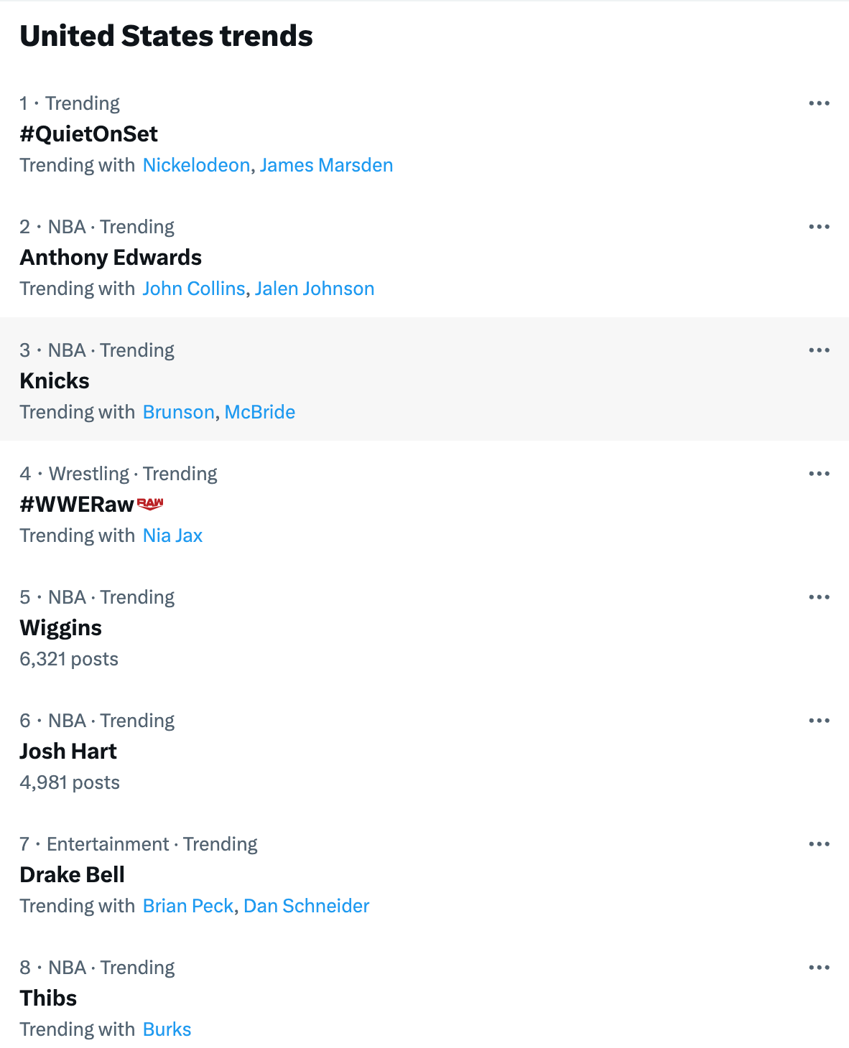
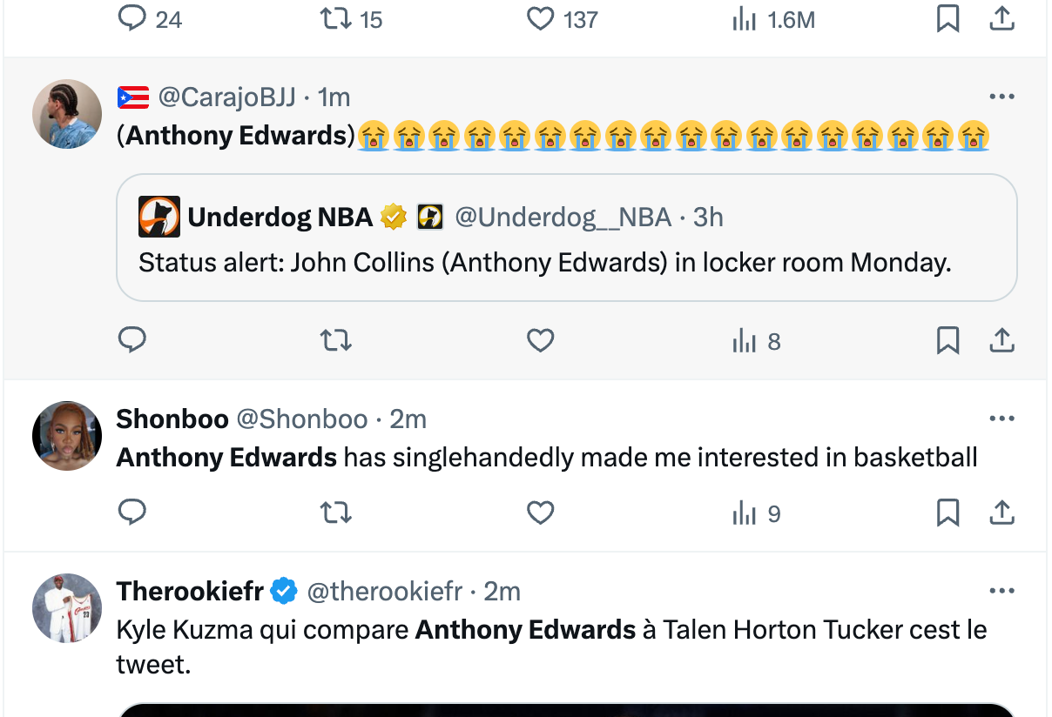
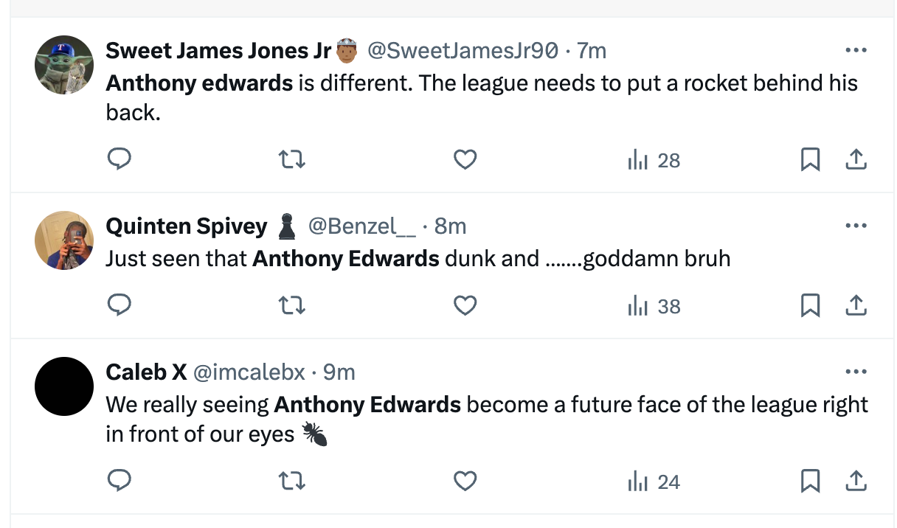
Data Source
Data Sources: We will primarily gather data from multiple sources, including social media platforms such as Twitter and Facebook.(proxy)
Data Utilization: We will leverage this data for real-time sentiment analysis and time series analysis to gain insights into public sentiment towards specific events or topics.

Slide 5
Timeline & Milestones
Week 1: Setup & Planning
Team assembly, tool setup, and data source identification.
Week 2: Data Collection & Preliminary Processing
Implement real-time data collection and start data cleaning, writing interface.
Week 3: Sentiment Analysis Implementation
Develop and integrate the sentiment analysis model.
Week 4: Dashboard Development & Project Wrap-Up
Finalize dashboard, test system, and prepare presentation.
End of Month: Presentation
Showcase project outcomes and insights.

Slide 6
Components in Scala
Repository: GitHub
Data Collection
Spark Streaming
Spider
Multi-threading
SQL
Data Processing
Spark distributed compute capability
Spark SQL
Spark DataFrame
Time Series
Sentiment Analysis
Spark MLlib
Spark NLP
Result Display
Spark backend
React frontend

Slide 7
Acceptance Criteria
User Dashboard Update Frequency
>>The user dashboard should refresh sentiment analysis results and display updated data at least every 30 seconds.
Accuracy of Sentiment Analysis:
>>The sentiment analysis model should achieve an accuracy of at least 70% when evaluated against a validated test dataset comprising diverse social media content.

Slide 8
Goals
Implement a system for instant sentiment analysis on social media to help find the trend of the public
Use advanced NLP and Machine Learning to categorize data
Continuously explore new technologies to improve sentiment analysis accuracy, efficiency, and insight depth.
Create a user-friendly dashboard that clearly presents real-data, trends, graphs and predictions, etc. Display UI can changed related to the user device(Mobile, Laptop)(Responsive Display)
Ensure the system can efficiently process large data volumes from various platforms without sacrificing speed or accuracy.

