Slide 1
Real-Time Social Media Sentiment Analysis Engine
Team 6 (3Dogs)
Yuhan Zhang (002846159)
Zhihan Zheng (002841000)
Yuxuan Qin (002200850)
RSSE

Slide 2
Introduction
to Real-Time Social Media Sentiment Analysis Engine
Our RSSE is tool designed to decode public sentiment in real time and provide users with data-driven advice for their decision-making.
1. Our system operates in real-time
2. Focuses on the social media platform Twitter
3. Applies sentiment analysis function decode the tweets, labeling them into negative/neutral/positive(-1/0/1)
4. A full system architecture with both frontend and backend support

Slide 3
Use Cases
Use case 1: Brand Manager Monitoring Brand Sentiment
Actor: Brand Manager
Action: Uses the engine to monitor and find topics related to their brand and view sentiment analysis of those topics.
Response: Receives real-time data and graph displayed on public sentiment towards their brand, giving advices and enabling strategic decisions regarding marketing and communication efforts to improve brand image or capitalize on positive sentiment.

Slide 4

Use Cases
Use case 2: Public Users Exploring Hot Topics
Actor: General Public
Action: Accesses the system to see sentiment analysis on hot issues in the media.
Response: Gains insight into the general mood and opinions around current events, helping them understand broader public reactions and potentially informing their own opinions or discussions.

Slide 5



Methodology Achieved
Data Collection
Multi-threading
SQL
Data Processing
Spark SQL
Spark DataFrame
Sentiment Analysis
Spark MLlib
Spark NLP
Result Display
Spark backend
React frontend

Slide 6
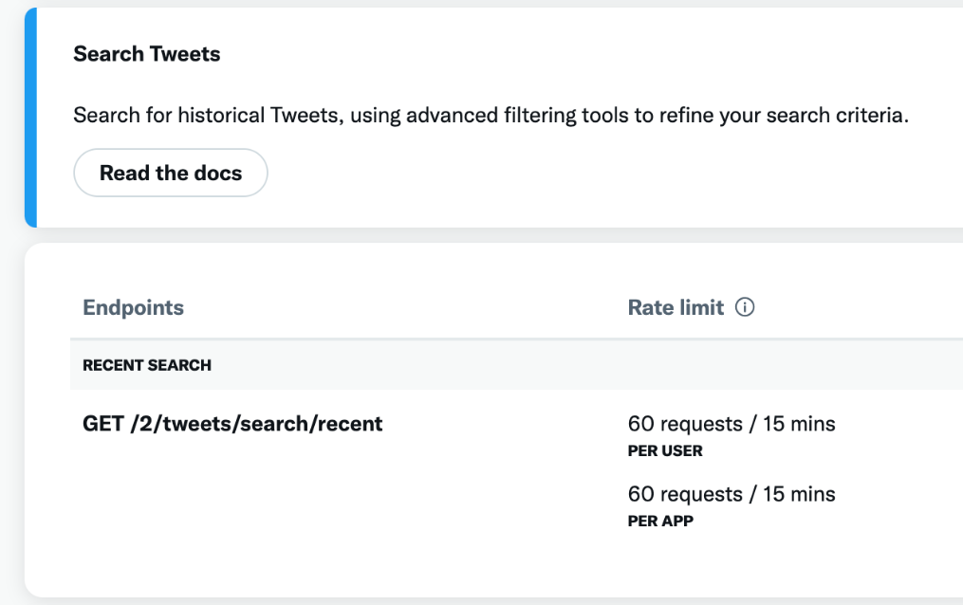
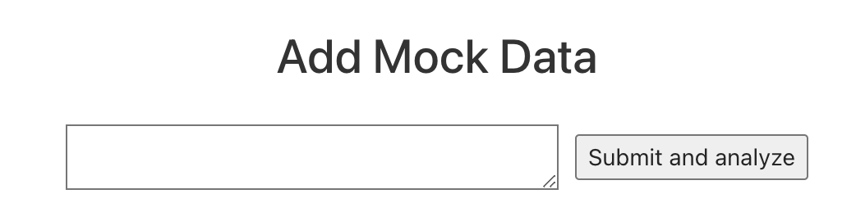
Core
——Data Collection
Original Expectations
1. Sentiment-140 Kaggle(1.6 million Tweets)(✔)
2. Spider towards Twitter API(--)
3. Mock data, data up to you!(new*)
Twitter free plan does not support tweets search :(

Slide 7
Core
——Data Processing
Original Expectations
1. Spark SQL(✔)
2. Spark distributed compute capability(✔)
1. Data Standardization: Normalize and standardize the format of 'sentiment-140' to ensure consistency across all datasets collected from social media
2. Data Storage: Store the data into Resources Repo(csv file)

Slide 8


Core
——Sentiment Analysis
Data Preprocessing
Clean the text by removing line breaks, URLs, and other non-relevant symbols to improve data quality.
Text Tokenization
Import the NLTK stopwords corpus to filter out common stopwords.
Apply text splitting to convert raw text into a list of words.
Feature Vectorization
Employ HashingTF from Spark's MLlib to vectorize the text data, transforming text into numerical feature vectors suitable for machine learning algorithms.
Model Training
Utilize the NaiveBayes classifier from Spark MLlib to train the sentiment analysis model on the prepared data.
Original Expectations:
1. Spark MLlib(✔)
2. Spark NLP(✔)

Slide 9
Core
——Result display
Original Expectations:
1. Spark Backend(✔)
2. React Frontend(✔)
Something New:
1. OpenAI API
Backend: Spark's Akka framework provided with two functional interfaces: one for viewing recent sentiment results of topics, and another for receiving mock data and invoking the model to update the data
Frontend: Utilizes React, offering two functions: one for retrieving sentiment analysis data on topics from the backend, and another for manually adding a data entry for text analysis, given AI advice based on data trend

Slide 10
Milestone
03/20-03/23: Set up the GitHub repository and initialized the project backend.
03/24-03/28: Selected the dataset and processed the data.
03/29-03/31: Chose a model for the dataset, initially achieving an accuracy of around 40%.
04/01-04/04: Identified issues with the initial model and improved model accuracy to over 67%.
04/04-04/07: Established the backend server using Akka and converted the interface to server logic.
04/08-04/10: Established the frontend and connected it with the backend.
04/11-04/12: Added the OpenAI dependency to the project.
04/13-04/14: Tested the system.

Slide 11
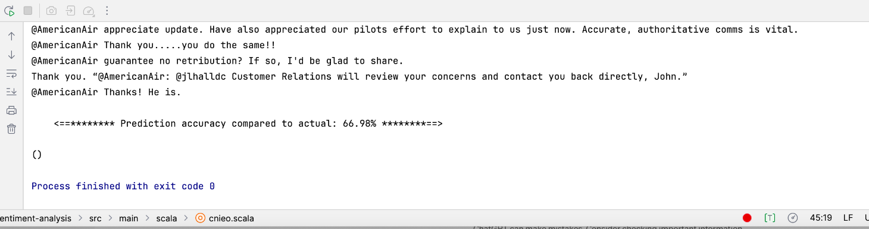
Criteria Achieved
Accuracy
Our model has a final accuracy of 67%.
The accuracy fluctuates a bit, but stays between 67% and 69%.
This did not meet our initial requirement of 70%.
We thought we could expand the training set to get a more efficient model.
We could also try to incorporate third party corpus like the Stanford corpus for further training.

Slide 12
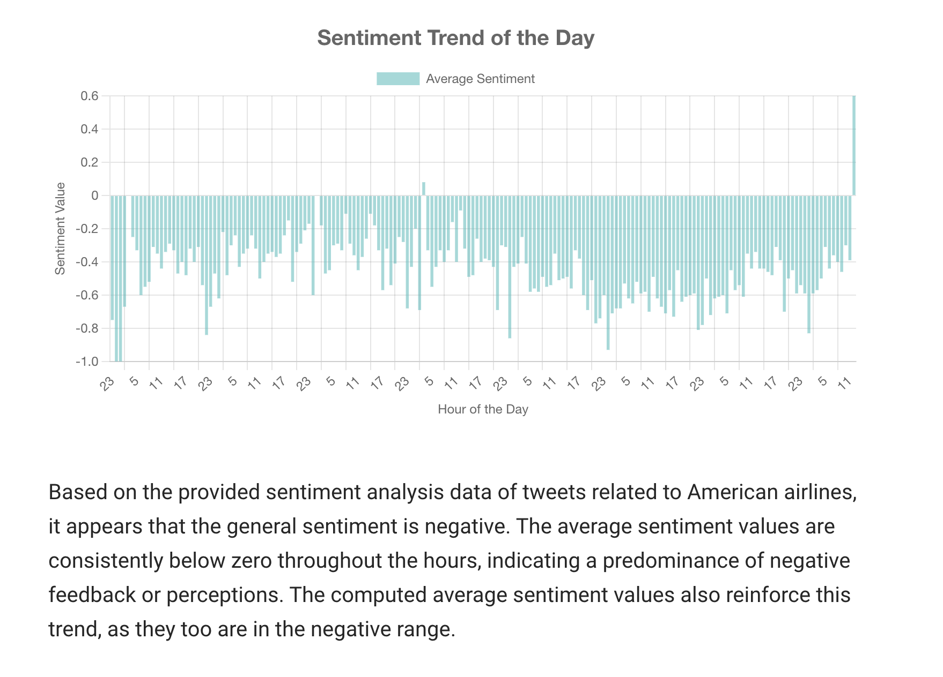
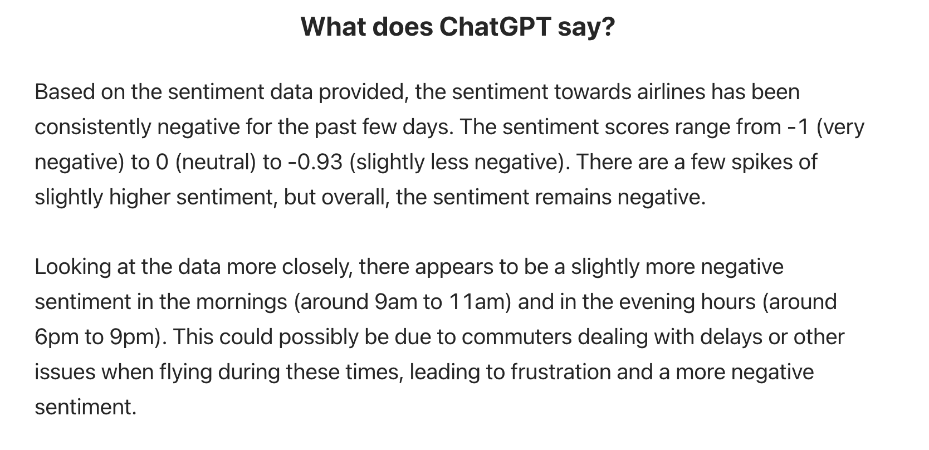
Criteria Achieved
Frontend
1.React frontend with diagram(✔)
Built a front-end using React and Node.js, where users can select different topics to get the latest sentiment trends related to that topic.
2.Incorporating AI engine (✔)
Incorporating the gpt-3.5-turbo-instruct model, gpt parses existing data and makes reasonable predictions. In the future, we can add a user quiz function.

Slide 13
Original Goals
Implement a system for instant sentiment analysis on social media to help find the trend of the public(✔)
Use advanced NLP and Machine Learning to categorize data(✔)
Ensure the system can efficiently process large data volumes from various platforms without sacrificing speed or accuracy.(✔,Future)
Create a user-friendly dashboard that clearly presents real-data, trends, graphs and predictions, etc. Display UI can changed related to the user device(Mobile, Laptop)(Responsive Display)(❌)

Slide 14
Future Improvement - Expand training set
Reason: Utilized 1.6 million tweets from the Sentiment-140 Kaggle dataset.
Result: Current model achieves <70% prediction accuracy.
Enhancement:
Expand Dataset: Incorporate additional datasets such as Stanford's corpus to enrich training data.
Manual Augmentation: Increase the training set manually by adding more diverse comments.

Slide 15

Future Improvement - Add multiple topics & Implement Twitter API
Reason: Currently display topic is using a single dataset focused on American Airlines comments on Twitter
Result: There is only one topic in our system
Enhancement:
Diverse Test Sets: Introduce additional test sets(Twitter API) covering a range of topics to enhance predictive accuracy and applicability.
Web Interface Updates: Add new pages to display results by topic with an integrated search functionality.

Slide 16
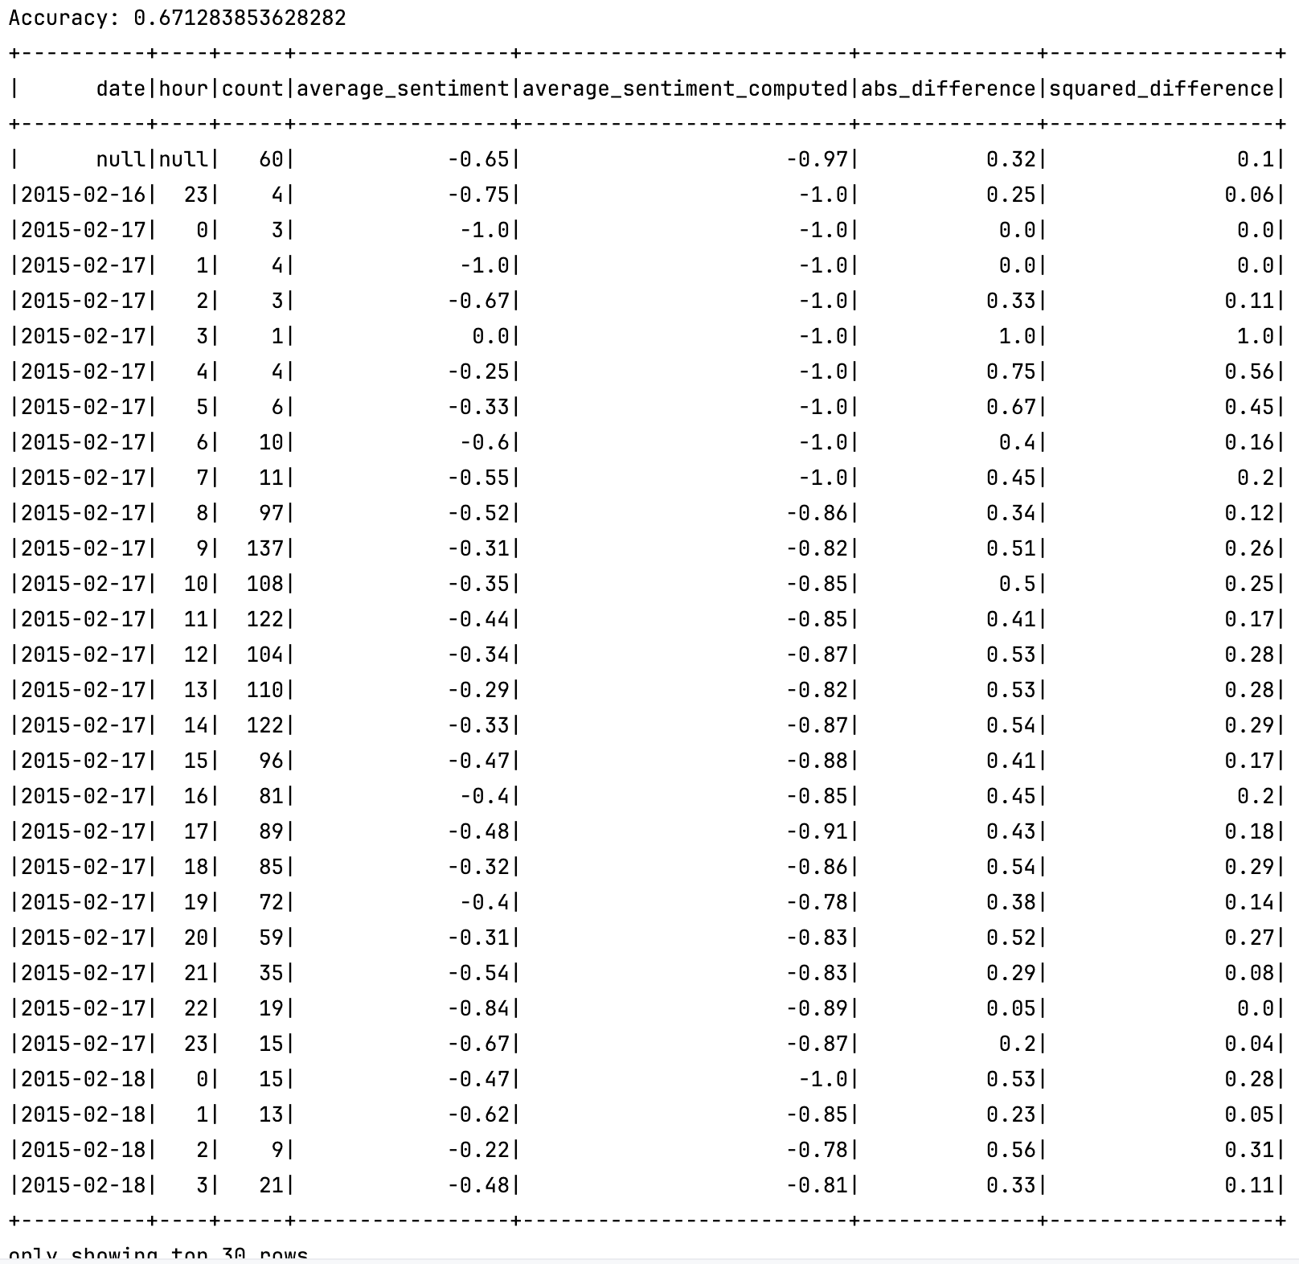
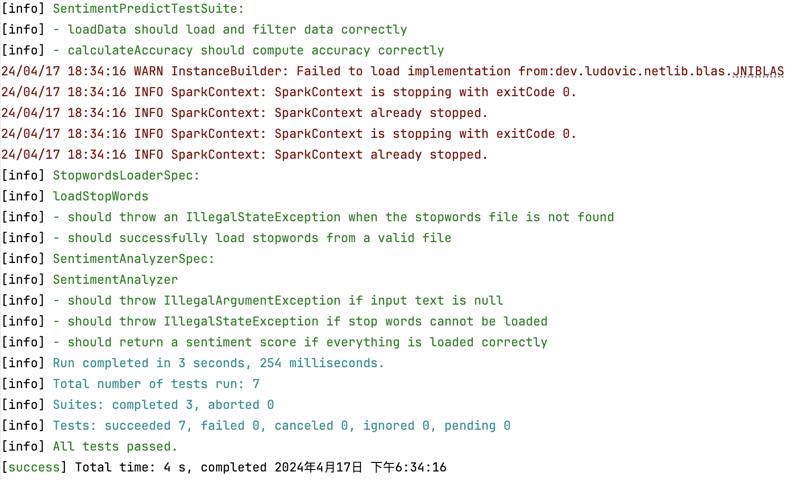
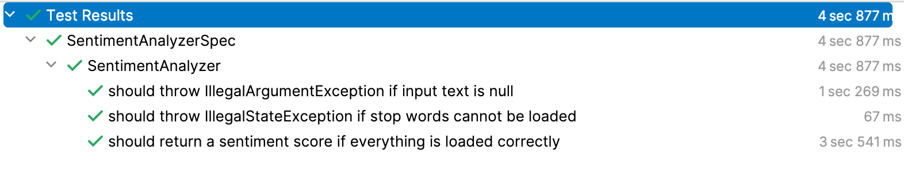
Tests
Load data
Prediction to sentiment

Slide 17
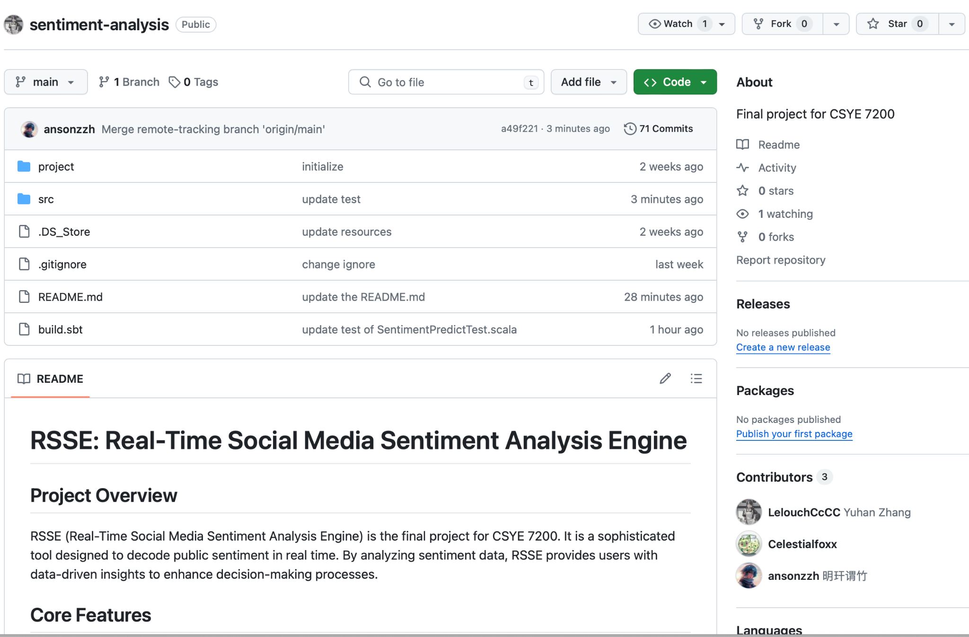
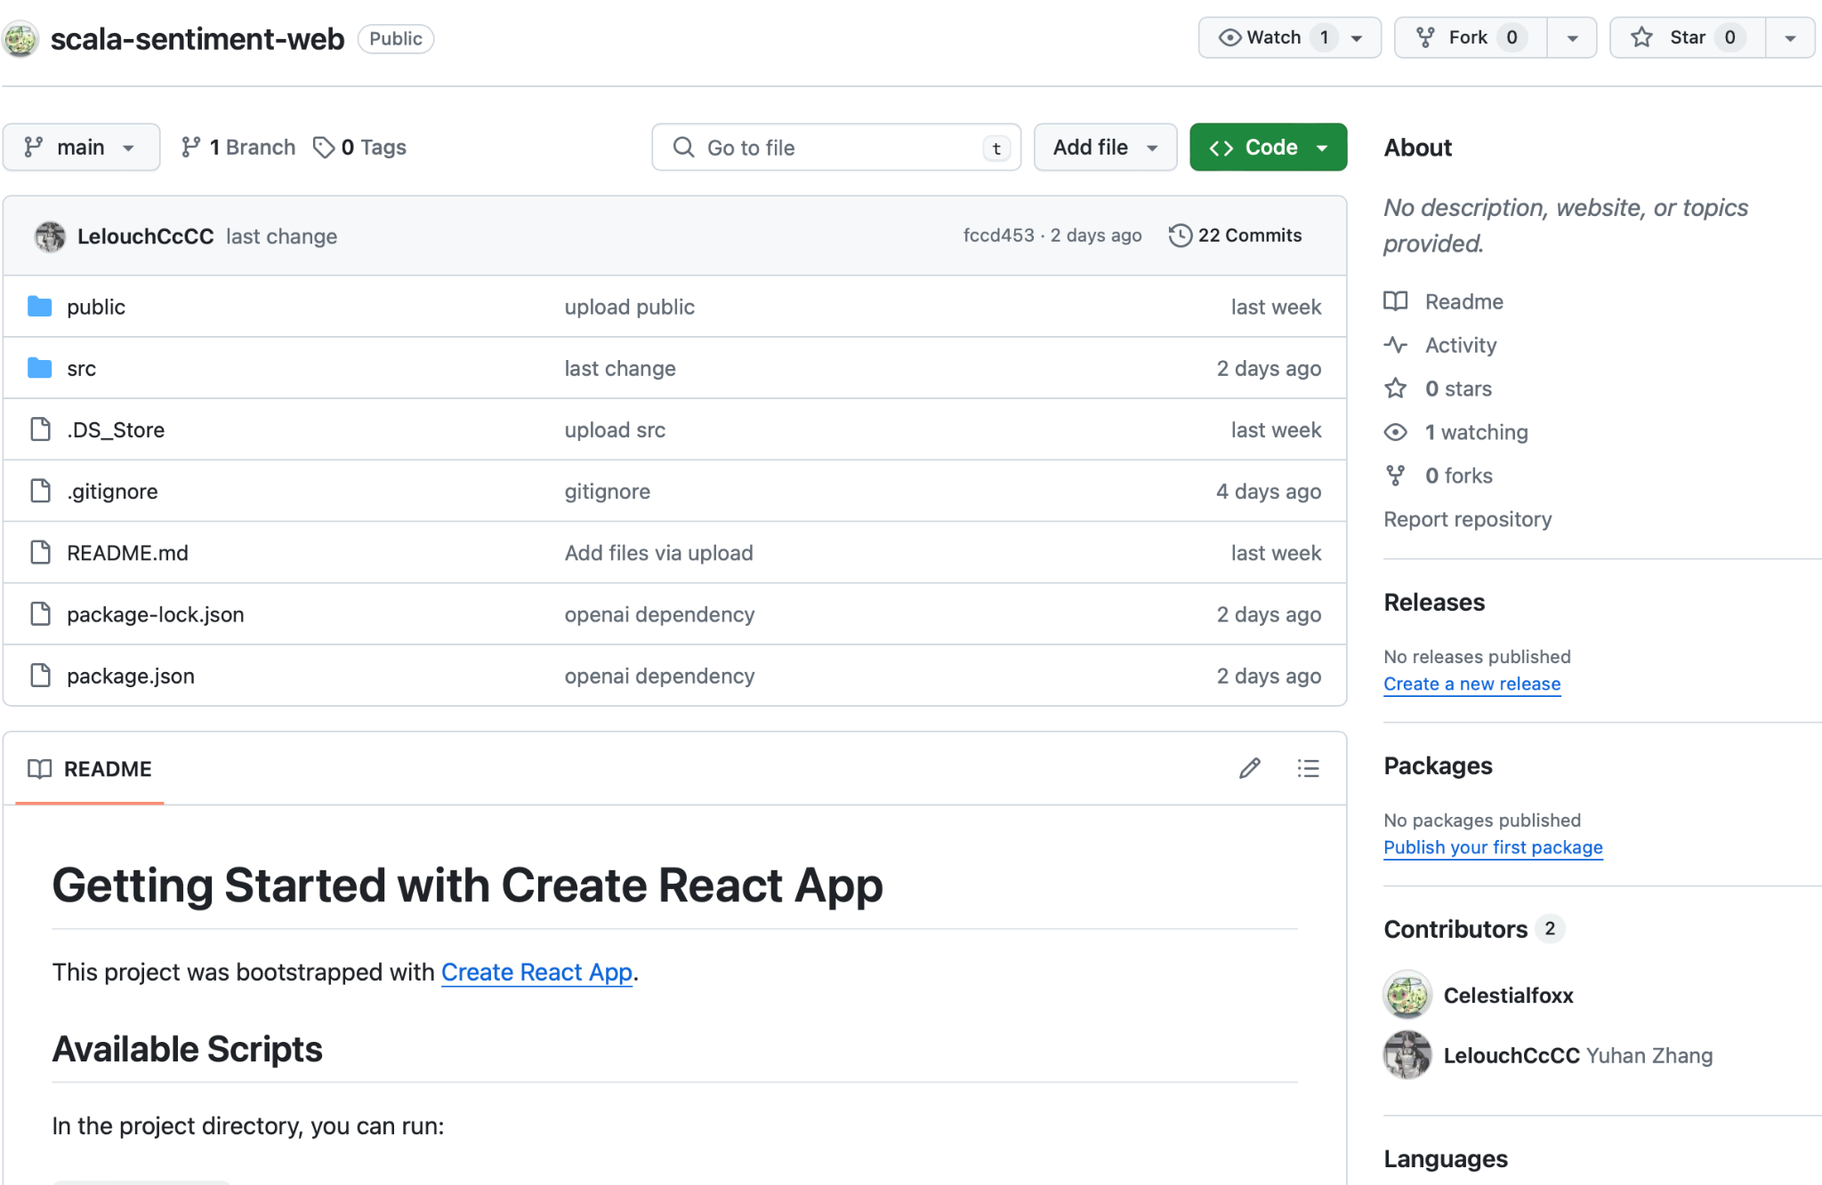
Repository
https://github.com/Celestialfoxx/scala-sentiment-web
https://github.com/LelouchCcCC/sentiment-analysis

