Slide 1
Aquatic Foods in the North Maluku Diet
Household Consumption and Nutrient Adequacy
SUSENAS March 2020
Farid Annam

Slide 2
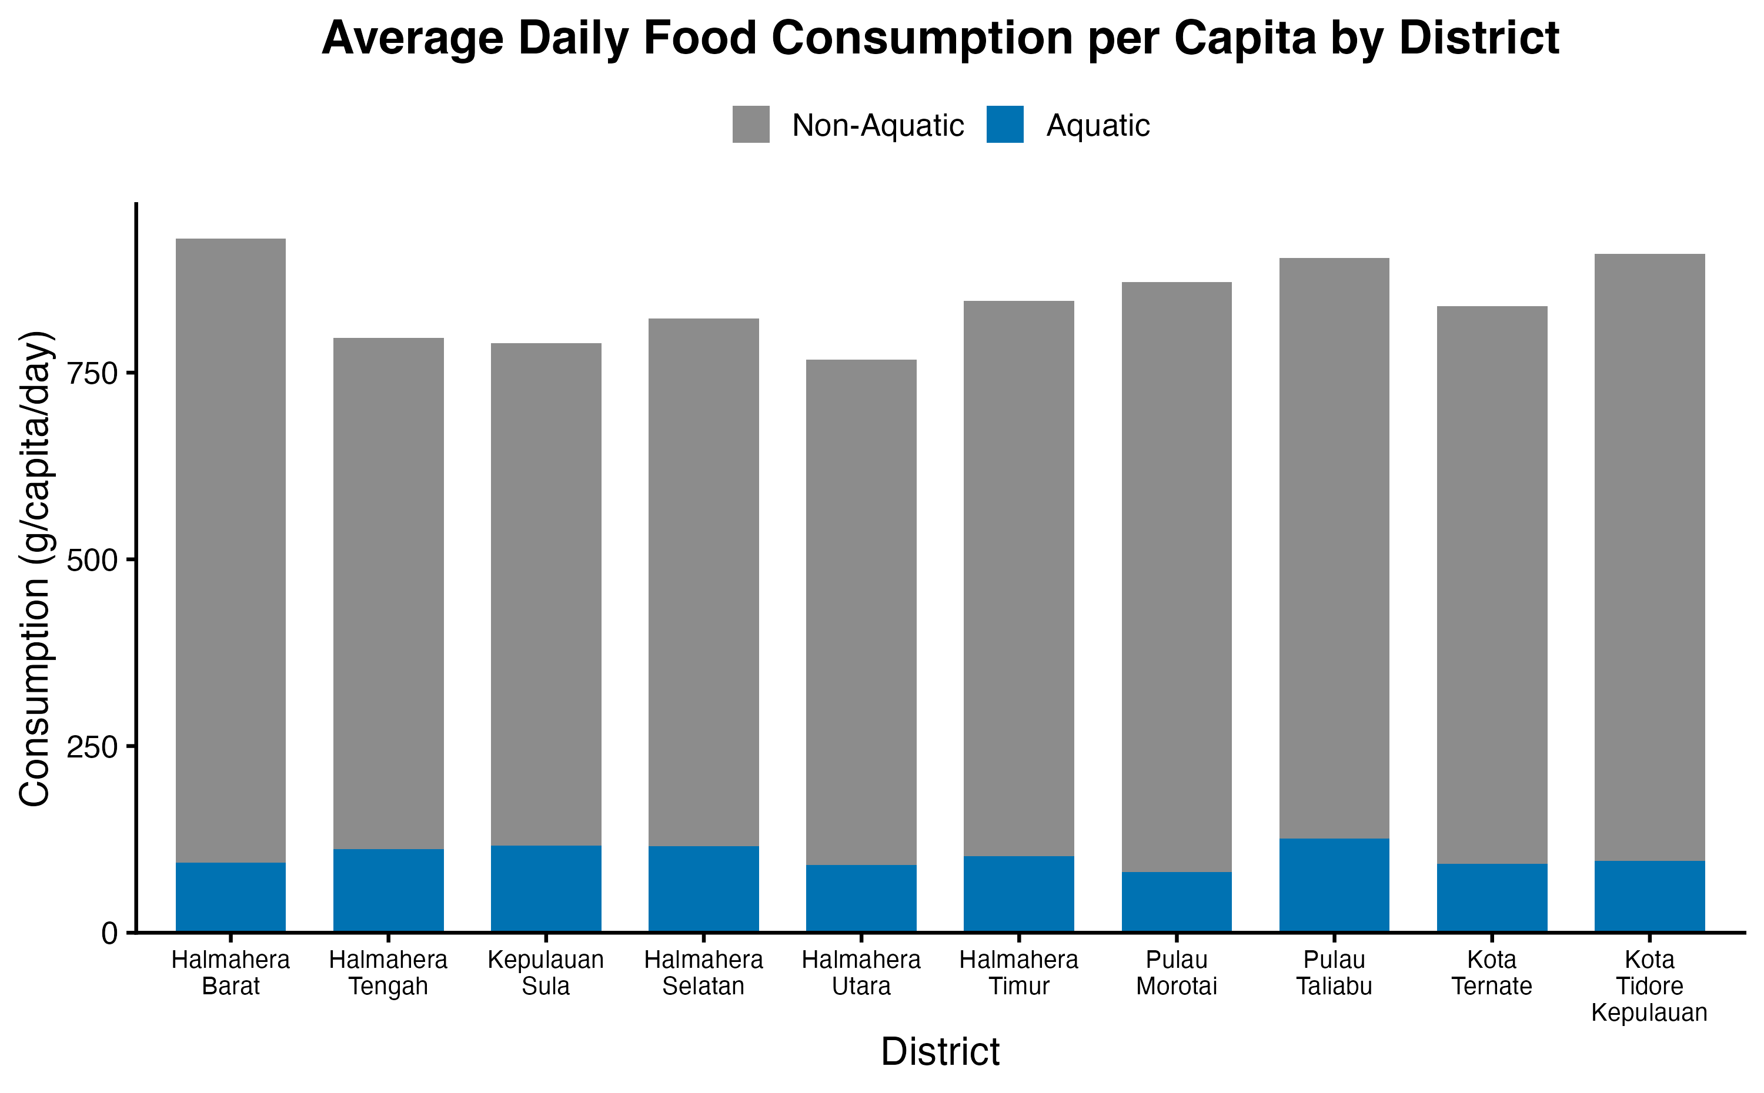
Average Daily Food Consumption per Capita by District
▪ Daily food consumption is 770 to 930 g per person across the ten districts.
▪ Aquatic foods add 80 to 130 g per person per day in every district.
▪ The weighted provincial fish figure is 101.6 g per person per day, match to the BPS March 2020 report.
▪ Aquatic foods are 9 to 15% of food weight: highest in Kepulauan Sula, Halmahera Selatan, and Halmahera Tengah, lowest in Pulau Morotai.

Slide 3
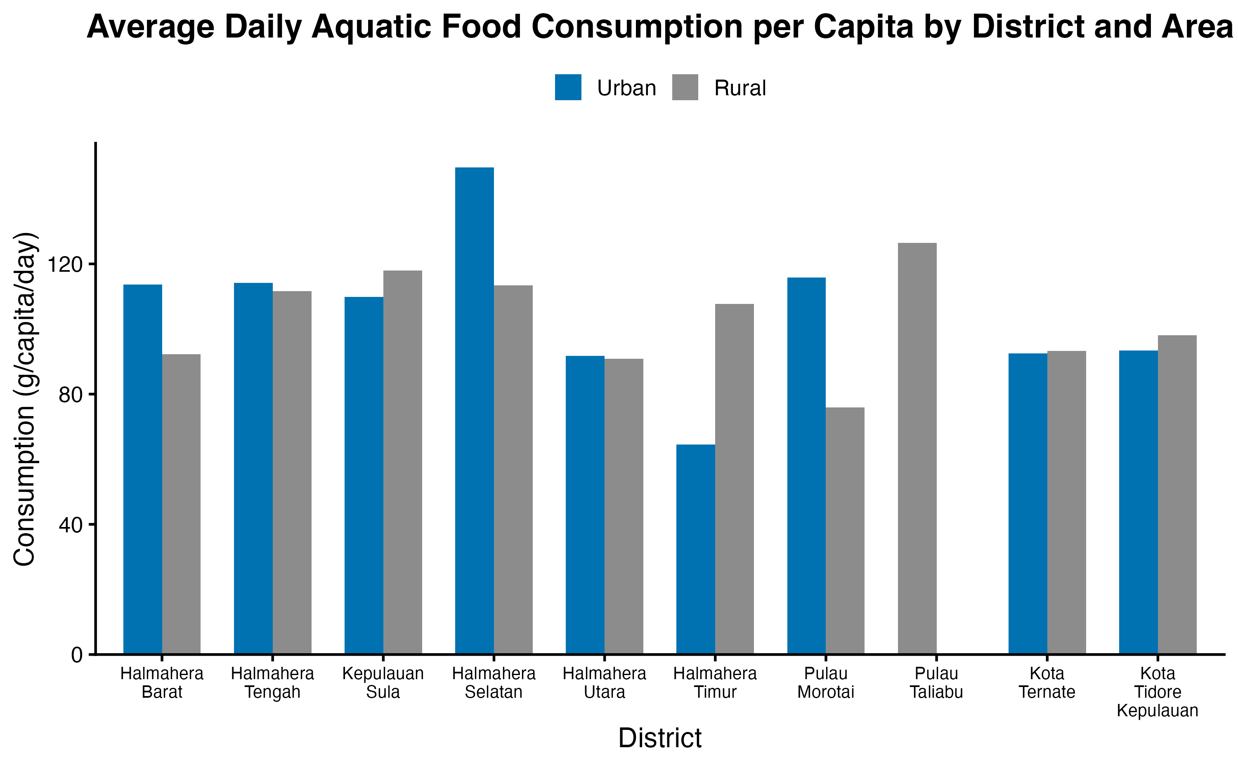
Urban and Rural Aquatic Consumption per Capita
▪ Urban and rural fish consumption differ by less than 5 g per day in Halmahera Tengah, Halmahera Utara, Kota Ternate and Kota Tidore Kepulauan.
▪ Rural consumption is higher in Halmahera Timur (108 vs 64 g). Urban consumption is higher in Pulau Morotai (116 vs 76 g) and Halmahera Selatan (150 vs 113 g).
▪ Pulau Taliabu has a rural sample only and the highest fish consumption, 127 g per person per day.

Slide 4
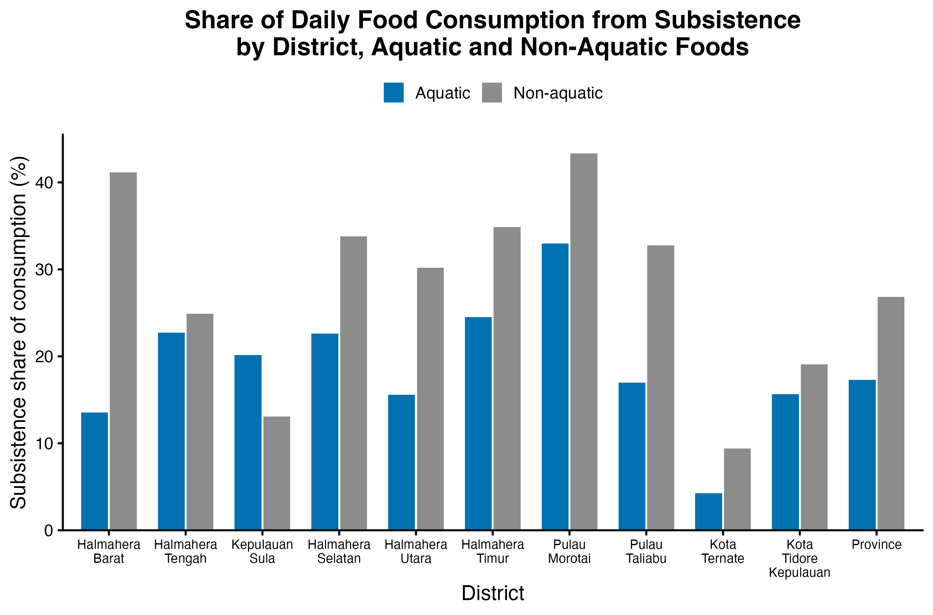
Subsistence Share of Consumption: Aquatic and Non-Aquatic Foods
▪ Province-wide, 17% of aquatic food and 27% of non-aquatic food come from subsistence.
▪ Non-aquatic food has a higher subsistence share in nine districts. Kepulauan Sula is the exception: 20% for aquatic food and 13% for non-aquatic food.
▪ Pulau Morotai has the highest shares: 33% aquatic and 43% non-aquatic. Kota Ternate has the lowest, 4% and 9%.

Slide 5
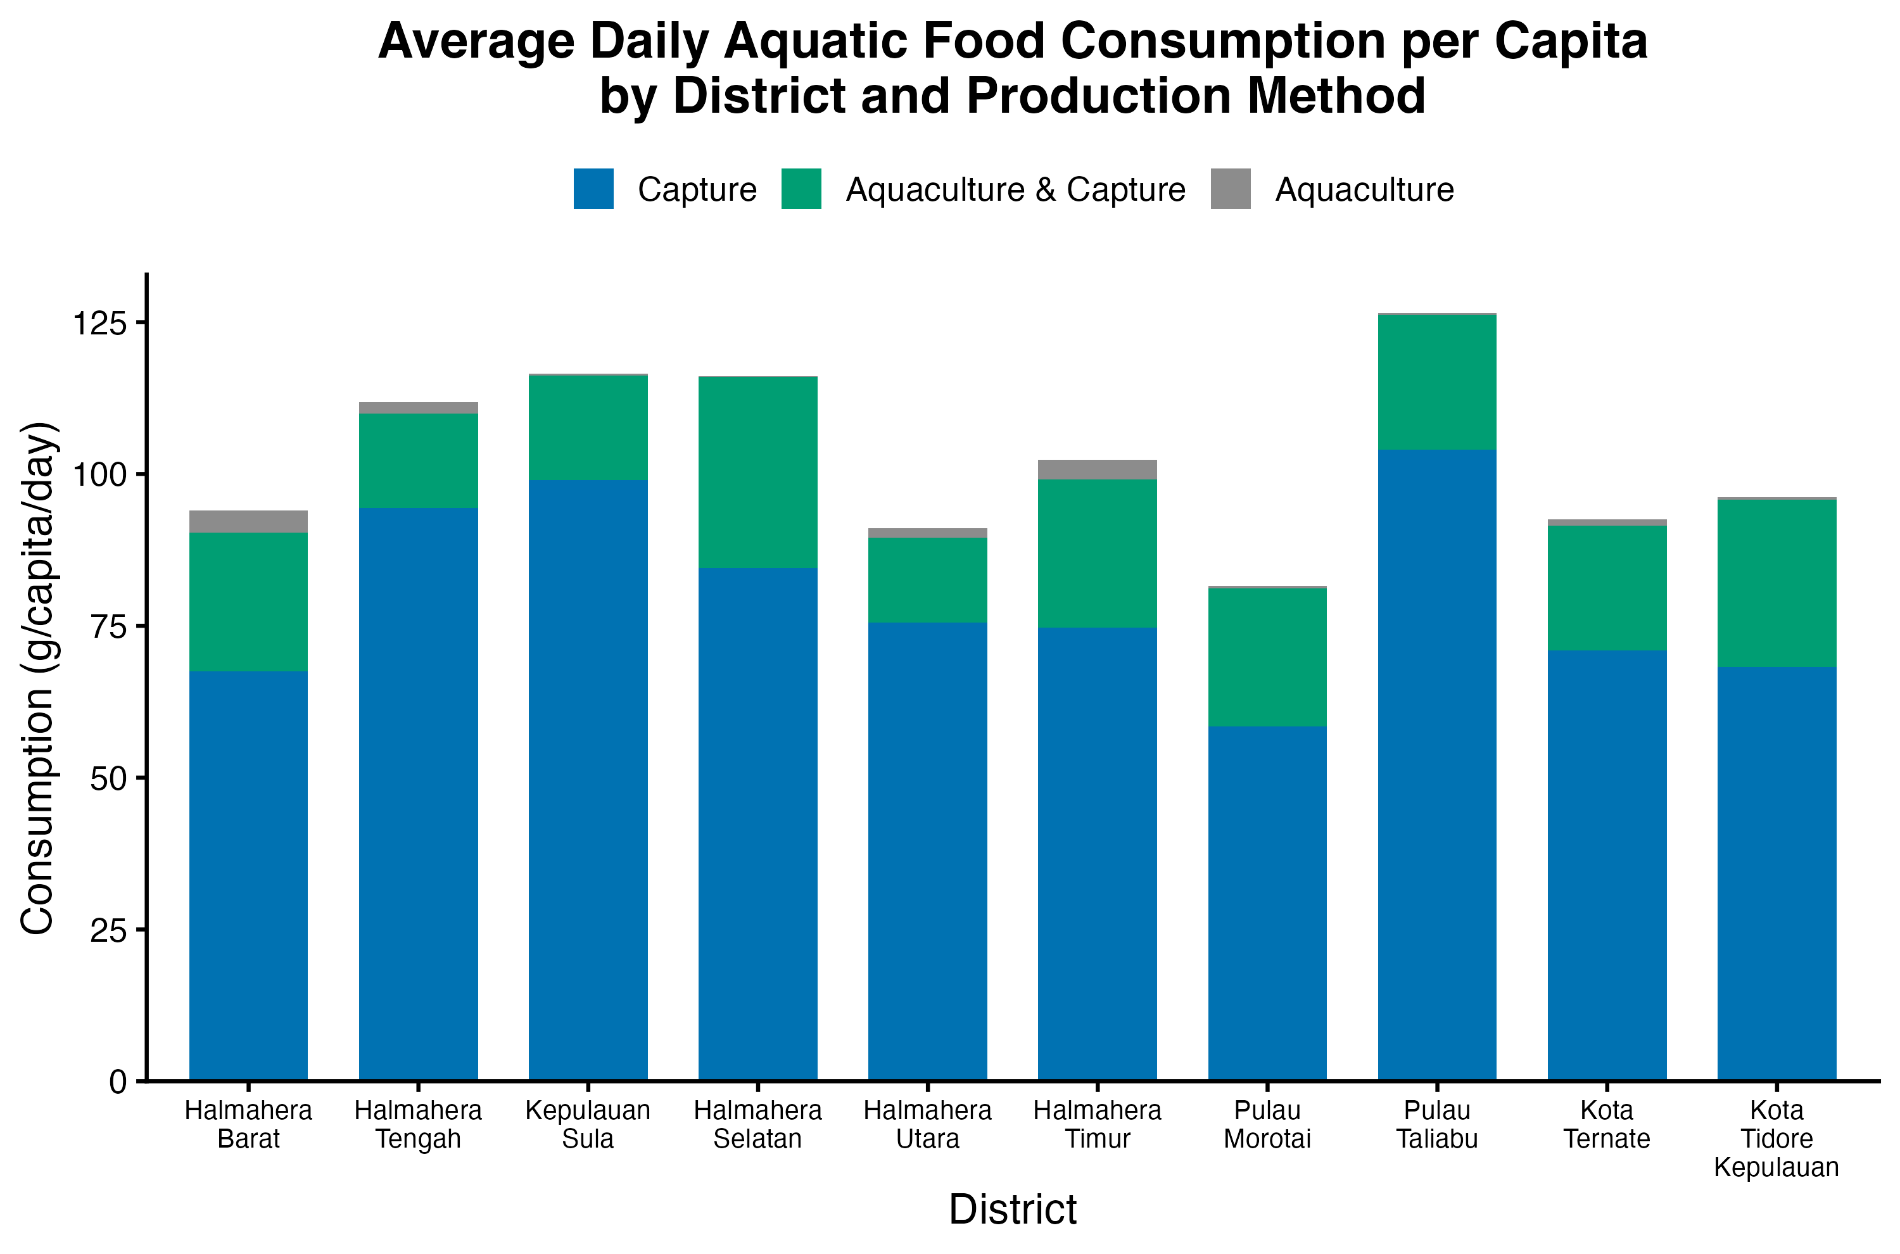
Aquatic Consumption by District and Production Method
▪ Capture fisheries supply 77% of aquatic food weight, 78 g per person per day.
▪ Species that come from both aquaculture and capture supply 22%. Aquaculture-only species supply 1%.

Slide 6
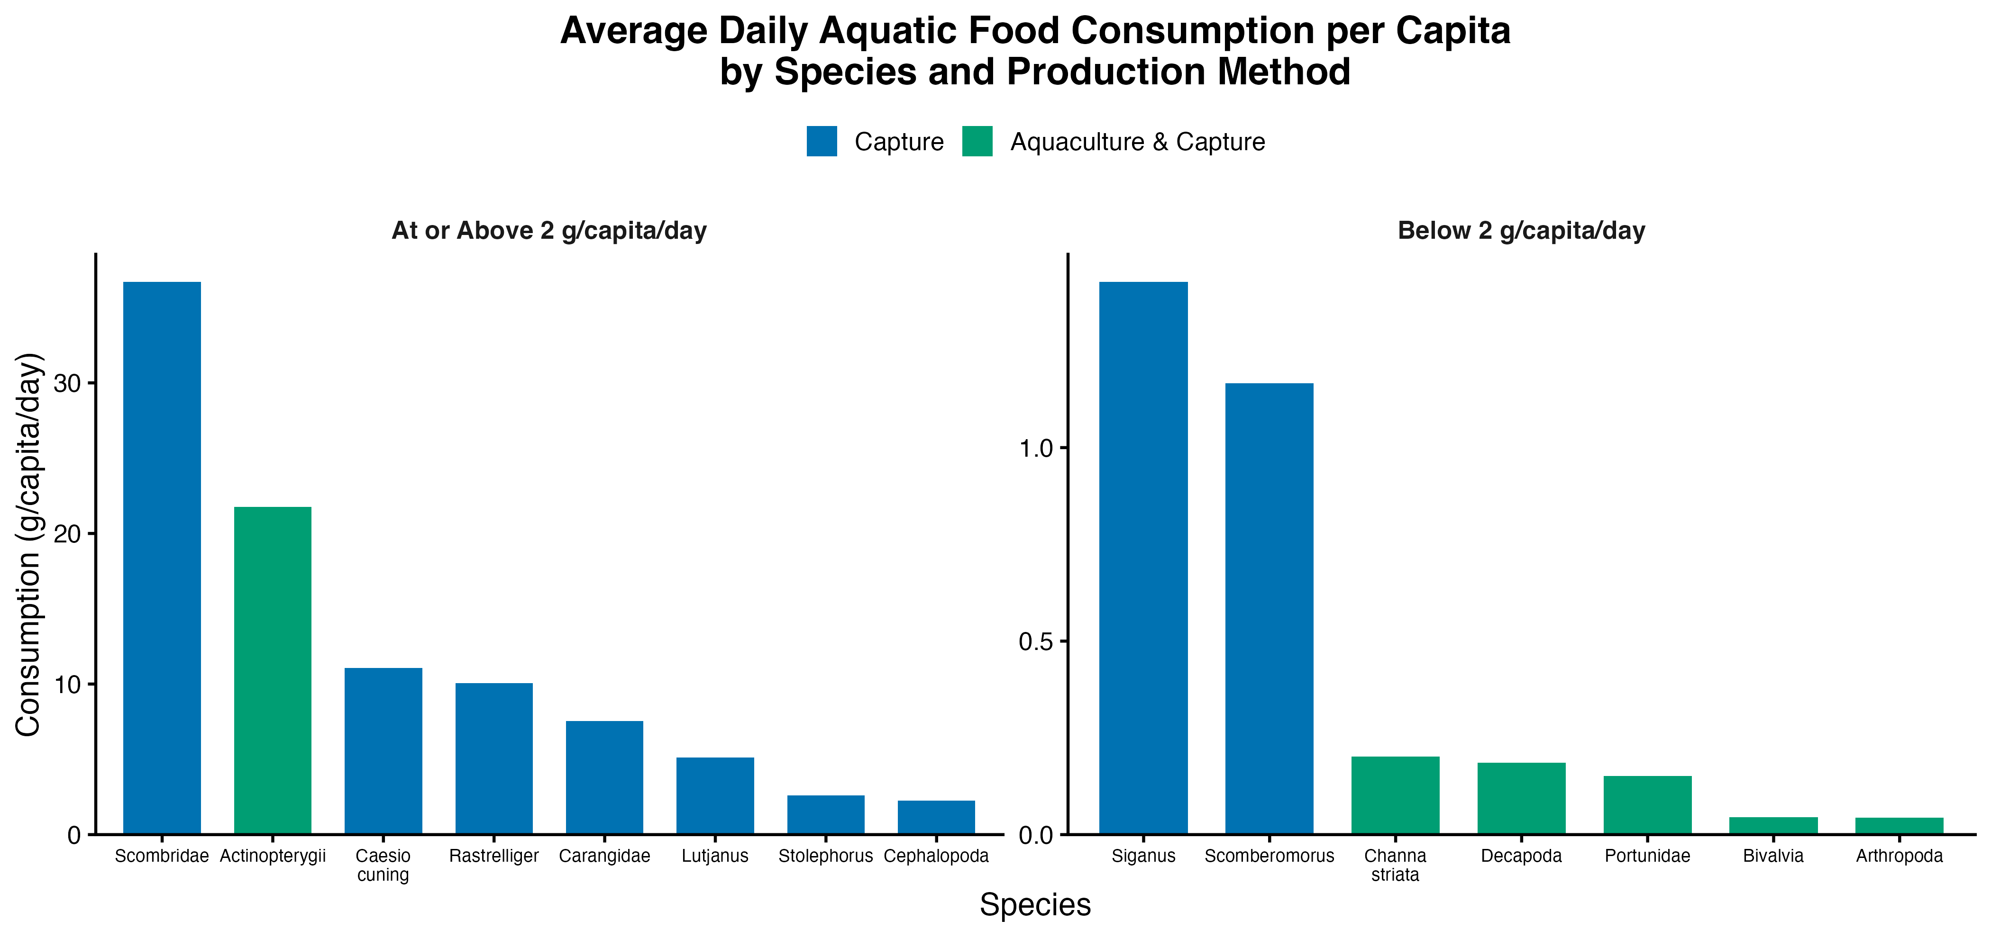
Aquatic Consumption by Fish Species
▪ The Scombridae group (tongkol, tuna, cakalang) is the largest contributor, 37 g per person per day, about one-third of all fish.
▪ Other fresh fish (Actinopterygii) follows with 22 g, then Caesio cuning (11 g) and Rastrelliger (10 g).
▪ The right panel shows the remaining species, each under 2 g per day.
▪ Fresh and preserved forms of a species are combined.

Slide 7
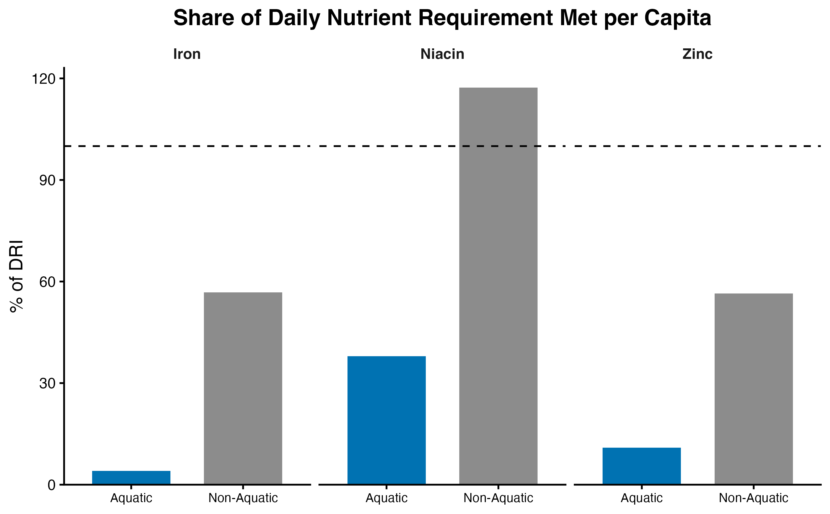
Nutrient Adequacy: Share of DRI Met per Capita
▪ Iron and zinc intake are below the requirement: 61% for iron and 67% for zinc (reference: adult women).
▪ Niacin intake is 155% of the requirement. Aquatic foods provide 38% of it.
▪ Aquatic foods provide 4% of the iron requirement and 11% of the zinc requirement, from 12% of food weight.
▪ Fish values now include the edible portion (19 to 61%), so fish contributions are lower than in the previous version.

Slide 8
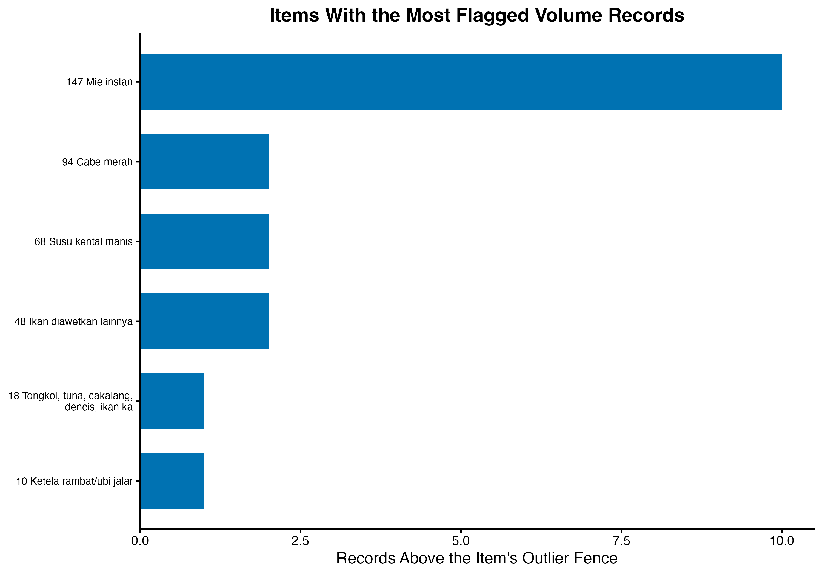
QC: Implausible Volumes
▪ Of 146,636 consumption records, 18 report amounts far above what other households buy of the same item.
▪ Ten of the 18 are instant noodles: households that report many packets per person per day, possibly small food stalls.

Slide 9
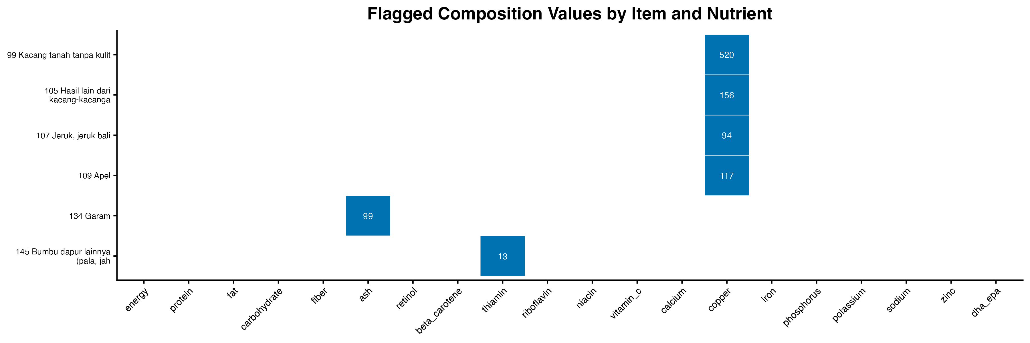
QC: Implausible Composition Values
▪ Screening the composition values flags six items across three nutrients.
▪ The copper values (520 mg per 100 g of peanuts, 117 mg per 100 g of apples) are impossible and point to a unit error in TKPI.
▪ The other two flags are true extremes, not errors: salt is 99% mineral matter, and dried spices are rich in thiamin.

Slide 10
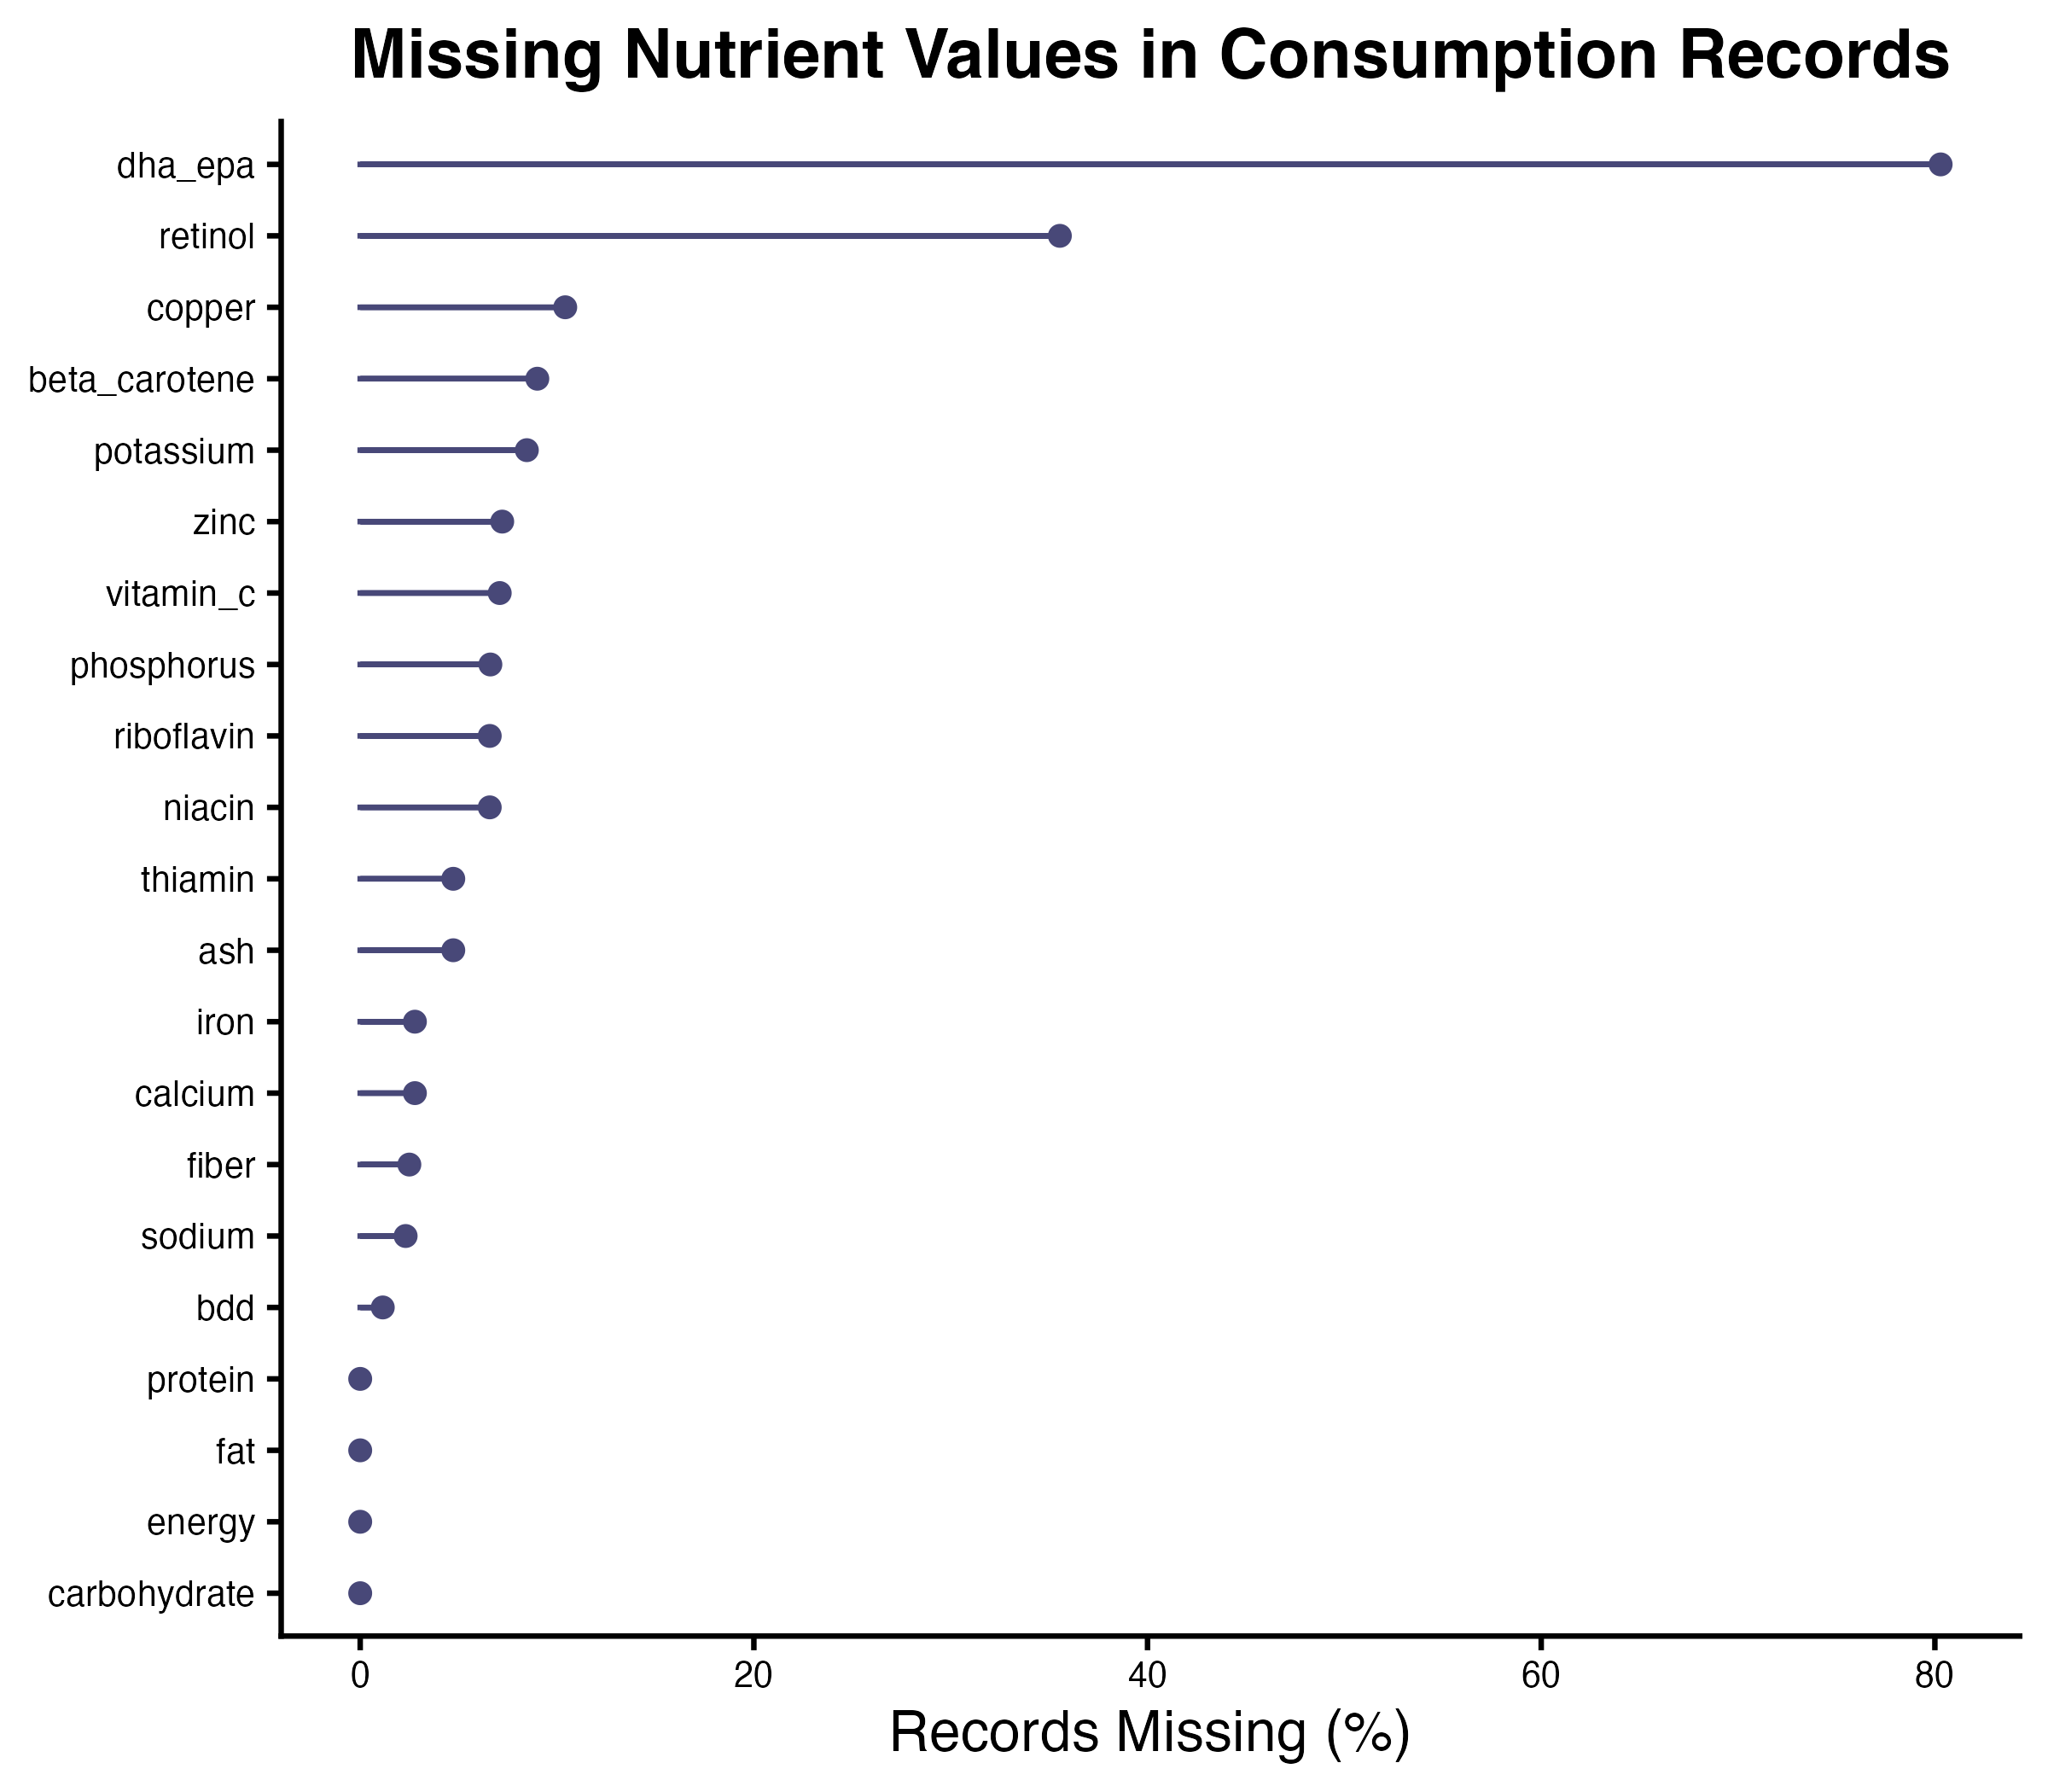
Data Quality: Missing Values by Nutrient
▪ Energy, protein, fat, and carbohydrate are complete in every record.
▪ Retinol is missing in 36% of records and copper in 10%. The other minerals and vitamins are missing in 2 to 9%.
▪ DHA+EPA is missing in 80% of records because only fish and a few prepared foods carry a value.
▪ A missing value counts as zero in the intake, so these nutrients are underestimated.

Slide 11
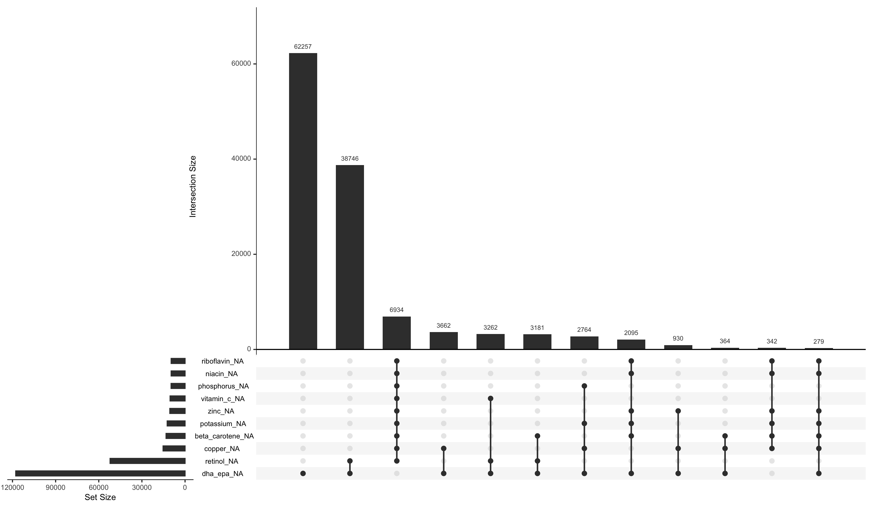
Data Quality: Missing-Data Patterns
▪ Each bar is one missing-data pattern: a set of nutrients that are blank in the same records.
▪ 62,257 records lack only DHA+EPA. 38,746 lack DHA+EPA and retinol.
▪ 6,934 records lack every vitamin and most minerals. These are three gap-filling items (coffee, MSG, packaged bumbu) built from product labels, which declare few nutrients.
▪ No record lacks energy, protein, fat, or carbohydrate.

Slide 12
Summary: What Aquatic Foods Contribute
▪ Aquatic foods are about 100 g per person per day, 9 to 15% of food weight, in all ten districts.
▪ Aquatic foods provide 22% of protein, 24% of niacin, 16% of zinc and 7% of iron intake.
▪ Capture fisheries supply 77% of aquatic food, led by the Scombridae group. Aquaculture supplies 1%.
▪ Iron (61% of requirement) and zinc (67%) are below the requirement in every district. Niacin exceeds it.

