Slide 1
Process of Silent
BASED ON AN IMPROVISED POWERPOINT BY FLIPFTW

Slide 2












Tokens
Blu
Red
This slide literally for my convenience

Slide 3
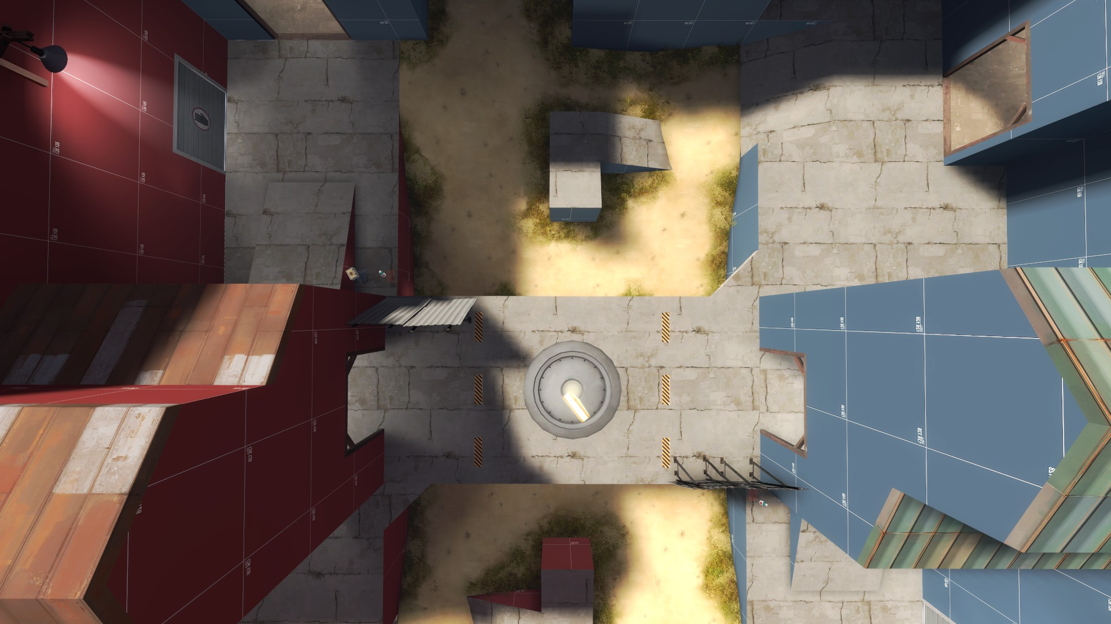
Midfight: Right
IK It’s left from this perspective, sue me
Goal: Faster rollout, lock out doors ASAP
Roamer: Rollout left to watch flank and to bomb enemy
Flank Scout: Take space on point, if enemy rolls fully on left maybe rotate through house
Pocket Soldier: Take space on point
Demo+Combo Scout: Rotate through house to either take space on point or just fight the enemy. Demo can bomb point
Med: Follow combo, arrow flank + pocket but keep beam on scout and demo
Enemy Left Mid
Enemy Right Mid
Both

Slide 4
Midfight: Left
IK It’s right from this perspective, sue me
Goal: Abuse higher ground to spam out enemy + trap enemy in their connector if they are conditioned
Roamer: Bomb point, spam connector to try to force enemies out. Skip jump through their connector or bomb from point when applicable. Spam through their connector when applicable.
Flank scout: Roll out with combo, deny enemies coming through connector. Rotate to Roamer on point to help.
Pocket: Take space on point, skip jump through connector if enemy is too passive
Combo Scout + Demo: Take space in connector if enemy takes right side mid, take space on point if enemy takes left side mid
Med: Stay on your left side, rotate heals between connector and point.
Enemy Left Mid
Enemy Right Mid
Both

Slide 5
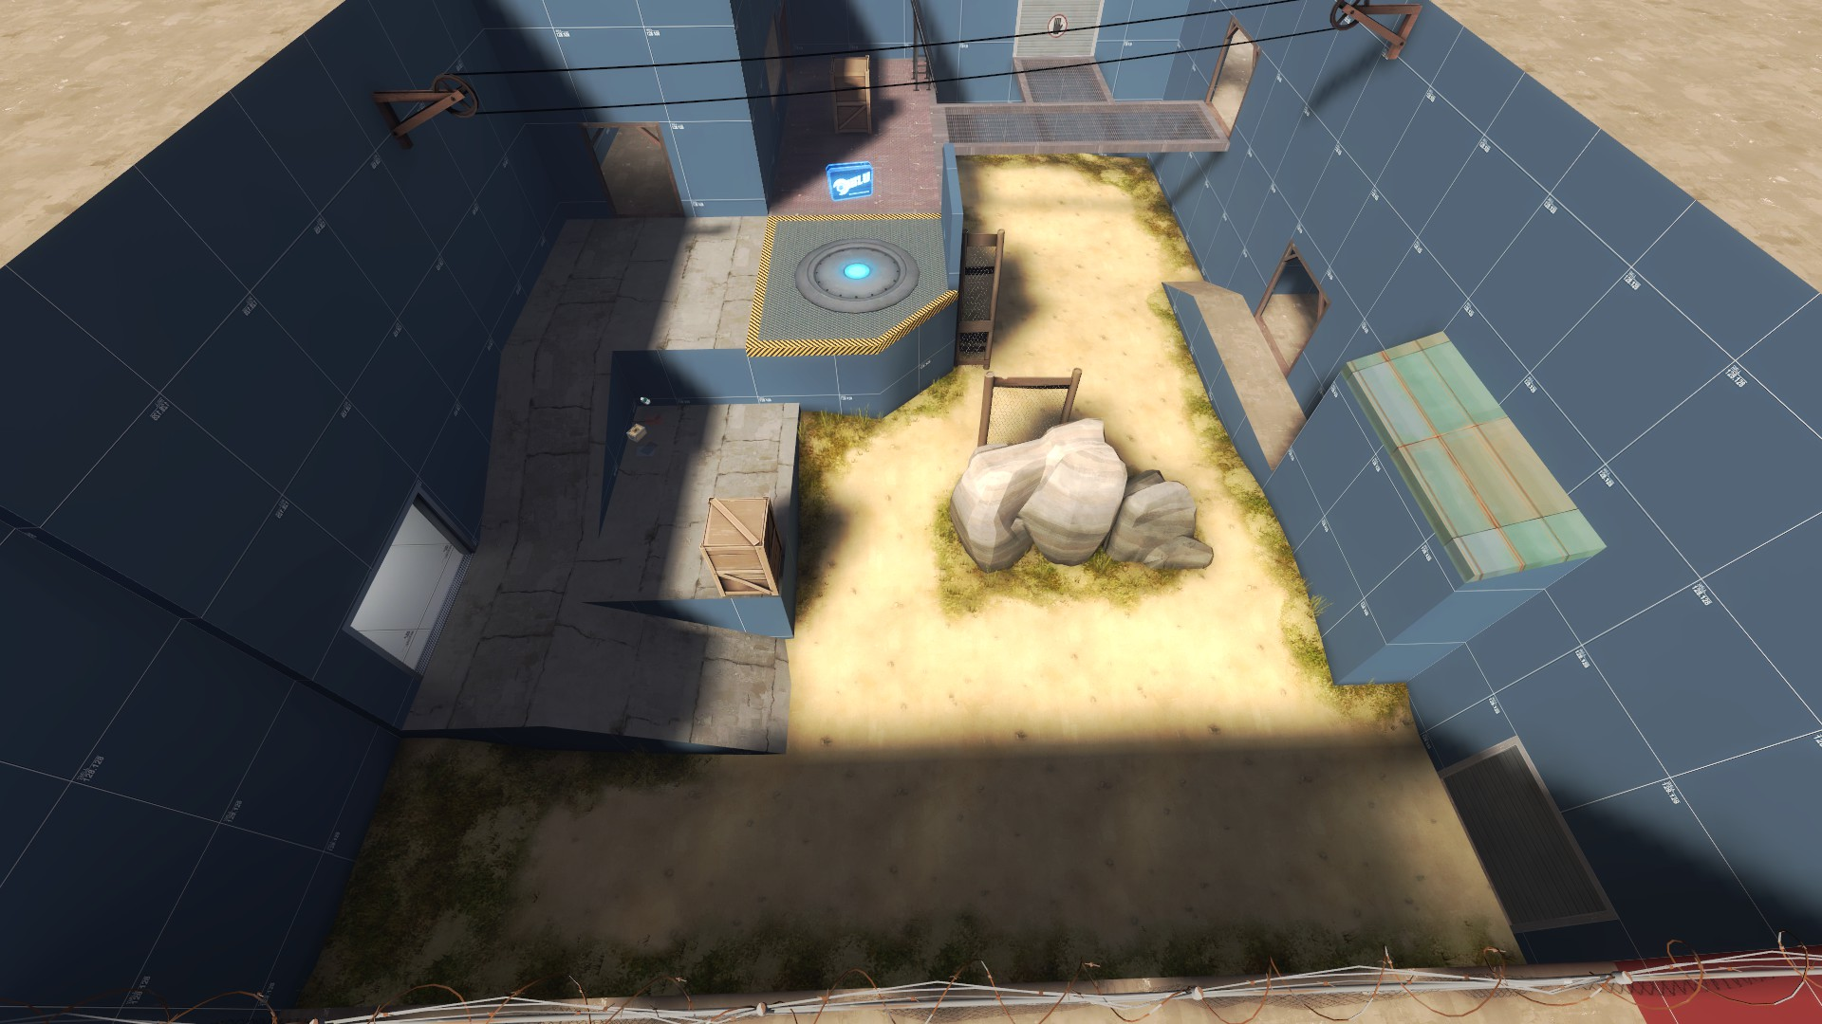
Second (Even Ubers Only)
Hold Low Ground, Deny any Lower pushes whatsoever.
Med: Standing on grey near exit. Keep beam on demo, combo scout, and pocket if he rotates back
Demo: Traps on shutter, ready to det at any opprotunity
Combo Scout: Standing on grey box, watching for bombs and protecting med
Flank Scout and Roamer: Watching/Spamming Killbox
Pocket Soldier: On rotate between rock and metal, helps combo or flank depending on where he’s needed. When on rock, watching for pushes from Killbox and flanks from Main to Toxic
Rotate
Vision

Slide 6
Second (Even Ubers)
Watch Highground route,deny any uber through whatsoever
Flank plays on Grey, can just run up to medic for a buff. Watches shutter and (partially watching Main if Pocket is dead)
Pocket watches Main from point, ready to jump anyone who steps out
Demo and scout watch Death Hallway, spams people trying to go Toxic
Rotate
Vision

Slide 7
Second (Disad)
Watch Highground route,deny any uber through whatsoever
Flank plays on Grey, can just run up to medic for a buff. Watches shutter and (partially watching Main if Pocket is dead)
Pocket watches Main from point, ready to jump anyone who steps out
Demo and scout watch Death Hallway, spams people trying to go Toxic
Rotate
Vision
Leaving

Slide 8
Second Holds
Second A is default hold, more consistently powerful and has plenty of room for rotations
Second B should only be held if you know that enemies will be coming Death Hallway, or if you are on Disad.
Second A is not good on disad, as it’s easier for enemies to get behind through Toxic.

Slide 9
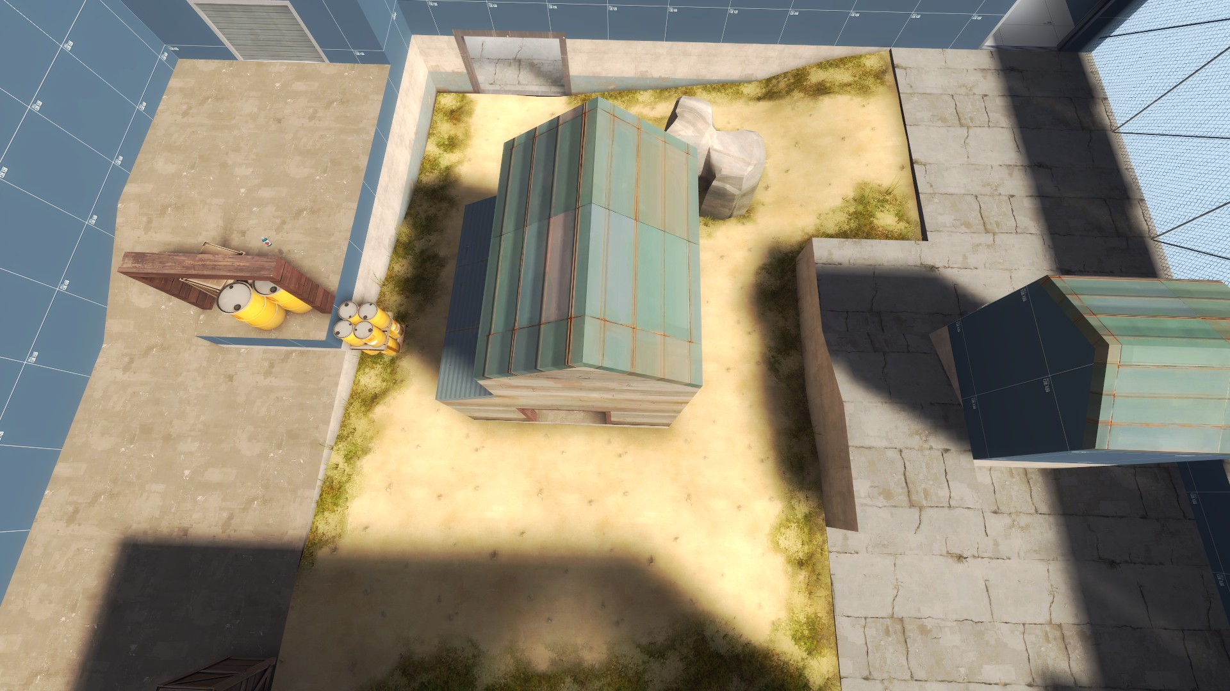
Last (No forward hold?)
Flank plays by tower(?) to spam out people trying to slip by from the far right
Pocket plays on roof to watch lower and spam people out
Demo has traps on shutter, det as soon as someone rears their heads
Rotate
Vision

