Slide 1

A data-powered strategy to select the safest aircraft for operational success and investor confidence.
Presentation by Your Joram Lemaiyan Mugesa

Slide 2
Agenda
Introduction to Aviation Risk Insights
Key Findings from Visualizations
Business Context and Importance
Recommendations for Action
NTSB Dataset Overview
Data Analysis Methodology

Slide 3
Problem Statement And Objectives :
To identify which aircraft make and model have the lowest historical accident rates, fewer fatal incidents, and lower safety risks.
Goal and Objectives :
To identify the safest aircraft manufacturers and models using real accident data.
Objectives:
Know which brands have a bad safety record
Find reliable aircraft models for commercial use
Make decisions based on evidence, not brand popularity

Slide 4

Business Context & Dataset
Importance of Safe Aircraft Investments
NTSB Accident Data Overview
Investing in aircraft with proven safety records significantly lowers financial risk, ensuring better returns while prioritizing human lives and well-being.
The dataset, covering 1962-2023, reveals crucial patterns and statistics about aviation accidents, enhancing informed decision-making for investors.

Slide 5
Data Analysis Process and Methodology Overview
4
Data Cleaning and Standardization
Combined Risk Score Calculation
Visualized insights in Tableau
Removed records with excessive missing values, standardized aircraft names, and corrected formatting issues to ensure accurate grouping and analysis.
Calculated a combined risk score for each aircraft make by multiplying accident frequency by average severity. This allowed us to rank aircraft based on both how often and how badly they were involved in incidents.
Developed interactive dashboards to compare aircraft safety performance and support business decision-making with clear, data-driven visuals.
Severity Scoring System
Created a custom severity score for each incident using weighted values for fatalities, serious, and minor injuries. This provided a clearer picture of accident impact. Weighted formula: Fatal × 3, Serious × 2, Minor × 1 Used to measure how severe each accident was.
Focused Analysis Areas
Grouped insights into three focus areas:
Make and Model Overview
Injury and Damage Patterns
Safer Aircraft Identification based on consistent survival outcomes.

Slide 6
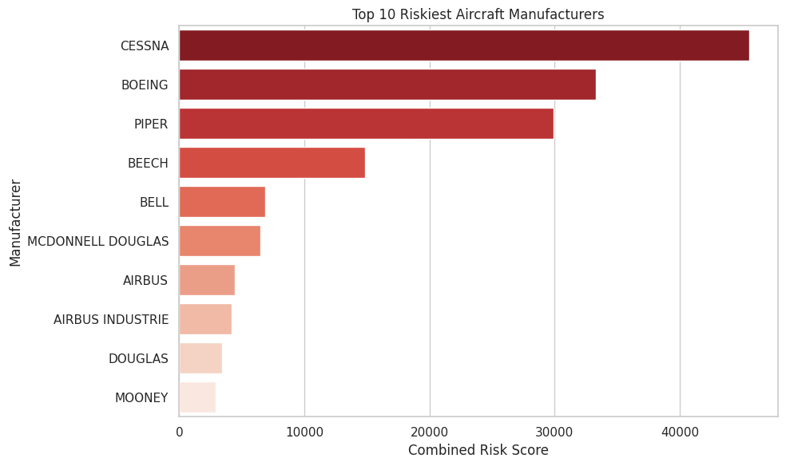
Key Findings – Riskiest Manufacturers
CESSNA, BOEING, and PIPER rank as the top three riskiest aircraft manufacturers, based on their high number of incidents combined with severe outcomes.
These brands contribute the highest combined risk scores, meaning they appear frequently in accidents and are often involved in serious or fatal ones.
This finding helps us narrow down which manufacturers pose higher long-term operational risks — and which to avoid during fleet selection.

Slide 7
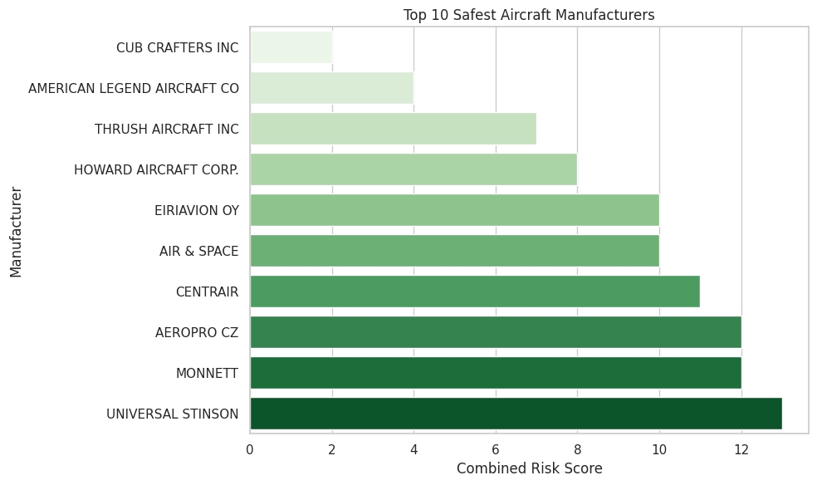
Key Findings – Safest Manufacturers
UNIVERSAL STINSON, MONNETT, and AEROPRO CZ are the top three safest aircraft manufacturers in this analysis, with the lowest combined risk scores.
These manufacturers consistently showed:
Low accident counts
Minimal injury severity
Higher survivability rates in reported incidents
Their safety records suggest they could be strong candidates for safe, stable, and low-risk fleet investments.

Slide 8
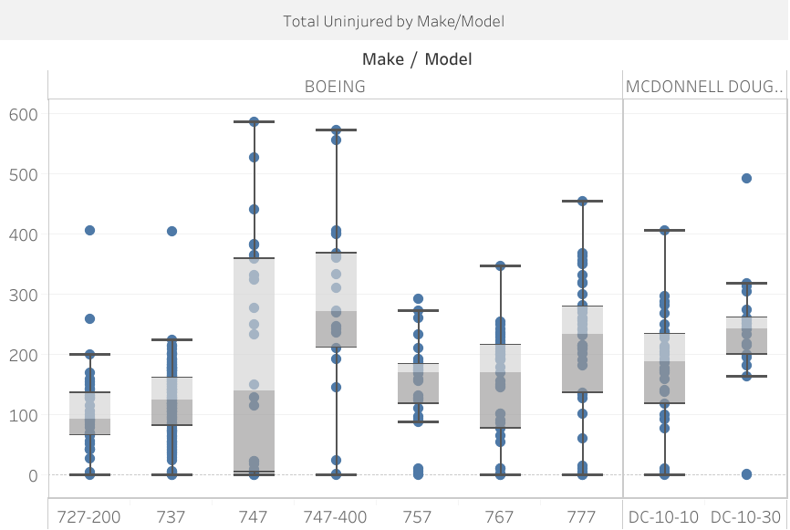
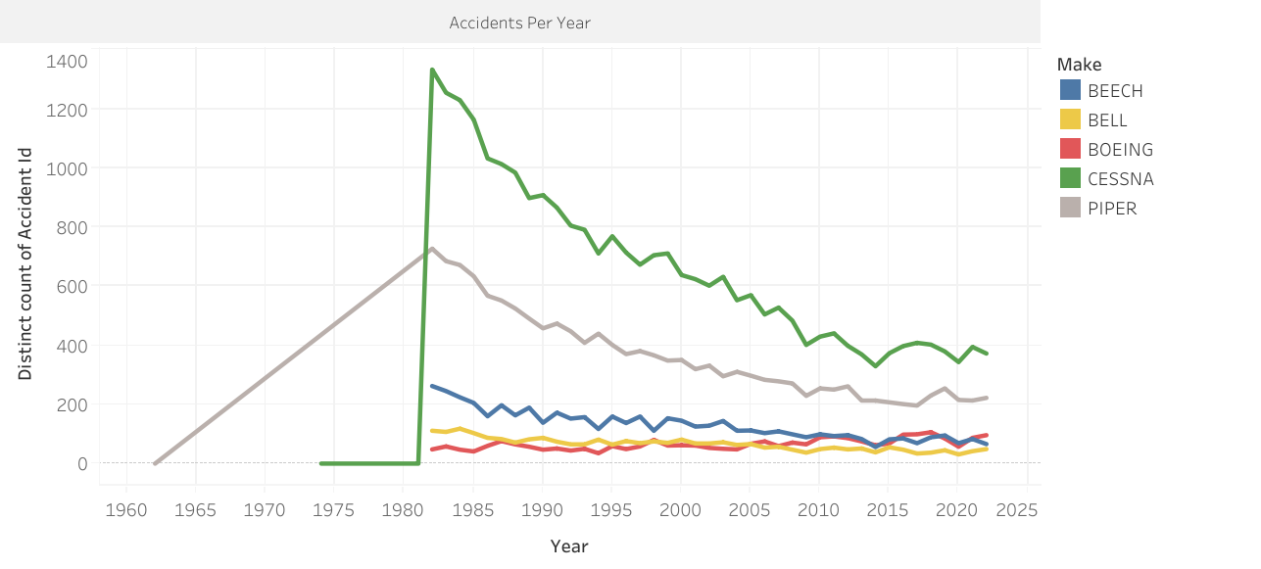
Accident Trends and Model-Level Safety Insights
Model-level safety varies greatly — some aircraft, like the Boeing 747 and DC-10-30, consistently show higher numbers of uninjured passengers across incidents.
Not all aircraft within a manufacturer are equal — this boxplot helps identify which specific models offer better survival outcomes.
Long-term accident trends show that CESSNA and PIPER have had consistently higher incident rates over time, while BOEING, BEECH, and BELL remained more stable.
These insights support our recommendation to evaluate both brands and individual aircraft models before purchase.

Slide 9
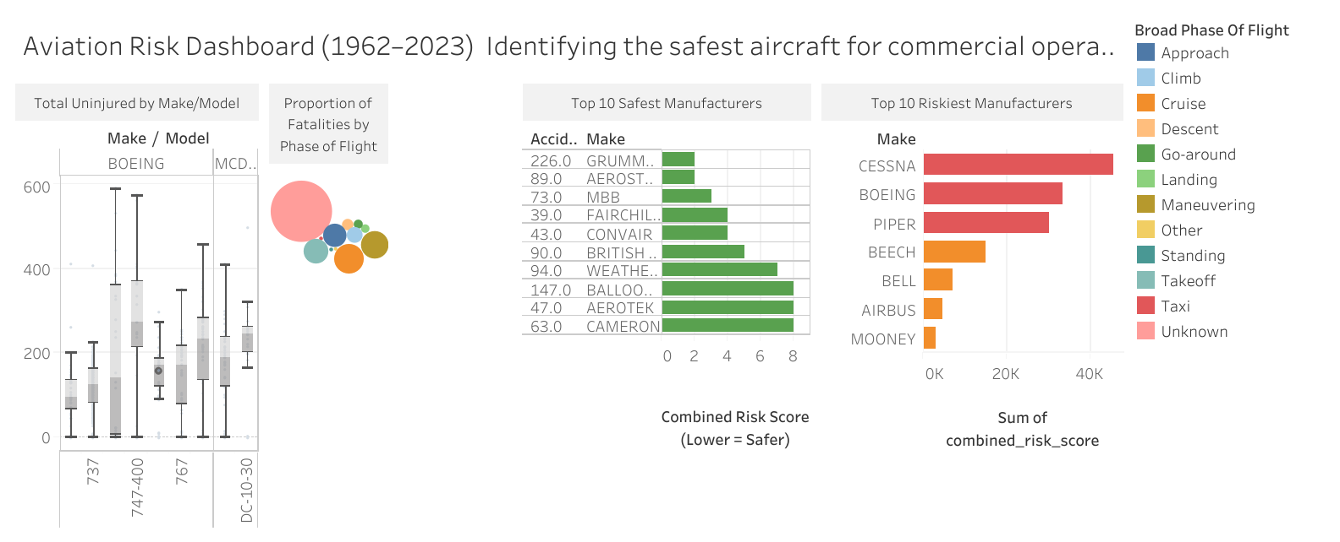
Aviation Risk Dashboard Summary (1962–2023) Identifying the Safest Aircraft for Commercial Operations
Models like the Boeing 737 and DC-10-30 show strong survival outcomes (high number of uninjured).Cruise and approach phases are where most fatalities occur — key focus areas for pilot training and safety systems.The safest manufacturers include GRUMMAN, AEROSTAR, and CAMERON.Highest-risk brands — CESSNA, BOEING, and PIPER — show both frequent and severe accident history.

Slide 10
Recommendations & Future
What the Data Tells Us
Area | Conclusion
Aircraft to Prioritize | Boeing 737 and Cessna 206B are reliable options for acquisition
Aircraft to Avoid | CESSNA 172/152, PIPER show high incident risk — use with cautio
Model vs. Make | Model-level safety varies widely — brand alone is not enough
Flight Phase Risks | Cruise and approach phases are deadliest — focus on safety training
Safety Score Usage | Combined Risk Score is a useful metric for future aircraft screening
We now have a data-backed foundation for safer decisions in aviation investment. Let’s apply these findings directly into procurement and safety planning.

Slide 11
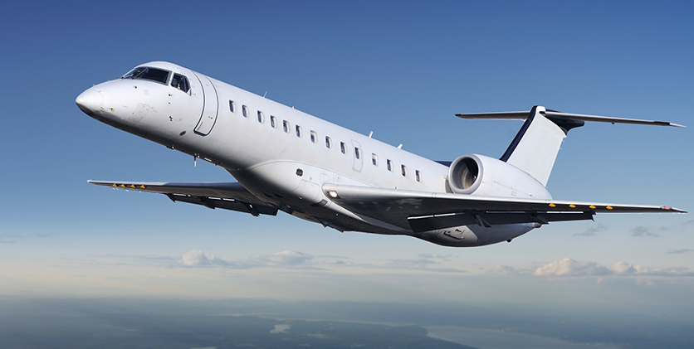
Thank You! Joram Mugesa

