Slide 1


Slide 2

OpenWoodChair : Team
Patrice Navarri – Toulouse
Dirk Thalheim - Hamburg
Airbus Operations
Michel & Jacqueline You
Gérard & Bernadette Véron
Retraités de l'Education Nationale
Fans de la première heure
Maine & Loire
Philippe Pacotte
Sympathisant MHK
Rennes
Jean-François Soucaille
Toulouse
Airbus Defence & Space
Olivier Heinry
FLOSS Manuals
Nantes
Marine Gimenez
Test Pilot
Lycée Airbus

Slide 3
OpenWoodChair : project's goals
◉ Allowing low-tech countries to build
a low-cost electric wheelchair for children
◉ forked from the OpenWheelChair project
based on pipes rather than wood

Slide 4
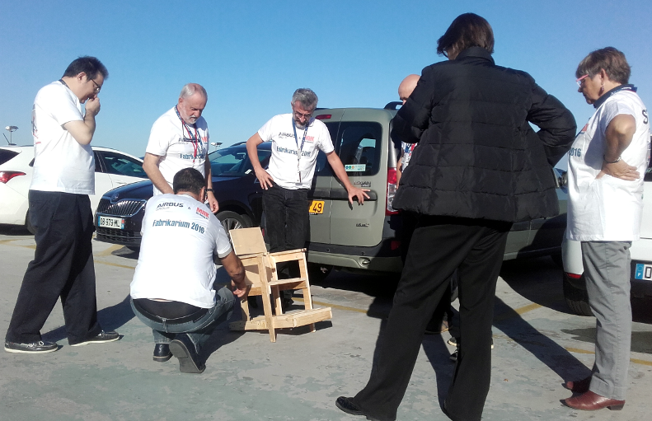
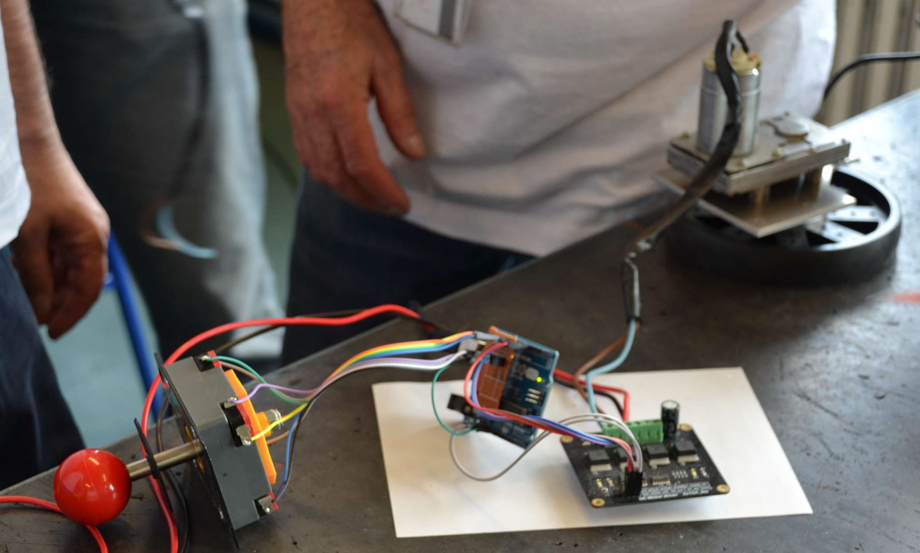
OpenWoodChair : project's activities
◉ looking for a cheap material : pallet wood
◉ improving the original proof of concept
◉ adapting the electronics
◉ junkyard + Ebay sourcing

Slide 5
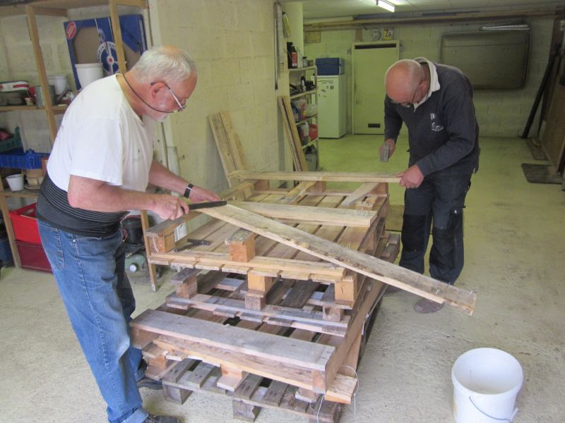
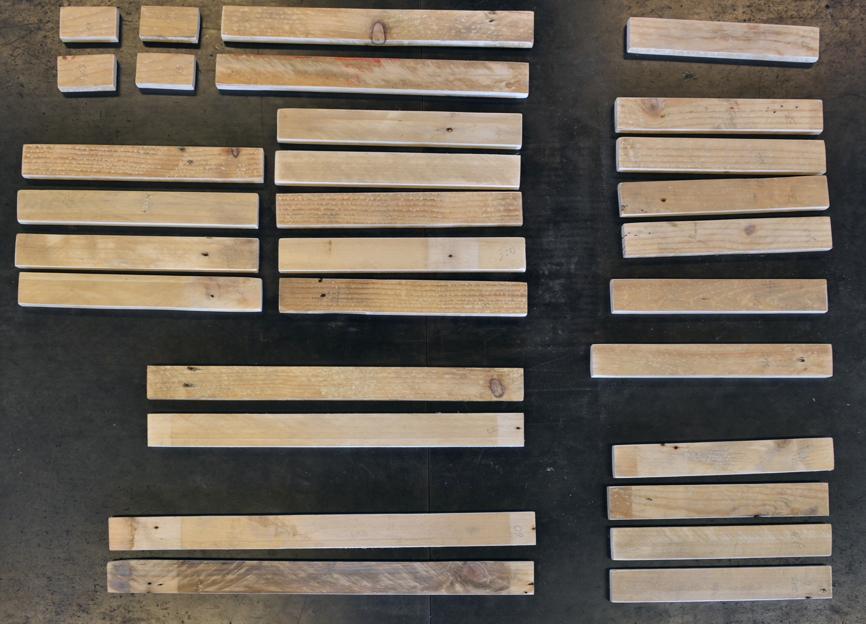
OpenWoodChair : step by step

Slide 6
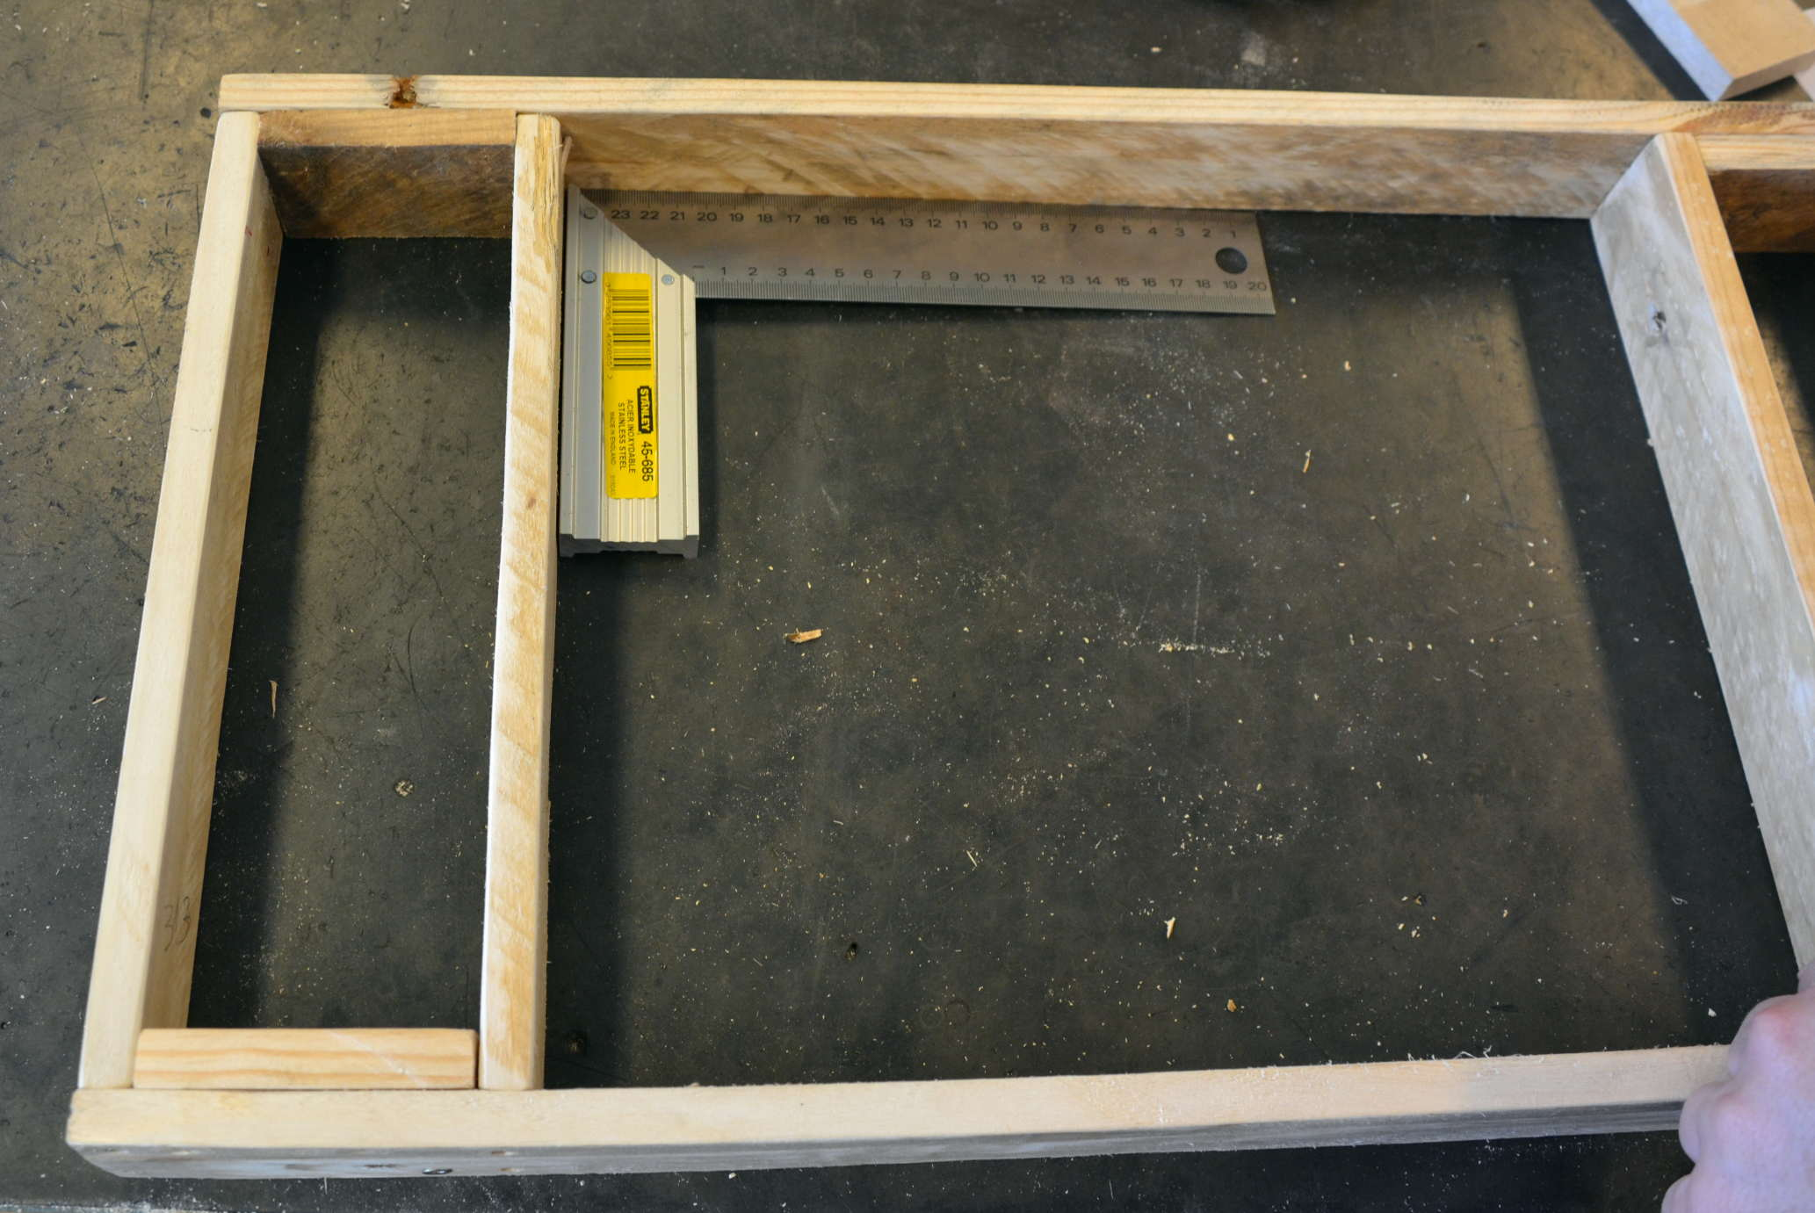
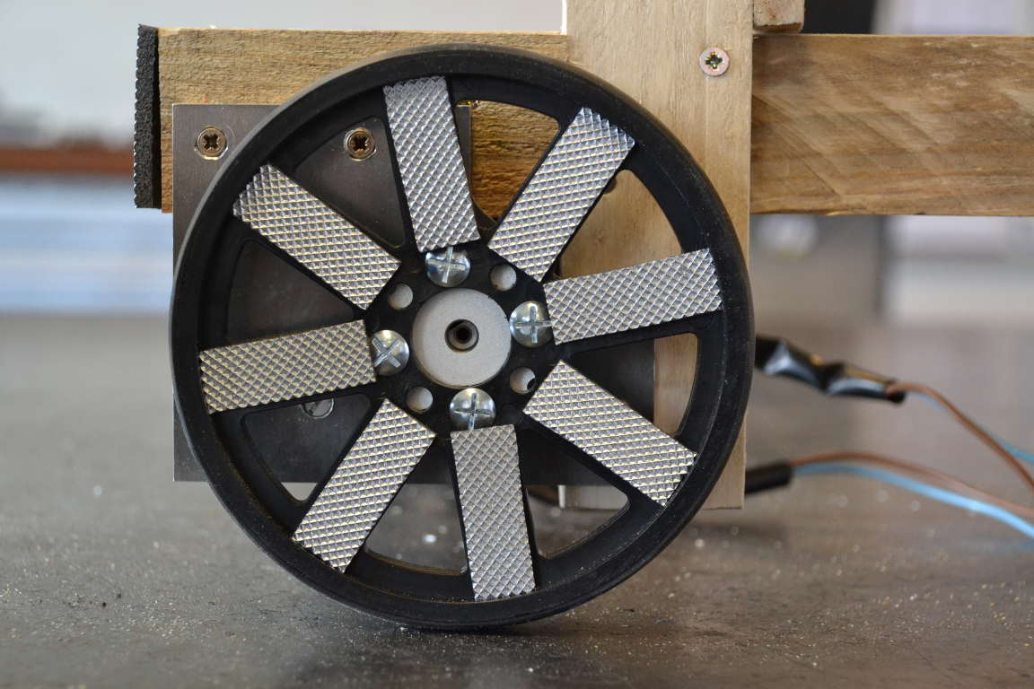
OpenWoodChair : step by step

Slide 7
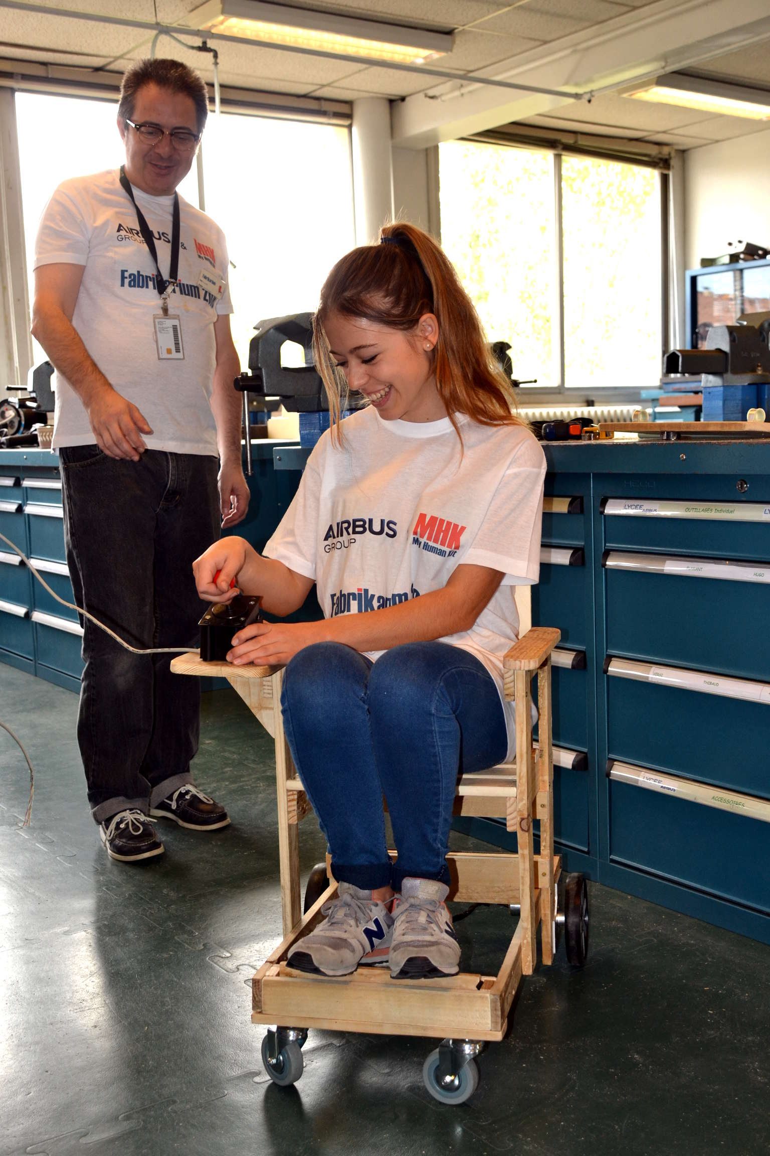
OpenWoodChair : step by step
Flight testing :
achieved !

Slide 8
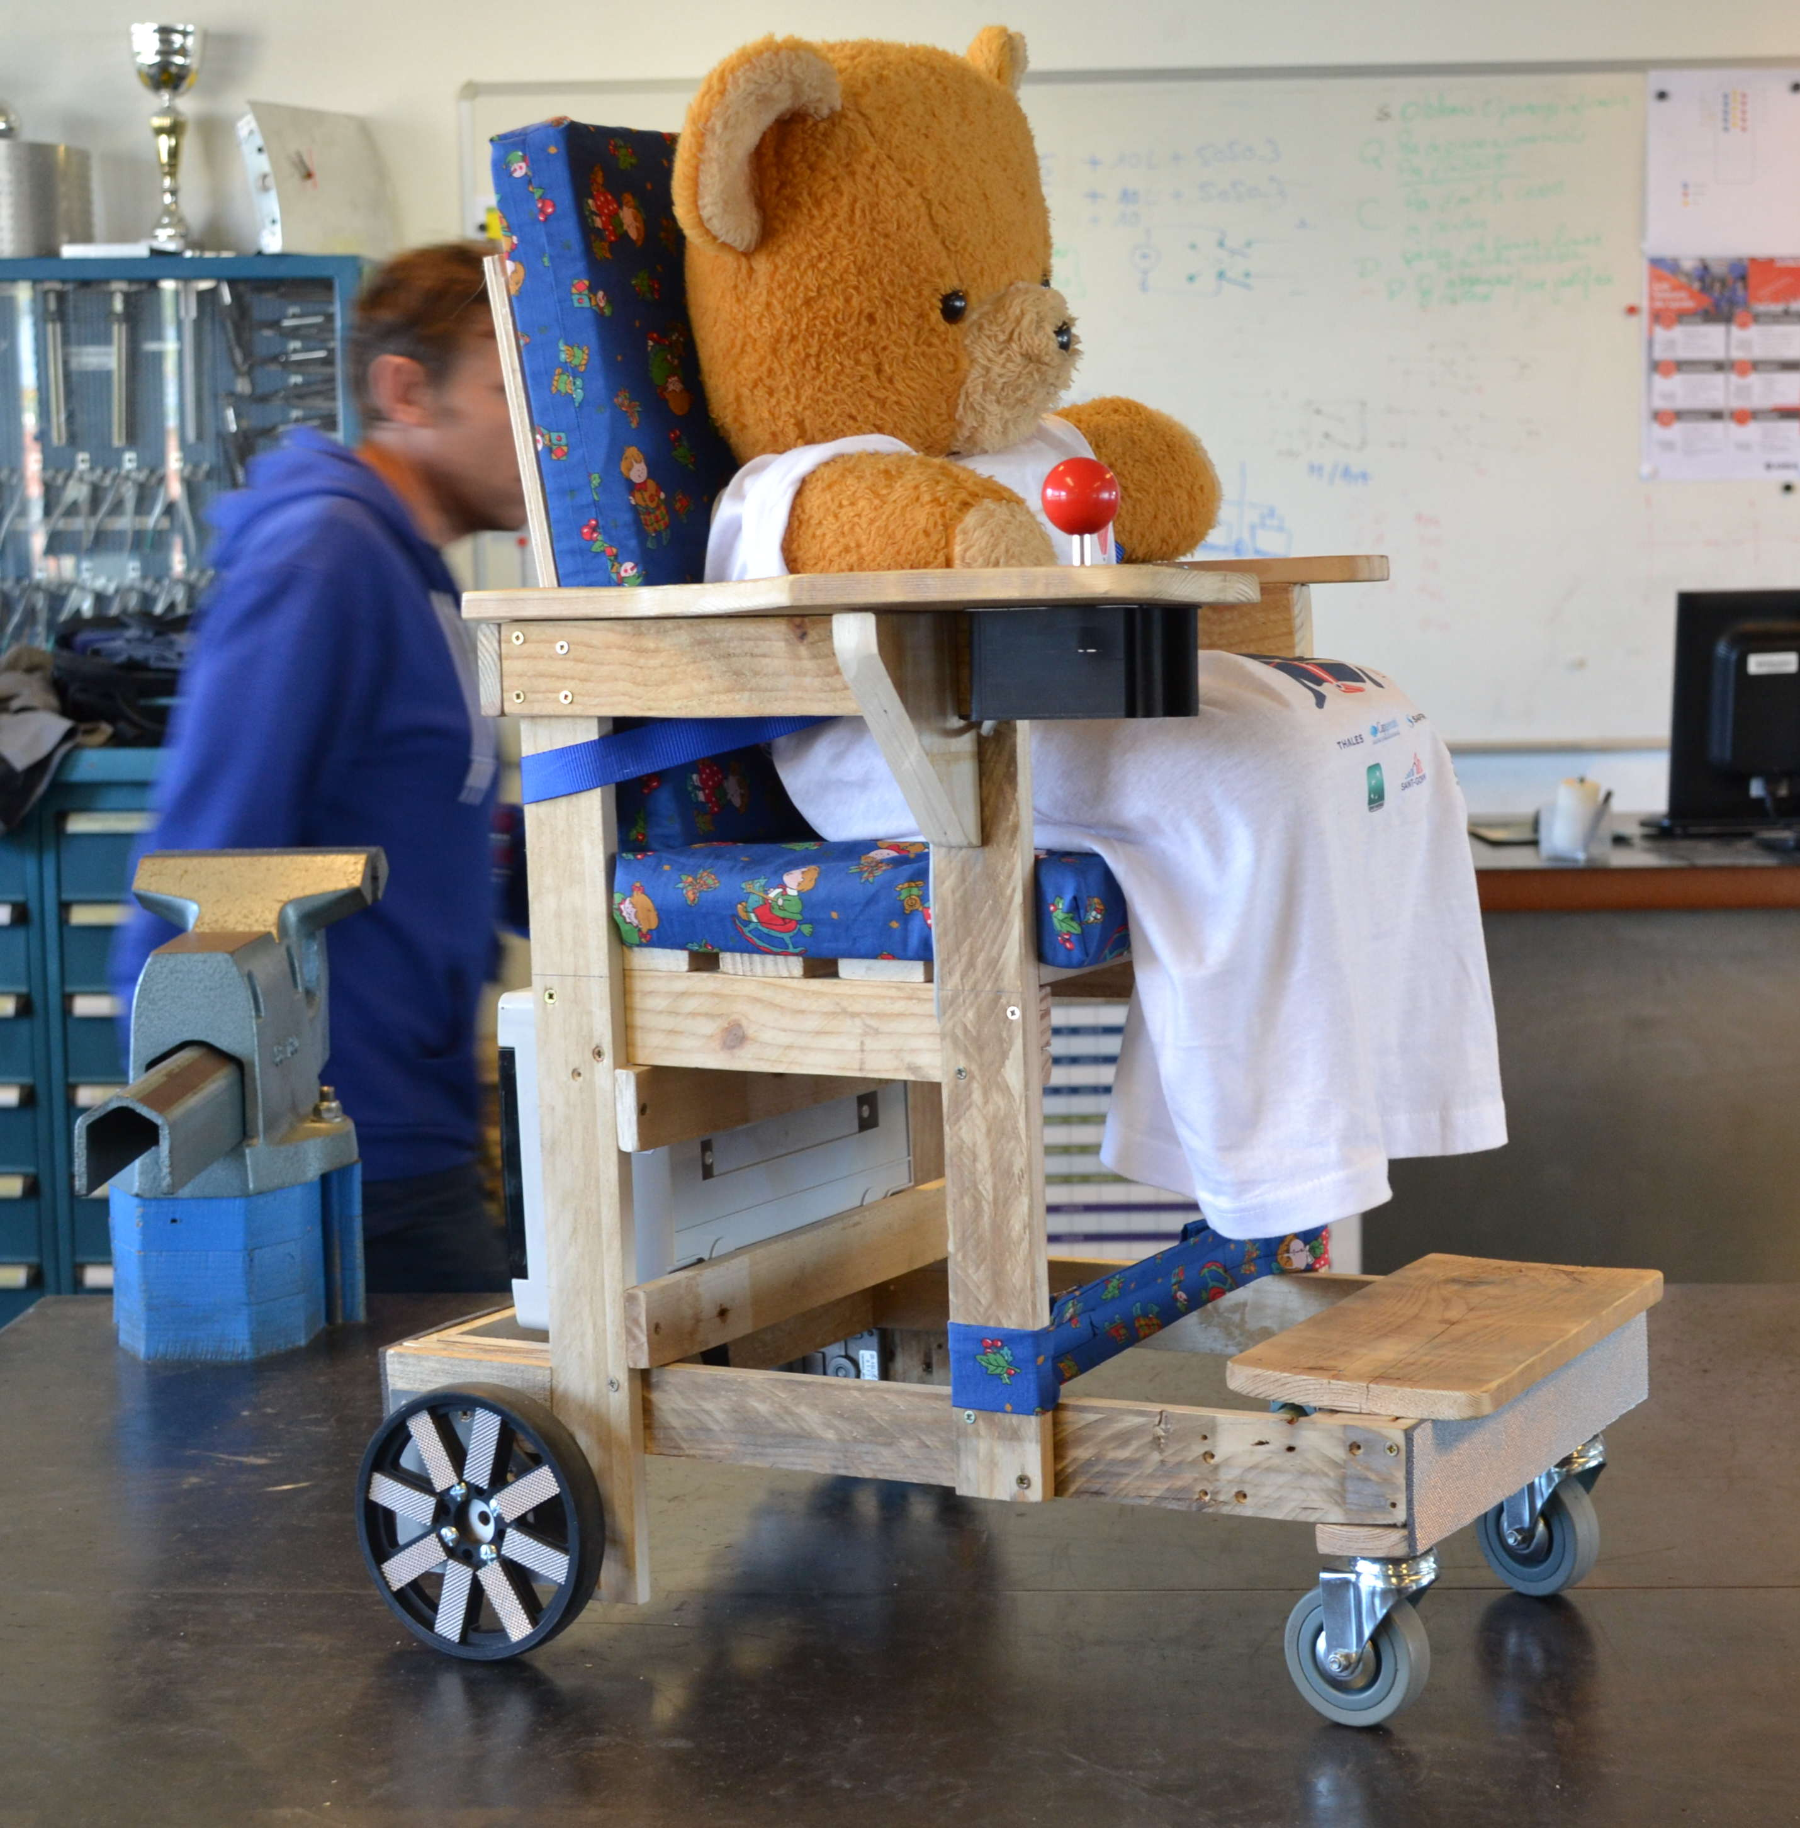
OpenWoodChair
Approved by Caramel
our mascott

Slide 9
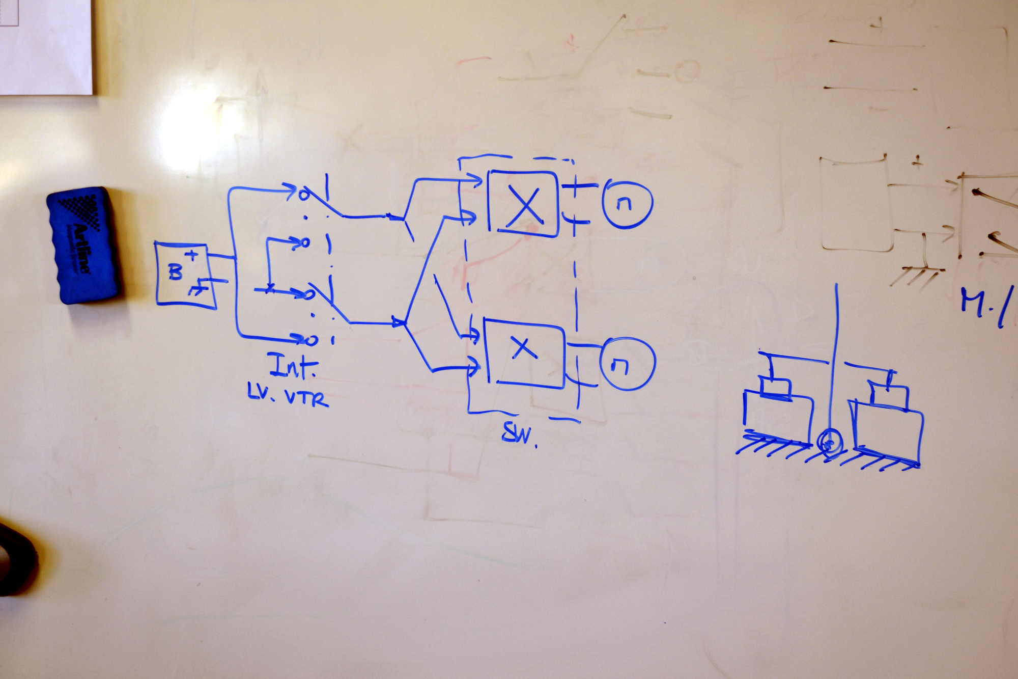
OpenWoodChair : way forward
◉ At the sprint's end, the chair is wheeeling
still, design is not as simple and robust
as originally wished
◉ Next sprint's goals :
Replace electronics by simple switches & wires
(automotive junk)
Critical parts remain :
◉ power and motors are difficult
to procure and maintain

Slide 10
OpenWoodChair
https://github.com/MHKit/OpenWoodChair

