Slide 1
Programming for graphics
Shadows

Slide 2
Anatomy of a Shadow

Slide 3
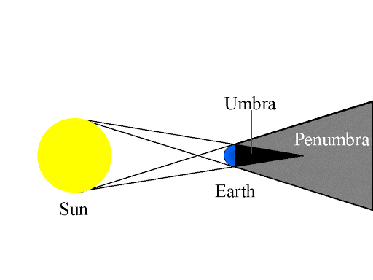

Slide 4
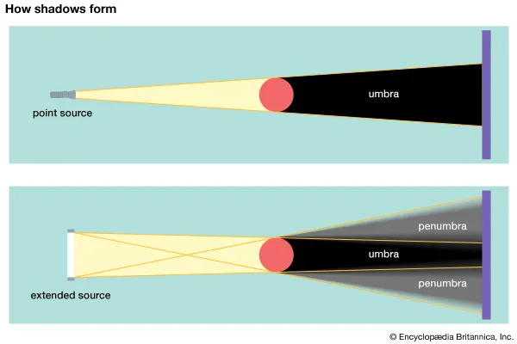
We always have Umbra’s
But
We only get penumbra’s when the shadow is cast from an area light

Slide 5
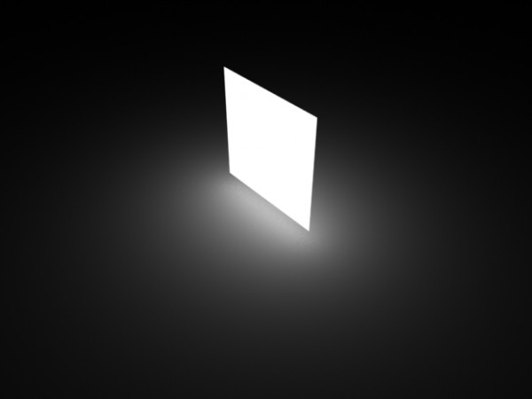
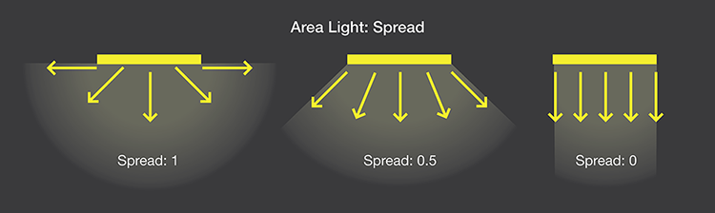
Area Lights
Surfaces that cast light from any point on their surface.
Directionality can change.

Slide 6
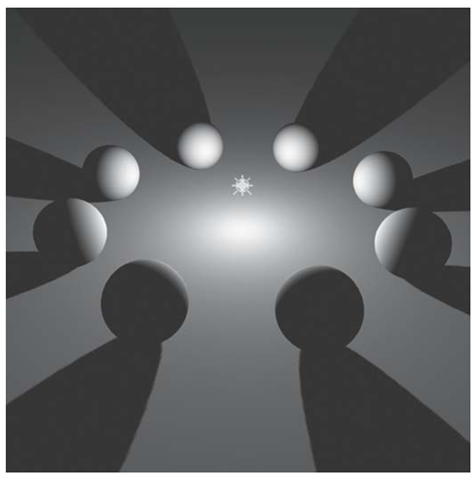
Point lights
We’re using point lights.
An infinitesimally small point that all light emanates from.
We will never see a penumbra.

Slide 7

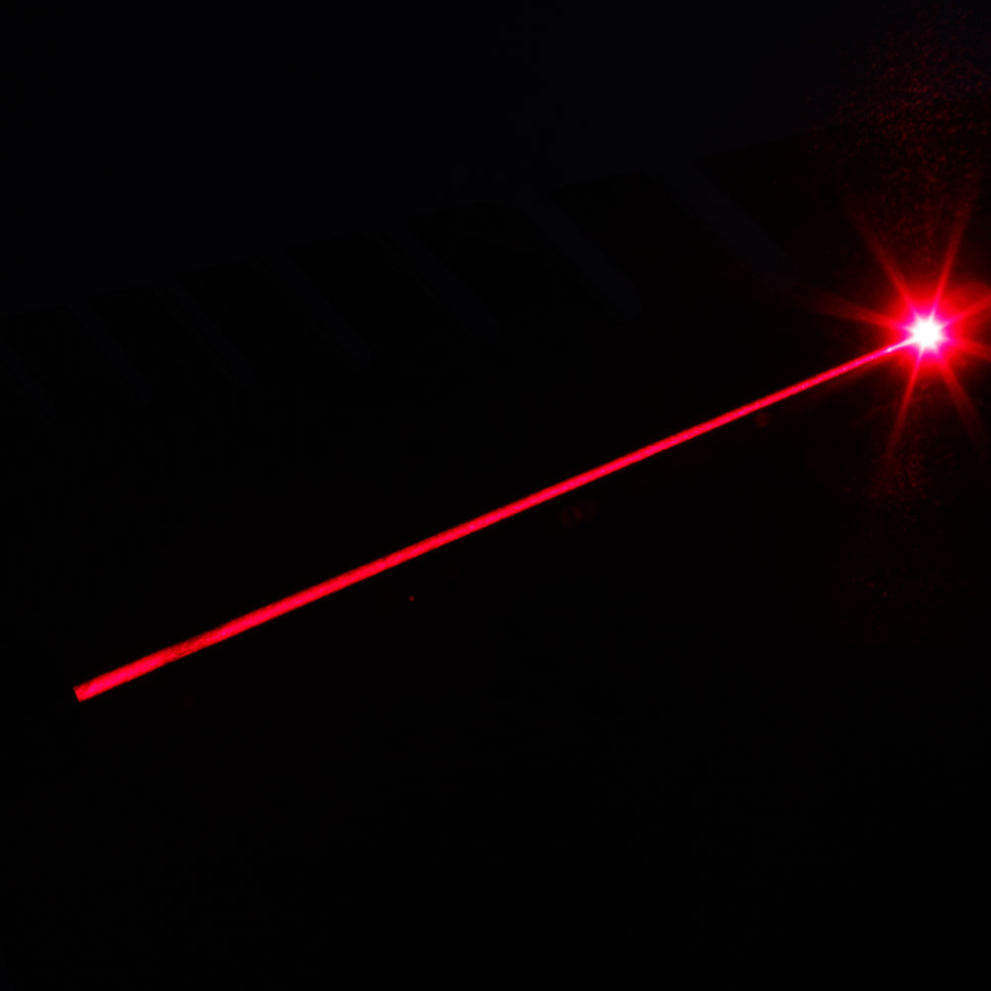

Real lights
Lights in the real world can be either point or area.
Most are area lights, they emit light across their surface
Lasers are the closest thing to point light (Lab lasers are far more accurate than the pointers we have.)

Slide 8
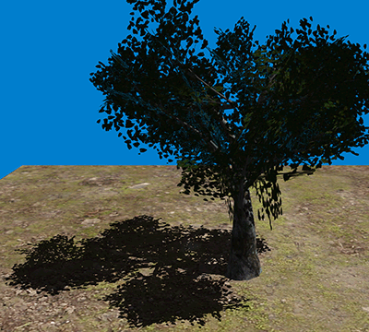
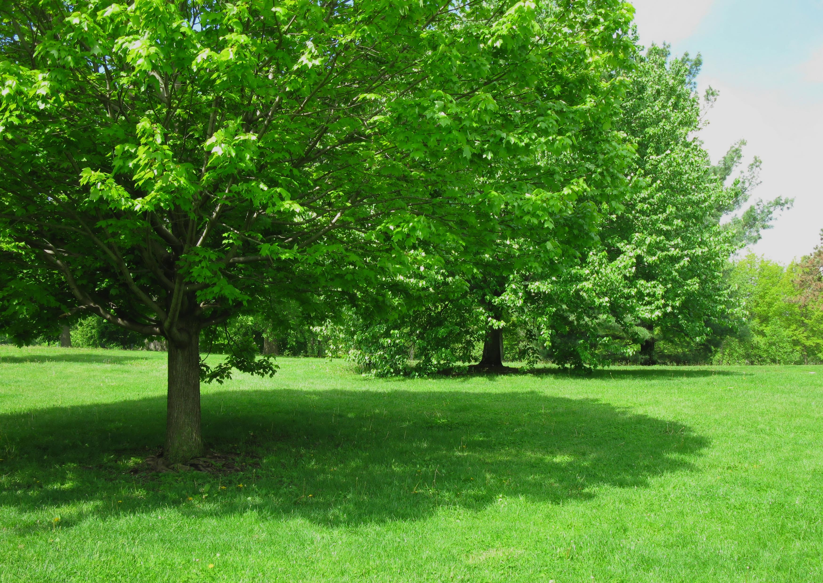
Why do we care
Computer Graphics approximates the real world.
Some things, like area lights, are hard to calculate (especially in real time)
That’s why we use point light a lot, there quick!
Shadows are no different, they approximate real world shadow’s

Slide 9
Different Shadowing techniques

Slide 10
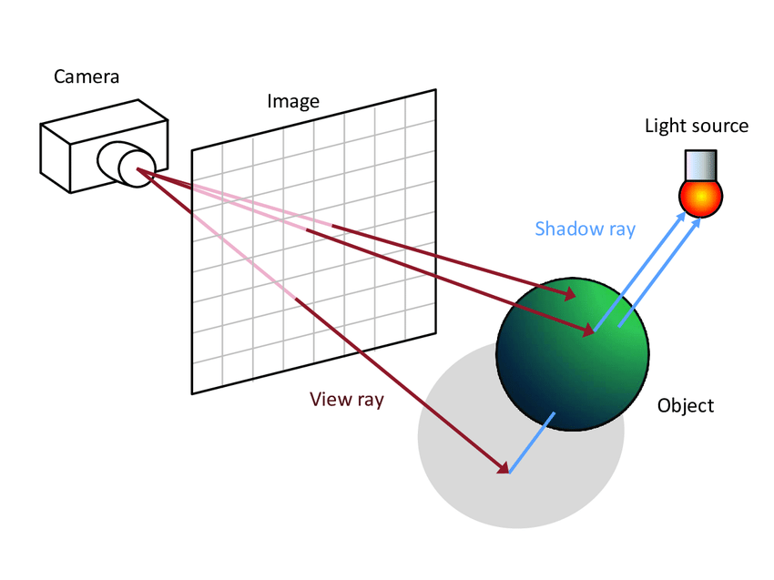
Ray Traced
Cast ray from camera, through pixel on screen.
When ray hits object, cast another ray to the nearest light source.
If secondary ray intersects another object, first object (at this fragment) is in shadow.
Sounds easy, actually
Very hard,
Lots of calculations
Was not possible in real time before RTX

Slide 11
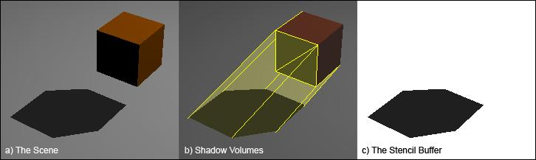
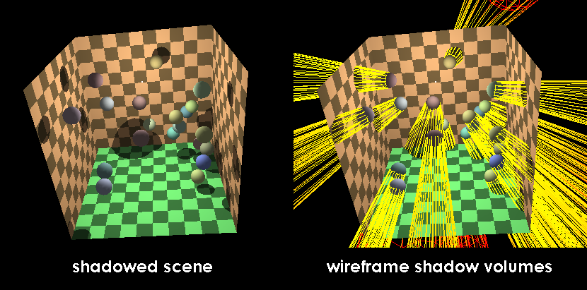
Shadow volumes
Project the geometry away from the light.
If a fragment is in the volume, it is in shadow
You can also use a stencil buffer to mask out the intersection points but we haven't covered this.

Slide 12
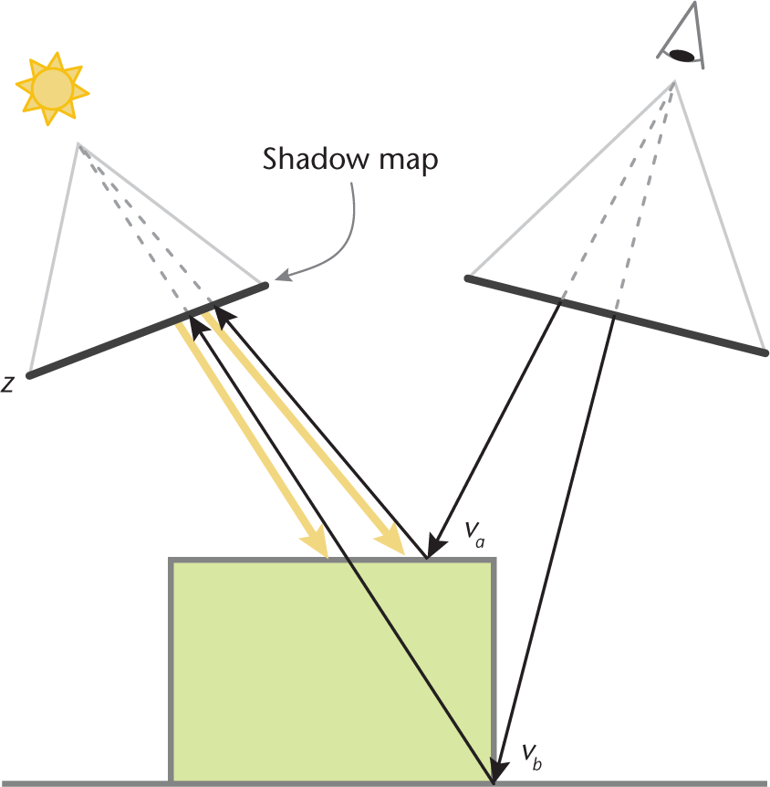
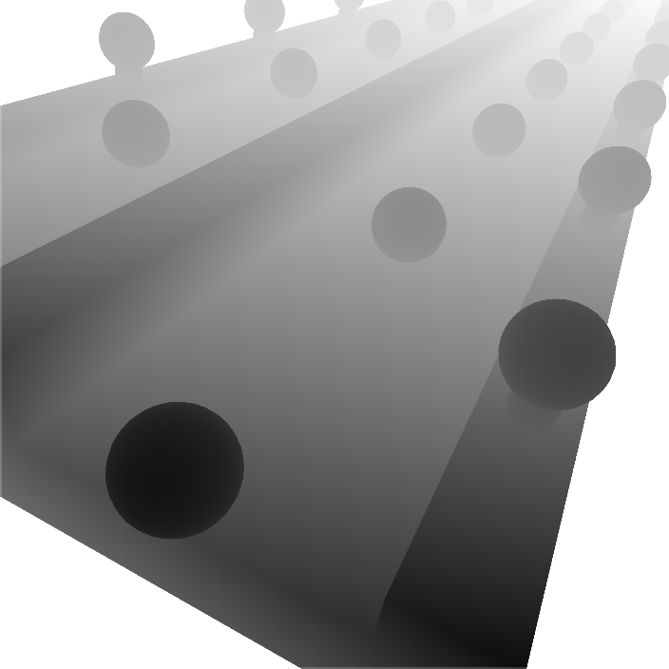
Shadow mapping
Render scene from lights point of view.
Gen depth map.
Use depth map in normal render to see if fragment is closer than point in depth map
This is the technique we will be using.

Slide 13
How To Shadow map

Slide 14
The specifics on how to do this will be in the tutorial

Slide 15
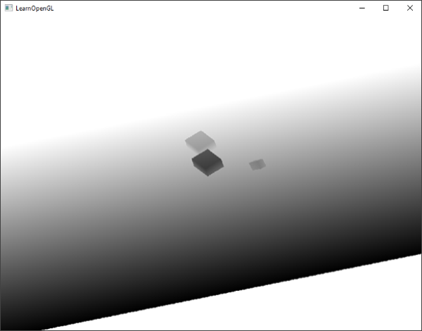
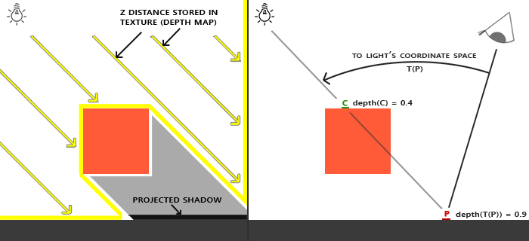
Shadow Pass
So we draw everything, for depth only, from the camera point of view
We will need to create a new view port (size of our shadow map texture)
We’ll pass the shadow map to the main render process along with the cameras MVP matrix (we’ll need this to transform the current fragment in to light space)

Slide 16
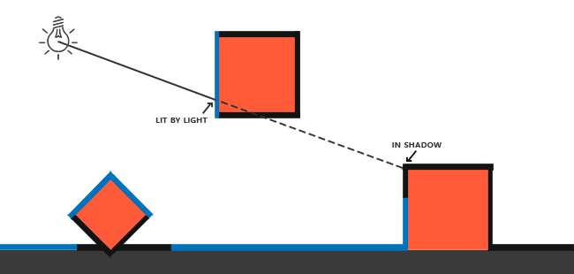
Render Pass
Render the scene normally but add new code to transform fragment in to light space and calculate distance from light.
If distance from light is greater than value in depth map, at that texture coordinate, fragment is in shadow

Slide 17
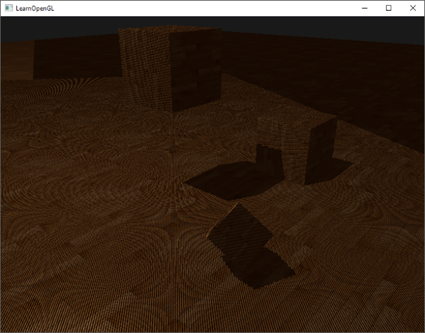
Output
This will be the output of our shadow map
Looks a little ….wrong….

Slide 18
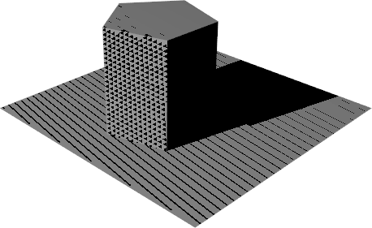
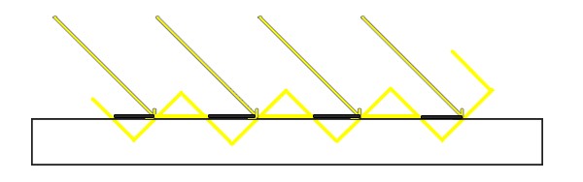
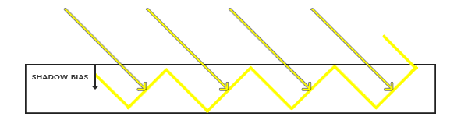
Shadow acne
Caused by perspective aliasing
Referencing the shadow map at surface level will lead to some fragment being above the shadow map and others begin below it.
To fix this we add a bias value to off set the shadow map in to the surface a little bit.

Slide 19
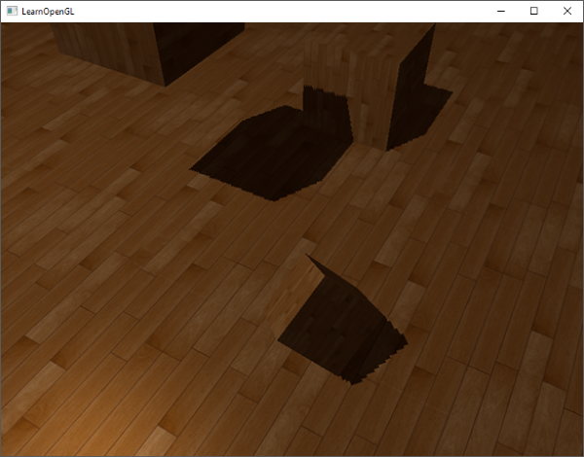
output

Slide 20
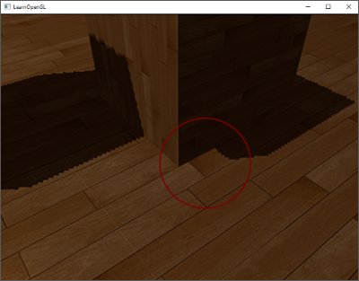
Peter panning
Shadows do not appear to line up with the bottom of the objects.
Makes it look like the object is floating.

Slide 21
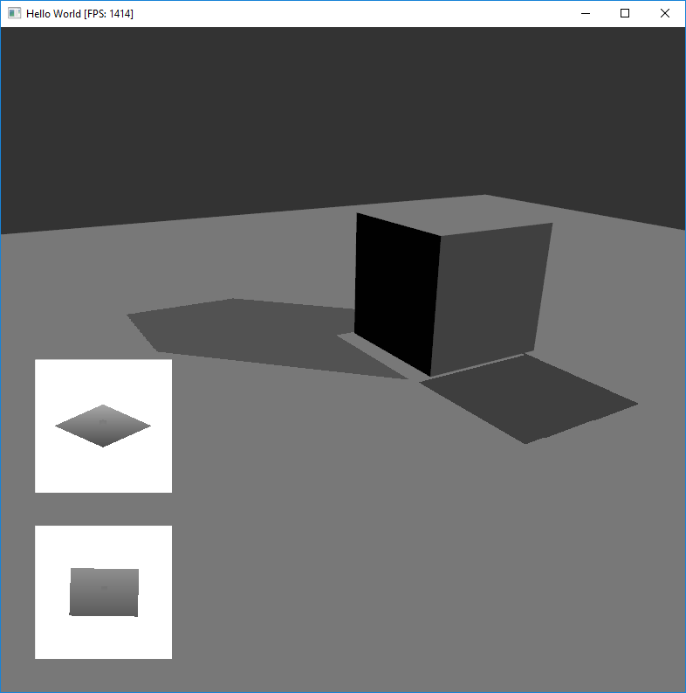
Peter panning
But really it is lining up just fine.
But not with the points you want.
This occurs because we are rendering the depth, for our shadow map, from the front faces of the object.
We should be using the back faces instead.

Slide 22
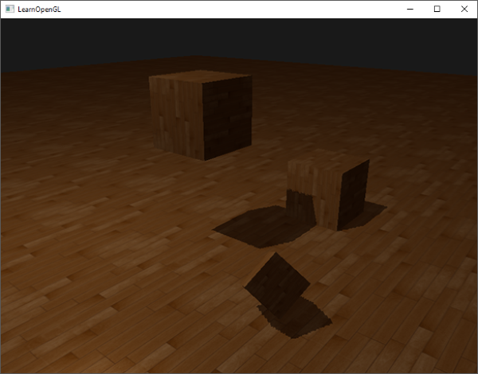

output
So we’ll just set our cull method to front and render our shadow map.
But remember to set it back to back faces, once your done!

Slide 23
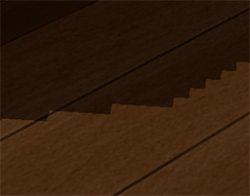
Soft edges
At the moment our shadows have very hard, pixelated edges

Slide 24
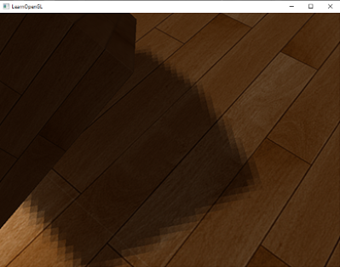
Soft edges
We want to soften them and remove some of the pixelation

Slide 25
Percentage closer filtering
A collection of techniques that try to soften the edges of shadows
Instead of sampling one point on the shadow map, we sample multiple and average the results.
float shadow = 0.0;
vec2 texelSize = 1.0 / textureSize(texture_depth, 0);
for(int x = -1; x <= 1; ++x)
{
for(int y = -1; y <= 1; ++y)
{
float pcfDepth = texture(texture_depth, projCoords.xy + vec2(x, y) * texelSize).r;
shadow += currentDepth - bias > pcfDepth ? 1.0 : 0.0;
}
}
shadow /= 9.0; // divide a little reduce collective intensity.

Slide 26
Show the Demo
Mention the shadow on the hands and arms

Slide 27
Questions?

Slide 28
Nick read page 348 real time rendering third ed

