Slide 1
Neural Nearest Neighbour
Sheng Zhong

Slide 2
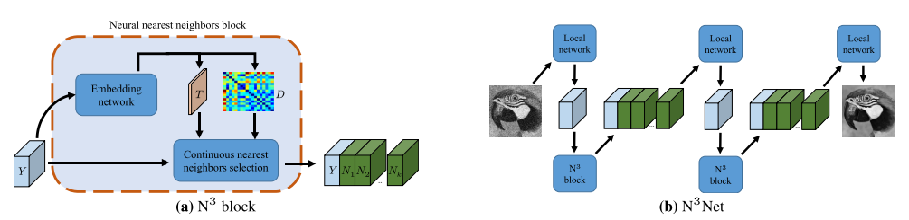
Work Being Replicated
Deterministic and differentiable relaxation of kNN: NNN
Configuration of NNN layers into N³ blocks and N³Net architectures
Use N³Net to beat state of the art in image tasks
Denoising
Single image super resolution (hallucinate details)

Slide 3
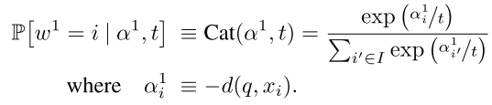
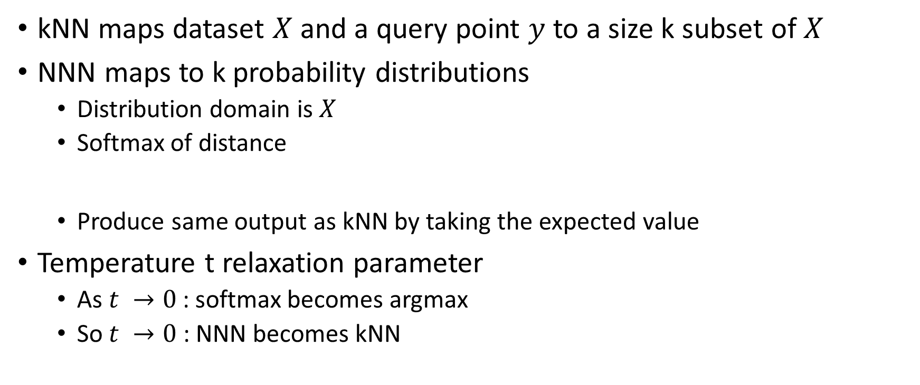
NNN
kNN maps dataset $X$ and a query point $y$ to a size k subset of$X$
NNN maps to k probability distributions
Distribution domain is $X$
Softmax of distance
Produce same output as kNN by taking the expected value
Temperature t relaxation parameter
As $t →0$ : softmax becomes argmax
So $t →0$ : NNN becomes kNN

Slide 4
Replication Activities
Existing code
NNN
N³Net
Dataset download
Denoise experiment
New implementation
NNN
Temperature experiments
Reuse
N³Net (swap in my NNN)
Denoise experiment
Dataset download

Slide 5
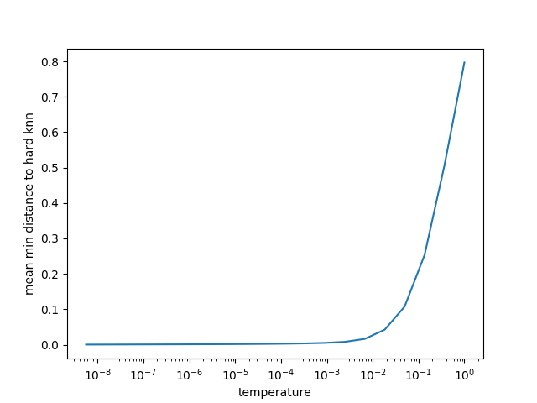

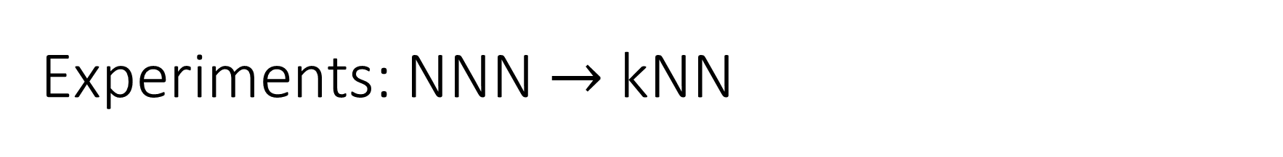
Experiments: NNN $→$ kNN
Dataset is 1D random: $X_{r}=\left\{v_{0},v_{1},…,v_{N}\right\}, v_{i}\sim 𝓝(0,σ^{2})$
Query set is entire dataset: $Y=X_{r}$
Experiment parameters
k = 3
N = 3000
$σ=0.5$
Performance metric
Average min distance to hard kNN
Average across N
Min across assignment inside neighbourhood

Slide 6
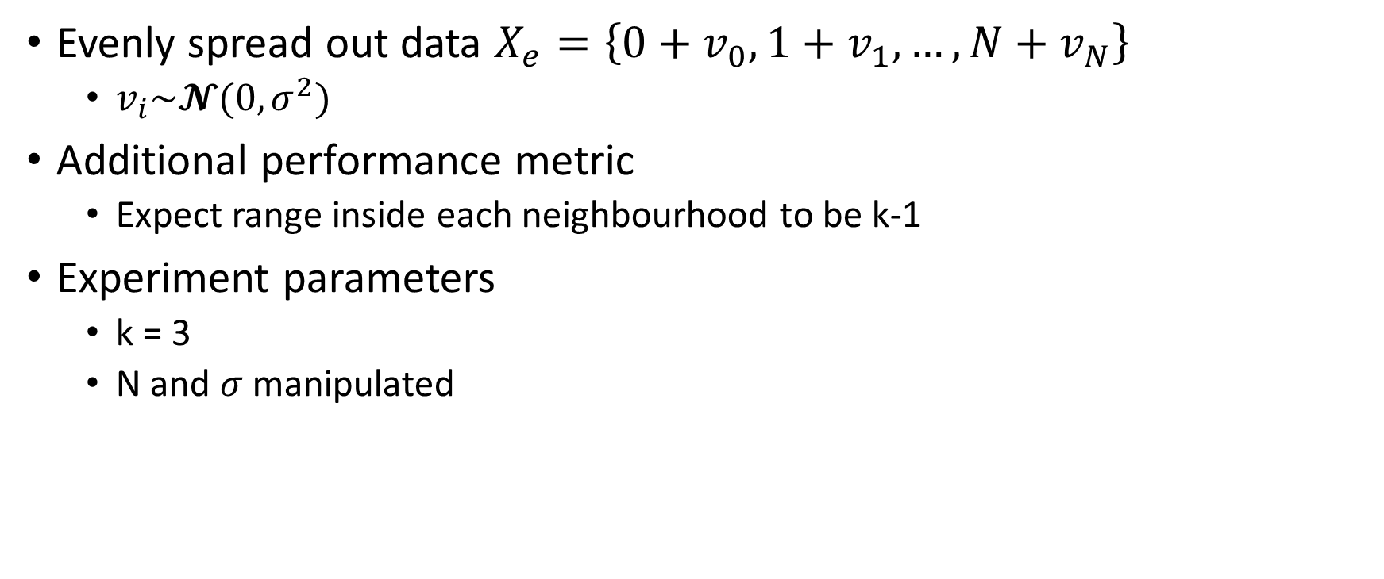
Experiments: NNN Limitations
Evenly spread out data $X_{e}=\left\{0+v_{0},1+v_{1},…,{N+v}_{N}\right\}$
$v_{i}\sim 𝓝(0,σ^{2})$
Additional performance metric
Expect range inside each neighbourhood to be k-1
Experiment parameters
k = 3
N and $σ$ manipulated

Slide 7
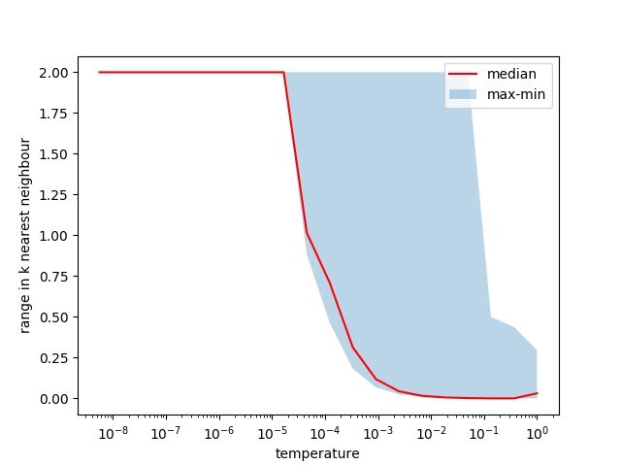
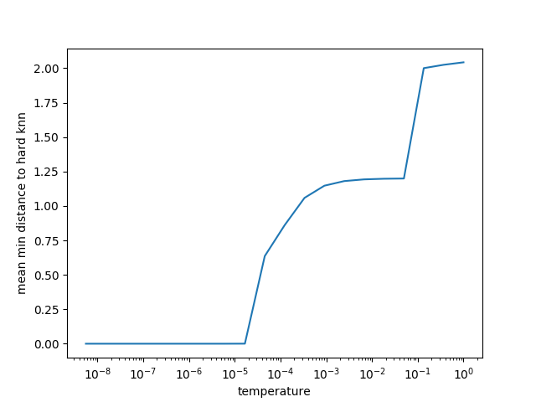
Nominal N=10 σ = 0.0001

Slide 8
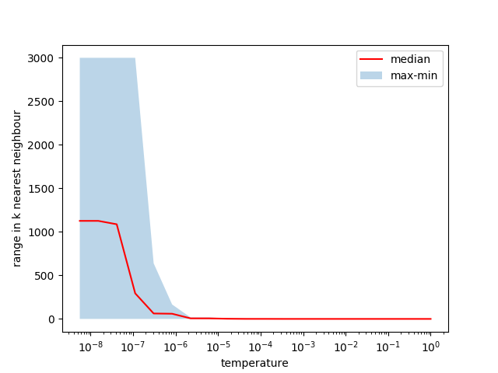
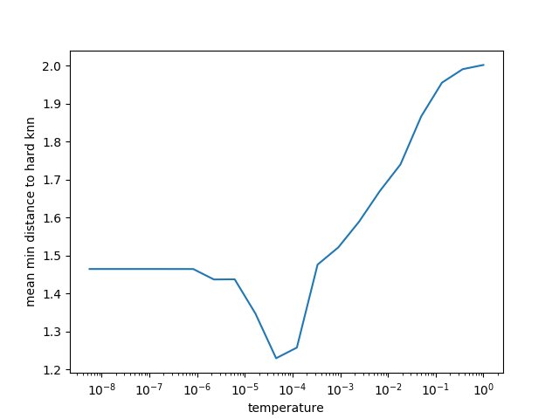
Stops working for N=3000 σ = 0.0001

Slide 9
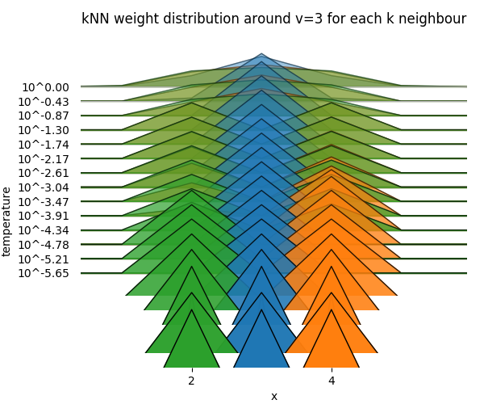

Sharp Convergence Threshold
Look at how distributions shift
Visualize for a specific query $y$
Looks same until $t={10}^{−3}$
Sharp drop at $t={10}^{−4.34}$

Slide 10
Reason for Sharp Threshold
2 and 4 are equally valid 2nd neighbours of 3
Difference from noise need amplification from temperature
Sharp because of exponential
Investigate noise vs temperature required for distinguished 2nd neighbour

Slide 11
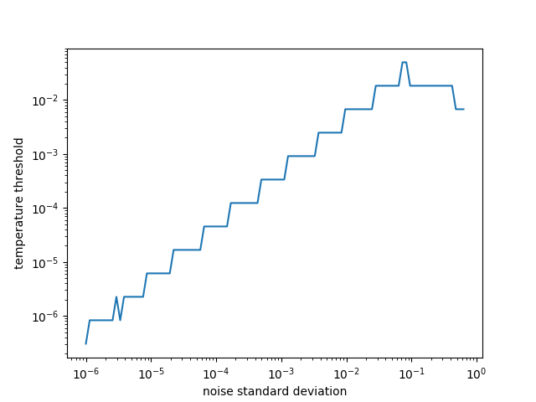
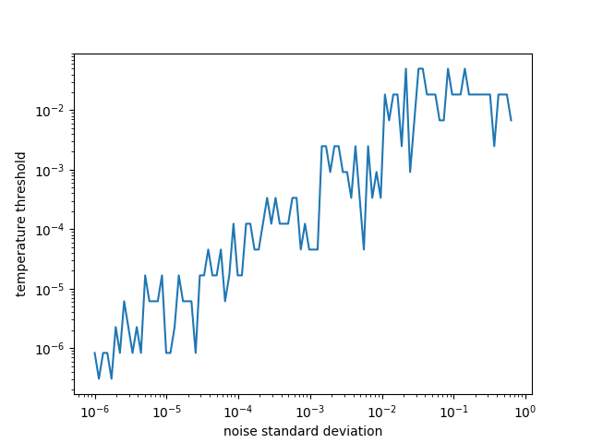
Noise vs Required Temperature
Fixed noise direction (RNG seed)
Random noise direction

Slide 12
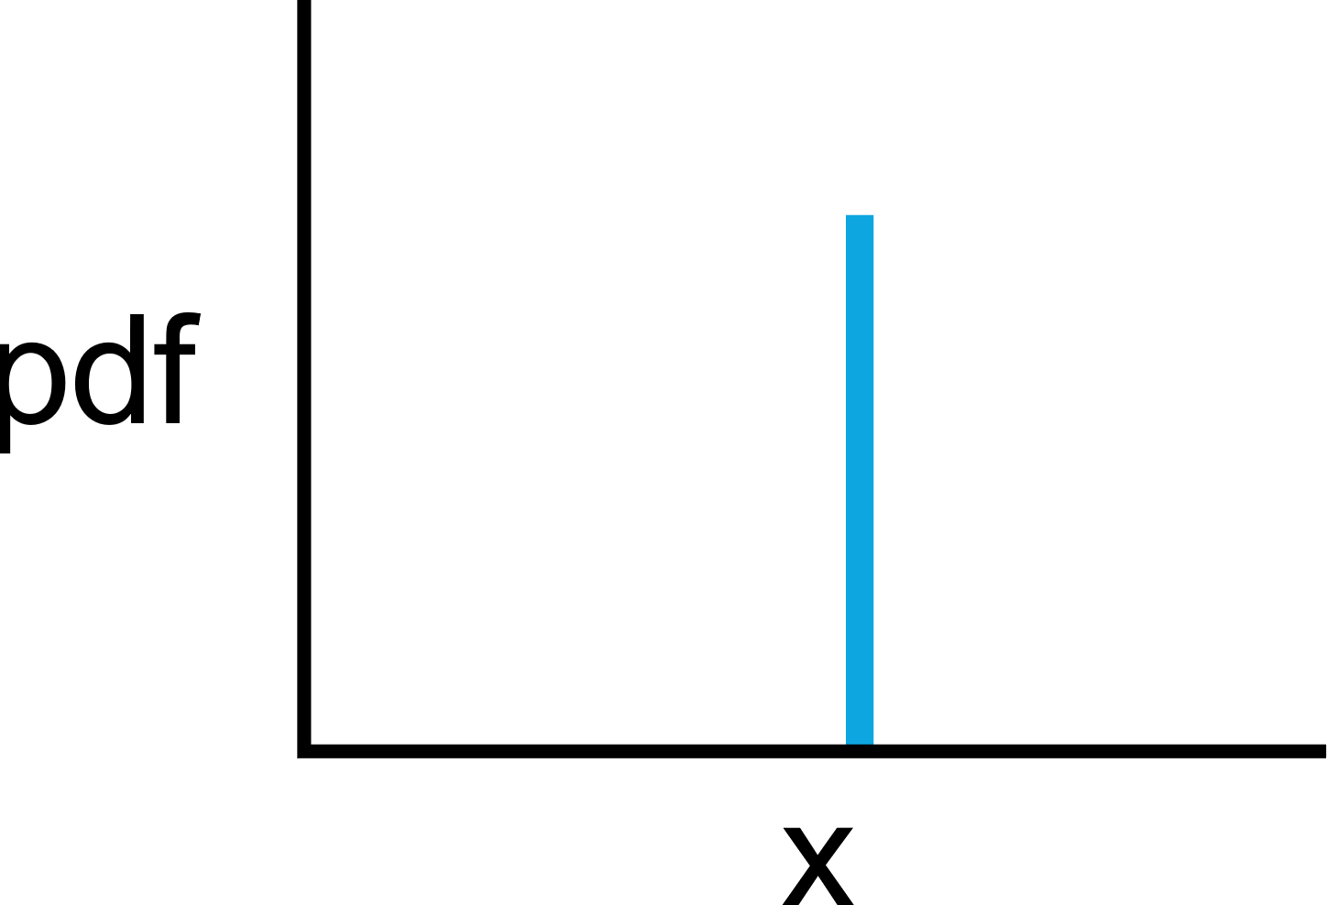
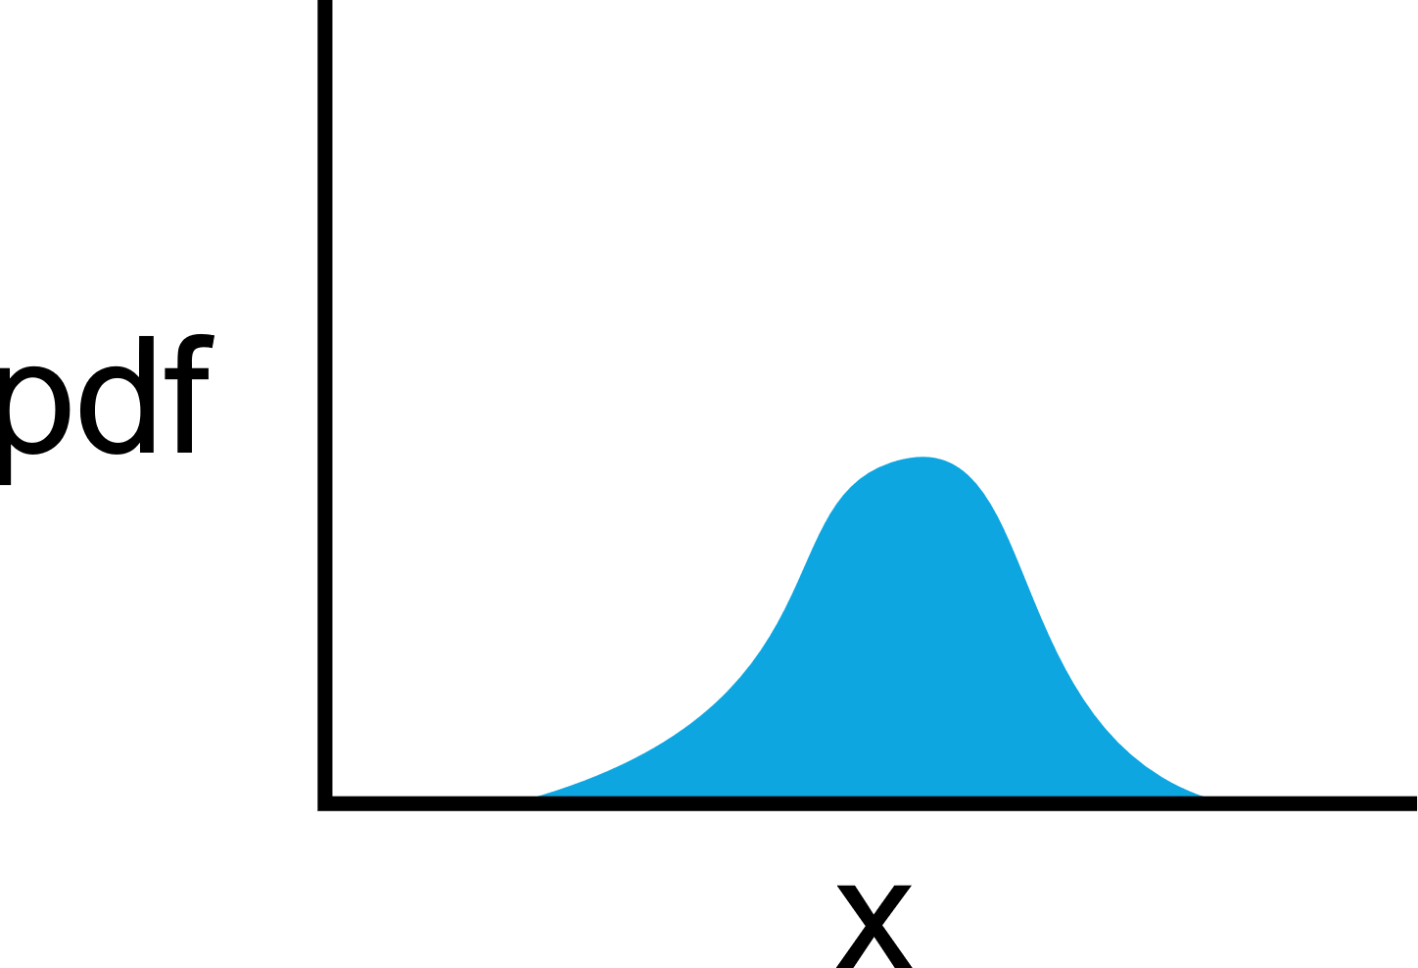


Disadvantage of Low Temperature
Distribution is mostly flat – no gradients
$$t→0$$
$$t≫0$$

Slide 13
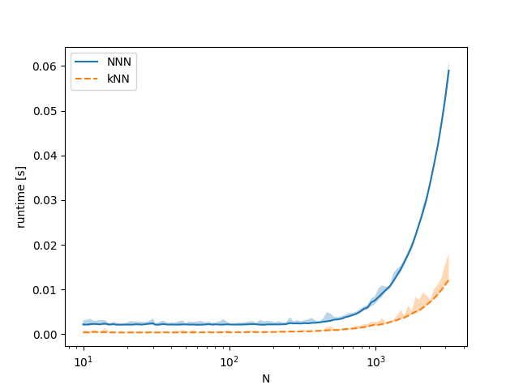
Experiment: Practicality
Compare against kNN
Runtime
Memory usage
Ran out for N=10000!

Slide 14
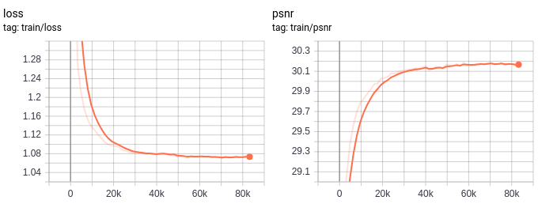
Experiment: Image Denoising
Swap my NNN in existing infrastructure
Training network takes 10 minutes each epoch
PSNR is denoise evaluation metric, higher is better

Slide 15
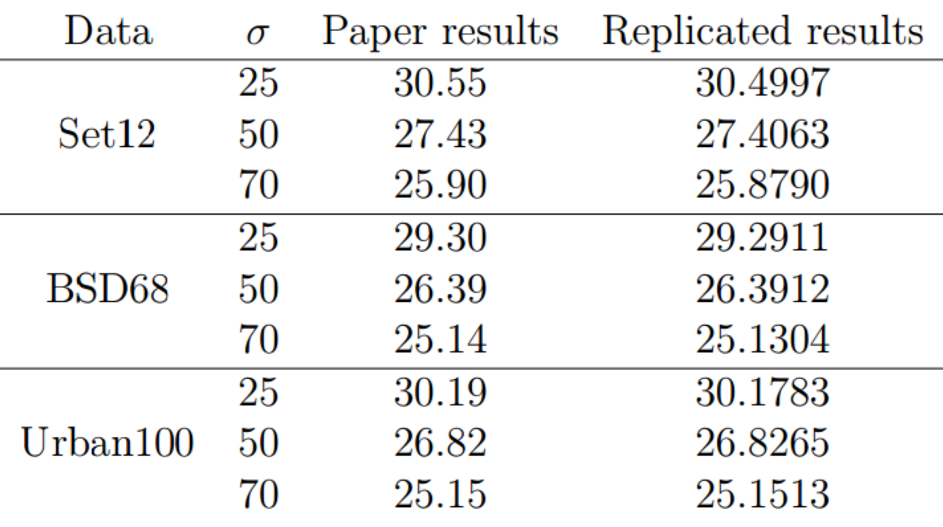
Compare against Published Results

Slide 16
Conclusion
Valid relaxation in most cases
Rarely get evenly spaced data
Solves a different problem
Gives 1st neighbour, 2nd neighbour, …
Unnecessary in most cases
Leads to memory issues and complexity
NNN Doesn’t work for datasets that grow
Good for fixed size datasets such as images

