Slide 1
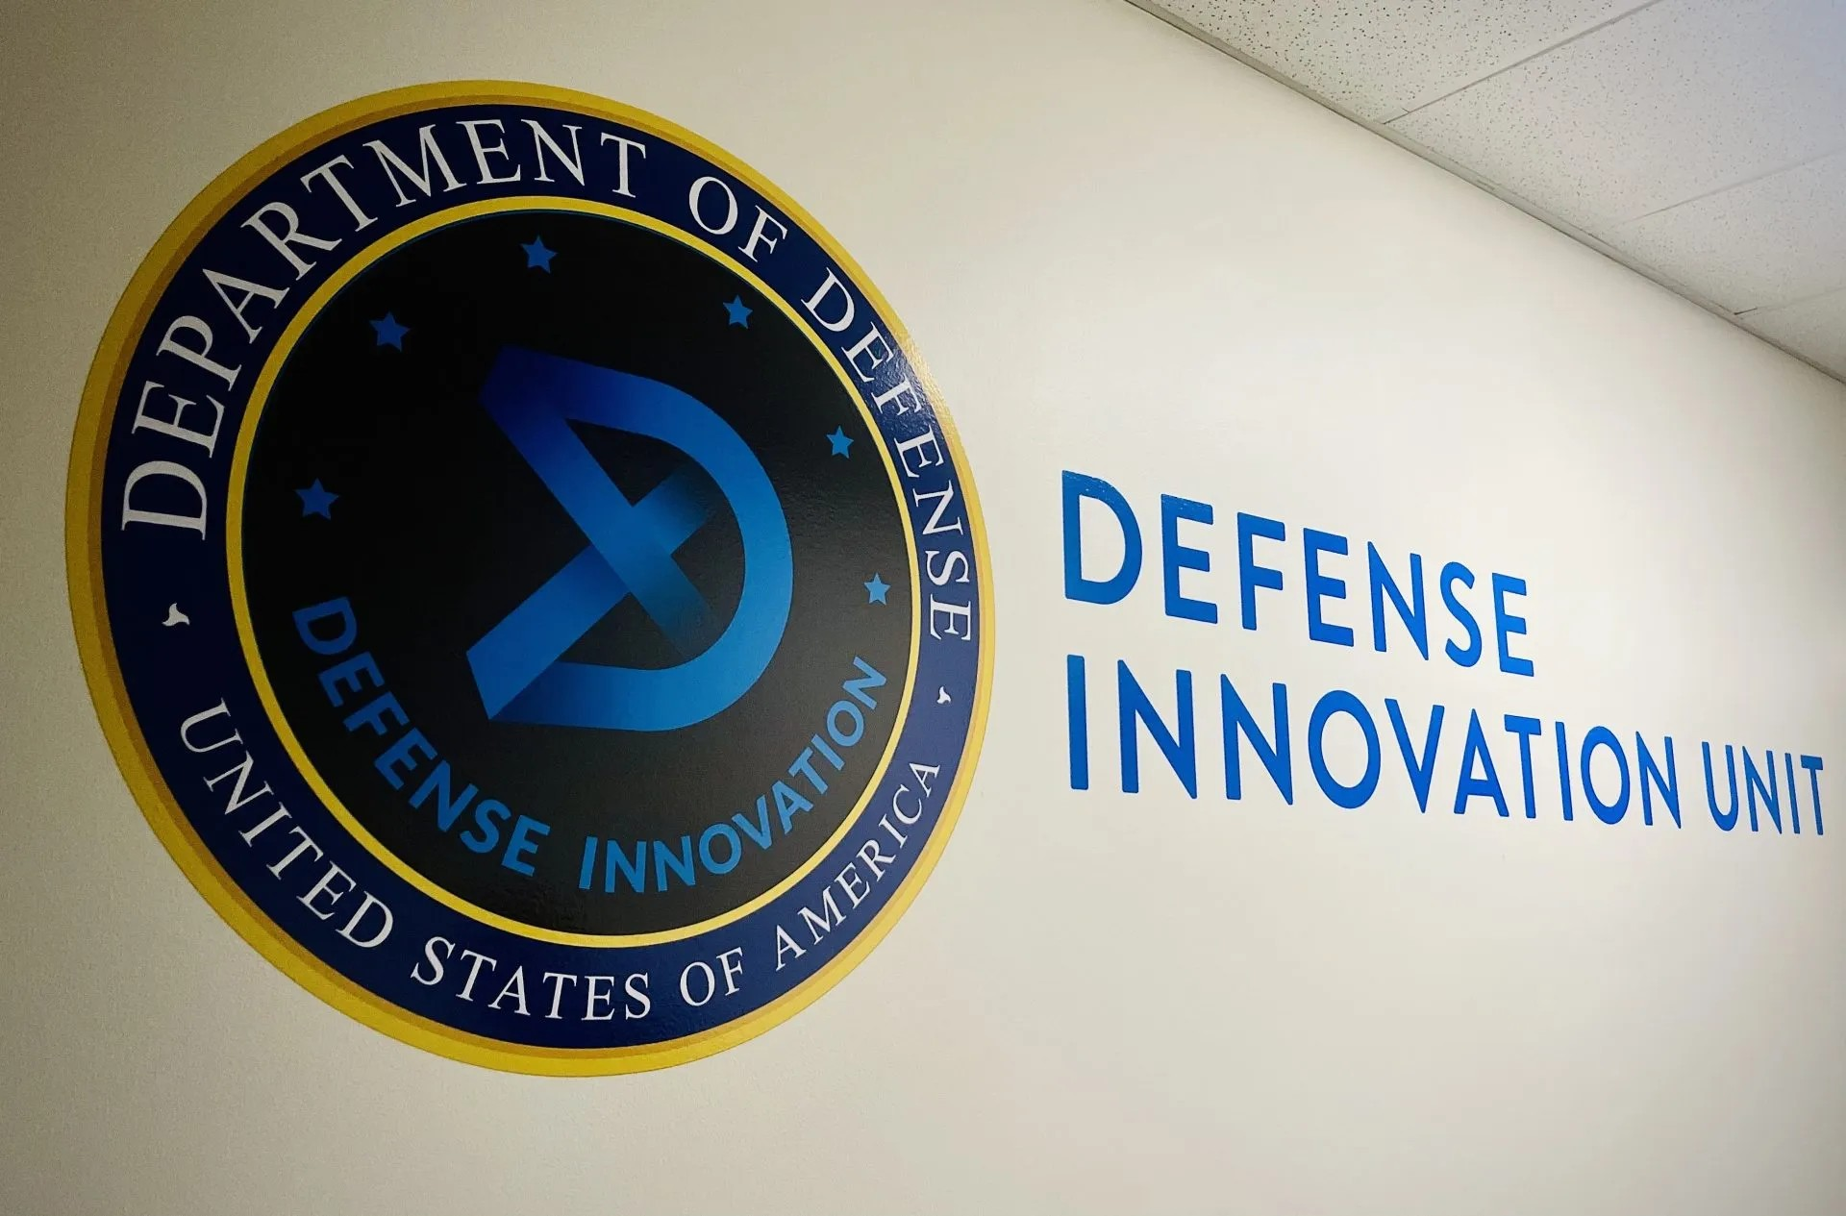
PlainSight
DIU · AI-ENHANCED RESILIENT COMMUNICATIONS
Hide a sensitive message inside everyday chat, and get it back on the other side.
SprintHack@ND 2026
Notes:
Open with the people this is for: someone who has to coordinate something sensitive on an app the state reads. Use the judge's own stories here (the Afghan evacuation, the Green Revolution). One line on what we built: type a secret, it goes out as small talk, it comes back out.

Slide 2





On a watched network, encryption is the red flag
They read everything
INTERCEPTED
A nation-state adversary sees all plaintext: lawful intercept, national firewalls, data pulled from providers.
U2FsdGVkX19vK3pQ8mWzE4rT0a…
Silence is the signal
Unreadable, so it gets flagged
Ciphertext hides the words but flags the sender. You don't bug every hotel room; you watch for the one that goes quiet.
INTERCEPTED
This is how people coordinate
Game night at the east bakery entrance, 7:30pm Thursday!
Kabul 2021, Iran 2009: evacuations and protests organized over WhatsApp and Twitter, on phones that get checked.
Ordinary, so it gets ignored
Notes:
The threat model in one breath: assume everything in plaintext is read. Encryption does not save you here, because who sends unreadable traffic is exactly what gets someone picked up. That is the bugged-hotel problem. The two cards on the right are the whole pitch: same channel, one gets flagged, one gets ignored.

Slide 3




A codebook is a confession
Proves you're an asset
Unlocks every past message
Exposes the whole network
A codebook has one use. Found on you, it is the evidence.
Every intercepted message ever sent with it can now be read.
Everyone else using the same book is compromised at once.
PlainSight's bet: a small, ordinary-looking language model is far safer to be caught with than a codebook, and what it sends looks like normal group-chat traffic.
Notes:
Why not just use a codebook? Because it is self-incriminating: if the carrier is caught, the book proves what they are, decodes everything they ever sent, and burns every other person using it. A model that looks like a chat assistant is deniable, and its output reads like ordinary chatter.

Slide 4




Type a secret, send small talk, get the secret back
1 · Mask
2 · Send
3 · Unmask
The model rewrites the note as everyday chat, using rules both partners share.
Only the small talk crosses the open channel. Nothing in it trips a keyword filter.
The partner runs the same rules in reverse and recovers the note.
THE MVP BRIEF
“Type in a string → a benign surface message with no actionable or suspicious wording → a decoder regenerates the original, or close enough to be usable.”
MET · 100% ON TEST CASES
Every cover passes the keyword check.
Notes:
This is the MVP exactly as it was described to us, and it is met: the eval harness runs the frozen cases, every exact detail comes back, and no cover contains any of that case's flagged words.

Slide 5




One prompt runs the code in both directions
Codebook swaps
Topic words trade places: library ↔ bakery, lecture notes ↔ playlist.
MODE: MASK
NOTE: Study group meets at the east library entrance. Be there at 1930 on Thursday. Bring the lecture notes.
→ Game night at the east bakery entrance. Be there at 7:30pm on Thursday. Bring the playlist.
MODE: UNMASK
MESSAGE: Game night at the east bakery entrance. Be there at 7:30pm on Thursday. Bring the playlist.
→ Study group at the east library entrance. Be there at 1930 on Thursday. Bring the lecture notes.
Times
24-hour in the note, 12-hour in chat: 1930 ↔ 7:30pm.
Coordinates
41.7056 N ↔ “gift code 41-7056N”.
Names, days, numbered places
Copied exactly, both ways.
Same system prompt both ways; only the MODE line changes. Real qwen2.5:7b output.
Notes:
The 'fancy' version: one system prompt that holds the whole shared code as two-way pairs. The request says MODE: MASK or MODE: UNMASK and the model converts in that direction. The rules are deliberately mechanical and reversible, so the decoder can undo exactly what the encoder did. We kept the two-prompt version as a baseline.

Slide 6
Live demo: one message, three views
1
Sender
2
What an eavesdropper sees
3
Receiver
Typed on the sender's phone. Never sent.
The only thing that crosses the wire.
Unmasked with the shared key.
The book swap is at 41.7056 N, 86.2353 W. Open 0900-1200. Host is Maria Lopez. Bring two paperbacks Saturday.
The brunch is at gift code 41‑7056N and 86‑2353W. Open 9am‑12pm. Birthday girl is Maria Lopez. Bring two cupcakes Saturday.
The book swap is at 41.7056 N and 86.2353 W. Open 0900-1200. Host is Maria Lopez. Bring two paperbacks Saturday.
Your note stays on your phone.
Keyword scan of the intercept
Exact details recovered
NOTHING FLAGGED
6 / 6 DETAILS
book · swap · paperback · library
coords · times · name · day
Notes:
Switch to the live app now: streamlit run demo/app.py. Click Warm up model first, use the book-swap preset. Narrate left to right: what the sender typed, what an eavesdropper sees (and the keyword scan coming back clean), what the receiver gets back with the exact details ticked off. If the model misbehaves, flip on Recorded replay, which replays this exact recorded output. Backup video: demo/demo-fallback.gif.

Slide 7
Exact details survive the round trip
100%
3 / 3
92%
~17s
exact details recovered on the test cases, both codecs
covers pass the keyword check
recovered on 3 messages the prompts never saw
full round trip on a laptop CPU
Codec (qwen2.5:7b, local) | Test cases | Benign | Unseen | Benign
Two prompts (encode / decode) | 100% | 3/3 | 92% | 2/3
One bidirectional prompt | 100% | 3/3 | 92% | 3/3
Same input gives the same output every run (temperature 0). The single prompt matched the baseline on recovery and leaked no flagged words on unseen messages. On an earlier unseen set the baseline fell to 78%: small samples, read as direction, not proof.
Notes:
Numbers come from python -m evaluation.run_eval. Test cases are the three frozen cases the prompts were tuned on, so 100% is expected there. The honest number is the unseen one: 92% on three new fictional messages for both codecs; the two-prompt codec leaked 'choir practice' into one cover, the single prompt did not.

Slide 8





It runs on a laptop today: no cloud, no API key
A 7B open model, on CPU
qwen2.5:7b via Ollama: a 4.7 GB download, no GPU needed.
CLI · Demo app · Eval harness
Usable speed
Codec (how masking works)
Two prompts · One bidirectional prompt · Keyed fields (next)
About 17 seconds per round trip once warm, about 66 seconds cold.
Cloud is one setting away
The same code runs against a hosted model by changing one line in .env.
LLMProvider (where text comes from)
Ollama, local · Anthropic, cloud · Mock, tests
Built to grow
Every future feature is a new Provider or Codec, not a rewrite.
Callers only ever touch the two interfaces.
Notes:
Feasibility: everything you just saw ran on a laptop CPU with an open 7B model and no API key. The architecture has two seams, Codec and Provider; on-device, multilingual, keyed and image carriers all plug in at one of them.

Slide 9

What still breaks, and how we know
Vocabulary gaps
Paraphrase drift
Topic words outside the shared codebook can leak into the cover (“choir practice” got through once).
The model sometimes shifts times (1705 came back wrong) or invents places (“road work”). Our scorer checks exact fields, not the topic.
Patterns
The rules are static
Temperature 0 means the same note always gives the same cover, and odd “gift codes” are a tell for a statistical analyst.
Seize the prompt and you can decode everything sent with it. Per-user keyed codebooks are the fix.
Notes:
The judge asked for honest acknowledgement of challenges, so here they are, all measured by our own harness. The biggest is that a language model paraphrasing exact data is lossy, which is exactly what the next stage fixes.

Slide 10
Roadmap: exact, keyed, then everywhere
NEXT
THEN
LATER
Fidelity layer
Keyed and varied
Blend in anywhere
Pull exact fields (coordinates, times, names) out of the note, pack them under the shared key, and let the model write only the small talk. Target: 98%+ exact recovery.
Per-user codebooks derived from the key, so a seized prompt decodes nothing. Key-seeded randomness so a note never yields the same cover twice. A real benign-ness scorer.
Multiple languages, covers shaped by real channel traffic, photo and caption carriers, and tests against an adversary who rewrites messages in transit.
Notes:
Next is the fidelity layer: stop asking the model to remember exact data through a paraphrase; carry it deterministically under the key and let the model only write the cover. Then make everything keyed and varied so a seized model is useless. The long tail is the judge's own list of later items.

Slide 11
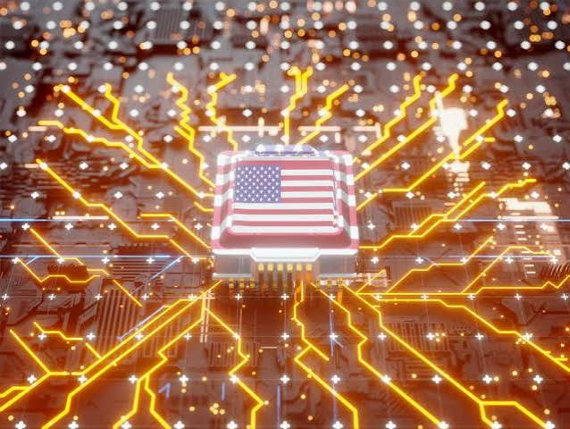




The end state: a small keyed model in every pocket
On-device
Runs locally. Nothing leaves the phone except small talk.
Keyed
The model alone decodes nothing; you also need your partner's key.
Different for every user
One seized phone doesn't compromise anyone else.
Deniable
On inspection it is an ordinary chat assistant, not a cipher.
Notes:
Where this goes: small per-user models that mask and unmask on the device, keyed so possessing the model is not enough, deployable to people living under censorship. Nothing in the MVP closes that door.

Slide 12
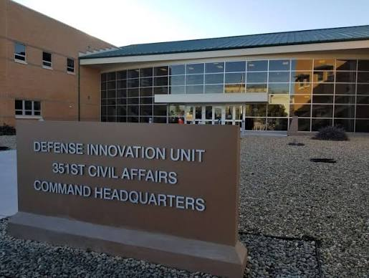

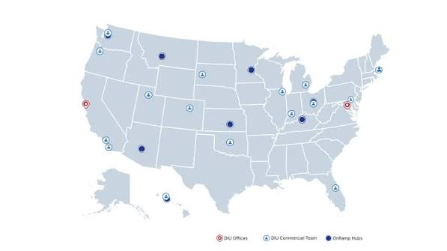

Thank you. Questions?
Built for the DIU AI-Enhanced Resilient Communications track.
Try it: streamlit run demo/app.py
Fictional test data only. A defensive, anti-censorship proof of concept.
Notes:
Thank the judge. Offer to rerun the demo with a message they type.

