Slide 1

COMP9313: Big Data Management Lecturer: Xin Cao Course web site: http://www.cse.unsw.edu.au/~cs9313/

Slide 2
Chapter 10: Recommender Systems

Slide 3










Recommendations
Examples:
Search
Recommendations
Items
Products, web sites, blogs, news items, …

Slide 4

Recommender Systems

Slide 5
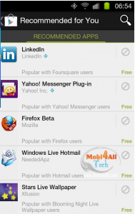

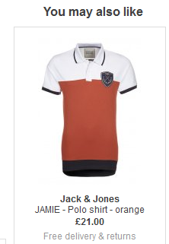
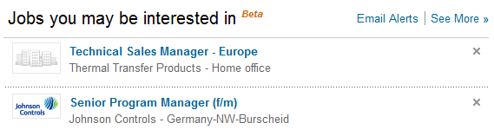
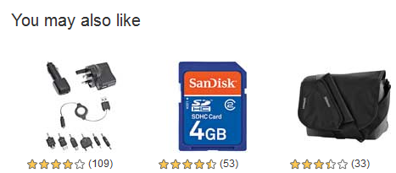
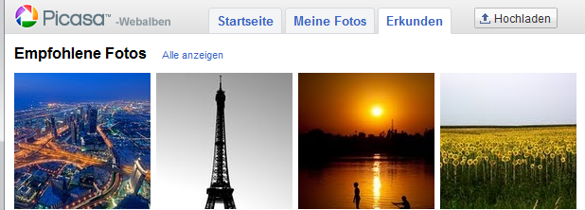
Recommender Systems
Application areas

Slide 6
Why using Recommender Systems?
Value for the customer
Find things that are interesting
Narrow down the set of choices
Help me explore the space of options
Discover new things
Entertainment
…
Value for the provider
Additional and probably unique personalized service for the customer
Increase trust and customer loyalty
Increase sales, click trough rates, conversion etc.
Opportunities for promotion, persuasion
Obtain more knowledge about customers
…

Slide 7
Real-world Check
Myths from industry
Amazon.com generates X percent of their sales through the recommendation lists (30 < X < 70)
Netflix (DVD rental and movie streaming) generates X percent of their sales through the recommendation lists (30 < X < 70)

Slide 8
Recommender systems
RS seen as a function
Given:
User model (e.g. ratings, preferences, demographics, situational context)
Items (with or without description of item characteristics)
Find:
Relevance score. Used for ranking.
Finally:
Recommend items that are assumed to be relevant
But:
Remember that relevance might be context-dependent
Characteristics of the list itself might be important (diversity)

Slide 9
Formal Model
X = set of Customers
S = set of Items
Utility function u: X × S → R
R = set of ratings
R is a totally ordered set
e.g., 0-5 stars, real number in [0,1]
Utility Matrix
Avatar
LOTR
Matrix
Pirates
Alice
Bob
Carol
David

Slide 10
Key Problems
Gathering “known” ratings for matrix
How to collect the data in the utility matrix
Extrapolate unknown ratings from the known ones
Mainly interested in high unknown ratings
We are not interested in knowing what you don’t like but what you like
Evaluating extrapolation methods
How to measure success/performance of recommendation methods

Slide 11
Gathering Ratings
Explicit
Ask people to rate items
Doesn’t work well in practice – people can’t be bothered
Implicit
Learn ratings from user actions
E.g., purchase implies high rating
What about low ratings?

Slide 12
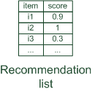

Paradigms of recommender systems
Recommender systems reduce information overload by estimating relevance

Slide 13


Paradigms of recommender systems
Personalized recommendations

Slide 14

Paradigms of recommender systems
Collaborative: "Tell me what's popular among my peers"

Slide 15

Paradigms of recommender systems
Content-based: "Show me more of the same what I've liked"

Slide 16


Paradigms of recommender systems
Knowledge-based: "Tell me what fits based on my needs"

Slide 17
Paradigms of recommender systems
Hybrid: combinations of various inputs and/or composition of different mechanism

Slide 18


Recommender systems: basic techniques
 | Pros | Cons
Content-based | No community required, comparison between items possible | Content descriptions necessary, cold start for new users, no surprises
Collaborative | No knowledge-engineering effort, serendipity of results, learns market segments | Requires some form of rating feedback, cold start for new users and new items
Knowledge-based | Deterministic recommendations, assured quality, no cold-start, can resemble sales dialogue | Knowledge engineering effort to bootstrap, basically static, does not react to short-term trends

Slide 19
Content-based Recommendations
Main idea: Recommend items to customer x similar to previous items rated highly by x
What do we need:
Some information about the available items such as the genre ("content")
Some sort of user profile describing what the user likes (the preferences)
Example:
Movie recommendations:
Recommend movies with same actor(s), director, genre, …
Websites, blogs, news:
Recommend other sites with “similar” content

Slide 20
Plan of Action
Item profiles
likes
build
recommend
match
Red
Circles
Triangles
User profile

Slide 21
Item Profiles
For each item, create an item profile
Profile is a set (vector) of features
Movies: author, title, actor, director,…
Text: Set of “important” words in document
How to pick important features?
Usual heuristic from text mining is TF-IDF (Term frequency * Inverse Doc Frequency)
Term … Feature
Document … Item

Slide 22
Term-Frequency - Inverse Document Frequency (TF-IDF)
Compute the overall importance of keywords
Given a keyword i and a document j
TF-IDF (i,j) = TF(i,j) * IDF(i)
Term frequency (TF)
Let freq(i,j) number of occurrences of keyword i in document j
Let maxOthers(i,j) denote the highest number of occurrences of another keyword of j
$TF\left(i,j\right)= \frac{freq(i,j)}{maxOthers(i,j)}$
Inverse Document Frequency (IDF)
N: number of all recommendable documents
n(i): number of documents in which keyword i appears
$IDF(i)=log\frac{N}{n(i)}$

Slide 23
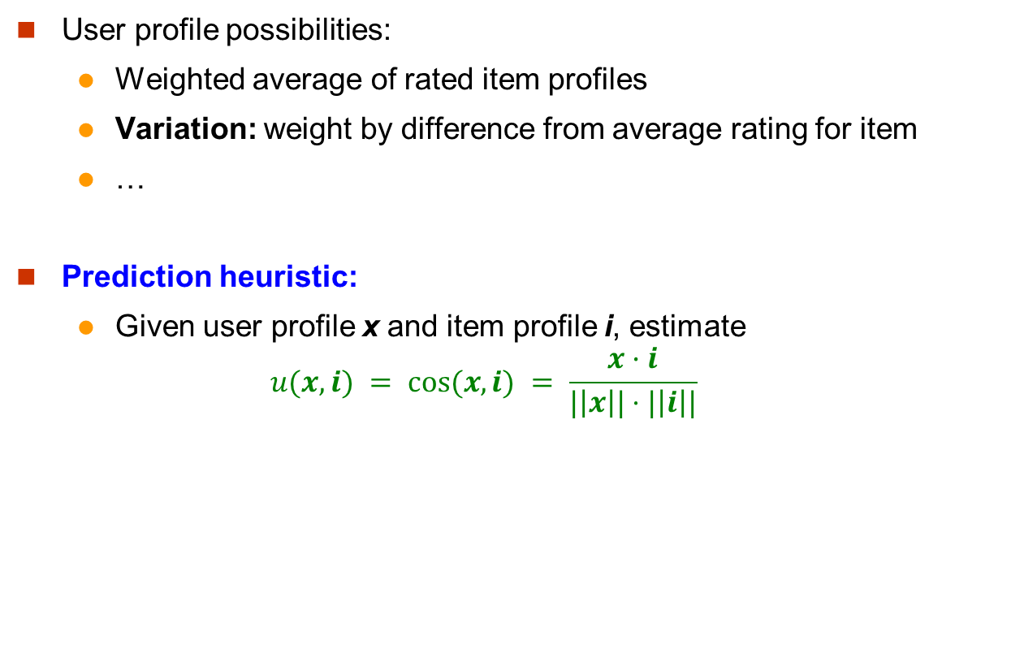
User Profiles and Prediction
User profile possibilities:
Weighted average of rated item profiles
Variation: weight by difference from average rating for item
…
Prediction heuristic:
Given user profile x and item profile i, estimate
$$u(x,i) = cos⁡(x,i) = \frac{x·i}{|\left|x\right||⋅|\left|i\right||}$$

Slide 24
Pros: Content-based Approach
+: No need for data on other users
No cold-start or sparsity problems
+: Able to recommend to users with unique tastes
+: Able to recommend new & unpopular items
No first-rater problem
+: Able to provide explanations
Can provide explanations of recommended items by listing content-features that caused an item to be recommended

Slide 25
Cons: Content-based Approach
–: Finding the appropriate features is hard
E.g., images, movies, music
–: Recommendations for new users
How to build a user profile?
–: Overspecialization
Never recommends items outside user’s content profile
People might have multiple interests
Unable to exploit quality judgments of other users

Slide 26
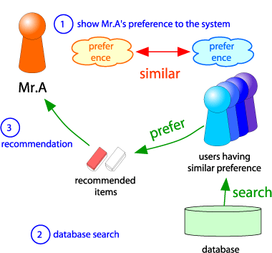
Collaborative Filtering
Consider user x
Find set N of other users whose ratings are “similar” to x’s ratings
Estimate x’s ratings based on ratings of users in N
x
N

Slide 27
User-based Nearest-Neighbor Collaborative Filtering
The basic technique:
Given an "active user" (Alice) and an item i not yet seen by Alice
The goal is to estimate Alice's rating for this item, e.g., by
find a set of users (peers) who liked the same items as Alice in the past and who have rated item I
use, e.g. the average of their ratings to predict, if Alice will like item I
do this for all items Alice has not seen and recommend the best-rated
 | Item1 | Item2 | Item3 | Item4 | Item5
Alice | 5 | 3 | 4 | 4 | ?
User1 | 3 | 1 | 2 | 3 | 3
User2 | 4 | 3 | 4 | 3 | 5
User3 | 3 | 3 | 1 | 5 | 4
User4 | 1 | 5 | 5 | 2 | 1

Slide 28
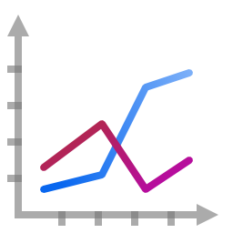
User-based Nearest-Neighbor Collaborative Filtering (Cont’)
Some first questions
How do we measure similarity?
How many neighbors should we consider?
How do we generate a prediction from the neighbors' ratings?
 | Item1 | Item2 | Item3 | Item4 | Item5
Alice | 5 | 3 | 4 | 4 | ?
User1 | 3 | 1 | 2 | 3 | 3
User2 | 4 | 3 | 4 | 3 | 5
User3 | 3 | 3 | 1 | 5 | 4
User4 | 1 | 5 | 5 | 2 | 1

Slide 29
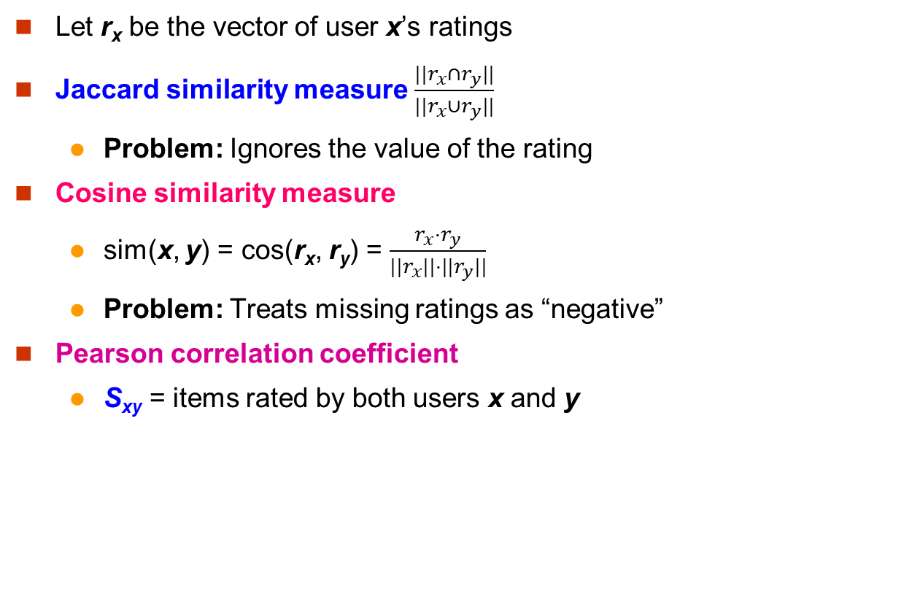
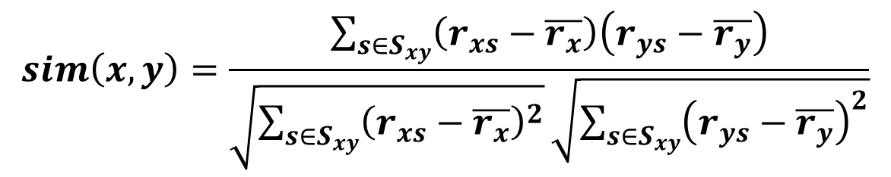
Finding “Similar” Users
r_{x} = [*, _, _, *, ***]
r_{y} = [*, _, **, **, _]
Let r_{x} be the vector of user x’s ratings
Jaccard similarity measure $\frac{{||r}_{x}∩r_{y}||}{||r_{x}{∪r}_{y}||}$
Problem: Ignores the value of the rating
Cosine similarity measure
sim(x, y) = cos(r_{x}, r_{y}) = $\frac{r_{x}⋅r_{y}}{||r_{x}||⋅{||r}_{y}||}$
Problem: Treats missing ratings as “negative”
Pearson correlation coefficient
S_{xy} = items rated by both users x and y
r_{x}, r_{y} as sets:
r_{x} = {1, 4, 5}
r_{y} = {1, 3, 4}
r_{x}, r_{y} as points:
r_{x} = {1, 0, 0, 1, 3}
r_{y} = {1, 0, 2, 2, 0}
$$sim\left(x,y\right)=\frac{\sum_{s∈S_{xy}}{\left(r_{xs}−\overline{r_{x}}\right)\left(r_{ys}−\overline{r_{y}}\right)}}{\sqrt{\sum_{s∈S_{xy}}{{\left(r_{xs}−\overline{r_{x}}\right)}^{2}}}\sqrt{\sum_{s∈S_{xy}}{{\left(r_{ys}−\overline{r_{y}}\right)}^{2}}}}$$
r_{x}, r_{y} … avg. rating of x, y
Notes:
-- Jaccard is not appropriate as we want to consider weights

Slide 30
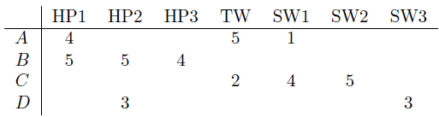
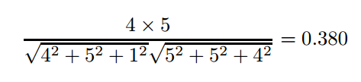
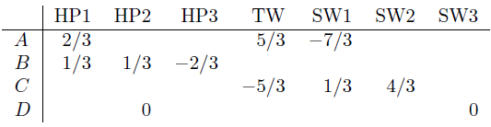
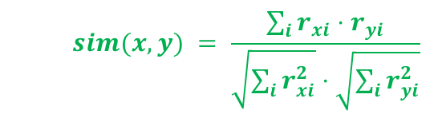
Similarity Metric
Cosine similarity:
$$sim(x, y) = \frac{\sum_{i}{r_{xi}⋅r_{yi}}}{\sqrt{\sum_{i}{r_{xi}^{2}}}⋅\sqrt{\sum_{i}{r_{yi}^{2}}}}$$
Intuitively we want: sim(A, B) > sim(A, C)
Jaccard similarity: 1/5 < 2/4
Cosine similarity: 0.380 > 0.322
Considers missing ratings as “negative”
Solution: subtract the (row) mean
sim A,B vs. A,C:
0.092 > -0.559
Notice cosine sim. is correlation when data is centered at 0

Slide 31
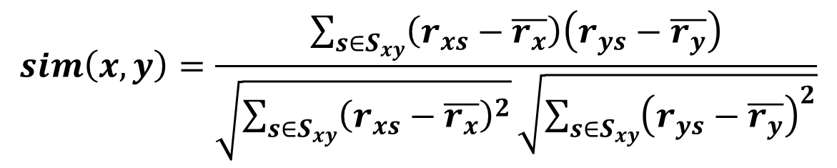
Similarity Metric (Cont’)
A popular similarity measure in user-based CF: Pearson correlation
Possible similarity values between -1 and 1;
$$sim\left(x,y\right)=\frac{\sum_{s∈S_{xy}}{\left(r_{xs}−\overline{r_{x}}\right)\left(r_{ys}−\overline{r_{y}}\right)}}{\sqrt{\sum_{s∈S_{xy}}{{\left(r_{xs}−\overline{r_{x}}\right)}^{2}}}\sqrt{\sum_{s∈S_{xy}}{{\left(r_{ys}−\overline{r_{y}}\right)}^{2}}}}$$
 | Item1 | Item2 | Item3 | Item4 | Item5
Alice | 5 | 3 | 4 | 4 | ?
User1 | 3 | 1 | 2 | 3 | 3
User2 | 4 | 3 | 4 | 3 | 5
User3 | 3 | 3 | 1 | 5 | 4
User4 | 1 | 5 | 5 | 2 | 1
sim = 0,85
sim = 0,70
sim = -0,79

Slide 32
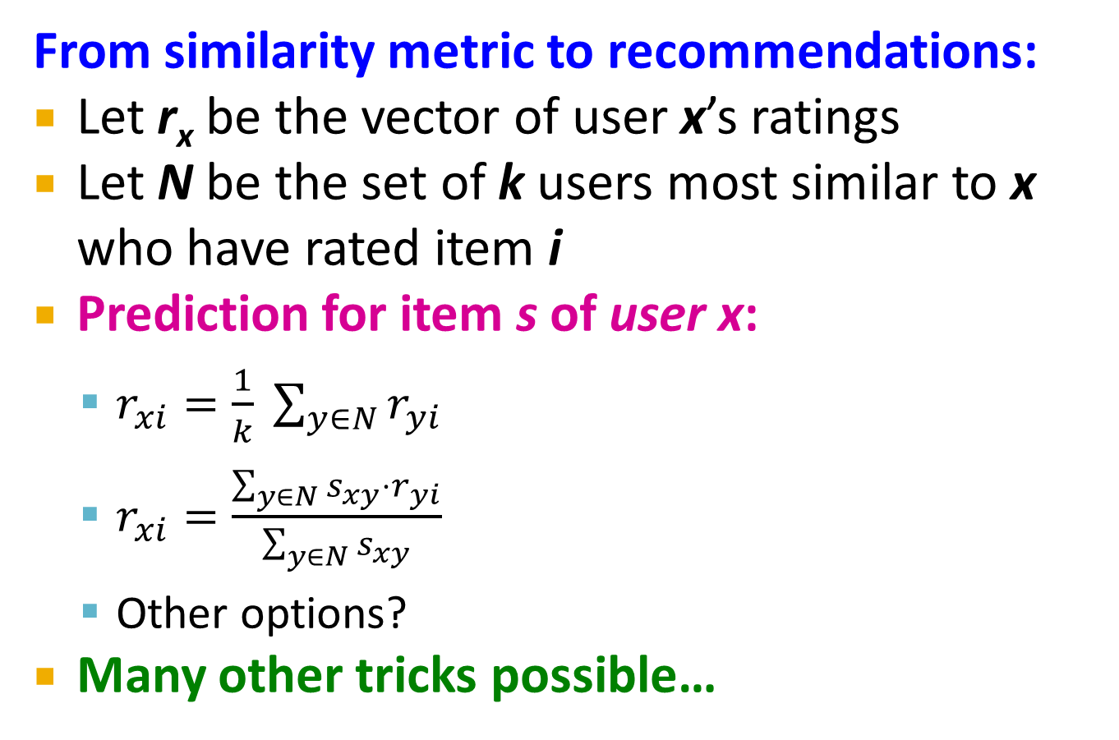
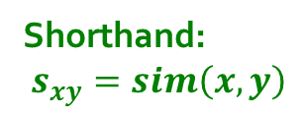
Rating Predictions
From similarity metric to recommendations:
Let r_{x} be the vector of user x’s ratings
Let N be the set of k users most similar to x who have rated item i
Prediction for item s of user x:
$r_{xi}=\frac{1}{k} \sum_{y∈N}{r_{yi}}$
$r_{xi}=\frac{\sum_{y∈N}{s_{xy}⋅r_{yi}}}{\sum_{y∈N}{s_{xy}}}$
Other options?
Many other tricks possible…
Shorthand: $s_{xy}=sim\left(x,y\right)$

Slide 33
Memory-based and Model-based Approaches
User-based CF is said to be "memory-based"
the rating matrix is directly used to find neighbors / make predictions
does not scale for most real-world scenarios
large e-commerce sites have tens of millions of customers and millions of items
Model-based approaches
based on an offline pre-processing or "model-learning" phase
at run-time, only the learned model is used to make predictions
models are updated / re-trained periodically
large variety of techniques used
model-building and updating can be computationally expensive

Slide 34
Item-Item Collaborative Filtering
So far: User-user collaborative filtering
Another view: Item-item
Basic idea:
Use the similarity between items (and not users) to make predictions
For item i, find other similar items
Estimate rating for item i based on ratings for similar items
Can use same similarity metrics and prediction functions as in user-user model
s_{ij}… similarity of items i and j
r_{xj}…rating of user u on item j
N(i;x)… set items rated by x similar to i

Slide 35
Item-Item Collaborative Filtering
Example:
Look for items that are similar to Item5
Take Alice's ratings for these items to predict the rating for Item5
 | Item1 | Item2 | Item3 | Item4 | Item5
Alice | 5 | 3 | 4 | 4 | ?
User1 | 3 | 1 | 2 | 3 | 3
User2 | 4 | 3 | 4 | 3 | 5
User3 | 3 | 3 | 1 | 5 | 4
User4 | 1 | 5 | 5 | 2 | 1

Slide 36
Item-Item CF (|N|=2)
users
12 | 11 | 10 | 9 | 8 | 7 | 6 | 5 | 4 | 3 | 2 | 1
 | 4 |  | 5 |  |  | 5 |  |  | 3 |  | 1 | 1
3 | 1 | 2 |  |  | 4 |  |  | 4 | 5 |  |  | 2
 | 5 | 3 | 4 |  | 3 |  | 2 | 1 |  | 4 | 2 | 3
 | 2 |  |  | 4 |  |  | 5 |  | 4 | 2 |  | 4
5 | 2 |  |  |  |  | 2 | 4 | 3 | 4 |  |  | 5
 | 4 |  |  | 2 |  |  | 3 |  | 3 |  | 1 | 6
movies
- unknown rating
- rating between 1 to 5

Slide 37
Item-Item CF (|N|=2)
users
12 | 11 | 10 | 9 | 8 | 7 | 6 | 5 | 4 | 3 | 2 | 1
 | 4 |  | 5 |  |  | 5 | ? |  | 3 |  | 1 | 1
3 | 1 | 2 |  |  | 4 |  |  | 4 | 5 |  |  | 2
 | 5 | 3 | 4 |  | 3 |  | 2 | 1 |  | 4 | 2 | 3
 | 2 |  |  | 4 |  |  | 5 |  | 4 | 2 |  | 4
5 | 2 |  |  |  |  | 2 | 4 | 3 | 4 |  |  | 5
 | 4 |  |  | 2 |  |  | 3 |  | 3 |  | 1 | 6
movies
- estimate rating of movie 1 by user 5

Slide 38
Item-Item CF (|N|=2)
users
12 | 11 | 10 | 9 | 8 | 7 | 6 | 5 | 4 | 3 | 2 | 1
 | 4 |  | 5 |  |  | 5 | ? |  | 3 |  | 1 | 1
3 | 1 | 2 |  |  | 4 |  |  | 4 | 5 |  |  | 2
 | 5 | 3 | 4 |  | 3 |  | 2 | 1 |  | 4 | 2 | 3
 | 2 |  |  | 4 |  |  | 5 |  | 4 | 2 |  | 4
5 | 2 |  |  |  |  | 2 | 4 | 3 | 4 |  |  | 5
 | 4 |  |  | 2 |  |  | 3 |  | 3 |  | 1 | 6
sim(1,m)
1.00
-0.18
0.41
-0.10
-0.31
0.59
movies
Neighbor selection: Identify movies similar to movie 1, rated by user 5
Here we use Pearson correlation as similarity:
1) Subtract mean rating m_{i} from each movie i m₁ = (1+3+5+5+4)/5 = 3.6 row 1: [-2.6, 0, -0.6, 0, 0, 1.4, 0, 0, 1.4, 0, 0.4, 0]
2) Compute cosine similarities between rows

Slide 39
Item-Item CF (|N|=2)
users
12 | 11 | 10 | 9 | 8 | 7 | 6 | 5 | 4 | 3 | 2 | 1
 | 4 |  | 5 |  |  | 5 | ? |  | 3 |  | 1 | 1
3 | 1 | 2 |  |  | 4 |  |  | 4 | 5 |  |  | 2
 | 5 | 3 | 4 |  | 3 |  | 2 | 1 |  | 4 | 2 | 3
 | 2 |  |  | 4 |  |  | 5 |  | 4 | 2 |  | 4
5 | 2 |  |  |  |  | 2 | 4 | 3 | 4 |  |  | 5
 | 4 |  |  | 2 |  |  | 3 |  | 3 |  | 1 | 6
sim(1,m)
1.00
-0.18
0.41
-0.10
-0.31
0.59
movies
Compute similarity weights: s_{1,3}=0.41, s_{1,6}=0.59

Slide 40
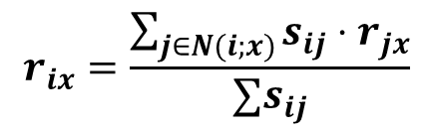
Item-Item CF (|N|=2)
users
12 | 11 | 10 | 9 | 8 | 7 | 6 | 5 | 4 | 3 | 2 | 1
 | 4 |  | 5 |  |  | 5 | 2.6 |  | 3 |  | 1 | 1
3 | 1 | 2 |  |  | 4 |  |  | 4 | 5 |  |  | 2
 | 5 | 3 | 4 |  | 3 |  | 2 | 1 |  | 4 | 2 | 3
 | 2 |  |  | 4 |  |  | 5 |  | 4 | 2 |  | 4
5 | 2 |  |  |  |  | 2 | 4 | 3 | 4 |  |  | 5
 | 4 |  |  | 2 |  |  | 3 |  | 3 |  | 1 | 6
movies
Predict by taking weighted average:
r_{1.5} = (0.41*2 + 0.59*3) / (0.41+0.59) = 2.6
$$r_{ix}=\frac{\sum_{j∈N(i;x)}{s_{ij}⋅r_{jx}}}{∑s_{ij}}$$

Slide 41

CF: Common Practice
Before:
Define similarity s_{ij} of items i and j
Select k nearest neighbors N(i; x)
Items most similar to i, that were rated by x
Estimate rating r_{xi} as the weighted average:
baseline estimate for r_{xi}
μ = overall mean movie rating
b_{x} = rating deviation of user x
= (avg. rating of user x) – μ
b_{i} = rating deviation of movie i
$$b_{xi}=μ+b_{x}+b_{i}$$

Slide 42
Item-Item vs. User-User
Avatar
LOTR
Matrix
Pirates
Alice
Bob
Carol
David
In practice, it has been observed that item-item often works better than user-user
Why? Items are simpler, users have multiple tastes
Notes:
There is a difference in the typical behavior of users and items, as it
pertains to similarity. Intuitively, items tend to be classifiable in simple
terms. For example, music tends to belong to a single genre. It is impossi-
ble, e.g., for a piece of music to be both 60’s rock and 1700’s baroque. On
the other hand, there are individuals who like both 60’s rock and 1700’s
baroque, and who buy examples of both types of music.
The consequence is that it is easier to discover items that are similar because they belong
to the same genre, than it is to detect that two users are similar because
they prefer one genre in common, while each also likes some genres that
the other doesn’t care for.

Slide 43
Pros/Cons of Collaborative Filtering
+ Works for any kind of item
No feature selection needed
- Cold Start:
Need enough users in the system to find a match
- Sparsity:
The user/ratings matrix is sparse
Hard to find users that have rated the same items
- First rater:
Cannot recommend an item that has not been previously rated
New items, Esoteric items
- Popularity bias:
Cannot recommend items to someone with unique taste
Tends to recommend popular items

Slide 44
Collaborative Filtering: Complexity
Expensive step is finding k most similar customers: O(|X|)
Too expensive to do at runtime
Could pre-compute
Naïve pre-computation takes time O(k ·|X|)
X … set of customers
Ways of doing this：
Near-neighbor search in high dimensions (LSH)
Clustering
Dimensionality reduction
… …
Supported by Hadoop: Apache Mahout https://mahout.apache.org/users/basics/algorithms.html

Slide 45


Why do we need knowledge-based recommendation?
Products with low number of available ratings
Time span plays an important role
Five-year-old ratings for computers
User lifestyle or family situation changes
Customers want to define their requirements explicitly
“The color of the car should be black"

Slide 46
Knowledge-Based Recommendation
Knowledge-based: "Tell me what fits based on my needs"

Slide 47
Knowledge-based Recommendation
Constraint-based
based on explicitly defined set of recommendation rules
fulfill recommendation rules
Case-based
based on different types of similarity measures
retrieve items that are similar to specified requirements
Both approaches are similar in their conversational recommendation process
users specify the requirements
systems try to identify solutions
if no solution can be found, users change requirements

Slide 48
Hybrid Methods
Implement two or more different recommenders and combine predictions
Perhaps using a linear model
Add content-based methods to collaborative filtering
Item profiles for new item problem
Demographics to deal with new user problem

Slide 49


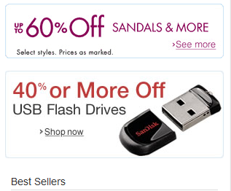
What is a Good Recommendation in Practice?
Total sales numbers
Promotion of certain items
…
Click-through-rates
Interactivity on platform
…
Customer return rates
Customer satisfaction and loyalty

Slide 50
Evaluation
movies
1 | 3 | 4
 | 3 | 5 |  |  | 5
 |  | 4 | 5 |  | 5
 |  | 3
 |  | 3
2 |  |  | 2 |  | 2
 |  |  |  | 5
 | 2 | 1 |  |  | 1
 | 3 |  |  | 3
1
users

Slide 51
Evaluation
movies
1 | 3 | 4
 | 3 | 5 |  |  | 5
 |  | 4 | 5 |  | 5
 |  | 3
 |  | 3
2 |  |  | ? |  | ?
 |  |  |  | ?
 | 2 | 1 |  |  | ?
 | 3 |  |  | ?
1
users
Test Data Set

Slide 52
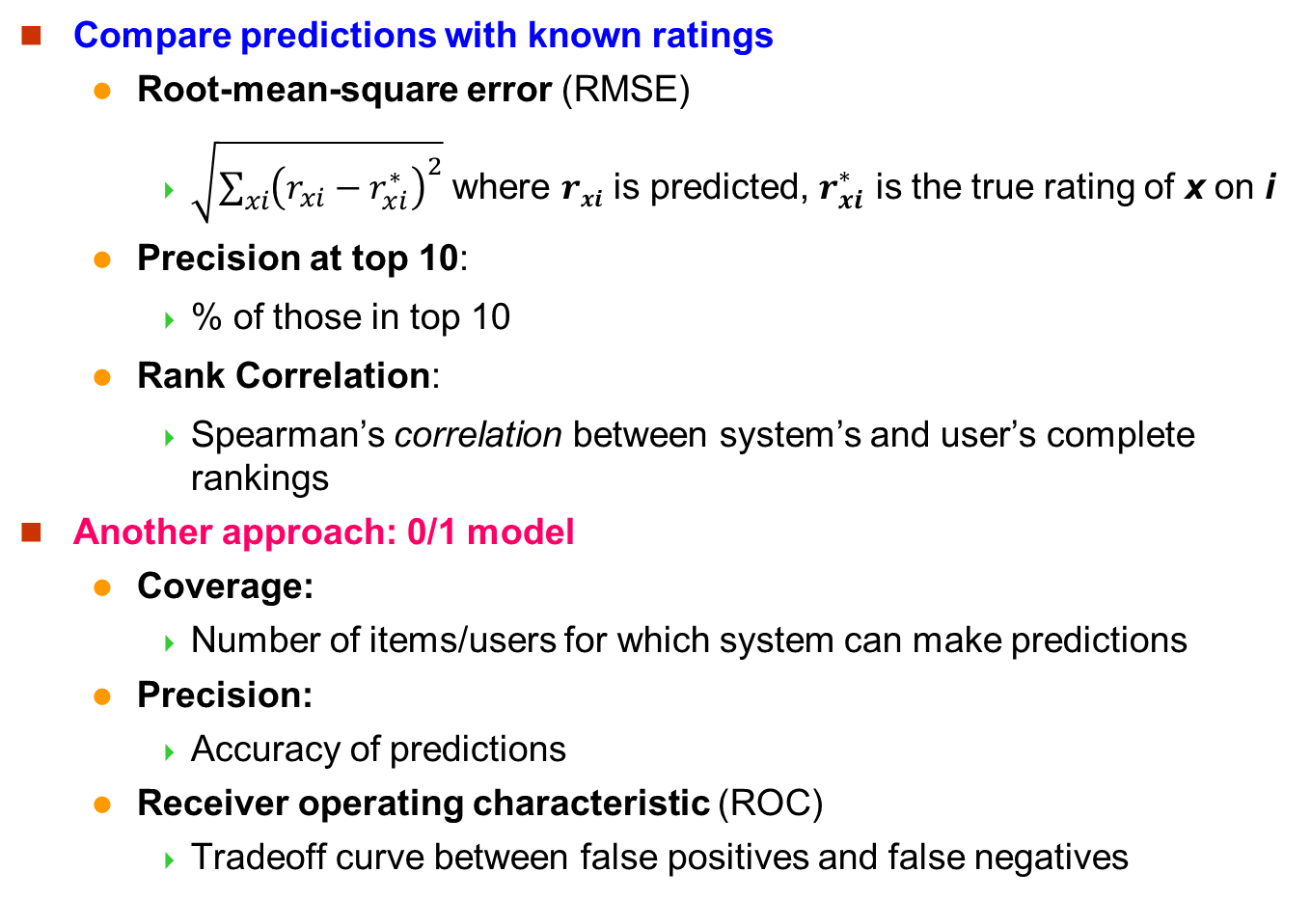
Evaluating Predictions
Compare predictions with known ratings
Root-mean-square error (RMSE)
$\sqrt{\sum_{xi}{{\left(r_{xi}−r_{xi}^{∗}\right)}^{2}}}$ where $rxi$ is predicted, $r_{xi}^{∗}$ is the true rating of x on i
Precision at top 10:
% of those in top 10
Rank Correlation:
Spearman’s correlation between system’s and user’s complete rankings
Another approach: 0/1 model
Coverage:
Number of items/users for which system can make predictions
Precision:
Accuracy of predictions
Receiver operating characteristic (ROC)
Tradeoff curve between false positives and false negatives

Slide 53
References
Chapter 9 of Mining of Massive Datasets.
Tutorial: Recommender Systems. IJCAI 2013.

Slide 54
End of Chapter 10

