Slide 1

COMP9313: Big Data Management Lecturer: Xin Cao Course web site: http://www.cse.unsw.edu.au/~cs9313/

Slide 2
Chapter 12: Revision and Exam Preparation

Slide 3
Revision of Chapters Required in Exam

Slide 4
Topic 1： MapReduce (Chapters 2-4)

Slide 5
Map and Reduce Functions
PSEUDO-CODE
Programmers specify two functions:
map (k₁, v₁) → list [<k₂, v₂>]
Map transforms the input into key-value pairs to process
reduce (k₂, [v₂]) → [<k₃, v₃>]
Reduce aggregates the list of values for each key
All values with the same key are sent to the same reducer
Optionally, also:
combine (k₂, [v₂]) → [<k₃, v₃>]
Mini-reducers that run in memory after the map phase
Used as an optimization to reduce network traffic
partition (k₂, number of partitions) → partition for k₂
Often a simple hash of the key, e.g., hash(k₂) mod n
Divides up key space for parallel reduce operations
Grouping comparator: controls which keys are grouped together for a single call to Reducer.reduce() function
The execution framework handles everything else…

Slide 6
Combiners
Often a Map task will produce many pairs of the form (k,v₁), (k,v₂), … for the same key k
E.g., popular words in the word count example
Combiners are a general mechanism to reduce the amount of intermediate data, thus saving network time
They could be thought of as “mini-reducers”
Warning!
The use of combiners must be thought carefully
Optional in Hadoop: the correctness of the algorithm cannot depend on computation (or even execution) of the combiners
A combiner operates on each map output key. It must have the same output key-value types as the Mapper class.
A combiner can produce summary information from a large dataset because it replaces the original Map output
Works only if reduce function is commutative and associative
In general, reducer and combiner are not interchangeable

Slide 7
Partitioner
Partitioner controls the partitioning of the keys of the intermediate map-outputs.
The key (or a subset of the key) is used to derive the partition, typically by a hash function.
The total number of partitions is the same as the number of reduce tasks for the job.
This controls which of the m reduce tasks the intermediate key (and hence the record) is sent to for reduction.
System uses HashPartitioner by default:
hash(key) mod R
Sometimes useful to override the hash function:
E.g., hash(hostname(URL)) mod R ensures URLs from a host end up in the same output file
Job sets Partitioner implementation (in Main)

Slide 8
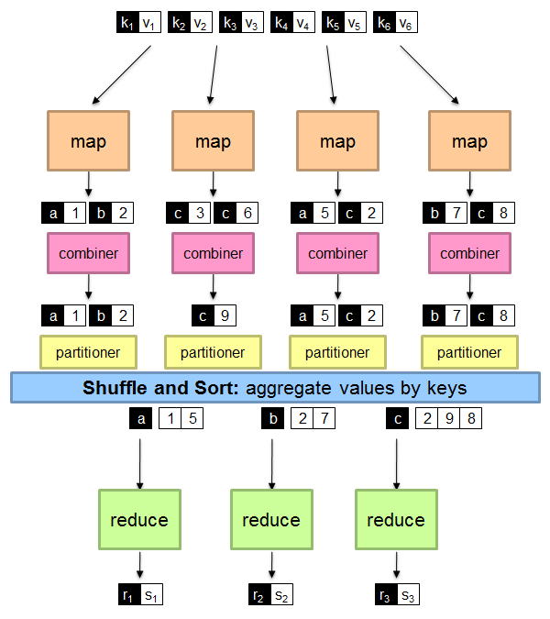
A Brief View of MapReduce

Slide 9
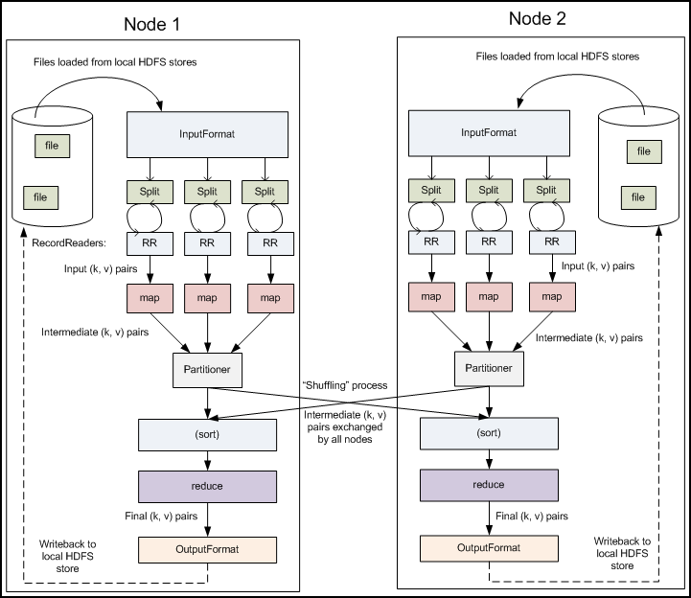
MapReduce Data Flow

Slide 10
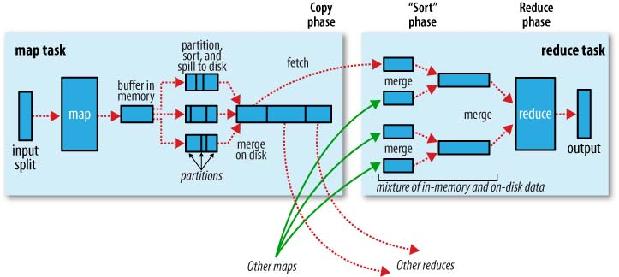
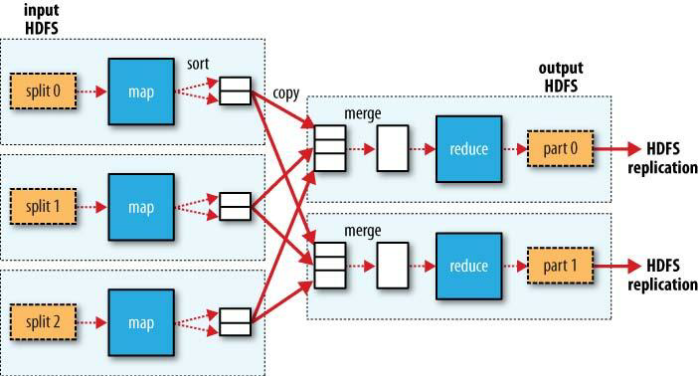
MapReduce Data Flow

Slide 11
MapReduce Algorithm Design Patterns
In-mapper combining, where the functionality of the combiner is moved into the mapper.
Scalability issue (not suitable for huge data) : More memory required for a mapper to store intermediate results
The related patterns “pairs” and “stripes” for keeping track of joint events from a large number of observations.
“Order inversion”, where the main idea is to convert the sequencing of computations into a sorting problem.
You need to guarantee that all key-value pairs relevant to the same term are sent to the same reducer
“Value-to-key conversion”, which provides a scalable solution for secondary sorting.
Grouping comparator

Slide 12
Topic 2： Spark Core (Chapter 6)

Slide 13
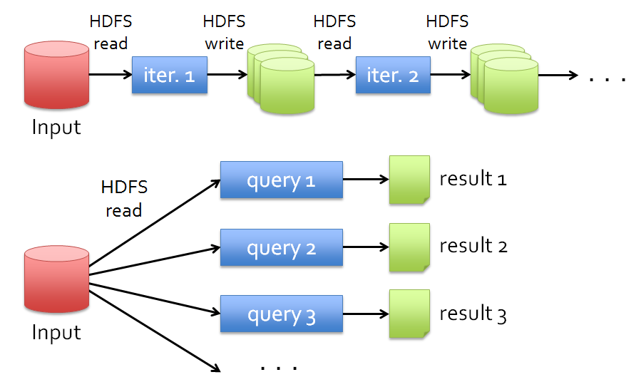
Data Sharing in MapReduce
Slow due to replication, serialization, and disk IO
Complex apps, streaming, and interactive queries all need one thing that MapReduce lacks:
Efficient primitives for data sharing

Slide 14
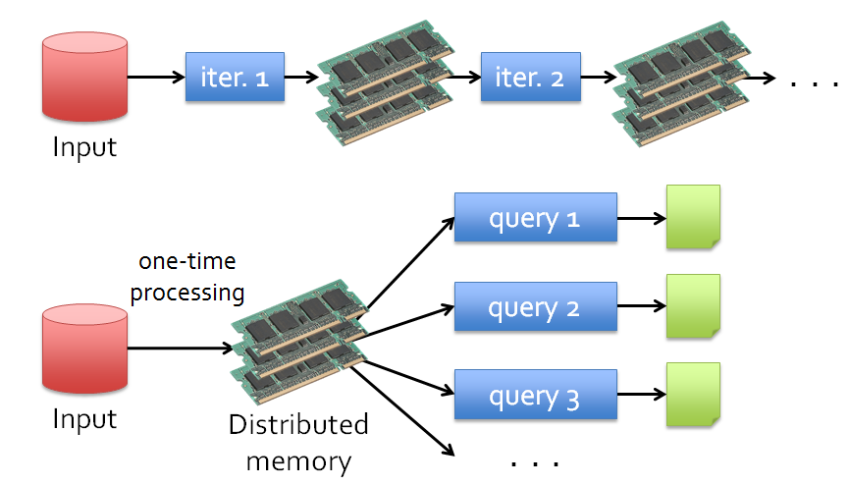
Data Sharing in Spark Using RDD
10-100× faster than network and disk

Slide 15
What is RDD
Resilient Distributed Datasets: A Fault-Tolerant Abstraction for In-Memory Cluster Computing. Matei Zaharia, et al. NSDI’12
RDD is a distributed memory abstraction that lets programmers perform in-memory computations on large clusters in a fault-tolerant manner.
Resilient
Fault-tolerant, is able to recompute missing or damaged partitions due to node failures.
Distributed
Data residing on multiple nodes in a cluster.
Dataset
A collection of partitioned elements, e.g. tuples or other objects (that represent records of the data you work with).
RDD is the primary data abstraction in Apache Spark and the core of Spark. It enables operations on collection of elements in parallel.

Slide 16
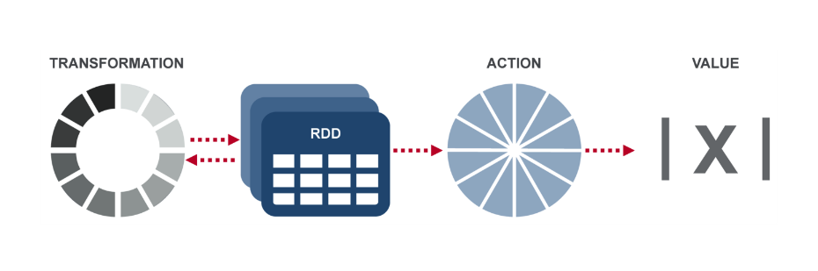
RDD Operations
Transformation: returns a new RDD.
Nothing gets evaluated when you call a Transformation function, it just takes an RDD and return a new RDD.
Transformation functions include map, filter, flatMap, groupByKey, reduceByKey, aggregateByKey, filter, join, etc.
Action: evaluates and returns a new value.
When an Action function is called on a RDD object, all the data processing queries are computed at that time and the result value is returned.
Action operations include reduce, collect, count, first, take, countByKey, foreach, saveAsTextFile, etc.

Slide 17
RDD Operations

Slide 18
Topic 3： Finding Similar Items (Chapter 9)
The Big Picture
Candidate
pairs:
those pairs
of signatures
that we need
to test for
similarity
Shingling
Min Hashing
Locality-
Sensitive
Hashing
Docu-
ment
The set
of strings
of length k
that appear
in the doc-
ument
Signatures:
short integer
vectors that
represent the
sets, and
reflect their
similarity

Slide 19
Shingling
A k-shingle (or k-gram) for a document is a sequence of k tokens that appears in the doc
Tokens can be characters, words or something else, depending on the application
Assume tokens = characters for examples
Example: k=2; document D₁ = abcab Set of 2-shingles: S(D₁) = {ab, bc, ca}
Documents that are intuitively similar will have many shingles in common.
Example: k=3, “The dog which chased the cat” versus “The dog that chased the cat”.
Only 3-shingles replaced are g_w, _wh, whi, hic, ich, ch_, and h_c.

Slide 20
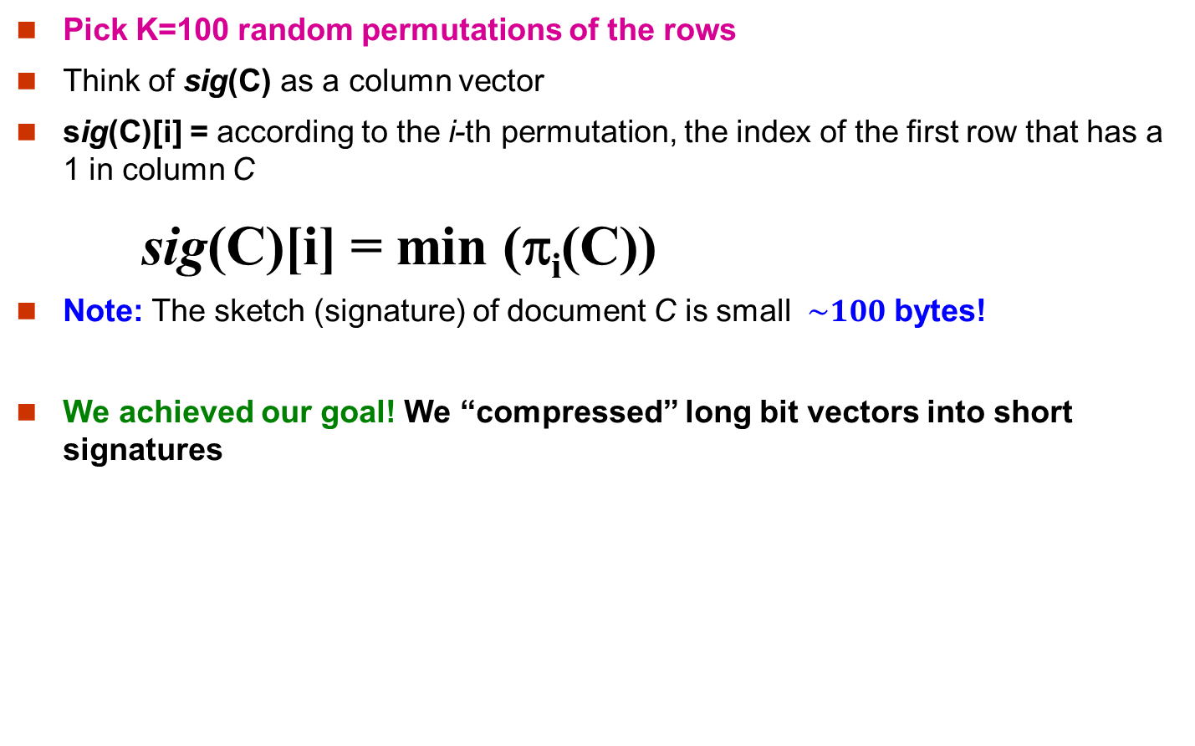
Min-Hash Signatures
Pick K=100 random permutations of the rows
Think of sig(C) as a column vector
sig(C)[i] = according to the i-th permutation, the index of the first row that has a 1 in column C
sig(C)[i] = min (π_{i}(C))
Note: The sketch (signature) of document C is small $\sim 100$ bytes!
We achieved our goal! We “compressed” long bit vectors into short signatures

Slide 21
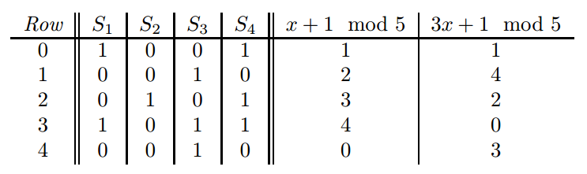
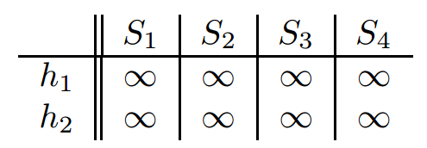
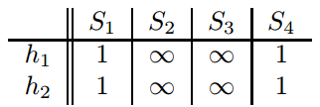
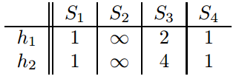
Implementation Example
0. Initialize all sig(C)[i] = ∞
Row 0: we see that the values of h₁(0) and
h₂(0) are both 1, thus sig(S₁)[0] = 1,
sig(S₁)[1] = 1, sig(S₄)[0] = 1, sig(S₄)[0] = 1,
Row 1, we see h₁(1) = 2 and h₂(1) = 4，
thus sig(S₃)[0] = 2, sig(S₃)[1] = 4

Slide 22
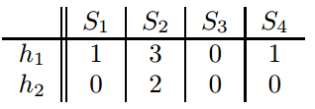
Implementation Example
We can estimate the Jaccard similarities of the underlying sets from this signature matrix.
Signature matrix: SIM(S₁, S₄) = 1.0
Jaccard Similarity: SIM(S₁, S₄) = 2/3

Slide 23
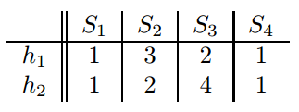
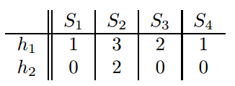
Implementation Example
Row 2: h₁(2) = 3 and h₂(2) = 2, thus
sig(S₂)[0] = 3, sig(S₂)[1] = 2, no update for S₄
Row 3: h₁(2) = 4 and h₂(2) = 0, update
sig(S₁)[1] = 0, sig(S₃)[1] = 0, sig(S₄)[1] = 0,
Row 4: h₁(2) = 0 and h₂(2) = 3, update
sig(S₃)[0] = 0,

Slide 24
Partition M into b Bands
r rows
per band
b bands
One
signature
Signature matrix M

Slide 25
Hashing Bands
Buckets
Columns 2 and 6
are probably identical
(candidate pair)
Columns 6 and 7 are
surely different.
Matrix M
r rows
b bands

Slide 26
b bands, r rows/band
The probability that the minhash signatures for the documents agree in any one particular row of the signature matrix is t (sim(C₁, C₂) )
Pick any band (r rows)
Prob. that all rows in band equal = t^{r}
Prob. that some row in band unequal = 1 - t^{r}
Prob. that no band identical = (1 - t^{r})^{b}
Prob. that at least 1 band identical = 1 - (1 - t^{r})^{b}

Slide 27
What b Bands of r Rows Gives You
No bands
identical
At least
one band
identical
(
)^{b}
Probability
of sharing
a bucket
s ~ (1/b)^{1/r}
1 -
1 -
t^{r}
All rows
of a band
are equal
Some row
of a band
unequal
Similarity t=sim(C₁, C₂) of two sets

Slide 28
Topic 4： Mining Data Streams (Chapter 8)
Types of queries one wants on answer on a data stream: (we’ll learn these today)
Sampling data from a stream
Construct a random sample
Queries over sliding windows
Number of items of type x in the last k elements of the stream
Filtering a data stream
Select elements with property x from the stream
Counting distinct elements (Not required)
Number of distinct elements in the last k elements of the stream

Slide 29
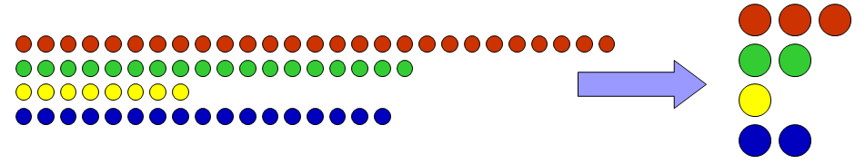
Sampling Data Streams
Since we can not store the entire stream, one obvious approach is to store a sample
Two different problems:
(1) Sample a fixed proportion of elements in the stream (say 1 in 10)
As the stream grows the sample also gets bigger
(2) Maintain a random sample of fixed size over a potentially infinite stream
As the stream grows, the sample is of fixed size
At any “time” t we would like a random sample of s elements
What is the property of the sample we want to maintain? For all time steps t, each of t elements seen so far has equal probability of being sampled

Slide 30
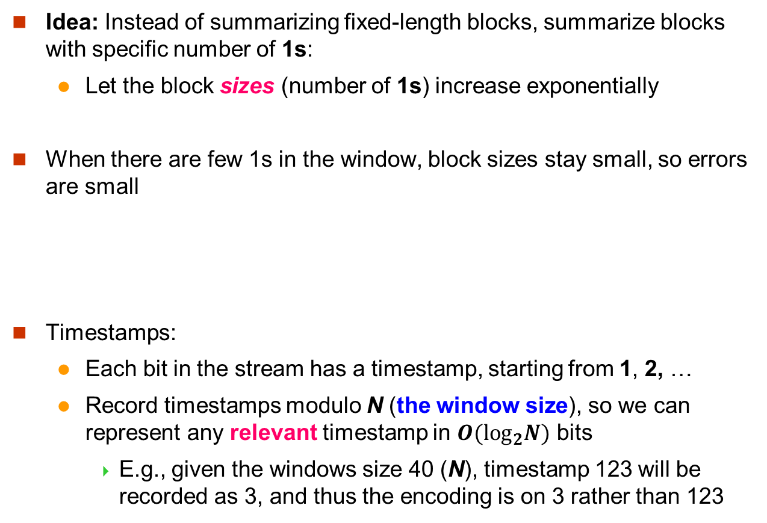
Fixup: DGIM Algorithm
Idea: Instead of summarizing fixed-length blocks, summarize blocks with specific number of 1s:
Let the block sizes (number of 1s) increase exponentially
When there are few 1s in the window, block sizes stay small, so errors are small
Timestamps:
Each bit in the stream has a timestamp, starting from 1, 2, …
Record timestamps modulo N (the window size), so we can represent any relevant timestamp in $O(\log_{2}N)$ bits
E.g., given the windows size 40 (N), timestamp 123 will be recorded as 3, and thus the encoding is on 3 rather than 123
1001010110001011010101010101011010101010101110101010111010100010110010
N

Slide 31
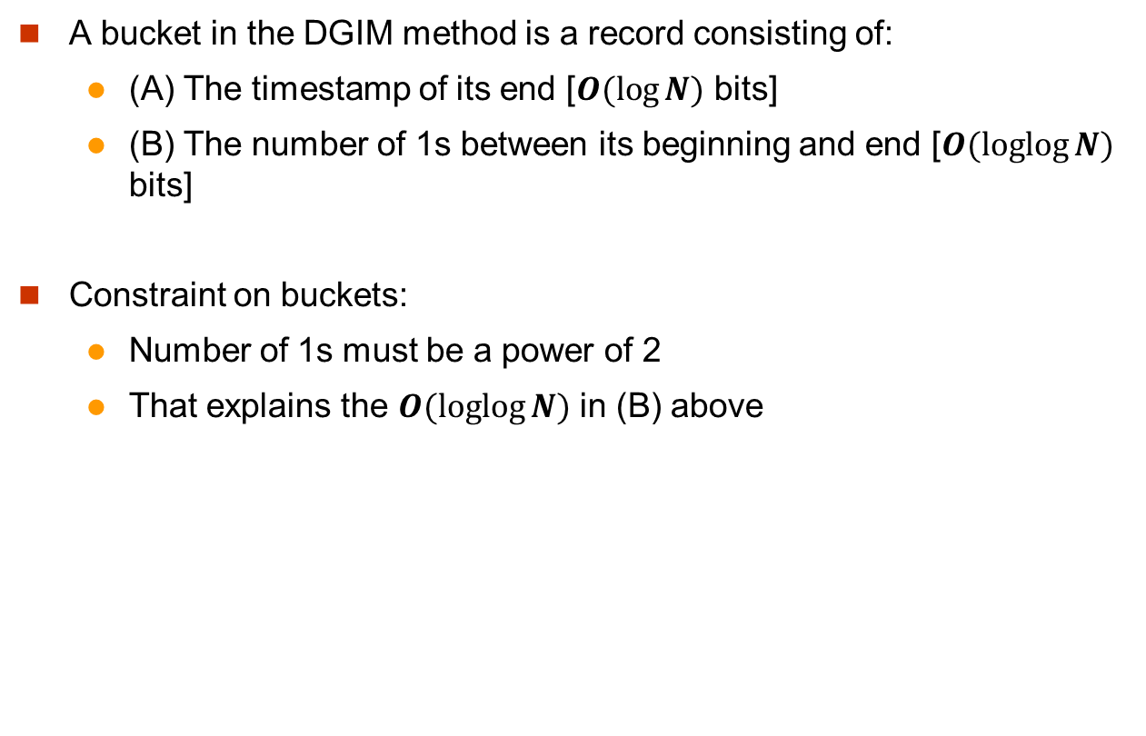
DGIM: Buckets
A bucket in the DGIM method is a record consisting of:
(A) The timestamp of its end [$O(log⁡N)$ bits]
(B) The number of 1s between its beginning and end [$O(loglog⁡N)$ bits]
Constraint on buckets:
Number of 1s must be a power of 2
That explains the $O(loglog⁡N)$ in (B) above
1001010110001011010101010101011010101010101110101010111010100010110010

Slide 32
Representing a Stream by Buckets
The right end of a bucket is always a position with a 1
Every position with a 1 is in some bucket
Either one or two buckets with the same power-of-2 number of 1s
Buckets do not overlap in timestamps
Buckets are sorted by size
Earlier buckets are not smaller than later buckets
Buckets disappear when their end-time is > N time units in the past

Slide 33
Updating Buckets
When a new bit comes in, drop the last (oldest) bucket if its end-time is prior to N time units before the current time
2 cases: Current bit is 0 or 1
If the current bit is 0: no other changes are needed
If the current bit is 1:
(1) Create a new bucket of size 1, for just this bit
End timestamp = current time
(2) If there are now three buckets of size 1, combine the oldest two into a bucket of size 2
(3) If there are now three buckets of size 2, combine the oldest two into a bucket of size 4
(4) And so on …

Slide 34
Example: Updating Buckets
Current state of the stream:
1001010110001011010101010101011010101010101110101010111010100010110010
Bit of value 1 arrives
0010101100010110101010101010110101010101011101010101110101000101100101
Two white buckets get merged into a yellow bucket
0010101100010110101010101010110101010101011101010101110101000101100101
Next bit 1 arrives, new orange white is created, then 0 comes, then 1:
0101100010110101010101010110101010101011101010101110101000101100101101
Buckets get merged…
0101100010110101010101010110101010101011101010101110101000101100101101
State of the buckets after merging
0101100010110101010101010110101010101011101010101110101000101100101101

Slide 35
Bloom Filter
Consider: |S| = m, |B| = n
Use k independent hash functions h₁ ,…, h_{k}
Initialization:
Set B to all 0s
Hash each element s∈ S using each hash function h_{i}, set B[h_{i}(s)] = 1 (for each i = 1,.., k)
Run-time:
When a stream element with key x arrives
If B[h_{i}(x)] = 1 for all i = 1,..., k then declare that x is in S
That is, x hashes to a bucket set to 1 for every hash function h_{i}(x)
Otherwise discard the element x

Slide 36
Bloom Filter Example
Consider a Bloom filter of size m=10 and number of hash functions k=3. Let H(x) denote the result of the three hash functions.
The 10-bit array is initialized as below
Insert x₀ with H(x₀） = {1， 4， 9}
Insert x₁ with H(x₁) = {4, 5, 8}
Query y₀ with H(y₀) = {0, 4, 8} => ???
Query y₁ with H(y₁) = {1, 5, 8} => ???
Another Example: https://llimllib.github.io/bloomfilter-tutorial/
0 | 1 | 2 | 3 | 4 | 5 | 6 | 7 | 8 | 9
0 | 0 | 0 | 0 | 0 | 0 | 0 | 0 | 0 | 0
0 | 1 | 2 | 3 | 4 | 5 | 6 | 7 | 8 | 9
0 | 1 | 0 | 0 | 1 | 0 | 0 | 0 | 0 | 1
0 | 1 | 2 | 3 | 4 | 5 | 6 | 7 | 8 | 9
0 | 1 | 0 | 0 | 1 | 1 | 0 | 0 | 1 | 1
False positive!

Slide 37
Topic 5： Recommender Systems (Chapter 10)
Recommender systems
Content-based recommendation
Collaborative recommendation
User-user collaborative filtering
Item-item collaborative filtering
Knowledge-based recommendation
Avatar
LOTR
Matrix
Pirates
Alice
Bob
Carol
David

Slide 38
Revision of Assignments

Slide 39
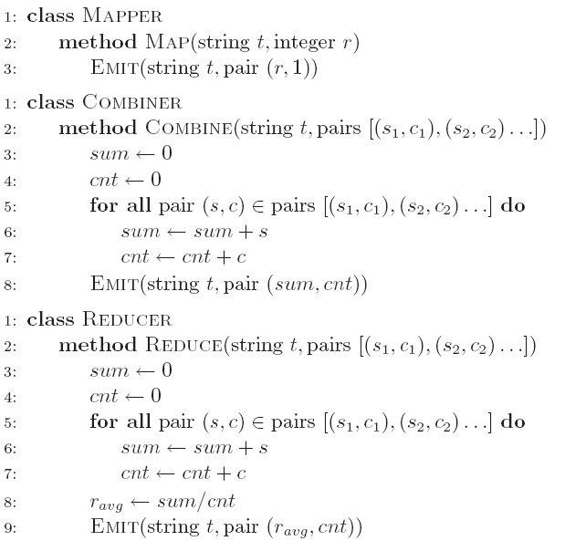
Revision of Project 1
Compute the average length of words starting with each letter:
Combiner

Slide 40
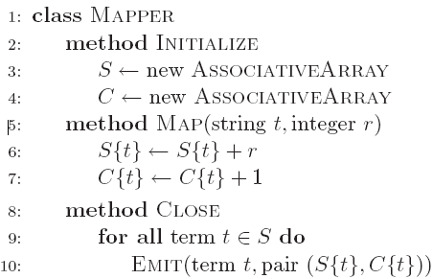
Revision of Project 1
Compute the average length of words starting with each letter:
In-mapper combining

Slide 41
Revision of Project 2
Single target shortest path
Compute based on out-links
Keep track of paths
Termination condition: no updates
Note: use counter to check if the number of updates is 0

Slide 42
Revision of Project 3
P1: Find the top-k terms that appear in the most lines
Solution 1:
val words = textFile.flatMap(_.toLowerCase().split("[\\s*$&#/\"'\\,.:;?!\\[\\](){}<>~\\-_]+").distinct)
val pairs = words.filter(_.length>0).filter(x => x.charAt(0) <='z' && x.charAt(0)>='a').map(x=>(x,1)).reduceByKey(_+_)
val topk = pairs.sortBy(_._1).sortBy(_._2, false).take(k).map(x => x._1 + '\t' + x._2)

Slide 43
Revision of Project 3
P1: Find the top-k terms that appear in the most lines
Solution 2:
def pairGen(wordArray: Array[String]) : collection.mutable.Set[String] = {
val aset = collection.mutable.Set[String]()
for(i <- 0 to wordArray.length -1){
val term1 = wordArray(i)
if(term1.length > 0 && term1.charAt(0) <= ‘z’ && term1.charAt(0) >= ‘a’ && !aset.contains(term1)){
aset.add(term1)
}
}
return aset
}
val words = textFile.map(_.toLowerCase().split("[\\s*$&#/\"'\\,.:;?!\\[\\](){}<>~\\-_]+"))
val pairs = words.flatMap(x => pairGen(x)).map(x=> (x, 1)).reduceByKey(_+_)
val topk = pairs.sortBy(_._1).sortBy(_._2, false).take(k).map(x => x._1 + '\t' + x._2)

Slide 44
Revision of Project 3
P2: Reverse graph edge direction
val pairs = sc.textFile(graphFile).map(x=>(x.split('\t')(0),x.split('\t')(1)))
val res = pairs.map(_.swap).groupByKey().sortBy(_._1.toInt).mapValues(x=>x.toSeq.sortWith(_.toInt<_.toInt))
val fmtres = res.map{case(x, y) => s"""$x\t${y.mkString(",")}"""}
fmtres.saveAsTextFile(outputFolder)

Slide 45
Revision of Project 4
Set similarity join
An excellent algorithm should be able to get the result within 20 minutes using one reducer.
In the worst case, your program should finish within one hour.
One Hint: one trick in the first stage can help you getting rid of the stage of removing duplicates.
Briefly describe the optimization techniques you used in this project in a text file, and submit it together with your program.
Marks depends on the scalability and the efficiency.

Slide 46
Final exam
Final written exam (100 pts)
Five questions in total on five topics
Two hours
You can bring the notes on one double-sided A4 page
If you are ill on the day of the exam, do not attend the exam – I will not accept any medical special consideration claims from people who already attempted the exam.

Slide 47
Question 1 MapReduce
Part A: MapReduce concepts
Part B: MapReduce algorithm design
Sample Questions:
Assume that you are given a data set crawled from a location-based social network, in which each line of the data is in format of (userID, a list of locations the user has visited <loc1, loc2, …>). Your task is to compute for each location the set of users who have visited it, and the users are sorted in ascending order according to their IDs.
Assume that in an online shopping system, a huge log file stores the information of each transaction. Each line of the log is in format of “userID\tproduct\t price\t time”. Your task is to use MapReduce to find out the top-5 most expensive products purchased by each user in 2016.
Given a large text file, find the top-k words that appear the most frequently.

Slide 48
Question 2 Spark
Part A: Spark concepts
Part B: Show output of the given code
Part C: Spark algorithm design
Sample Questions:
What is the output?
val lines = sc.parallelize(List("hello world", "this is a scala program", "to create a pair RDD", "in spark"))
val pairs = lines.map(x => (x.split(" ")(0), x))
pairs.filter {case (key, value) => key.length <3}.foreach(println)
Problem 1 of Lab 8: Compute the average length of words starting with each letter.

Slide 49
Question 3 Finding Similar Items
Shingling
Min Hashing
LSH
Sample Questions:
Question 2 in the last assignment

Slide 50
Question 4 Mining Data Streams
Sampling
DGIM
Filtering
Sample Question:
Question 3 in the last assignment

Slide 51
Question 5 Recommender Systems
Content-based recommendation
Collaborative recommendation
User-user
Item-item
Sample Question:
Consider three users u₁, u₂, and u₃, and four movies m₁, m₂, m₃, and m₄. The users rated the movies using a 4-point scale: -1: bad, 1: fair, 2: good, and 3: great. A rating of 0 means that the user did not rate the movie. The three users’ ratings for the four movies are: u₁ = (3, 0, 0, -1), u₂ = (2, -1, 0, 3), u₃ = (3, 0, 3, 1)
Which user has more similar taste to u₁ based on cosine similarity, u₂ or u₃? Show detailed calculation process.
User u₁ has not yet watched movies m₂ and m₃. Which movie(s) are you going to recommend to user u₁, based on the user-based collaborative filtering approach? Justify your answer.
Question 4 in the last assignment

Slide 52

myExperience Survey

Slide 53
Thank you!

