Slide 1
SongGenAI
AI Song Generation Platform
Exercise 4 — Apply Strategy Pattern for Song Generation
Sudha Sutaschuto · Software Engineering
Django
Suno AI
Strategy Pattern
1 / 10

Slide 2
What It Does
Core user journey from login to library
1
Creator registers
Google OAuth login
2
Fill a Form
Title · Genre · Mood · Duration
3
Song generated
Mock (instant) or Suno AI (async)
4
Song Manager
PENDING → SUCCESS · Playback · Download
5
Organize & Share
Libraries · UUID share links · Public toggle
6
Browse page
Public songs visible to all users
7
Credits tracked
CreditTransaction on every generation
mock mode → instant · no API · offline
suno mode → ~30s async · Suno API key + ngrok
2 / 10

Slide 3
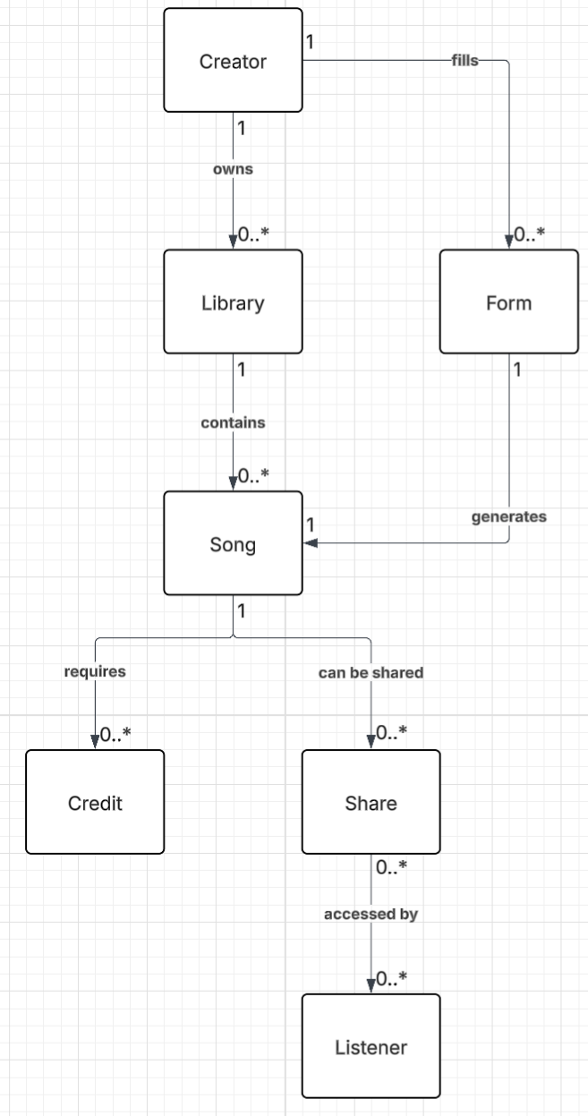
Domain Model
8 entities · relationships shown below
• One Form → exactly one Song (OneToOneField)
• Every generation → one CreditTransaction (DEDUCT)
• One Song → many Shares (each has UUID token)
• One Song → many Libraries (ManyToManyField)
• Failed generation → REFUND transaction
3 / 10

Slide 4
Architecture
Service-oriented layers — thin controllers, fat services
Routes
/generation/ /manager/ /browse/ /user/ /playback/
↓
Controllers
Extract params · return JSON or HTML · no business logic
↓
Services
Business logic · DB queries · validation · formatting
↓
Strategies
SongGeneratorStrategy: Mock or Suno — swappable via env var
↓
Models
Django ORM — Creator, Form, Song, Library, Share, CreditTransaction
4 / 10

Slide 5
Strategy Pattern
Core design — swappable generation algorithm using factory and stratergy
❝ How do we swap Mock ↔ Suno without touching controllers or services? ❞
«abstract» SongGeneratorStrategy
+ generate(form) → Song
MockSongGeneratorStrategy
SunoSongGeneratorStrategy
Instant SUCCESS · fixed audio URL No API call · fully offline
Async PENDING → callback → SUCCESS Real Suno AI · real audio URL
# app/strategies/factory.py
def get_generator_strategy() -> SongGeneratorStrategy:
strategy_name = getattr(settings, "GENERATOR_STRATEGY", "mock").lower()
if strategy_name == "suno":
return SunoSongGeneratorStrategy()
return MockSongGeneratorStrategy()
Switch strategy: GENERATOR_STRATEGY=suno → no controller or service changes needed
5 / 10

Slide 6
Strategy in Action
Mock vs Suno — same interface, different behaviour
Mock Strategy — instant SUCCESS
Suno Strategy — async PENDING → SUCCESS
{
"message": "Song created successfully",
"song_title": "Generated Song 1",
"status": "SUCCESS",
"audio_url": "soundhelix.com/.../SoundHelix-Song-1.mp3",
"duration_seconds": 229
}
{
"message": "Song created successfully",
"song_title": "Fire Run",
"status": "PENDING",
"task_id": "abc123xyz",
"audio_url": null
}
✓ Status → SUCCESS immediately
✓ Status → PENDING on first response
✓ Fixed placeholder audio URL
✓ Suno calls /generation/suno/callback/
✓ CreditTransaction DEDUCT created
✓ Song updated → SUCCESS + real audio URL
✓ No API call, no internet needed
✓ Frontend polls until status resolves
Both implement the same generate(form) → Song interface — callers never know which ran
6 / 10

Slide 7
Credit System
Transaction log — not a mutable balance field
✗ Naive approach
✓ Our approach
creator.credits -= 1
creator.save()
CreditTransaction.objects.create(
creator = form.creator,
transaction_type = "DEDUCT",
amount = 1,
note = "Song generation"
)
✗ No history
✗ No audit trail
✗ Can't reconstruct balance
Type
When
✗ No refund tracking
ADD
Credits purchased or granted
DEDUCT
Generation started
REFUND
Generation failed
Balance = SUM(ADD + REFUND) − SUM(DEDUCT) · always recomputable from history
7 / 10

Slide 8
Key Features
Full-stack — auth, generation, library, sharing, playback
Google OAuth
Song Generation
Login via Google — no passwords stored
Form → Strategy → Song · async status polling
Song Manager
Libraries
History · playback · download · visibility toggle
Organize songs into named collections
Share Links
Browse Page
UUID token · shareable URL · no full URL in DB
Public songs visible to all users, not just creators
Global Audio Player
Credit Tracking
Persistent player across page navigation
ADD / DEDUCT / REFUND transactions per generation
8 / 10

Slide 9
What I Learned
Design decisions and engineering challenges
Strategy Pattern Benefits
Engineering Challenges
Open/Closed Principle — add ElevenLabs strategy without modifying existing code
Suno API is async — designed PENDING status + webhook callback flow
Testability — mock strategy = full end-to-end test with zero API calls
Suno response structure varies — robust parsing without crashing on missing keys
Configurability — runtime selection via env var, no code changes to swap
Credit REFUND must fire on failure, not just success — transactional thinking
9 / 10

