Slide 1
Q1 Fit Diagnostics
Spray penetration curve-fit quality, translated for mechanical engineering review
Main message: the clean CDF fits are generally usable for synthetic data generation. Median RMSE is 1.25 mm and median R2 is 0.9969.
23,008
20,998
1.25
2.56
90.0%
candidate CDF plume traces
clean accepted fits (91.3%)
median RMSE [mm]
95th percentile RMSE [mm]
clean and RMSE < 3 mm
What is being checked:
- Does the simplified curve follow measured spray penetration closely enough?
- Do the fitted constants move in physically sensible directions with pressure and nozzle geometry?
- Are optimization failures or parameter ambiguity likely to contaminate the exported data?
Source: MLP/synthetic_data/fit_diagnostics and MLP/curve_fit/fit_raw_data.py

Slide 2
From Video Measurements To Diagnostics
q1 fit diagnostics
1. Raw plume series
2. Clean and align
3. Fit q1 curve
Penetration in mm vs time for each plume
->
Remove early zeros, bad jumps, negative values, and align onset
->
Least-squares fit of onset-ramped t^(1/4) penetration
4. Quality gates
5. Aggregate
6. Diagnose
Keep plausible fits, reject outliers and weak traces
->
Pool clean rows and per-frame residuals
->
RMSE, residuals, convergence, parameter uncertainty
Code map: prepare_cleaned_series -> fit_quarter_only -> apply_filter_masking -> fit_diagnostics.run_all
Source: MLP/synthetic_data/fit_diagnostics and MLP/curve_fit/fit_raw_data.py

Slide 3
The Fitted Curve In Plain Terms
q1 fit diagnostics
S(t) = sigmoid((t - t0) / s) * k * t^(1/4)
The sigmoid is a smooth valve: before onset penetration is near zero, after onset the curve follows a quarter-root growth law.
k
t0
s
growth scale. Median fitted k = 446 mm/s^(1/4)
onset time. Median = 0.309 ms
transition width. Median = 0.146 ms
Mechanical interpretation:
- k says how aggressively the visible penetration grows after onset.
- t0 says when the plume becomes visible after hydraulic delay correction.
- s says how sharply the plume turns on. Very large or nonphysical values are rejected.
Source: MLP/synthetic_data/fit_diagnostics and MLP/curve_fit/fit_raw_data.py

Slide 4
Quality Gates Keep The Exported Curves Conservative
q1 fit diagnostics
2,010
91.3%
0.76-1.80
517,529
flagged CDF fits
clean survival rate
middle 50% RMSE [mm]
clean per-frame points
Most rejected fits are statistical outliers:
- robust outlier: 2,000
- basic gate failed: 30
- 5 ms penetration out of range: 29
Hard plausibility checks include:
- solver success and finite RMSE
- at least 10 valid points
- 0 < t0 < measured time range
- s < 1 ms and t0 < 0.8 ms
- penetration at 5 ms between 18 and 300 mm
Engineering read: the deck focuses on clean rows; flagged rows are kept separately for audit, not mixed into training-quality data.
Source: MLP/synthetic_data/fit_diagnostics and MLP/curve_fit/fit_raw_data.py

Slide 5
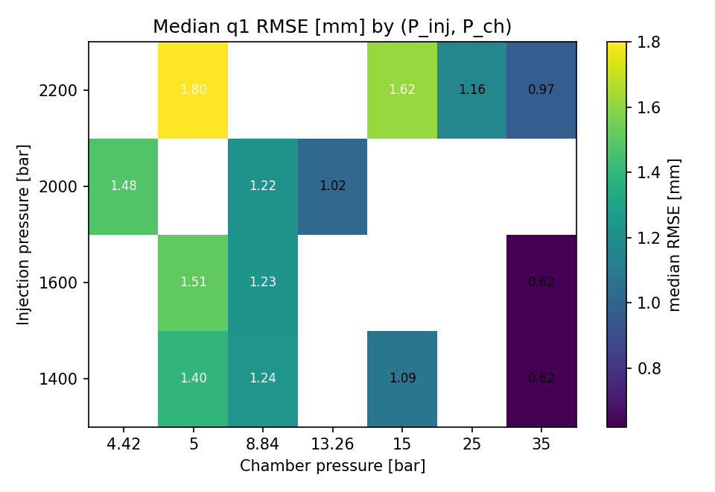
Fit Error Across Operating Conditions
q1 fit diagnostics
What to look for:
- Lower values mean the fitted curve is closer to the measured plume.
- Overall median RMSE is 1.25 mm; 95% are below 2.56 mm.
- Error is not uniform: the pressure condition matters.
Lowest median-RMSE cells:
- Pinj 1600 bar, Pch 35.00 bar: 0.62 mm
- Pinj 1400 bar, Pch 35.00 bar: 0.62 mm
- Pinj 2200 bar, Pch 35.00 bar: 0.97 mm
Highest median-RMSE cells:
- Pinj 2200 bar, Pch 5.00 bar: 1.80 mm
- Pinj 2200 bar, Pch 15.00 bar: 1.62 mm
- Pinj 1600 bar, Pch 5.00 bar: 1.51 mm
Source: MLP/synthetic_data/fit_diagnostics and MLP/curve_fit/fit_raw_data.py

Slide 6
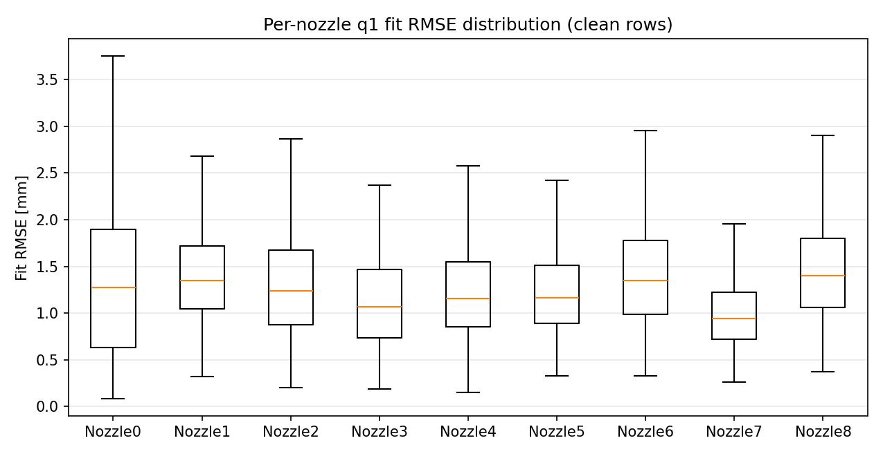
Per-Nozzle Fit Error
q1 fit diagnostics
Nozzle comparison:
- Boxes summarize the spread of RMSE by nozzle.
- The fitted model performs best when the curve shape is repeatable within the nozzle and condition.
Median RMSE by nozzle:
- Nozzle7: 0.94 mm, p95 1.84 mm
- Nozzle3: 1.07 mm, p95 2.11 mm
- Nozzle4: 1.16 mm, p95 2.40 mm
- Nozzle5: 1.16 mm, p95 2.33 mm
- Nozzle2: 1.24 mm, p95 2.37 mm
- Nozzle0: 1.27 mm, p95 2.65 mm
- Nozzle1: 1.34 mm, p95 2.34 mm
- Nozzle6: 1.35 mm, p95 2.53 mm
- Nozzle8: 1.40 mm, p95 2.46 mm
Source: MLP/synthetic_data/fit_diagnostics and MLP/curve_fit/fit_raw_data.py

Slide 7
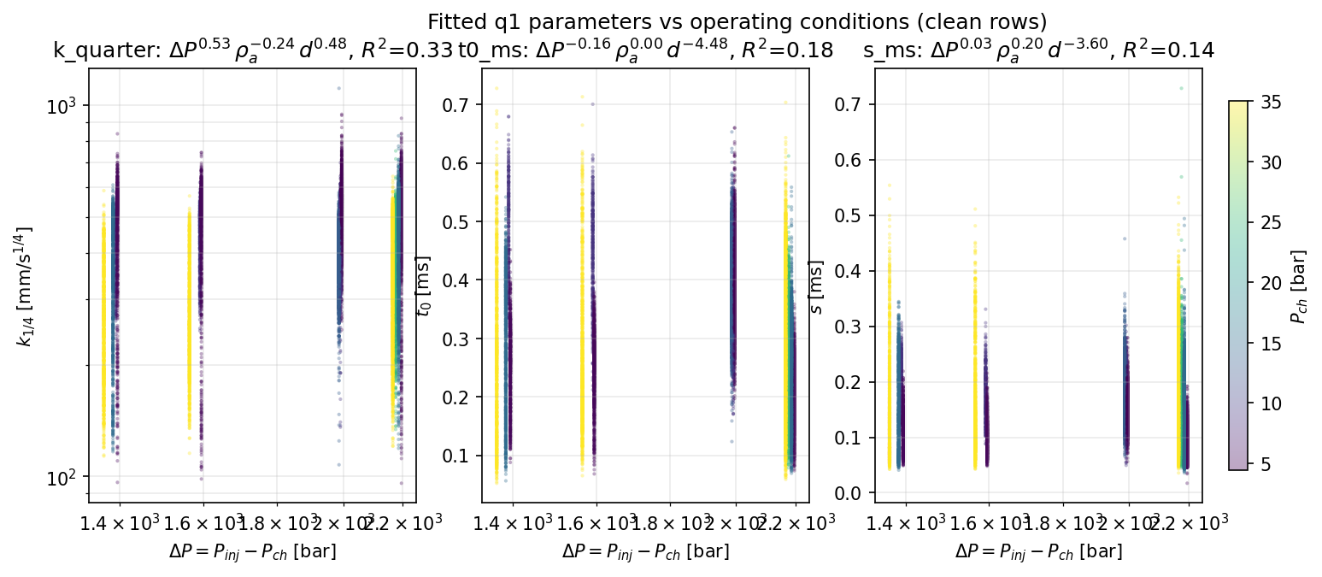
Do The Parameters Move Like Physics Suggests?
q1 fit diagnostics
Most important result:
- k scales as DeltaP^0.53, rho_air^-0.24, diameter^0.48.
- Signs match the expected trend: higher pressure drop and larger holes increase penetration; higher chamber density reduces it.
Caution:
- Simple pressure-density-diameter scaling explains only R2 = 0.33 for k.
- t0 and s have lower R2, so onset and transition width also depend on imaging, plume interaction, and cleaning details.
Source: MLP/synthetic_data/fit_diagnostics and MLP/curve_fit/fit_raw_data.py

Slide 8
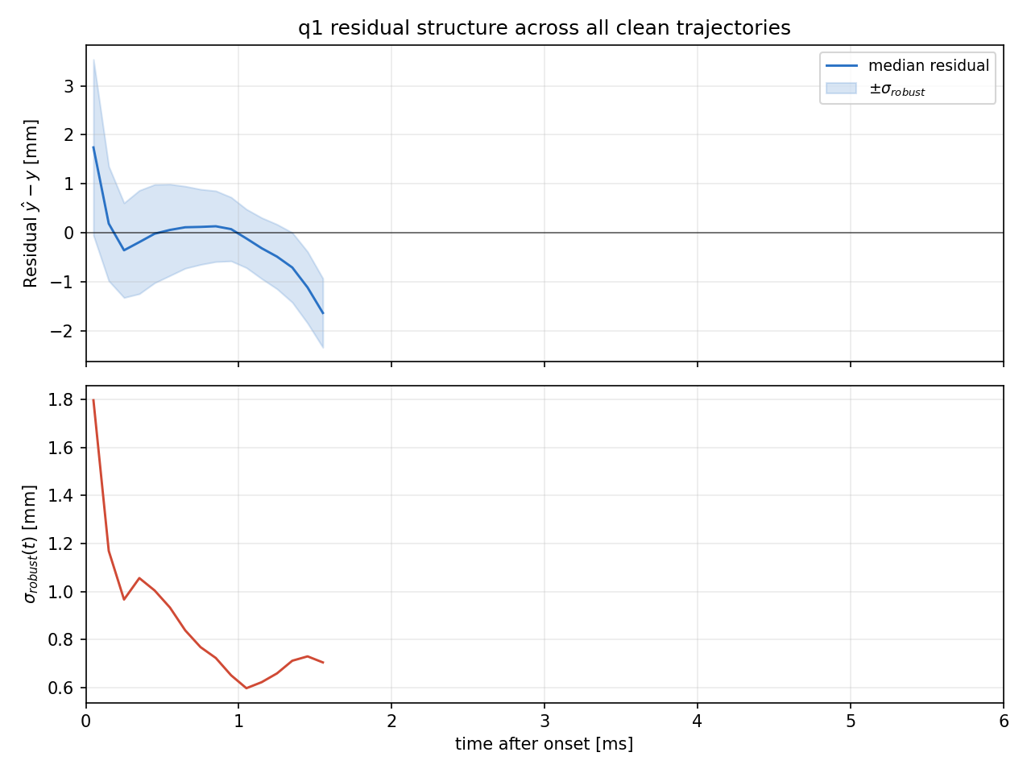
Residuals Show Where The Curve Is Biased
q1 fit diagnostics
Residual = fitted penetration - measured penetration.
- At 0.05 ms: median residual 1.74 mm.
- Around 0.95 ms: median residual 0.07 mm.
- At 1.55 ms: median residual -1.64 mm, but only 170 points.
Engineering read:
- The curve is close to unbiased after the initial transient.
- Early time is the hardest region because onset timing and image thresholding dominate.
- Late-time bins have low sample count, so do not over-interpret the tail.
Source: MLP/synthetic_data/fit_diagnostics and MLP/curve_fit/fit_raw_data.py

Slide 9
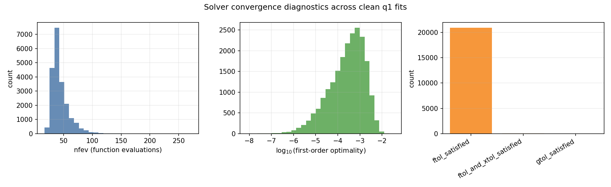
The Solver Is Not The Bottleneck
q1 fit diagnostics
Termination summary:
- ftol_satisfied: 20,937 fits, median nfev 40
- ftol_and_xtol_satisfied: 60 fits, median nfev 42
- gtol_satisfied: 1 fits, median nfev 27
No max-iteration failure appears in the clean-row summary. Most fits stop because further improvement in cost becomes tiny.
Source: MLP/synthetic_data/fit_diagnostics and MLP/curve_fit/fit_raw_data.py

Slide 10
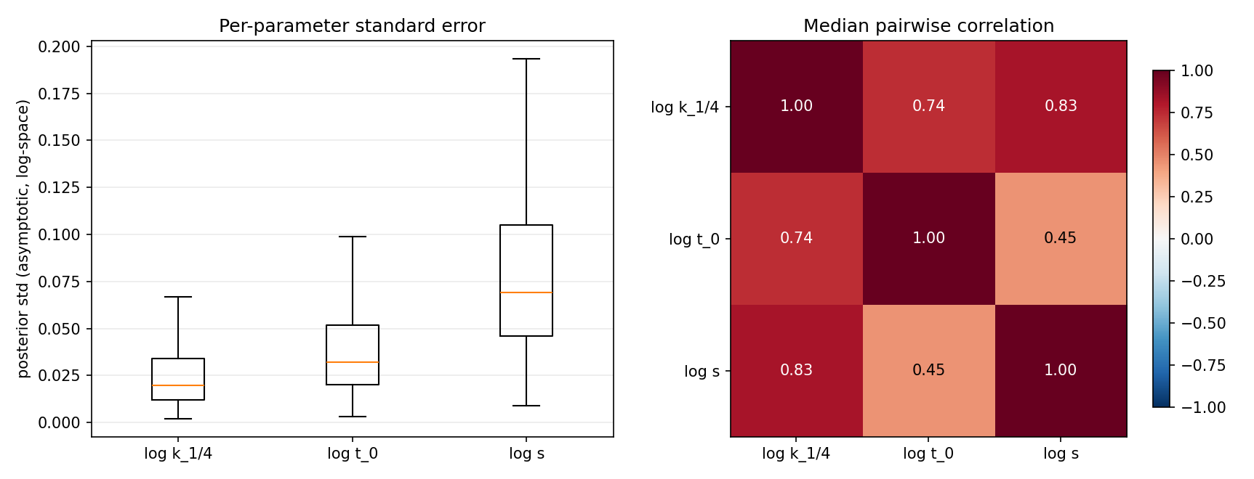
Parameter Identifiability
q1 fit diagnostics
What this means:
- Typical log-space std: k 0.020, t0 0.032, s 0.069.
- These are small enough that the fitted curves are stable.
Important caveat:
- k, t0, and s are correlated, especially k with s.
- Use the full fitted curve for engineering comparison. Avoid over-interpreting a single parameter by itself.
Source: MLP/synthetic_data/fit_diagnostics and MLP/curve_fit/fit_raw_data.py

Slide 11
How To Use These Results
q1 fit diagnostics
Use clean fits for:
- generating synthetic penetration trajectories
- training downstream MLP models
- comparing conditions with a compact curve representation
- estimating time-dependent residual spread
Do not use them blindly for:
- diagnosing individual failed plumes without checking flagged plots
- claiming t0 or s are pure physical delays
- extrapolating after the measured time range
- treating late residual bins with low counts as final truth
Recommended next checks: inspect the highest-RMSE conditions, tighten early-onset alignment if needed, and report RMSE plus residual sigma(t) when using synthetic data.
Source: MLP/synthetic_data/fit_diagnostics and MLP/curve_fit/fit_raw_data.py

Slide 12
File And Code Map
q1 fit diagnostics
Primary fitting code:
- MLP/curve_fit/fit_raw_data.py
- Model: spray_penetration_model_quarter_only
- Fit: fit_quarter_only uses scipy least_squares with Huber loss
- Filtering: apply_filter_masking creates clean and flagged rows
- End of script: summarize_dataset, summarize_filter_survival, fit_diagnostics
Diagnostics used in this deck:
- MLP/synthetic_data/fit_diagnostics/error_by_condition
- MLP/synthetic_data/fit_diagnostics/param_distributions
- MLP/synthetic_data/fit_diagnostics/residual_structure
- MLP/synthetic_data/fit_diagnostics/convergence
- MLP/synthetic_data/fit_diagnostics/identifiability
Source: MLP/synthetic_data/fit_diagnostics and MLP/curve_fit/fit_raw_data.py

Slide 13
Bottom Line For Review
q1 fit diagnostics
Accepted q1 fits are accurate enough for the intended surrogate-data role: median error 1.25 mm, p95 2.56 mm, and 91.3% of CDF candidates survive cleaning.
Decision points:
- Green light for using clean q1 CDF rows as compact synthetic data.
- Keep flagged rows out of training unless manually reviewed.
- If early-time accuracy matters most, improve onset alignment before changing the curve law.
- If individual parameter interpretation matters, add a parameter-correlation caveat to reports.
Source: MLP/synthetic_data/fit_diagnostics and MLP/curve_fit/fit_raw_data.py

