Slide 2
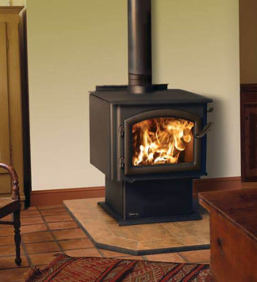
Mini Project Lagrangian multiplier applied to dynamic heating systems
Leandro Morita
Arsen Zakaryan

Slide 3
Agenda
Context
Objective function
Constraints
Putting it all together
Example

Slide 4
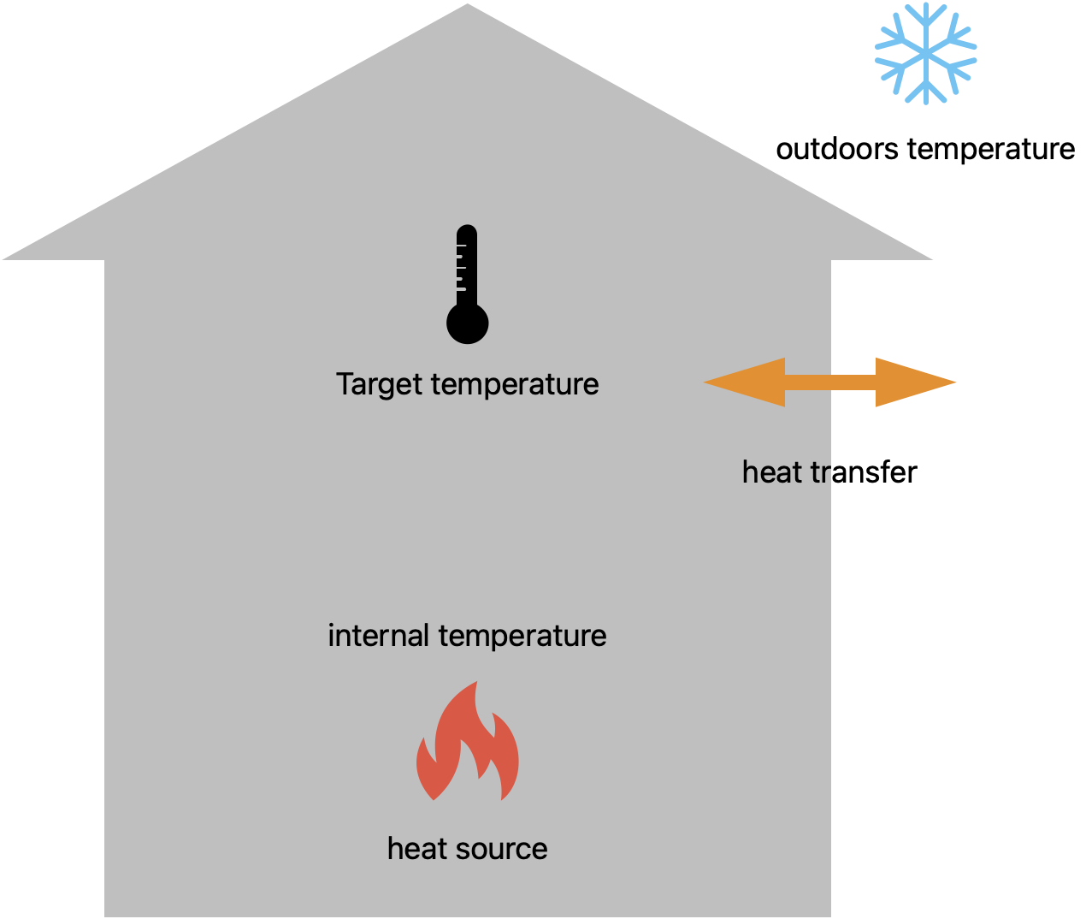
Context
Goal: minimize the amount of fuel (heat source) so the internal temperature follows the target temperature considering the system losses

Slide 5
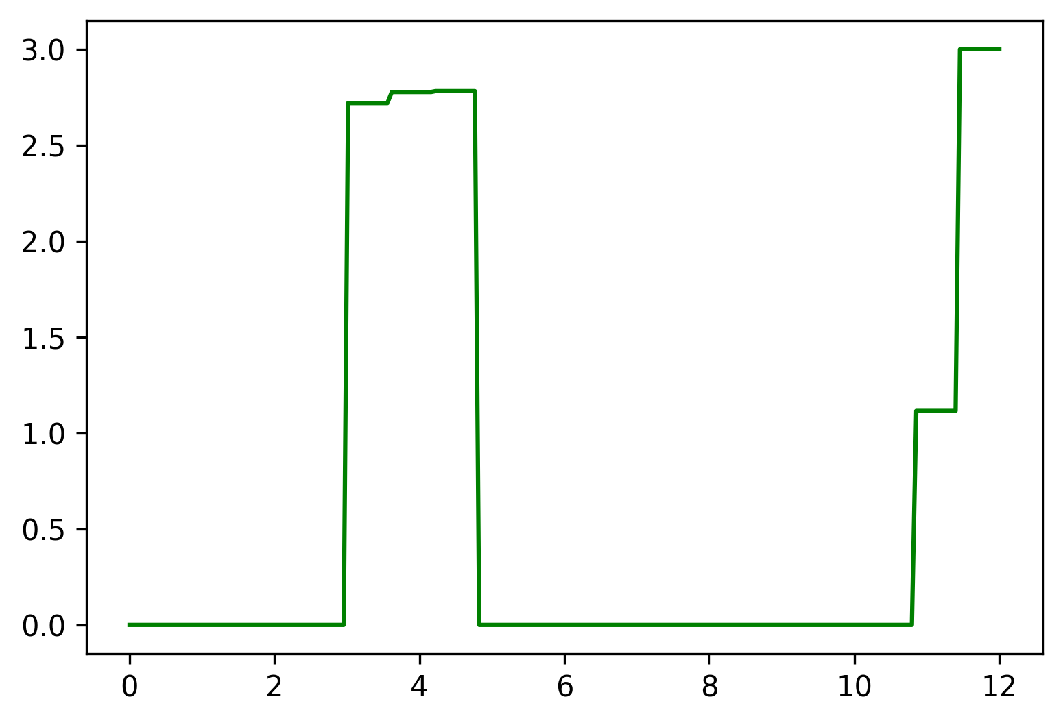
Context
Goal: minimize the amount of fuel (heat source) so the internal temperature follows the target temperature considering the system losses

Slide 6
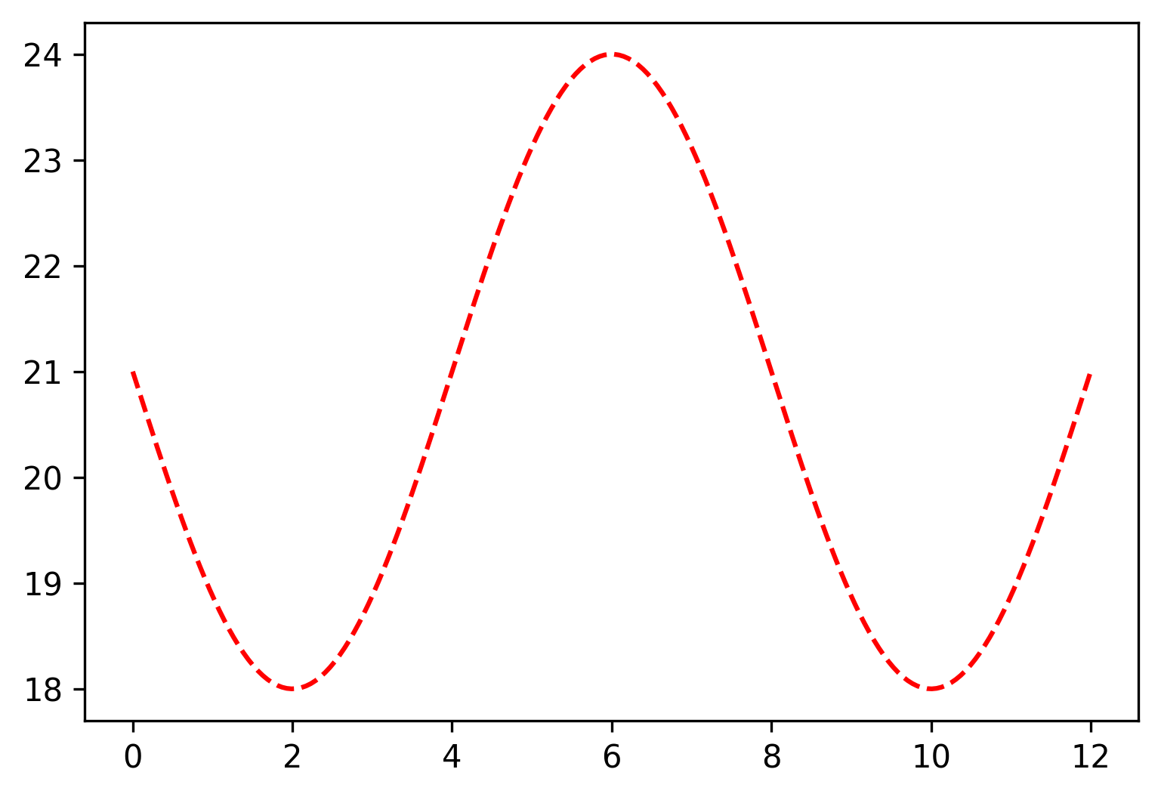
Context
Goal: minimize the amount of fuel (heat source) so the internal temperature follows the target temperature considering the system losses

Slide 7
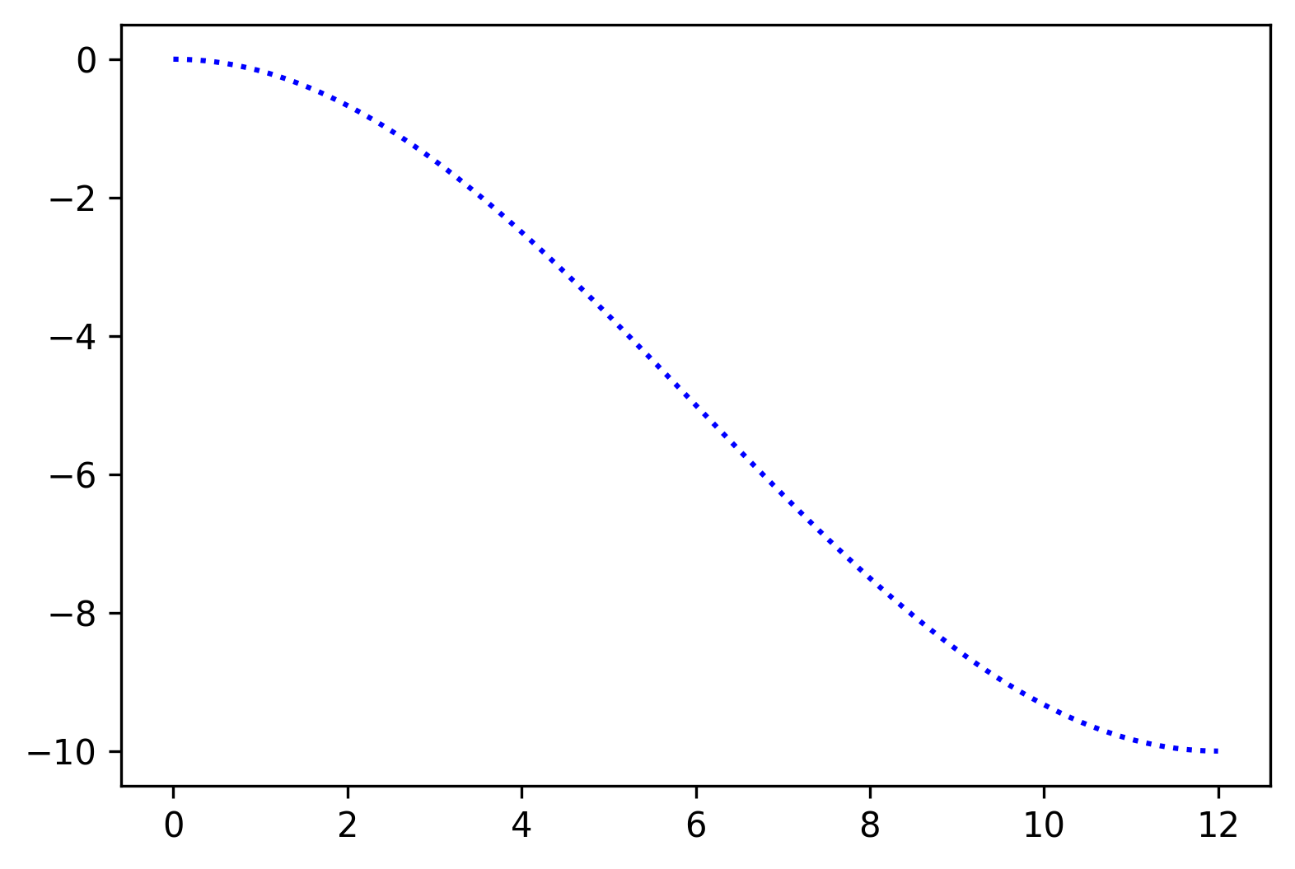
Context
Goal: minimize the amount of fuel (heat source) so the internal temperature follows the target temperature considering the system losses

Slide 8
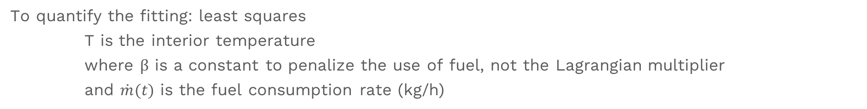
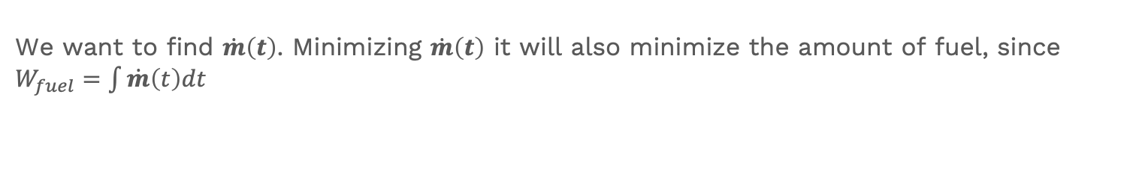
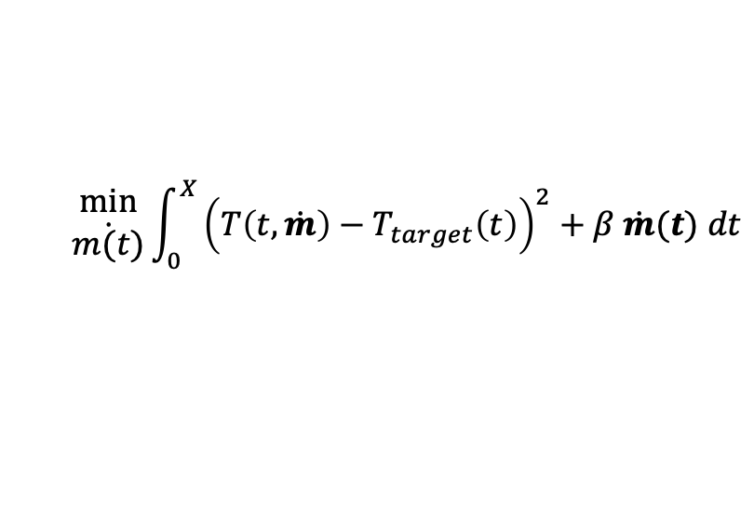

Objective function
To quantify the fitting: least squares
T is the interior temperature
where β is a constant to penalize the use of fuel, not the Lagrangian multiplier
and $\dot{m}(t)$ is the fuel consumption rate (kg/h)
${\left(T\left(t,\dot{m}\right)−T_{target}\left(t\right)\right)}^{2}$+$β \dot{m}(t)$
Then, the objective function
$$\begin{aligned}min \\ \dot{m(t)}\end{aligned}{\int_{0}^{X}{{\left(T\left(t,\dot{m}\right)−T_{target}\left(t\right)\right)}^{2}+β \dot{m}(t) dt}}$$
We want to find $\dot{m}\left(t\right)$. Minimizing $\dot{m}\left(t\right)$ it will also minimize the amount of fuel, since $W_{fuel}=\int{\dot{m}\left(t\right)dt}$
Notes:
The objective function takes into account both the fitting to the target and the minimization of the amount of fuel

Slide 9
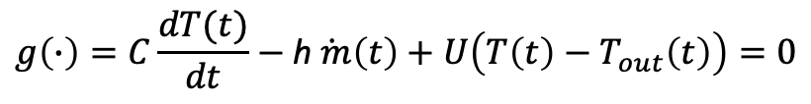
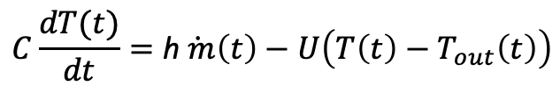

Constraints
1) The burner geometry and fuel characteristics impose an upper boundary on $\dot{m}$
$$0≤\dot{m}(t)≤{\dot{m}}_{max}$$
2) The system dynamics is modeled through heat equations
$$C\frac{dT(t)}{dt}=\text{h}\dot{ m}\left(t\right)−U\left(T\left(t\right)−T_{out}\left(t\right)\right)$$
the variation of temperature in the system is due to unbalance between heat generated and losses due to conduction between the indoors and outdoors.
Rearranging to use in out fitting with constraints problem:
$$g\left(∙\right)=C\frac{dT(t)}{dt}−\text{h}\dot{ m}\left(t\right)+U\left(T\left(t\right)−T_{out}\left(t\right)\right)=0$$
Notes:
C: specific heat capacity (J/kg.K)
h: specific enthalpy (kJ/kg)
U: thermal conductance of surface area (W/K)

Slide 10
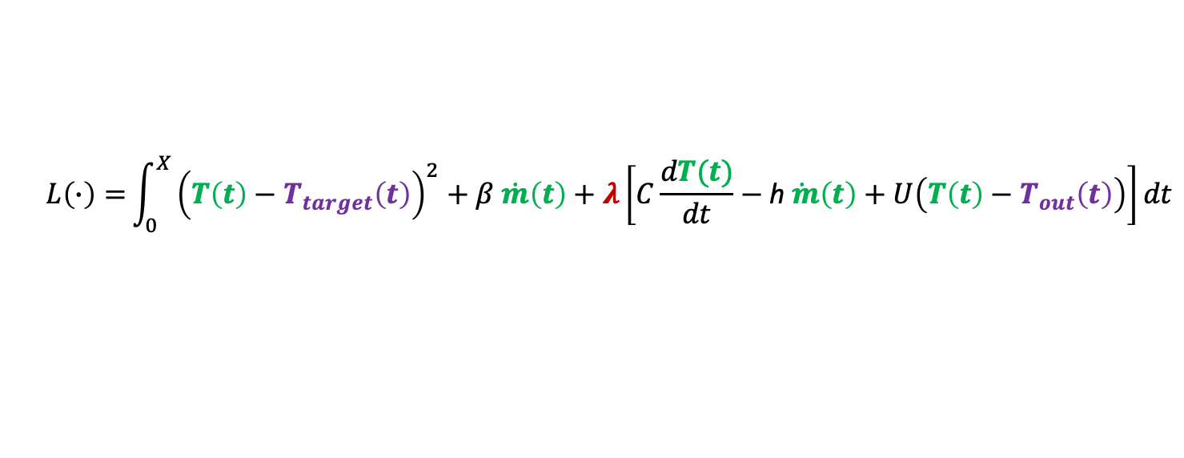
Putting it all together
Gathering the objective function and the constraints into a single function L:
$$L\left(∙\right)={\int_{0}^{X}{{\left(T\left(t\right)−T_{target}\left(t\right)\right)}^{2}+β \dot{m}\left(t\right)+λ\left[C\frac{dT(t)}{dt}−\text{h}\dot{ m}\left(t\right)+U\left(T\left(t\right)−T_{out}\left(t\right)\right)\right]dt}}$$
Measured variables
Unmeasured variables

Slide 11
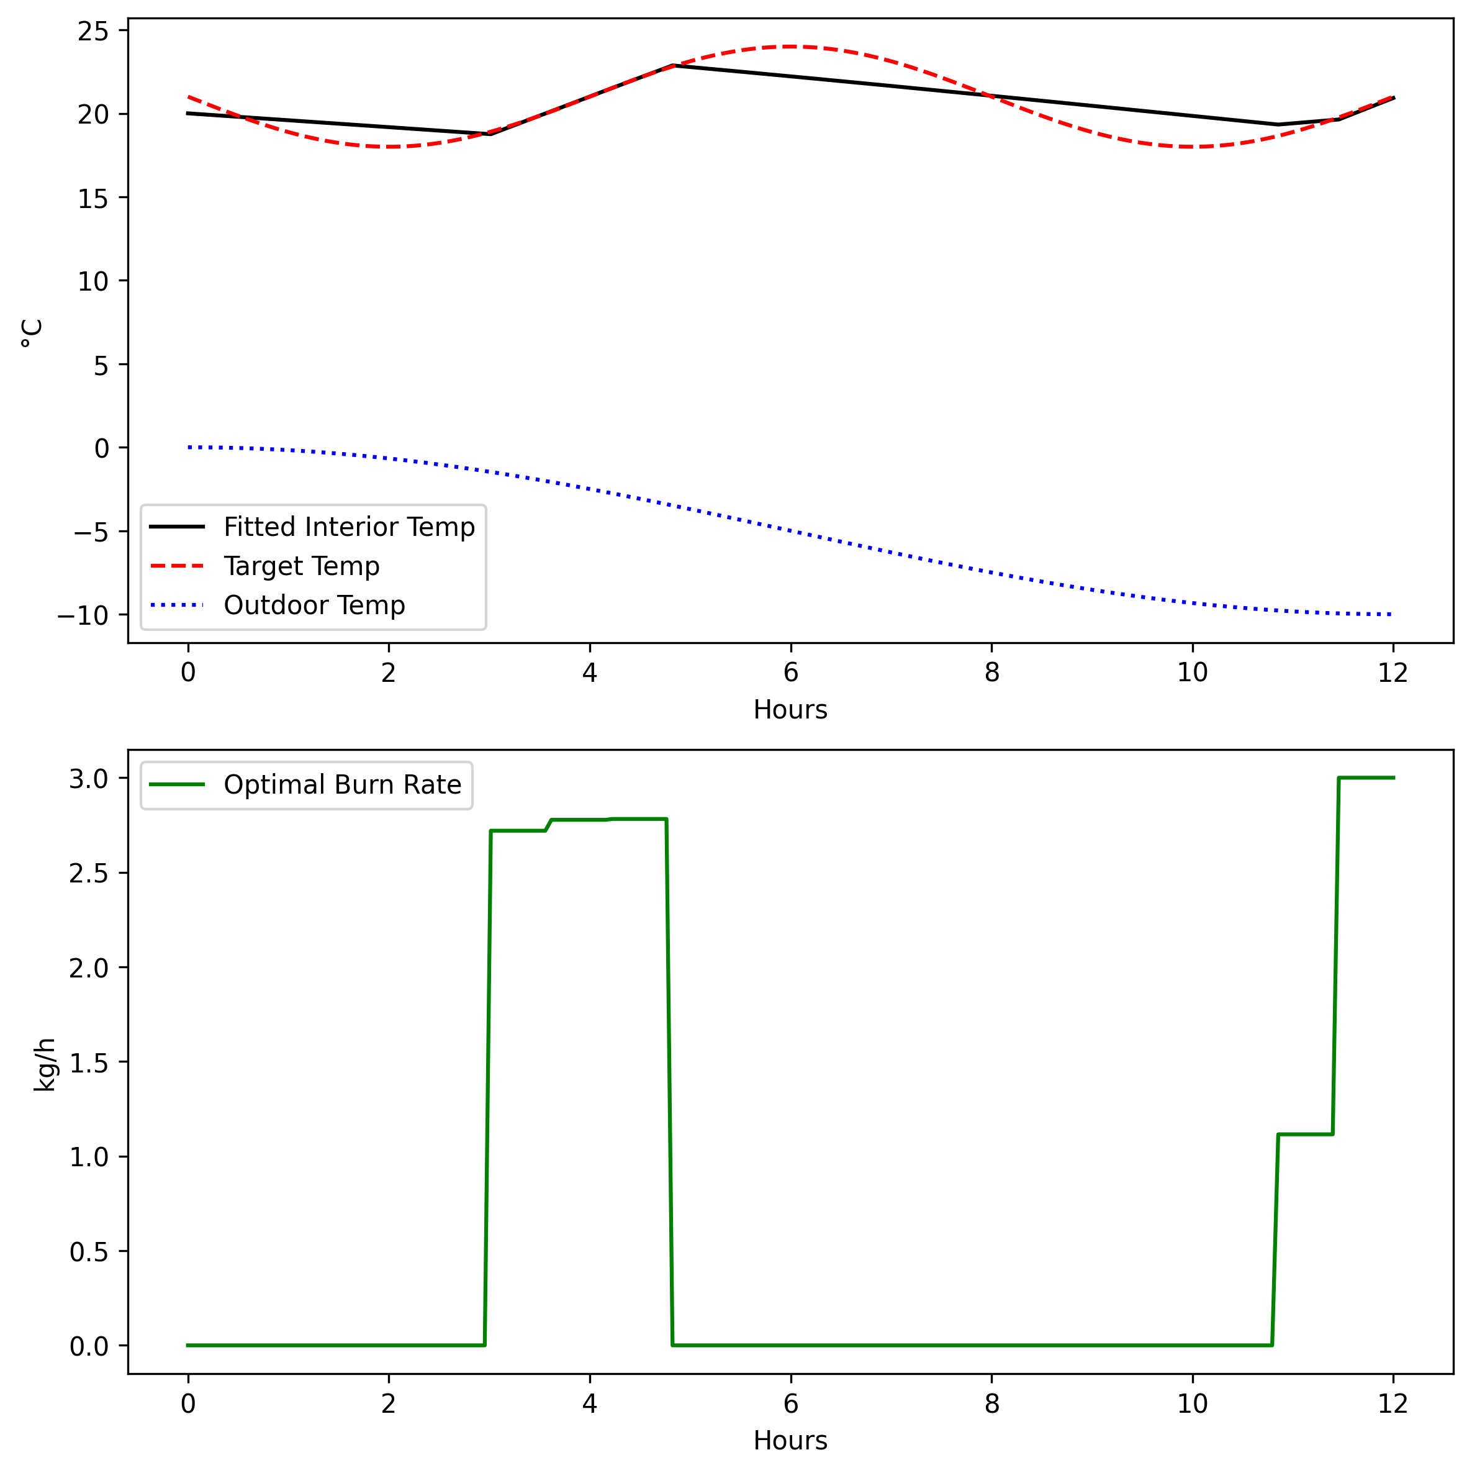
Example

