Slide 1

PASSENGER POSITIONING SYSTEM
DATABASE DESIGN

Slide 2
Table Of Contents
01
02
03
04
05
DEFINITION AND ARCHITECTURE OF DBMS
WHY RDBMS AND MYSQL?
DESIGN
ARCHITECTURE
IMPLEMENTATION

Slide 3
01
DEFINITION AND ARCHITECTURE OF A DBMS
A DBMS (Database Management System) is a software system that enables users to create, store, organize, and manage data in a secure and efficient manner. It provides a platform for multiple users to access and manipulate data simultaneously.

Slide 4
ARCHITECTURE OF A DBMS
Database
Application server

Slide 5
02
WHY RDBMS AND MySQL?
An RDBMS is a type of database management system (DBMS) that stores data in a row-based table structure which connects related data elements.
MySQL is an Oracle-backed open source relational database management system (RDBMS) based on Structured Query Language (SQL).

Slide 6
WHY RDBMS AND MySQL?
Why RDBMS
Why MySQL
Data Consistency
Efficient Data Management
With RDBMS, information about the location of passengers and vehicles is accurate and up-to-date
An ideal choice for our system that needs to track the location of multiple vehicles and passengers in real-time
Data Security
High-performance
With RDBMS, data is protected from unauthorized access or modification
MySQL can handle large volumes of data without compromising on speed or reliability.
Scalability
Cost-effective
An RDBMS can scale to handle increased traffic and data volumes
MySQL is easy to install and maintain, which further reduces the overall cost of the system

Slide 7
03
DESIGN OF OUR DATABASE
The database development involves a number of designs carefully taken into consideration:
Conceptual design
Relational Schema
Physical design

Slide 8
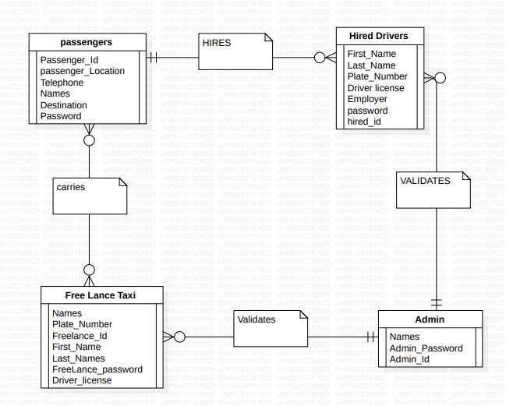
CONCEPTUAL DESIGN
For the conceptual design, an entity relationship diagram was used which identifies the entities that constitute the system and the relationships between them.

Slide 9
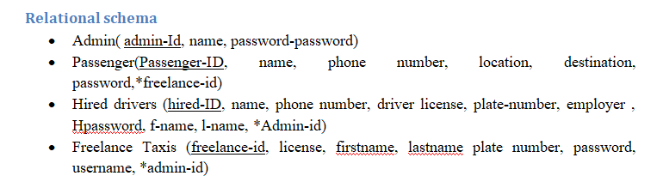
RELATIONAL SCHEMA
A relational (database) schema is a set of table definitions (stored base tables or derived views), constraints, and derivation rules

Slide 10

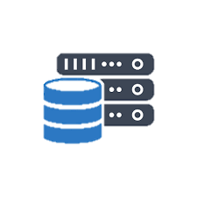
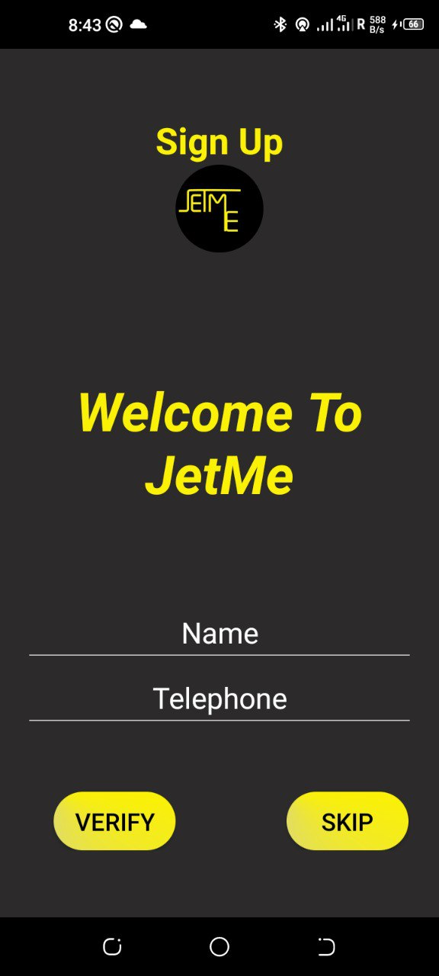
04
ARCHITECTURE OF OUR DATABASE
RetroFit
URL & HTTP METHOD
Request
RestAPI
JSON
Java Objects

Slide 11
05
IMPLEMENTATION OF OUR DATABASE
MySQL
Integration with RetroFit

Slide 12
MySQL is the software in charge of managing the database
Database
Application server

Slide 13
JETME Database
RestAPI
MySQL

Slide 14
THANK YOU!

